Slide 1
Fuel Retention and Erosion of Metallic Plasma-Facing Materials under the Influence of Plasma Impurities
A. Kreter¹, L. Buzi^{1,2,3}, G. De Temmerman^{2,4}, T. Dittmar¹, R.P. Doerner⁵, Ch. Linsmeier¹, D. Nishijima⁵, M. Reinhart¹ and B. Unterberg¹
¹ Forschungszentrum Jülich GmbH, Institut für Energie- und Klimaforschung – Plasmaphysik, Partner in the Trilateral Euregio Cluster (TEC), 52425 Jülich, Germany
² FOM Institute DIFFER - Dutch Institute for Fundamental Energy Research, Edisonbaan 14, 3439 MN, PO Box 1207, 3430 BE Nieuwegein, The Netherlands
³ Gent University, Sint-Pietersnieuwstraat 41, B-9000, Gent, Belgium
⁴ ITER Organization, Route de Vinon sur Verdon, 13115 Saint Paul Lez Durance, France
⁵ Center for Energy Research, University of California at San Diego, 9500 Gilman Drive, La Jolla, CA 92093-0417, USA
25th Fusion Energy Conference (FEC 2014)
Saint Petersburg, Russia
15 October 2014

Slide 2
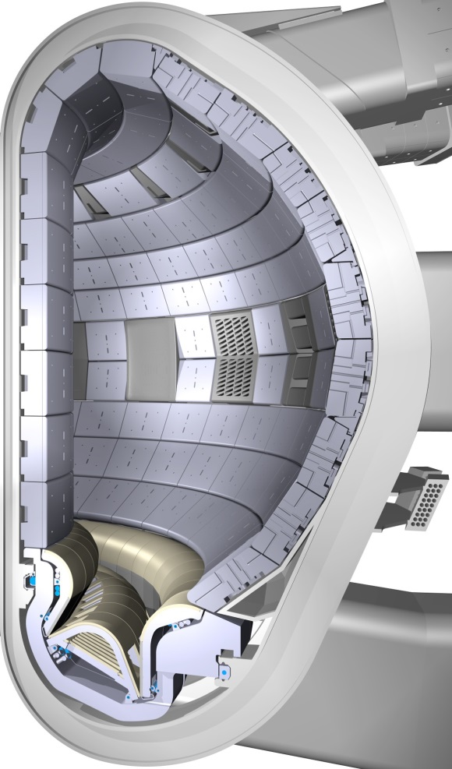
Plasma-wall interaction largely defines the availability of fusion reactor
Crucial issues for reactor availability
Erosion of plasma-facing components
⇒ Limited lifetime of plasma-facing components
Fuel retention in bulk wall material and deposited layers
⇒ Accumulation of radioactive tritium in vacuum vessel
(amount of in-vessel retained tritium is limited in ITER due to safety regulations to ~1kg)
First wall materials in ITER
Beryllium for main chamber wall
Tungsten for divertor
Impurities in reactor
Helium from D-T reactions
Impurity seeding for edge plasma cooling, argon is one of the candidates
Influence of impurities on PWI processes needs to be investigated
Be
W

Slide 3
This contribution: interaction of impurity containing plasma with beryllium and tungsten
Beryllium
Erosion and fuel retention under influence of helium and argon
Qualification of aluminium as possible substitute for beryllium in relevant studies
Tungsten
Influence of the incident ion flux on fuel retention and surface morphology
Fuel retention under influence of helium and argon
Experimental studies were performed in linear plasma devices PSI-2, PISCES-B and Magnum-PSI

Slide 4
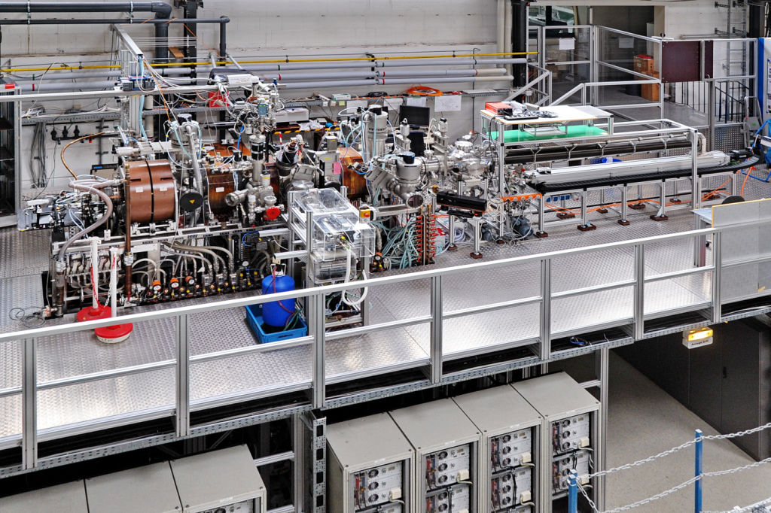
Linear plasma device PSI-2 (FZJ)
Coils
Target station
Plasma source
TEAC
Side-fed manipulator
3 m
Periphery level

Slide 5
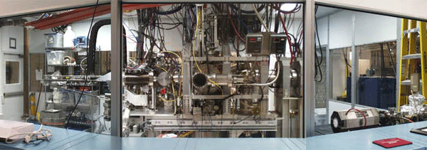
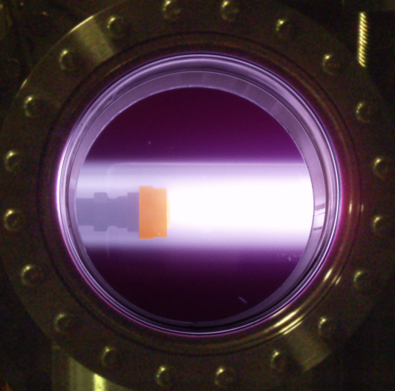
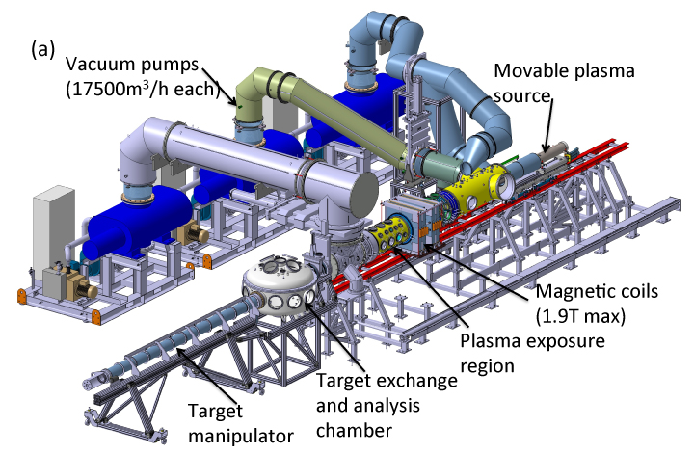
Linear plasma devices PISCES-B and Magnum-PSI
PISCES-B (UCSD): compatible with beryllium
[R. P. Doerner et al, Phys. Scr. T111 (2004) 75]
Magnum-PSI (FOM-DIFFER): high particle and heat loads
[G. De Temmerman et al., Fusion Eng. Des. 88 (2013) 483]

Slide 6
Plasma exposure parameters in linear plasma devices
Parameter | PSI-2 | PISCES-B | Magnum-PSI | ITER divertor
Electron temperature | 1 - 40 eV | 3 - 50 eV | 0.1 – 10 eV | ~1 - 10 eV
El. density | ~10¹⁷ - 10¹⁹ m⁻³ | ~10¹⁷ - 10¹⁹ m⁻³ | ~10¹⁹ - 10²¹ m⁻³ | ~10²⁰ - 10²¹ m⁻³
Particle flux | ~10²¹ - 10²² m⁻²s⁻¹ | ~10²¹ - 10²³ m⁻²s⁻¹ | ~10²³ - 10²⁵ m⁻²s⁻¹ | ~10²⁴ - 10²⁵ m⁻²s⁻¹
Particle fluence | up to ~10²⁷ m⁻² per exposure | up to ~10²⁷ m⁻² per exposure | up to ~10²⁷ m⁻² per exposure | ~10²⁶ - 10²⁷ m⁻² per pulse (400 s)
Incident ion energy | 10 - 300 eV (negative bias) | 10 - 300 eV (negative bias) | 1 - 300 eV (negative bias) | ~10 eV
Wall (sample) temperature | 300 - 2000 K | 300 - 2000 K | 300 - 2000 K | 500 - 1300 K (steady-state)
Special features |  | Beryllium compatibility | High particle flux
Transients (ELMs, disruptions) can be simulated by laser or pulsed plasma irradiation
Fluence per experiment is ~10x – 100x higher than in present pulsed tokamaks
Exposure parameters can be pre-selected to simulate particular ITER conditions

Slide 7
Erosion and fuel retention of beryllium and aluminium

Slide 8
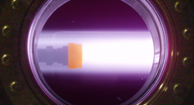
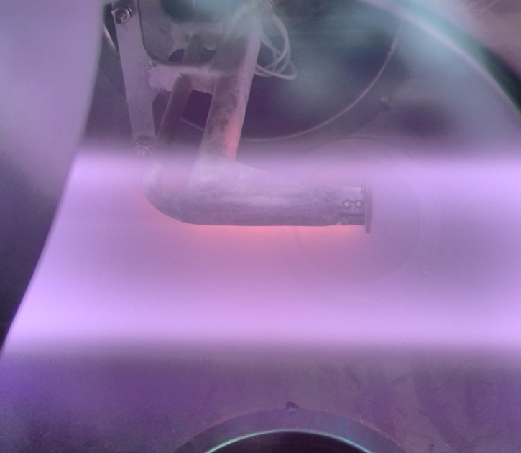
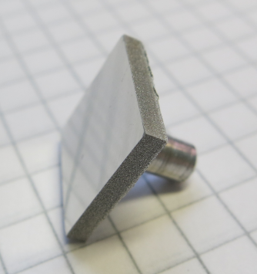
Erosion of beryllium and aluminium
PISCES-B / PSI-2 exposure conditions
Controlled Ar or He seeding 0-100% (controlled by spectroscopy: uncertainty in Ar fraction due to presence of Ar²⁺ and ArD⁺)
Steady-state and reproducible plasma
Γ_{i} ~ 10²² m⁻²s⁻¹
Φ ~ 1·10²⁶ m⁻²
E_{i} = 40-100 eV
T_{s} = 350±30 K
Be (press-sintered Brush Wellman S-65C) and Al targets
Diagnostics and sample analysis
Erosion from target is measured by spectroscopy and mass loss
PISCES-B data published in
A. Kreter et al, Phys. Scr. T159 (2014) 014039
PISCES target in plasma
PSI-2 target in plasma
Al sample
Sample holder

Slide 9
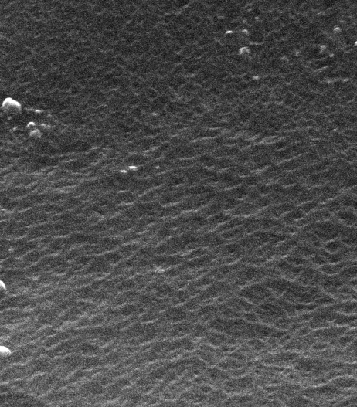
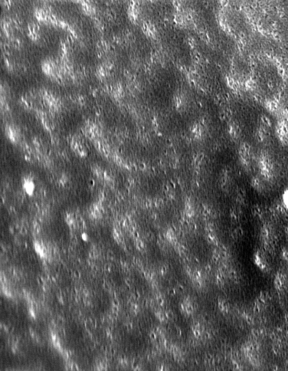
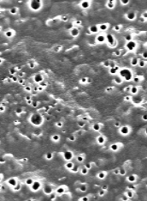
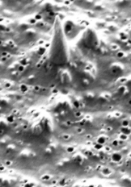
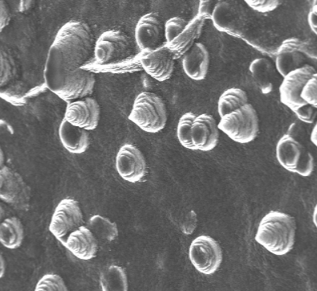
Surface morphology of Be and Al after exposure to D/Ar plasma
5 µm
Beryllium in PISCES-B
…
3 % 10 %
0 %
Ar fraction 100 %
2 % 6 % 15 %
…
Aluminium in PSI-2
Fine-scale grass-like structure in pure D plasma
Gradual smoothing out of surface with increase of Ar fraction

Slide 10
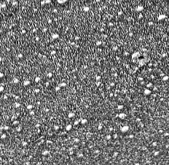
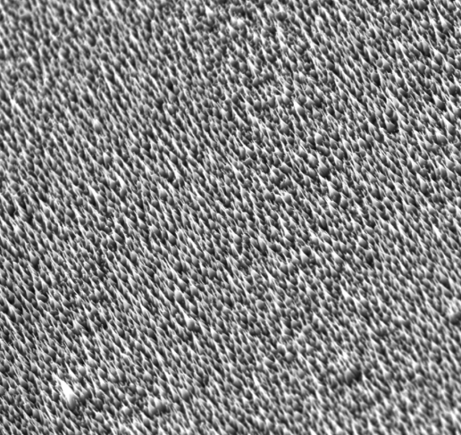
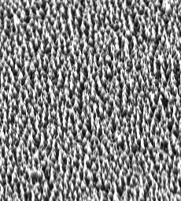
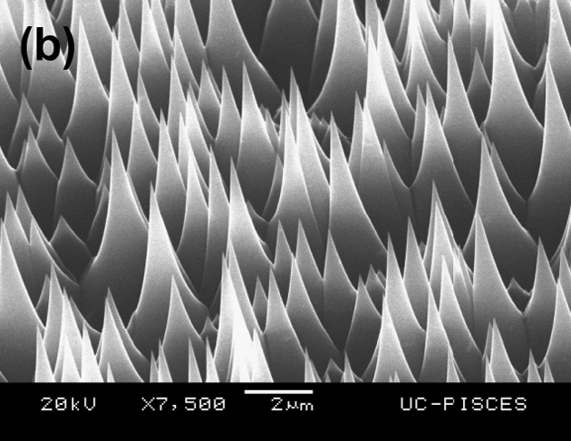
Surface morphology of Be and Al after exposure to D/He plasma
Aluminium in PSI-2
1 % 15 %
0 %
He fraction 100 %
…
10 µm
Beryllium in PISCES-B
in pure helium plasma [R. Doerner et al., JNM 455 (2014) 1]
Helium does not suppress formation
of grass-like structure, unlike argon

Slide 11
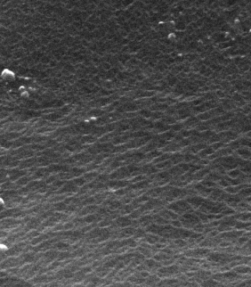
Measured and calculated sputtering yields in deuterium-argon plasma
Beryllium erosion by argon studied in PISCES-B
Aluminium erosion by argon studied in PSI-2
0.05
0.010
0.04
Calculation (TRIM code)
for flat surface
agreement
0.008
Calculation (TRIM code) for flat surface
0.03
0.006
Sputtering yield
Sputtering yield
discrepancy
discrepancy
0.02
0.004
agreement
0.01
0.002
Experiment
Experiment
0
0
0
20
40
60
80
100
0
20
40
60
80
100
Ar fraction of incident D+Ar ion flux [%]
Ar fraction of incident D+Ar ion flux [%]
Pure D: Rough Be surface
Pure Ar: Smooth Be surface
Pure D: Rough Al surface
Pure Ar: Smooth Al surface
5 μm
5 μm
5 μm
5 μm
Reduced erosion of Be and Al in pure D plasma due to rough grass-like surface and dilution of subsurface layer by deuterium
Admixture of Ar to D plasma recovers erosion to expected values

Slide 12
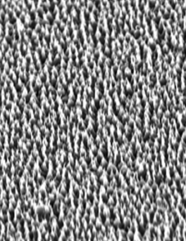
Measured and calculated sputtering yields in deuterium-helium plasma
Aluminium erosion by helium studied in PSI-2
Influence of surface roughness on effective sputtering
0.03
escaping sputtered particles
Calculation (TRIM code)
for flat surface
0.02
Sputtering yield
0.01
trapped
sputtered
particles
Experiment
0
0
20
40
60
80
100
He ion fraction [%]
Pure D: Rough Al surface
Pure He: Rough Al surface
rough grass-like structure
Rough grass-like structures can significantly reduce effective sputtering yield
5 μm
5 μm
Discrepancy also for pure He plasma → rough grass-like surface still present

Slide 13
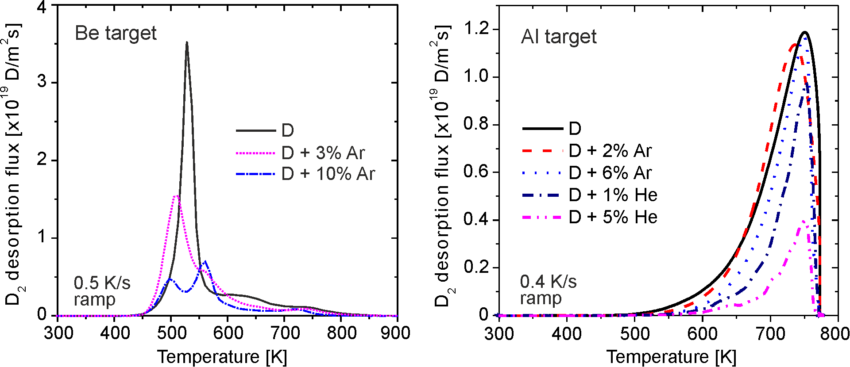
Deuterium retention in Be and Al under influence of argon and helium
Deuterium retention in beryllium studied in PISCES-B
Deuterium retention in aluminium studied in PSI-2
Different TDS spectra of Al and Be
Typical several-peak structure for beryllium incl. low-temperature supersaturation peak
Single broad peak for aluminium
Different behaviour of retention Al and Be under influence of argon
Aluminium cannot be used as beryllium surrogate for fuel retention studies

Slide 14
Deuterium retention in tungsten as function of incident ion flux
Incident ion flux for this study:
Magnum-PSI ≈ 5×10²³ m⁻²s⁻¹
PSI-2 ≈ 1×10²² m⁻²s⁻¹
Incident ion fluence kept constant by longer exposures in PSI-2 !

Slide 15
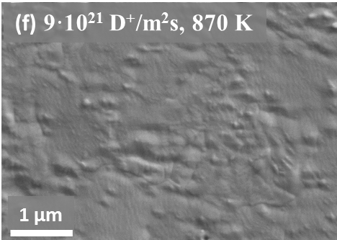
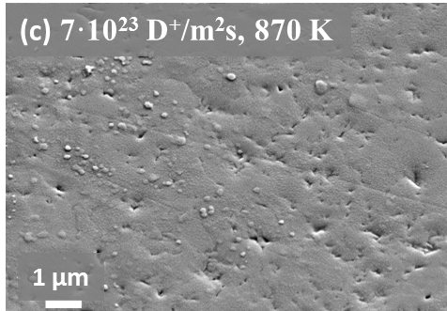
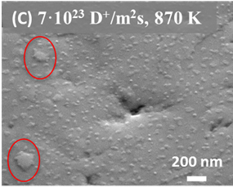
Blister formation in tungsten by deuterium irradiation at high surface temperatures
SEM images of tungsten exposed to
low flux in PSI-2
high flux in Magnum-PSI
No blisters
At high flux, blistering occurred for T_{s} > 800 K !
[L. Buzi et al., J. Nucl. Mater. 455 (2014) 316]

Slide 16
Blistering and deuterium retention in tungsten exposed to different ion fluxes
Deuterium retention for different ion fluxes and sample temperatures (total fluence kept constant!)
Domain of blister formation
10
22
PSI-2: flux ≈10²² m⁻²s⁻¹
10
21
Deuterium retention [m⁻²]
10
20
Magnum-PSI: flux ≈5×10²³ m⁻²s⁻¹
500
600
700
800
900
Sample temperature [K]
The presence of blisters correlates with the total amount of retained deuterium
At low and moderate exposure temperatures: higher retention for lower flux
At high exposure temperatures: higher retention for higher flux
[L. Buzi et al., J. Nucl. Mater. 455 (2014) 316]

Slide 17
Deuterium retention in tungsten under influence of helium and argon

Slide 18
Deuterium retention in tungsten under influence of helium and argon
Thermal desorption spectra (TDS) of tungsten exposed to mixed plasmas
8
8
7
0.4 K/s ramp
D
7
0.4 K/s ramp
D
D + 1% He
D + 2% Ar
6
D + 5% He
6
D + 6% Ar
5
5
D release rate [×10¹⁷ m⁻²s⁻¹]
D release rate [×10¹⁷ m⁻²s⁻¹]
4
4
3
3
2
2
1
1
0
0
200
400
600
800
0
0
200
400
600
800
Desorption temperature [°C]
Desorption temperature [°C]
Total amount of deuterium retained in exposed tungsten
Effect of helium:
Total deuterium retention is reduced by a factor of 3
Nano-size bubbles observed by TEM in depth up to ~10 nm
Effect of argon:
Total deuterium retention slightly increased
TDS spectra show different shapes
Change in trapping sites due to material damage by argon
[M. Reinhart et al., PSI 2014 Kanazawa, submitted to JNM]
5
D + Ar
4
3
Deuterium retention [×10²⁰ m⁻²]
2
D + He
1
0
0
1
2
3
4
5
6
7
8
Impurity ion fraction [%]

Slide 19
Conclusions
Beryllium
Erosion of beryllium and aluminium exhibits similar features
Pure D plasma: Fine-scale grass-like structures, reduced measured sputtering yield than calculated (factor ~10)
Addition of Ar: Grass-like structures are suppressed, sputtering increases to calculated values
Mechanisms of deuterium retention in aluminium are different than in beryllium
Tungsten
Relation of retention for low and high fluxes is temperature-dependent
Blistering occurred for high flux at surface temperatures of >800 K
Helium significantly reduces deuterium retention in tungsten, while argon slightly increases it

Slide 20
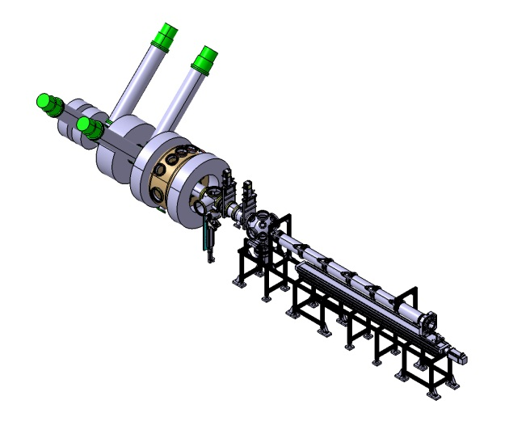
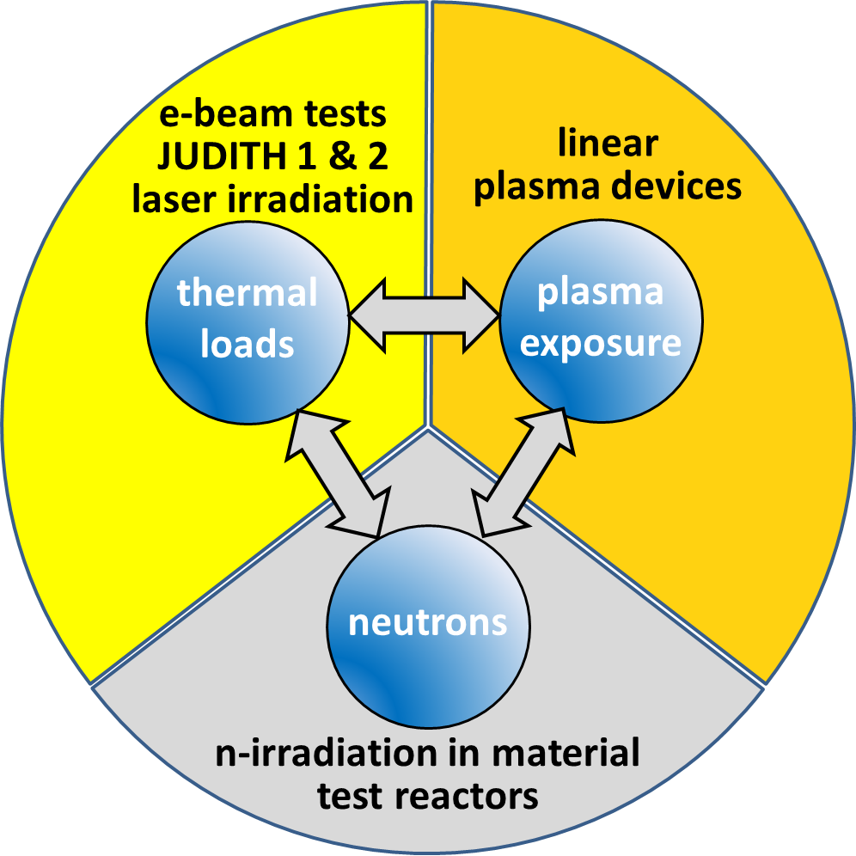
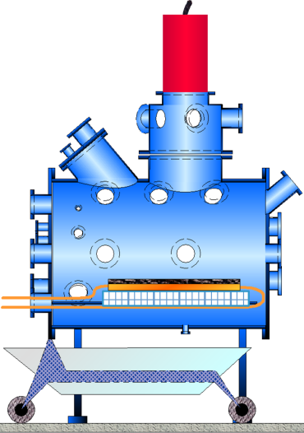
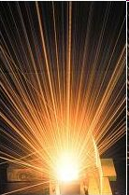
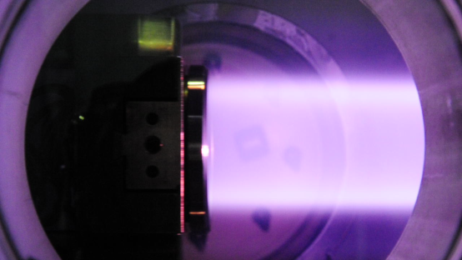
Jülich beyond TEXTOR: integral concept on plasma-material interaction in nuclear environment
Development and integrated characterization of thermo-mechanical and physical-chemical properties of neutron irradiated and toxic plasma-facing materials under high heat loads and plasma exposure
Focus on material optimization for plasma-material interaction processes (tritium retention, embrittlement, erosion)
JULE-PSI linear plasma device (in construction for HML)
JUDITH 1 and JUDITH 2 HHF e-beam facilities
PSI-2 linear plasma device (operational outside HML)
Nuclear infrastructure (Hot Material Labs)
available at FZJ

Slide 21
Backup slides

Slide 22
Mechanisms of reduction of Be and Al sputtering in deuterium plasma and effect of argon
Sputtering yield from mass loss measurements in comparison to calculations in binary collision approximation
 | Sputtering yield (Experiment) | Ratio Experiment/TRIM*
Pure D | 1.4×10⁻³ | 0.05
3% Ar | 3.1×10⁻³ | 0.1
10% Ar | 9.2×10⁻³ | 0.3
Pure Ar (0.75 Ar⁺ + 0.25 Ar²⁺) | 4.1×10⁻³ | 0.9
For pure D exposure, reduced sputtering can be explained by following effects [Doerner et al., J. Nucl. Mater. 438 (2013) S272]
Enhanced prompt re-deposition on rough surface → a reduction factor of 2-3
Protecting effect of D incorporated in Be (by dilution and less efficient change of momentum direction of incident particles necessary for sputtering) → TRIM calculations predict for D/Be = 50% a reduction factor of 4
Two-fold effect of Ar leading to higher erosion of Be by D
Reduction of surface roughness → Less prompt re-deposition
Reduced D retention in Be target → Less efficient protecting effect of D

Slide 23
Mechanism of development of grass-like structure
Model proposed by R.P. Doerner et al., J. Nucl. Mater. 455 (2014) 1
Y. Yamamura et al., "Angular Dependence of Sputtering Yields of Monatomic Solids", Report No. IPPJ-AM-26, 1983:
$\frac{Y(θ)}{Y (0)}=t^{f}\exp\left(−Σ\left(t−1\right)\right), t=\frac{1}{\cos{θ}}$
f and Σ are parameters for fitting of empirical formula to experimental data
Incident angle on the grass-like structure vs. angle for Y(θ)= 0.5·Y(0):
3.5
3.0
Deuterium
Aluminium
 | Be (PISCES-B) | Be (model) | Al (model)
Deuterium | 85.0° | 84.8° | 85.5°
Helium | 80.5° | 80.2° | 81.0°
Argon | - | 74.2° | 74.4°
2.5
Beryllium
2.0
Helium
1.5
Y(Θ)/Y(0)
1.0
Argon
0.5
0.0
0
20
40
60
80
Incident angle Θ [°]

