Slide 1
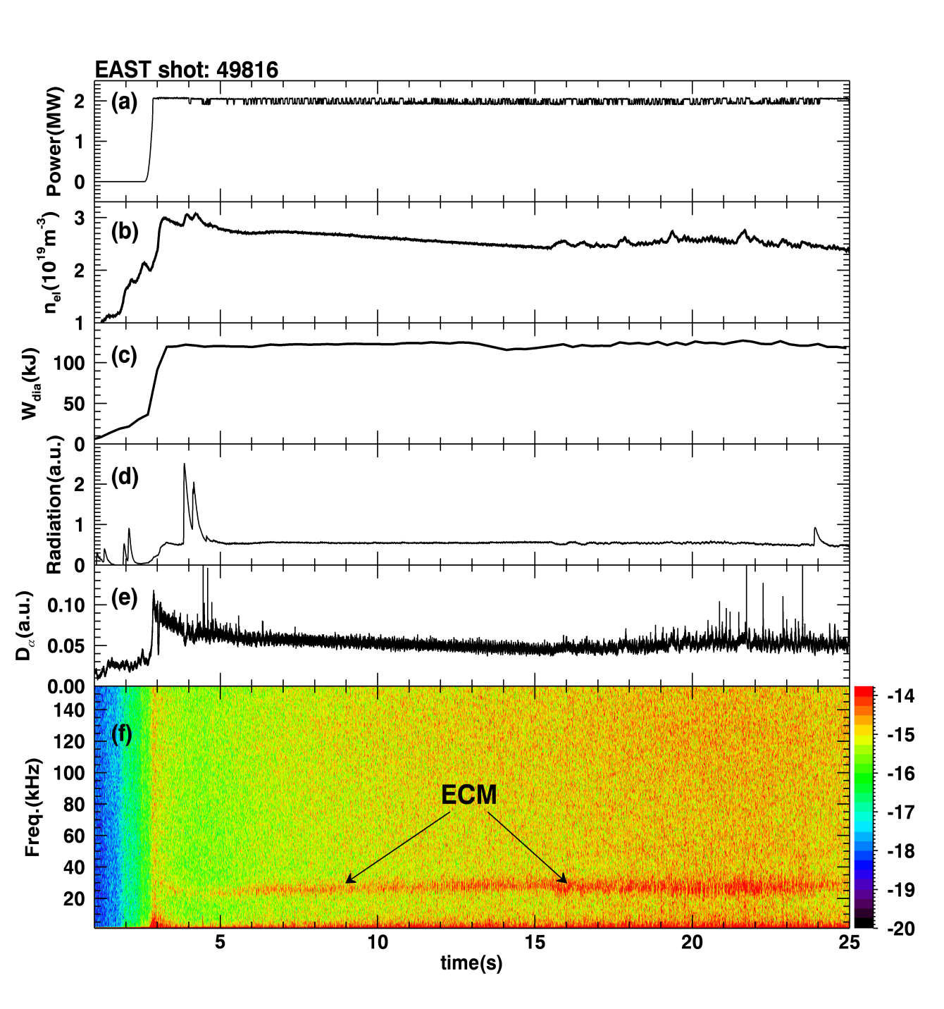
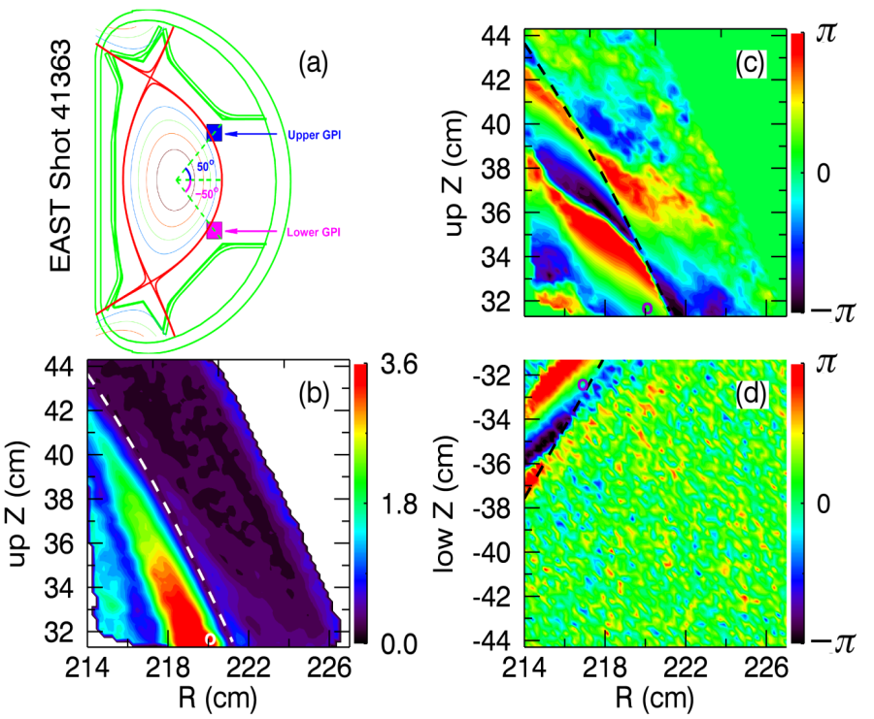
EX/9-5
LHCD Power > 2 P_{th} Loop Voltage ~ 0
Controllable Density
H₉₈~1.2, β_{n}~1.1, T_{e0}~3.5keV, W_{dia}~120kJ
Stationary XUV radiation
Mostly ELM-free
An Edge Coherent Mode (ECM) sits at the pedestal gradient region, leading to particle and heat exhaust across the pedestal.
GYRO simulations suggest DTEM
Long-pulse No/Small ELM H-mode with H₉₈~1.2, β_{n}~1.1, T_{e0}~3.5keV, q₉₅=4.5-7, δ_{low}~0.56, κ~1.6, sustained by LHCD with intensive lithium wall coating.
G.S. Xu gsxu@ipp.ac.cn

