Slide 1
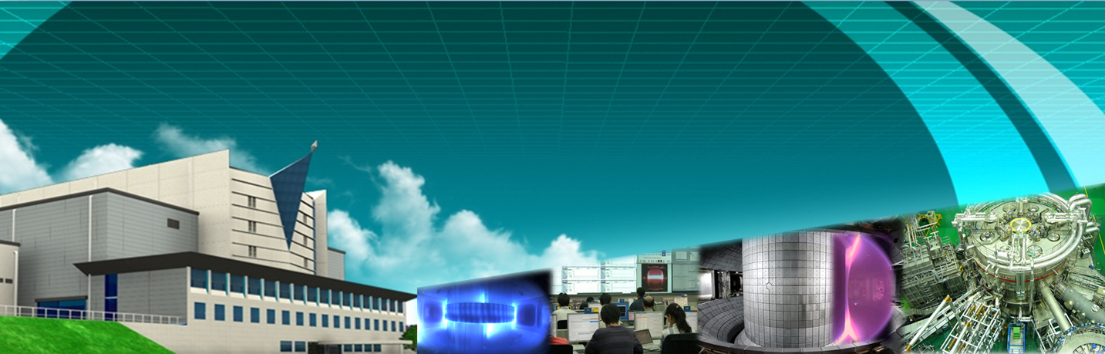
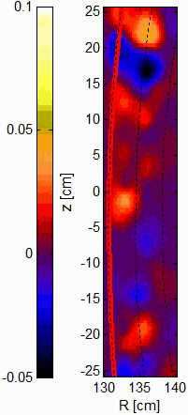
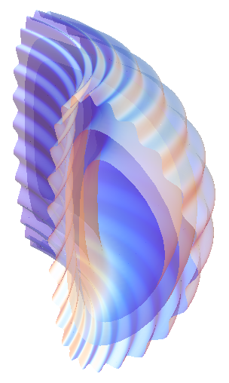
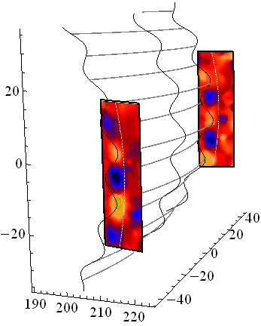
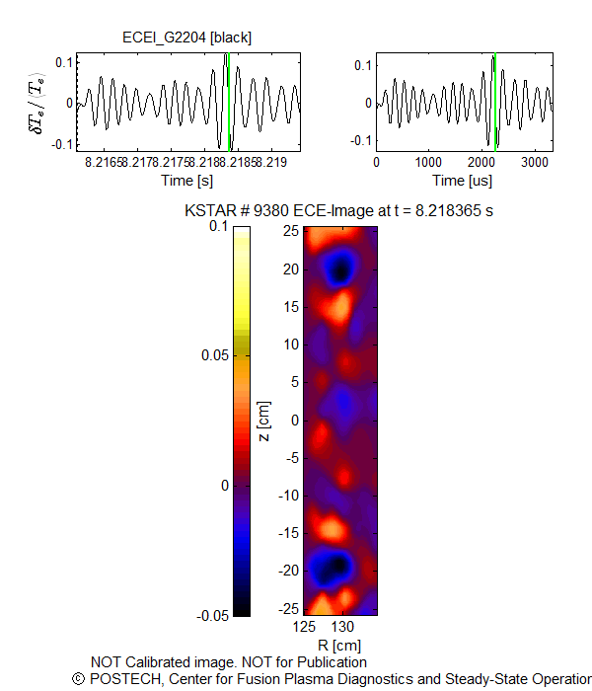
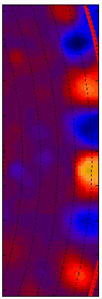
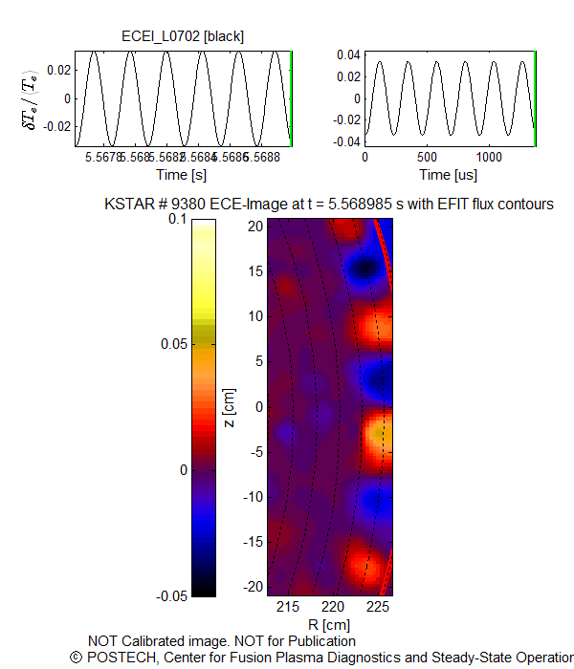





Simultaneous measurement of the ELMs at both high and low field sides and ELM dynamics in crash-free period in KSTAR
Hyeon K. Park
UNIST, Ulsan, Korea
at
25th IAEA FEC Conference
Oct. 12 -18 2014,
St. Petersburg,
Russian Federation
ELMs at the
high & low field sides
ELMs in 3D
[low field side)
In collaboration with
W. Lee (UNIST), M.J. Choi, M. Kim, J.H. Lee, J.E. Lee, G.S. Yun (POSTECH), X.Q. Xu (LLNL), S.A. Sabbagh, Y.S. Park (Columbia U.) ,C.W. Domier, N.C. Luhmann, Jr. (UC Davis), S.G. Lee (NFRI), KSTAR Team

Slide 2
Outline
KSTAR 2D/3D ECE Imaging and MIR system
  2D validation of the physics in modeling → predictive capability of MHD and transport physics modeling
Images of the ELMs in H-mode plasma
  Growth -> Saturation -> Crash
  Validate the measured ELMs with synthetic images
ELMs at High field side
  Discrepancies with the current understanding
ELM dynamics during the crash free period
  Underlying dynamics of suppression/mitigation of the ELMs?

Slide 3
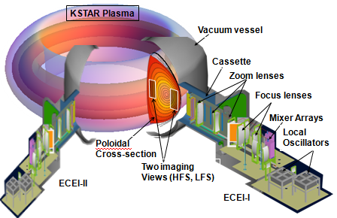
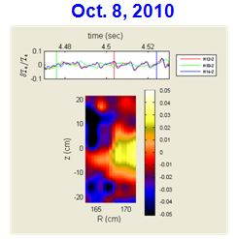

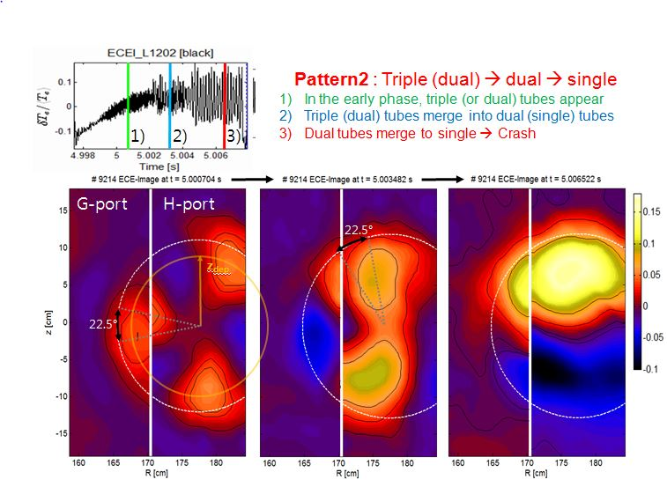
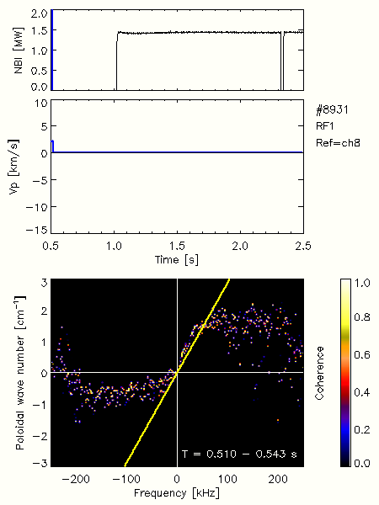
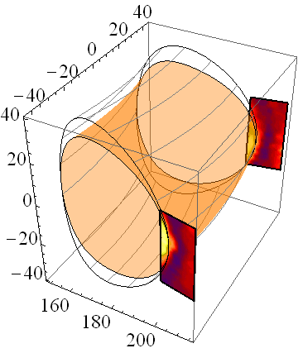
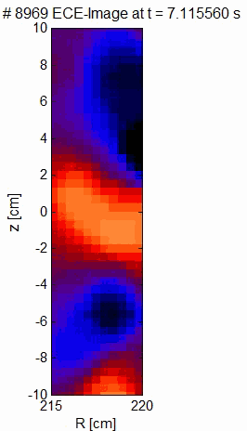
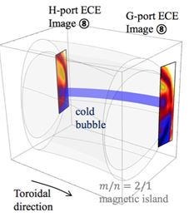
KSTAR 2D/3D Imaging systems
at 23rd FEC
Daejeon
Korea
H
G
Modified
sawtooth
Combined
with 2D MIR
EX/P8-12, G. Yun
m/n=2/1 mode
2D T_{e}
fluctuation
(30-50 kHz)
T_{e} fluctuation
(k vs. ω)
Cold bubble
Leads to disruption
2D Density fluctuation
EX/P8-13, W. Lee
EX/P8-15, Choi

Slide 4
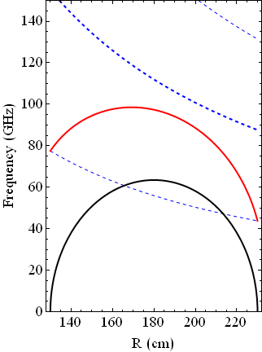
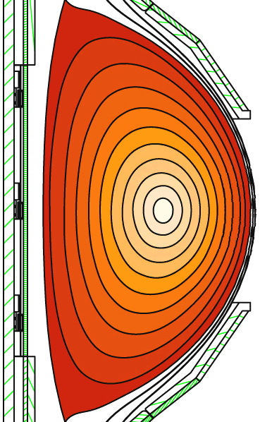
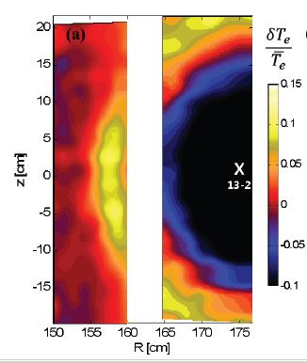
KSTAR ECEI viewing windows (B₀=2.0 T)
High Field Side (HFS)
Low Field Side (LFS)
HFS
LFS
HFS
O-mode
Measurement
with O-mode
polarization is
verified for
Sawtooth crash
J. Lee_JINST_(2011)
Poloidal view of
the KSTAR plasma
Characteristic frequencies of
the electron cyclotron emission

Slide 5
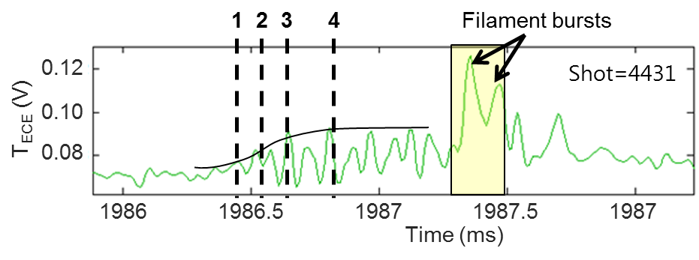

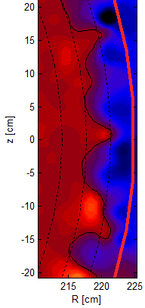
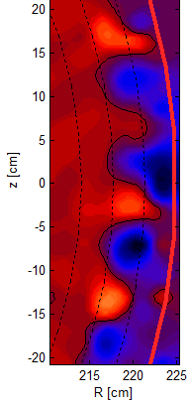
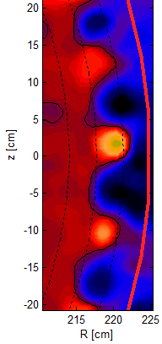

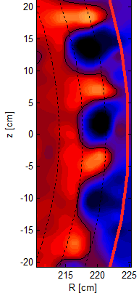
Dynamics of a single ELM in KSTAR H-mode plasmas
(1) Initial growth
(2) Saturation
1
2
3
4
0 μs
100 μs
200 μs
400 μs
LCFS
LCFS
G.S. Yun et al., PRL 107 (2011)

Slide 6
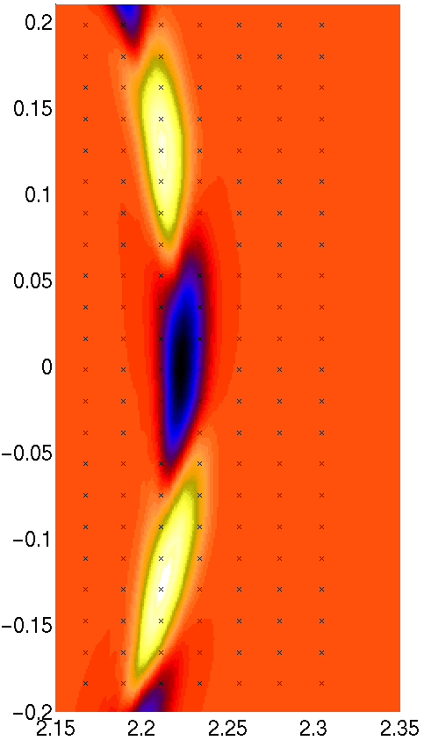
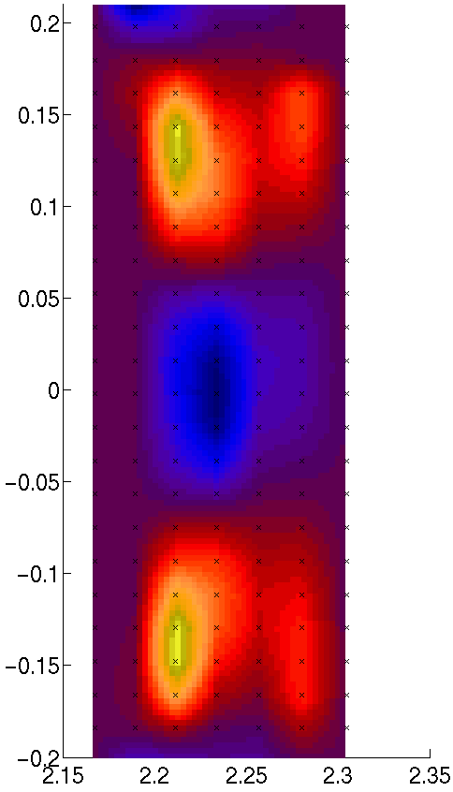
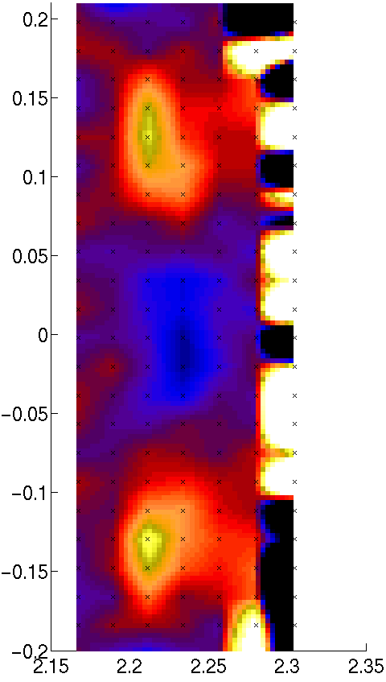
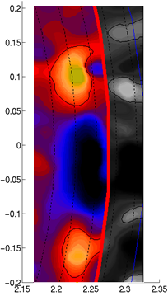

Validation of the ELM structure
BOUT++
Simulation*
Synthetic Image
(ideal)
Synthetic Image
with system noise
Measured
image
δT/<T>
phantom
Instrument Function
Major radius (cm)
Observed structure = a faithful representation of ELM filaments
  Phantom image outside the separatrix due to ECE downshift from inside (well known); masked by finite system noise and scattered emission
  We ignore ECE signals contaminated by the downshifts
M. Kim et al., NF 54 (2014)

Slide 7
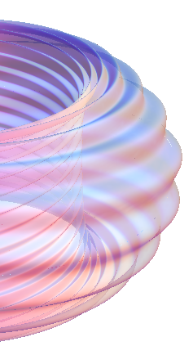
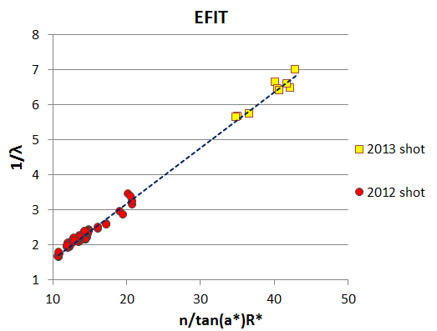
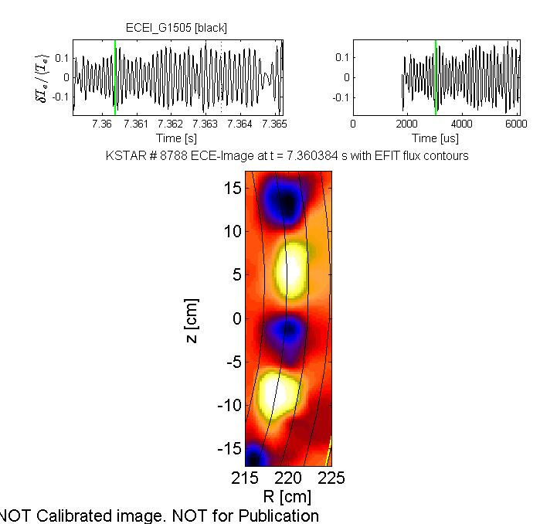
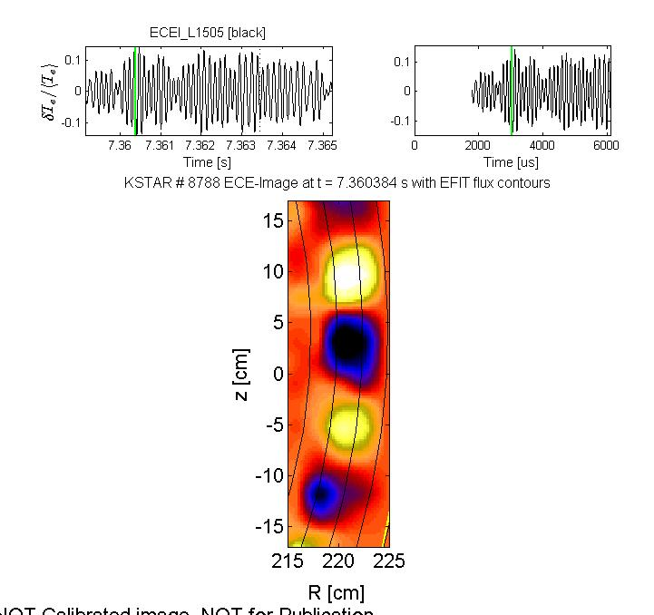


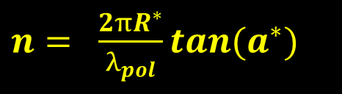

Relationship between toroidal (n), poloidal (m) mode numbers & pitch angle (α∗)
ECEI-1
Poloidal
spacing
$n= \frac{2πR^{∗}}{λ_{pol}}tan(a^{∗})$
ECEI-2
Pitch angle
$$a^{∗}$$
Toroidal spacing
Range of toroidal mode numbers
4 < n < 16
$${22.5}^{°}$$
$$tan(a^{∗})= \frac{poloidal spacing}{Toroidal spacing}$$
ECEI-2 (GFS)
ECEI-1 (LFS)
ch_15
ch_10
J.H. Lee, RSI, 85 (2014)
J.E. Lee, 9th APFA conference (2013)
Notes:
There are two ways to determine q95
Using the equilibrium fitting code, calculate the safety factor at the 95% poloidal flux surface.
As you can see the formula is formed by some of plasma parameters

Slide 8

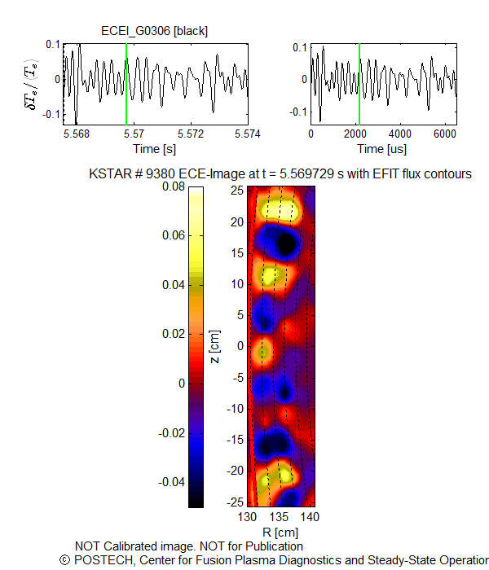
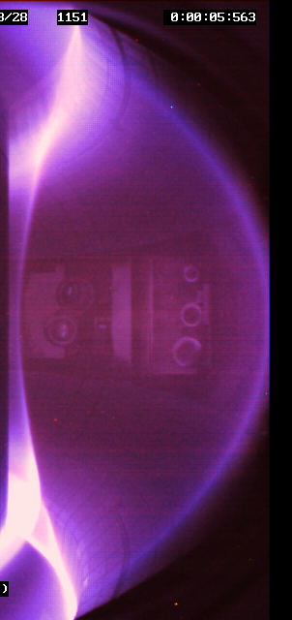
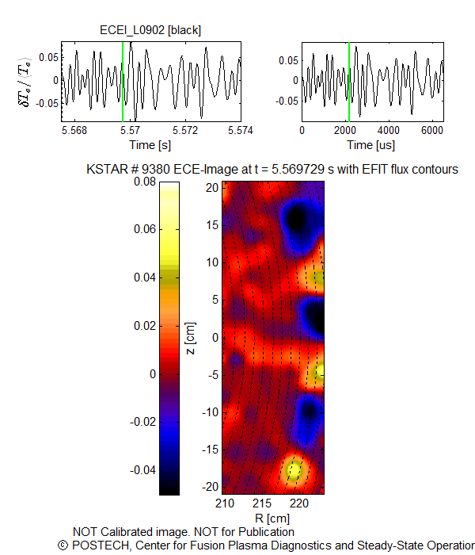


Simultaneous measurement of the ELMs at both HFS and LFS (2013)
ECEI ~5.569s HFS image
TV image with EFIT
ECEI ~5.569s LFS image
KSTAR #9380
ECEI_{LFS, 0902}
LFS-0902 X
ECEI_{HFS, 0306}
HFS-0306
X

Slide 9

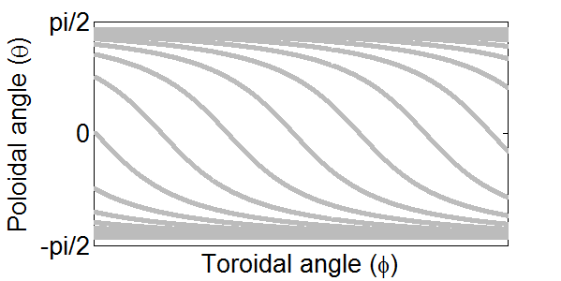
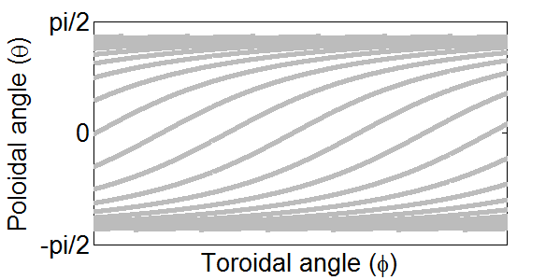






Rotation direction and mode strength
KSTAR #9380
ECEI ~5.569s HFS image
KSTAR #9380
ECEI ~5.569s LFS image
LFS edge
ECEI
$$I_{p}$$
$$B_{tor}$$
$$V_{tor}$$
$$λ_{pol}$$
$$α$$
$$λ_{tor}$$
HFS edge
ECEI
$$I_{p}$$
$$B_{tor}$$
$$V_{tor}$$
$$λ_{pol}$$
$$α$$
$$λ_{tor}$$
Rotation direction – Asymmetries in toroidal and/or poloidal velocity
Comparable mode strength at HFS and LFS – No shear flow damping at HFS ?

Slide 10
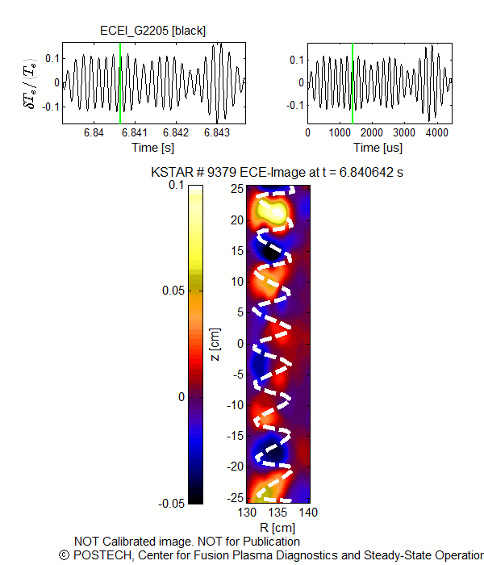
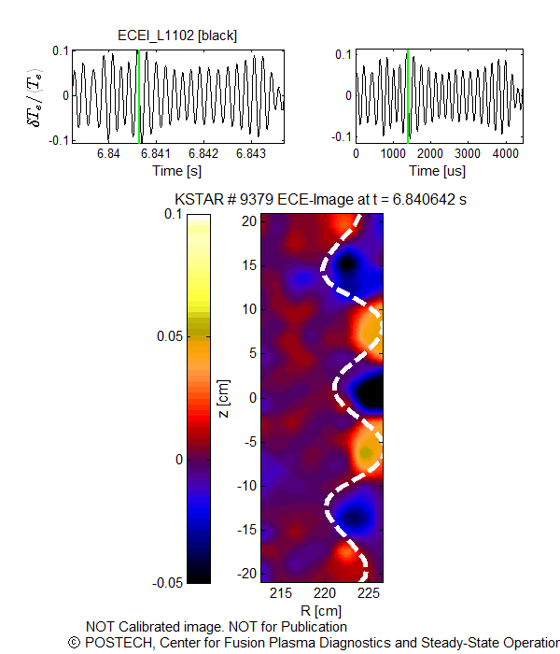

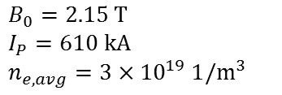


Mode spacing based on Ballooning mode
Refraction effect - the actual mode spacing in HFS should be larger than the observed one.
$$B_{0}=2.15 T$$
$$I_{P}=610 kA$$
$$n_{e,avg}=3×{10}^{19} 1/m^{3}$$
$$W_{tot}=270 kJ$$
$$q_{95}≈6$$
ECEI ~6.840s HFS image
ECEI ~6.840s LFS image
$$10cm$$
Z [m]
$$13cm$$
Refractive index
n_{e}(max)~3x10¹⁹/m³
R [m]
In and out pressure asymmetry ? unlikely
The structure of ELM filaments at the HFS is not consistent with the ballooning mode structure.

Slide 11
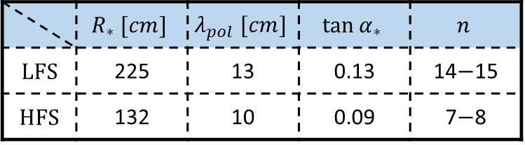

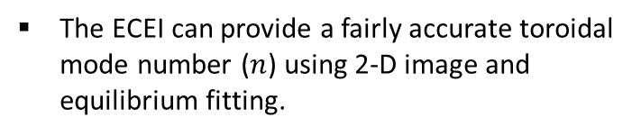
2-D correlation image of the HFS & LFS ELMs
The ECEI can provide a fairly accurate toroidal mode number ($n$) using 2-D image and equilibrium fitting.
$$R_{xy}$$
HFS-2205
X
Pitch (mid-plane)
$n= \frac{2πR^{∗}}{λ_{pol}}tan(a^{∗})$
LFS-0902
X
LFS | 225 | 13 | 0.13
HFS | 132 | 10 | 0.09
ELM structure + strong shear flow in HFS edge -> streamer like role ?

Slide 12
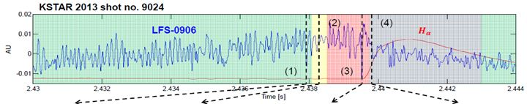
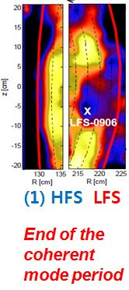
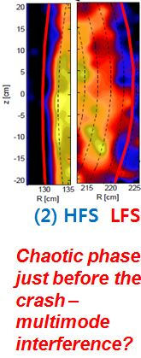
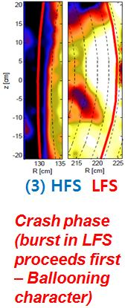
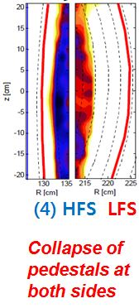
Burst process of the HFS & LFS ELMs (2013)
Time evolution of a single global ELM crash

Slide 13
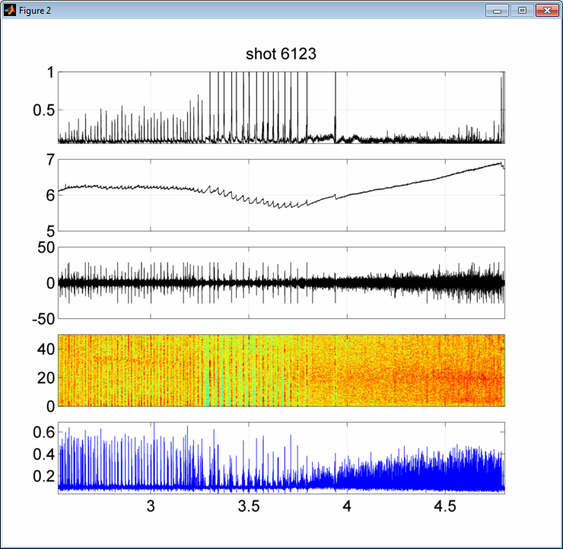
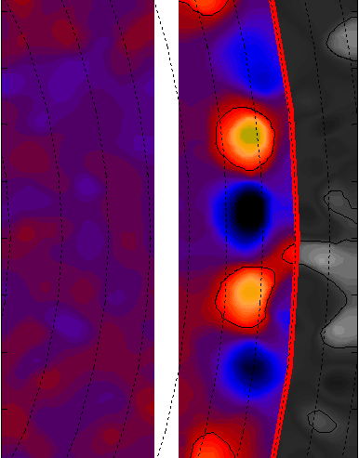
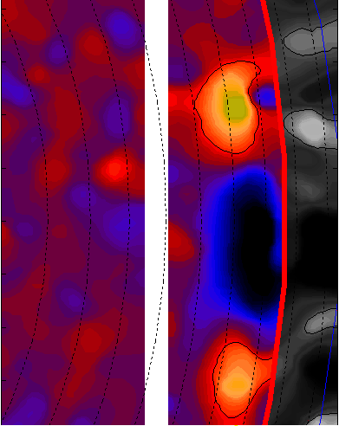
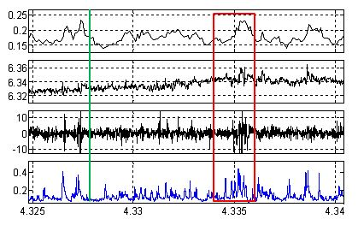


ELMs & crashes in crash free period (2011)
B₀=2T, I_{p}=600kA, T_{e}(0)~2.5 keV, <n_{e}>~3×10¹³ cm⁻³ W_{tot}~250kJ →240kJ
A
B
C
n=1 MP
D_{α}
change from n=10 to n=5 mode
n_{e} (m⁻²)
15
A
B
10
dB/dt
(T/s)
5
0
-5
f (kHz)
-10
-15
rf
(0.6 GHz)
205
210
215
220
225
230
Major radius R(cm)
No steady ELMs
ELMs with tiny crashes accompanied with rf bursts
C
ELM crash free period
(No steady ELM)
Time (s)
No large crash but
occasional tiny crashes
205
210
215
220
225
230
No changes in background
Time (sec)
G.S.Yun, PoP 19 (2012)
Notes:
$ν_{e}^{∗}≡\frac{ν_{ee}q_{95}R0}{v_{Te}}×{\left(\frac{R0}{a}\right)}^{3/2}\sim 0.3$ using Te=500eV and ne=1e13 cm-3

Slide 14




ELMs & crashes in crash free period (2012)
D_{α}
MP
B₀ = 1.8 T, I_{p} = 510 kA
q₉₅ ~ 4.5, P_{NBI} = 2.7 MW
W_{tot}: 220→180 kJ
n_{e} (m⁻²)
A
B
C
dB/dt
(T/s)
f (kHz)
rf
(0.2 GHz)
Time (s)
Observation has been consistent over 3 years
High-n → suppression or
High-n → low-n → suppression
Suppressed time consist of
  Smaller bursts (bunching and single), brief moment without ELM, and persistent ELM with higher n without crash
rf signal (<200 MHz) is a good measure of ELM crash
Broad-band dB/dt signal is not from high-n mode crash (Note: EX/1-5 Y. Jun)

Slide 15



Illustration of no burst and burst cases (2012)
rf signal is much
better indicator
of the ELM crash
Bursting
ELM period
Steady
ELM period
Little change in magnetic signals !!

Slide 16
Summary
Findings from the HFS ELMs
  Mode number discrepancies – in/out asymmetry in pressure profile or Ballooning representation incorrect??
  Large mode amplitude – high flow shear damping at the HFS??
  Rotation direction – asymmetries in toroidal/poloidal velocities + others (e.g., Pfirsch Schluter flow)??
  Crash proceeds first at LFS – Ballooning characteristics??
ELM dynamics during the “suppression” period
  Change of the edge confinement → less free energy → higher n, higher frequency, smaller crashes (bunching and singles), persistent ELMs without crash and brief moment without ELMs :marginal free energy or intricate physics??
  Broad spectra of dB/dt signals during ELM suppression period is not from the high-n mode burst

