Slide 1
TH/7-1 Multi-phase Simulation of Alfvén Eigenmodes and Fast Ion Distribution Flattening in DIII-D Experiment
Y. Todo (NIFS, SOKENDAI) M. A. Van Zeeland (GA) A. Bierwage (JAEA) W. W. Heidbrink (Univ. California, Irvine) M. E. Austin (IFS, Univ. Texas at Austin)
25th IAEA Fusion Energy Conference (October 13-18, 2014, St. Petersburg, Russian Federation)

Slide 2
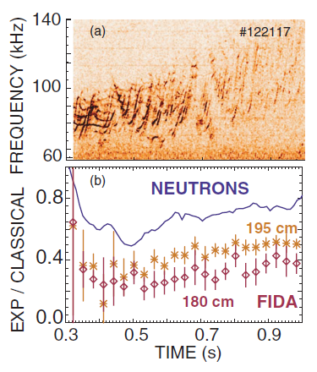
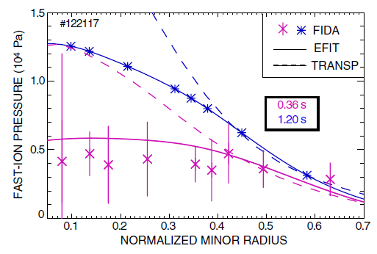
Anomalous Flattening of Fast ion Profile on DIII-D
[W. W. Heidbrink, PRL 99, 245002 (2007)]
Anomalous flattening of the fast-ion profile during Alfvén-eigenmode activity
A rich spectrum of TAEs and RSAEs with reversed q profile in current ramp-up phase

Slide 3
Theoretical studies related to the DIII-D experiments
Alfvén eigenmodes
An excellent agreement in δTe profile between NOVA prediction and ECE measurement [Van Zeeland (2009)]
Shearing of 2D AE profile was compared with TAEFL code [Tobias (2011)]
EP nonperturbative effects on TAE profile and freq. [Wang (2013)]
Validation of GK codes on transition from RSAE to TAE [Spong (2012)]
EP transport
Multiple low amplitude modes (dB/B~10^-4) can account for significant modification of fast ion distributions [White (2010)]
Modeling of fast ion losses and stability of AE modes [Van Zeeland (2011, 2012)]
Nonlinear simulations [Vlad (2009), Y. Chen (2013)]

Slide 4
We try a first comprehensive simulation of AE amplitude and EP transport !
Energetic Particles
destabilize
Alfvén Eigenmodes
transport
AE stability and amplitude depend on EP distribution
EP transport depends on AE amplitude
AEs and EP distribution should be solved in a self-consistent way. Difficulty arises from a gap between time scales:
slowing down time ~ 0.1-1 s, AE period ~ 10^-5 s

Slide 5
Life of an energetic particle: idea of multi-phase simulation
v
v₀
resonance with AE1
slowing down process
resonance with AE2
t
in the slowing down process, energetic particle resonates with multiple AEs
resonance regions have finite width (Δv) in velocity space
interaction with AEs can be simulated at intervals shorter than τ_{s}*Δv/v

Slide 6
Multi-phase Simulation [Y. Todo, Nucl. Fusion 54, 104012 (2014)]
Classical
Hybrid
Classical
Hybrid
・・・・・・
4ms
1ms
4ms
1ms
・・・・・・
Classical
Hybrid
Classical
Hybrid
4ms
1ms
4ms
>1ms, until a steady state appears
Hybrid simulation of energetic particles and an MHD fluid
Multi-phase simulation =
classical simulation w/o MHD perturbations for 4ms +
EP-MHD hybrid simulation for 1ms; performed alternately
reduce computational time to 1/5

Slide 7
Objectives
Multi-phase simulation of a DIII-D experiment (#142111) and validation on
anomalous flattening of fast ion profile
electron temperature fluctuation: frequency, spatial profile, and amplitude
Analysis of fast ion transport process in the simulation result

Slide 8
An extended MHD model coupled with energetic particles
based on an extended MHD model given by Hazeltine and Meiss
EP effect
thermal ion diamagnetic drift
+
equilibrium toroidal rotation
ν=η/μ₀=ν_{n}=χ= 5×10⁻⁷v_{A}R₀

Slide 9
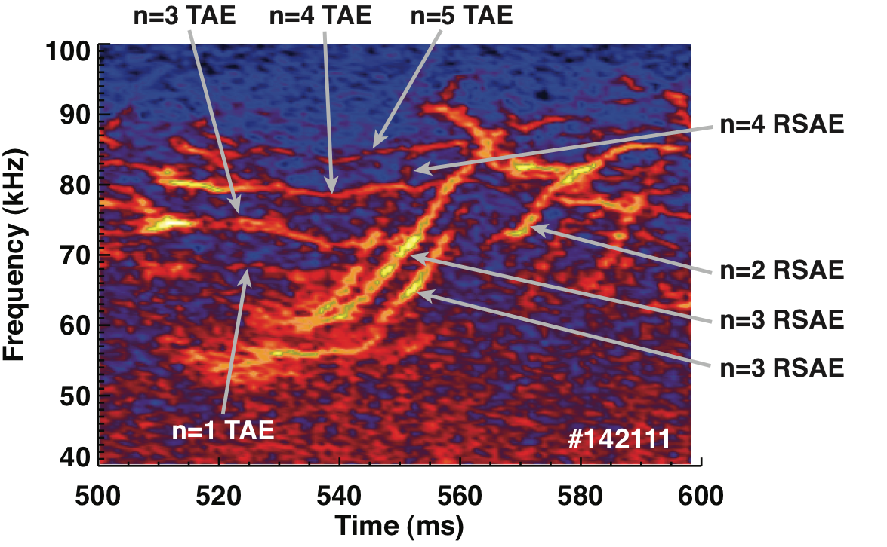
Frequency spectrum evolution in the experiment at t~525ms #142111
[M. A. Van Zeeland, NF 52, 094023 (2012)]
AEs with n=1-5 are observed.
In the simulation, energetic particle drive is restricted to n=1-5 to reduce numerical noise.

Slide 10
Setup of simulation
DIII-D discharge #142111 at t=525ms is investigated using an equilibrium data reconstructed with EFIT code.
Realistic beam ion deposition profile (full, half, and third energy components) is given by TRANSP code.
Collisions (slowing down, pitch angle scattering, energy diffusion) with realistic parameters are taken into account.
Particle losses take place at the plasma boundary (r/a=1).
8 million particles are injected with constant time intervals in 150ms.
Beam injection power is 6.25MW.

Slide 11
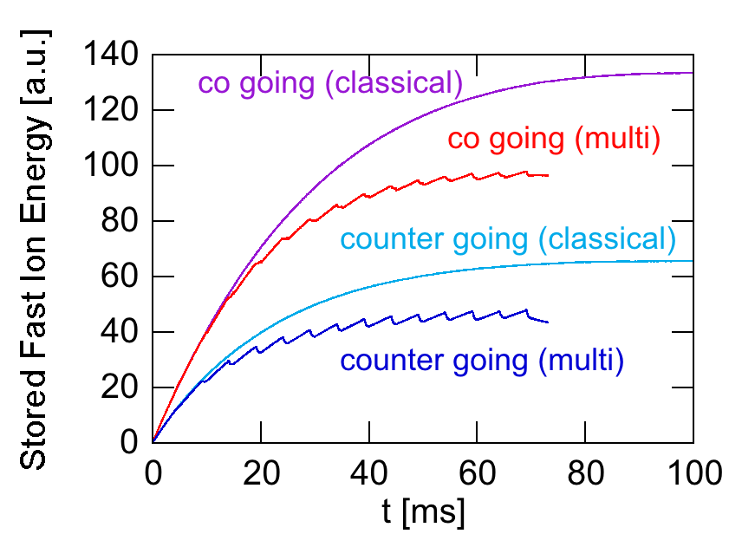
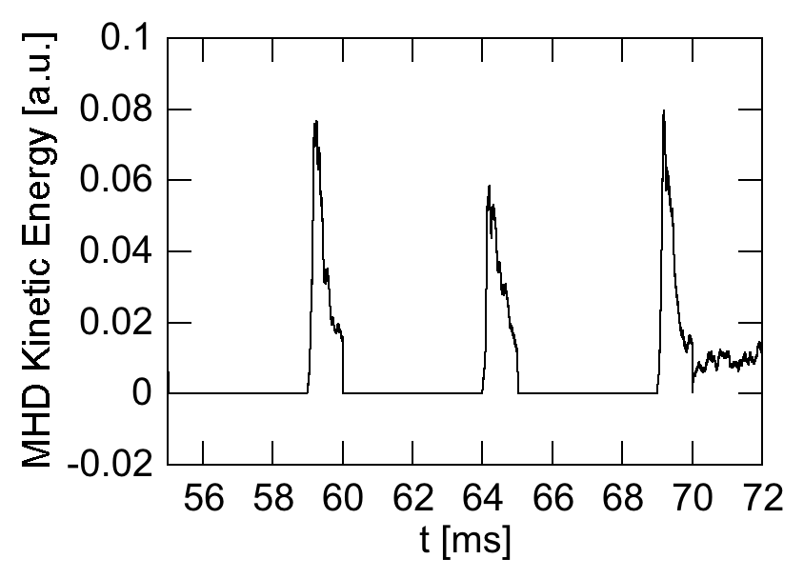
Time evolution of stored fast ion energy and MHD kinetic energy
Multi phase simulation: classical phase is run w/o MHD for 4ms and then hybrid phase is run with MHD for 1ms. This combination is repeated until stored fast ion energy is saturated at t=70ms.
After t=70ms, the MHD fluctuation reaches to a steady level.

Slide 12
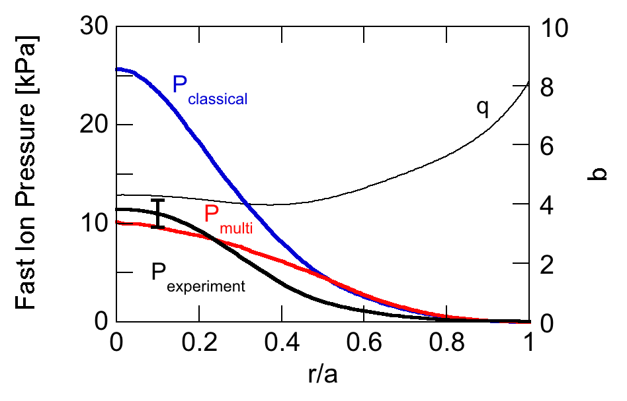
Comparison of fast ion pressure profiles (classical, multi-phase, exp.)
Fast ion pressure profile flattening takes place in the multi phase simulation.
The fast pressure profile in the multi-phase simulation is close to that in the experiment.

Slide 13
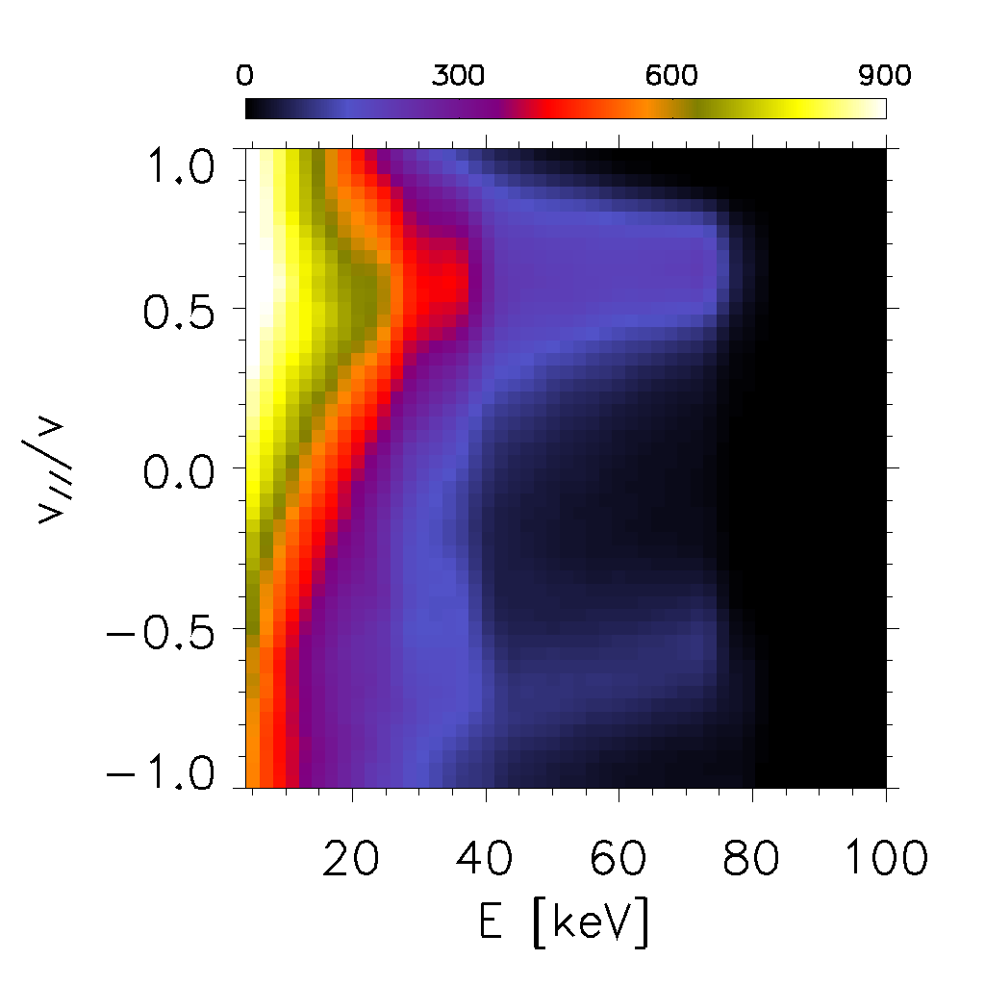
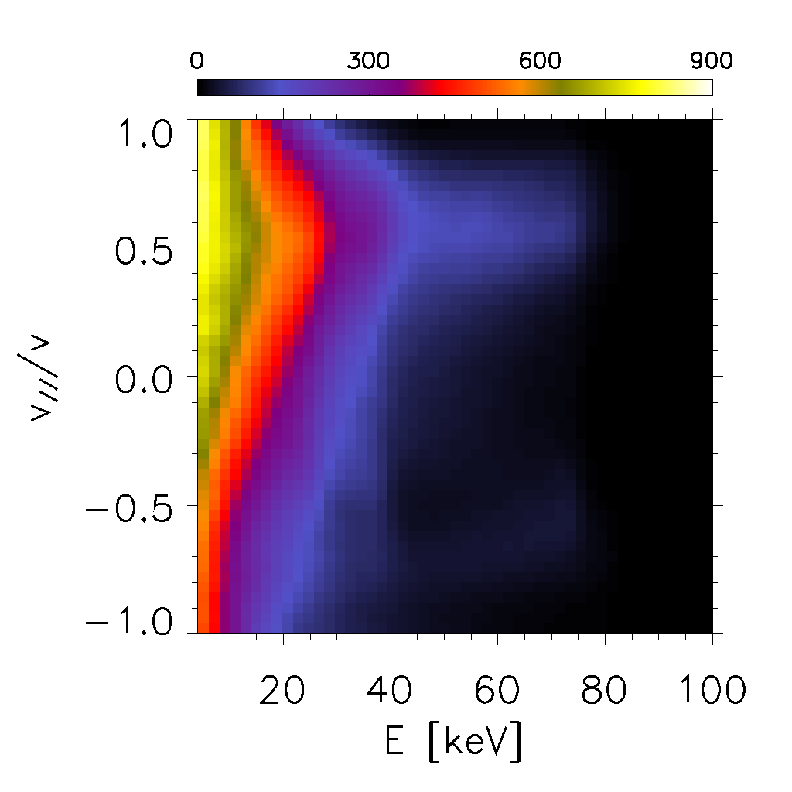
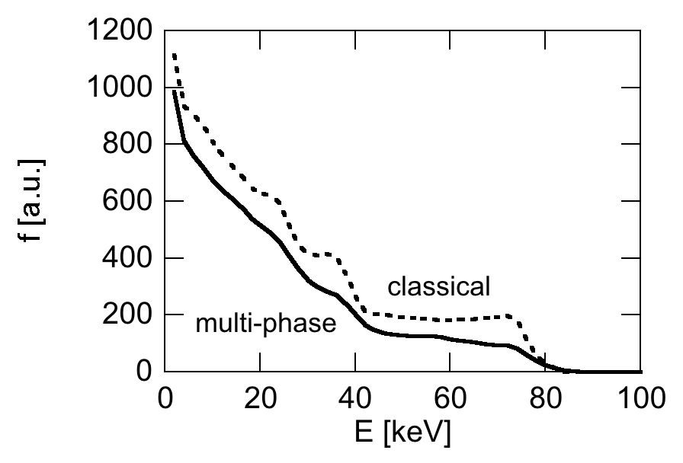
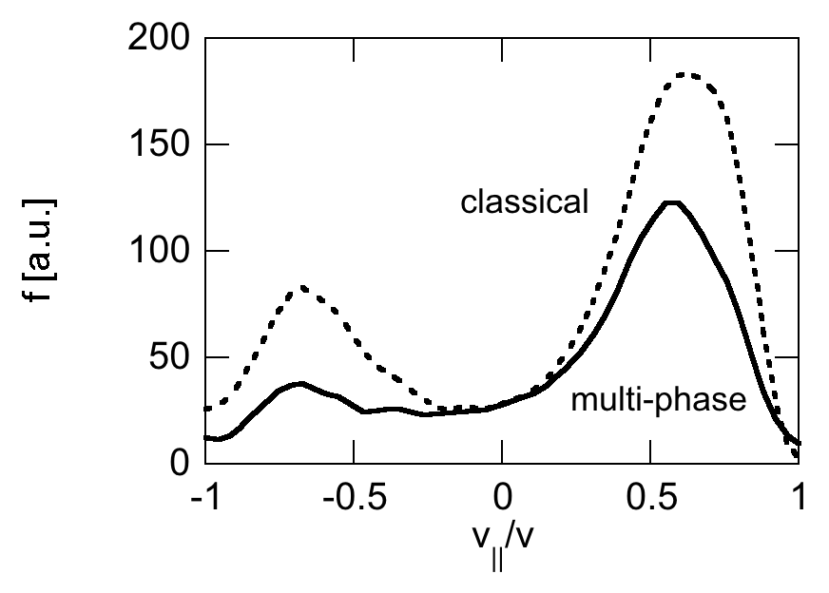
Fast ion distribution in velocity space
Classical
Multi-phase

Slide 14
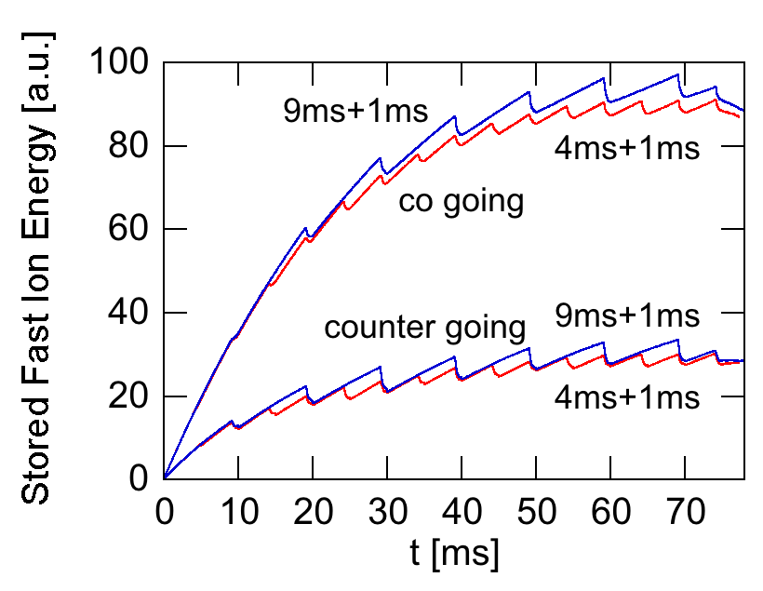
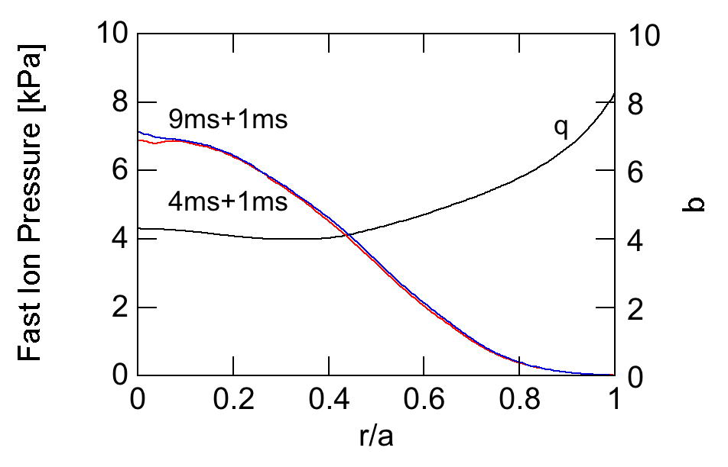
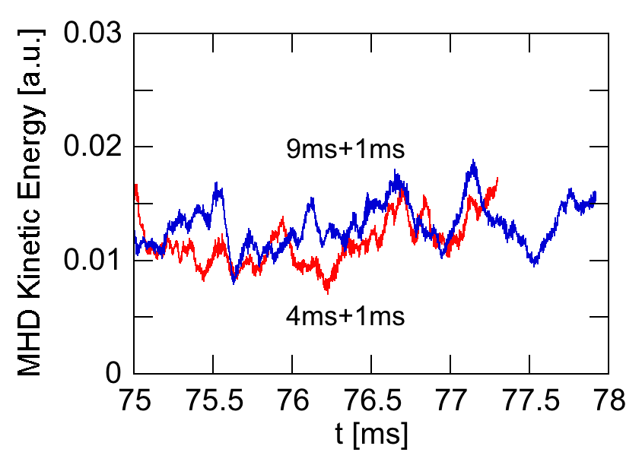
Comparison among classical phase durations
two classical phase durations (4ms and 9ms) are compared
very good agreement in fast ion pressure profile (top right)
similar MHD fluctuation level (bottom)

Slide 15
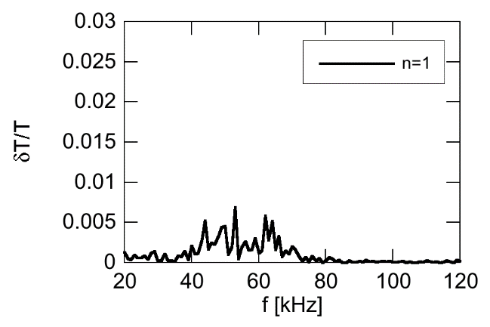
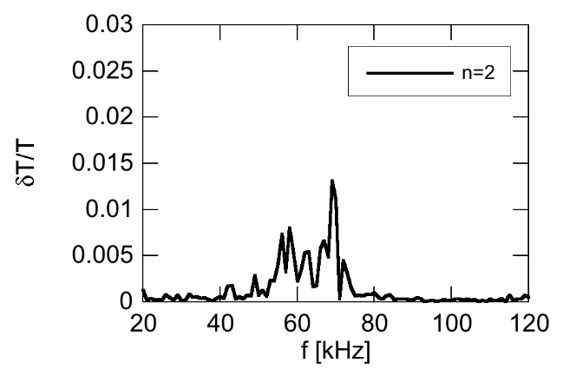
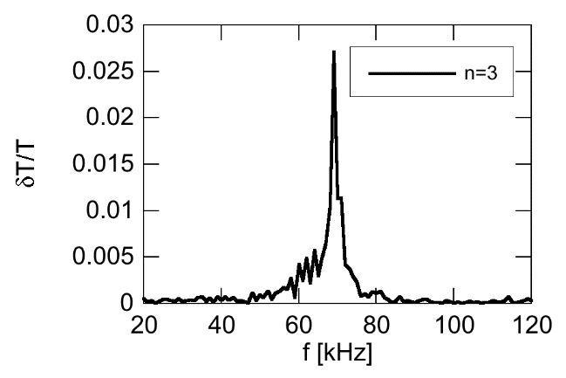
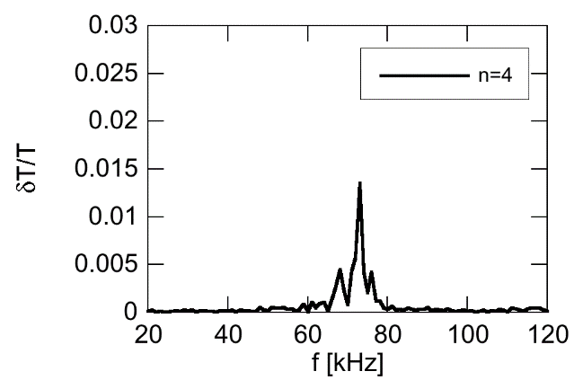
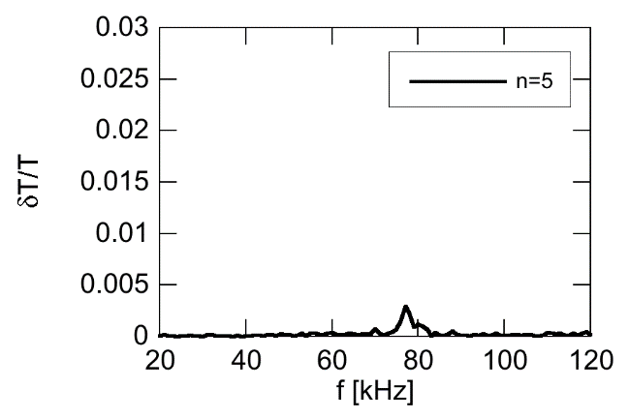
Bulk temperature fluctuation spectra at r/a=0.49 at t≥70ms
n=1
n=2
n=3
n=4
n=5
Comparison in frequency (sim., exp.): n=1 (62kHz, 68kHz), n=3 (69kHz, 74kHz), n=4 (73kHz, 79kHz), n=5 (77kHz, 84kHz)
n=2 mode is missing at the simulated moment in experiment

Slide 16
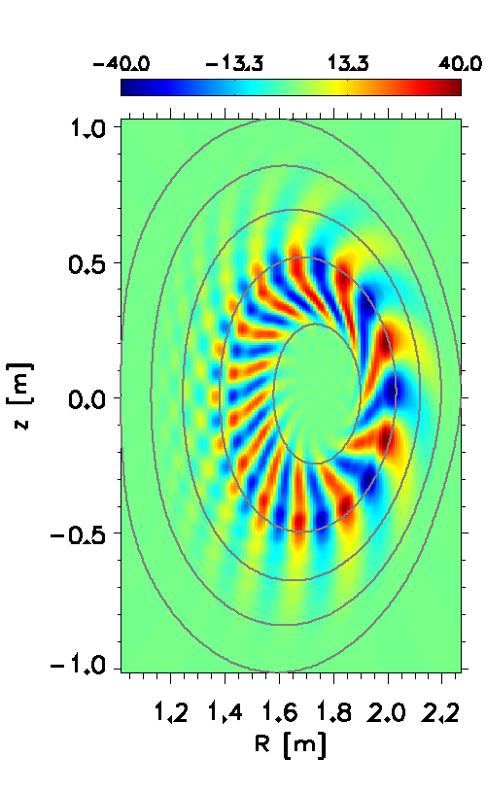
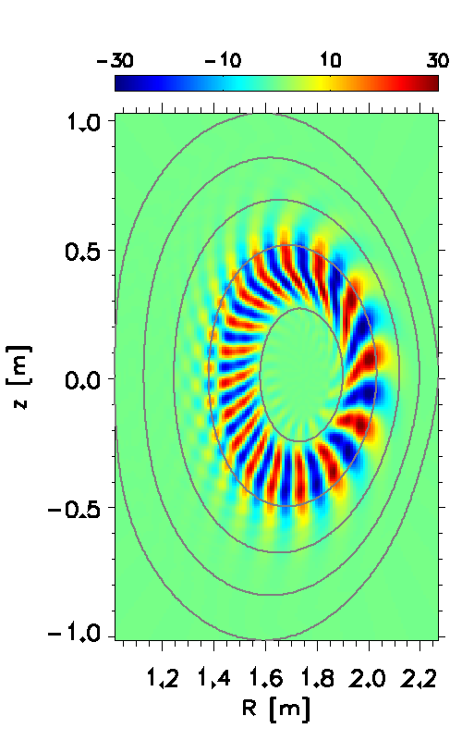
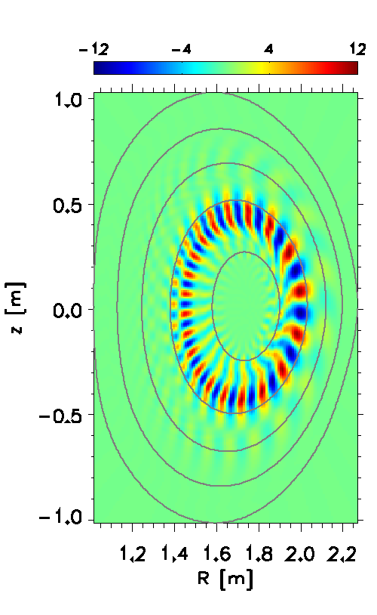
δTe Spatial Profiles in multi-phase simulation
n=3, f=69kHz
n=4, f=73kHz
n=5, f=77kHz

Slide 17
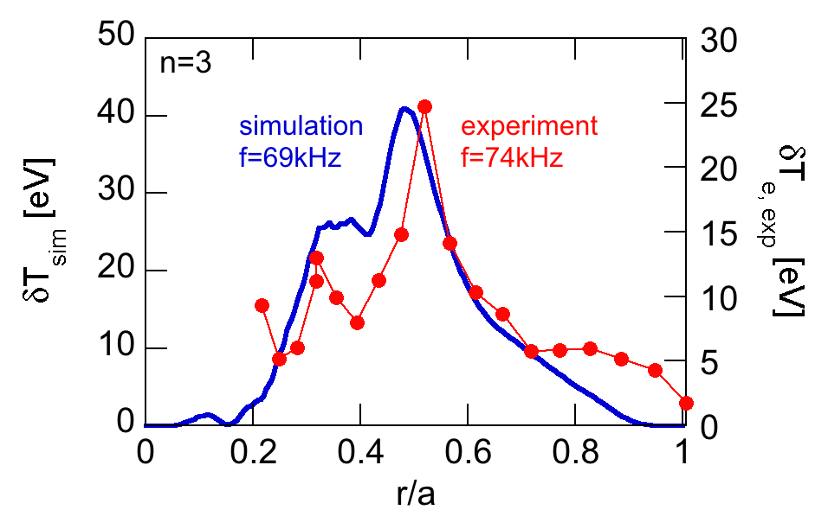
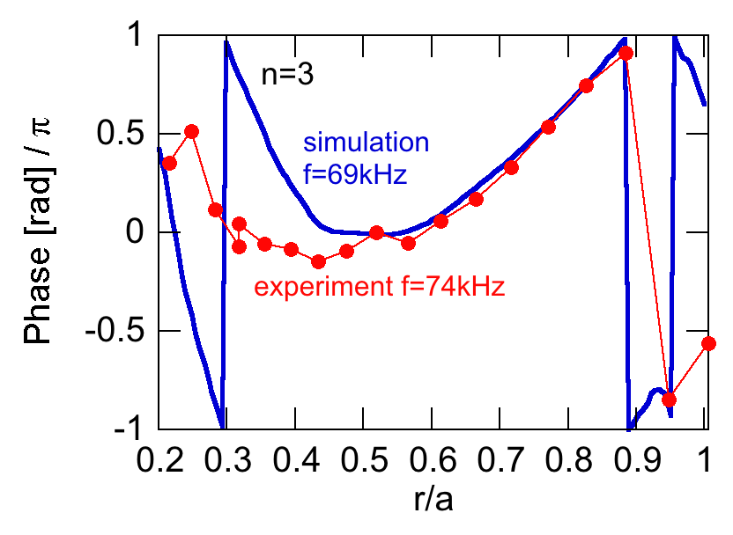
Comparison of temperature fluctuation profile with ECE measurement for n=3
good agreement in spatial profile (left)
good agreement in amplitude within a factor of 2 (left)
good agreement in phase profile (right)

Slide 18
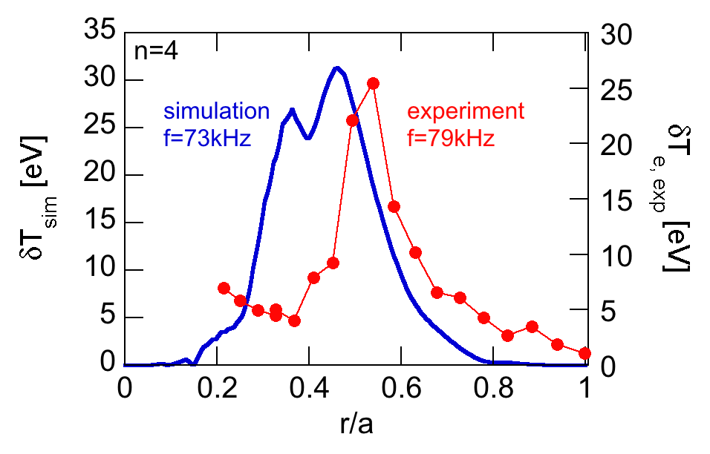
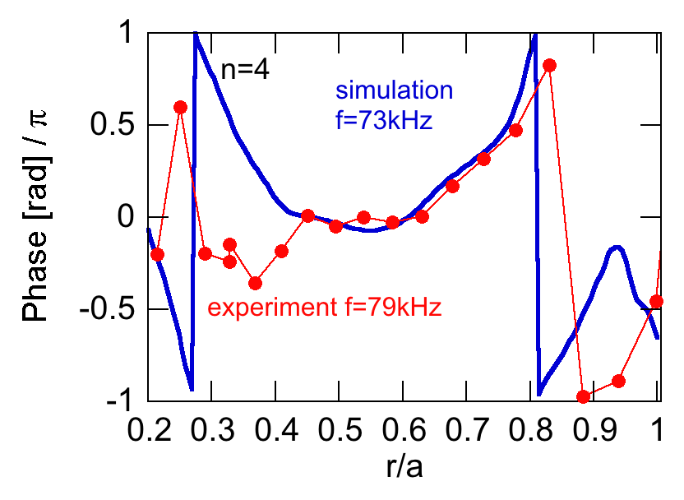
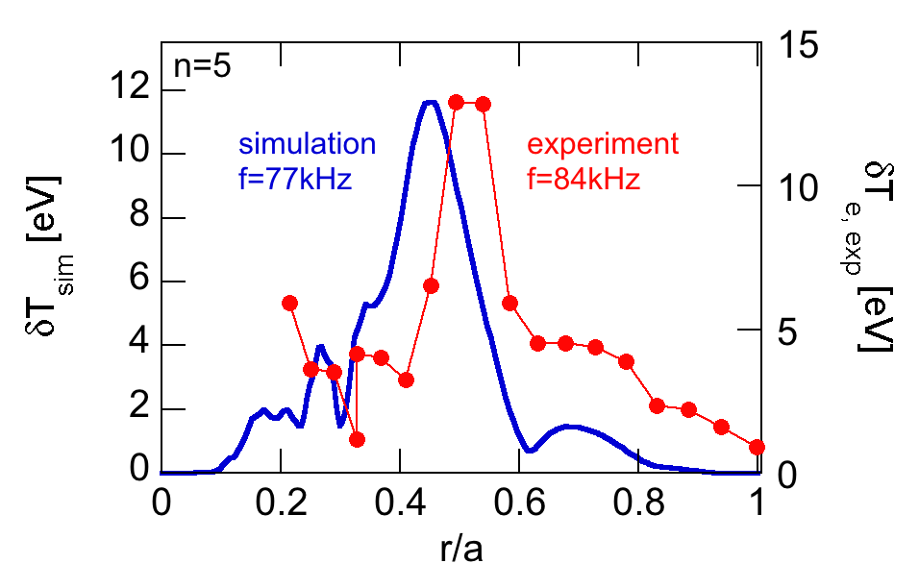
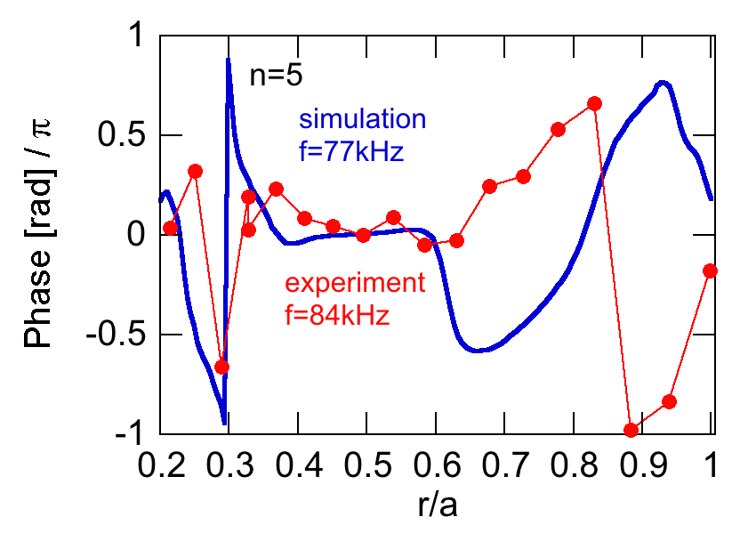
Comparison of temperature fluctuation profiles with ECE measurement for n=4 and 5
n=4
n=4 phase
n=5
n=5 phase
good agreement in spatial profile (left)
good agreement in amplitude within 20% (left)
good agreement (n=4) and reasonable agreement (n=5) in phase profile (right)

Slide 19
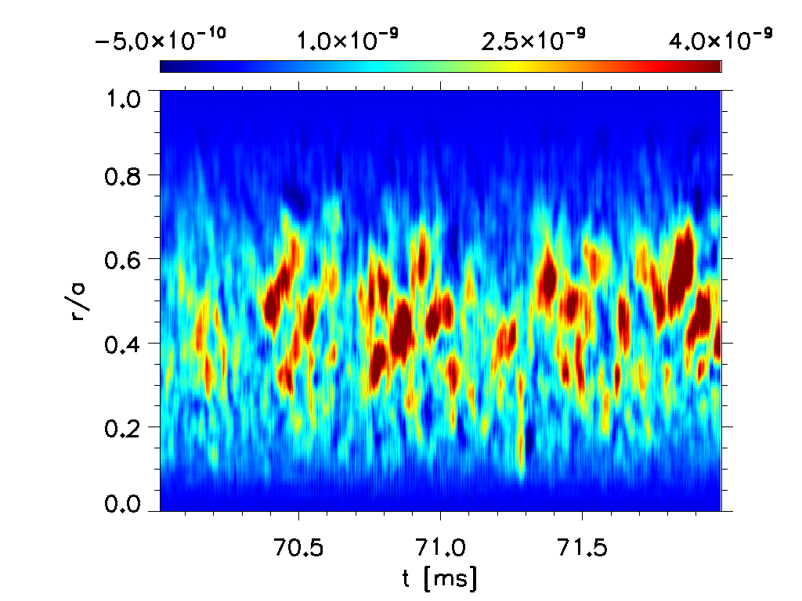
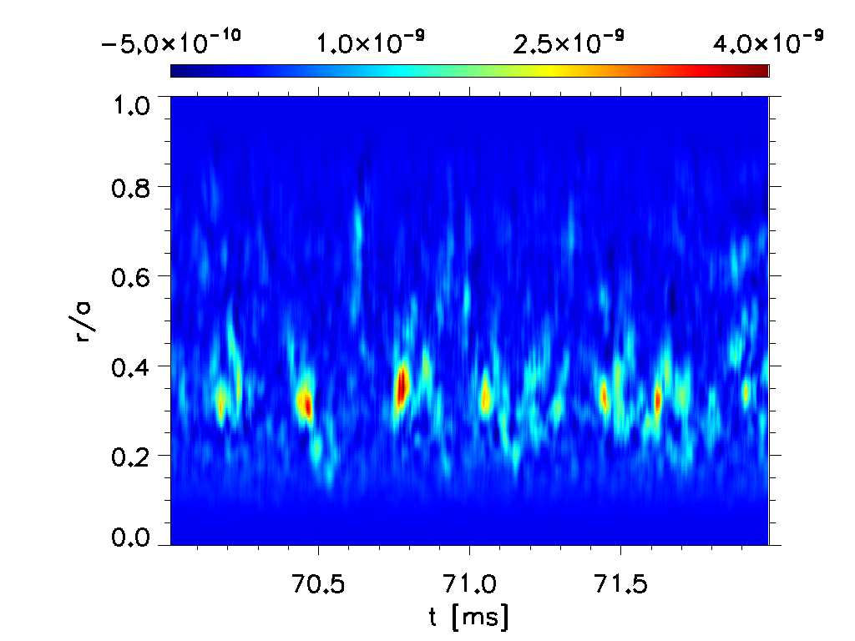
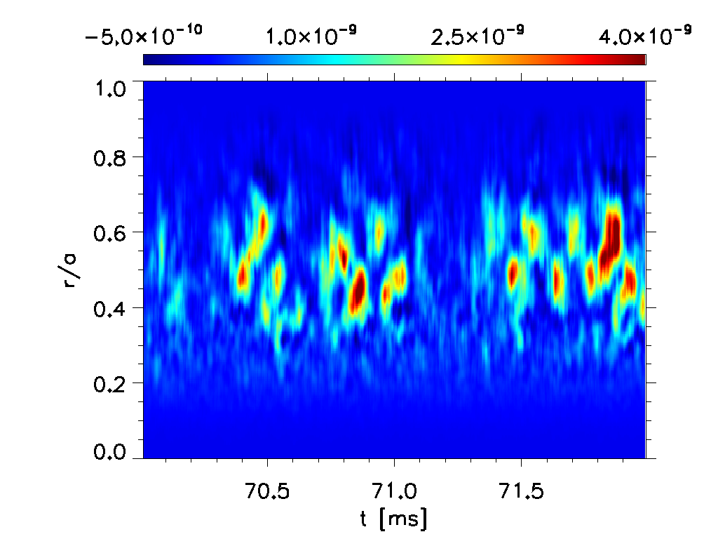
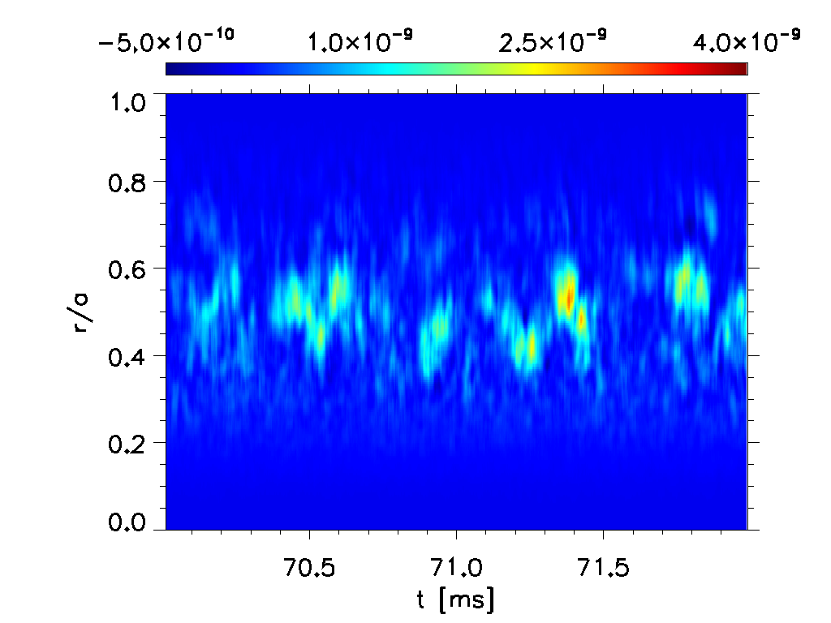
Evolution of fast ion energy flux brought about by AEs
n=2
n=3
steady and intermittent flux
avalanches with multiple modes
consistent with resonance overlap (Berk & Breizman 1995)
n=4

Slide 20
Summary
First comprehensive simulation that predicts
nonlinear saturated amplitude of AEs
and fast ion pressure profile consistent with measured values in experiment
Temperature fluctuation profiles brought about by three of TAEs in the simulation are compared with experiment.
good agreement in radial profiles of amplitude and phase
good agreement in absolute amplitude within a factor of 2
Steady and intermittent fast ion energy flux with avalanches
The multi-phase simulation is useful for the prediction of AE activity and EP transport in burning plasmas

