Slide 1
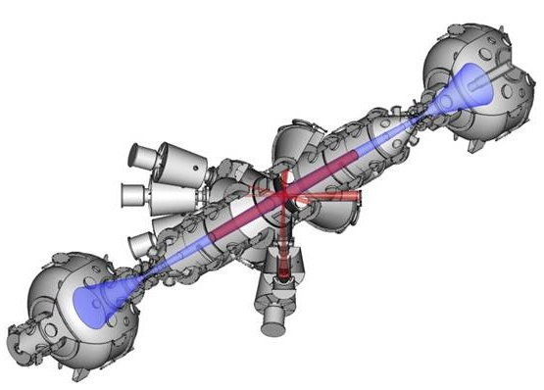
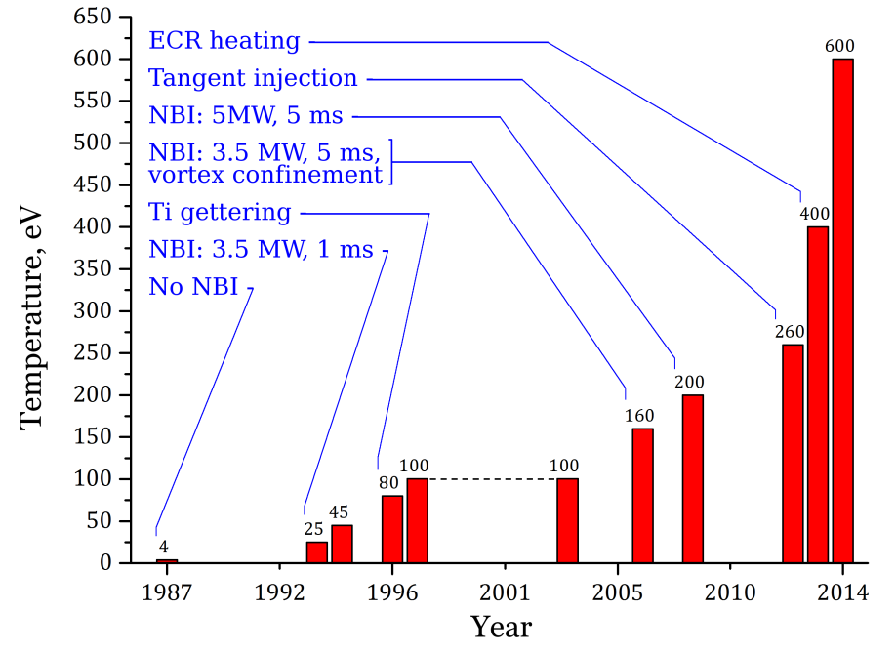
The GDT device at the Budker Institute of Nuclear Physics is an experimental facility for studies on the main issues of development of fusion systems based on axisymmetric mirror traps for different applications including powerful neutron sources
An original method of electron cyclotron plasma heating was proposed and successfully implemented in experiment
A record value of the electron temperature was obtained, that allows one to position the mirror traps as the basis for development a nuclear fusion reactor
It was shown that the longitudinal thermal conductivity is not a factor limiting the possibility of nuclear fusion applications for magnetic mirror traps
Magnetic field at midplane | up to 0.35 Т
Mirror ratio | 40
Trapped/total NB power | 1.8 MW/5 MW
Duration of NB injection | 5 ms
Mean energy of hot ions | 10 keV
ECRH total power | 700 kW
Warm ion density at midplane | 2∙10¹⁹ m⁻³
Local hot ion density | up to 5∙10¹⁹ m⁻³
Electron temperature | up to 650 eV
Maximum local plasma β | 0.6
Progress of electron temperature in GDT experiments

