Slide 1
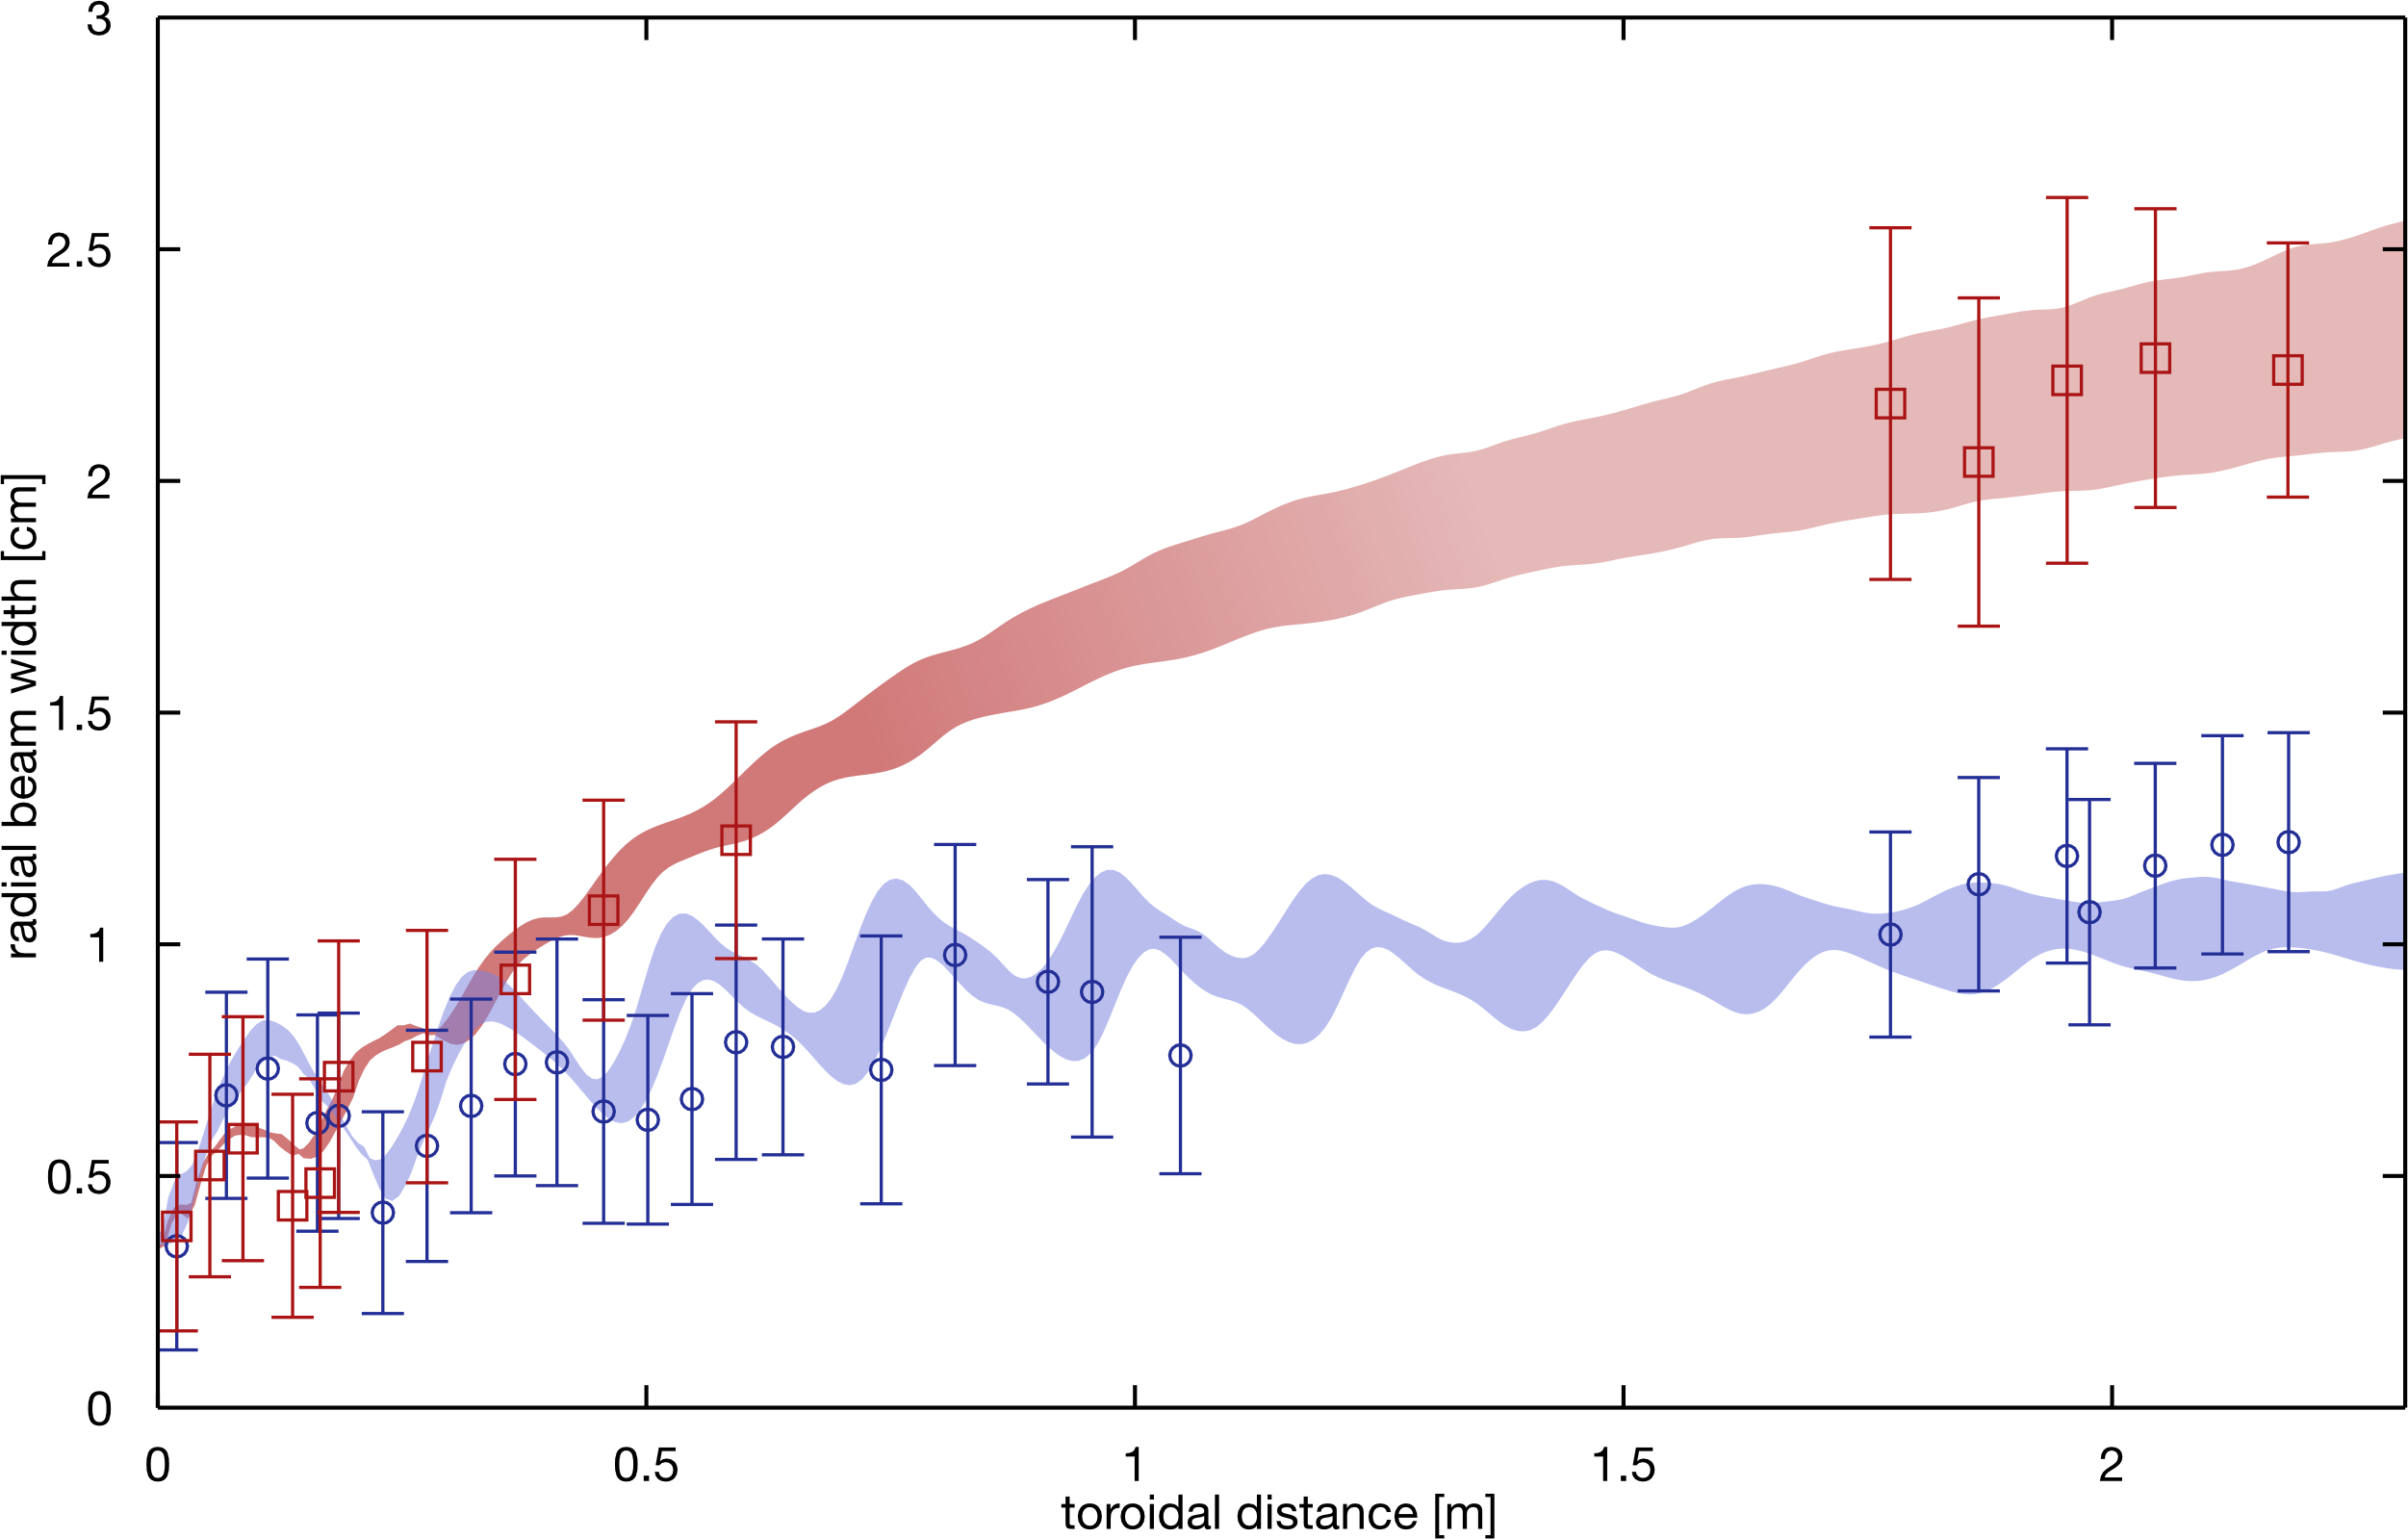
Basic investigations of turbulence and interactions with plasma and suprathermal ions in the TORPEX device with open and closed field lines
Spreading of the ion beam
30eV ions
70eV ions
3D measurements together with numerical simulations reveal that the turbulent transport of suprathermal ions can be super- or sub-diffusive depending on the ion energy.
Quasi-coherent, field-aligned ballooning modes are observed in closed-field line configurations.

