Slide 1
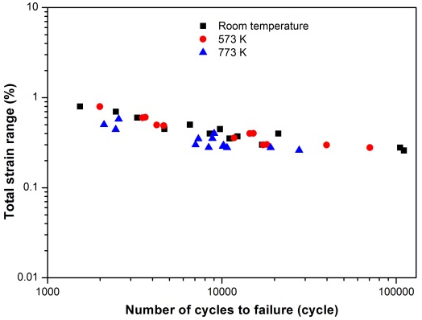
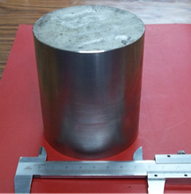
R&D Status of Reduced Activation Ferritic/Martensitic Steel for CN TBM Pinghuai Wang ^{*1}, Jiming Chen¹, Shi Liu², Zhangjian Zhou³, Zengyu Xu¹ ¹ Southwestern Institute of Physics, Chengdu, Sichuan, China ² Institute of Metal Research, Chinese Academy of Sciences, Shenyang, China ³ University of Science and Technology Beijing, Beijing, China E-mail contact of main author: wangph@swip.ac.cn
CLF-1 is a Reduced Activation Ferritic-Martensitic (RAFM) steel developed for use as structural material in the ITER Test Blanket Modules (TBMs) of Helium-Cooled Ceramic Breeder (HCCB) concept. This paper gives an overview of the R&D status of CLF-1 for TBM, including the material development, the current properties databases, the neutron irradiation experiment and the qualification plan for the use of CLF-1 in ITER TBM.
2 Qualification plan of CLF-1 steel
A qualification of the CLF-1 steel is started for material supply for CN ITER HCCB TBM manufacturing. Larger than 5 tons ingots will be melted, with at least three for material qualification tests.
For qualification, current data is insufficient. Various properties will be measured to a sufficient numbers of data for specify the design criteria, by sampling from various products of plates, rods, pipes, welding joints, etc., according to code/standard.
1 Current status of CLF-1 steel
1.1 Material development
Optimizing CLF-1 processing procedures was done. Several 1 ton ingots have been produced. Products in large scale developed, and they have totally fulfilled the needs for manufacturing small size mock-ups, and a 1/3 size CN HCCB TBM was manufactured.
1.2 Properties of CLF-1 steel
Various physical and mechanical properties are available for the TBM design.
3 R&D for ODS steel
A 9Cr ODS F/M steel based on CLF-1 RAFM steel (named as ODS-CLF) has been developed in China. The first batch of the ODS-CLF was in the scale of 2 kilograms.
The fabricated ODS steel shows rather fine grain microstructure and a large amount of ultrafine oxide particles with a size ranging from several nm up to ~50 nm were found.
As-hipped ODS-CLF steel
Summary
To provide material support for the design and fabrication of CN HCCB TBM, a kind of RAFM steel CLF-1 was developed at SWIP. The smelting scale of CLF-1 steel have been 1-ton and the base properties are similar to the other RAFM steel. Materials development, welding techniques optimization and properties databases are accumulating for the design and fabrication of full size CN HCCB TBM. In addition, for the further use of the RAFM steel for the DEMO, a kind of ODS steel (ODS-CLF) has been developed to improve the high temperature strength.
Larson-Miller parameter of CLF-1 steel
Low cycle fatigue properties of the CLF-1 steel
1.3 Neutron irradiation
A neutron irradiation campaign has been started in the high flux engineering test reactor (HFETR) in China.
An irradiation dose of 0.5dpa has been finished at the irradiation temperature of 573K. In the end of 2014, a target dose irradiation level will be about 1dpa and the irradiation temperature is 573K with an accuracy of ±20K in the specimens.

