Slide 1
Development of Tungsten Monoblock Technology for ITER Full-Tungsten Divertor in Japan
FIP/1-1
25th Fusion Energy Conference (FEC 2014)
Saint Petersburg, Russia, 13-18 October 2014
Y. SEKI, K. Ezato, S. Suzuki, K. Yokoyama, K. Mohri (JAEA), T. Hirai, F. Escourbiac (ITER Org.),
V. Kuznetsov (NIIEFA)
Disclaimer
The views and opinions expressed herein do not necessarily reflect those of the ITER Organization.

Slide 2
Outline
Situation on the ITER divertor development
Carbon fiber reinforced composite (CFC) divertor design and full-tungsten (W) divertor target design
Technical challenge on full-W divertor technology
R&D efforts toward full-W divertor
  High heat flux test of small-scale divertor mock-ups for demonstration of durability/thermal performance
  High heat flux test of tungsten armor part of full-scale prototype plasma facing unit (PFU)
  Technical achievements on full-W divertor
Summary

Slide 3
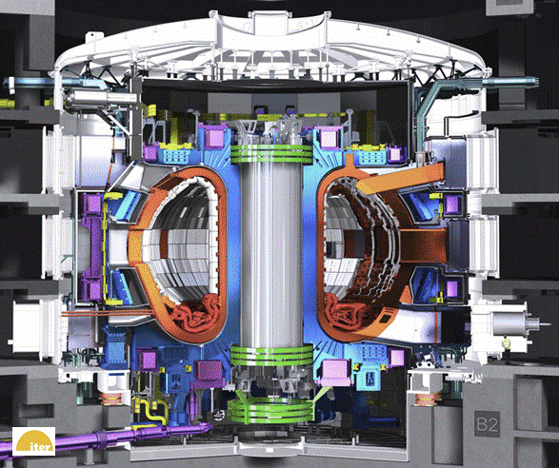
ITER divertor
Inner Vertical Target
; IVT (EU)
Outer Vertical Target
; OVT (JA)
from 2009
~3.5m
Dome
; DO (RF)
Cassette Body
; CB (EU)
Divertor components are procured as "in-kind" by 3 Parties.
Number of Outer Vertical Target (OVT) to be procured：54 cassettes ( with an addition of spares and full-scale prototype)

Slide 4
Situation from the ITER CFC divertor to full-W divertor
In 2011, ITER Organization (IO) proposed to start with full-W divertor target. ITER Council (IC) endorsed recommendation to delay the decision on the specific choice of divertor for up to two years.
  Toward the final selection of the armor material, JAEA and IO signed the task agreement on the "Full-W Outer Vertical Target Qualification Program" on December 2012.
  Small-scale mock-ups with tungsten monoblocks have been provided to investigate the durability/thermal performance against high heat flux.
Technical achievements demonstrated by JAEA provided an essential boost for full-W divertor.
In 2013, IC approved the first ITER divertor make use of all-tungsten plasma-facing components
Implementation of the decision into the baseline.

Slide 5
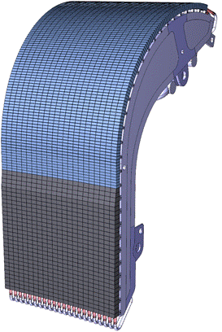
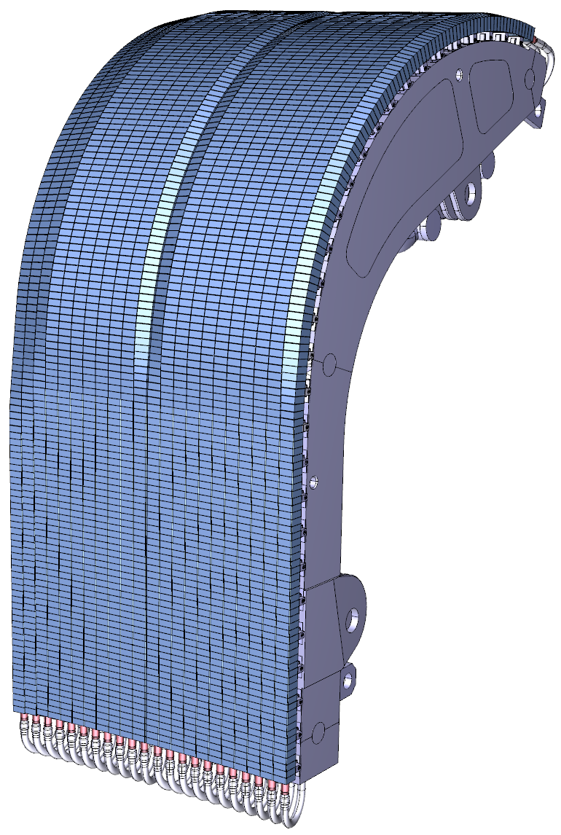
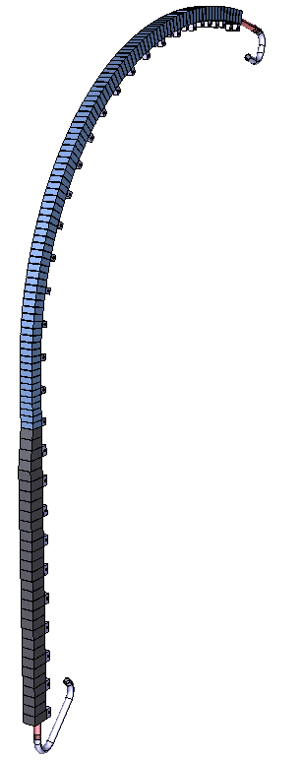
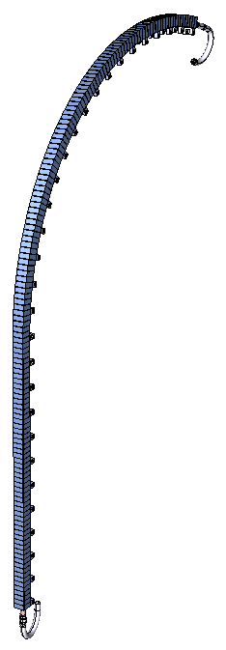
CFC divertor and full-W divertor outer vertical target (OVT) design
 | CFC divertor OVT design | Full-W divertor OVT design
Operation phase | H/He | H/He/DD/DT
Armor materials | Target: CFC Baffle: W | Target: Tungsten (W) Baffle: W
Heat Load | Target: 10-20MW/m², Baffle: 5-10MW/m² (steady state)
Coolant | Water, 70ºC, 4MPa
11 PFUs on half cassette
11 PFUs on half cassette
Baffle: W
5-10MW/m²
PFU
PFU
Straight part of W
Full-W
Design change
Target: CFC
Detail design is currently underway in IO.
10-20MW/m²
Technological challenge
Concerning the development and validation of the W monoblock technology that withstands 20MW/m² surface heat flux, R&D of a full-W divertor was started.

Slide 6
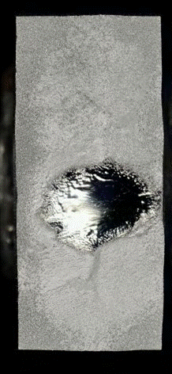
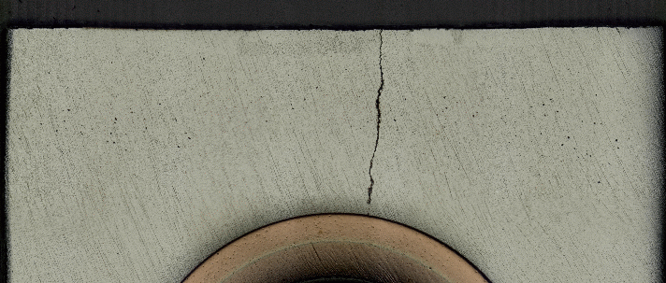
Technical challenge toward full-W divertor – HHF handling capability
20 MW/m²
Achieved
No proven technology
500 cycles
Performance goal
Observation
Crack
Melting
Heat load
10 MW/m²
Achieved
Achieved
1000 cycles
5000 cycles
5 MW/m²
Achieved
5000 cycles
CFC armor
W armor
Design change
The development and validation of the W monoblock technology that withstands 20 MW/m² for the thermal performance were “challenge”.

Slide 7
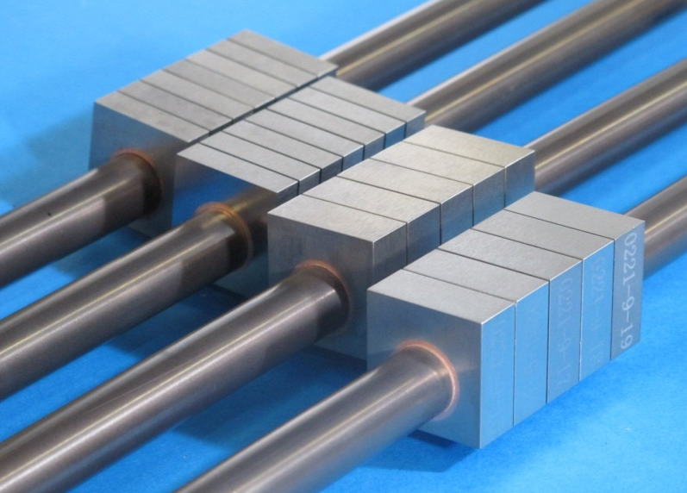
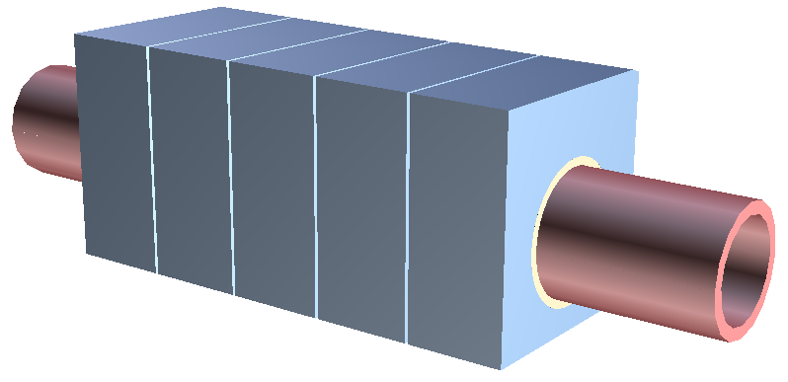
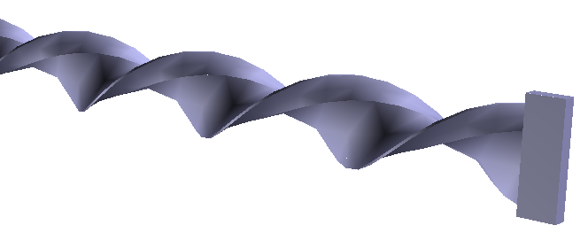
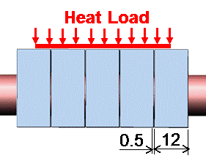
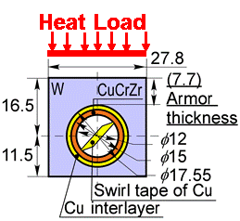
R&D on the full-tungsten divertor target in JAEA
Small-scale mock-ups
Two-phased bonding process
Key point of the manufacturing is to be a two-phased bonding process.
Before the R&D, two joint surfaces were bonded at the same time.
The W/Cu joint is bonded before the brazing onto the CuCrZr tube. Improvements are
  Ultrasonic testing (UT) for each joint,
  Higher accuracy of UT,
  Position tolerances of the Cu/CuCrZr.
  These operations can reduce the rejection rate of PFUs due to deficient bonding interface.
Bonding technology for the W/Cu interlayer joint with durability to high heat flux of 20 MW/m²
  Direct casting of copper
  Diffusion bonding
  HIP bonding
  Different bonding methods help hedge a risk of the series product of ITER divertor.
Insertion of swirl tape
Bonding methods

Slide 8
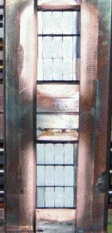
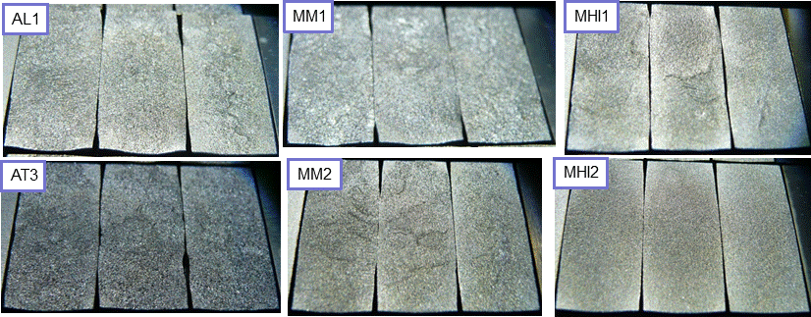
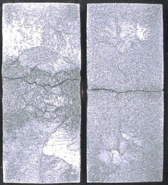
High heat flux test results of small-scale mock-ups at IDTF
Direct casting
Diff. bonding
Direct casting
MM1
AL1
AT3
HIP bonding
Diff. bonding
Direct casting
MHI1
MHI2
MM2
Recrystallization of the W armor without a macroscopic crack
All W monoblocks of 6 small-scale mock-ups withstood
  5000 cycles at 10 MW/m² and 1000 cycles at 20 MW/m².
None of W monoblock showed macroscopic cracks along the tube axis (so-called, self-castellation) that often appeared in monoblocks after HHF test at 20 MW/m².
Neighboring W monoblocks (gap 0.5 mm) contacted by deformation of W.
Crack
Example of self castellation

Slide 9
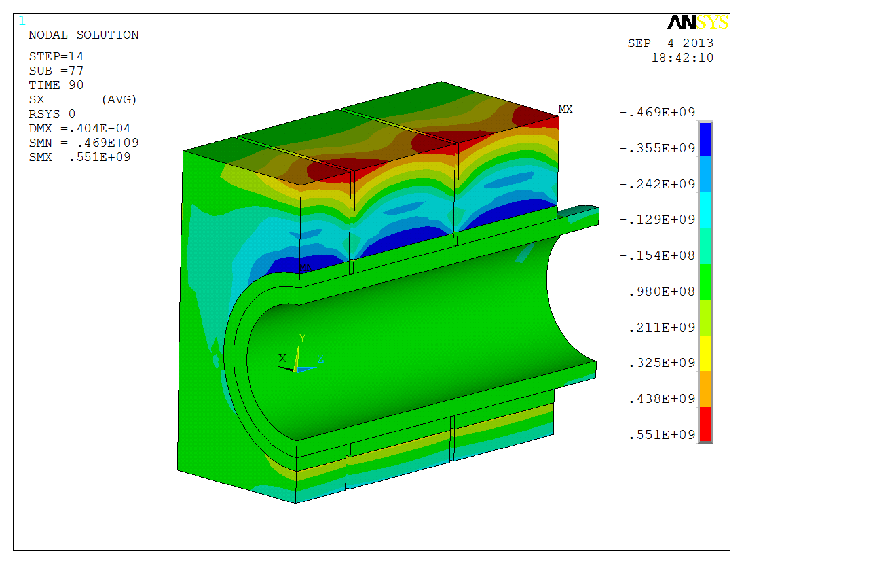
Stress analysis of W monoblocks under 20 MW/m²
3D elastic-plastic stress analysis has been carried out to investigate the stress distribution in tungsten monoblocks.
More than 500 MPa of normal stress along x-direction appeared at the central edge of the tungsten monoblock. The location where the maximum stress appeared is exactly the same as the deformation distribution in the small-scale mock-ups.
Point A
Y
X
Z
σ_{xx} distribution
at the end of 3rd cycle (t = 90s)
The stress concentration will cause surface cracking because of the recrystallized W material. It depends on balance between the stress, mechanical strength of recrystallized W.
Heating
Cooling
Heating
Cooling
Heating
Cooling

Slide 10
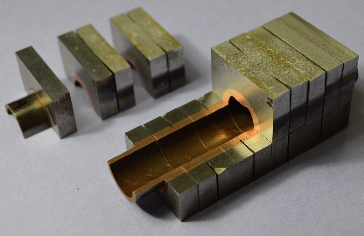
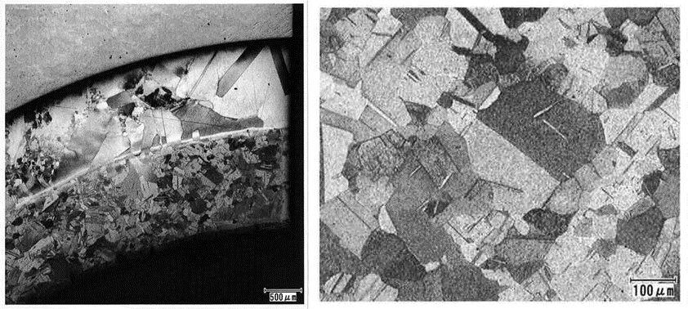
Destructive testing of small-scale mock-up after HHF testing
Defect-free in all bonding interfaces after HHF testing.
x25
x100
W monoblock
CuCrZr-pipe
OFCu-interlayer
CuCrZr-tube
The grain size of CuCrZr in the tube’s thickness of 1.5 mm is enormously important to prevent a water leak and tube rapture. The grain sizes remained 90-100 μm after the HHF testing of 10 MW/m² × 5000 cycles and 20 MW/m² × 1000 cycles in comparison with average gain size at not heat-affected zone, 76-95 μm.

Slide 11
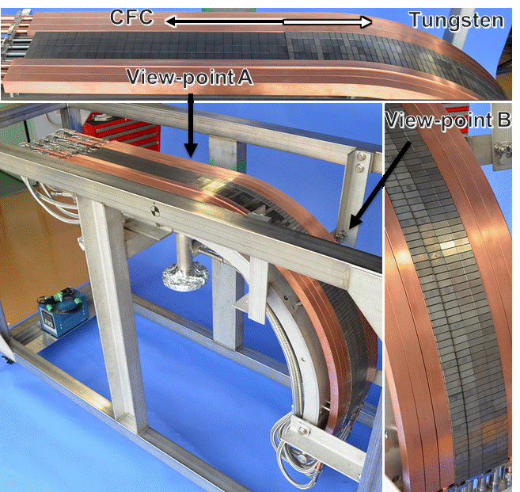
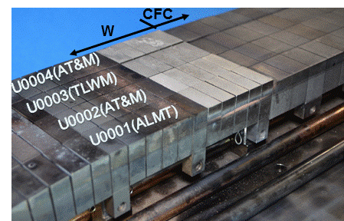
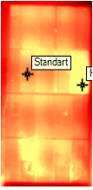
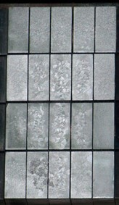
High heat flux test of W part of the full-scale prototype PFU of CFC divertor
Straight W part of OVT PFUs after 5000 cycles at 10 MW/m² and 1000 cycles at 20 MW/m²
T_{surf.max.}=~2300ºC
20 W monoblocks (4 PFUs) of 12mm (axial) x 27.8mm (poloidal) x 7.7 mm (W thickness at the top of the tube).
No degradation of the heat removal capability of the W monoblocks of all PFUs was found through 5000 cycles at 10 MW/m² and 1000 cycles at 20MW/m².
This result fulfills the IO acceptance criteria for “target" part.
In so far as straight W part, the result indicates that the current W monoblock technology is acceptable for the requirements of the full-scale and full-W divertor.
Recrystallization

Slide 12


Technical achievements on full-W divertor target
20 MW/m²
Achieved
Performance goal
Achieved
500 cycles
1000 cycles
All tested W monoblocks were clear.
No Crack
No melting
Heat load
10 MW/m²
Achieved
Achieved
1000 cycles
5000 cycles
5 MW/m²
Achieved
5000 cycles
CFC armor
W armor
Design change
The development and validation of the W monoblock technology that withstands 20 MW/m² without defects were “achieved”.

Slide 13
Summary
The full-W divertor qualification program has been implemented by JAEA.
Bonding process was divided to two-phased to improve a quality control of the bonding. The joint between W/Cu is bonded before the brazing between Cu/CuCuCr tube. This improvement of manufacturing process gave us effects which are “to enable ultrasonic testing (UT) for each joint separately”, “to keep higher accuracy of UT” and “to easily control position tolerance”. These operations can reduce the rejection rate of PFUs due to deficient bonding interface.
As the first phase for the technology validation and demonstration of the full-W divertor, the small-scale mock-ups were manufactured for HHF testing at IDTF in Efremov institute.
JAEA succeeded in demonstrating that W monoblock technology is able to withstand the heat flux without the macroscopic crack, traces of melting and degradation of the heat removal capability. The grain sizes of CuCrZr tube remained 90-100 μm after the HHF testing.
Manufacturing full-W divertor is common challenge for the international community. Our result contributes to global development for full-W divertor. It triggers the start of contract talks for corporate transactions between the European and Japanese companies for the manufacturing full-W divertor.
R&D has been performed under close collaboration with RFDA, EUDA and IO.

Slide 14
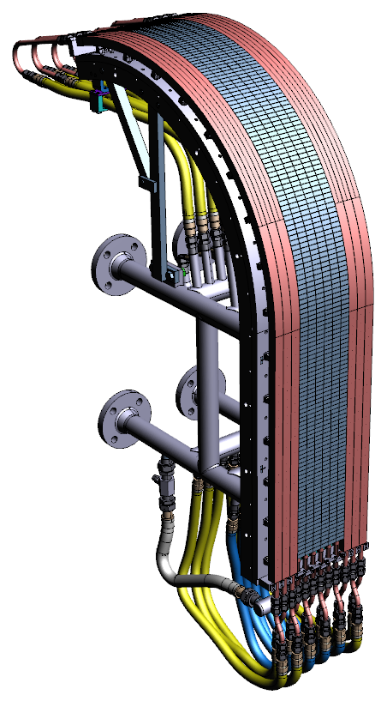
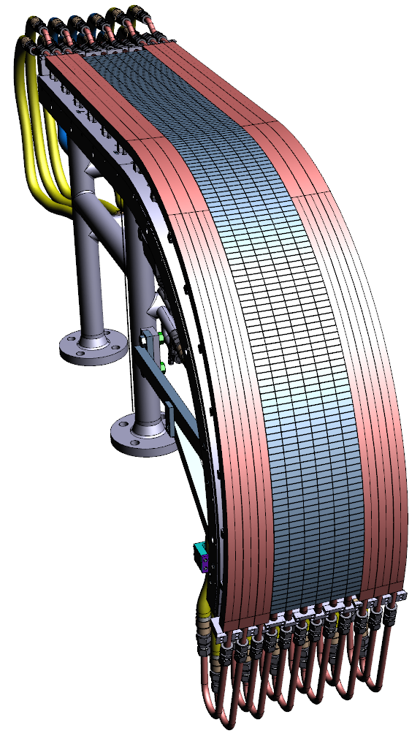
Next Step
As for the demonstration of the full-scale PFUs, JAEA has already started manufacturing of 6 full-scale prototype PFUs of full-W divertor and will finish manufacturing and inspection by March 2015. HHF tests of the full-W prototype PFUs is scheduled in 2015 to demonstrate the technology of manufacturing full-scale PFUs and the performance.
Full-scale of full-W prototype PFUs
Test assembly of Full-scale of full-W prototype PFUs for HHF testing

Slide 15
Stock slide

Slide 16
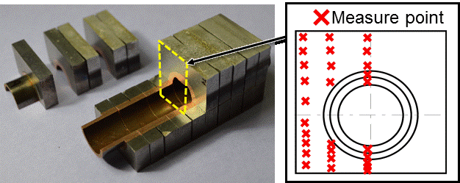
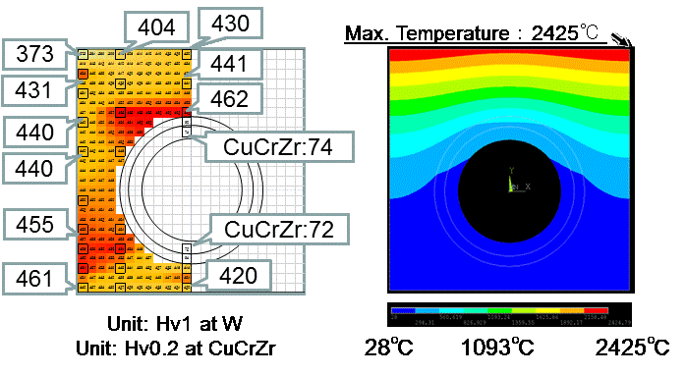
Micro hardness of small-scale mock-ups
Micro hardness measurements were performed by Vickers hardness to evaluate the characterization of mechanical properties dependence on temperature after the HHF testing of 10 MW/m² × 5000 cycles and 20 MW/m² × 1000 cycles.
The profile of the Vickers hardness is good agreement with that of temperature distribution at the cross-section of W monoblock calculated by a thermal analysis in steady state at 20MW/m².
The measure points nearest a plasma facing surface is 1.0 mm away from the heated surface.
The contour of the Vickers hardness indicates mechanical properties of W monoblock changed by increasing temperature during HHF testing.
The profile of the Vickers hardness is good agreement with that of temperature distribution at the cross-section calculated by a thermal analysis at 20MW/m².

Slide 17
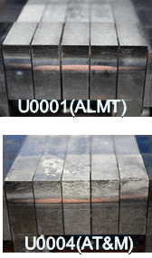
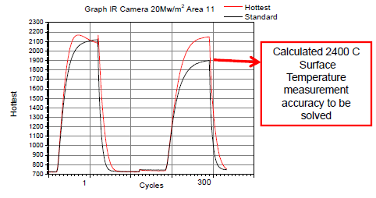
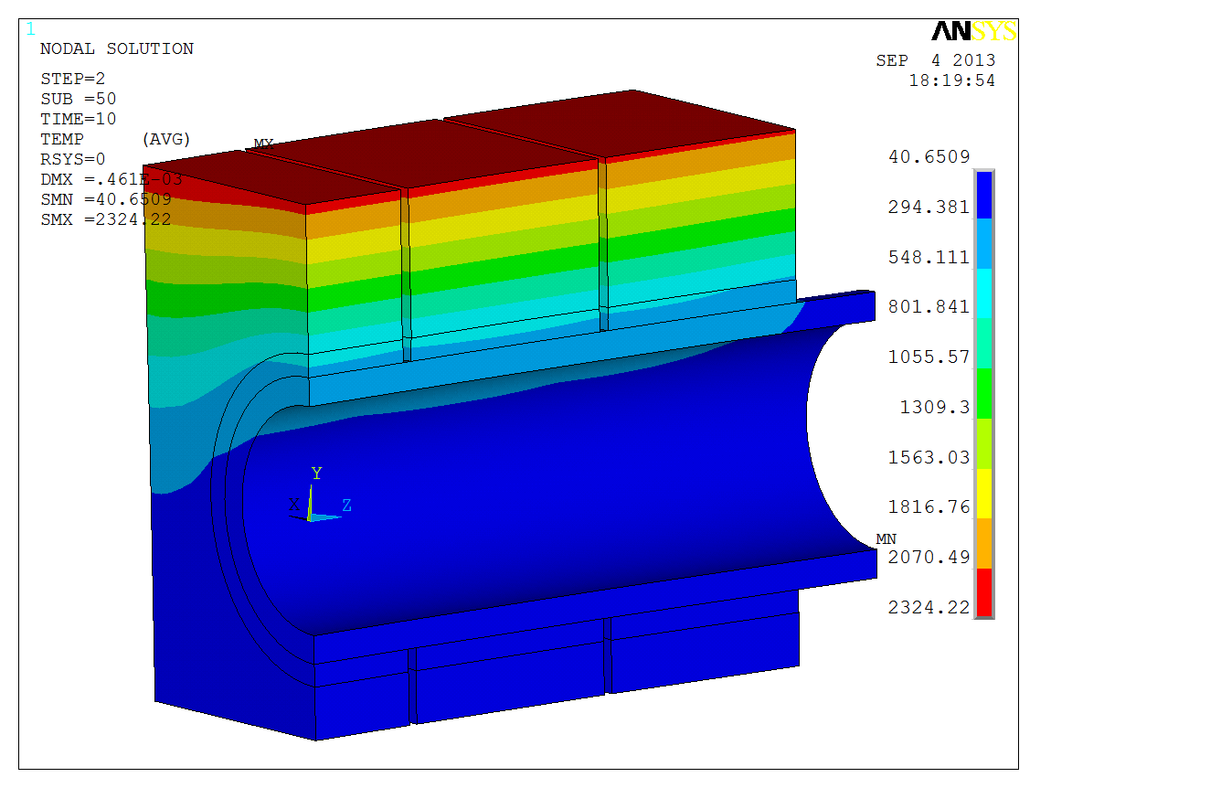
High heat flux test of tungsten part of the full-scale prototype PFU (PFU#1)
Recrystallization
Straight W part of OVT PFUs after 1000 cycles at 20 MW/m²
Recrystallization
T_{surf.max.}=~2300ºC
No degradation of the heat removal capability of the tungsten armored part of all PFUs was found through 1000 cycles at 20MW/m².
This result fulfills the IO acceptance criteria for "target" part, and indicate that the current tungsten monoblock technology is acceptable for the requirements of the full-tungsten vertical target.

