Slide 1
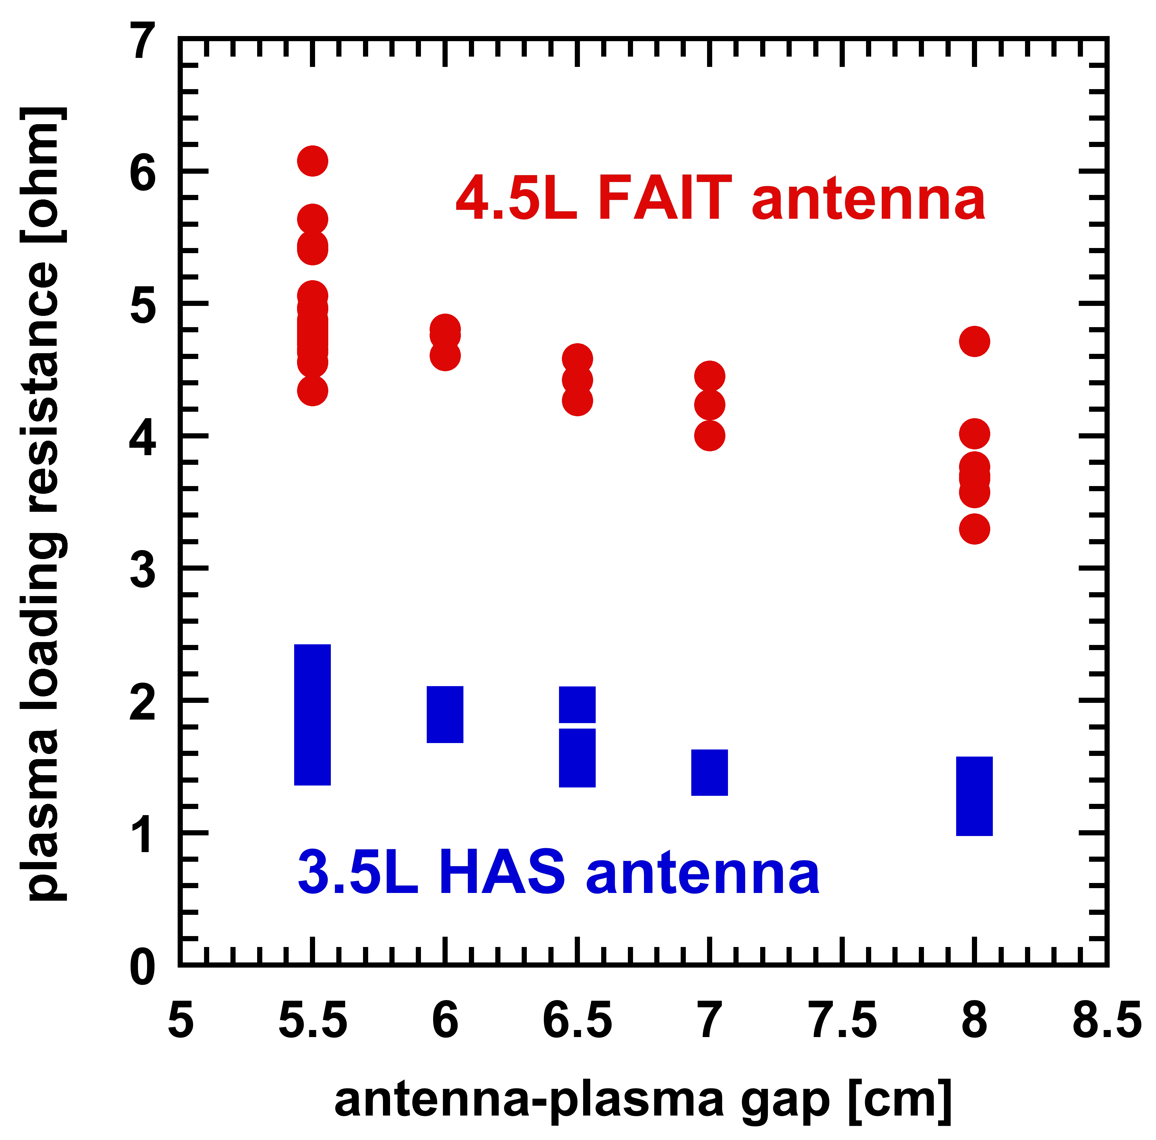
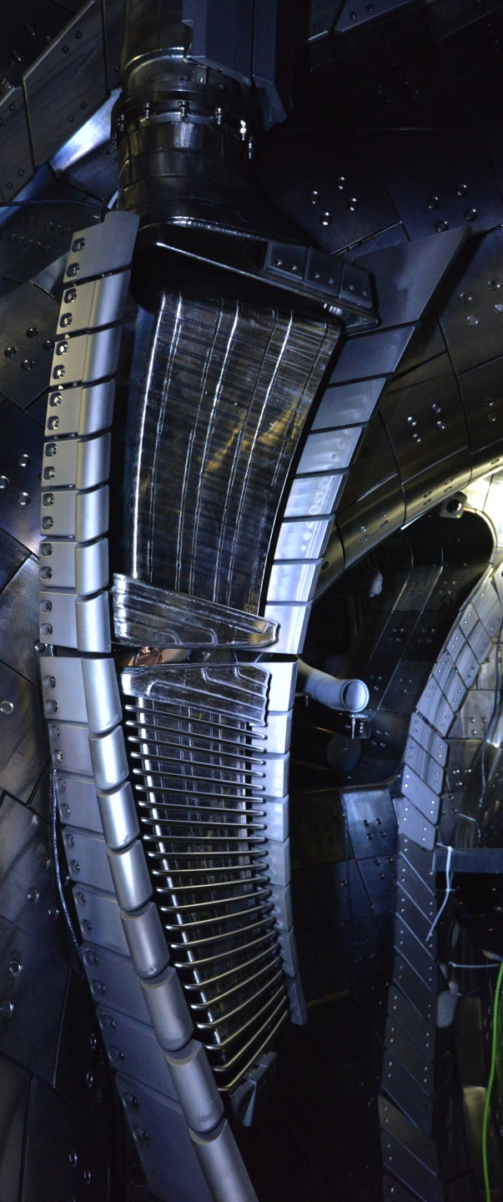
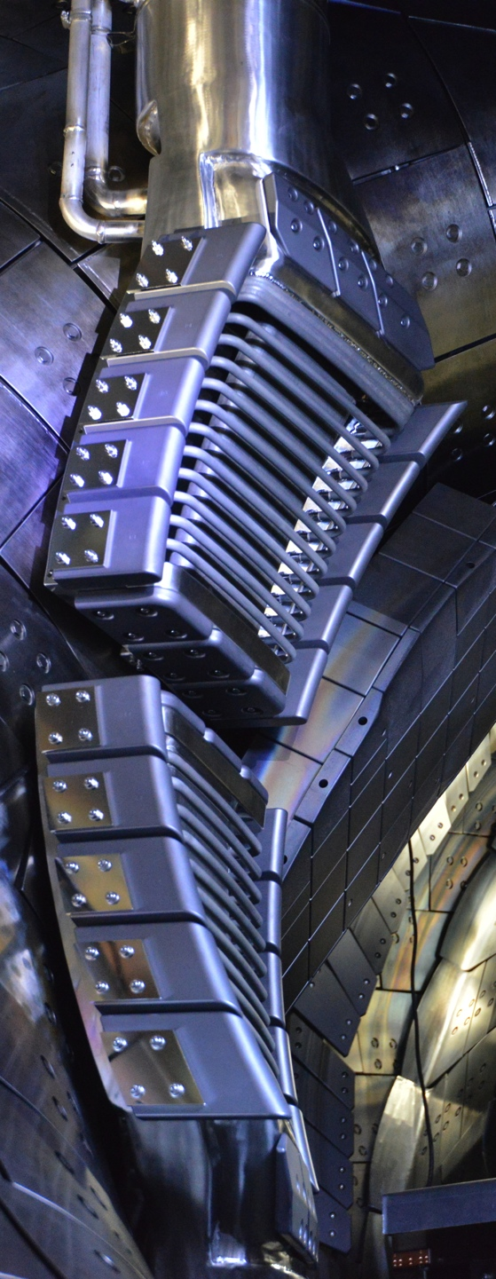
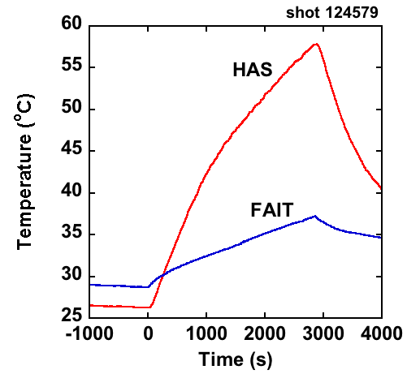
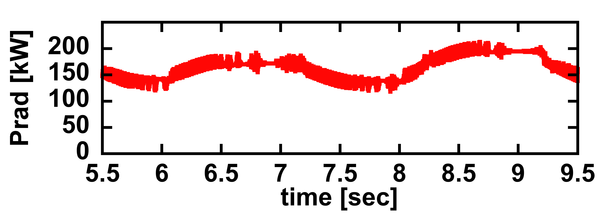
Experiment and development of the ICRF antennas considering the application to future fusion reactor
FIP/P5-3
T. Seki
Antenna without Faraday shield (FS-less antenna)
Field-Aligned Impedance Transforming (FAIT) antenna
@feedthrough
Higher loading resistance and no harmful influence in injection from FS-less antenna
High loading resistance and reduced temperature rise by impedance transformer
Both antennas were used for high power and steady-state operation similar to other antennas without any problems

