Slide 1
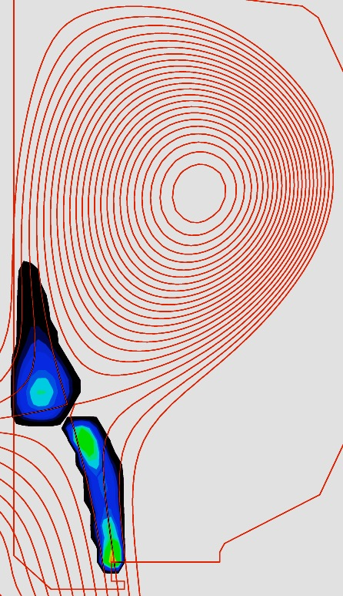
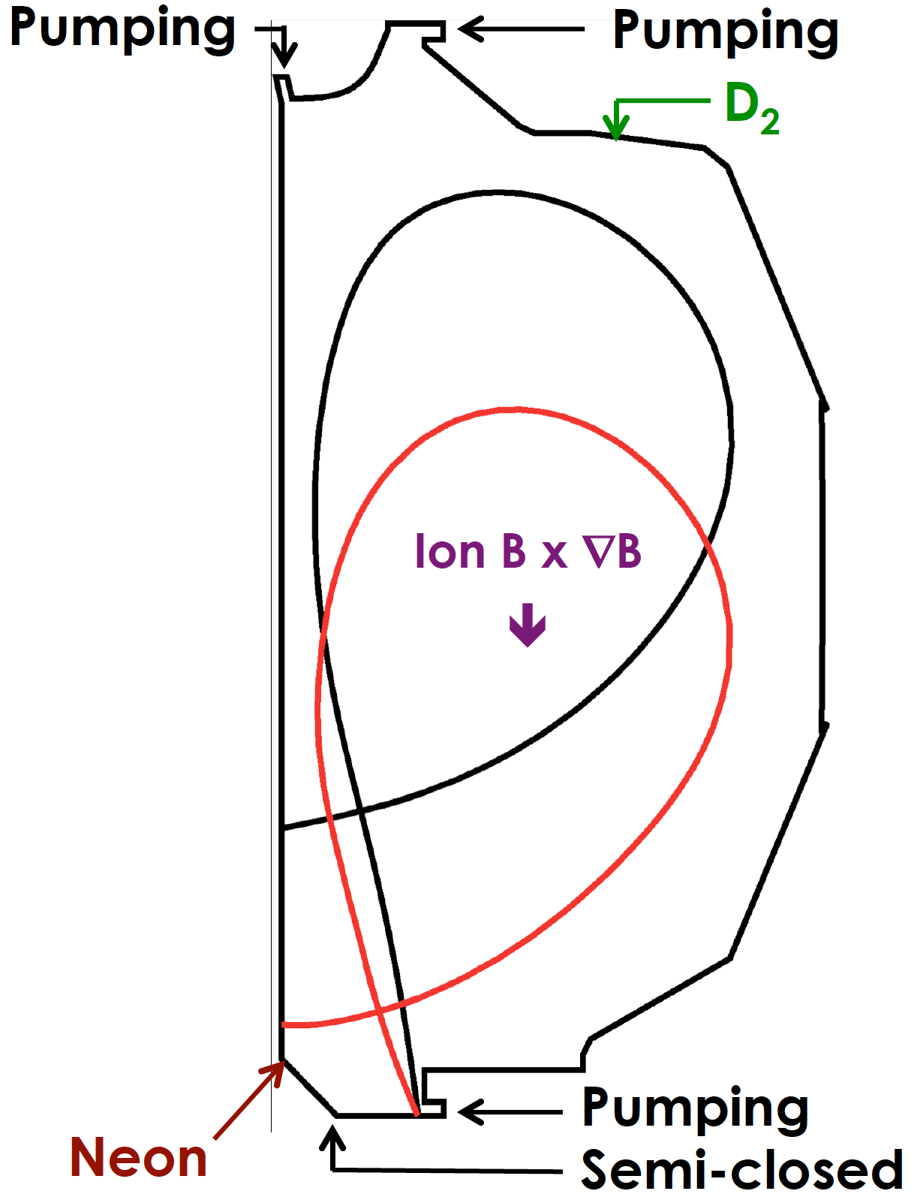
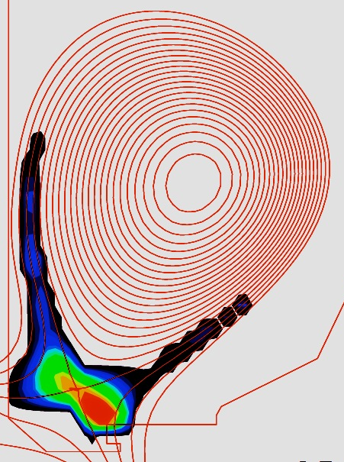
Increased Connection Length Leads to Significantly Lower Heat Flux at Lower Density
Consistent with preliminary 2-D analysis along leg (SOLPS)
Time-averaged poloidal spreading of radiated power along the outer divertor leg driven by ELM behavior
DIII-D, EX/P2-26
26m
Detached: Radiation near Xpoint
Re-attached: Radiation near plate
0.6
0.4
0.2
0
P_{IN} = 6.0-9.5 MW
β_{N} = 1.9
I_{P} = 0.8 MA
B_{T} = 2.1 T
(m⁻²)
Radiative Leg
peak
____
P_{IN}
q_{⊥div}
L|| = 26 m
L|| = 18 m
18m
+ Neon
3 4 5 6
_
n_{e} (10¹⁹ m⁻³)
Divertor leg geometry an important aspect of divertor optimization
Notes:
LEAD IN ON NEED TO UNDERSTAND OPTIMIZATION – GEOMTRY ONE KEY ELEMENTS

