Slide 1

Indication of bulk-ion heating by Energetic particle driven Geodesic Acoustic Mode on LHD
NIFS M.Osakabe
T.Ido^{１}, K.Ogawa^{１}, A.Shimizu^{１}, M.Yokoyama^{１}, R.Seki^{１}, C.Suzuki^{１}, M. Isobe^{１}, K. Toi^{１}, D. A. Spong², K.Nagaoka^{１}, Y.Takeiri^{１}, H.Igami^{１}, T.Seki^{１}, K.Nagasaki³ and LHD experiment group
¹ National Institute for Fusion Science, Toki, 509-5292, Japan.
²Oak Ridge National Laboratory, Oak Ridge, Tennessee 37831, USA.
³Institute for Advanced Energy, Kyoto University, Uji, 611-0011, Japan
Notes:
Thank you chair man. It is my great honor to be here to make a presentation of “Indication of bulk-ion heating by Energetic particle driven Geodesic Acoustic Mode on LHD”

Slide 2
CONTENTS
Background & Motivation
Experimental Observations
  Brief description of the phenomena
  Bulk-ion behaviors
  Fast-ion behaviors
  Mode structures/ Frequencies
Possible candidate to explain the phenomena
  Orbit topology change
  Enhancement of classical ion heating by the deformation of the energetic particle’s spectra with mode activities.
  Confinement improvement with the mode.
  Anomalous ion-heating with the mode.
SUMMARY
Notes:
This is the contents of my talk.
First, I would like to talk about the background and the motivation.
Then, I will explain the experimental observations. Here, the phenomena are briefly described. Bulk-ion and Fast-ion behaviors are shown.
The structure of the mode and its frequency are also described.
Thirdly, the possible mechanism to explain this phenomena are discussed. There are four candidates as shown here.
Finally, I will summarize my talk.

Slide 3
Background & Motivation
Zonal Flow(ZF) and Geodesic Acoustic Mode(GAM) get much interests recently, since it could be a knob to regulate turbulence in plasmas and to reduce anomalous transport. Moreover, additional heating by GAM is theoretically pointed out (GAM channeling).*
Energetic-particle(EP) induced GAMs are observed in several toroidal devices, such as JET, DIIID and LHD**. Effect of GAMs on the energetic particle behaviors needs to be investigated.
Recently, an influence of EP induced GAM on bulk-ions was observed on LHD.
    *M.Sasaki, et.al., PPCF 53(2011)085017
    **H.L.Berk, et.al., Nucl. Fusion 46, S888, C.J.Boswell, et.al., Phys. Lett. A , 358, 154, R.Nazikian, PRL 101, 185002, G.Y.Fu, PRL 101, 185002, K.Toi: 22nd IAEA-FEC, EX P8-4, T.Ido : 23rd IAEA-FEC
Notes:
Zonal Flow and Geodesic Acoustic Mode get much interests recently, since it could be a knob to regulate turbulence in plasmas and to reduce anomalous transport. Moreover, additional heating by GAM is theoretically pointed out.
Energetic-particle induced GAMs are observed in several toroidal devices, such as JET, DIIID and LHD. Effect of GAMs on the energetic particle behaviors needs to be investigated.
Recently, an influence of EP induced GAM on bulk-ions was observed on LHD.

Slide 4
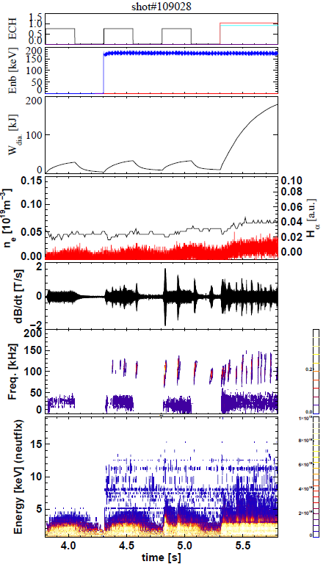
On LHD, increase of low energy neutrals are observed with up-sweeping n=0 modes by tangential NPA at low density plasmas.
a)
b)
The mode was only excited during counter-NB injection phase.
Superposition of ECH seems to be effective to excite the mode.
The typical initial frequencies of the mode are 50 -100kHz. The flux increase was associated with relatively large amplitude modes.
No significant increase of Hα-signals were observed.
  => Measured increase in neutral flux are due to the low energy ion behaviors.
Typical slowing-down time is estimated to be ~10[s] at the core
c)
d)
e)
f)
g)
Notes:
The typical discharge waveforms are shown here. From top, ECH input power, NB injection energy, stored energy measured by diamagnetic loop, line averaged density, H-alpha, and Mirnov-coil signals are shown. The spectrogram of the Mirnov-coil signal and low energy neutral spectra are also shown by colored contours.
As can be seen here, the bursting mode activities were only excited during counter-NB injection phase, which indicates the mode was excited by energetic particles.
It was also found that the mode prefers to appear with the ECH superposition.
The typical initial frequencies of the mode were 50-100kHz (click!). The toroidal mode number was evaluated from a Mirnov-coil array and is zero.
The flux increase was associated with relatively large amplitude modes (click!).
No significant increase of H-alpha signals were observed, which indicates the measured increase in low energy neutrals reflects the behavior of bulk-ions in plasmas.
(click) This graph shows electron temperature , electron density and slowing-down time profiles. The electron density was extremely low, which is order of 10 to the 17th per cubic meters. Thus, the typical slowing-down times are exceeding 10-second at the core region.

Slide 5
Bulk-ion behavior
Neutral flux close to the bulk-ion energies are starts to increase after the mode excitation.
The effective ion temperature also starts to increase after the mode excitation.
Either confinement property of bulk-ions or bulk-ion heating mechanisms seem to be changed with the mode excitation.
Notes:
The temporal behavior of low energy neutrals with a bursting activity are shown here. The low energy neutrals close to the bulk ion temperature were increased with the mode activity, especially at the relatively higher energies. As indicated in the previous slide, the H-alpha was not changed with the mode activities. Thus, these flux increase are due to the ion behavior change.
(click!) The spectra before the mode activity is shown by black, and (click!) that after the activity is shown by red.
As shown here, the effective ion temperature evaluated from the slope of the spectra increases with the mode activity.
(click!) These data indicate either the bulk ion confinement properties or heating mechanisms are changed with the mode activity.

Slide 6
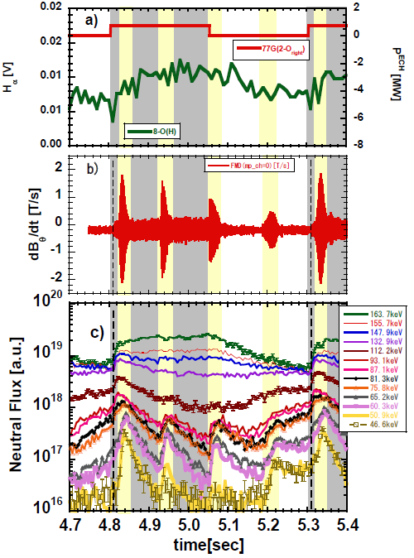
Fast-Ion Behavior
The flux increase and its decay were observed with the mode activity.
Decay times of the increased flux were order of 10-100 ms.
  The fast-ions influenced by the mode activity were not promptly lost and were circulating on confined orbits.
The decay times were smaller than the expected slowing-down time of fast-ions and almost no-delays of decays were found at each energy.
  They were lost before they undergo slowing-down process.
The decay times have energy dependence. They became smaller as the energy decreases.
  By comparing the decay time with charge exchange cross section, the charge exchange loss was found to be the dominant loss process.
The charge exchange loss process produces the positive gradients in the energy spectra.
Source of instability drive.
Induces clump-hole formation in the energy spectra.
Notes:
Fast-ion behavior is shown here. The fast neutrals were measured by the tangential-NPA by changing its energy range.
As shown here the flux increase and its decay were observed with the mode activity, especially below 100keV. Again, the H-alphas are not changing significantly.
(Click 1) Decay times of the increased flux were order of 10-100ms. (Click 2) The fast-ions influenced by the mode activity were not promptly lost and were circulating on confined orbit.
(Click 3) The decay times were smaller than the expected slowing-down time and no-delays of decay were found. (click 4) They were lost before they undergo slowing-down process and the loss process started almost simultaneously.
(Click 5) The decay times have energy dependence. They became smaller as the energy decrease.
(click 6) By comparing the decay times with the charge exchange cross section, it was found that the charge exchange loss was the dominant process.
(click 7) Here, the change of energetic particle spectra are shown with the mode activity. The dashed line indicates the spectra before the mode activity. Red lines show the spectra at the initial phase and the blue lines show that during the maximum mode activity, and the green lines show that at the end of the mode activity. The bottom figure shows the difference of those from the spectrum before the mode activity.
As can be seen from the figure the charge exchange loss produces the positive gradients in the energy spectra, which is the source of instability drive and induces the clump-hole formation in the energy spectra.

Slide 7
Mode structure and its frequency
Notes:
Now, I am moving to the mode structure and its frequency.

Slide 8
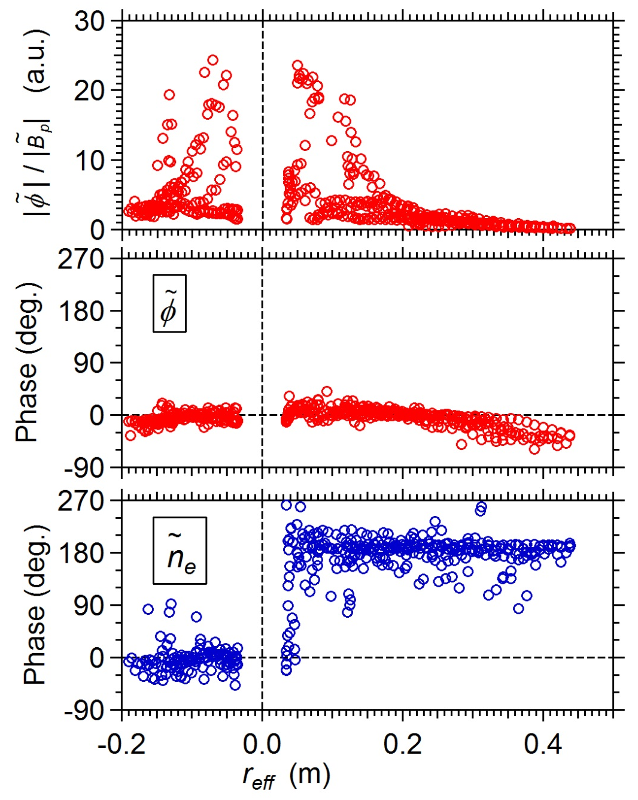
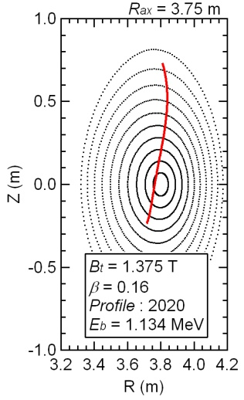
Evaluation of poloidal mode structure by HIBP measurement.
(The amplitudes are normalized by |Bp| to remove variation among events.)
T.Ido, et.al.
Upper side
Symmetry
Lower side
The spatial structures are consistent with the structures of the GAM. ( : m ~ 0, : m ~ 1)
Asymmetry
Lower side
Upper side
Notes:
This viewgraph shows the radial structure of the electrostatic potential and density perturbation measured by Heavy Ion Beam Probe.
The right-hand side figure shows the radial position of the HIBP measurement. The radial profile of electrostatic potential perturbation was symmetric indicating the even poloidal mode numbers, and that of the density perturbation was asymmetric indicating the even poloidal mode number.
These are consistent with the structure of GAM.

Slide 9
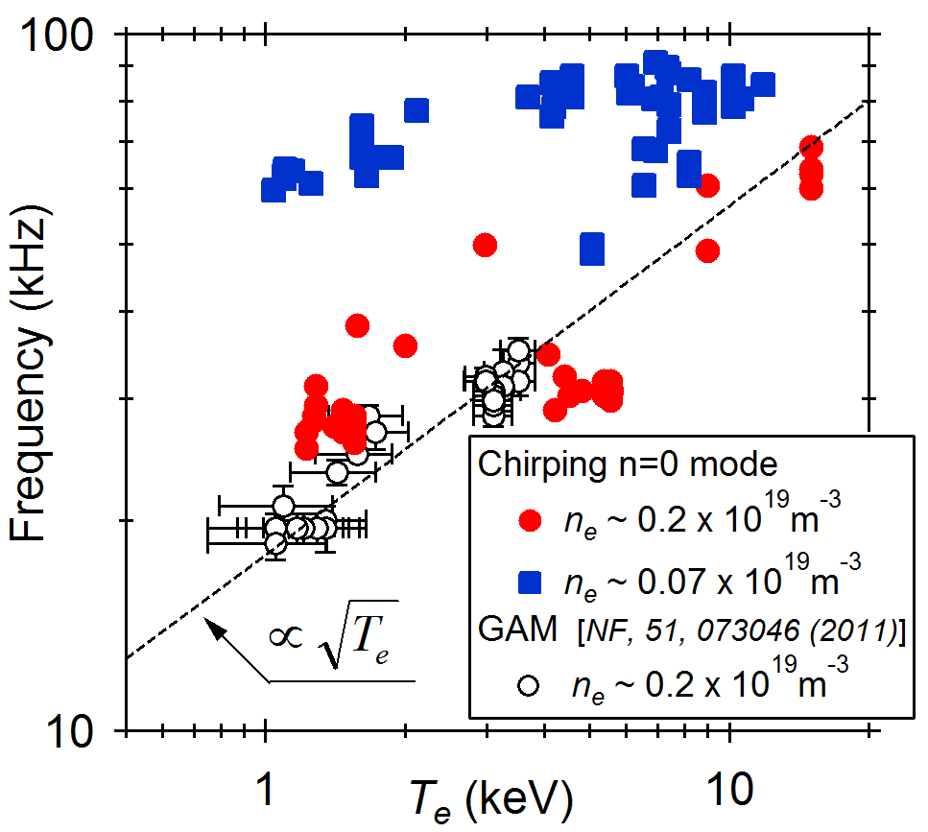
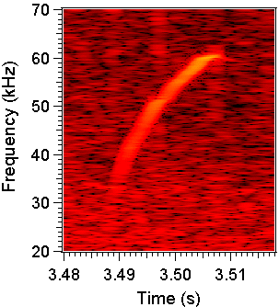
T_{e} dependence of the initial frequency of n = 0 mode
T.Ido, et.al.
85 kHz, where E_{b} = 175 keV,
ι = 0.35, R = 3.75m
One has the T_{e} ^{0.5}-dependence of the mode frequency. (=> GAM)
The other mode has weak T_{e} -dependence of the frequency. The mode frequency is much larger than the usual GAM, and is close to the orbital frequency of the fast-ions produced by the NBI.
Notes:
This plot shows the observed temperature dependence of the initial frequency of the mode.
The mode can be categorized into two groups. One has root-Te dependence, as shown by red, which is consistent to GAM property.
We consider this mode is GAM.
On the other hand, the other mode has weak T_{e} -dependence. The mode frequency is much larger than the usual GAM, and is close to the orbital frequency of fast-ions which are produced by the tangential NBI.

Slide 10
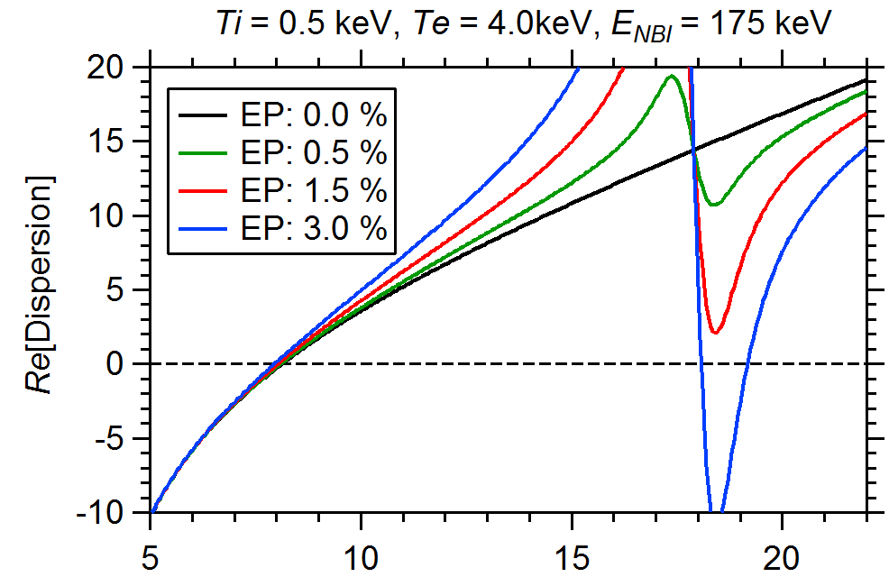
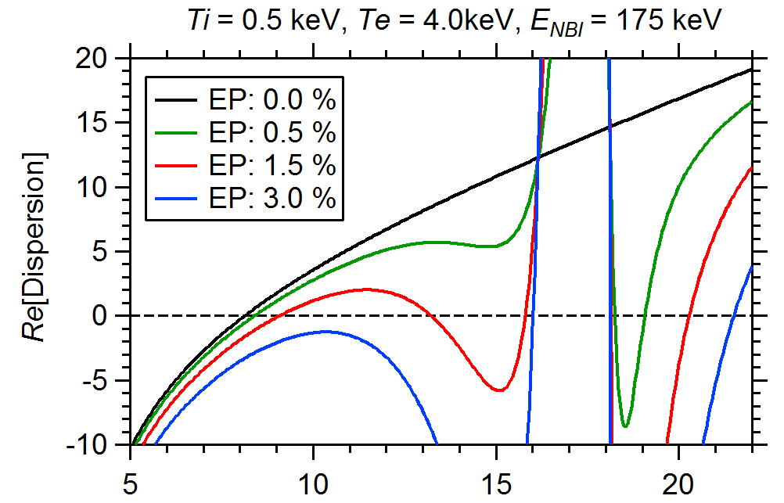
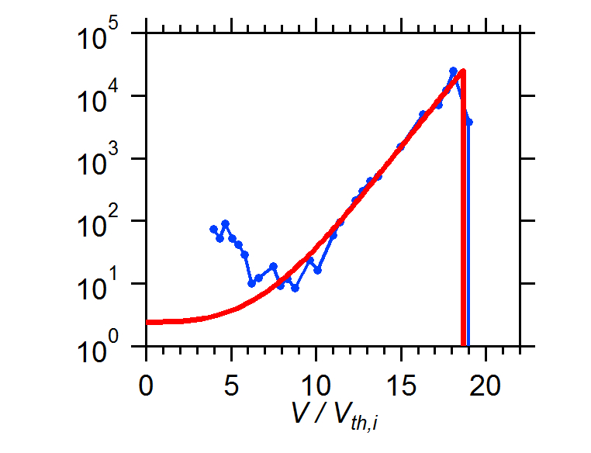
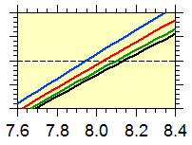

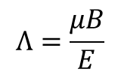

The FI affects the GAM frequency
T.Ido, et.al.
The GAM frequency is modified by FIs. (G.Y.Fu, PRL,101,185002 (2008) )
$$Λ=\frac{μB}{E}$$
$∇∙\left({J^{bulk}}_{geodesic}+J_{polarization}\right)$=0
$∇∙\left({J^{bulk}}_{geodesic}+{J^{FI}}_{geodesic}+J_{polarization}\right)$=0
(T.Watari, et al, PoP, 13, 062504 (2006)
Slowing-down distribution
γ_{Growth} < 0
α = 6.8
γ_{Growth} > 0
γ_{Growth} > 0
The freq. of FI-driven GAM can be
much higher than the ordinary GAM freq.
Notes:
The modification of GAM frequency by Fast-Ions was first shown by Fu, by using this analytical form of fast-ion distribution function.
We had followed Watari’s method by including the fast-ion geodesic current in this equation. When we apply the same fast-ion distribution function as to Fu’s assumption. We got results similar to the Fu’s. In this case, the frequency of EGAM is smaller than the usual GAM.
On the other hand, the fast-ion energy distribution function has positive gradient due to the charge exchange loss in our case. (click-1)
We have modified the analytic form of fast-ion distribution function as shown here (click-2). This part (click-3) express the contribution of charge exchange loss in the analytic form. With this modification, the dispersion relation becomes different (click-4). Here (click-5), we have three roots of positive growth rates as shown by red stars, and two roots of negative growth rates as shown by blue stars.
As shown here, the GAM frequency can be much higher than that the ordinary GAM frequency.

Slide 11
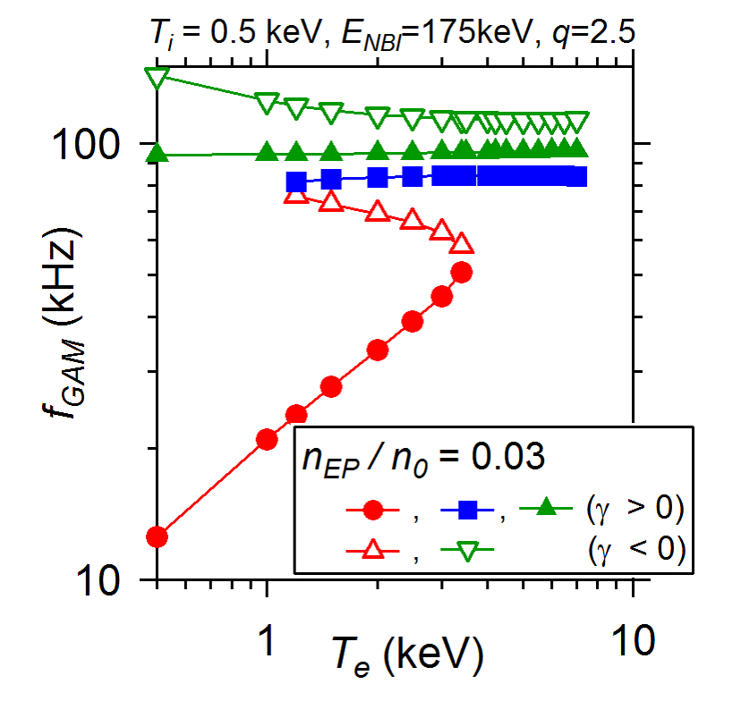
Observed n=0 mode with weak Te-dependence is also identified as GAM
EGAM
T.Ido, et.al.
n=0 mode (Experiment)
More detailed analysis based on numerical simulation can be found at H.Wang TH/P1-12
Notes:
This figure shows the temperature dependence of the all branches.
Closed symbols indicate the frequency with positive growth rate while the open symbols indicate that with negative growth rates.
The red circle is the modification of the ordinary GAM, and
The blue and green are the high frequency energetic particle modes.
The high frequency modes have weak Te dependence, as is similar to the experimental observation.
So, we conclude the observed n=0 mode at higher frequency is also EGAM.

Slide 12
Mechanisms which might explain this phenomenon
Change of orbit topology by the GAM. activities
Enhanced ion-heating by the classical collision process due to the deformation of fast-ion spectra by the GAM
Improvement in bulk-ion energy confinement with the mode
Enhanced ion-heating with the mode
Notes:
As mechanisms to explain the phenomenon, following four candidates are considered. The first one is the orbit topology change of bulk-ions by the GAM activities. The second one is the enhanced ion-heating by the classical collision process due to the deformation of fast-ion spectra by the GAM. The third one is the improvement of bulk-ion energy confinement and the fourth is the anomalous enhanced ion-heating with the mode activity.

Slide 13
Mechanisms which might explain this phenomena
Change of orbit topology by the GAM. activities
Enhanced ion-heating by the classical collision process due to the deformation of fast-ion spectra by the GAM
Improvement in bulk-ion energy confinement with the mode
Enhanced ion-heating with the mode
These effects were examined by numerical calculations:
The first one was examined by orbit calculations with perturbed electrostatic potential by delta5d.
  The effect was small. Thus, it was ruled out.
The second one was examined by TASK-3D calculation with an artificial spectral deformation, which reproduces the experimental observation.
  The effect was also small. Thus, it was ruled out.
Notes:
For the first and the second candidate, I just describe the result to save the time.
(click-1,2) These effects were examined by numerical calculations.
(click-3) The first one was examined by orbit calculations with perturbed electrostatic potential by delta5d.
(click-4) The effect was small, thus it was ruled out.
(click-5) The second one was examined by TASK-3D calculation with an artificial deformation of fast-ion spectra, which reproduces the experimental observations.
(click-6) The effect was also small. Thus, it was ruled out.

Slide 14
Mechanisms which might explain this phenomena
Change of orbit topology by the GAM. activities
Deformation of fast-ion energy spectra by the mode and the enhancement of ion-heating by classical collision process.
Improvement in bulk-ion energy confinement with the mode
Enhanced ion-heating with the mode
Notes:
Now, I move to the third and fourth candidates.
These candidates are difficult to discuss, separately.

Slide 15
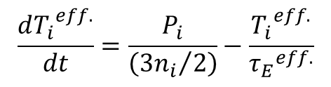
The effects of confinement improvement and enhanced ion-heating were evaluated by 0-D power balance model
To investigate the possibility of these effects, typical values of characteristic numbers, P_{i} (ion-heating power density) and τ_{E}^{eff.} (effective ion energy confinement time) were examined in a simple power balance model with an assumption of constant ion–density.
$$\frac{d{T_{i}}^{eff.}}{dt}=\frac{P_{i}}{\left({3n_{i}}/2\right)}−\frac{{T_{i}}^{eff.}}{{τ_{E}}_{}^{eff.}}$$
50-150kHz
n_{e}=n_{i} assumed
c)
Original value of P_{i} and τ_{E}^{eff.} can be evaluated from:
(i) Ion heating power estimated by TASK3D:
P_{i}= 170W/m³ => τ_{E}^{eff.} = 364ms .
(ii) Ion temperature decay:
τ_{E}^{eff.} =~80ms => P_{i}= 774W/m³
Notes:
These effects are evaluated by a simple power balance model by assuming reasonable heating powers and confinement times.
By the TASK3D calculation, the ion heating power was estimated to be 170W/m³. From the power balance at the stationary phase (click), the confinement time was estimated to be about 360ms.
On the other hand, the confinement time can be also evaluated from the decay time of the effective ion temperature and is about 80ms.
In this case, the ion heating power was evaluated at the stationary phase and is about 780W/m³. The discrepancy of these two cases might be come from the overestimation of ion density. The discrepancy can be reduced by decreasing the ion density. In the following viewgraphs, we adopt latter case (click). The choice of former and latter cases will not change the discussion, significantly.

Slide 16
Evaluation of the enhanced ion-heating case and the confinement improvement case
In the enhanced ion-heating case, the observed ion temperature was reproduced by assuming 4.3[kW/m³]of ion heating power during the mode activity.
In the case of improved confinement case, the observed ion temperature behavior could not be reproduced even if the confinement time of infinitely large number was assumed(τ_{E}=~10000[s]).
The candidate of “confinement improvement”
Was ruled out. Thus, “the ion heating enhancement” becomes most probable candidate.
Notes:
We have evaluated the enhanced ion-heating case and the confinement improved case. The enhanced ion heating case is shown by red-curves, while the confinement improvement case is shown by blue dashed curves. In the case of ion-heating enhancement, we have found the observed increase in ion temperature can be reproduced by the 5.6 times larger ion heating power than the original ion-heating power.
On the other hand, we failed to reproduce the observed ion-temperature change in the case of confinement improvement. Even if we have assumed the infinitely large value of confinement time, the evaluated ion temperature increase was too small.
(click) Thus, the ion heating enhancement becomes the most probable candidate.

Slide 17
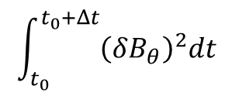
Ion temperature behavior with the time integrated value of mode amplitudes
Although clear response of the flux increase was observed with the mode activity, the correlation between the mode amplitude and the temperature behavior was not clear.
If we assume, the ion-heating power is related to the mode amplitude, the stored energy would correspond to its time integrated value.
$$\int_{t_{0}}^{t_{0}+Δt}{{\left(δB_{θ}\right)}^{2}dt}$$
Notes:
Although clear response of the flux increase was observed with the mode activity, the correlation between the mode amplitude and the temperature behavior was not clear due to the holding of increased effective ion temperature after the mode amplitude maximum.
If we assume, the ion-heating power is related to the mode amplitude, the stored energy by the ions would correspond to its time integrated value.
(Click) Here, the time integrated value of the square of the mode amplitude was compared to the effective ion temperature.
This also indicate the ion was heated by the mode activities.

Slide 18
SUMMARY
On LHD, phenomena indicating the ion-temperature increase associated with FI induced n=0 mode was observed by tangential NPA at very low density plasmas.
Its poloidal mode structure was examined by the HIBP measurement, and were consistent to the GAM.
According to the Te-dependence of the frequency, mode can be classified into two categories, i.e., one has Te^{1/2}-dependence and the other has weak Te-dependence. The frequency of the latter mode are almost equal to the orbital frequency of fast-ions.
Considering the positive gradient in the energy spectra of fast-ions, these frequency features can be explained in the framework of GAM. Thus, observed mode was identified to be GAM.
Four candidates were proposed to explain the phenomena; (1)change of measured ion spectra due to the orbit topology change, (2)increase of classical ion heating power by the deformation of energetic particle spectra, (3) improved energy confinement, and (4) enhanced ion heating with the mode activities. Among them, the enhanced ion heating with the mode activities becomes most probable candidate.
But, the heating mechanism was left as an open question for the future studies.
Notes:
On LHD, phenomena indicating the ion-temperature increase associated with FI induced n=0 mode was observed by tangential NPA at very low density plasmas.
Its poloidal mode structure was examined by the HIBP measurement, and were consistent to the GAM.
According to the Te-dependence of the frequency, mode can be classified into two categories, i.e., one has Te^{1/2}-dependence and the other has weak Te-dependence. The frequency of the latter mode are almost equal to the orbital frequency of fast-ions.
Considering the positive gradient in the energy spectra of fast-ions, these frequency features can be explained in the framework of GAM. Thus, observed mode was identified to be GAM.
Four candidates were proposed to explain the phenomena; (1)change of measured ion spectra due to the orbit topology change, (2)increase of classical ion heating power by the deformation of energetic particle spectra, (3) improved energy confinement, and (4) enhanced ion heating with the mode activities. Among them, the enhanced ion heating with the mode activities becomes most probable candidate.
But, the heating mechanism was left as an open question for the future studies.

Slide 19
Backup viewgraphs

Slide 20
Charge Exchange loss was seems to be significant at the discharge.
Decay constants of the neutral flux show similar energy dependence to the reactivity(σ_{cx}v) for Charge eXchange (CX) loss with Hydrogen neutrals.
If we assume the neutral density is ~2x10¹⁵[m⁻³], the decay constants agree the CX-loss time, qualitatively.
The evaluated neutral density is consistent to the neutral density calculation by AURORA-code.
The CX-loss is the major loss process of the clump.
Evaluated CX-loss time (10- 100ms) is much smaller than the slowing-down time(order of 1s) of fast-ions
The CX-loss of the fast-ions diminishes the slowing-down feature of the clump.
Positive-gradient in the energy spectra can be formed by CX-loss.

Slide 21
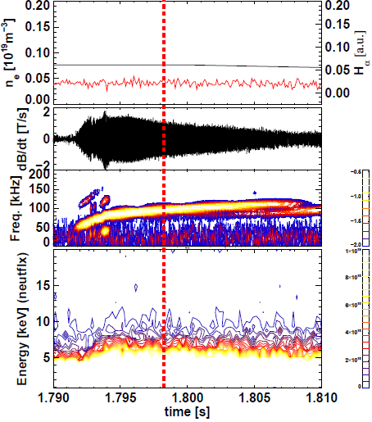
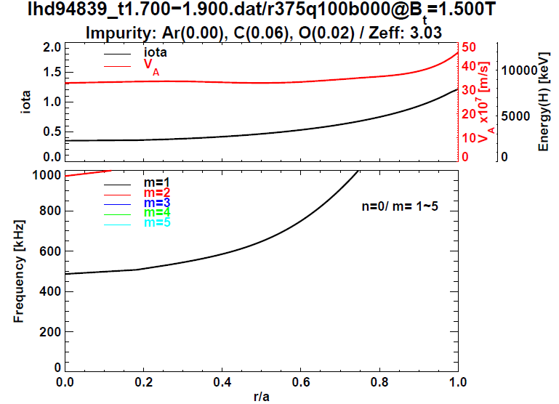
Toroidal mode number is n=0
iota (=1/q)
Freq. [kHz]
The initial frequency of the mode is much smaller than expected n=0 GAE frequencies (f>500kHz).

Slide 22
Toroidal mode is zero. Phase for poloidal structure has a slope of unity, but ..
a phase jump was observed at around θ=0[deg]. This indicates a formation of standing-wave like structure.
Standing wave is formed by the sum of two modes having a same mode number and propagating opposite to each other.
  In the case of m>3, we should observe more than three nodes.
  In the case of m=1, it is difficult to have a node like structure with a slope of m=1.
The m=2 is the most likely in this case.
*Consistent to theoretical prediction for poloidal mode of Magnetic component of GAM; Zhou D, PoP, 14, 104502 (2007 )

Slide 23
Confinement improvement case
- P_{ion} constant model -
Energy confinement was assumed to be improved to infinite number during the mode activity.
Estimated temperature rise was smaller than the experimental observation.
Charge-exchange loss time of 5~100ms for bulk ions with background neutrals (10¹⁴~ 10¹⁵m⁻³) will also suppress the confinement improvement.
Confinement improvement can not explain the measured temperature rise.

Slide 24
Enhanced ion-heating case
- Constant confinement time model -
Ion heating power was assumed to be increased during the mode activity.
The amount of heating power was determined so that the observed temperature rise was reproduced.
The P_{i} enhancement factors of;
  21 (P_{i}=3.6kW/m³) for τ_{i}^{eff.}=364ms, and
  5.6 (P_{i}=4.3kW/m³) for τ_{i}^{eff.}=80ms.
  are necessary to explain the observed temperature rise.
Indication of enhanced ion-heating power during the mode activity.

Slide 25
Combination of m=2/-2 mode might explain the observed phase structure*.
In the case of m>3, we should observe more than three nodes in the poloidal phase diagram.
In the case of m=1, it is difficult to have a node like structure with a slope of m=1.
Further investigation is necessary since it sometimes show m=1 structure without node.
*Consistent to theoretical prediction of poloidal mode of Magnetic component of GAM; Zhou D, PoP, 14, 104502 (2007 )

Slide 26

The EP affects the GAM frequency
T.Ido, et.al.
The GAM frequency is modified by FIs. (G.Y.Fu, PRL,101,185002 (2008) )
$$Λ=\frac{μB}{E}$$
$∇∙\left({J^{bulk}}_{geodesic}+J_{polarization}\right)$=0
$∇∙\left({J^{bulk}}_{geodesic}+{J^{EP}}_{geodesic}+J_{polarization}\right)$=0
(T.Watari, et al, PoP, 13, 062504 (2006)
Slowing-down distribution
Notes:
The modification of GAM by Fast-Ions were shown by Fu. Using this analytical form of fast-ion distribution function.
We had followed Watari’s method by including the fast-ion geodesic current in this equation. When we apply the

Slide 27
The EP affects the GAM frequency
T.Ido, et.al.
The GAM frequency is modified by FIs. (G.Y.Fu, PRL,101,185002 (2008) )
$$Λ=\frac{μB}{E}$$
$∇∙\left({J^{bulk}}_{geodesic}+J_{polarization}\right)$=0
$∇∙\left({J^{bulk}}_{geodesic}+{J^{EP}}_{geodesic}+J_{polarization}\right)$=0
(T.Watari, et al, PoP, 13, 062504 (2006)
Slowing-down distribution
γ_{Growth} < 0
α = 6.8
γ_{Growth} > 0
γ_{Growth} > 0
The freq. of EP-driven GAM can be
much higher than the ordinary GAM freq.
Notes:
The modification of GAM by Fast-Ions were shown by Fu. Using this analytical form of fast-ion distribution function.
We had followed Watari’s method by including the fast-ion geodesic current in this equation. When we apply the

Slide 28
Mechanisms which might explain this phenomena
Change of orbit topology by the GAM. activities
Deformation of fast-ion energy spectra by the mode
Improvement in bulk-ion energy confinement with the mode
Enhanced ion-heating with the mode

Slide 29
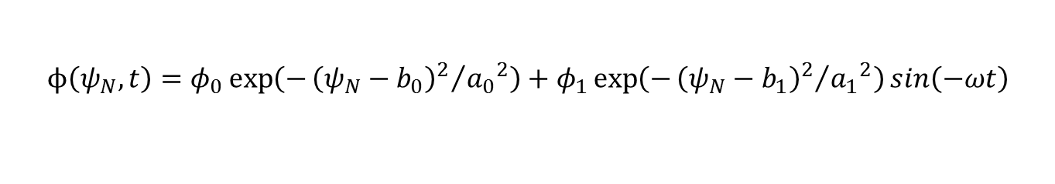
Effect of electrostatic potential on the topology of particle orbit
$$ϕ\left(ψ_{N},t\right)=φ_{0}\exp\left(−{{\left(ψ_{N}−b_{0}\right)}^{2}}/{{a_{0}}^{2}}\right)+φ_{1}\exp\left(−{{\left(ψ_{N}−b_{1}\right)}^{2}}/{{a_{1}}^{2}}\right)sin\left(−ωt\right)$$
delta5d
Effect of ExB-drift on the deviation of particle orbit is small. Thus, it seems to be difficult to claim this is responsible to the phenomena.

Slide 30
The change of orbit topologies would change the Ti-profile.
AURORA
The observed change seems to correspond to the increase of Ti central value rather than the change of the shape.

Slide 31
Mechanisms which might explain this phenomena
Change of orbit topology by the GAM. activities
Deformation of fast-ion energy spectra by the mode
Improvement in bulk-ion energy confinement with the mode
Enhanced ion-heating with the mode

Slide 32
When the energetic particle spectra was deformed, it might increase ion-heating power, classically.
Because, the population of energetic particles close to the E_{c}(~15Te ) would increase by the deformation. Thus, the ion-heating rate might increase.
E_{c}=75keV
a)
Time-dependent analysis of NB heating power was performed based on TASK3D-code to evaluate the classical bulk-ion heating power by EPs .
The possible increase of the heating power by the deformation was examined by introducing artificial deformation of the spectra in the calculation.
T_{e}(0)=5keV
b)

Slide 33
Increment of classical ion heating power by the deformation of the spectra is too small to cause observed increase of the ion temperature.
Energetic particle spectra at t=4.94s with classical slowing-down spectra were evaluated by TASK3D code.
The spectra was artificially deformed to reproduced the observed clump-hole formation. The increment of ion heating power by the deformation was examined.
r/a=~0.02
This candidate is also ruled out.

Slide 34
Evaluated energy loss of EP by the deformation of the spectra reaches to 0.6[kJ/m³] at the core.
Considering the duration time of the mode (~8[ms]), the average power loss of EPs are ~75[kW/m³], which is larger than the necessary ion heating power (~4[kW/m³]).

Slide 35
During the GAM bursting activity, the Clump-Hole formation was observed in high energy part, and the ion temperature increase was observed for the low energy part.
Low energy range
High energy range
NBI
(175keV)

