Slide 1
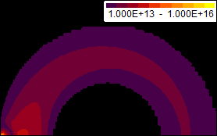
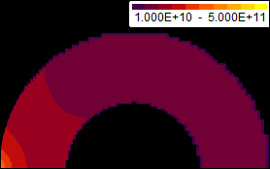
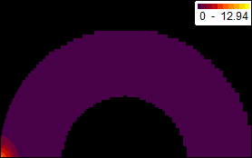
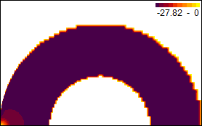
Novel 2D model to predict wall current density distribution in Glow Discharge Conditioning in ITER
Wall current density distribution on ITER PFCs needed to predict system performance
Glow discharges operate in a hollow-cathode regime
plasma sustained by ionization by fast secondary electrons
2 electron populations : slow (bulk) + fast (secondary) → 2D multi-fluid model
fluid model for bulk electrons + effective fluid model for fast electrons
rate & transport coefficients pre-calculated by 0D Monte-Carlo simulation
benchmarked against experimental glow discharges (laboratory , JET, RFX)
with one or two anode(s)
homogenous current density at reasonably short distances from the anode
Current density close to total anode current divided by the wall surface area
Higher, more uniform current density expected with all 7 anodes foreseen in ITER
[G. Hagelaar & D. Kogut, submitted to PPCF]
n_{e} (m⁻³)
n_{e fast}(m⁻³)
H₂-GDC at 0.3 Pa
T_{e} (eV)
V_{plasma}-V_{anode}
375 V

