Slide 1
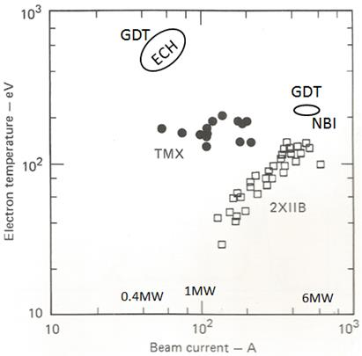
GDT With ECH Te = 750 eV Sufficient for a D-T Fusion Neutron Source
Magnetic Mirror Device Historic Thompson Data:
2XIIB (1977), TMX(1980), GDT(2014)

