Slide 1
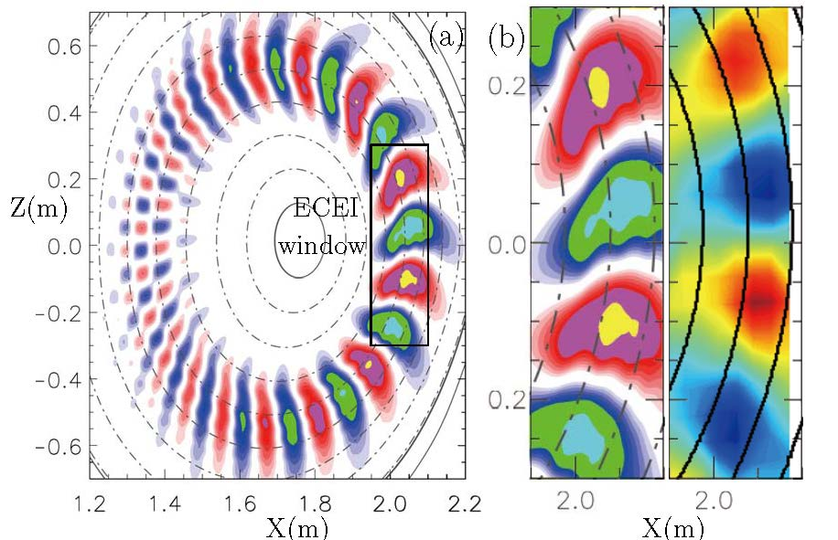
Radial Localization of Toroidal Alfven Eigenmode (TAE) and Zonal Field Generation
Lin, TH/7-2
GTC global gyrokinetic simulations with kinetic effects of thermal ions and electrons recover experimental results of TAE in DIII-D
Energetic particle (EP) non-perturbative contributions to TAE induce mode radial localization and break mode radial symmetry
Zonal flow generated by mode coupling and cause TAE saturation
Next step: EP transport by TAE
GTC
DIII-D
GTC simulation of TAE in DIII-D shot 142111 at 525ms
[Z. Wang, Z. Lin, I. Holod, W. Heidbrink, B. Tobias, M. Van Zeeland, M. Austin, PRL111, 145003 (2013)]

