Slide 1


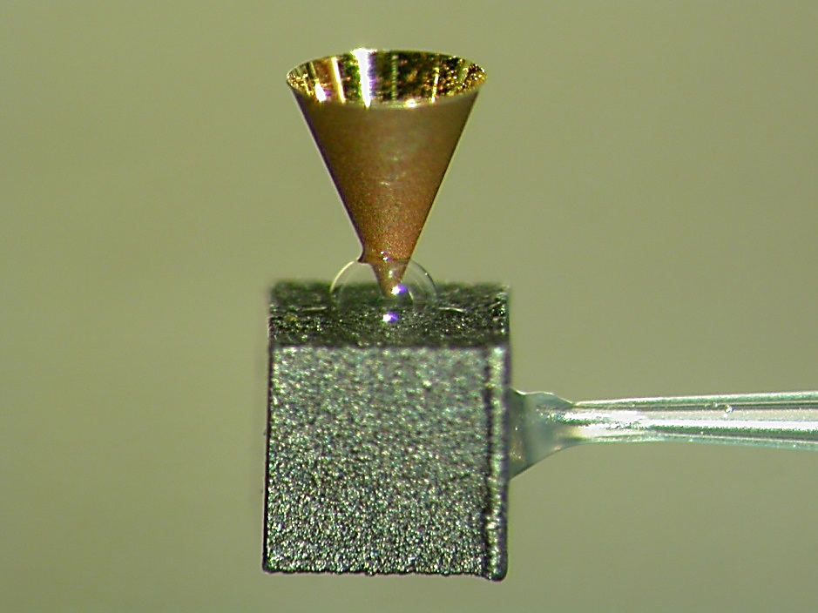
ILE, Osaka
Experimental Platform for Efficient Heating of Fusion Fuel with Fast-Ignition Scheme
1 mm
Shinsuke Fujioka*
*Institute of Laser Engineering, Osaka University, Japan
IAEA Fusion Energy Conference 2014

Slide 2
Slope temperature and divergence of relativistic electron beam (REB) must be controlled for efficient heating of fusion fuel.
Summary
  Fast-Ignition Realization EXperiment (FIREX) was performed on GEKKO XII - LFEX laser facility.
  There are three difficulties of the fast-ignition scheme, namely “shut-in”, “diverging” and “ unstoppable” of REB.
  All physical parameters of the REB were measured to evaluate absolutely the heating efficiency.
The most critical problem is generation of too energetic REB (> 15 MeV) in a long-scale preformed plasma.
Plasma mirror will be installed to suppress generation of too energetic REB.
Guiding of REB was demonstrated with 0.6 kT of external B-field.

Slide 3
Three difficulties in fast-ignition scheme;
“shut-in”, “diverging”, and “unstoppable” of REB.
Fast Ignition Basic Experiment Platform
ILE, Osaka
cone
Heating laser
Fusion fuel
Heating laser
Shut-in
A few MeV electrons, which may heat efficiently a fuel core, are absorbed in the cone wall itself. Most of these absorbed electrons are not ejected from the cone.
Diverging
Electron beam has a large divergence angle (> 100 deg.). Energy flux of the e-beam decreases significantly during transport.
Unstoppable
Too energetic electrons are generated by laser-plasma interactions, those electrons do not deposit their energy within the fuel.

Slide 4
Divergence, energy distribution and flux of REB
are measured by using x-ray convertor attached target.
Fast Ignition Basic Experiment Platform
ILE, Osaka
X-ray shadowgraph
Absolute x-ray yield measurement
Fuel
cross section
Laser- Electron
Conversion
Efficiency
2 x fuel areal density
Heating
Efficiency
Electron
Transmittance
=
X
X
X
E-beam cross section @fuel
Range of e-beam
Kα imaging
with a tracer layer
T_{e} measurement
with hard x-rays
Fast ignition basic experiment
PS shell
Ta
e⁻
1 mm
X ray
LFEX
e⁻
e⁻
X ray
GXII
X ray

Slide 5
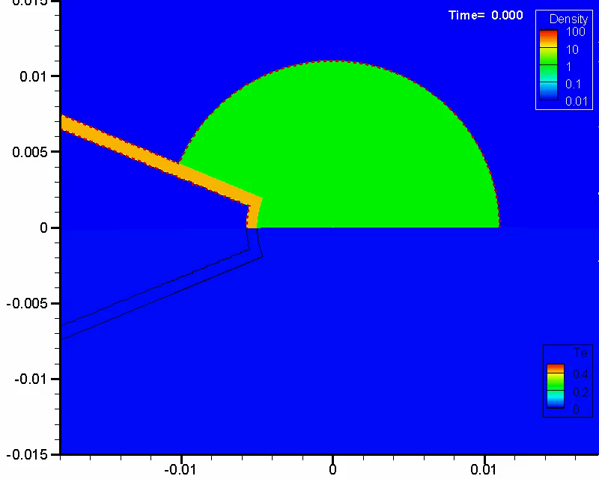
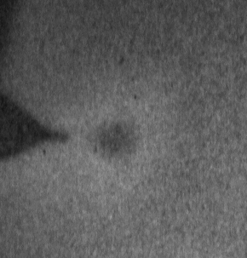
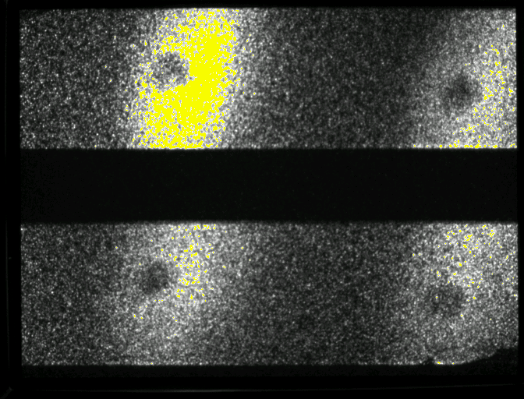
ρR_{max} = 54 mg/cm² and ρ_{max} = 22 g/cm³ are obtained with
a plastic ball with asymmetric-spherical irradiation.
Fast Ignition Basic Experiment Platform
ILE, Osaka
2D simulation
X-ray shadow
of compressed plastic ball
Density
200 µm
200 µm
Temperature
@max. comp.

Slide 6
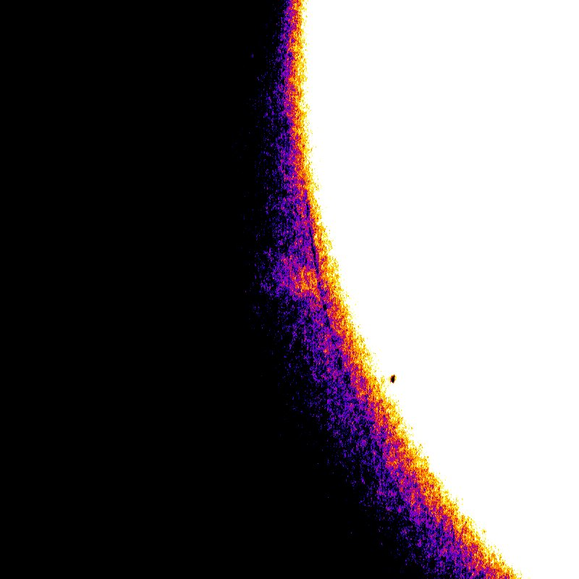
Cross section of REB is measured by imaging
Kα emission from a varied tracer layer.
Fast Ignition Basic Experiment Platform
ILE, Osaka
C/Cu/C block target
Monochromatic Kα image
Kα x-ray
Kα x-ray
e⁻
LFEX
e⁻
e⁻
Kα x-ray
Kα x-ray
100 µmφ
Cu tracer layer

Slide 7
Absolute energy sepectrum of REB was obtained
from hard x-ray spectrum with 2-T assumption.
Fast Ignition Basic Experiment Platform
ILE, Osaka
Energy distribution of REB measured with ESM & HEXS
T_{REB1} = 1 MeV
(7.9% of E_{REB})
T_{REB1} = 1 MeV
determined from HEXS
Vacuum Electron Spectrum
Effect of sheath field
T_{REB2} = 15 MeV
(92.1% of E_{REB})
ESM signal
T_{REB2} = 15 MeV
determined from ESM

Slide 8

Heating efficiency is evaluated with measured divergence, energy distribution and flux of REB.
Summary of FI Basic Experiment
ILE, Osaka
Heating efficiency estimation
π (50/2 µm)²
0.11 g/cm²
=
=
Laser- Electron
Conversion
Efficiency
Fuel cross section
2 x Fuel rho-R
Electron
Transmittance
X
X
X
E-beam cross section @fuel
Range of e-beam
=
=
4.4 g/cm²
(weighted for 1 & 15 MeV)
π (100/2 µm)²
=
=
=
Heating
Efficiency
=
40 %*
X
25 %
X
2.5 %
!!!
0.3%
=
Reduction of T_{e} is essential for efficient heating.
See details in the poster by Z. Zhang (IFE/P6-2, Thursday).

Slide 9
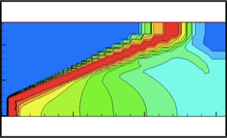
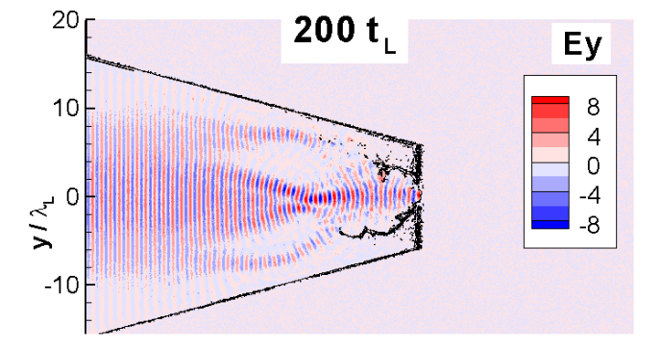
Too energetic electrons are generated in a long-scale
plasma generated by foot of the heating laser pulse.
Suppression of Too Energetic REB Generation
ILE, Osaka
Long-scale plasma generated by foot pulse
Long-scale plasma generated by foot pulse
Laser filamentation
in a long scale plasma
Energetic electrons increase
Preferable electrons decrease

Slide 10
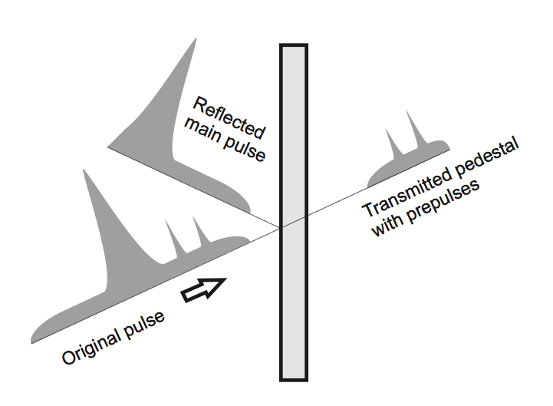
Foot pulse can be removed by using plasma mirror.
It is a challenge to install plasma mirror to kJ lasers system.
Suppression of Too Energetic REB Generation
ILE, Osaka
Typical shape of laser pulse
Principle of plasma mirror
10²⁰ W/cm²
Intensity (log scale)
1 ps
10¹⁰ W/cm²
200 ps
Time (log scale)
See details in the poster by A. Morace (IFE/P6-4, Thursday).

Slide 11
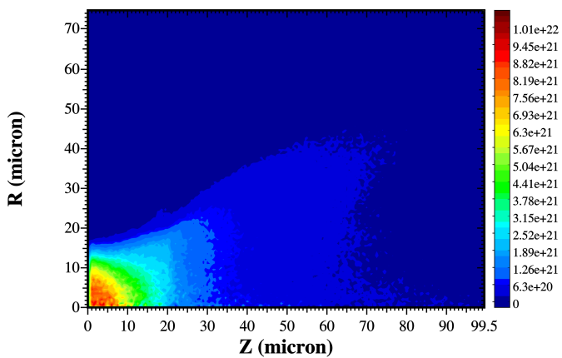
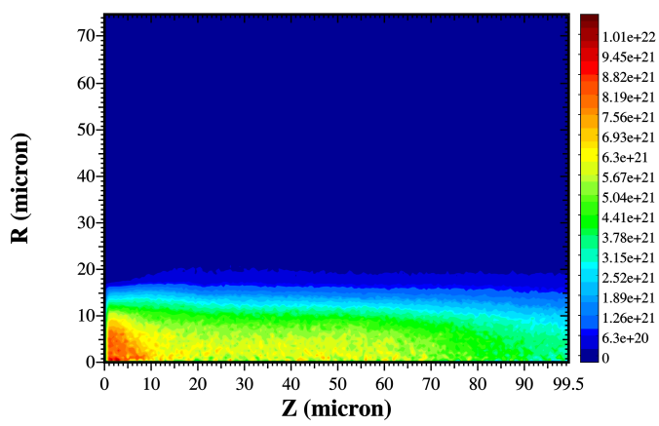

Laser-generated relativistic electron beams can be
guide by a few kT of externally imposed B-field
Guiding REB with external B-field
ILE, Osaka
#Simulation by Prof. Honrubia.
B_{z,ext} = 0
B_{z,ext} = 2 kT
2.1ps
2.1ps
n_{b}
(cm⁻³)
B_{z}
Fuel
Divergence of REB is a critical issue for the fast-ignition ICF.
See details in a poster by T. Johzaki (IFE/P6-5, Thursday).

Slide 12
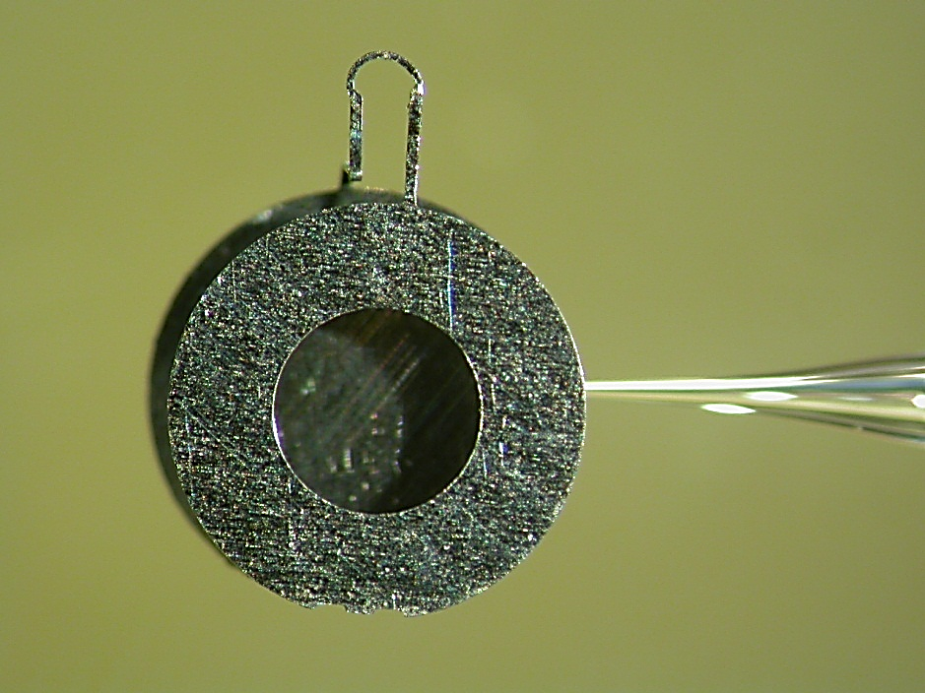
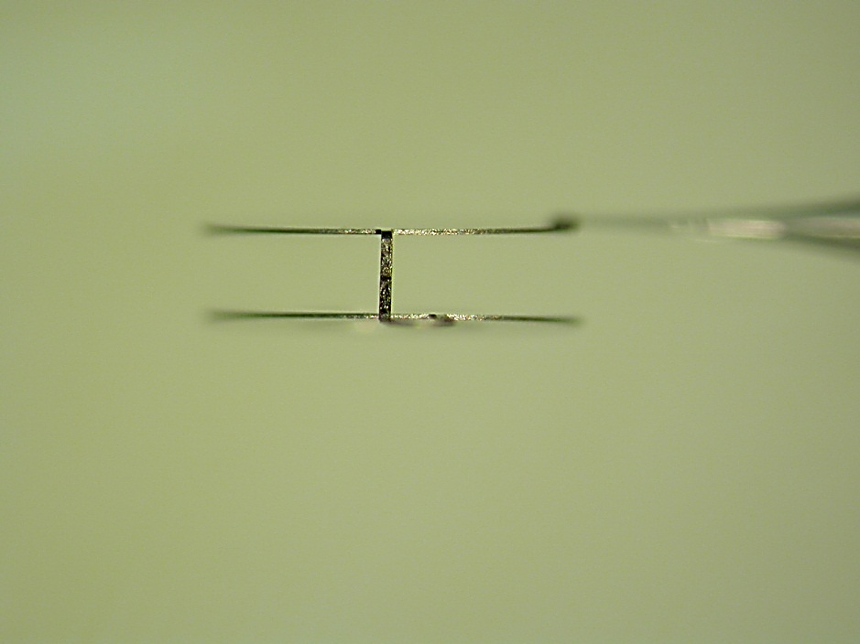
1 kT B-field* was generated
with a capacitor-coil target# and a ns-kJ laser.
Suppression of Too Energetic REB Generation
ILE, Osaka
*S. Fujioka et al., Sci. Rep. (2013).
#H. Daido et al., PRL (1985), C. Courtois et al., JAP (2005),
Photo of capacitor-coil target
One-turn coil
Current ~ several MA
B
2nd disk w/hole
kJ-ns laser beams
1mm
1st disk

Slide 13
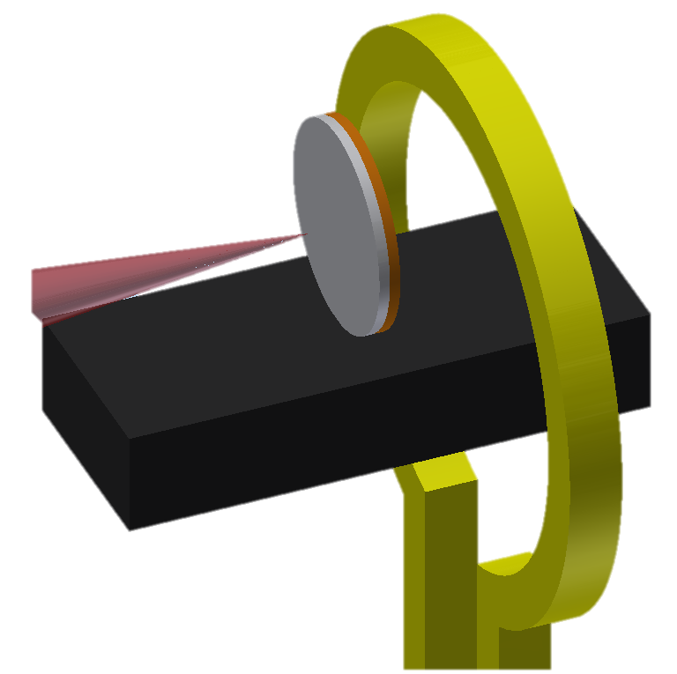
Laser-generated REB was pinched
by externally imposed 0.6-kT magnetic field.
Suppression of Too Energetic REB Generation
ILE, Osaka
Experimental setup
Spatial profile of transmitted REB
w/o B
w/ B
w/o B
w/B
n_{b}
(cm⁻³)
Notes:
Eint = 0.036kJ
Elimp = 2.5 kJ
⇒ himp = 1.44 %

Slide 14
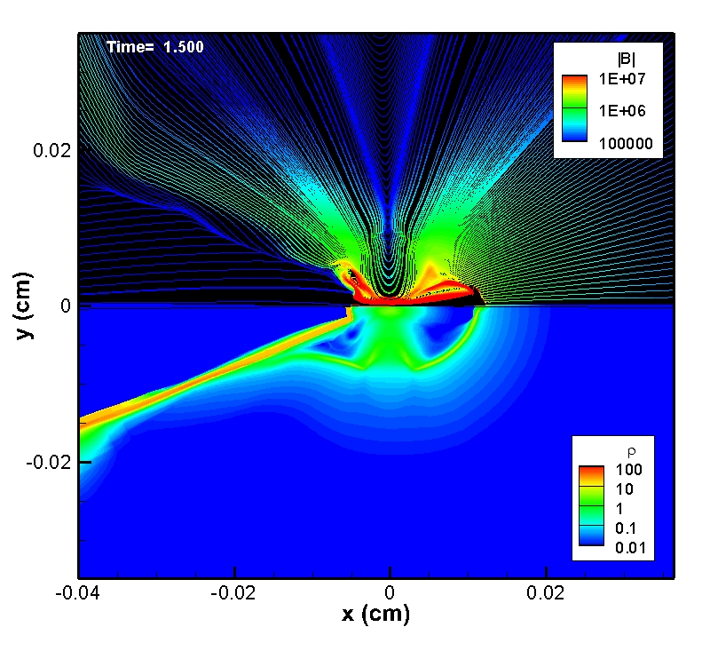
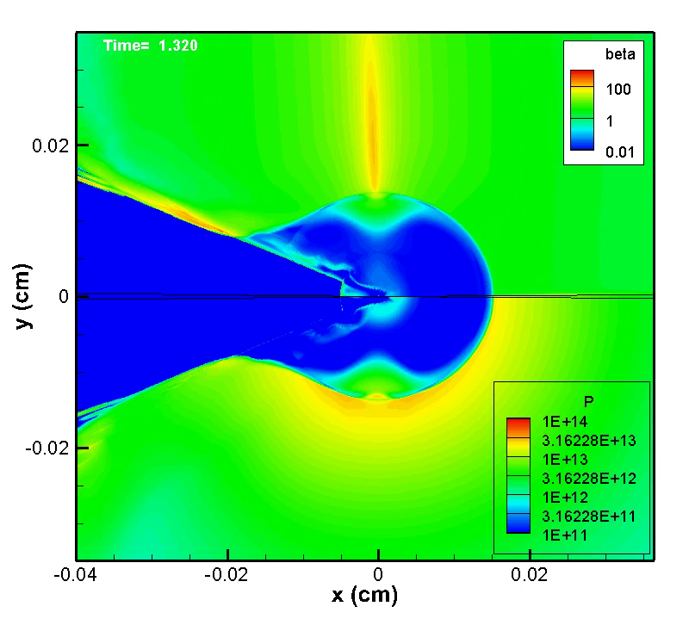
2D radiative-MHD code is under development
for full computation of B-assisted fast ignition scheme.
Suppression of Too Energetic REB Generation
ILE, Osaka
Computations by 2D-Rad-MHD code (PINOCO-MHD)
Magnetic field [G]
β value
Pressure [dyn/cm²]
Density profile [g/cm³]
See details in the poster by H. Nagatomo (IFE/P6-6, Thursday).
Notes:
Eint = 0.036kJ
Elimp = 2.5 kJ
⇒ himp = 1.44 %

Slide 15















S. Fujioka, Z. Zhang, Y. Arikawa, A. Morace, T. Nagai, Y. Abe, K. Ishihara, S. Kojima, S. Sakata, M. Taga, T. Ikenouchi, H. Inoue, T. Utsugi, S. Hattori, H. Lee, T. Hosoda, K. Matsuo, Y. Fujimoto, T. Jitsuno, Y. Hironaka, K. Mima, M. Murakami, N. Miyanaga, H. Nagatomo, M. Nakai,Y. Nakata, K. Nishihara, H. Nishimura, T. Norimatsu, T. Sano, Y. Sakawa, K. Shigemori, K. Tsubakimoto, A. Yogo, H. Shiraga, H. Azechi
Institute of Laser Engineering, Osaka University, Japan
A. Sunahara
Institute for Laser Technology, Japan
T. Johzaki
Hiroshima University, Japan
T. Morita, N. Yamamoto, H. Nakashima
Kyusyu University, Japan
K. Kondo
Tokyo Inst. Tech., Japan
T. Enoto
RIKEN, Japan
A. Iwamoto, T. Ozaki, T. Watanabe, H. Sakagami
National Institute for Fusion Science, Japan
H. Sawada, Y. Sentoku
University of Nevada, Reno, USA
Y-T. Li
Institute of Physics, China
G. Zhao, F-L. Wang, J. Zhong
National Astronomical Observatories , China
J. Santos, L. Giuffrida, M. Bailly-Grandvaux, D. Batani, R. Bouillaud,
P. Forestier-Colleoni, S. Hulin, Ph. Nicolaï, V. Tikhonchuk
CELIA, Univ. Bordeaux, France
J.L. Dubois, J. Gazave, D. Raffestin and J. Ribolzi.
CEA, France
M. Chevrot, S. Dorard, E. Loyez, J.R. Marques, F. Serres
LULI, Ecole Polytechnique, France
J. Honrubia
Universidad Politécnica de Madrid, Spain
D. Salzmann
Weizmann Institute of Science, Israel
Y. Kuramitsu
National Central University, Taiwan

Slide 16
Acknowledgement
This research was supported by the Japanese Ministry of Education, Science, Sports, and Culture (MEXT), by a Grant-in-Aid for Young Scientists (A) for ’Extreme Magnetic Field Generation for Quantum Beam Control and Laboratory X-ray Astronomy (No. 24684044), ‘Bilateral Program for Supporting International Joint Research by JSPS’, ’ Collaboration Research program by NIFS (NIFS12KUGK057 and NIFS11KUGK054) and by the Institute of Laser Engineering at Osaka University (under contract ’Laboratory X-ray Astrophysics with Strong Magnetic Field’).

Slide 17
Slope temperature and divergence of relativistic electron beam (REB) must be controlled for efficient heating of fusion fuel.
Summary
  Fast-Ignition Realization EXperiment (FIREX) was performed on GEKKO XII - LFEX laser facility.
  There are three difficulties of the fast-ignition scheme, namely “shut-in”, “diverging” and “ unstoppable” of REB.
  All physical parameters of the REB were measured to evaluate absolutely the heating efficiency.
The most critical problem is generation of too energetic REB (> 15 MeV) in a long-scale preformed plasma.
Plasma mirror will be installed to suppress generation of too energetic REB.
Guiding of REB was demonstrated with 0.6 kT of external B-field.

Slide 18
The fast ignition consists of three stages; “compression
by ns-laser”, “heating by ps-laser”, and “ignition&burning”.
FIREX: Fast Ignition Realization EXperiment
ILE, Osaka
Compression
(x 1000 solid density)
Heating
(up to 5 keV)
Ignition
& Burn
10 kJ-PW laser – LFEX – is constructing for FIREX-I.

Slide 19
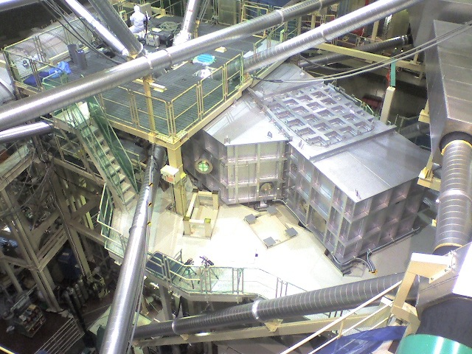
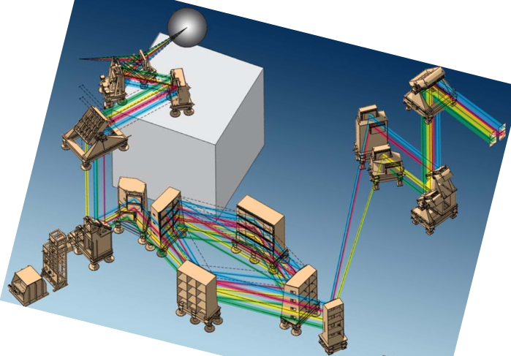
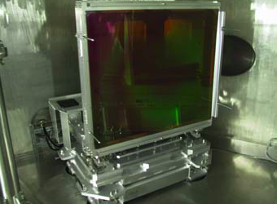
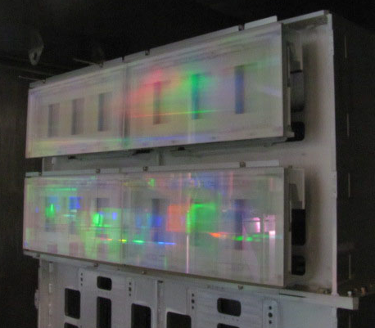
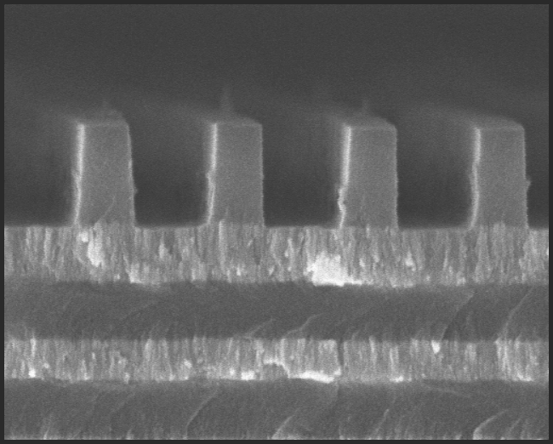
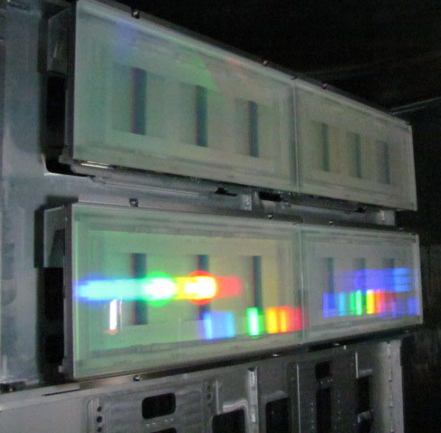
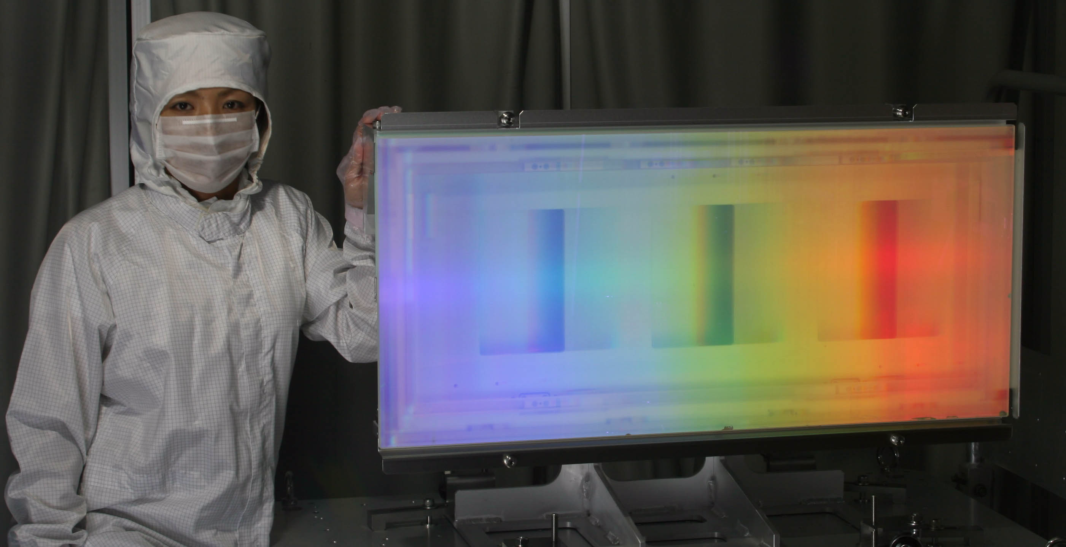
Three beams of the LFEX laser are in operation.
The full four beams will be operational from this November.
FIREX: Fast Ignition Realization EXperiment
ILE, Osaka
Beam# 4 beam
Energy 700 J/beam, 2.8 kJ/total
Duration < 1 ps
Wavelength 1053 nm
Interaction chamber
Off axis
parabola mirror
Monitor 3
M-10
M1
SM1
M9
M7
M5
SM2
M6
Grating 2
M7
0.575 µm
Monitor 1
M4
SiO₂
HfO₂
Grating 1
SiO₂
M3
HfO₂
M2
Notes:
Again, this shows the path from the amplifier output , gratings, focusing optics, and the target chamber.
Beam configuration is 2x2 here, and then 1x4 here, and finally it is 2x2 again, and goes into the target chamber.
The whole system after M2 is inside vacuum chambers.

Slide 20
FIREX (Fast Ignition Realization Experiment) target design
is refined based on the recent studies.
Magnetized Fast Ignition: MFI
ILE, Osaka
Coil
Cone
Heating
(4 of 4)
Compression
(9 of 12)
B-generation
(3 of 12)
Laser-driven capacitor

Slide 21
There are a lot of unexplored plasma physics
in magnetized fast ignition scheme.
Magnetized Fast Ignition: MFI
ILE, Osaka
EM wave propagation
e-beam guiding
B_{z}
2.1ps
Hydrodynamic instability
Thermal insulation

Slide 22
There are a lot of unexplored plasma physics
in magnetized fast ignition scheme.
Magnetized Fast Ignition: MFI
ILE, Osaka
Flow chart of magnetized fast igntion
kilo Tesla
B-field
Field compression
c) Whistler wave propagation
d) Thermal
Insulation
e) α particle
confinement
a) hydrodynamic instability
b) Fast electron guiding
Efficient
Heating
Ignition
High Gain
Dense fuel generation

Slide 23
Strong Magnetic Field Generation
with laser-driven capacitor-coil target

Slide 24
We generate 1 kT B-field* with a capacitor-coil target#
and a ns-kJ laser (GEKKO [JAPAN] & LULI [FRANCE]) .
Strong-B Generation
ILE, Osaka
*S. Fujioka et al., Sci. Rep. (2013).
#H. Daido et al., PRL (1985), C. Courtois et al., JAP (2005),
Photo of capacitor-coil target
One-turn coil
Current ~ several MA
B
2nd disk w/hole
kJ-ns laser beams
1mm
1st disk

Slide 25
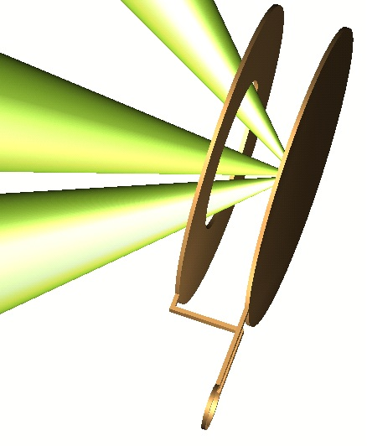
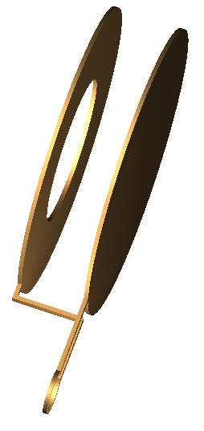
Movement of non-thermal hot electrons between the disks
drives electric current in the wire.
Strong-B Generation
ILE, Osaka
Non-thermal hot electron generation
Electrons accumulates on the disk
Current is driven in wire
-
-
-
electron
-
GEKKO XII
kJ-ns pulses
-
Plasma
-
-
current
B

Slide 26
600 T of the maximum strength and 2 ns of FWHM duration
of B-field generated with a capacitor-coil target.
Strong-B Generation
ILE, Osaka
Temporal history of B-field
600 T of the peak magnitude and 2 ns of the duration
Strength of B-field (T)
at coil center
t = 0.6 ns
(Half-rise time)
Time (ns)

Slide 27
Electrons traveling with a plasma expansion front# are accumulated on the capacitor disk.
Strong-B Generation
ILE, Osaka
#P. Mora, PRL (2003).
Drawing of C-C target
Plasma profile between disks
Rarefaction
wave front
Ion expansion front
LASER
n_{i} (x)
n_{e} (x)
Total charge density (/cm²) at the front is -σ
σ
Charge density (/cm²)
σ
0
-2σ
Position (normalized)

Slide 28
Electric potential difference of the capacitor
can be calculated with the isothermal expansion model#.
Strong-B Generation
ILE, Osaka
#P. Mora, PRL (2003).
Total charge density at the ion front (C/m²)
Q = σS
Charge accumulated on the disk.
S is the size of the disk (m²)
Temperature of hot electrons generated by resonance absorption
Time duration for that the ion front arrives at the accumulation disk.
Electric field at the ion front.
d
d is the distance between the disks.
V = 0.5 MV, I = 0.3 MA, and B = 750 T for 1 kJ with the model.

Slide 29
Hydrodynamics of a magnetized HEDP

Slide 30
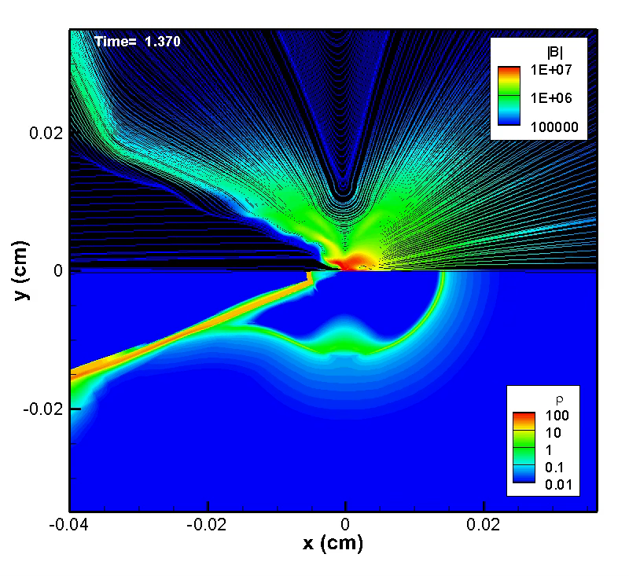
Hydrodynamics of a HED plasma under strong B-field
is important in Magnetized Fast Igntion.
Hydrodynamics in strong B-field
ILE, Osaka
2D hydrodynamic simulation of laser-driven implosion under strong B-field

Slide 31
Thermal conductivity becomes anisotropic
under strong B-field.
Hydrodynamics in strong B-field
ILE, Osaka
Thermal conductivity
in parallel B-field
Braginskii coefficient
k_{para} = k_{w/o B}
k_{perp} = k _{w/o B}/(1+(ω_{ce}τ_{e})²)
k_{w/o B} : conductivity (w/o B)
ω_{ce} : elec. gyrofrequency
τ_{e} : elec. collisional time
T_{e} = 100 eV, n_{e} = 9 x 10²¹ cm⁻³
ω_{ce}τ_{e} ~ 1
k_{perp}
k_{para}
B

Slide 32
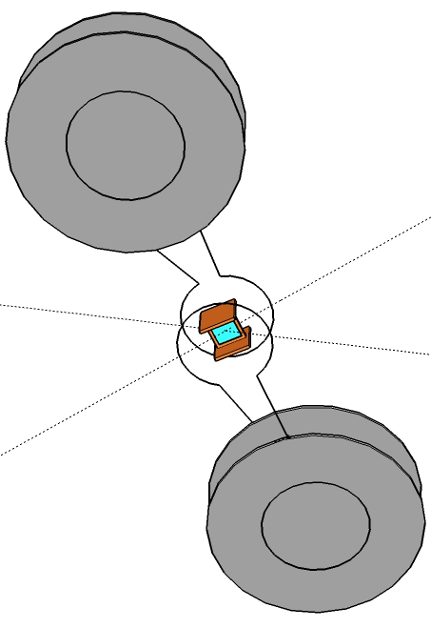
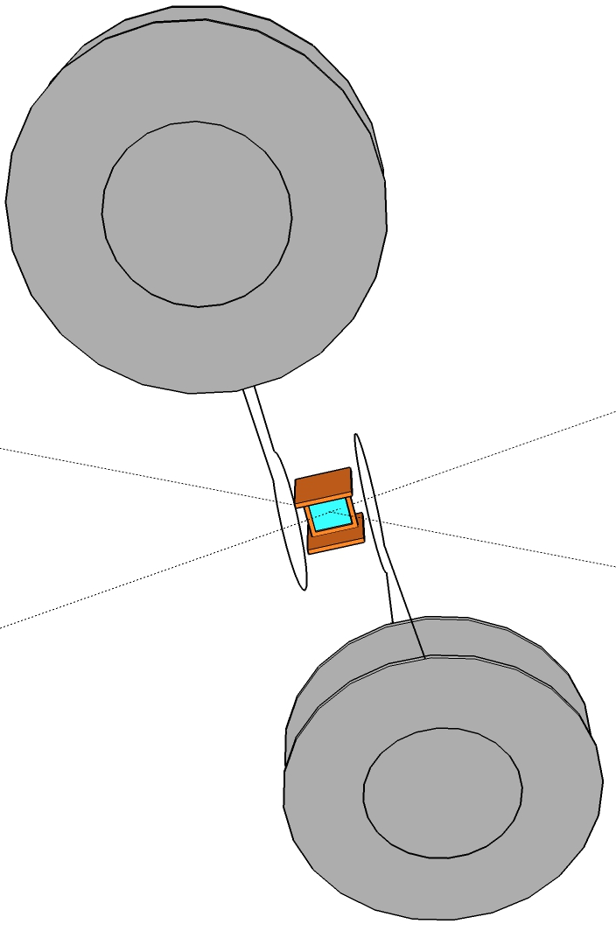
Uniform magnetic field was generated for this experiment
by using a Helmholtz-type coil-capacitor target.
Hydrodynamics in strong B-field
ILE, Osaka
Parallel B-field
Geometry
Perpendicular B-field
Geometry
25 µm-thick PS foil
900 µm gap
1500 µm-diameter coil
Each capacitor was driven by 1.5 kJ/1.2 ns laser.

Slide 33
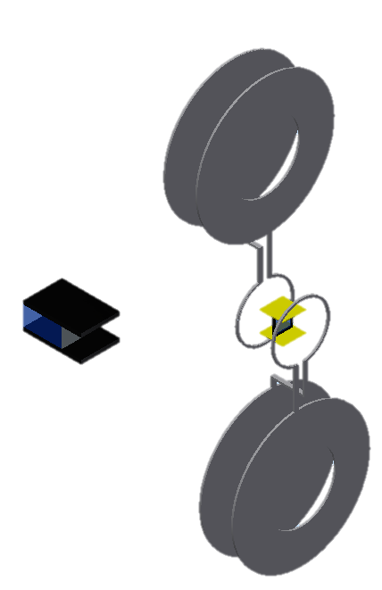
220 T of the magnetic field at the center was obtained
from Faraday rotation measurement and LADIA code.
Hydrodynamics in strong B-field
ILE, Osaka
Experiment set-up of
Faraday rotation measurement
TGG crystal as Faraday medium is located at (-3, -3, 0).
B-field profile
along coil center axis
0.21 MA current in the Helmholtz coil corresponds to 220 T at the center.
TGG crystal
3 mm
3 mm

Slide 34
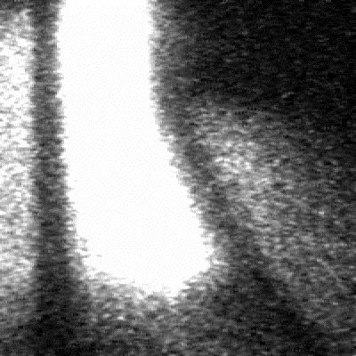
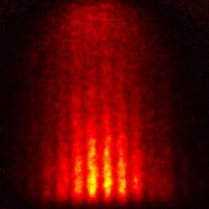
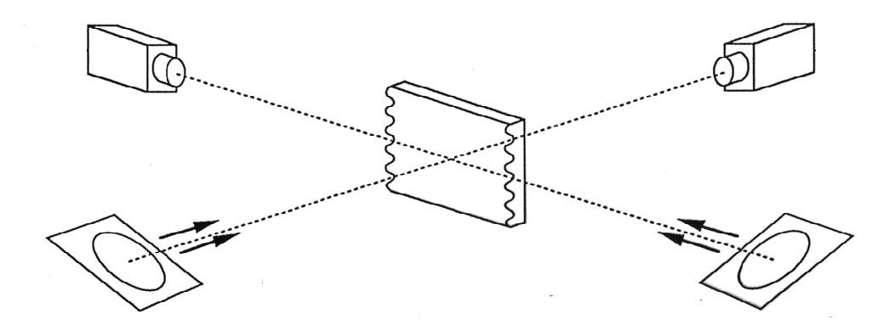
Hydrodynamics of magnetized HED plasma will be studied with face-on and side-on x-ray backlighting.
Hydrodynamics in strong B-field
ILE, Osaka
Side-on XBL
Face-on XBL
1 ns
LASER
300 μm
1 ns
X-ray CCD camera
X-ray streak camera
Slit
Slit
Flash x-ray
Corrugated CH target
Cu foil for side-on BL
(~ 1.2 keV)
Zn foil for face-on BL
(~ 1.5 keV)
1.2-ns laser pulse
1.2-ns laser pulse
Notes:
In the RT experiment, we used both face-on and side-on x-ray backlighting technique.
In the face-on geometry, Slit imager was coupled with an x-ray streak camera.
We can obtain temporal evolution of areal-mass-density perturbation due to the RT instability.
In the side-on geometry, Fresnel phase zone-plate was used as a two-dimensional spatial resolved imager.
X-ray detector was an x-ray CCD camera, and flash x-ray backlighting technique was used to obtained 100 ps-single flame x-ray image with an x-ray CCD camera.
In the side-on geometry, perturbation amplitude of the target is directly measured.

Slide 35
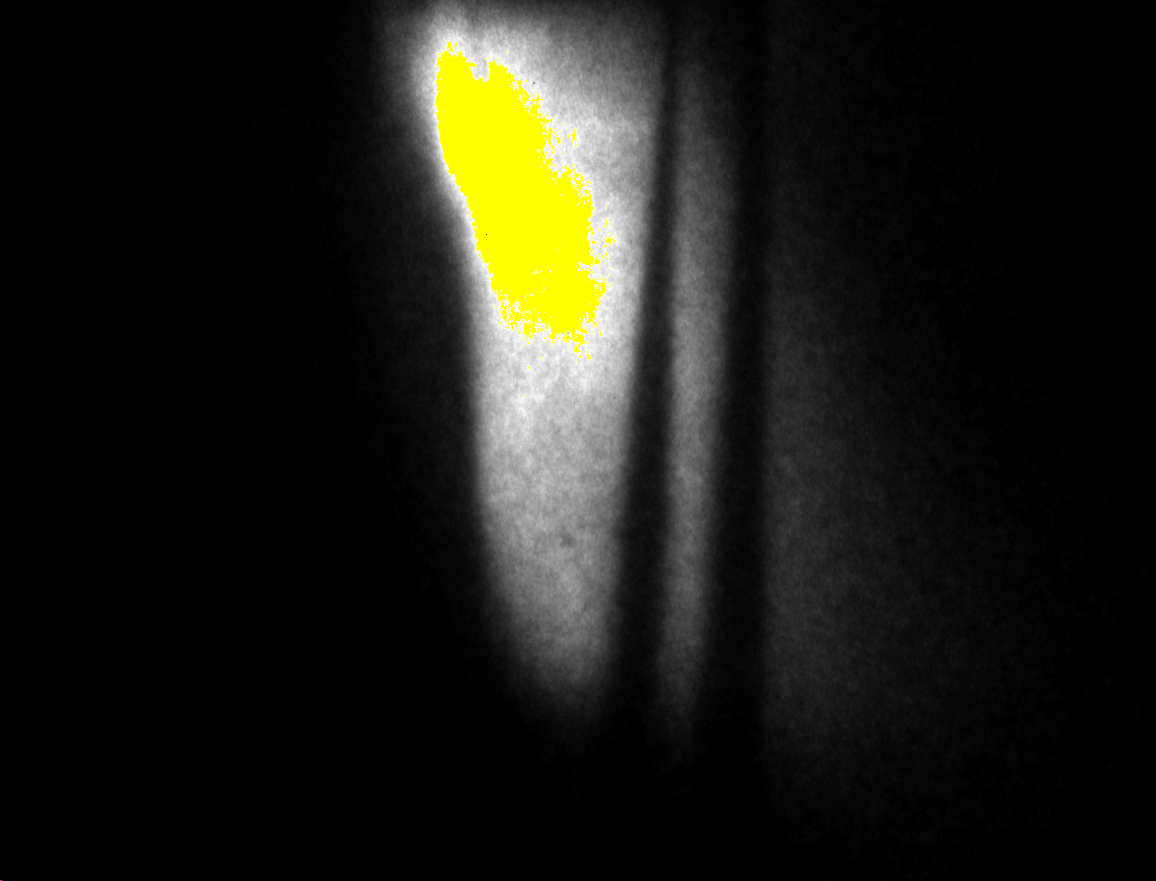
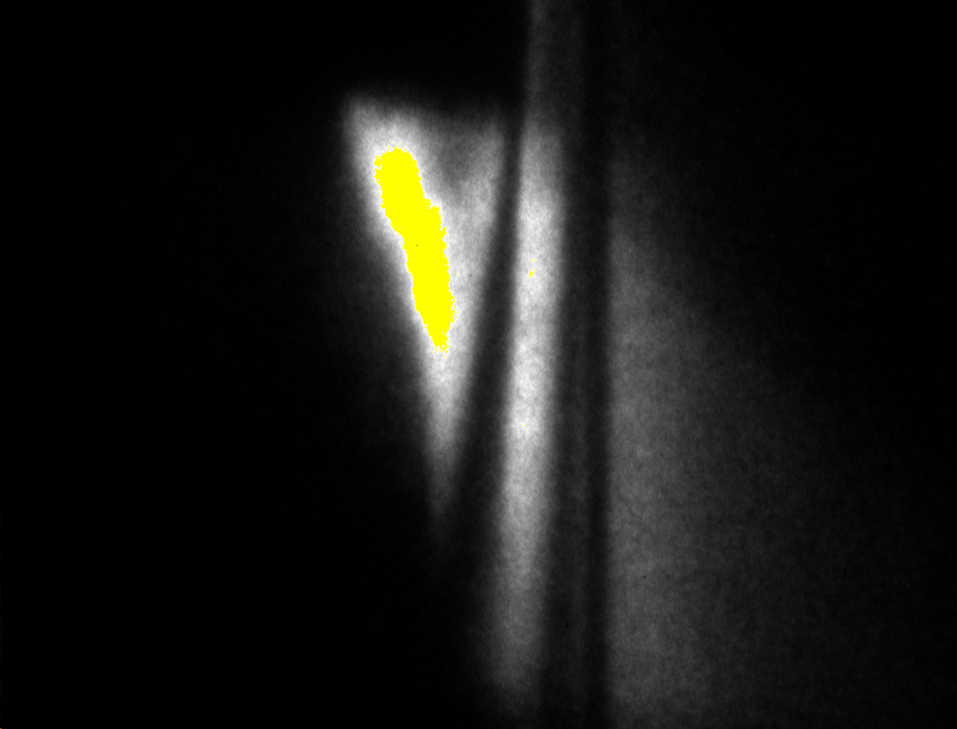
Laser-driven plastic foil is faster in parallel B-field
than that without B-field.
Hydrodynamics in strong B-field
ILE, Osaka
Side-on x-ray shadowgraph
w/o B-field
Side-on x-ray shadowgraph
w/ parallel B-field
B
Space (100 µm)
Time (1 ns)
LASER
LASER

Slide 36
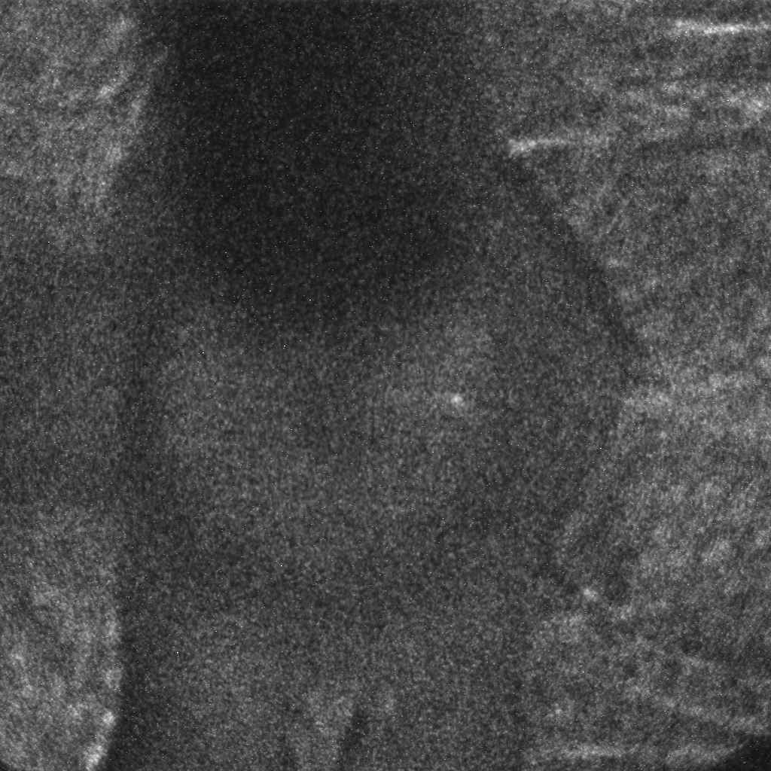
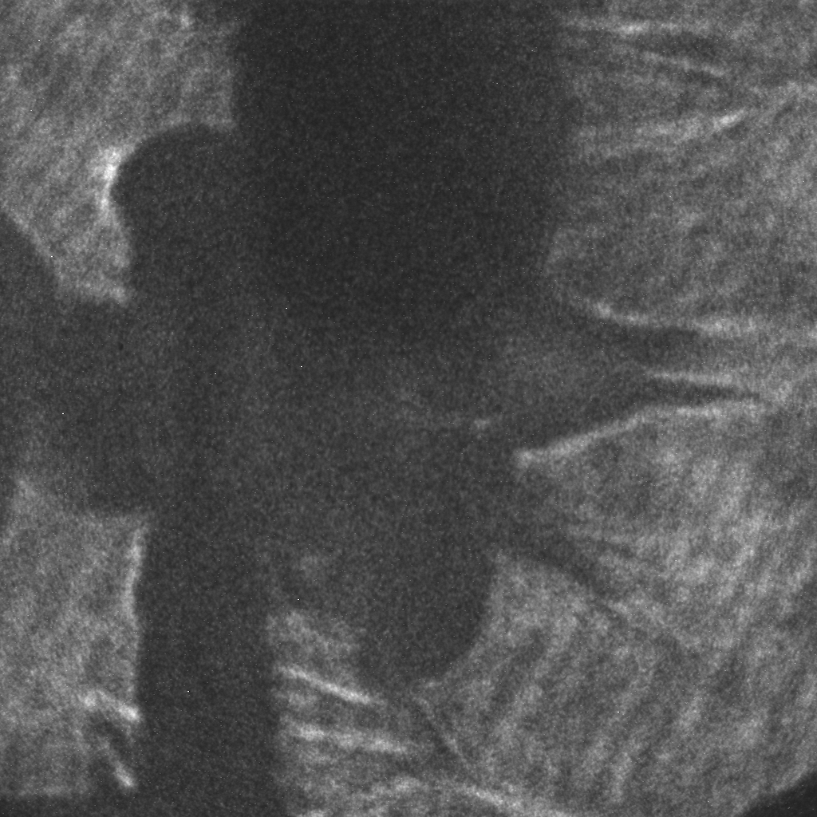
B-field changes shape of ablated plasmas by B-field.
Plasma expansion was flatten in parallel B-geometry.
Hydrodynamics in strong B-field
ILE, Osaka
Ablating plasma image
(parallel B-field)
Ablating plasma image
(perpendicular B-field)
B
B
after 5 ns
after 3 ns
LASER
LASER

Slide 37
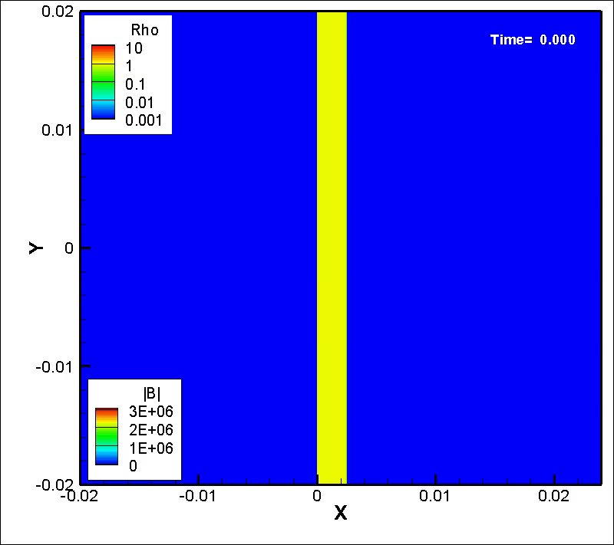
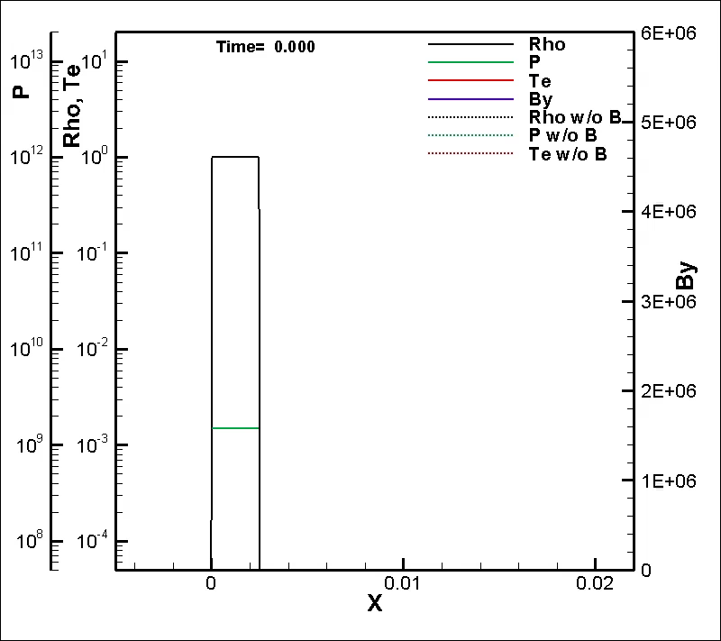
Two dimensional simulation of HEDP with external B-field
is on going to understand the experimental results.
Hydrodynamics in strong B-field
ILE, Osaka
2D hydro simulation (parallel B)
1D profile
Lorenz force effect (magnetic pressure) is not included in this simulation.

Slide 38
Guiding of laser-produced REB by B

Slide 39
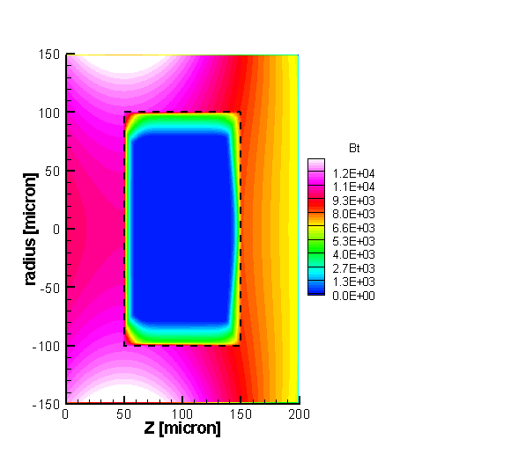
1 ns of diffusion time
corresponds to 10 eV of preheat of a plastic target.
Guiding REB with external B-field
ILE, Osaka
Diffusion of magnetic field in metal target
After Prof. Honrubia.
μ₀ : permeability
η : resistivity
L : diffusion length
Diffusion time of magnetic field
Notes:
Eint = 0.036kJ
Elimp = 2.5 kJ
⇒ himp = 1.44 %

Slide 40
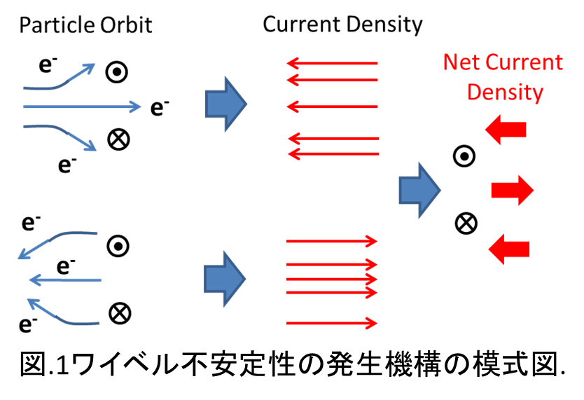
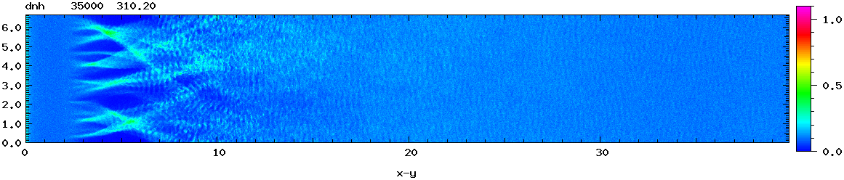
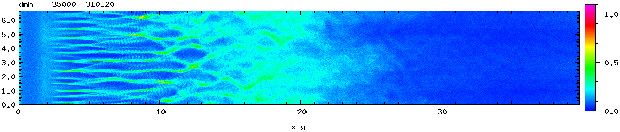
Weibel instability, source of REB divergence,
can be suppressed by external magnetic field.
Guiding REB with external B-field
ILE, Osaka
Weibel instability in counter streaming electrons
Initial spatial non-uniformity of B-field makes local current density non-uniform. The non-uniform current density amplifies B-field non-uniformity.
Suppression of Weibel instabity with external B-field
External B-field guide return current and suppress instability growth.
ω_{c}/ω_{pe} = 0
B
ω_{c}/ω_{pe} = 0.7

Slide 41
Alternative approaches for 5 keV
with truly isolated target and ion heating

Slide 42
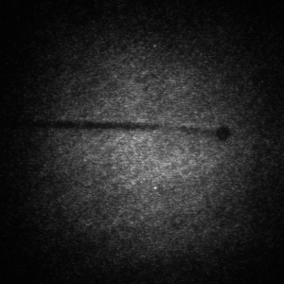
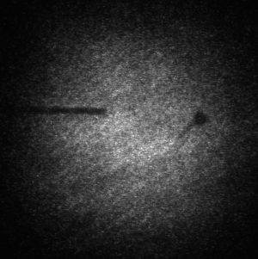
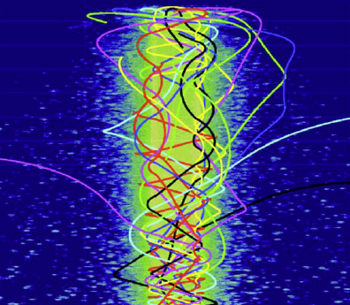
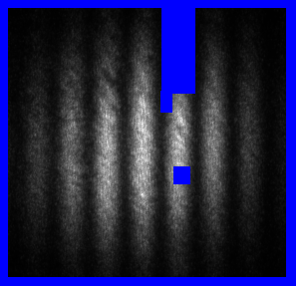
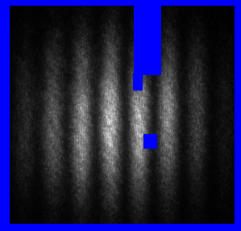
Truly isolated target is proposed to demonstrate
fast heating of material to several keV temperature.
Alternative approaches
ILE, Osaka
REB trapping
by self-generated E-field.
REB may be confined by strong self-generated E-field in a truly isolated target.
Target isolation
by stalk cutting with a 1J laser pulse
Target stalk is the major route, through which electrons is supplied to a positively charged target.
0 ns
+10 µs
1 J laser
pulse
Initial
position
H.-S. Park, PoP 13, 056309 (2006)
Notes:
Eint = 0.036kJ
Elimp = 2.5 kJ
⇒ himp = 1.44 %

Slide 43
Two teams are organized to conduct supportively
electron-based fast-ignition and ion-based fast-ignition.
Alternative approaches
ILE, Osaka
43

Slide 44
SUMMARY
Current status of “conventional” Fast-ignition researches in Osaka
    Basic experiment platform is developed for absolute measurement of all physics parameters those determine heating efficiency.
    Generation of too energetic electron (> 10 MeV) in a long-scale preformed plasma is the most crucial problem.
    “Cool REB” campaign will be conducted with a plasma mirror and the experiment platform in 2014.
Hydrodynamics of a HED plasma under strong B-field,
    Electron thermal conduction is anisotropic in strong B-field.
    Hydrodynamics of a laser-driven plastic foil was clearly changed by externally imposed B-field.
Guiding of relativistic electron beam (REB) by strong B-field,
    Guiding of REB is a key for the magnetized fast-ignition ICF .
    Pinching of the REB was clearly observed with sub-kT B-field.
    Suppression of the Weibel instability will be studied.
Alternative approaches for Fast Igntion
    Truly isolated target was developed to confine energetic electrons by self-generated E-field.
    Two teams are organized to conduct supportively both of electron-based and ion-based FI.

Slide 45
Acknowledgement
This research was supported by the Japanese Ministry of Education, Science, Sports, and Culture (MEXT), by Special Education and Research Expenses for ’Laboratory Astrophysics with High-Power Laser’ and a Grant-in-Aid for Young Scientists (A) for ’Extreme Magnetic Field Genera- tion for Quantum Beam Control and Laboratory X-ray Astronomy (No. 24684044), ‘Bilateral Program for Supporting International Joint Research by JSPS’, ’ Collaboration Research program by NIFS (NIFS12KUGK057 and NIFS11KUGK054) and by the Institute of Laser Engineering at Osaka University (under contract ’Laboratory X-ray Astrophysics with Strong Magnetic Field’).

Slide 46
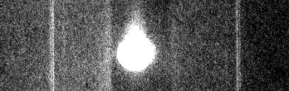
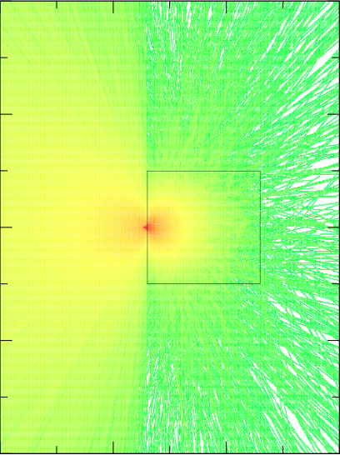
Kα signal from a block was used to evaluate conversion efficiency. MonteCarlo code was used to compute Kα yield.
Fast Ignition basic experiment
ILE, Osaka
Detection image of LAUE spectrometer
Trajectory of electrons
computed by PHITS code
0th order
1st order
1st order
Lineout of the LAUE spectrometer
100 KeV
Kα1
Kα2
Kβ
Ta cube: 1 mm
Slope temp.: 1 MeV
Divergence: 45 deg. (half)
Beam dia.: 60 μm
46

Slide 47
During Ph. D (1999 ~ 2004) Rayleigh-Taylor instability in laser-driven plastic plasma (< 10¹⁵ W/cm²)
2004 ~ 2009 Extreme Ultraviolet Light Source Development for Industry (< 10¹² W/cm²)
2009 ~ 2013 Photo-ionized plasma generation with high-power laser (< 10¹⁵ W/cm²)
2012 ~ Strong Magnetic Field Generation with High Power Laser & Fast-Ignition Laser Fusion (< 10²⁰ W/cm²)

Slide 48
REB was generated by ps-laser pulse. Cu-Kα and CTR emanated from REB were imaged from the rear side.
Guiding REB with external B-field
ILE, Osaka
CTR represents properties of REB.
CTR emission from the rear side was imaged with lens on an visible streak camera.
The slit of the streak camera is fully open (several mm).
The streak camera is operated with a slow sweep velocity.
The streak camera acts as a flaming camera in this condition, because duration of the CTR emission is a few ps.
Cu Kα imaging was relatively unstable because strong background was generated by the ns-pulse.
Notes:
Eint = 0.036kJ
Elimp = 2.5 kJ
⇒ himp = 1.44 %

Slide 49
Atomic physics in a magnetized HED plasma
is also important in ICF and astrophysics.
Strong-B Applications
ILE, Osaka
RM instability in strong-B
Vorticity of the Rechtmyer-Meshkov instability carried by the Alfven wave.
Deceleration phase w/strong-B
Pressure by compressed magnetic field suppresses hydrodynamic instability.
Alfven speed << RM growth rate
Alfven speed > RM growth rate
T. Sano et al., PRL 2013.
L. J. Perkins et al., PoP 2013.

Slide 50
It takes finite time (a few ns)
that pulsed B-field diffuses into a plastic target.
Guiding REB with external B-field
ILE, Osaka
Diffusion of magnetic field in metal target
Diffusion time of magnetic field.
μ₀ : permeability
η : resistivity
L : diffusion length
t_{diff}(Al@10 eV, 50 µm) = 0.7 ns
t_{diff}(CH@10 eV, 50 µm) = 1.5 ns
☺
Smaller than
After Prof. Honrubia.
B-field duration t_{B}=3ns
Target can be magnetized within duration of B-field pulse.

Slide 51
An ablating plasma may be shaped by ambipolar diffusion initiated by electrons guided by B-field.
Hydrodynamics in strong magnetic field
ILE, Osaka
Electron
Ion
B
E

Slide 52
B-flux density was measured
by using Faraday effect of a fused silica in B-field.
Strong-B Generation
ILE, Osaka
#S. Fujioka et al., Sci. Rep. (2013).
600 µm
Coil
Fused silica
Probe
500 µmφ
600 µmφ
Visible streak camera
w
w
photocathode slit
Image lens 2
500 or 100 µm
Iris
Image lens 1
Wollaston prism
(divergence angle 5 deg)
Fused silica
Band pass
filter
B
HA filter
λ/2 wave plate
Probe beam
(YAG@532 nm)
GEKKO XII laser
Rotation angle is determined from intensity ratio I_{H} and I_{V}.

Slide 53
71 deg. of Faraday rotation (corresponding to 0.4 kT) was observed around 1.5 ns after the GEKKO laser irradiation.
Strong-B Generation
ILE, Osaka
#S. Fujioka et al., Sci. Rep. (2013).
Reference w/o B
Streak image w/B
−１
w
w
−１
w
w
0
0
laser fire
1
1
Time (ns)
Time (ns)
2
2
3
3
Black out
4
4
Fused silica becomes opaque for probe light soon after B-generation.

Slide 54
1 kT B-field@850 µm from the coil
was obtained with the laser-driven capacitor-coil target.
Strong-B Generation
ILE, Osaka
Max. B flux density vs. Intensity
S. Fujioka et al., Sci. Rep. (2013).
λ_{L} = 0.53 µm
λ_{L} = 1.053 µm
Faraday rotation measurement
Pick-up probe measurement

Slide 55
The goal of the FIREX-I is to demonstrate efficient fuel heating up to 5 keV with the fast-ignition scheme.
For efficient heating,
    Reduction of preformed plasma generation.
    Development of long & low-Z cone.
    Generation of > 1 kT B-field to guide e-beam.
For testing novel ideas,
    Development of FI-basic and heating exp platforms.
    Development of 0.1 – 30 MeV x-ray spectrometers.
    Development of x-ray insensitive neutron detectors.
    Estimation of heating efficiency with all measured values.
For 5 keV heating,
    Reduction of electron temperature is essential.
    Guiding of low-temperature electron by strong-B field will be studied.

Slide 56
Heating experimental shows x17 enhancement of DD-neutron yield. This result is being analyzed with simulation.
Result of Fast Ignition Heating Experiment
ILE, Osaka
CD ball
1D simulation
GXII
Υ_{n} = 6.4 x 10⁴
CD ball
x 17
5ps
LFEX
GXII
Υ_{n} = (1.1 +/- 0.6) x 10⁶
Notes:
この二つのグラフはMANDALAのヒストグラムのデータです。横軸は時間、縦軸はカウント数です。冒頭で述べたとおり、2010年までの高速点火実験では、追加熱エネルギー５００J程度でこのようにｇｎだらけになってしまい、DDの到着時刻にピークを確認することができませんでしたが、コリメーター導入の結果、2012年は追加熱が１ｋJ以上のショットでもこの程度のｇｎ量に抑えることができていて、DD中性子のピークを確認できるまでになりました。
またこの赤いラインは、チャンネルの生存率を表します。カウントモードのMANDALAは、一度信号がかかると、その信号が閾値以下に立ち下がるまでは次の信号を検出できません。したがってすべてのチャンネルが立ち下がった状態が１、すべてのチャンネルが立ち上がりのままである状態を０として、各時刻のアクティブなチャンネルの割合を示しています。2010年ではこのようにX線の到達後、生存率の回復が遅く、DD時刻においても生存率は６割程度でしたが、シンチの小型化により、生存率の回復が格段に速くなりました。
これにより、2012年の高速点火実験シリーズでは、すべてのショットにおいてイールド評価を行うことができました。

Slide 57
Future direction
based on FI basic and heating experiments.

Slide 58
Low temperature (< 1 MeV) electron beam generated with “defocused” short laser pulse must be guided.
Future direction
ILE, Osaka
DLC plate + Au coating
After Sunahara, Johzaki, Fujioka.
Coil
“Defocused”
Heating Laser
T_{e} < 1 MeV
e-beam
Focal spot d_{L} = 360 µm (for 1 x 10¹⁸ W/cm²)
>> Fuel diameter (70 µm)
Laser-driven capacitor

Slide 59
Target: Polystyrene 25 µmt
Laser: 1.3 ns Gaussian
SSD
w/ RPP
3w
Spot diameter 300 µm
Energy 230 J (total)
Intensity < 3 x 10¹⁴ W/cm² （実際はこれよりもう少し小さい）
Trajectoryを1Dと合わせて評価
< 3 x 10¹⁴ W/cm²
1.3ns
Notes:
In the RT experiment, we used both face-on and side-on x-ray backlighting technique.
In the face-on geometry, Slit imager was coupled with an x-ray streak camera.
We can obtain temporal evolution of areal-mass-density perturbation due to the RT instability.
In the side-on geometry, Fresnel phase zone-plate was used as a two-dimensional spatial resolved imager.
X-ray detector was an x-ray CCD camera, and flash x-ray backlighting technique was used to obtained 100 ps-single flame x-ray image with an x-ray CCD camera.
In the side-on geometry, perturbation amplitude of the target is directly measured.

Slide 60
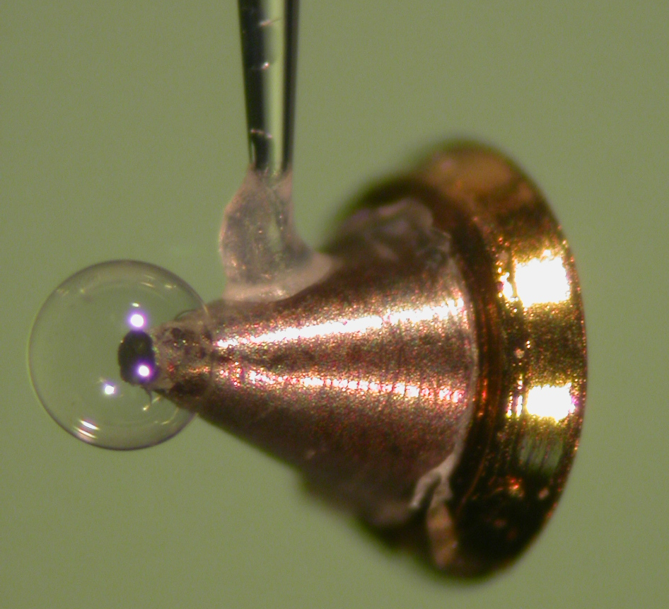
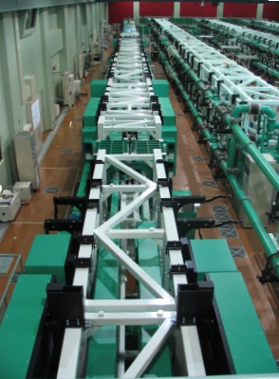

Cone-attached surrogate fuel is
compressed by GEKKO-XII laser and heated by LFEX laser
FIREX: Fast Ignition Realization EXperiment
ILE, Osaka
Compression Laser:
GEKKO-XII
Fusion Fuel
Heating Laser:
LFEX
Beam# 12 beams
Energy 280 J/beams
(2.5 kJ total)
Duration 1.3 ns
(Flat top)
Wavelength 527 nm
Shell
Diameter 500 µm
Thickness 7 µm
Material CD plastic
Solid ball
Diameter 200 µm
Material CD plastic
Cone
Angle 45 deg.
Material Gold or DLC
Beam# 3 beam
Energy 500 J/beam
Duration < 2 ps
Wavelength 1053 nm
Notes:
We have performed integrated experiments of Fast Ignition target by using Gekko-XII for implosion of the shell target, and LFEX for heating.
The target was a plastic shell with a gold cone.

Slide 61
AOPF quencher* and saturable absorber
are introduced to reduce the pedestal intensity.
Reduction of Preformed Plasma
ILE, Osaka
*K. Kondo et al., J. Opt. Soc. Am. B, Vol. 23 (2006).
1st OPCPA
2nd OPCPA
3rd OPCPA
Oscillator System
Saturable absorber
Fiber Osc.
Fiber Amp.
Compressor
Grating Stretcher
Grating Stretcher
*AOPF
Quencher
Pump laser
Pump laser
Pump laser
Notes:
According to these test results, we designed the rear-end sub-system which consists of beam transport optics, 1x4 vertical arrayed pulse compressor, final focusing optics and beam monitoring optics as shown here.

