Slide 1
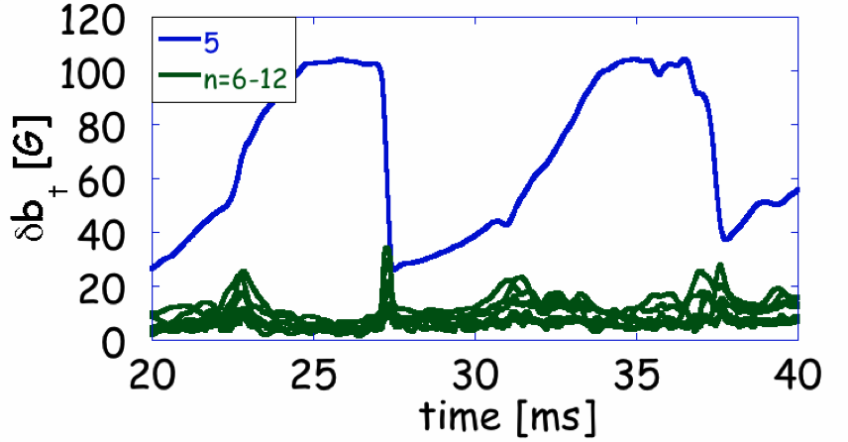
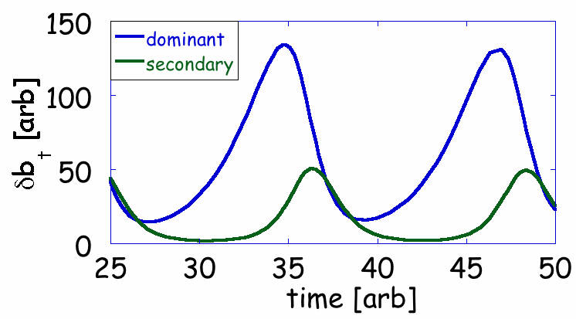
Helical states in the RFP may form due to shear suppression
Experiment
Core mode dominates
secondary modes
eV
Heating during
growth phase
Radius
Theory
10¹⁹ m⁻³
Sustained rise
in density
Radius
kPa
Are there
pressure-limiting
effects?
Radius
Shear from the dominant tearing mode suppresses nonlinear interaction with other modes (akin to L-H transition in Tokamaks)
Time dynamics replicated by a predator-prey model
Time [ms]
A new experimental technique uses an imposed error field to control locking position of structure
Structure can be positioned in alignment with advanced diagnostics to create data ensembles

