Slide 1
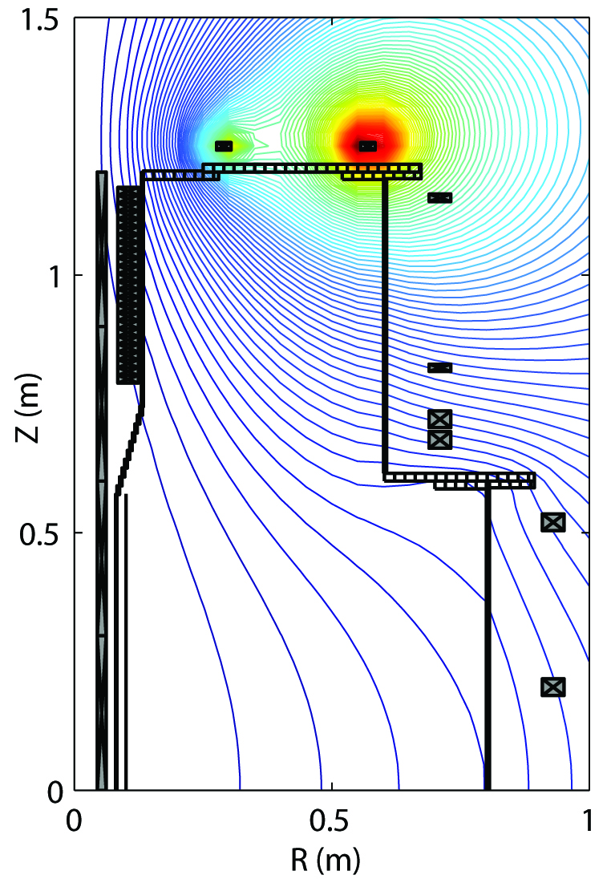
Higher n_{e} and T_{e} by ECH pre-ionization in a Trapped Particle Configuration (TPC), a mirror like configuration that enables trapping of particle by magnetic mirror effect.
ψ contour of Typical TPC in VEST
Radial profiled of n_{e} and Te in TPC, perfect field null with TF only
and typical field null configuration in VEST
The particle confinement time is experimentally estimated to be ~3 ms for TPC, ~1 ms for perfect field null with TF only and <0.4 ms for typical field null configuration in VEST.
Efficient plasma start-up with reduced volt-second consumption is possible with ECH pre-ionization by forming TPC saving ~40 % of volt-second required without TPC though connection length and E_{t}∙B_{t}/B_{p} reduces.
I_{p} and V_{loop} in discharges
with and without TPC
Connection length and E_{t}•B_{t}/B_{p}
in discharge with and without TPC
Plasma current and estimated volt-second provided by CS (left) with TPC and (right) without TPC

