Slide 1





Core microturbulence and edge MHD interplay and stabilization by fast ions in tokamak confined plasmas
J. Garcia¹, J. Citrin^{1,2}, T. Görler³, N. Hayashi⁴, F. Jenko³, P. Maget¹, P. Mantica⁵, M.J. Pueschel⁶, D. Told³, C. Bourdelle¹, R. Dumont¹, G. Giruzzi¹, G.M.D. Hogeweij², S. Ide⁴, T. Johnson⁷, H. Urano⁴, the JT-60U Team and JET contributors∗
JET-EFDA, Culham Science Centre, Abingdon, OX14 3DB, UK
1CEA, IRFM, F-13108 Saint-Paul-lez-Durance, France.
2FOM Institute DIFFER – Dutch Institute for Fundamental Energy Research - Association EURATOM-FOM, Nieuwegein, The Netherlands
3Max Planck Institute for Plasma Physics, Boltzmannstr. 2, 85748 Garching, Germany
4Japan Atomic Energy Agency, Mukouyama, Naka City, Ibaraki, 311-0193 Japan
5Istituto di Fisica del Plasma “P. Caldirola”, Associazione Euratom-ENEA-CNR,Milano, Italy
6University of Wisconsin-Madison, Madison, Wisconsin 53706, USA
7Euratom-VR Association, EES, KTH, Stockholm, Sweden
25th Fusion Energy Conference, Saint Petersburg, Russia

Slide 2
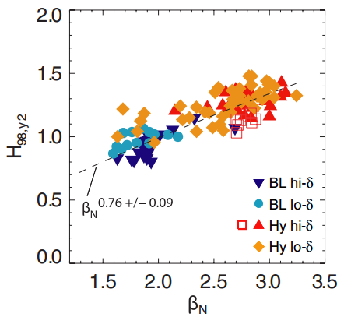
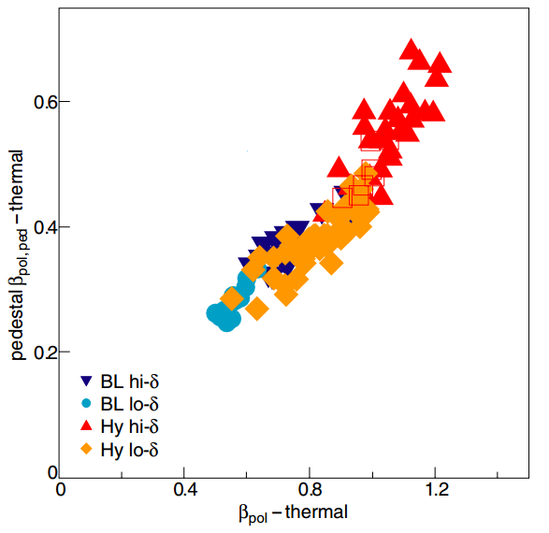
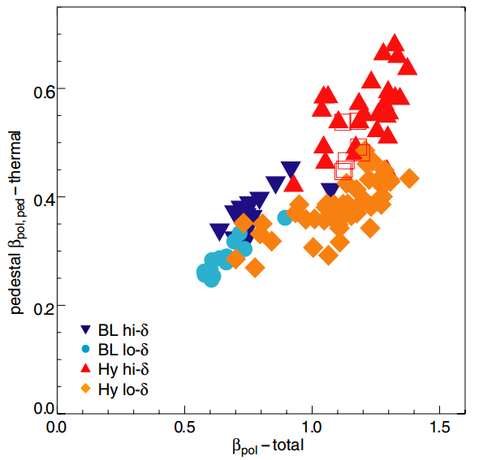
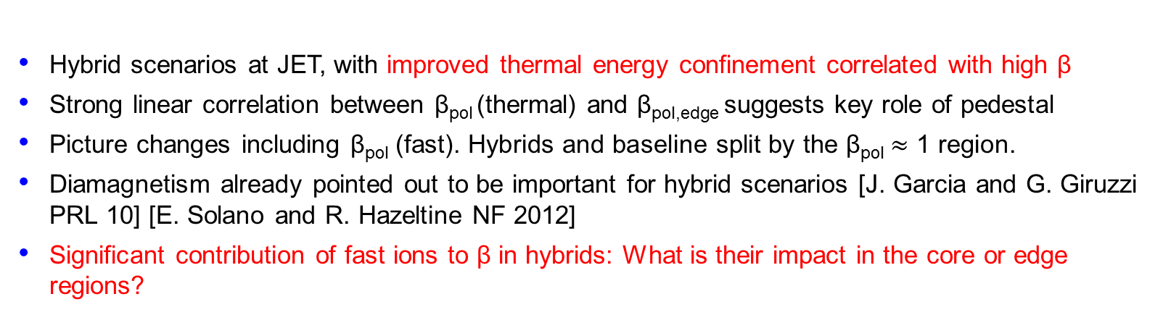
Motivation: High thermal energy confinement in the presence of high β
Pedestal β_{pol}-thermal
Pedestal β_{pol}-thermal
M.N.A. Beurskens et al., NF 2013
Hybrid scenarios at JET, with improved thermal energy confinement correlated with high β
Strong linear correlation between β_{pol} (thermal) and β_{pol,edge} suggests key role of pedestal
Picture changes including $\text{β}\text{pol} \text{(}\text{fast}\text{)}\text{. }\text{Hybrids} \text{and} \text{baseline} \text{split} \text{by} \text{the} \text{β}\text{pol}≈\text{1 }\text{region}\text{. }$
Diamagnetism already pointed out to be important for hybrid scenarios [J. Garcia and G. Giruzzi PRL 10] [E. Solano and R. Hazeltine NF 2012]
Significant contribution of fast ions to β in hybrids: What is their impact in the core or edge regions?
β_{pol}-total
β_{pol}-thermal

Slide 3
Outline
Tools and discharges used
Impact of fast ions on microturbulence of JET hybrid regimes: Reduction of ITG turbulence
Analysis of the physical mechanisms: Electromagnetic effects and pressure gradients important at high β
Impact of fast ions on the pedestal pressure: Pedestal improvement and core-edge coupling through fast ions
Extrapolation to ITER
Conclusions

Slide 4
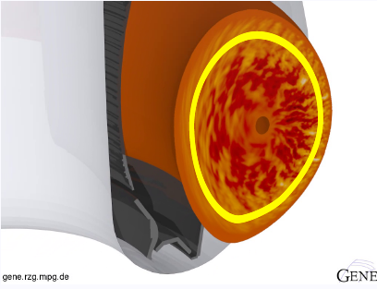

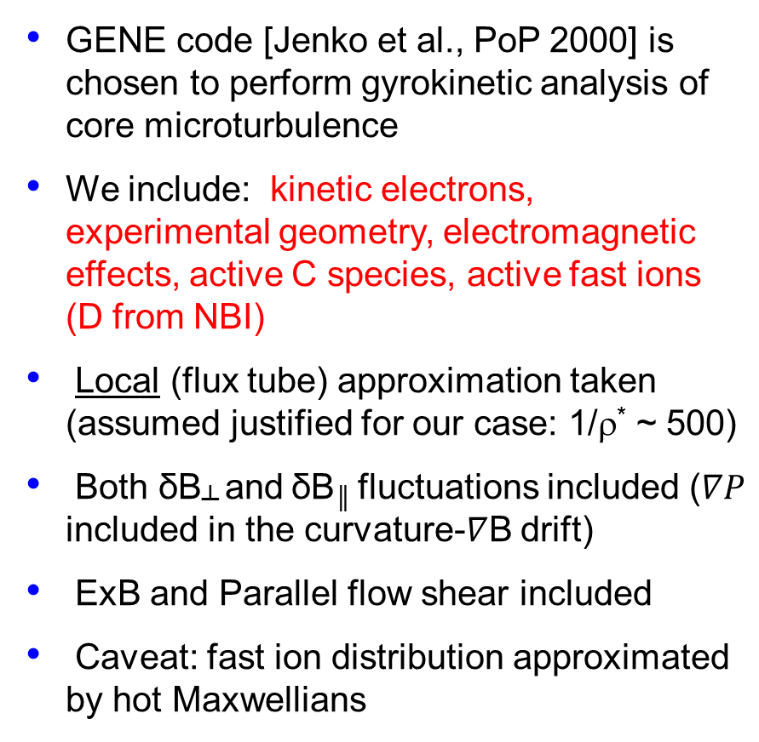
Choice of assumptions
GENE code [Jenko et al., PoP 2000] is chosen to perform gyrokinetic analysis of core microturbulence
We include: kinetic electrons, experimental geometry, electromagnetic effects, active C species, active fast ions (D from NBI)
Local (flux tube) approximation taken (assumed justified for our case: 1/ρ* ~ 500)
Both δB┴ and δB║ fluctuations included ($∇P$ included in the curvature-$∇$B drift)
ExB and Parallel flow shear included
Caveat: fast ion distribution approximated by hot Maxwellians

Slide 5
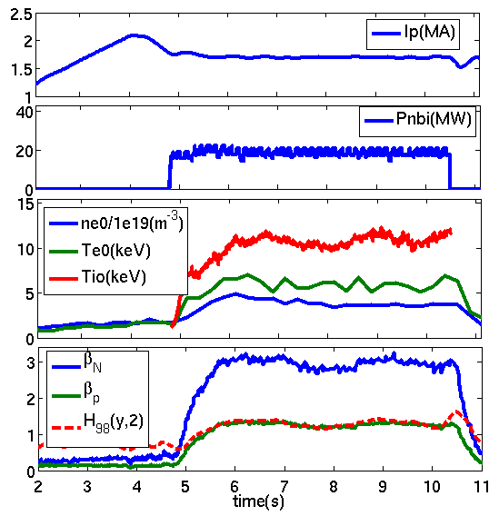
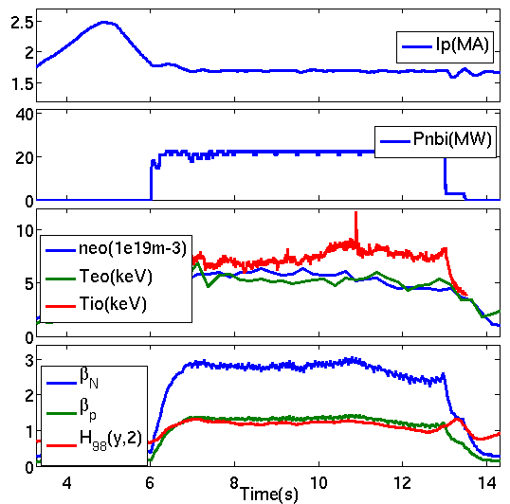
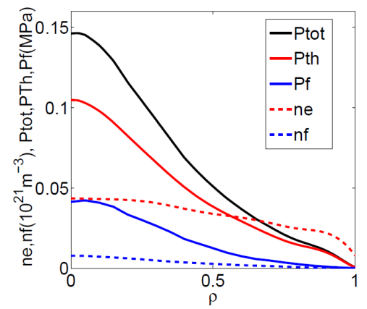
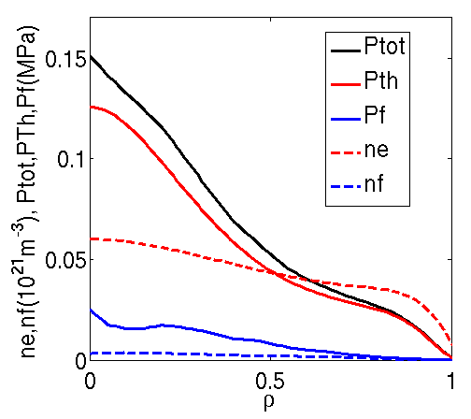
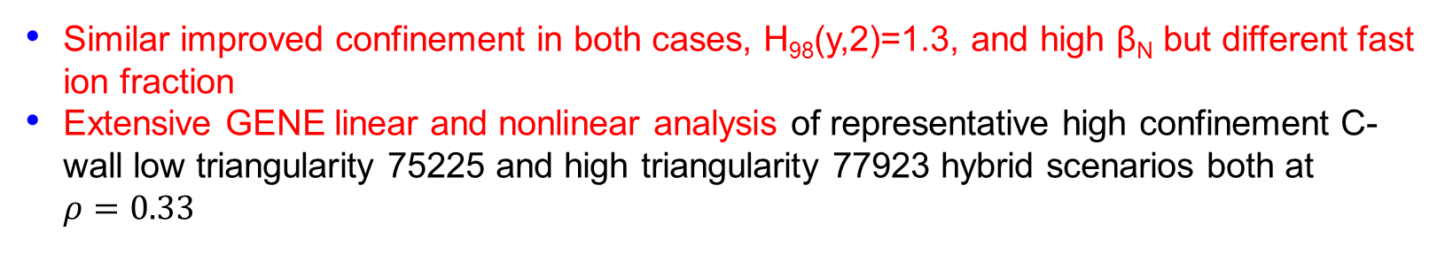
Discharges selected
75225 Low δ
77923 High δ
J.Hobirk PPCF 2012
J. Garcia and G. Giruzzi Nucl. Fusion 2013
Similar improved confinement in both cases, H₉₈(y,2)=1.3, and high β_{N} but different fast ion fraction
Extensive GENE linear and nonlinear analysis of representative high confinement C-wall low triangularity 75225 and high triangularity 77923 hybrid scenarios both at $ρ=0.33$

Slide 6
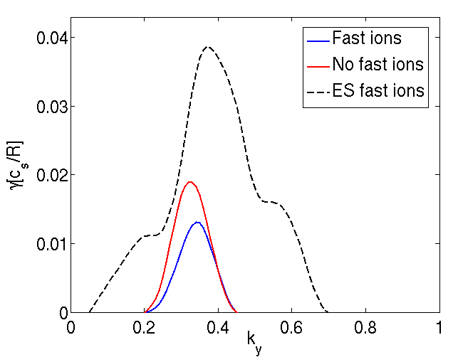
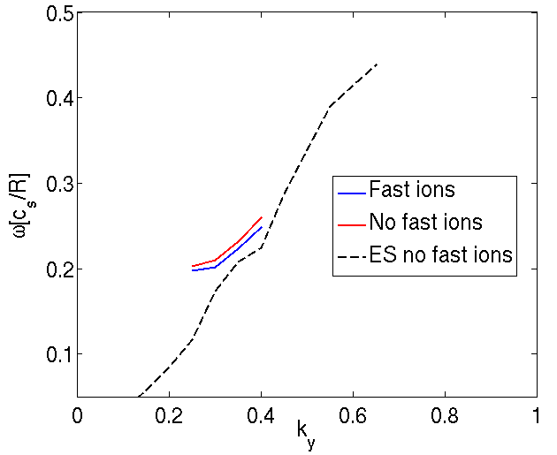
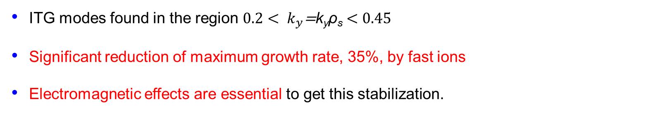
Linear study in inner half-radius: High δ case
Linear spectra of JET high δ hybrid scenario at $ρ=0.33$
ITG modes found in the region $0.2< k_{y}\text{=}\text{k}\text{y}\text{ρ}\text{s}<0.45$
Significant reduction of maximum growth rate, 35%, by fast ions
Electromagnetic effects are essential to get this stabilization.

Slide 7
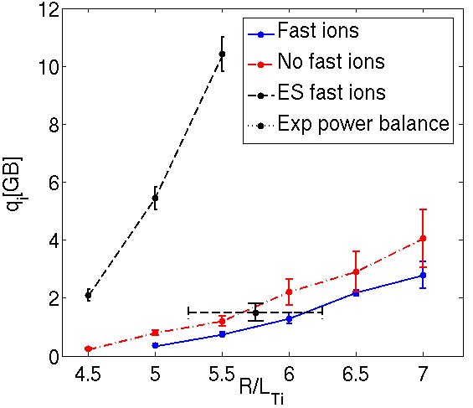
Nonlinear study in inner half-radius: High δ case
GENE nonlinear simulation of JET high δ @ ρ=0.33. 4 ion species, finite-β, collisions, real geometry, rotation
  Fast ion impact significant, 10% increase of R/L_{Ti} for the same heat flux.
  EM-effects are a key factor in reaching power balance fluxes. Main effect is stiffness reduction.
  Heat flux reduction at constant R/L_{Ti} is stronger than linear reduction
  Extraordinary agreement between experimental and calculated fluxes.

Slide 8
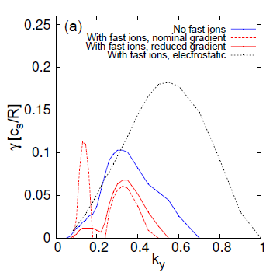
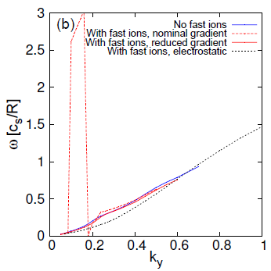
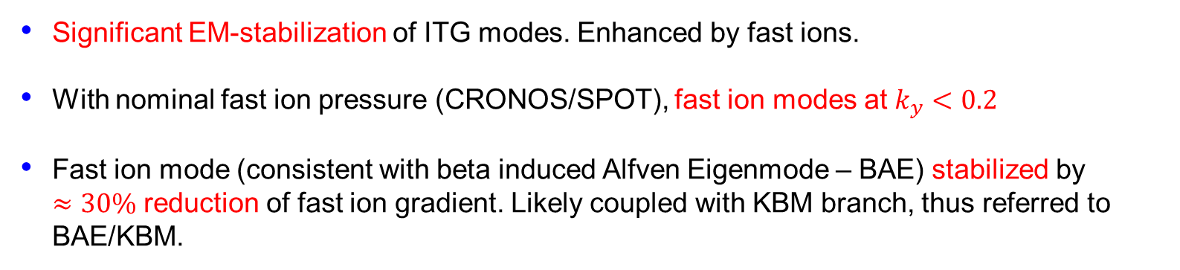
Linear study in inner half-radius: Low δ case
Linear spectra of low δ hybrid scenario at $ρ=0.33$
Significant EM-stabilization of ITG modes. Enhanced by fast ions.
With nominal fast ion pressure (CRONOS/SPOT), fast ion modes at $k_{y}<0.2$
Fast ion mode (consistent with beta induced Alfven Eigenmode – BAE) stabilized by $≈30\%$ reduction of fast ion gradient. Likely coupled with KBM branch, thus referred to BAE/KBM.

Slide 9
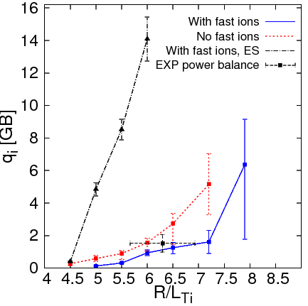
Nonlinear study in inner half-radius: Low δ case
GENE nonlinear simulation of low δ @ ρ=0.33. 4 ion species, finite-β, collisions, real geometry, rotation
  Fast ion effects stronger than previous discharge: 10-20% increase of R/L_{Ti} for the same heat flux
  Only fast ions change the threshold
  EM-effects + fast ions are key factor for obtaining experimental heat fluxes
  Fluxes calculated with reduced fast ion pressure gradient.
  Fast ion transport necessary

Slide 10
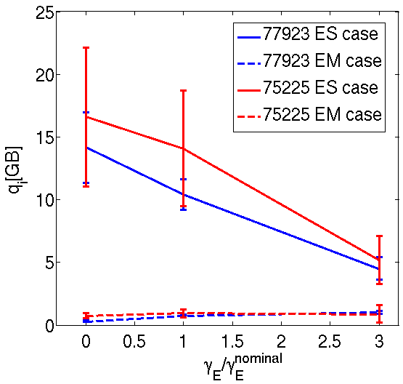
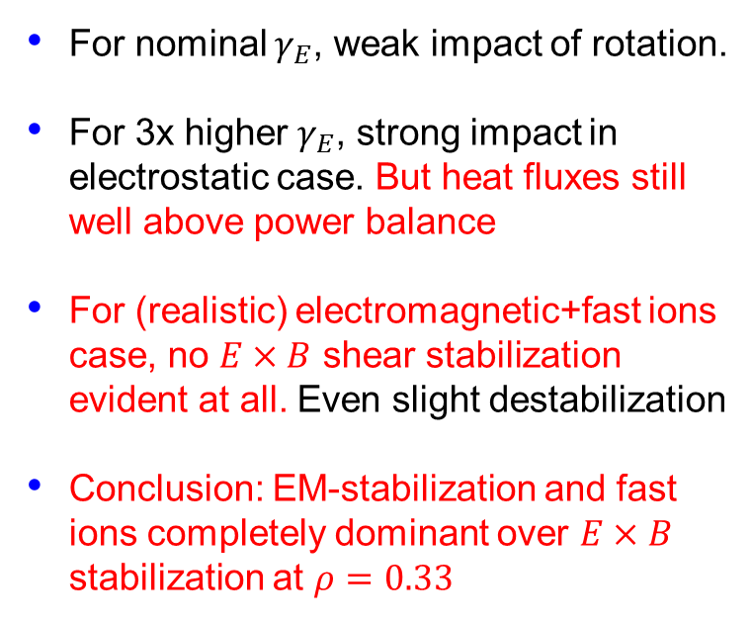
Flow shear stabilization ineffective at inner half-radius
For nominal $γ_{E}$, weak impact of rotation.
For 3x higher $γ_{E}$, strong impact in electrostatic case. But heat fluxes still well above power balance
For (realistic) electromagnetic+fast ions case, no $E×B$ shear stabilization evident at all. Even slight destabilization
Conclusion: EM-stabilization and fast ions completely dominant over $E×B$ stabilization at $ρ=0.33$

Slide 11
Other (non-EM) fast ion stabilization mechanisms of ITG are less important
Fast ions can stabilise ITG turbulence through 3 general mechanisms
Dilution of main ion species (e.g. Tardini NF 2007)
Geometric effect: increased Shafranov shift due to suprathermal pressure which alters
drift frequencies and stabilises ITG at low magnetic shear (e.g. Bourdelle NF 2005)
The 3rd stabilizing effect is key in these discharges
Stabilization by electromagnetic effects.
  ANY pressure gradient stabilizes ITG turbulence in electromagnetic simulations.
  Fast ions provide a net source of pressure gradient as they do not contribute to ITG turbulence
  Has been analyzed linearly for JET discharges [M.Romanelli PPCF 2011].
  Nonlinear electromagnetic stabilization is greater than the linear stabilization [J. Citrin PRL 2013]
These 2 effects do not dominate in these discharges following dedicated checks

Slide 12
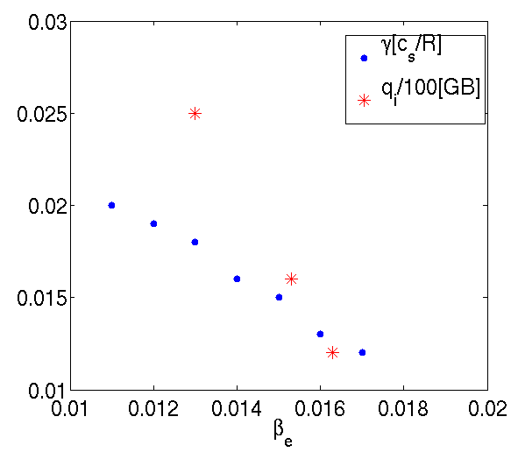
Linear vs non-linear stabilization in hybrid scenarios
High δ
EM stabilization stronger non linearly: higher ion heat flux reduction with β_{e} than growth rate reduction
This has been linked with an increase in zonal flow impact (Pueschel et al., PoP 2008, 2010, 2013)
Further analysis will be performed and inclusion in quasi-linear models required

Slide 13
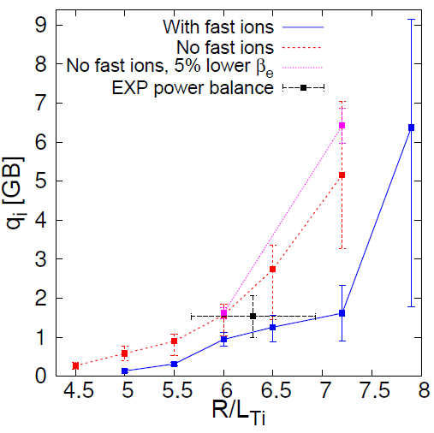
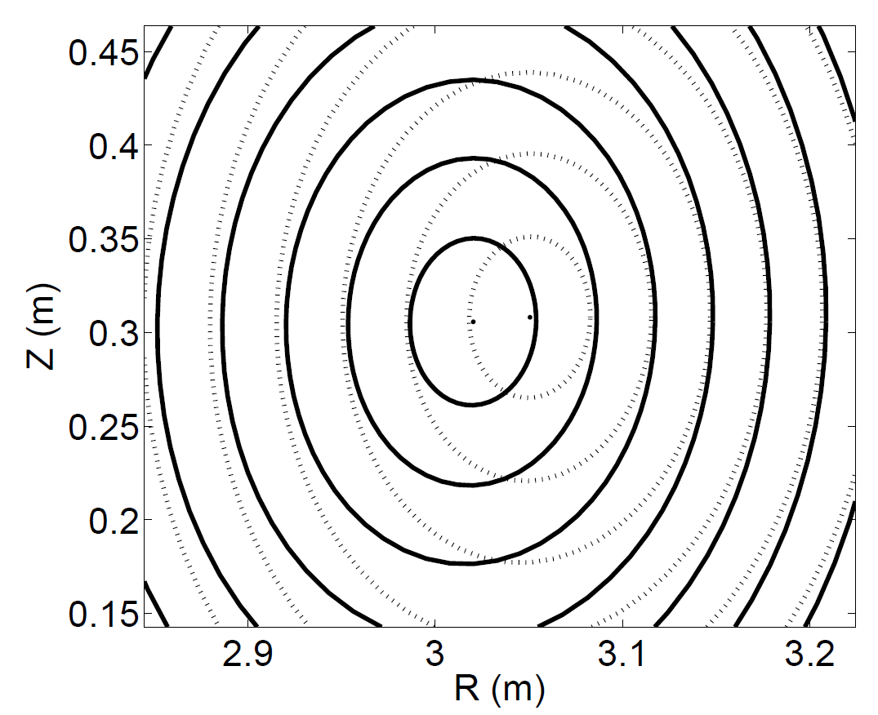
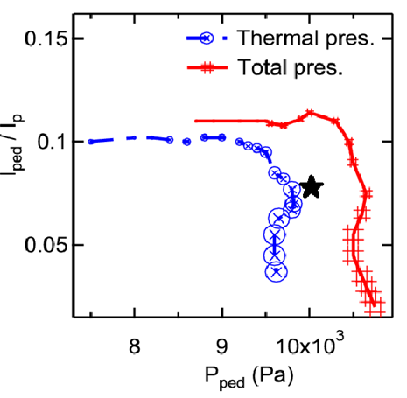
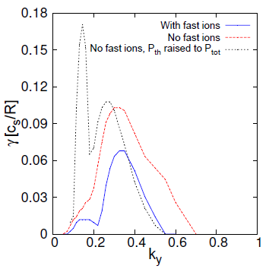
Edge analysis low δ
  Peeling Ballooning analysis performed with the MISHKA code for low δ
  The extra β_{fast} provided by the fast ions, β_{N,th}=2.13 β_{N}=2.9, expands the stable region by 10% through Shafranov-shift
  Alternative linear run: Fast ions pressure is removed and temperature gradients increased to match P_{thermal}=P_{tot} : Growth rates highly increased
  Core-edge coupling by fast ions through plasma stiffness
  Other mechanisms for core and edge interplay: C. Challis this conference EX/9-3, R. Cesario et al. PPCF (2013)

Slide 14
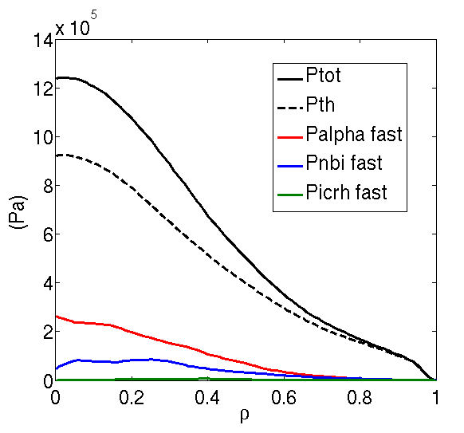
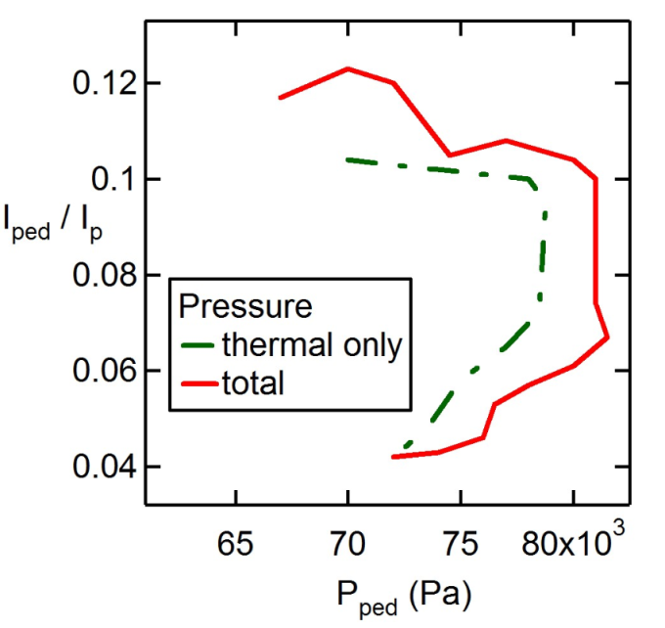
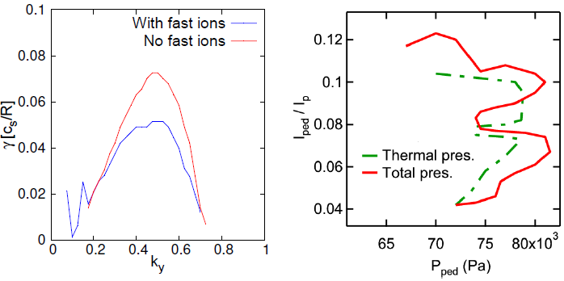
Extrapolation to ITER
  Same analysis performed to the ITER hybrid scenario [K Besseghir, J Garcia PPFC 2013]
  Fast ions from alphas and beams highly contribute to β and β’ due to their high energy
  Maximum ITG linear growth rate reduced by 30%
  The stable pedestal boundary is also expanded by 10%
  Core and edge improvement in ITER expected to be of the same level as JET

Slide 15
Conclusions
  Fast ions and electromagnetic effects are key ingredients for understanding ITG turbulence reduction
  These effects are essential for describing high beta plasmas
  Fast ions increase total 𝛽′ and 𝛽 in system, and thus more EM-stabilization in the core and more edge pressure while not adding to the ITG drive.
  Concept of “free 𝛽” (as long as below BAE/KBM mode limit)
  Core-edge coupling due to fast ions is a solid mechanism for improved confinement: more efficient at high power!
  Unlike ExB shear, this effect could explain core improved confinement in JET hybrid scenarios
  The impact on ITER hybrid expected to be of the same level as on JET
  Good scaling for Tokamak reactors!

Slide 17
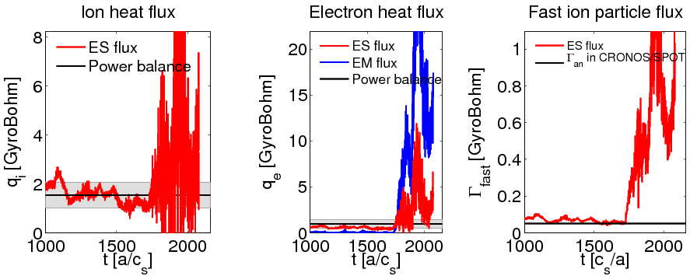
With fast ion mode in NL simulation, fluxes far above power balance levels
What happens nonlinearly if we allow the BAE/KBM mode to be unstable?
Phase 1
Phase 2
Phase 1: With 30% reduced fast ion pressure (no BAE/KBM mode)
Phase 2: increase to nominal fast ion pressure and restart simulation
System with fast ion mode has fluxes clearly above power balance values. Limit cycles? Robustly maintained below limit? Needs further study.
Supports use of a “stiff” fast ion transport model in reduced modelling frameworks

Slide 18
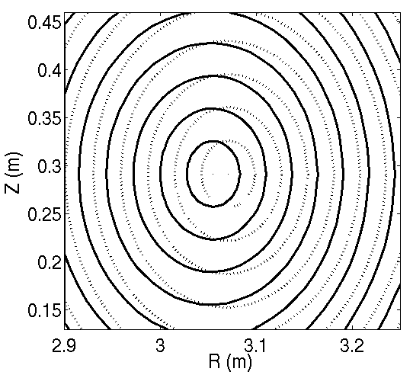
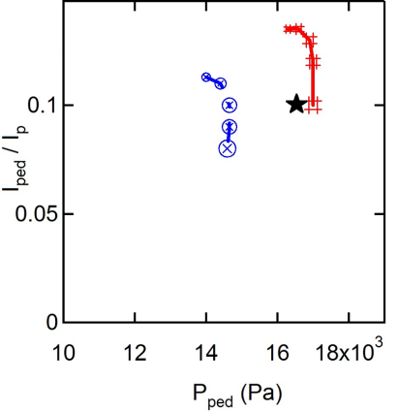
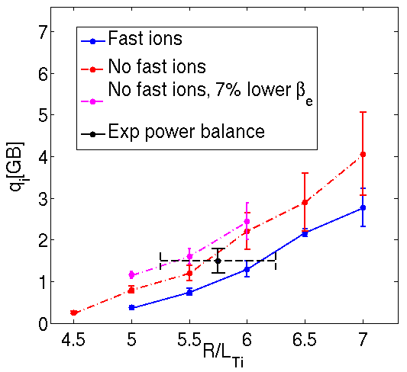
Edge analysis high δ
  Peeling Ballooning analysis performed for high δ discharge
  Lower contribution of fast ions than for low δ, β_{N,th}=2.46 β_{N}=2.8.
  However, larger boundary region expansion, by 14%
  Triangularity critically changes the impact of fast ions: from mostly in the core to mostly at the edge.

