Slide 1

Summary: EXS, EXW, ICC
Abhijit Sen
25th IAEA Fusion Energy Conference
St. Petersburg, 13-18 October, 2014
Thanks to all authors and overview speakers who sent slides
Special thanks to C. Greenfield, P. Kaw, H. Yamada
Notes:
Chuck: Many of your “concluding remarks on…” slides contain redundant information – I suggest removing them since I don’t think they add anything.

Slide 2
Outline
Topic Number of Papers
Magnetic Confinement Expts: Stability (EXS) 56
Magnetic Confinement Expts: Waves (EXW) 54
Innovative Confinement Concepts (ICC) 15
Subtopics for EXS & EXW (guided by ITER priority needs)
  Disruptions/Runaways (control, mitigation, prediction)
  ELMS (control, mitigation) & 3D physics
  Waves and Energetic Particles
  MHD instabilities (nonlinear interactions, control)
  Current Drive & RF Heating

Slide 3
Disruptions / Runaways – a major concern for
ITER operation
Main Issues
EX/P3-18, Campbell
Uncertainties associated with disruption loads that can impact the
structural integrity of the machine
How to limit the number of disruptions to protect machine life
  Disruption avoidance /control
  Disruption prediction
Need for a reliable disruption mitigation system (thermal, current and
runaway mitigation) – input required before final design review 2017
Many gaps in physics basis and a lack of fundamental understanding
Notes:
Chuck: If this is taken verbatim from Campbell's presentation I wouldn't change it. Otherwise I would consider breaking out runaway electron suppression as a separate issue, since it is the one DMS area ITER still says is unresolved. The JET disruption talk and Nick Eidietis' DIII-D talk both addressed it.

Slide 4
Disruption Research has Increased and Become
More Focused since the 2012 FEC
Prediction and avoidance
  Both empirical and theory-based
  Halo currents – measurements and modeling
  Exploration of various techniques for disruption avoidance
Characterization
  Enlarged experimental database + modeling has led to improved understanding
  Asymmetric events – causes and consequences
Mitigation and control
  Thermal/current quench mitigation experiments
  Runaway generation and control
ITPA has played a major role in coordinating and contributing towards joint experimental + modeling activities
Notes:
Chuck: I reorganized this slide and reordered the following section accordingly
NOTE THAT I DON’T SEE ANYTHING ABOUT HALO CURRENTS IN YOUR SLIDES

Slide 5
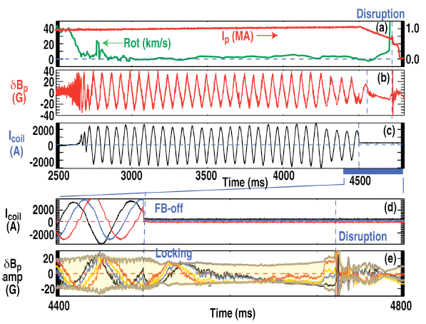
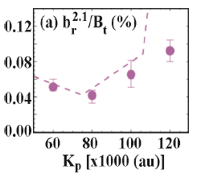
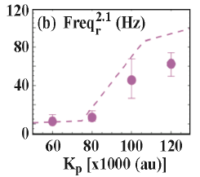
Disruption Avoidance / Control
EX/P2-42, Okabayashi
Avoidance of tearing mode locking and disruption with electro-magnetic torque
introduced by feedback-based mode rotation control in DIII-D and RFX-mod
RFX
DIII-D

Slide 6
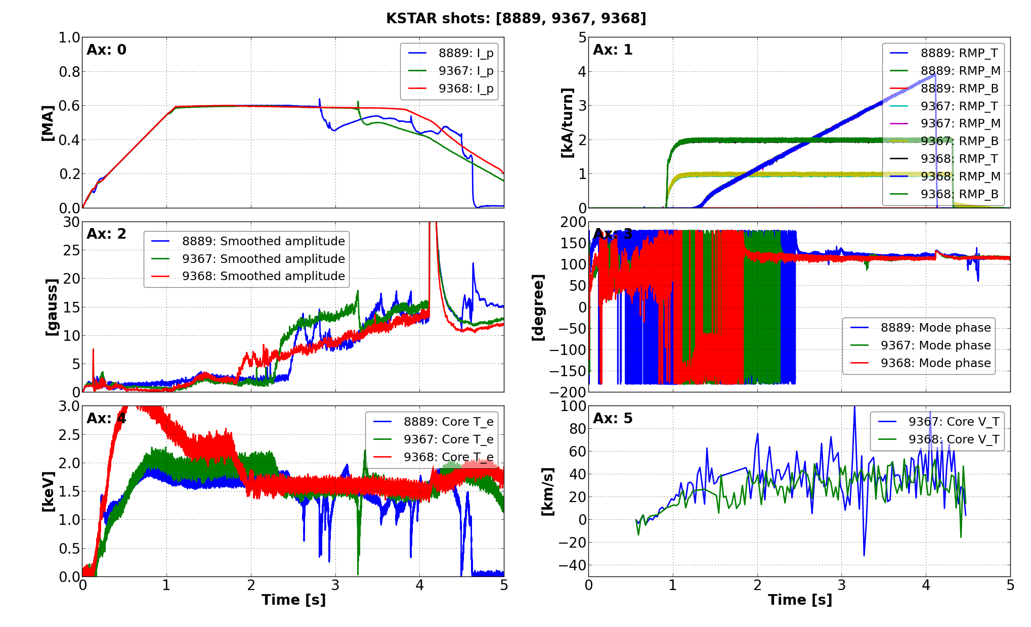
Plasma is less susceptible to minor disruption of n=1 locked mode under stronger n=2 even field.
Early disruption
#8889 (no n=2) > #9367 (n=2, 1 kA/t) > #9368 (n=2, 2 kA/t)
No disruption
KSTAR
Slide-away
Relative change
Notes:
This slide is a punch line of this talk.
In n=2 even configuration, plasma is less susceptible to disruption under stronger n=2 field.
n=2 1 kA/t case delays disruption when compared to pure n=1 case.
Furthermore, in n=2 2 kA/t case, disruption does not take place.

Slide 7
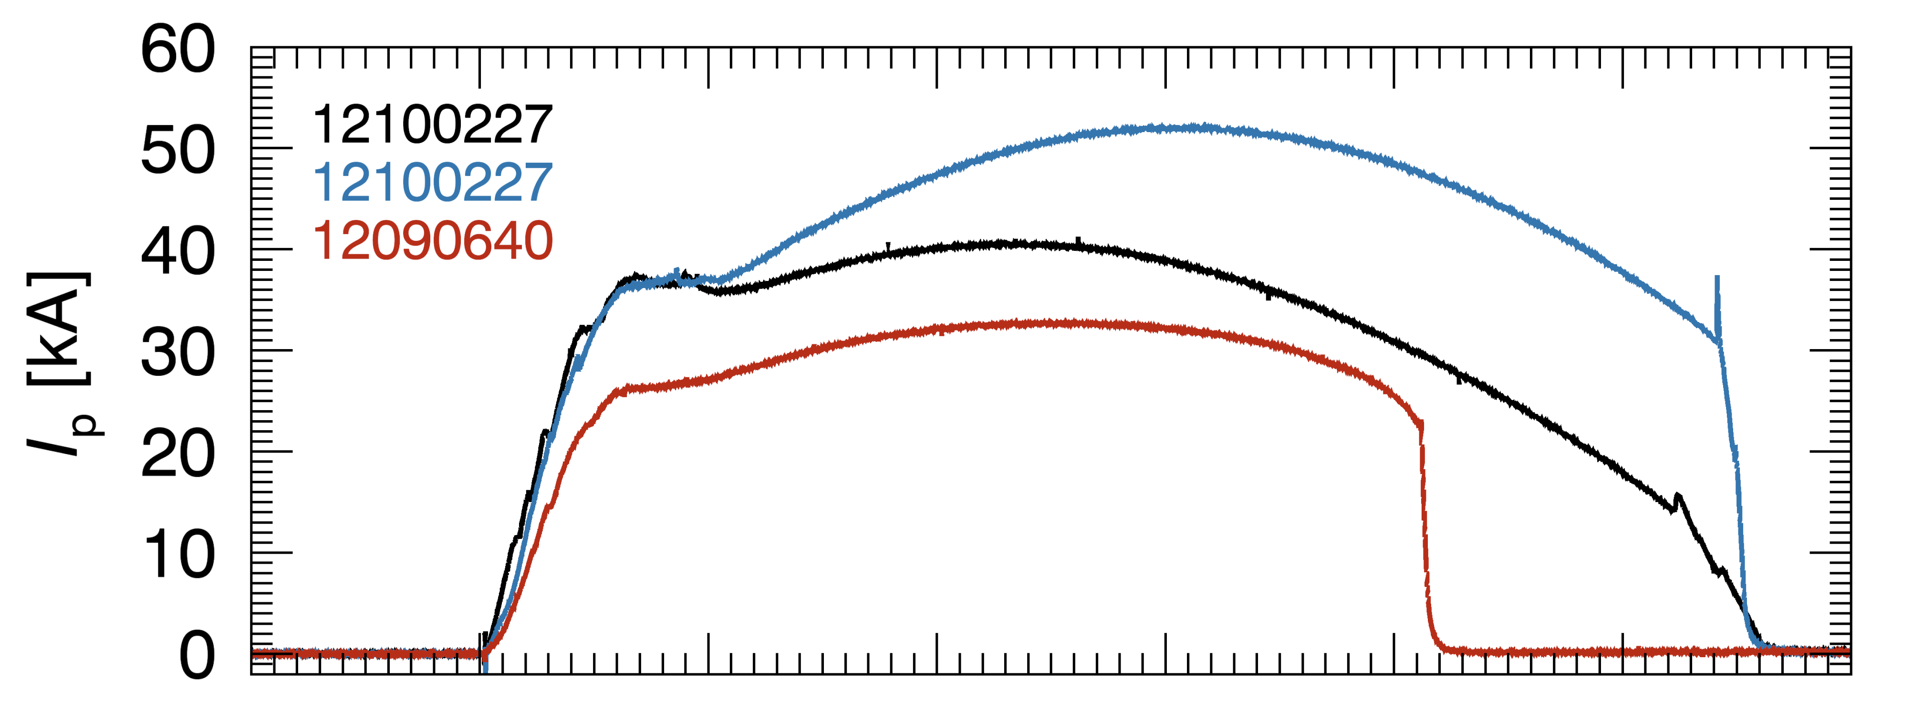
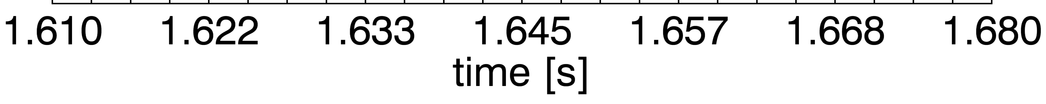
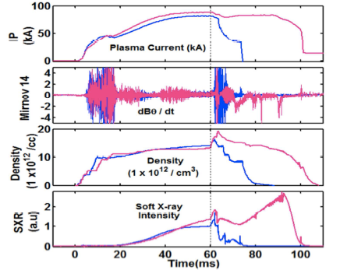
Disruption Avoidance / Control
EX/P4-18, Maurer
Strong 3D equilibrium shaping, applied
to tokamak like discharges on the
Compact Toroidal Hybrid (CTH)
expand its disruption free operating
regime
EX/5-3, Tanna; EX/P7-16, Kulkarni;
EX/P7-17, Dhyani
Disruption control using biased electrodes
in ADITYA tokamak to control MHD modes
Similar effects also observed with the use
of ICRF at the edge

Slide 8
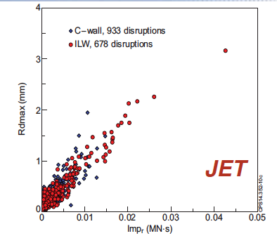
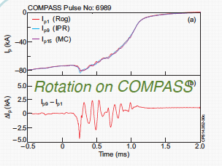
Asymmetrical Disruptions in JET and COMPASS
P5-33, Gerasimov
Highlights the frequent occurrence of asymmetric disruptions
in JET and the magnitude of their consequent sideways forces
Resonance rotation with the natural vessel frequencies
3D JET model calculations for vessel poloidal currents
Comparison with COMPASS data – consistency in terms of
amplitude of asymmetry and rotation behaviour

Slide 9
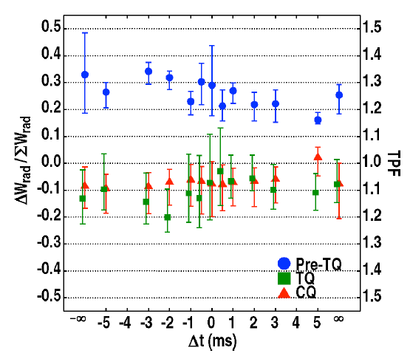
Thermal and Current Quench Mitigation
EX/P2-22, Eidietis
Measurement of Radiated Power Asymmetry During Disruption
Mitigation on the DIII-D Tokamak
radiation asymmetry during the thermal quench (TQ) and current quench (CQ) is
largely insensitive to the number or location of injection sites
application of an n=1 error field can
modify the magnitude of the asymmetry
during the TQ, supporting recent modeling
results that indicate n=1 MHD during the
TQ may be a cause of the radiation
Asymmetry
results provide a firmer understanding
of the 3D physics affecting the ITER
DMS design
Notes:
Chuck: I just changed the title

Slide 10
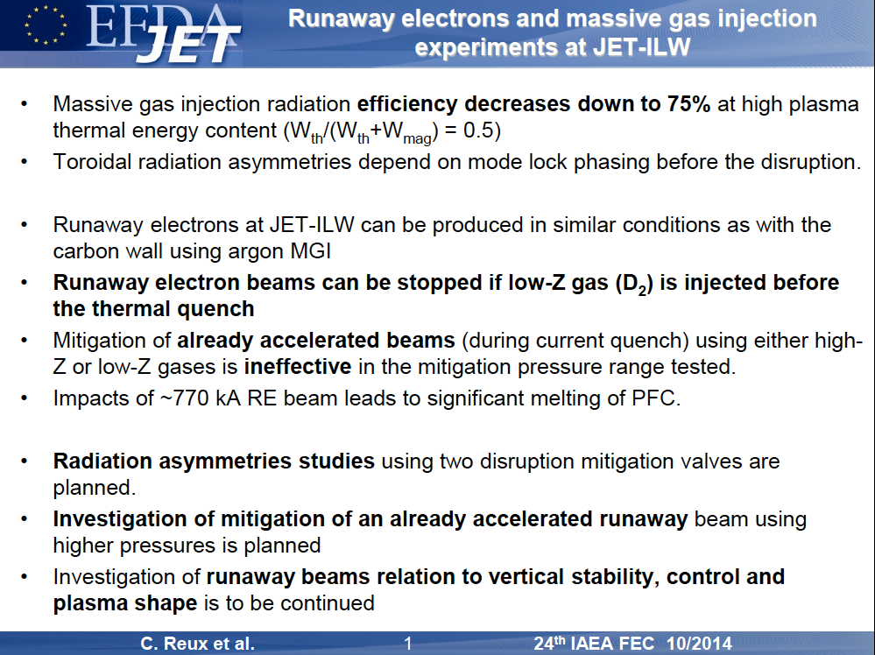
EX/5-2, Reux

Slide 11
Runaway electron beams stopped only by low-Z gas injected before current quench
EX/5-2, Reux
Notes:
Chuck: Same as previous slide with yellow overlay

Slide 12
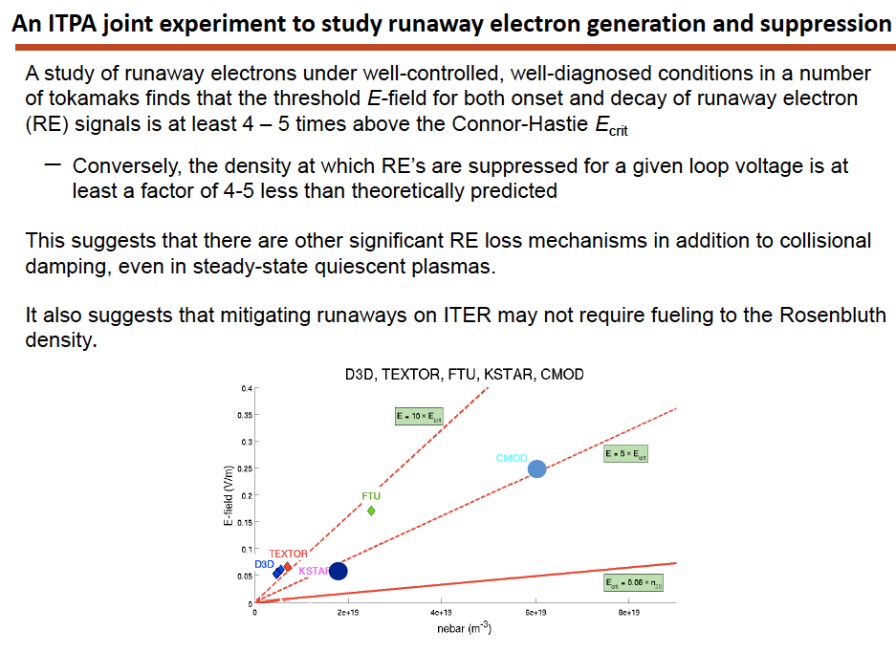
Runaway Generation / Control
EX/5-1, Granetz
Notes:
Chuck: Since this is Bob Granetz’s summary slide (I checked), I think we should just leave it alone.

Slide 13
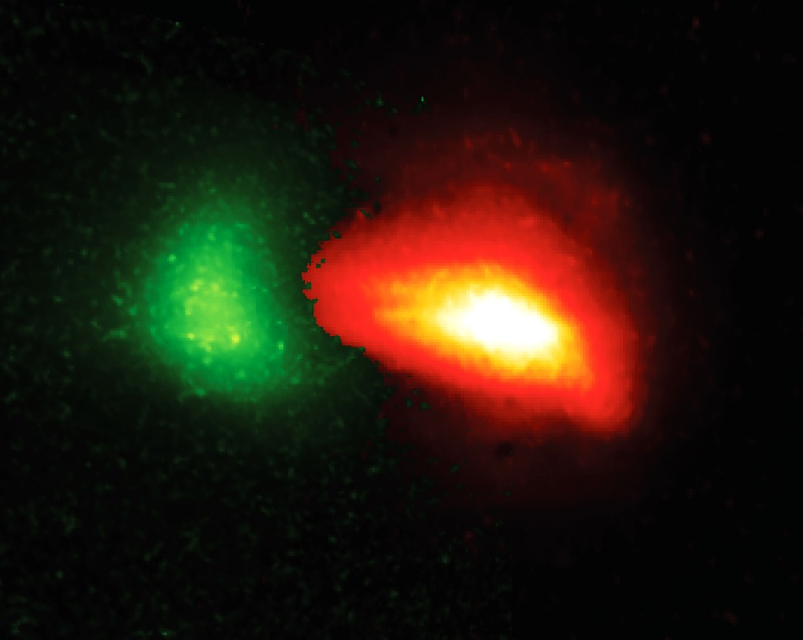
DIII-D Expt on RE Mitigation using SPI
Ne SPI impacts
at RE edge
Injection of Ne Shattered Pellets
into early CQ is effective in suppressing runaway growth
RE current dissipation explained
by RE-ion pitch angle scattering
  Higher Z more effective
  at RE dissipation
RE
Seed
RE seed in core
EX/PD/1-1, Eidietis

Slide 14
ELMS – Characterization / Mitigation / Suppression
Progress since 2012 FEC
RMP ELM mitigation and suppression of Type I ELMs
  Expanded operating space
  Shown to be robust to loss of coils (reassuring for ITER)
Alternate external suppression methods appear promising
  Pellet pacing, SMBI, gas injection, LHW,…
Improved understanding of ELM dynamics from better diagnostic measurements and modeling studies – also some challenges
Notes:
Chuck: reorganized for clarity

Slide 15
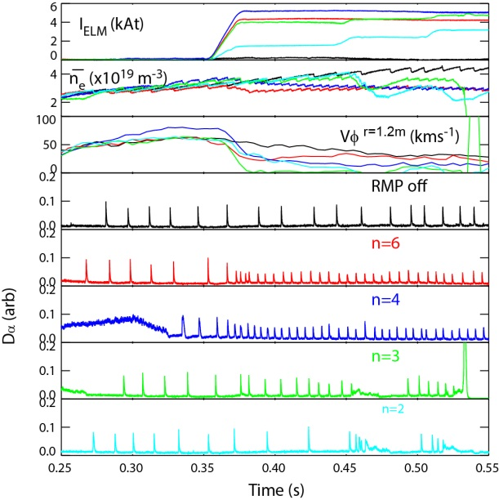
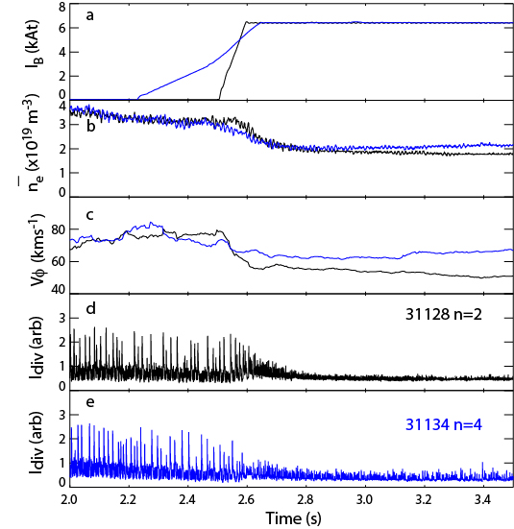
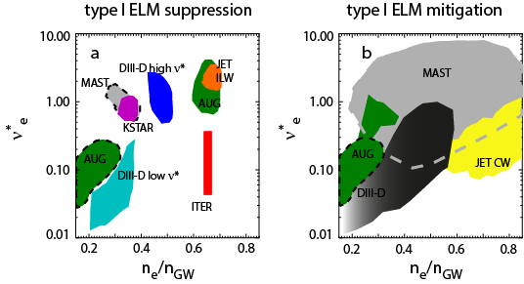
Expanded Operating Space on ELMs on MAST and AUGEEE
EX/1-2, Kirk
MAST
AUG
Sustained ELM mitigation/type I ELM suppression has been achieved on MAST and AUG with magnetic perturbations with a range of toroidal mode numbers
ELM size and target heat loads are reduced but at a price of a reduction in confinement
Dashed curves expanded operating space for the type I ELM suppression/mitigation from MAST and ASDEX Upgrade
Results show that regimes with tolerable ELMs can be established over a wide operating space in a range of devices

Slide 16
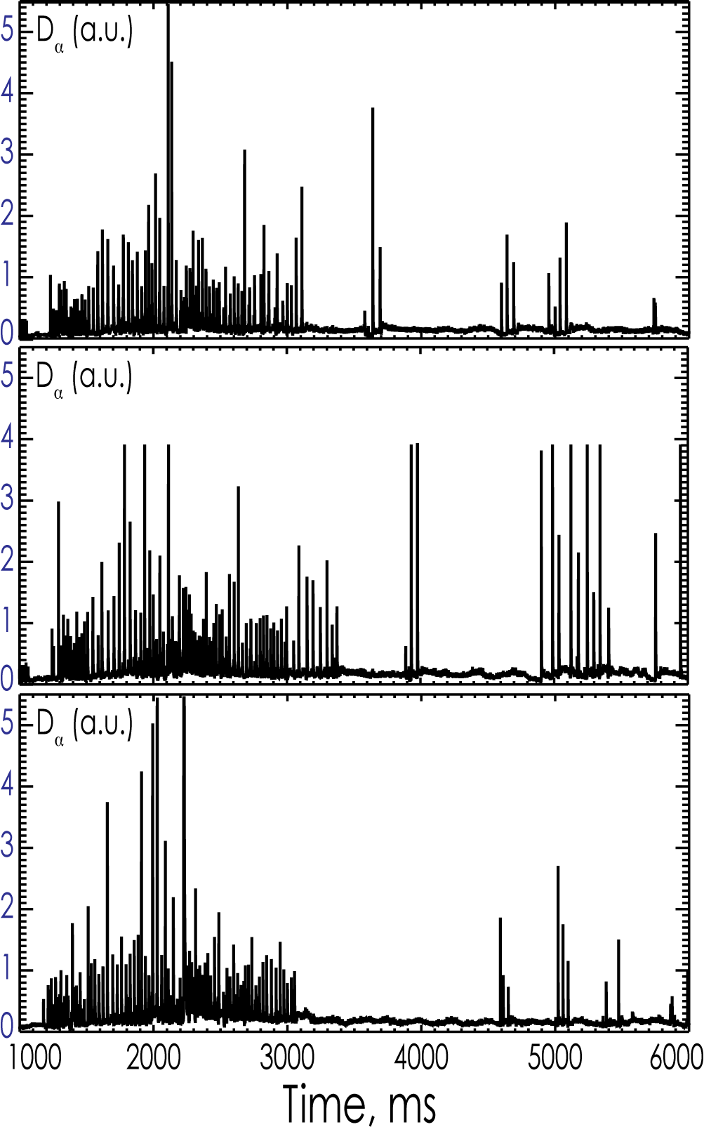
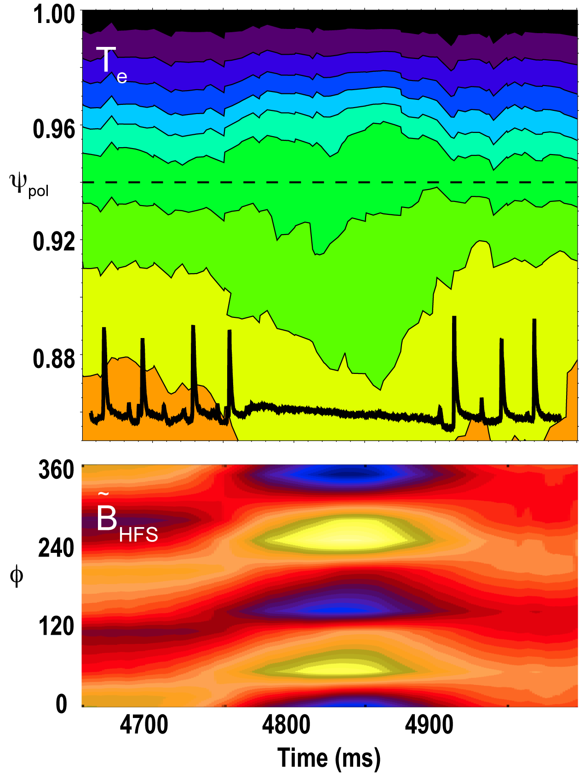
Advances in Basic Understanding of ELM Suppression
ELM suppression achieved with as few as 5 internal coils
New data reveals bifurcation indicative of resonant field penetration at ELM suppression
5 coils
7 coils
11 coils
DIII-D results
Highlights importance of plasma response to RMP fields
EX/1-1, Wade; EX/P2-21, Orlov
Notes:
3D fields drive tearing at pedestal top to restrict its width → Prevents ELM instability
Vary n=2 field structure from kink to pitch-aligned resonance
Two distinct ideal MHD plasma modes
Ramp from exciting one to the other
Penetration of pitch-aligned field
ω_{e |} →0 at pedestal top
Pedestal width narrows
Transition to ELM suppression
Flattens pedestal temperature
Non-linear growth of pitch
aligned response
Validates 2-fluid MHD predictions of
island formation & overlap (M3D-C1)

Slide 17
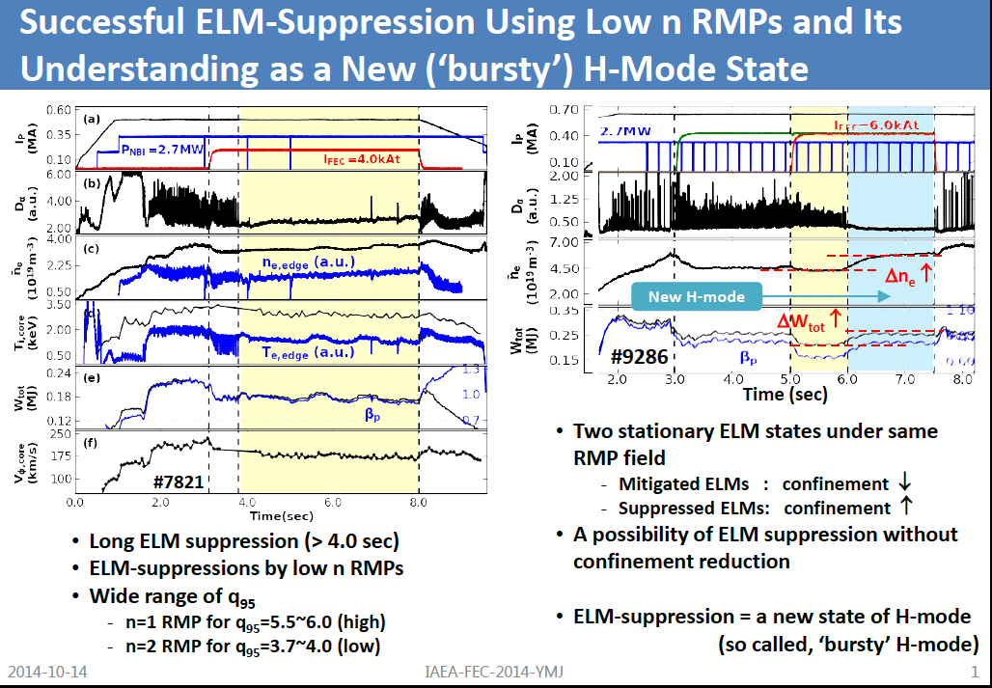
EX/1-5, Jeon
KSTAR

Slide 18
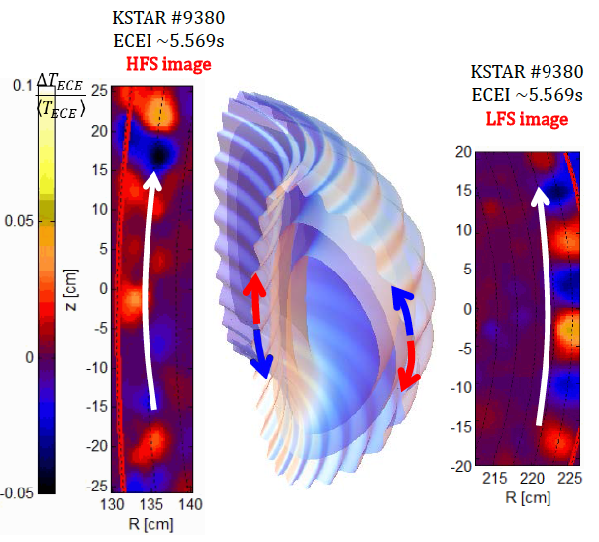
Simultaneous Measurement of ELMs at both High
and Low Field Sides in KSTAR
Comparable mode strength at HFS
and LFS
Asymmetries in toroidal/poloidal
rotation velocities
Mode structure at HFS not consistent
with Ballooning Mode model
Mode numbers different on the two
sides
EX/8-1, Park

Slide 19
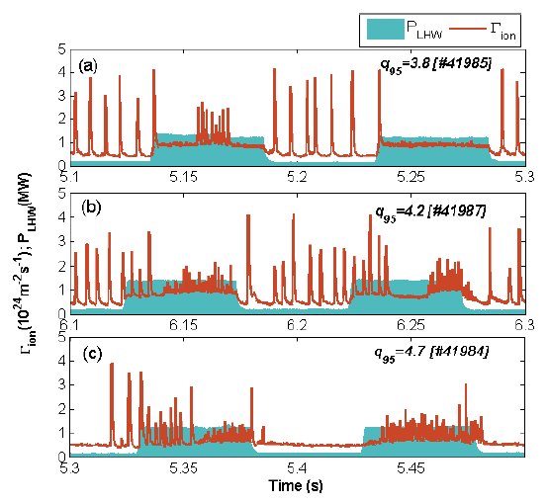
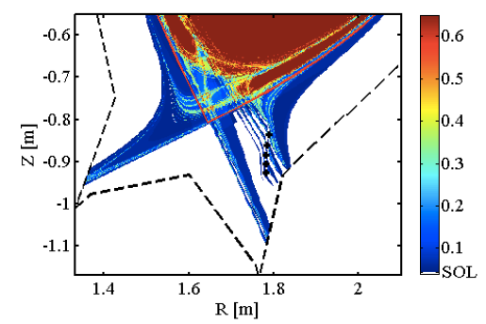
ELM mitigation by Lower Hybrid Waves in EAST
EX/P3-8, Liang
ELM mitigation with LHW obtained
over a wide range of q₉₅
Attributed to formation of helical
current filaments in SOL
ELM freq. increases from 150 Hz
to about 1 KHz
Strong modification of plasma edge

Slide 20
Other MHD and 3D physics studies
Improved understanding of Neoclassical Toroidal Viscosity (NTV) in tokamaks
Feedback control of RWM allows tokamak operation at q₉₅≤2
Helical modes observed in KSTAR
Basic studies of MHD instabilities
Notes:
Chuck: Added slide

Slide 21
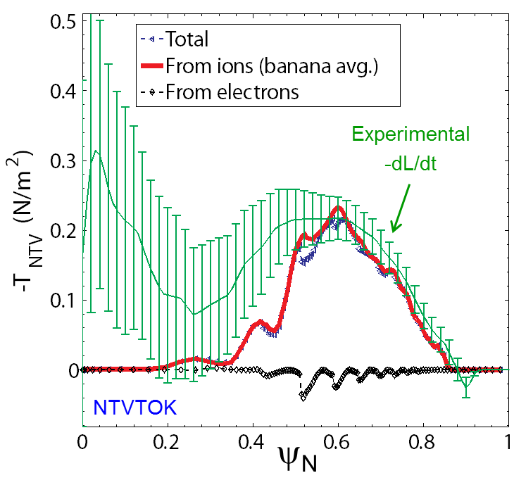
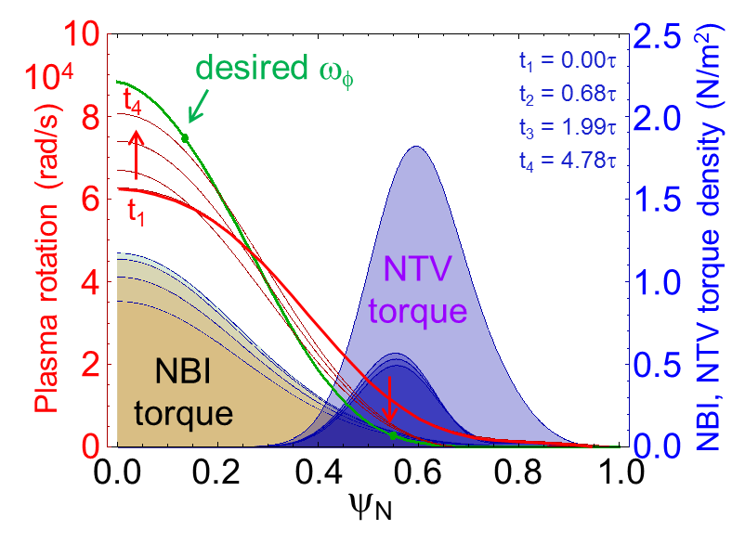
Neoclassical Toroidal Viscosity for Rotation Control and the Evaluation of Plasma Response
EX/1-4, Sabbagh
Highlights
Perturbation experiments measure NTV torque profile and compare to theory
Experimental NTV characteristics
  NTV experiments on NSTX and KSTAR
  NTV torque T_{NTV} from applied 3D field is a radially extended, relatively smooth profile
  Perturbation experiments measure T_{NTV} profile
Aspects of NTV for rotation control
  Varies as δB²; T_{NTV} ∝ T_{i}^{5/2} in primary collisionality regime for large tokamaks
  No hysteresis on the rotation profile when altered by non-resonant NTV is key for control
  Rotation controller using NTV and NBI tested for NSTX-U; model-based design saves power
NTV analysis to assess plasma response
  Non-resonant NTV quantitatively consistent with fully-penetrated field assumption
  Surface-averaged 3D field profile from M3D-C¹ single fluid model consistent with field used for quantitative NTV agreement in experiment
Rotation controller using NTV and NBI
21

Slide 22
DIII-D and RFX-mod achieved reproducible tokamak operation at q₉₅<2 thanks to feedback control of 2/1 RWM – for many resistive wall times using 3D magnetic fields
EX/P2-41, Martin
Ip
q95
2/1 RWM
Blue curve: with feedback control
Red curve: w/o feedback control

Slide 23
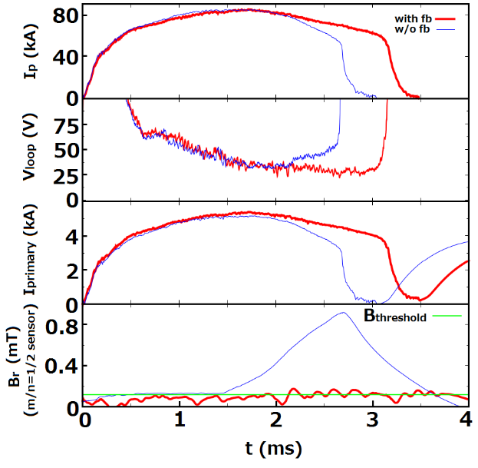
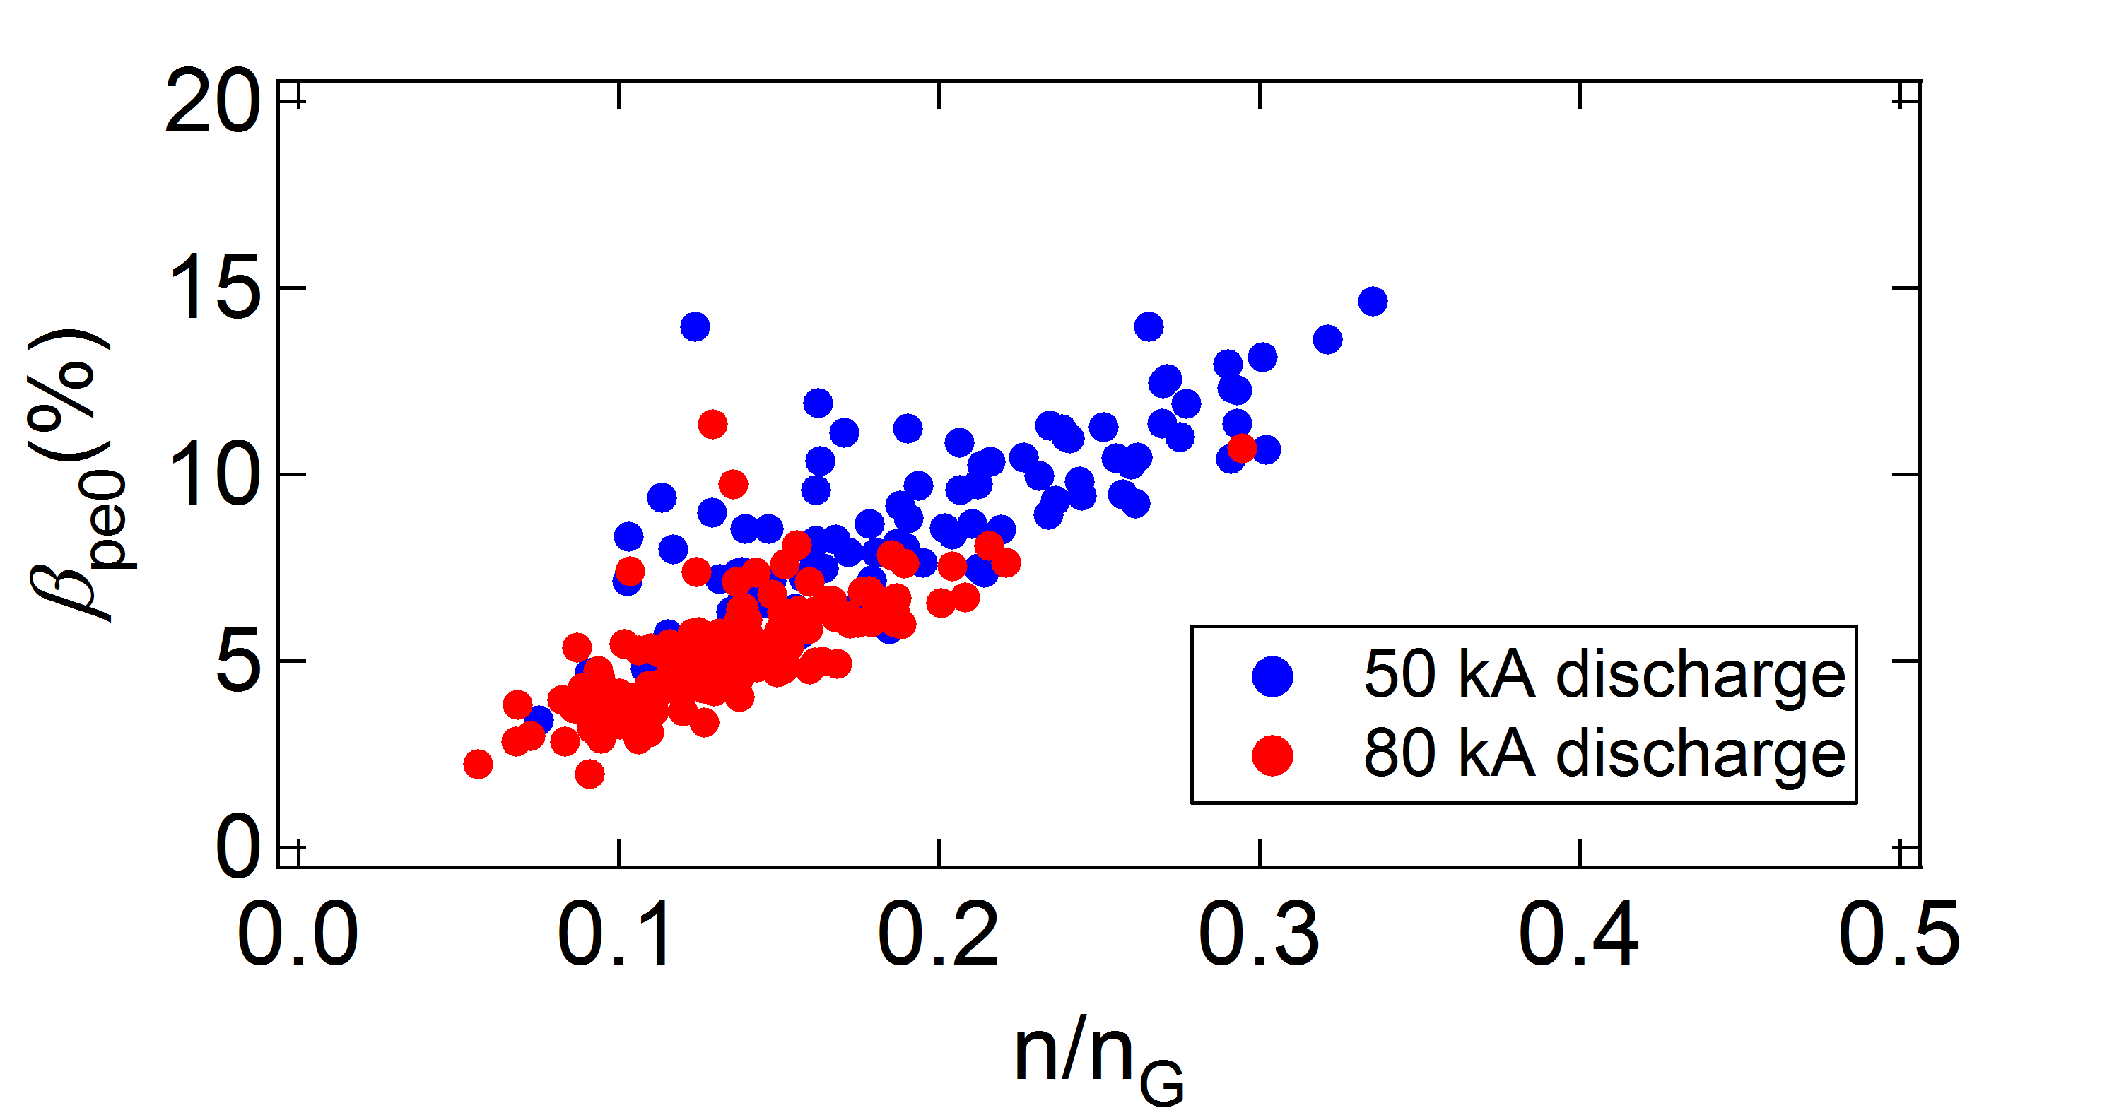
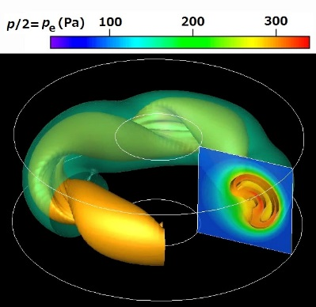
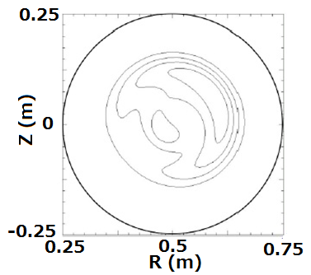
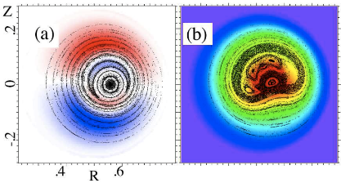
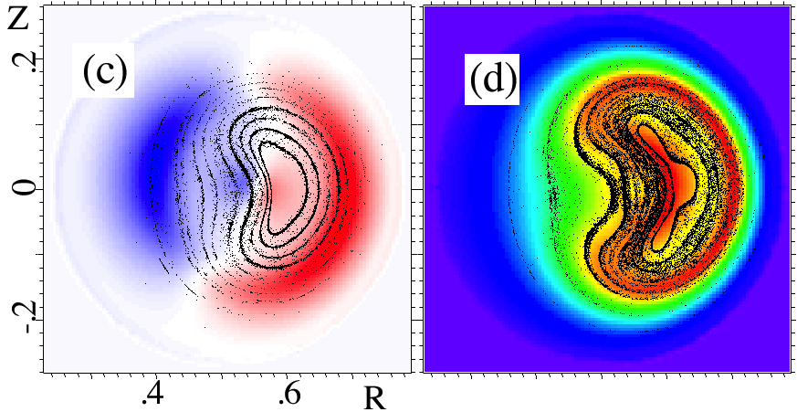
Active MHD control has resulted in RWM-stabilized, high-β_{p}, low-A RFP plasmas, and two routes to helical RFP states are identified
Definition:
Central electron pressure vs. Ip² shows that feedback stabilization of RWM has led to improved performance with attainment of electron poloidal beta10~15%. Density limit studies are becoming important in low-A RFP.
Using saddle coil array for feedback MHD control, RWM was suppressed and the RFP discharge duration could be extended to the upper bound determined by the iron core saturation.
EX/P3-52, Masamune
Growth of both the resonant (left) and non-resonant (left) mode can lead to self-organized helical RFP with almost identical deformation. Resonant mode accompanies reconnection (MIPS simulation).
Reconstructed magnetic surface shape using SXR CT during QSH phase shows good agreement with helical equi-pressure surface shape in 3-D MHD simulation using the MIPS code.

Slide 24
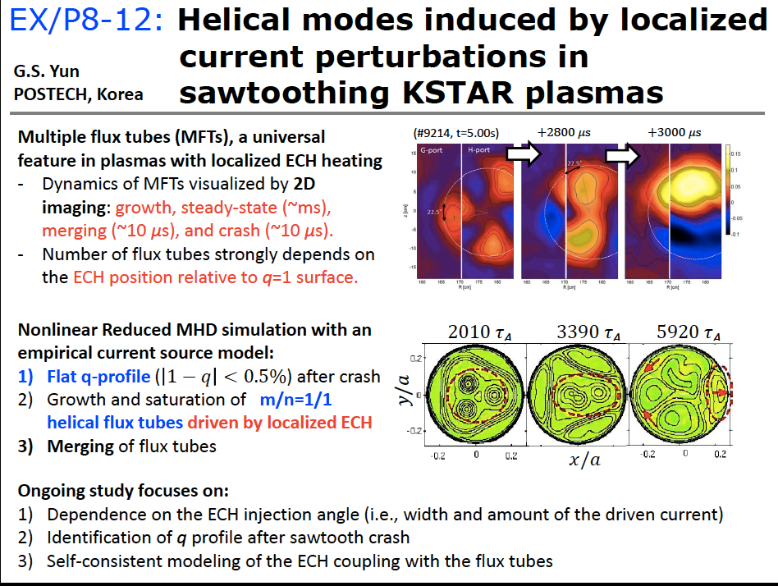

Slide 25
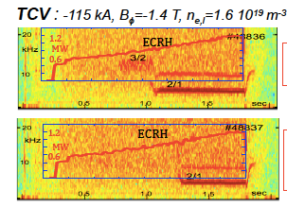
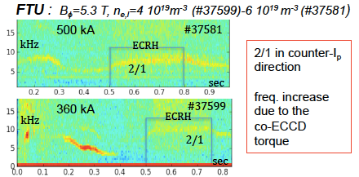
(R)MHD INSTABILITIES – BASIC STUDIES
Questions addressed: Triggering mechanisms, Mode Dynamics
FTU &TCV:
  2/1 TM triggered by Ne injection EX/P2-53, Botrugno
  TM onset by central EC power deposition EX/P2-54,Nowak

Slide 26
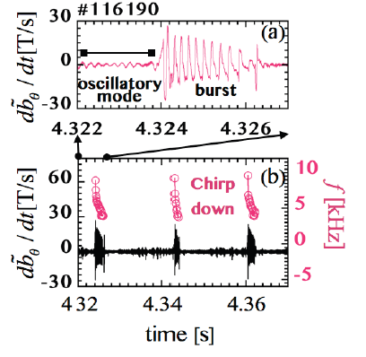
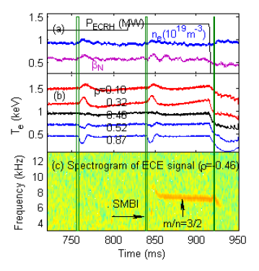
HL-2A:
NTM triggered by intrinsic
error fields EX/P7-19, Xu
NTM triggered by non-local
transport EX/6-4, Ji
Interaction between
MHD modes EX/P7-25, Yu
LHD:
Effects of low n MHD modes on
achievable beta values EX/P6-37
Bursting Resistive Interchange
Modes EX/P6-36
Energetic-Ion-Driven-Resistive
Interchange Mode (EIC)
SMBI induced NLT

Slide 27
Energetic Particles / Waves
Main Issues
Good confinement of EPs crucial for α heating of burning plasmas
Instabilities driven by EPs can degrade their confinement and also
alter their energy distribution; also impact on NB-CD
Characterization of stability boundaries
Better understanding of fast ion transport
Progress since 2012 FEC
Improved diagnostics, better nonlinear modeling have furthered our
understanding on a number of issues
Exptal database extended to include STs, stellarators, RFPs etc.
Provide more accurate correlations between fast ion losses & instabs.

Slide 28
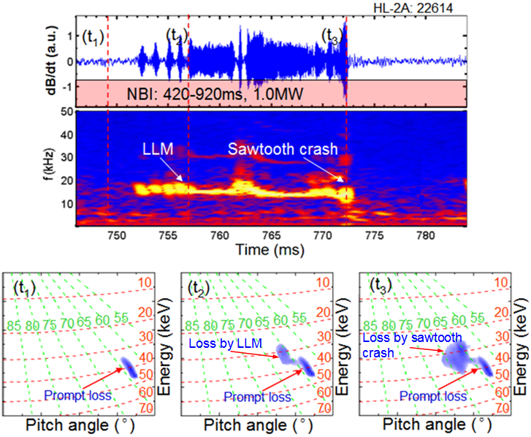
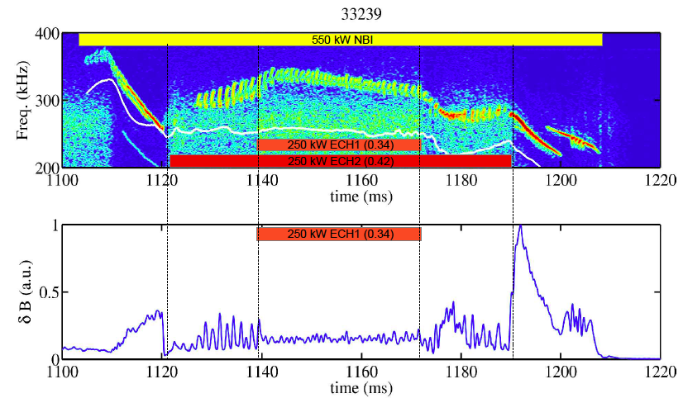
HL-2A
EX/P7-24, Zhang
TJ-II
EX/P4-46, Cappa
ECRH has a strong influence on the NBI
driven Alfvén modes in TJ-II. A second
EC beam can stabilize the AE.
Utilizing a new scintillator-based lost fast-ion
probe, recent HL-2A experiments have
elucidated a variety of neutral beam ion loss
behaviors in the presence of MHD instabilities.

Slide 29
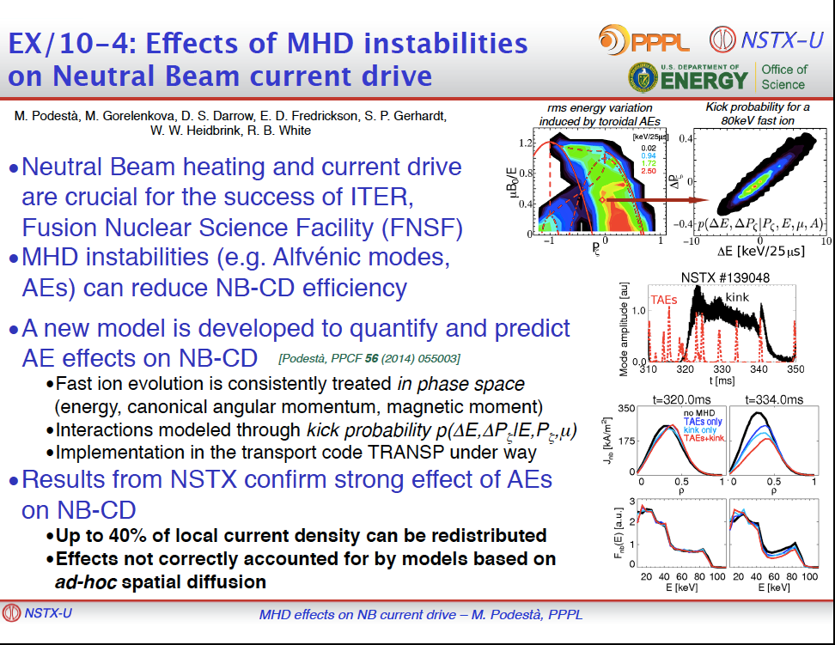

Slide 30
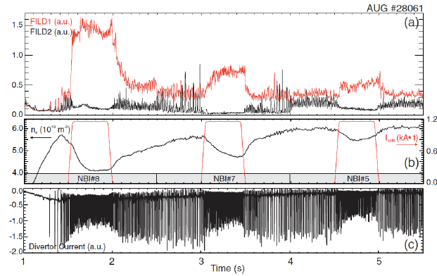
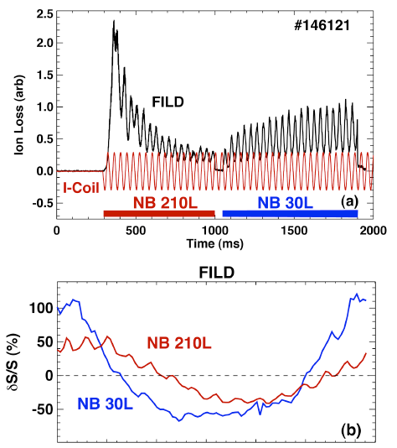
Fast-ion response to externally applied 3D magnetic perturbations
ASDEX-U
EX/P1-22, Garcia
DIII-D
EX/10-2, Van Zeeland
strong plasma & fast-ions response is
observed in H-mode regimes with low
collisionality / density and low q95.
Pitch angle and energy resolved measurements
+ wide field-of-view infrared imaging show fast
ion losses correlated with applied 3D fields.
in L-mode plasmas. Good agreement with model
simulations.

Slide 31
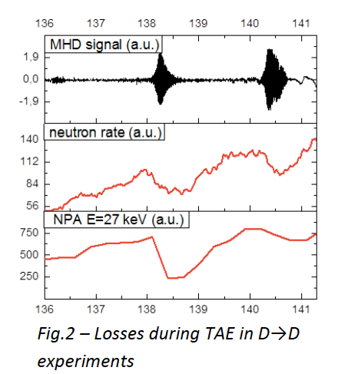
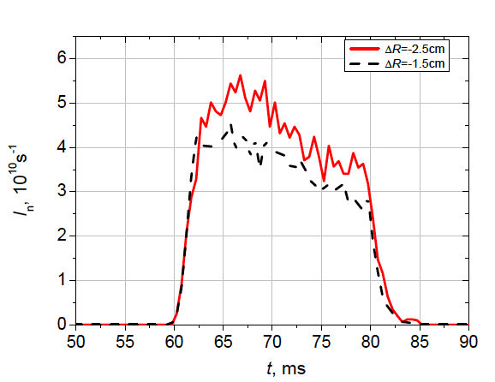
EX/P6-58, Kornev
EX/P1-33, Bakharev
TUMAN -3M
GLOBUS-M
Plot of neutron flux vs time for
different inward shifts of column
Particle losses highly correlated with TAE
Sawteeth induced losses >25%
Shift in plasma column inwards can reduce
losses

Slide 32
Noninductive Current Drive
Studies of LHCD physics and applications
ICRH optimization in JET
Solenoid-free ST startup

Slide 33


Near-Field Physics of Lower-Hybrid Wave Coupling
n_{e}0=1.5
n_{e}0=2
EX/4-2, Goniche
Tore Supra
P^{1/2}
n_{e}0=3
(10¹⁷m⁻³)
  Large data base (~230 points) indicate that
  E_{RF} scales as (P_{coupled}^{1/2}) assuming edge density near the cut-off density (~2×10¹⁷m⁻³)
L_{n}=2mm L_{n}=1.5mm
EX/P6-17, Parker
Alcator C-MOD
Loss of LHCD efficiency at high density is associated with Excitation of Parametric Decay Instabilities. PDI are excited near the separatrix and onset can be mitigated by modifying
conditions in the scrape-off layer. Launch from HFS may be more efficient – scheme for next machine.
EX/P3-11, Ding
High density experiments with LHCD analyzed by simulation using
experimental parameters, show that parametric instability , collision
absorption in the edge region, and density fluctuations could be
responsible for the low current drive efficiency at high density.
EAST

Slide 34
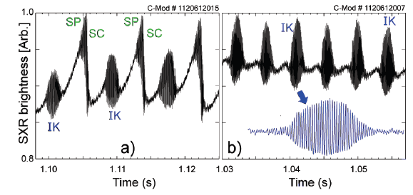
EX/P6-20, Delgado-Aparacio: Destabilization of Internal Kink by Suprathermal Electron Pressure Driven by Lower Hybrid Current Drive (LHCD)
A new type of periodic
fishbone-like instability
with a (1,1) internal
kink-like structure
distinct from the
sawtooth instability
On-axis SXR signatures of a (1,1) internal kink-like
(IK) mode in the a) presence or b) absence of
Sawtooth precursors (SP) and crashes (SC).
Demonstrate a direct dynamic relation between
LHCD generated fast electrons and a fishbone-like mode

Slide 35
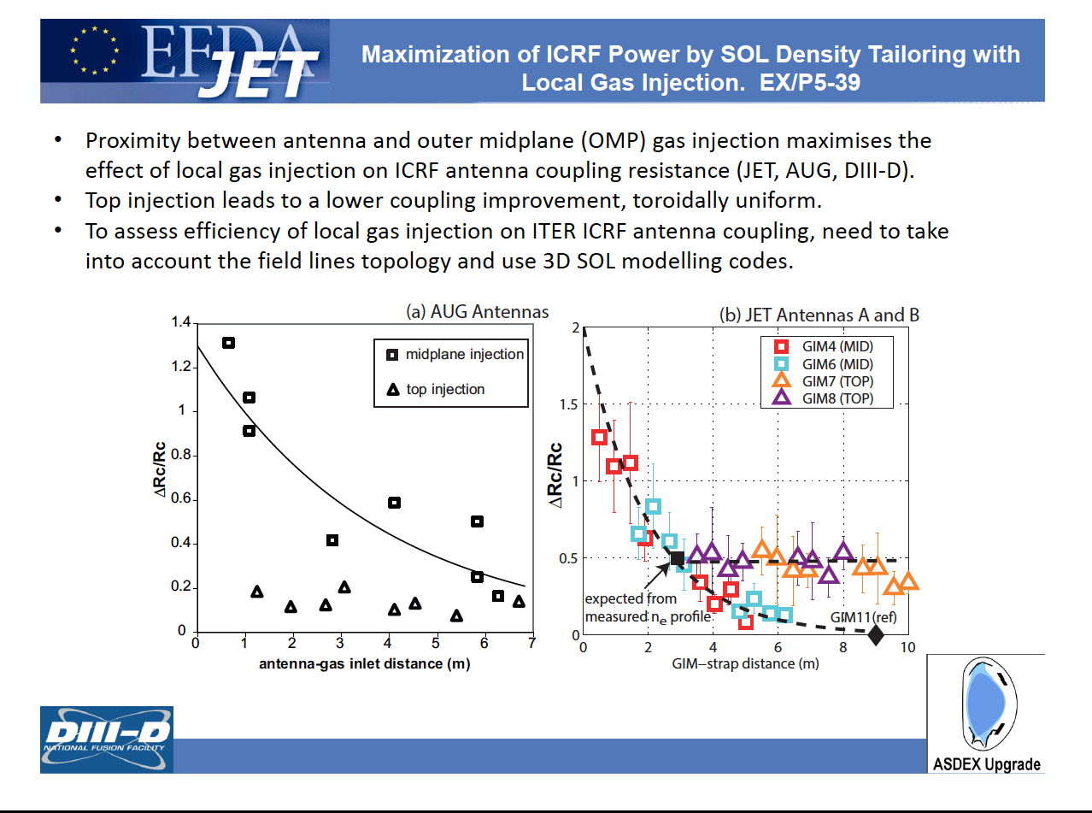

Slide 36
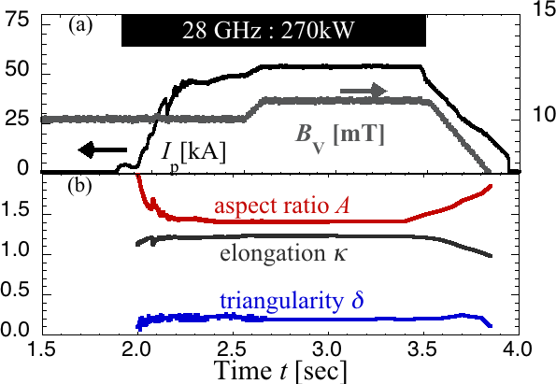
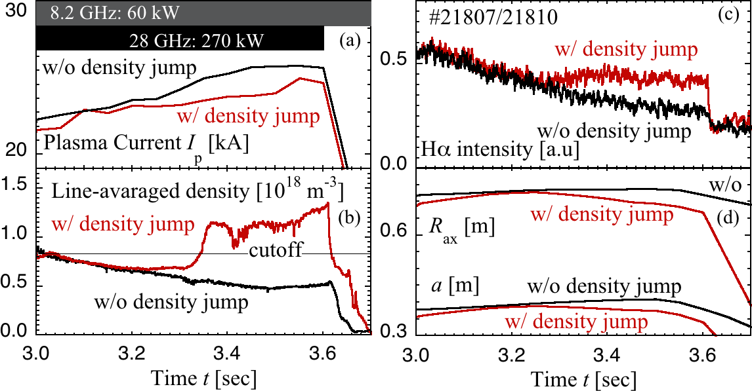
Fully Non-inductive Current Drive Experiments using 28 GHz and 8.2 GHz
Electron Cyclotron Waves in QUEST H. Idei, et al.
54 kA Plasma Sustainment in Low Aspect Ratio Config. by 28GHz Injection
Plasma current of 54 KA was non-
inductively sustained for 0.9 sec
by only 28 GHz injection.
Plasma shaping was almost kept for
1.3 sec.
Higher current of 66 kA was non-
inductively obtained by slow ramp-
up of vertical field also.
EX/P1-38
Non-inductive high current plasma start-up by 2nd ECH/ECCD has been demonstrated.
Over Dense Plasma Sustainment by 28 /8.2 GHz Injections after Spont Density Jump
Spontaneous density jump across the cutoff
density was observed in superposed 28 and
8.2 GHz injections.
Hα intensity was kept, magnetic axis R_{ax} and
minor radius a were slightly decreased
in the density jump case.
Plasma current I_{p} was once decreased, but was
recovered after the plasma shaping became
more stable.

Slide 37
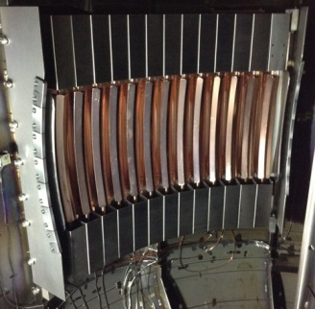
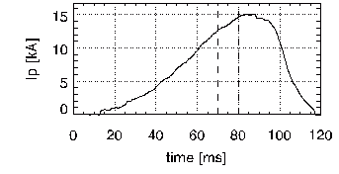
Non-inductive Plasma Start-up Experiments on the TST-2 Spherical Tokamak Using Waves in the Lower-Hybrid Frequency Range
Y. Takase for the TST-2 Group
Economically competitive tokamak reactor may be realized at low A = R/a by eliminating the central solenoid
→ Objective: Demonstrate I_{p} ramp-up by LHW on ST
Three antennas were used:
  Combline antenna
    Nonlinear excitation of LHW
  Grill (dielectric-loaded WG array) antenna
    Optimum n|| : 3-4
  CCC (capacitively-coupled combline) antenna
    Highest η_{CD} achieved (sharp n|| spectrum, good directivity)
Characteristics of LH driven plasma
  Pressure dominated by fast electrons
    3-fluid equilibrium being developed
    Importance of E_{r} and flows
  Fast electrons are poorly confined at I_{p} ~ 10 kA
    η_{CD} much smaller than in typical tokamak experiments
      Due to poor orbit confinement of fast electrons
    Expected to improve significantly at higher I_{p} and B_{t} (need power supply upgrade)
Various diagnostics and analysis tools are being developed
  Wave diagnostics, HX profile, E_{r}, flows, j profile, etc.
traveling wave
CCC antenna
28 kW LH + 4 kW EC
I_{p} / P_{RF} = 0.5 A/W

Slide 38
Innovative Confinement Concepts
15 papers
Tokamaks with novel magnetic configurations
Advances in Field Reversed Configurations
Spherical Configurations other than tokamaks (HIT-SI)
Advances in Spherical Tokamaks (TS4)
New ideas/concepts for fusion reactors
Notes:
Chuck: The last two bullets are not shown in your slides

Slide 39
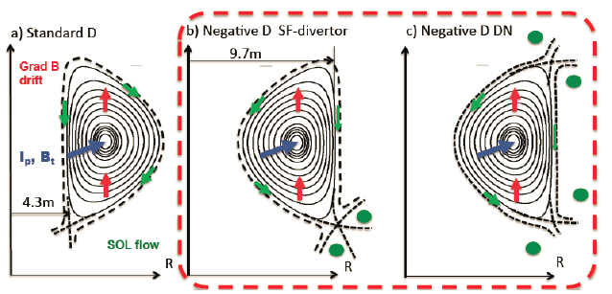
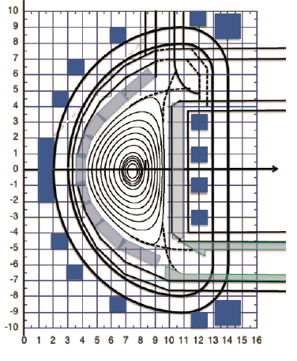


ICC PD/P5-1 S.Yu.Medvedev et al.
Negative triangularity tokamak: stability limits and perspectives as fusion energy system
  Power and particle control is an issue in D-shaped (δ > 0 ) cross-section tokamak with H-mode optimized for core confinement
Assess negative D to solve power and particle exhaust problem!
  Edge stability → different ELM regime (MHD stability)
  Geometry of power handling area ← larger R_{div}
  SOL flow → slower, wider SOL
  Better confinement: δ < 0 edge transport rather than core
  Technical merits: HFS ECCD, lower background magnetic field for internal PF coils, larger pumping conductance from divertor
  MHD stability
Positive shear l_{i}=0.9: β_{N}<3.2
Beta limit against n=1 external mode β_{N}>3 for optimized profiles
No 2nd stability access in the pedestal; high p’ in the 1st
n=0 stability to be mitigated
  Experimental proposals:
  TCV, HL-2M, DIII-D

Slide 40


Control of Rotational Instability in FRC
Toroidal spin-up in an FRC triggers a centrifugally- driven interchange-like mode n = 2.
Suppression of Spontaneous Rotation in a FRC by Magnetized Plasmoid Injection in NUCTE device
ICC/P5-43, Asai

Slide 41

Spherical Configuration
Significant progress on Current Drive in
HIT-SI
By increasing the frequency of the
Imposed Dynamo Current Drive (IDCD)
up to 68.5 kHz
Toroidal currents of 90 kA and current
gains of nearly 4, a spheromak record,
have been achieved.
dynamo current drive does not need
plasma-generated fluctuations -a stable
equilibrium with profile control can be
sustained with imposed fluctuations
Extrapolation to ITER - 80 kHz gives
injector powers less than 10 MW and
δB/B ≈ 10⁻⁴ indicating the effect on
confinement may be acceptable.
ICC/P4-31, Victor
1 Gwe Reactor Dynomak
Jarboe

Slide 42
Concluding Remarks
EXS , EXW:
      Focused international efforts on ITER relevant issues
      has considerably advanced our understanding on
      ELM physics and disruption phenomena
      Runaway mitigation system not yet firmly established
      - but there are promising leads that need to be followed
      Alternate ELM mitigation systems that do not require
      IVCs show considerable promise and may provide
      an attractive future option for ITER
      New ideas on disruption avoidance and control need
      validation on larger machines

Slide 43
Concluding Remarks
ICC:
    Heartening to see good scientific progress in alternatives to the tokamak/stellarator approach - e.g. Spheromaks, FRCs ….
    Exploration and development of such alternate schemes essential for improving our chances of early fusion power – we need to promote more new ideas
Exciting week - wealth of scientific results
- wonderful hospitality
Thanks to our hosts and IAEA

