Slide 1
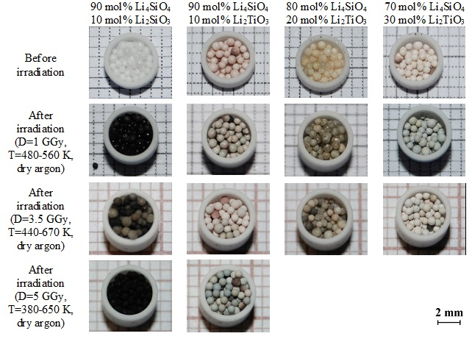
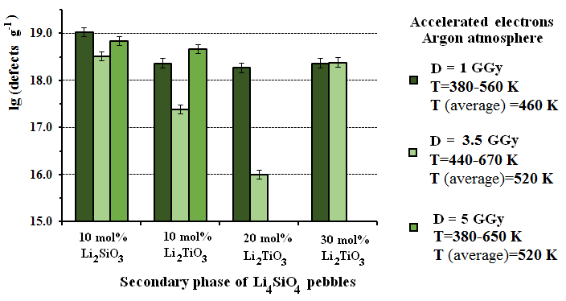
High-temperature Radiolysis of Modified Lithium Orthosilicate Pebbles with Additions of Titanium Dioxide
A. Zarins^{a*}, G. Kizaneª, A. Supeª, R. Knitter^{b}, M. H.H. Kolb^{b}, O. Leys^{b}, L. Baumane^{c}, D. Conkaª and O. Valtenbergsª.
ªUniversity of Latvia, Institute of Chemical Physics, Laboratory of Radiation Chemistry of Solid State, Kronvalda 4, LV-1010, Riga, Latvia. ^{b}Karlsruhe Institute of Technology, Institute for Applied Materials (IAM-WPT), 76021, Karlsruhe, Germany. ^{c}Latvian Institute of Organic Synthesis, Aizkraukles 21, LV-1006, Riga, Latvia.
For the ITER Helium Cooled Pebble Bed (HCPB) Test Blanket Module (TBM) two tritium breeding ceramic have been designed:
1) Reference composition: Li₄SiO₄ pebbles with 10 mol% Li₂SiO₃
2) Modified composition: Li₄SiO₄ pebbles with 10-30 mol% Li₂TiO₃
AIM OF WORK:
Investigation of the high-temperature radiolysis of the modified Li₄SiO₄ pebbles with different contents of Li₂TiO₃ for the first time, in order to estimate radiation stability.
Photographs of the reference and modified Li₄SiO₄ pebbles before and after irradiation with accelerated electrons.
MAIN CONCLUSIONS:
The modified Li₄SiO₄ pebbles with 10-30 mol% Li₂TiO₃ have slightly higher radiation stability in comparison to the reference Li₄SiO₄ pebbles with 10 mol% Li₂SiO₃.
The modified pebbles have the potential to combine the advantages of Li₄SiO₄ and Li₂TiO₃ as a tritium breeding ceramic for the HCPB TBM.
Total concentration of paramagnetic radiation-induced defects and radiolysis products in the different samples after irradiation.

