Slide 1
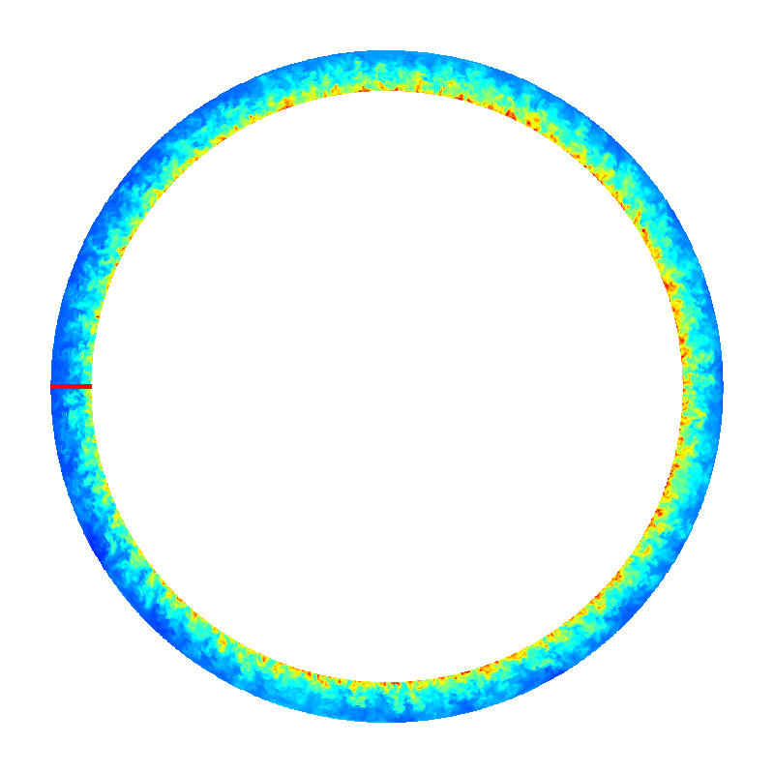
First-principles theory-based scaling of the SOL width in limited tokamak plasmas (P. Ricci et al.)
Reached the capability to perform first-principles simulations and analysis of turbulence in SOL
Limited plasmas: important for ITER start-up and ramp-down phases and as theory test bed
C-MOD simulation
B=3.8T, q=2,7 …
Obtained first-principles scaling of SOL width
In agreement with multi-machine database

