Slide 1
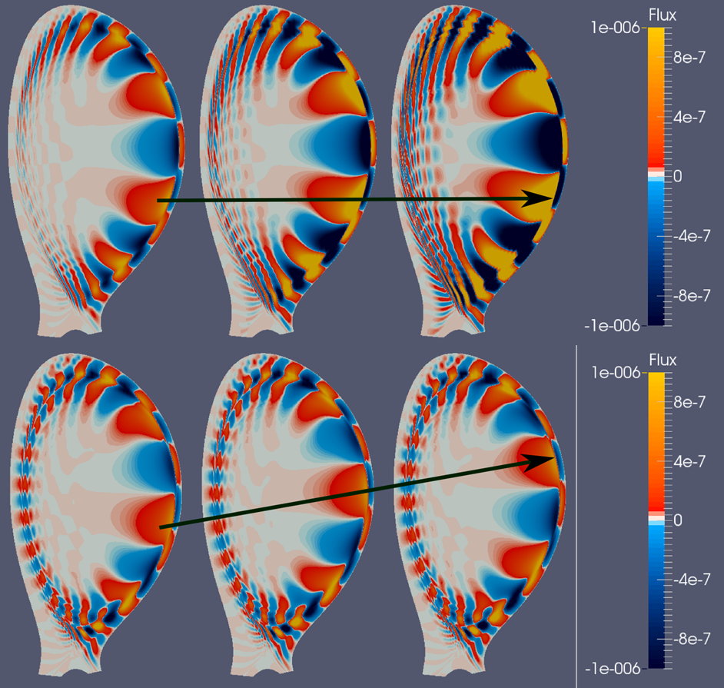
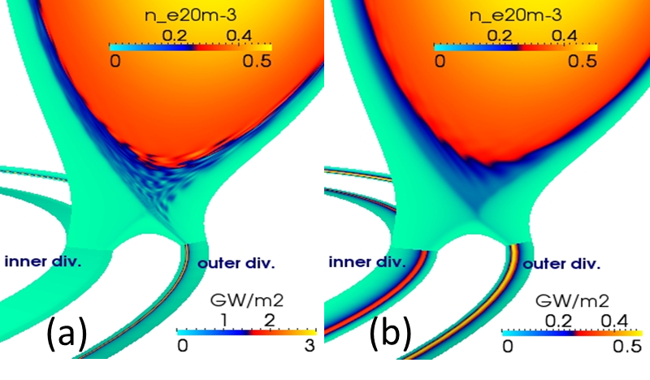
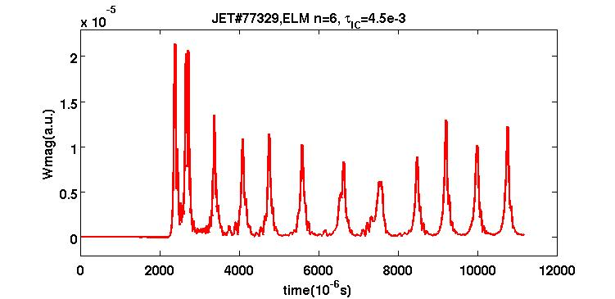
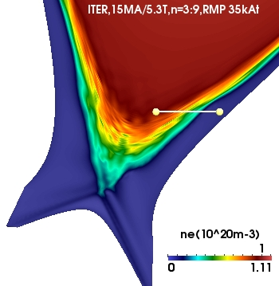
Non-linear MHD modelling of Edge Localized Modes and their interaction with Resonant Magnetic Perturbations in rotating plasmas. Becoulet M. et al TH/6-1Rb
The non-linear resistive reduced MHD code JOREK [Huysmans NF2007] in toroidal geometry with X-point and SOL and with relevant plasma flows : toroidal rotation, bi-fluid diamagnetic effects and neoclassical poloidal friction [Orain PoP2013] was used to study the ELM dynamics in the linear and non-linear phases and the interaction of ELMs with RMPs.
ELM dynamist with flows:
ELM precursor rotation in ExB (=el.dia) direction
Divertor heat flux during an ELM : in/out symmetry
w/o flows
w/o flows
with flows
with flows
Multi-cycles ELMs with diamagnetic stabilization
Non-linear drive of edge MHD turbulence by RMPs => mitigated ELMs =>Divertor heat flux is reduced by ~10
RMP off
RMPs in ITER
RMP on (JET,EFCC,40kAt)

