Slide 1


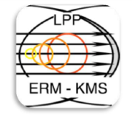


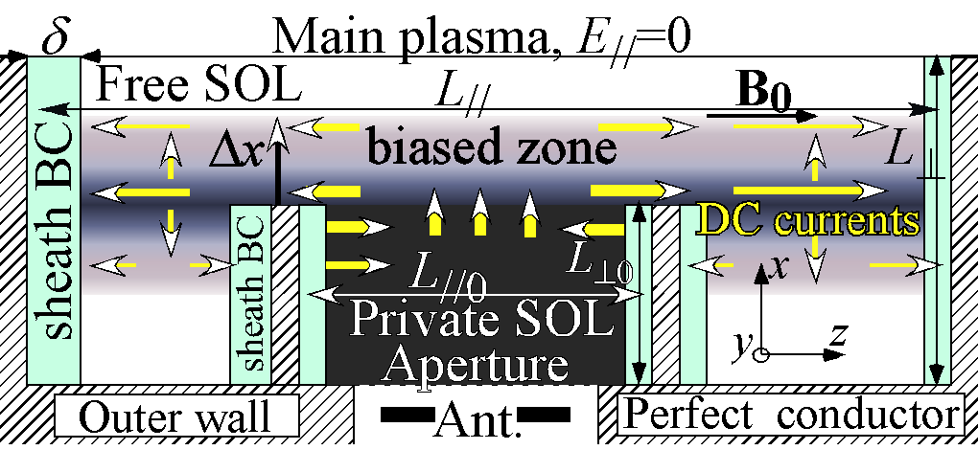
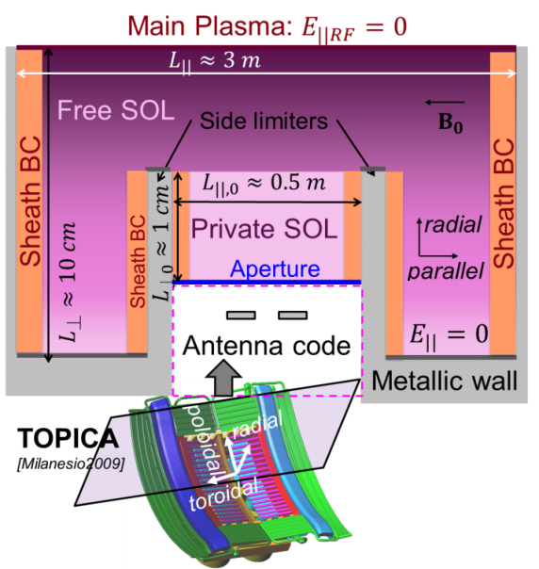
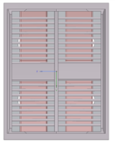
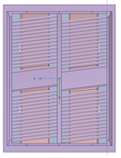
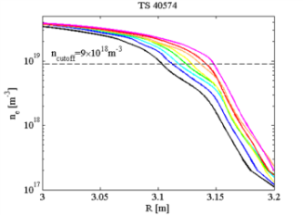
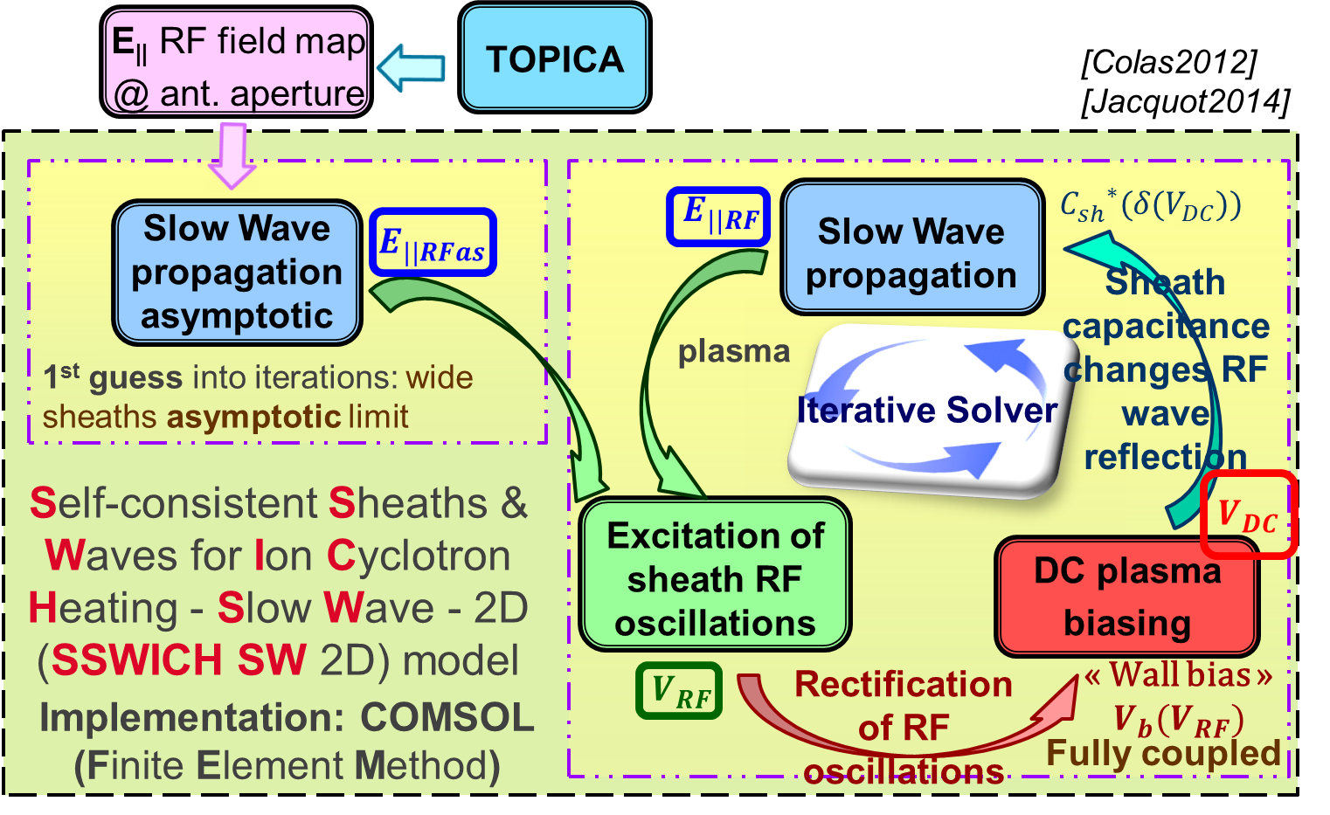
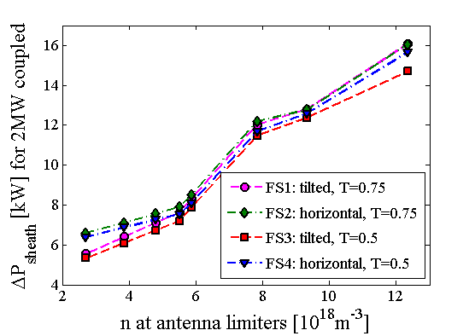
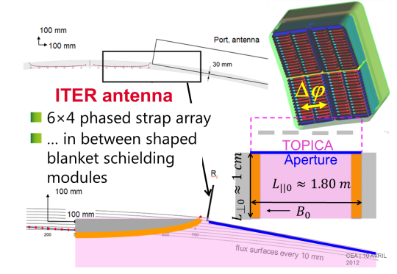
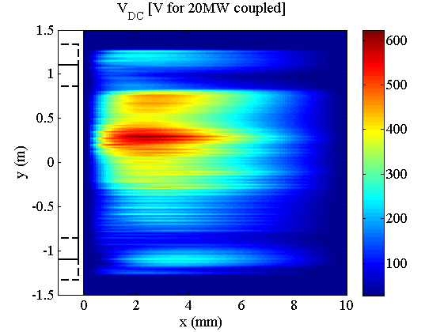
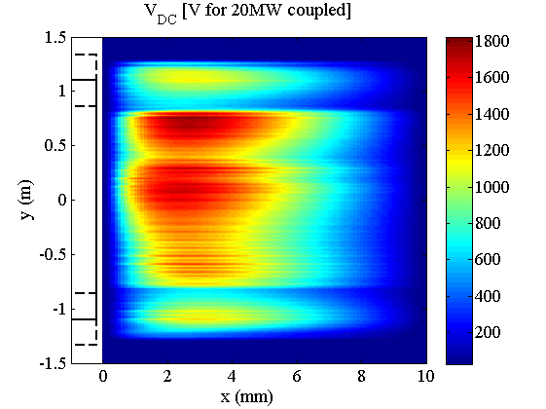
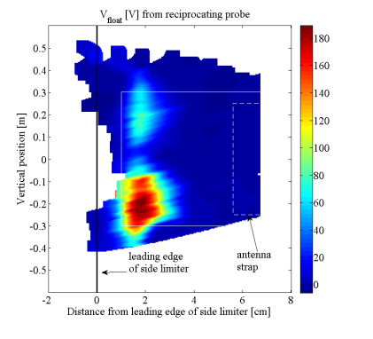
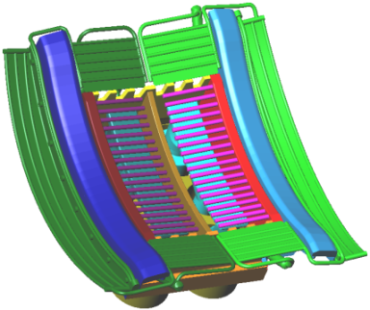
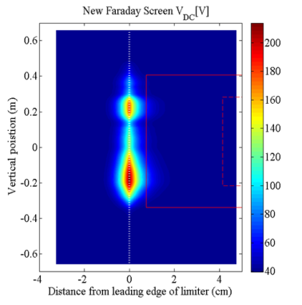
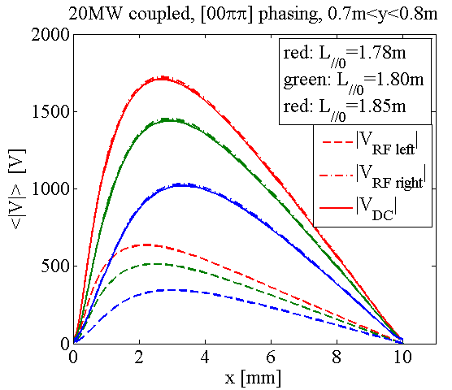
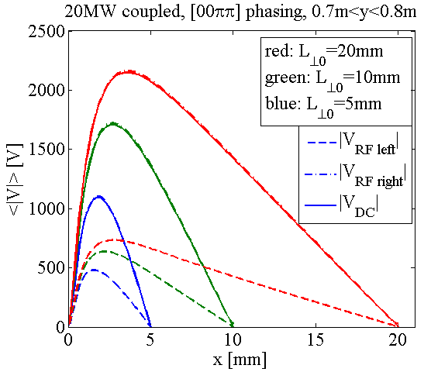

Self-Consistent Modeling of RF-Sheaths: Comparison with Tore Supra Measurements and Predictability for Future Machines
TH/P6-9
L. Colas¹, J. Jacquot^{1,6}, D. Milanesio², L. Lu¹, J-M. Bernard¹, S. Carpentier⁵, Y. Corre¹, F. Durodié³, E. Faudot⁴, M. Firdaouss¹, M. Goniche¹, J.-P. Gunn¹, W. Helou¹, S. Heuraux⁴, J. Hillairet¹, M. Kubič¹, Ph. U. Lamalle⁵, X. Litaudon¹, R. Maggiora², R. A. Pitts⁵
¹ CEA, IRFM, F-13108 Saint Paul-lez-Durance, France.
² Department of Electronics, Politecnico di Torino, Torino, Italy.
³ Association EURATOM-Belgian State, LPP-ERM-KMS, TEC partner, Brussels, Belgium
⁴ IJL UMR 7198, CNRS-Université de Lorraine, BP 70239, F-54506 Vandœuvre Cedex, France.
⁵ ITER Organization, Route de Vinon-sur-Verdon, CS 90 046, 13067 Saint Paul-lez-Durance, France.
⁶ now: Max-Planck-Institut für Plasmaphysik, EURATOM-Assoziation, Garching, Germany.
Motivations: why improve RF-sheath models?
Amplitude & radial extension of bias, DC current diffusion
In magnetic Fusion devices, non-linear wave-plasma interactions in the Scrape-Off Layer (SOL) often set operational limits for Radio-Frequency (RF) heating systems, due to impurity production or excessive heat loads. Understanding these interactions is key for reliable high-power Ion Cyclotron (IC) wave launch over long pulses in all-metal devices. Edge IC losses are attributed to a Direct Current (DC) biasing of the SOL plasma by RF sheath rectification. Here we propose, test and apply a new model.
  Direct local excitation of sheath oscillations by SW is efficient only in the private SOL
  DC biasing of free SOL therefore relies on DC current diffusion from private SOL.
  Associated DC current flow qualitatively consistent with observations
  ☹ Large uncertainty on
  cross field current diffusivity σ_{⊥DC}
Conventional approach (double probe driven by ∫ E_{//RF}.dl) is challenged experimentally
  Concepts « optimized » for Ṽ=|∫E//.dl|:
  ☹ Tore Supra prototype Faraday screen
  ☹ ALCATOR C-mod Field-Aligned antenna phased [0000]
DC potential peak characteristics ⬄ σ_{⊥DC}
  Radial extension at half height from leading edge
  Amplitude φ(0) at limiter leading edge
  ☹ Left-right sheath asymmetries
  ☹ DC current flows
  Fit on Tore Supra measurements from simplified theory
    - σ_{⊥DC}~0.8-2.1×10⁻⁸ ×Spitzer in free SOL
    - 2×10⁻⁸-10⁻⁶ in private SOL
  ☹ Transverse DC current transport is most likely turbulent, i.e. non-diffusive.
  ☹ No first principle theory
An alternative, self-consistent model: SSWICH – SW
Specifications
  Slow Wave propagation in Ion Cyclotron Range of Frequencies
  …. and DC SOL plasma biasing
  … coupled self-consistently by non-linear RF and DC sheath BCs at plasma-wall interface
  Walls // of ⊥ to B₀, developping unmagnetized RF sheaths
  Diffusive DC current transport, with small phenomenological transverse conductivity σ_{⊥DC}
  Excitation: realistic E// RF field map from antenna code TOPICA
(saturated private SOL)
relative comparison of Faraday screens for WEST antenna
Methodology
  4 Faraday screen concepts
    - horizontal vs tilted
    - …×2 transparencies
  …×8 plasmas:
  n_{e} scan in L-mode via radial shift
B₀
B₀
  Figure of merit: estimated power losses attributed to RF sheaths, summed over 2 ant. side limiters
Comparison of Faraday Screen designs
  FS bars aligned with B₀ do not suppress sheaths.
  Tilted FS bars slightly better than horizontal
  Denser FS slightly better than more transparent
Quantitative sensitivity to n_{e} @ antenna
  Difference tilted vs horizontal is reduced at high n_{e}
Relative comparison of strap phasings on ITER antenna
[0π0π]
[00ππ]
Poloidal
Comparison with Tore Supra measurements [Jacquot2014]
Strap toroidal phasing Δϕ
  Hierarchy of phasings
  for RF sheath power losses:
  [00ππ]>[0,π/2,π,3π/2],
  [0,-π/2,-π,-3π/2]>[0ππ0]>[0π0π]
  Also observed on JET [Lerche2009]
quantitative sensitivity to private SOL dimensions (L_{//0}, L_{⊥0})
Radial
[Kubič’2012]
[Jacquot2014]
v_{E×B}
radial
Poloidal
poloidal
Radial
Radial
Ref. plane for maps
CONCLUSIONS and PROSPECTS
probe2D mapping
Simulation
  SSWICH-SW was developped as a first step towards self-consistent modelling of RF wave propagation and DC SOL biasing in Ion Cyclotron Range of Frequencies.
  Comparisons with Tore Supra experiments showed qualitative agreement on the poloidal distribution of RF sheath intensities, left/right asymmetries of the heat loads, DC current flows and relative variations between two Faraday screens.
  Quantitative sensitivity to poorly constrained simulation parameters was outlined.
More experimental validation is needed
  Opportunities: ASDEX-Upgrade, JET, WEST & dedicated test beds ALINE, IShTAR
  Critical for constraining the numerical simulations: local SOL measurements
Improvements of SSWICH model are foreseen
  towards full-wave RF wave propagation, shaped walls and magnetized RF sheaths
Qualitative agreement
  Poloidal distribution of DC bias
  Left/right asymmetries of heat loads,
  DC E×B₀ density convection
  DC current flows
  Relative variations: 2 Faraday Screens.
Disagreement ?
  Radial position of potential peak
Quantitative uncertainty (see on right)
  Amplitude of DC bias
  Radial extension
Disclaimer: This work was supported by the European Communities under contract of Association between EURATOM and CEA, was carried out within the framework of the European Fusion Development Agreement. The views and opinions expressed herein do not necessarily reflect those of EFDA or the ITER Organization.

