Slide 1
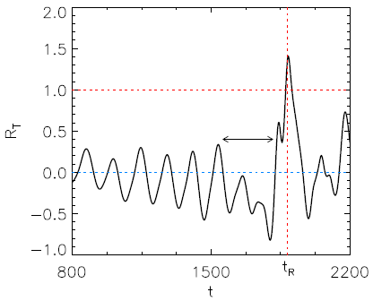
Summary (TH/8-1)
A flux-driven 3D nonlinear simulation of tokamak turbulence demonstrates
The formation of an edge transport barrier (ETB) above a threshold of the input power
ETB formation (or L→H transition) is triggered by turbulence-driven flows when R_{T} > 1 at t=t_{R} (transition time)
Two criteria should be satisfied to enter a H-mode:
R_{T} > 1 to trigger the L→H transition
ω_{ExB} > γ_{lin} for the sustainment of steady H-mode (ω_{ExB}: mean flow shear, γ_{lin}: linear growth rate)
The relation of R_{T} > 1 to empirical global power threshold scalings should be clarified (future work).
Normalized Reynolds power (R_{T})

