Slide 1
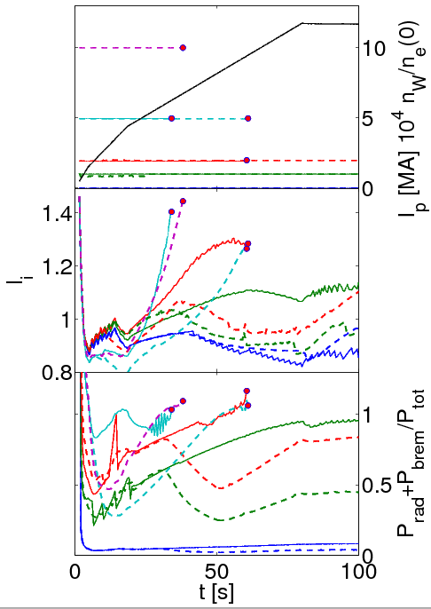
Impact of W on scenario simulations for ITER
G.M.D.Hogeweij, V. Leonov, J. Schweinzer, A.C.C. Sips, C. Angioni, G. Calabrò, R. Dux, A. Kallenbach,
E. Lerche, C. Maggi, Th. Pütterich, ITPA Integrated Operating Scenarios topical group, AUG team and JET EFDA Contributors
FOM Institute DIFFER, Association EURATOM-FOM, the Netherlands, www.differ.nl
Motivation:
Experiments at ASDEX Upgrade and JET → core W accumulation can have several detrimental effects:
strongly perturbed T_{e} and q profile during I_{p} RU
(periodic) loss of the H-mode
hollow T_{e} profile during H-mode, leading to locked MHD modes and finally disruption
Modelling effort:
RU only: CRONOS, with Bohm-gyroBohm model for thermal transport, plus either assuming flat or peaked n_{W}/n_{e}, or assuming neoclassical W transport in core
RU and flat-top: Impurity modelling with ZIMPUR + ASTRA for evolution of bulk plasma parameters using scaling based transport model
Result a:
Critical W concentration during RU, assuming flat or peaked n_{W}/n_{e}, or assuming neoclassical W transport in core
← case flat n_{W}/n_{e}
Result b:
Critical W (and Ar, Be) concentration during flat-top for various ITER scenarios – see table
Conclusions:
ZIMPUR and CRONOS results consistent.
During RU critical W concentration is a few times 10⁻⁵
For maintaining Q > 5 at 15 MA in ITER the W concentration should be below 7 10⁻⁵
Outlook:
More realistic W density profiles
Neoclassical and turbulent transport
Account for poloidal asymmetries

