Slide 1
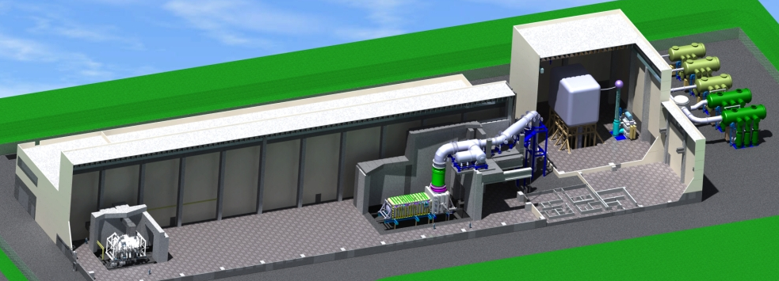
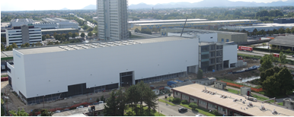
Progress in the realization of the PRIMA Neutral Beam Test Facility FIP2/4-Rc
SPIDER
MITICA
The ITER Heating Neutral Beam requirements (1MeV, 16.7MW, 1hour operation) have never been achieved simultaneously → A full scale Neutral Beam Test Facility is needed
The PRIMA Neutral Beam Test Facility is under construction at Consorzio RFX, Padova, Italy. It will hosts two experiments:
MITICA a full scale prototype of the Heating Neutral Beam of ITER
SPIDER a ITER HNB full-size negative ion source (D₂ 290 A/m² , D⁻ > e ; H₂ 350 A/m² , H⁻ >2e)
This realization is funded in kind by the Europe, Italy (host country), Japan and India
Realization is well in progress:
SPIDER is under installation. First experiment is scheduled in spring 2016
MITICA Design of components almost completed. First experiments at low beam energy will start in 2018; full power experiments are scheduled in 2019

