Slide 1
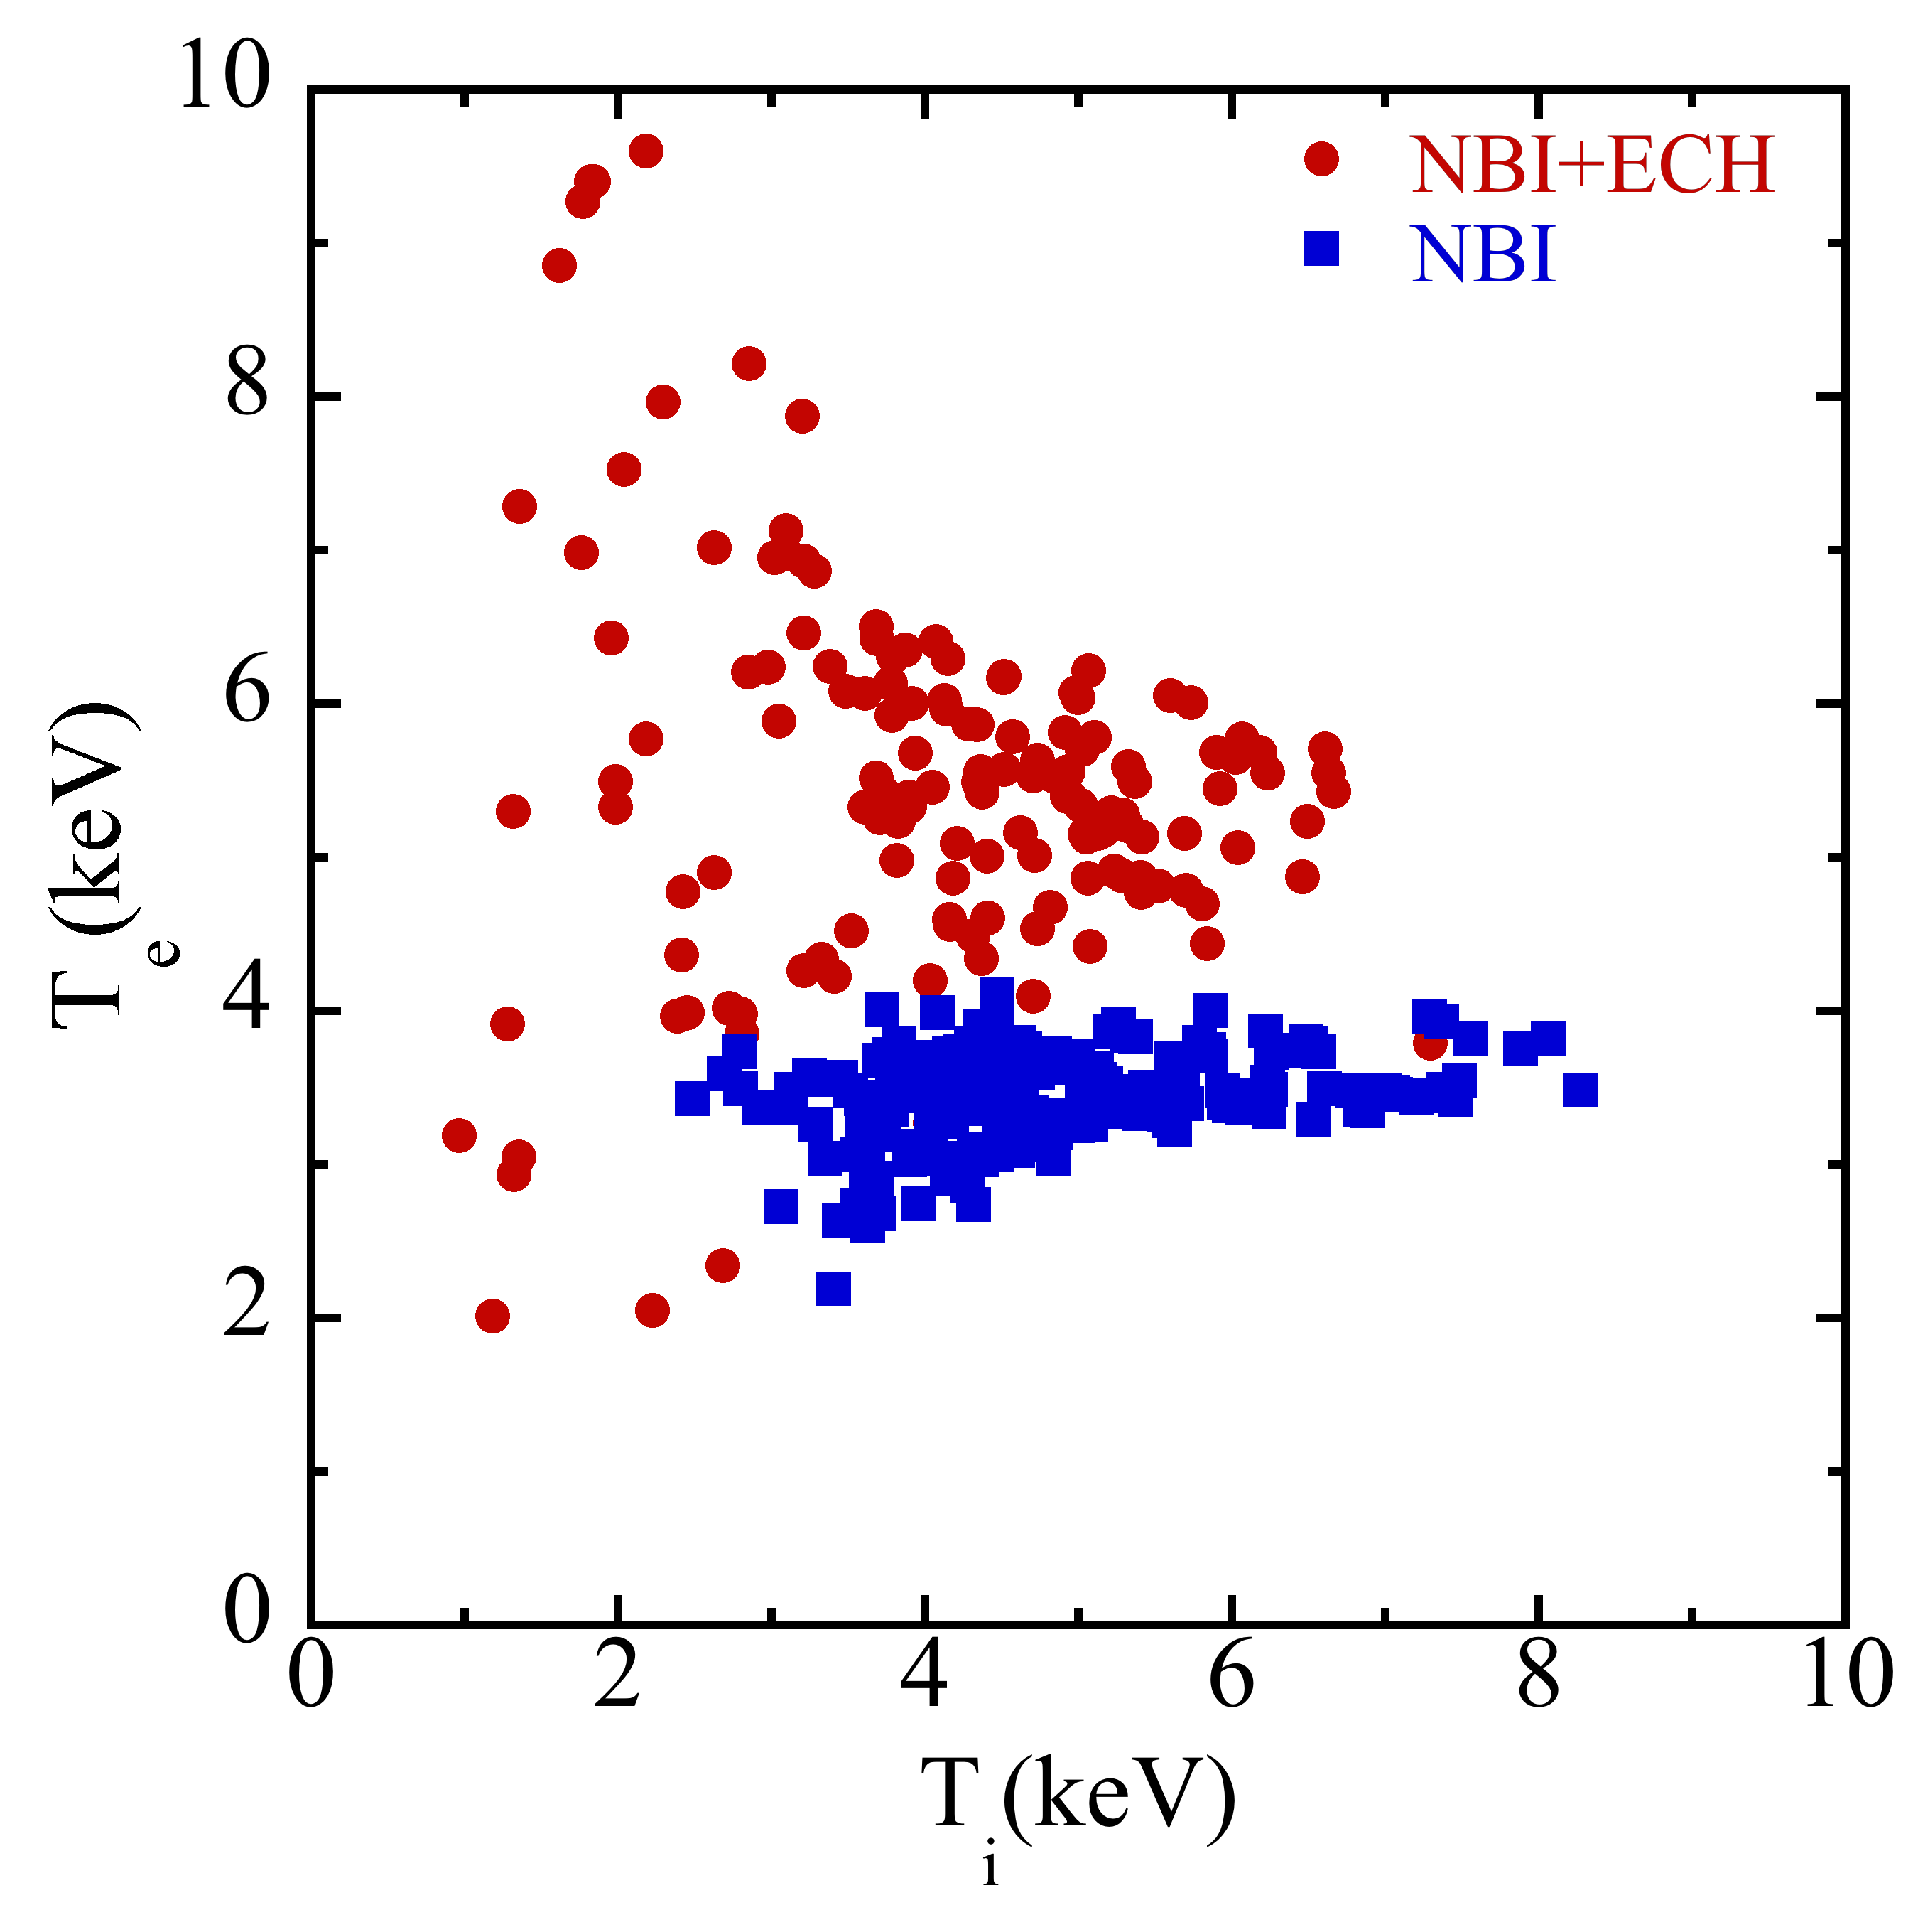
Significant Progress in the High Confinement and in the Long Pulse Operation has been Made in LHD
OV/2-3
K. Ida
Simultaneous achievement of electron and ion-ITB extend the parameter regime of T_{e}=T_{i} =6 keV in a short pulse
Steady state long pulse operation with 48 min. and T_{e}=T_{i} =2 keV is achieved

