Slide 1
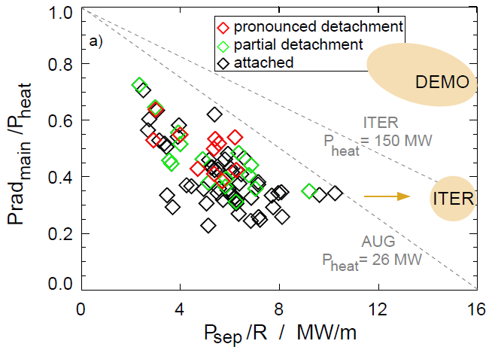
Power exhaust in AUG achieved 2/3 of ITER requirement in P_{sep}/R
& simultaneous control of core and divertor radiation
P_{sep}/R up to 10 MW/m with q_{max} well below 10 MW/m² in ASDEX Upgrade
No limit of (standard, vertical) divertor power dissipation capacity hit so far
Higher P_{sep}/R expected, needs higher power (power supply upgrade) and more gas (less pumping)
Also DEMO-relevant level of P_{rad,main}/P_{heat} achieved, but not simultaneously with high P_{sep}/R
2014
P_{sep}/R is divertor identity parameter, provided similar density and power width λ_{q}

