Slide 1
(FIP/2-5Ra) Development of DC ultra-high voltage insulation technology for ITER NBI H. Tobari et al., (JAEA) (FIP/2-5Rb) Progress in long pulse production of powerful negative ion beams for JT-60SA and ITER A. Kojima et al., (JAEA)
Recent progress on R&D toward Neutral Beam Injector
for ITER and JT-60SA
Rapporteur; Hiroyuki TOBARI
(Japan Atomic Energy Agency)
25th IAEA FEC
13-18 Oct. 2014, St. Petersburg, Russia

Slide 2
Target and status on NBIs for ITER and JT-60SA
Negative ion beam | (ITER NB) 1 MeV, 40 A, 3600 s | (JT-60SA) 500 keV, 22 A, 100 s
 | on or before FEC 2012 | on FEC 2014
Items | High voltage insulation
Insulating transformer | DC 500 kV, 10 s | DC 1 MV, 3600 s
HV bushing | Part test | 1MV vacuum insulation design
 | Long pule beam production & acceleration
High current beam | 13 A, 30 s | 15 A, 100 S
High energy beam | 980 keV, 0.4 s | 680 keV, 60 s

Slide 3
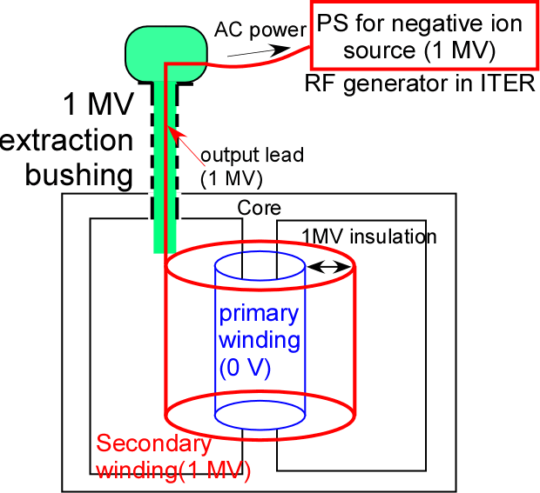
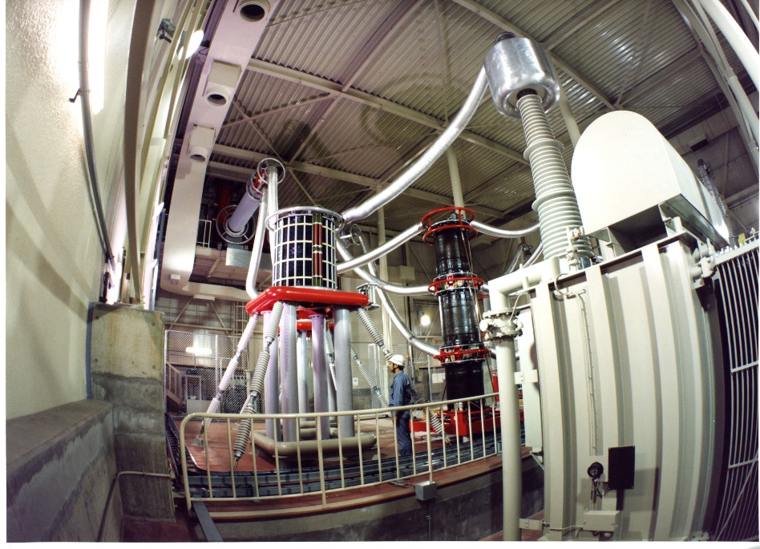
1 MV insulating transformer
【Function of the insulating transformer】
To feed AC power to the PS for negative ion source at DC 1 MV potential.
Extraction bushing
AC power
~2.5 m
transformer
Insulating transformer for JT-60U (DC 500 kV, 10 s)
A bushing extracting output lead at 1 MV from the transformer to the air is needed.
(Issue) φ=2 m, H=10 m insulator is required for 1 MV in ITER.
No existing manufacturing facility.

Slide 4
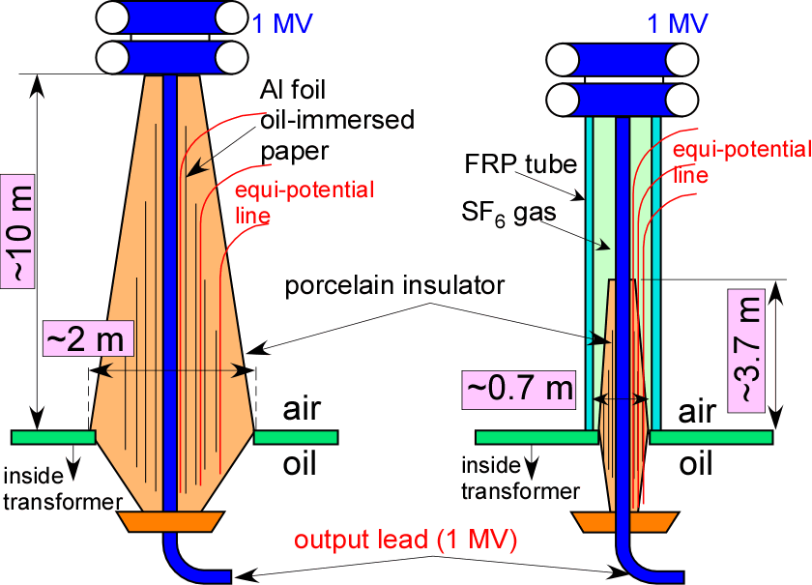
New 1 MV bushing
Condenser bushing(porcelain + aluminum foil + oil-immersed paper)
【New device】 Composite bushing
Combined with
Simple FRP tube
Small condenser bushing
Coax. of
Air insulation
outside
Air insulation
outside
@0.4 MPa
SF₆ gas insulation
inside
Oil insulation
inside
The 1 MV bushing with manufacturable parts has been newly devised.
Not manufacturable
with manufacturable parts

Slide 5
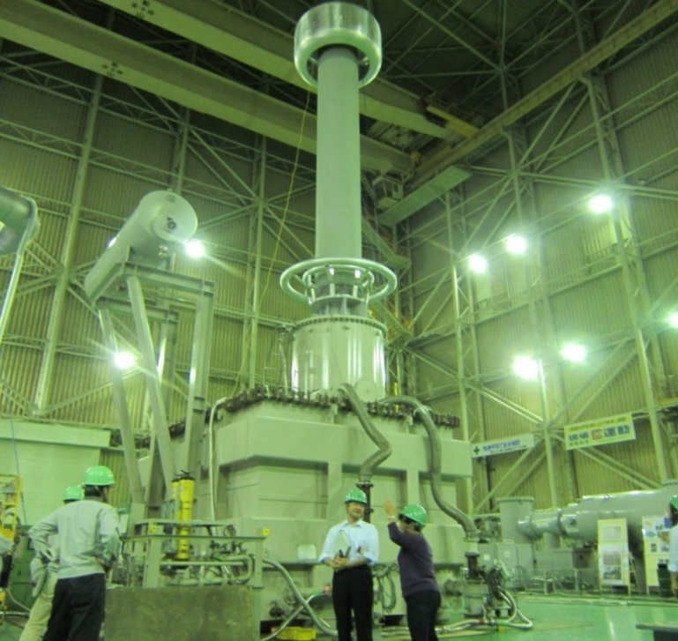
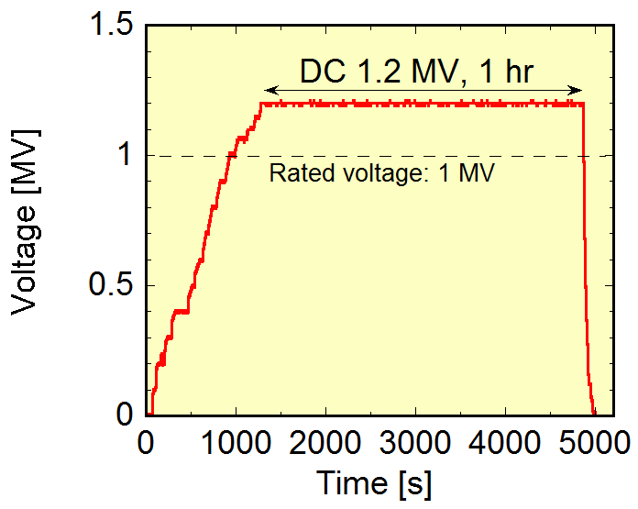
1 MV insulating transformer mockup
The 1 MV insulating transformer mockup has demonstrated stable insulation of 1.2 MV for 1 hr (including 20 % margin of rated voltage).
The ITER requirement was achieved.
Composite
bushing
Transformer
The 1 MV insulating transformer has been successfully developed for ITER.

Slide 6
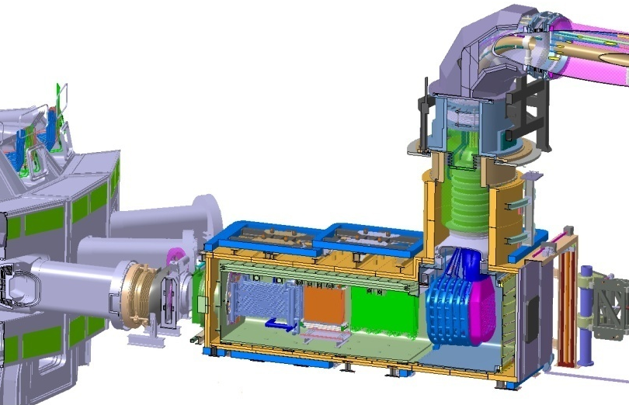
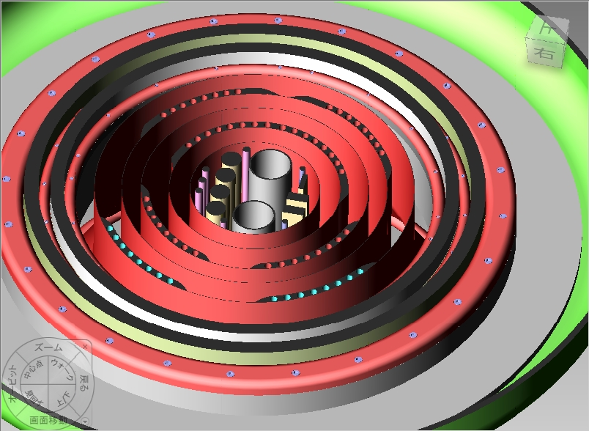
HV bushing
An insulating feedthrough to transmit 1 MV.
Tritium and vacuum boundary.
The world’s largest ceramic ring is utilized as five-stage insulator (FEC2010).
Transmission line
Cross sectional view
Conductors
SF₆
Cooling water pipes
φ1.46 m
HV bushing
~70mm
to Tokamak
D₀ beam
1MV
D-
200kV
800kV
Vacuum
400kV
600kV
Beam source
All conductors and pipes at five different potentials (200 kV~1 MV), electrically shielded by five coaxial cylindrical screen (e.g. φ=500 mm, H=3.6 m), in a single vacuum space in order to minimize the tritium boundary.
Even with the world’s largest ceramic ring (φ1.46 m I.D.), insulation distance of each gap is no more than around 70 mm.

Slide 7
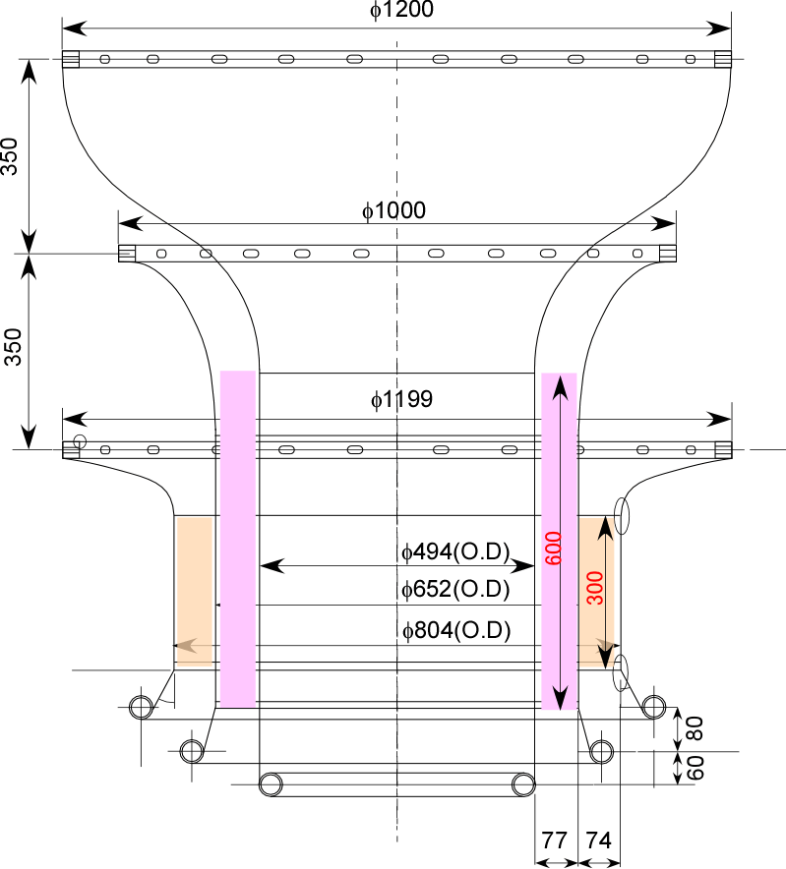
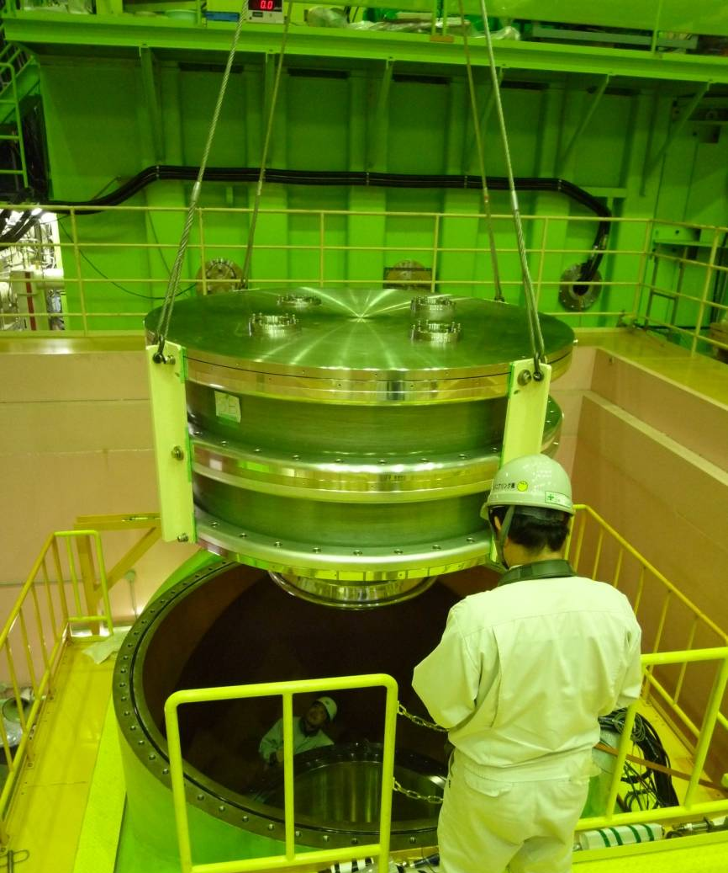
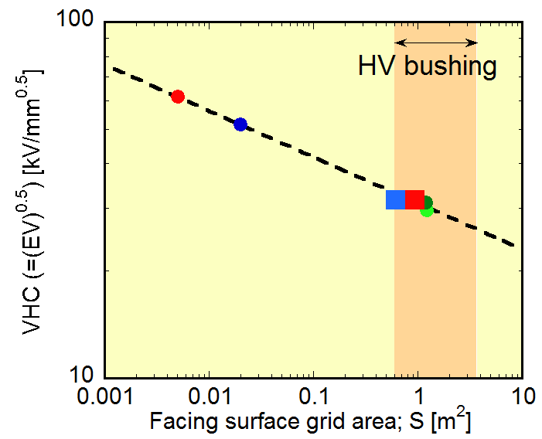
(Issue) Voltage holding in large coaxial electrodes is not clarified in the field of vacuum insulation.
Using this scaling, two-stage mockup was designed and and tested.
Inner structure
The dependence of voltage holding capability on surface area was investigated in wide range of surface area.
Two-stage mockup
φ2000 mm
Range of
VHC=31*S^{-0.13}
Stable insulation of 480 kV for 1 hr.
(including 20 % margin of rated voltage for ITER )
→vacuum insulation design for 1 MV is validated.
The empirical scaling for large electrode has been obtained.
Vacuum insulation of the HV bushing for ITER has been ensured.

Slide 8
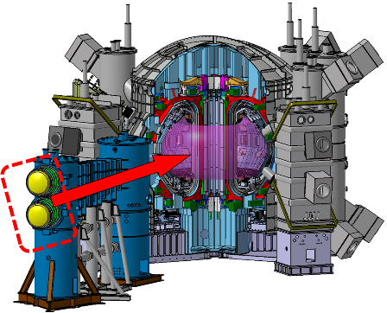
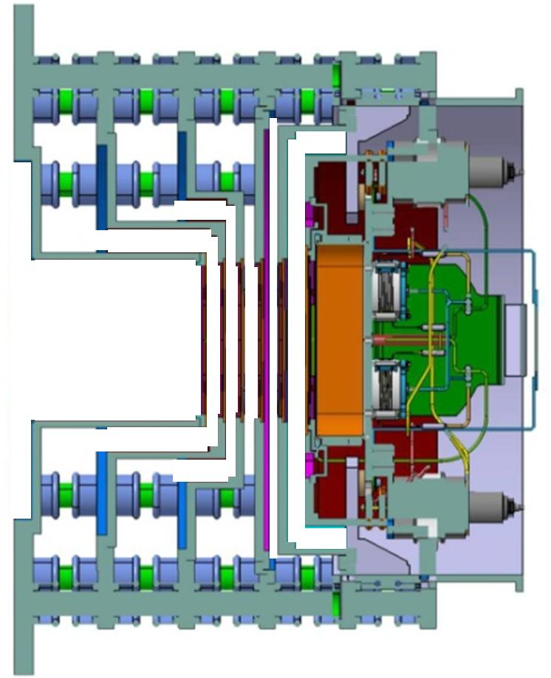
NBIs on ITER and JT-60SA
Cs-seeded negative ion source & Multi-Aperture Multi-Gap (MAMuG) accelerator
(Issue) Long pulse production
(Issue) Long pulse acceleration
ITER NBI
JT-60SA N-NBI
RF-driven negative ion source
Arc-driven negative ion source
Five-stage accelerator
Three-stage accelerator
2.7 m
2 m
D⁻ beam
1 MeV
40A, 200 A/m²
3600 s
D⁻ beam
500 keV
22 A, 130 A/m²
100 s
1.8 m

Slide 9
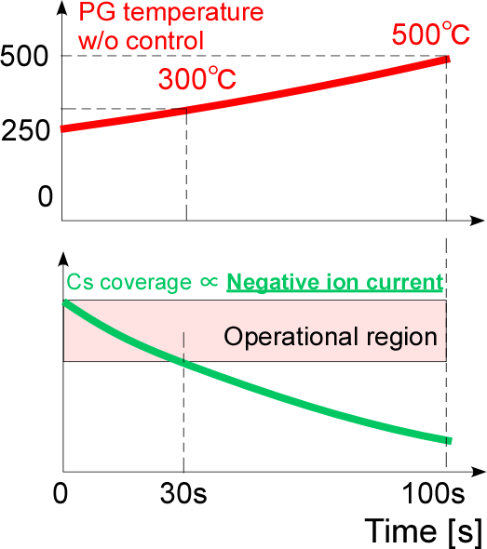
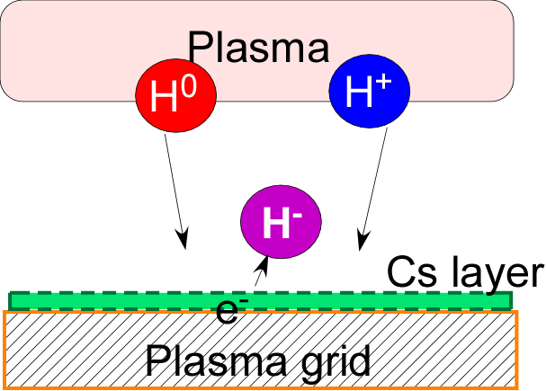
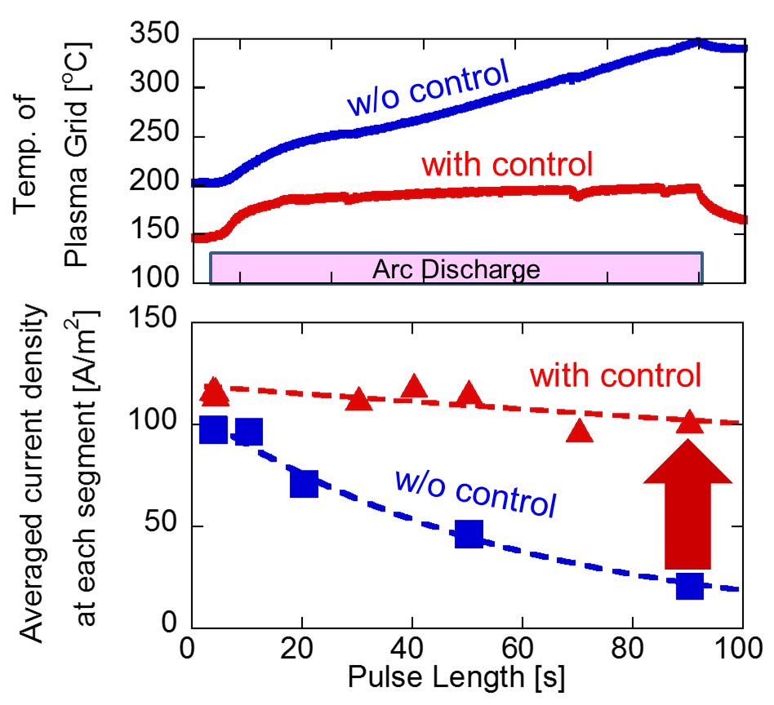
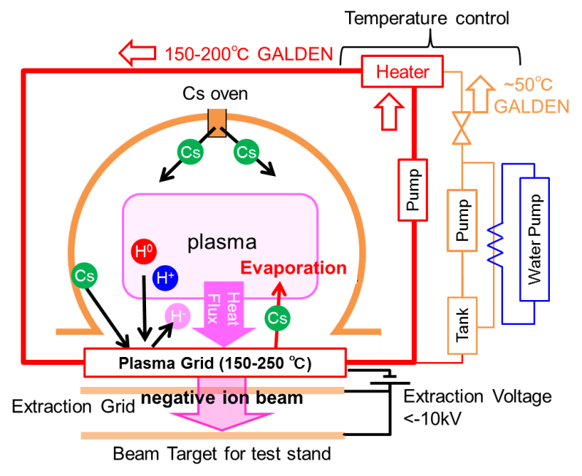
Long pulse production in Cs-seeded source
Plasma grid (PG) temperature control is issued for long pulse production.
Low work function
Active control of PG temp.
A 120-130 A/m² beams have successfully produced for 100 s (JT-60SA requirement).
Active temperature control of plasma grid has demonstrated the long-pulse beam production.

Slide 10
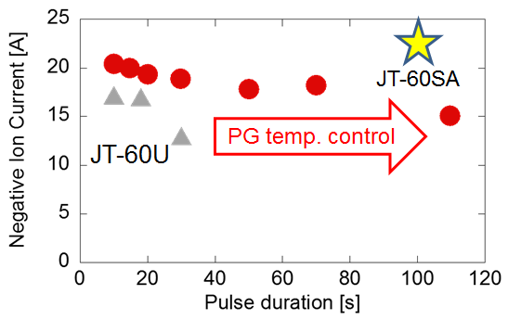
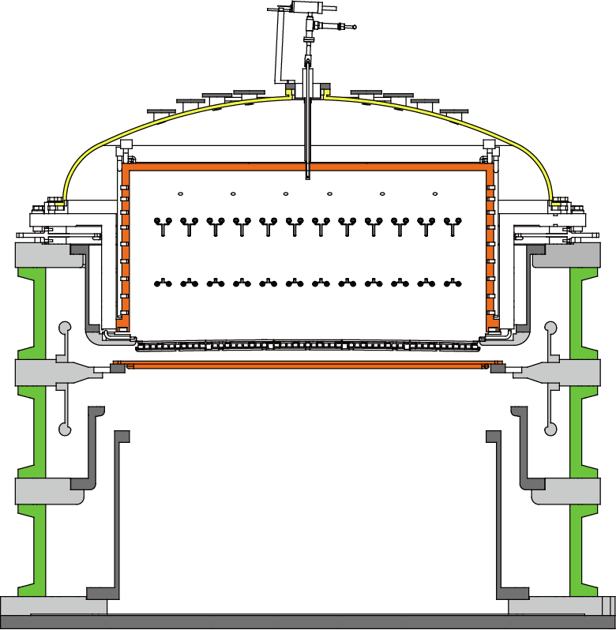
Achievement of long-pulse high-current production
Active PG temperature control has been applied to produce high current and long pulse negative ion beam in JT-60 negative ion source.
JT-60 negative ion source
Source plasma
1.8 m
Beam target
IR camera
Long pulse production of 15 A negative ion beam, equivalent to 70 % of the beam current (22 A) for JT-60SA, has been achieved for 100 s.
The reduction of beam current on the pulse duration time will be recovered by the feedback control of arc discharge power to produce the higher-current beam.

Slide 11
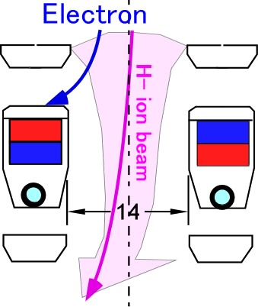
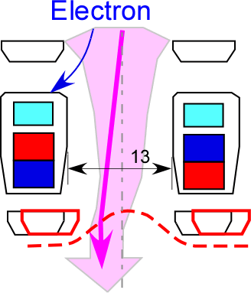
Long pulse acceleration in MAMuG accelerator
original
New
PG
MeV accelerator in JAEA
Negative ion source
EXG
extractor
magnet
FRP
Cooling channel
Aperture
offset(0.7 mm)
Acceleration grids
【Issue and solution】
Heat load on EXG
➔cooling channel close to heat receiving surface
310→150℃ around magnet (<allowable temp. (200 ℃) )
Grid heat load by beam deflection
➔controlling the beam steering by aperture offset
Grid heat load: 10 % of input power
H- beam
1 MeV
0.5 A, 200 A/m²
3600 s
2 m
Low grid heat load enables steady state operation.
The modification enabled the long pulse beam acceleration.

Slide 12
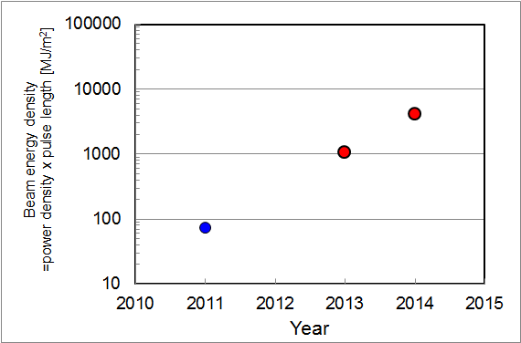
Achievement of long pulse acceleration
ITER
1 MeV, 40 A, 3600 s
1 MeV, 200 A/m², 60s
(facility limit)
683 keV, 100 A/m², 60 s
JT-60SA
0.5 MeV, 22 A, 100 s
882 keV, 130 A/m², 9 s
980 keV, 185 A/m², 0.4s
Recovery from earth quake 3.11
Beam energy density has been increased two orders of magnitude in the last two years.
No degradations of voltage holding and beam optics during long pulse acceleration.
Increases of beam energy and pulse length are in progress with further conditionings for ITER and JT-60 SA.

Slide 13
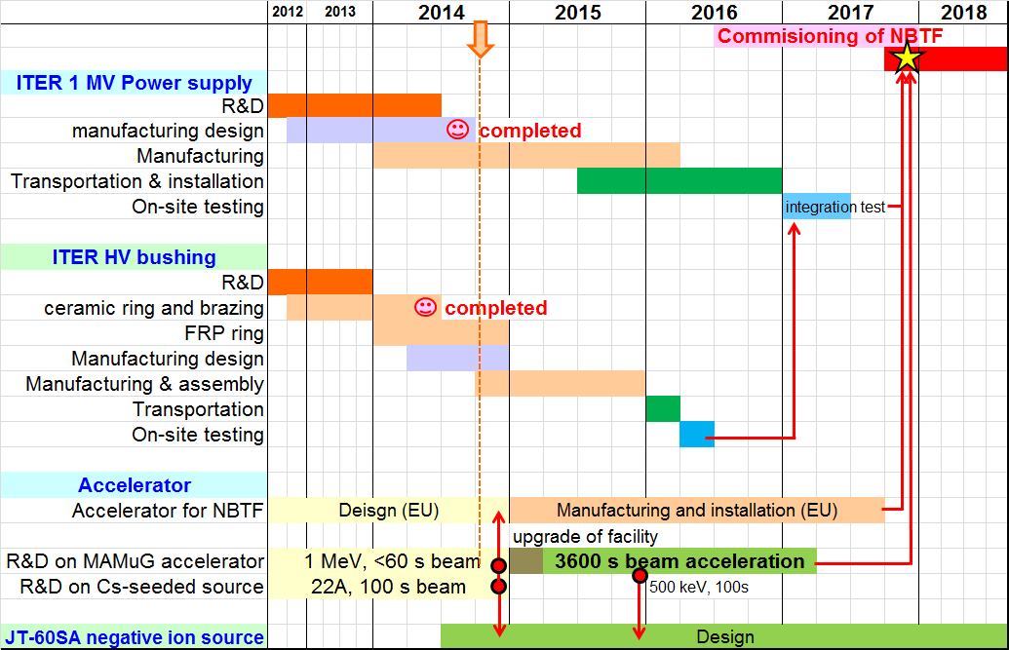
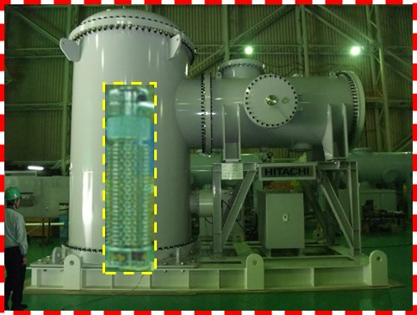
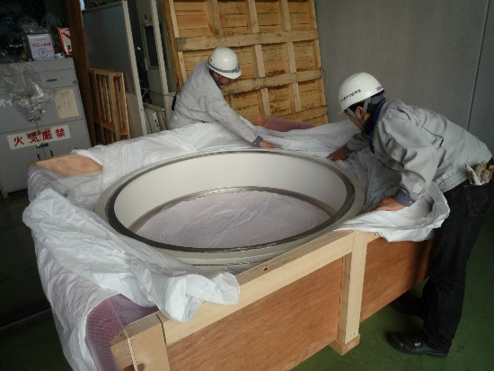
Present status and schedule
The procurement activities on ITER NBTF are in progress as scheduled in Japan.
1.3 MV testing PS (June 2014)
5 m
Brazing of ceramic (May 2014)
1.56 m

Slide 14
Summary
In order to realize NB system for ITER and JT-60SA, key technologies have been developed in the past two years.
DC high voltage technology;
The new composite bushing with manufacturable parts,
→The 1 MV insulating transformer has been realized.
1MV vacuum insulation scaling of large electrodes to be scalable to ITER
→The design of the HV busing has been ensured.
Beam production & acceleration;
Active temperature control technology of plasma grid in Cs-seeded negative ion source
→A 100 s negative ion beam production at 15 A.
Beam steering and heat removal technology on MAMuG accelerator
→A 60 s beam acceleration at 683 keV, 100 A/m², that is two orders of magnitude longer than the previous achievement.

Slide 15
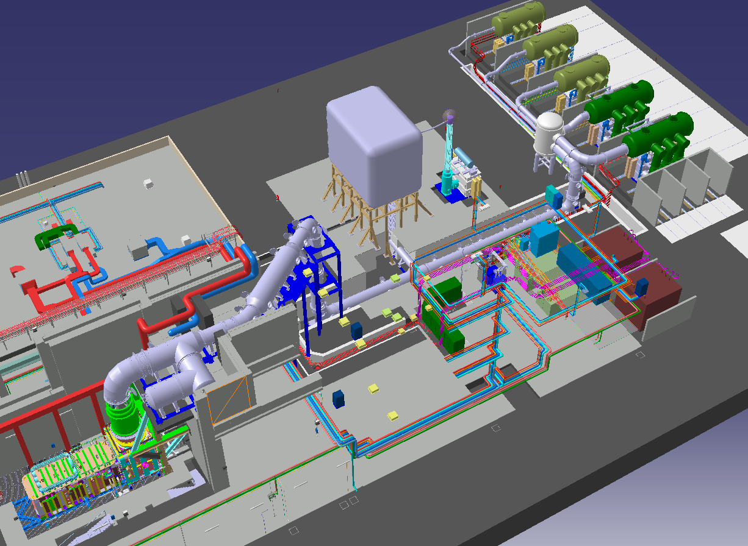
Neutral Beam Injector (NBI) System
Two NBIs in ITER
NBTF identical to ITER in Padova
1 MV
Insulating transformer
DC generator
200 kV x5
P/S for negative ion production
Transmission line
Power supply component
HV bushing
~100 m
To tokamak
D⁻
D⁰←
Beam source (negative ion source+ accelerator)
Beam line components

Slide 16
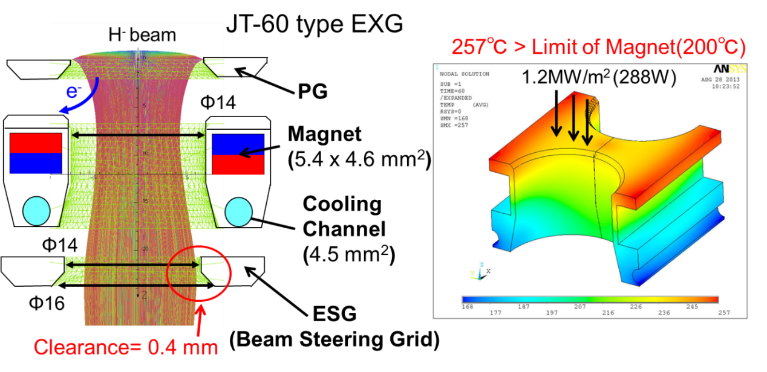
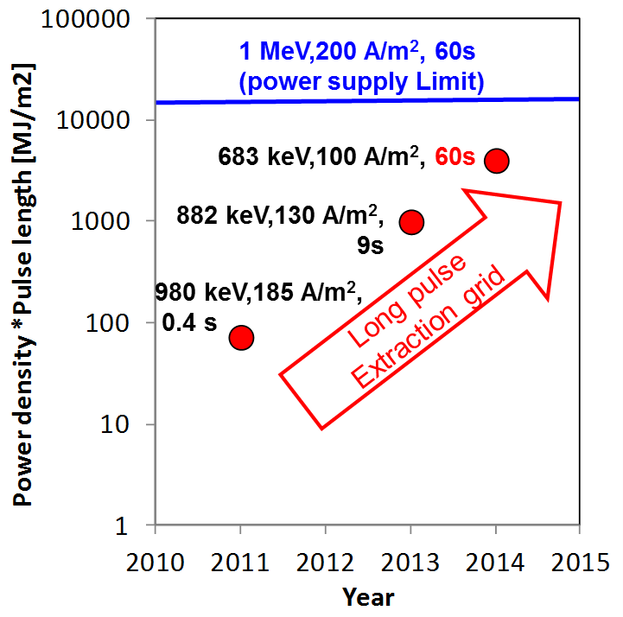
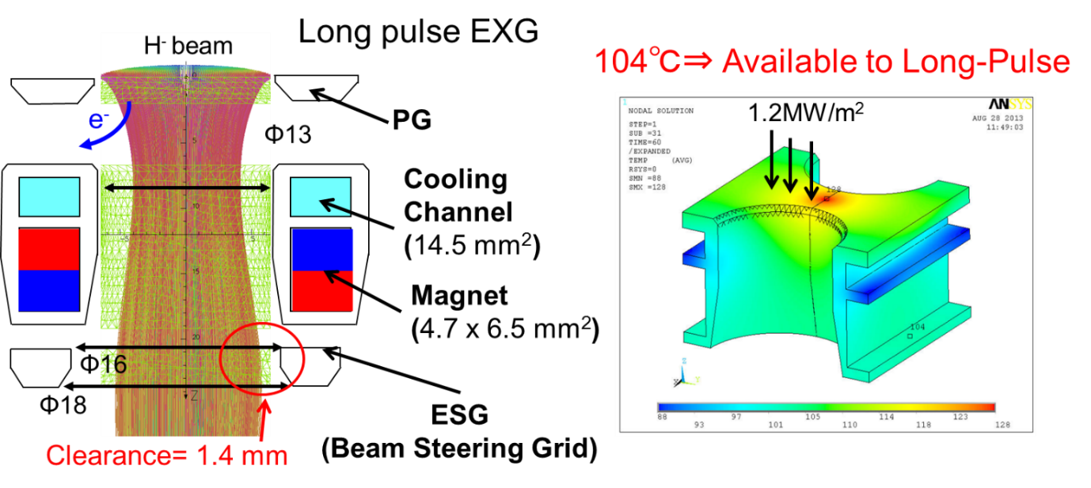
Long pulse acceleration of high power density beam
Heat load on the extraction grid is issued for long pulse beam acceleration.
【issue】Limited less than 1 MW/m².
High-power and long-pulse beam acceleration of 70 MW/m² for 60 s was achieved.

Slide 17
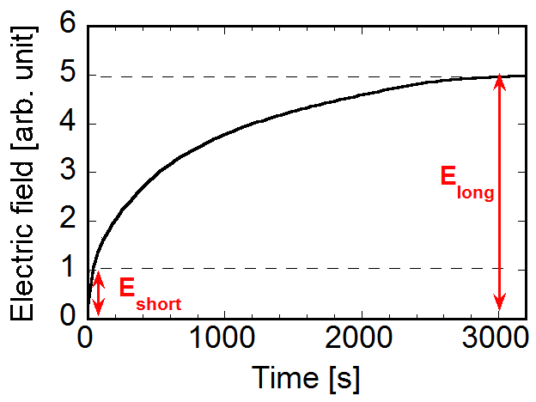
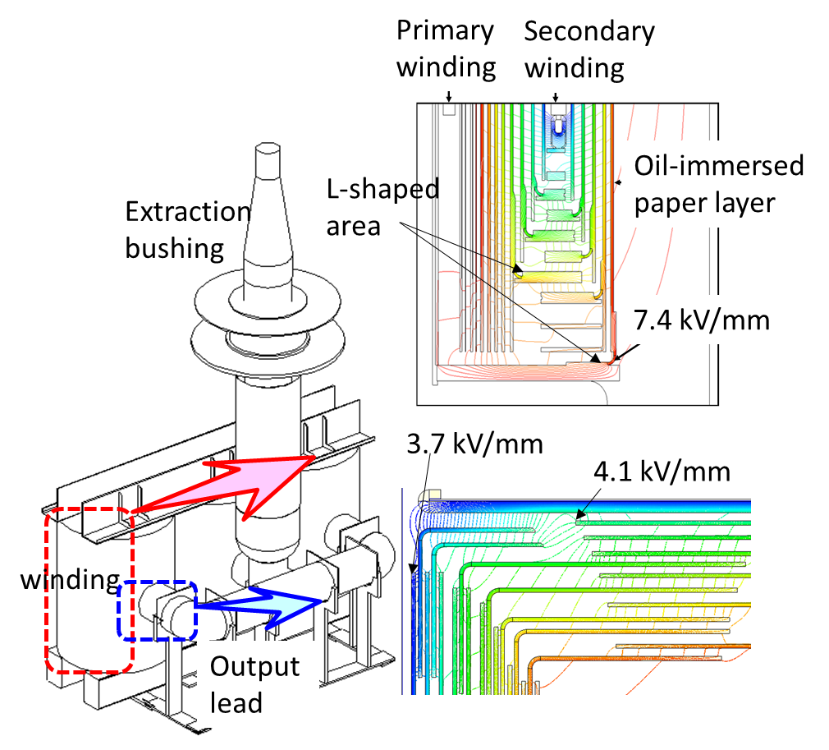
Insulation structure between windings for DC 1 MV
Time constant >3000 s
By applying existing insulation structure(DC 500 kV, 10 s) to DC long-pulse operation;
→Five times higher electric field (E_{long}/E_{short} = 5)
→Ten times higher in ITER (1 MV)
【Issue】
Dimension drastically increases.
Ten times larger transformer? Too large installation space!
Not acceptable in ITER.
【New device】
Insulation structure with insulation oil and oil-immersed paper layer to realize a feasible transformer
Insulation structure inside the transformer to sustain 1 MV for long pulse operation was established.
and barrier
Allowable electric field: 16 kV/mm

Slide 18
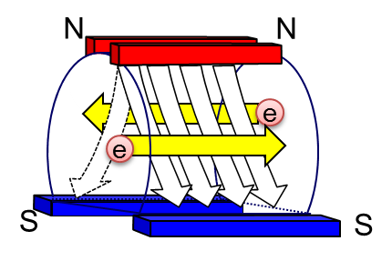
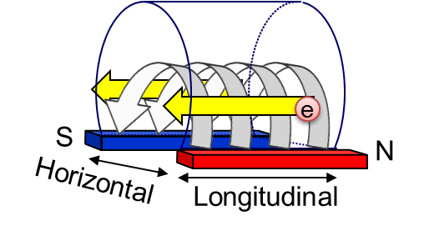
Improvement of spatial uniformity of
negative ion beam
Tent-shaped magnetic filter
Non uniform negative ion beams causes local grid heat load that prevents long pulse operation.
B×∇B drift direction
Magnetic field line
Negative ion beam
Due to magnetic (B×▽B) drift, primary electron drifts in one direction. Non-uniform negative ion production occurs in the source.
Beam Uniformity : 69 % ⇒ 83 %
32 A negative ion beam from total extraction area
22 A from segment 2~4.
Requirement on JT-60 SA was satisfied.

