Slide 1
Non-linear MHD simulations for ITER
G. Huijsmans¹, F. Liu¹, A. Loarte¹, S. Futatani³, F. Koechl⁴, M. Hoelzl⁵, A. Garofalo⁶, W. Solomon⁶, P.B. Snyder⁶, E. Nardon², F. Orain², M. Bécoulet² and JET contributors
Non-linear MHD modelling of ELMs and their interaction with RMPs in rotating plasmas
M. Bécoulet², F. Orain², J. Morales², X. Garbet², G. Dif-Pradalier², C. Passeron², G. Latu², E. Nardon², A. Fil², V. Grandgirard², G. Huijsmans¹, S. Pamela⁷, A. Kirk⁷, P. Cahyna⁸, M. Hoelzl⁵, E. Franck⁵, E. Sonnendrücker⁵, B. Nkonga⁹
¹ITER Organization,²CEA/IRFM, ³Ecole Centrale de Lyon, ⁴TU Wien, ⁵IPP/Garching, ⁶General Atomics, ⁷CCFE/Culham,
⁸IPP-ASCR/Prague, ⁹Universite de Nice

Slide 2
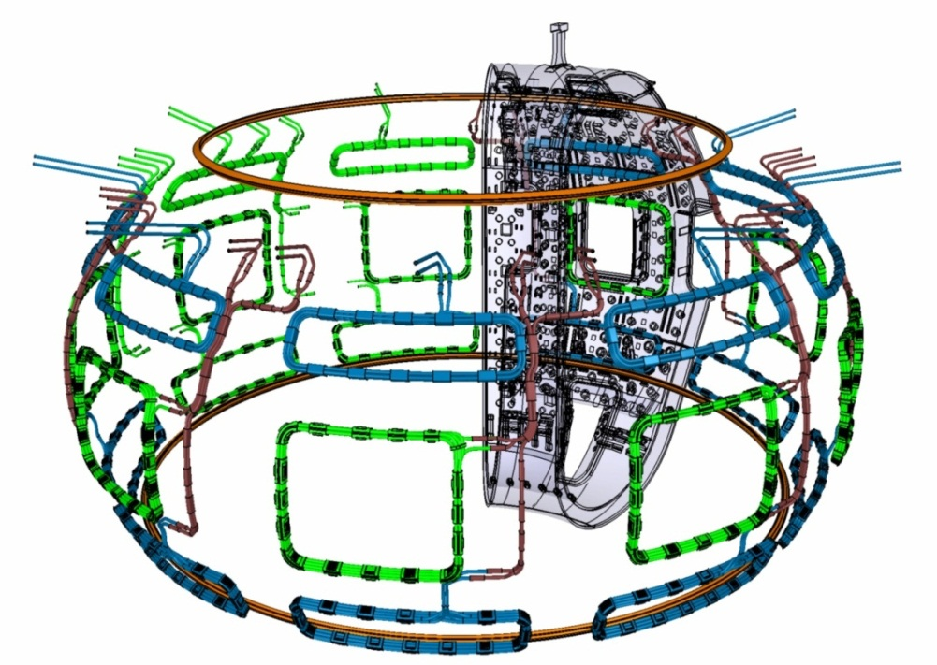
ELM Control in ITER
Natural ELMs in ITER
Exp. collisionality scaling: ∆W=20 MJ
Mitigation to 0.7MJ required
ITER ELM control methods
Magnetic perturbation coils (RMP)
Pellet injection
Alternatives?
Vertical kicks (Y. Gribov, PPC/P3-21)
QH-mode
Physics basis for ITER
Prediction natural ELM size requires simulations of multiple ELM cycles
Physics of RMP ELM mitigation
Minimum pellet size for ELM trigger, pellet triggered ELM size
Conditions for QH-mode in ITER
ITER ELM coils

Slide 3
Outline
Introduction
ITER ELM control
Non-linear MHD code JOREK
MHD model, flows
ELMs, multiple cycles
Diamagnetic flow
ELM control:
RMPs, ELM mitigation
Pellet pacing in JET
QH-mode in DIII-D
Narrow Scrape-off Layer MHD Stability in ITER
Conclusions
TH/6-1Rb
Becoulet et al.
TH/6-1Ra
Huijsmans et al.

Slide 4
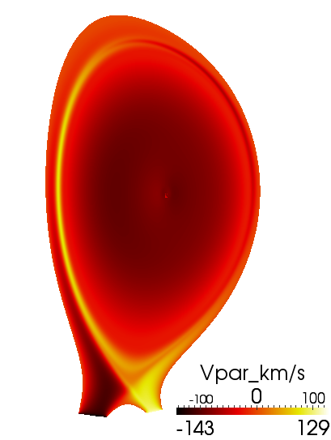
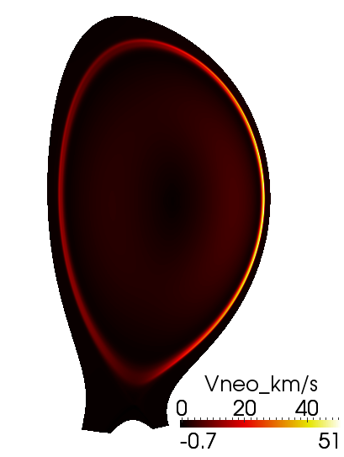
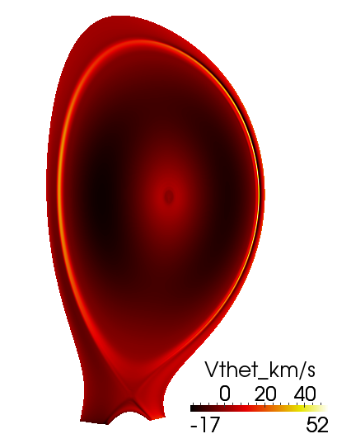
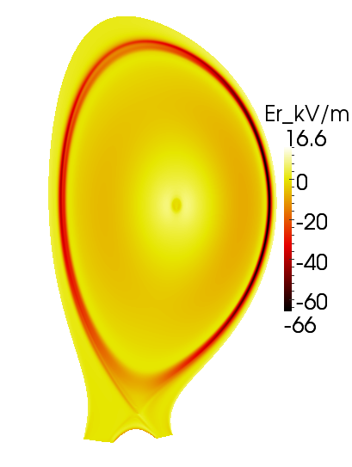
Non-Linear MHD code JOREK
3D toroidal geometry (reduced) MHD code
full domain, open-closed field lines, resistive wall, vacuum, PF coils
developed within (mostly) European collaboration
including flows: ion and electron diamagnetic flows, source of toroidal rotation, neoclassical poloidal viscosity
divertor sheath boundary conditions
Stationary equilibrium flows
JET #77329
V//=C_{s}
V_{neoclassic}
V_{poloidal}
E_{radial}

Slide 5
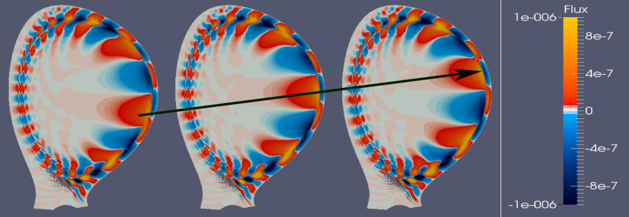
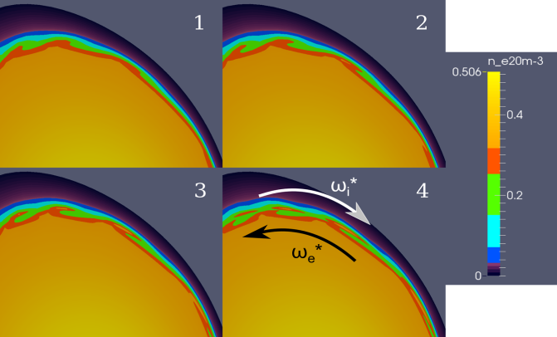
ELM Simulation: Mode Rotation
Observations in MAST, AUG, KSTAR: ELM precursor rotating poloidally mainly in the electron diamagnetic (=ExB) direction
ELM simulations with consistent poloidal, diamagnetic and parallel flows show linear ballooning mode (~precursor) moving in electron diamagnetic direction (~0.5ω_{e}*, in the lab frame, Vpol~20-40 km/s)
mode rotation in ion diamagnetic direction in plasma frame (~0.5ω_{i}*)
In the non-linear phase:
Reduction of flows
Filaments are sheared off in the opposite (ion) direction due to non-linear driven n=0 poloidal flow

Slide 6
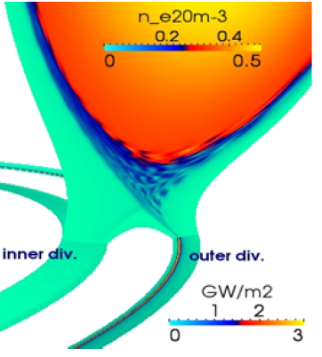
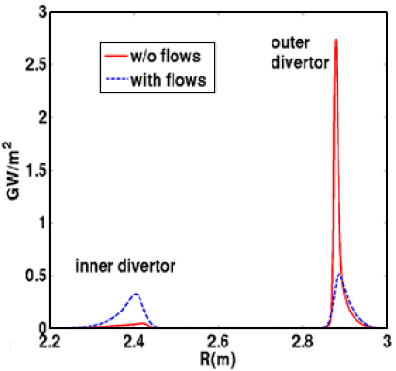
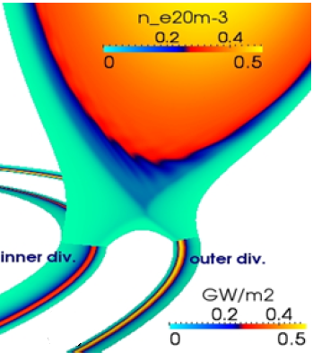
ELM Simulations with Diamagnetic Flows
Experimentally, ELM energy losses are predominantly (2:1) towards the inner divertor
Previously, ELM MHD simulations (not including diamagnetic flow) yielded larger heat load asymmetry towards the outer divertor
Including diamagnetic flows leads to a symmetric distribution (1:1) of ELM divertor heat loads
ω*=0 (no diamagnetic flows)
including ω*,V_{neo}, V_{tor}
Divertor Power

Slide 7
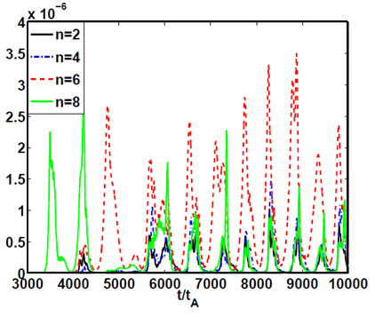
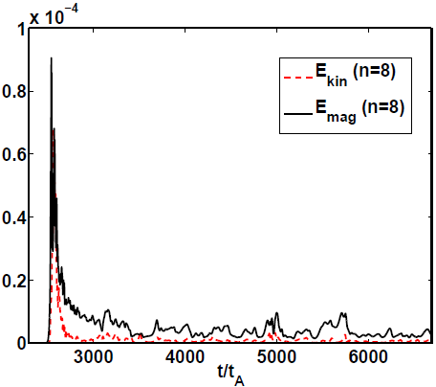
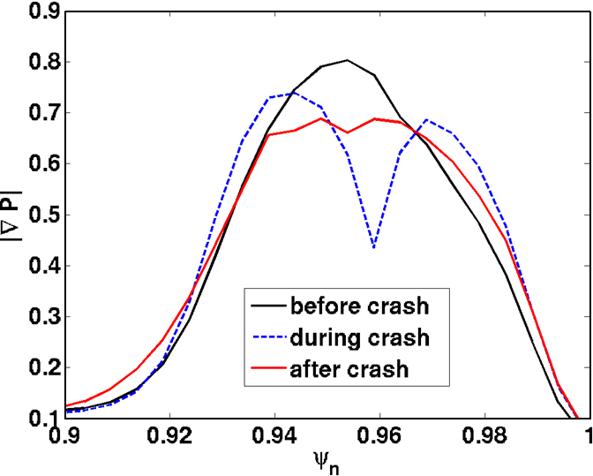
MHD Simulation of Multiple ELM Cycles
Without diamagnetic flow:
residual MHD after ELM crash prevents pedestal rebuild => single ELM
ELM size depends on initial conditions (no reliable ELM size predictions)
Including diamagnetic flows: regular ELMy regime
Stabilisation of residual MHD by diamagnetic flows allows pedestal rebuild
Small high frequency ELMs (~500-2000 Hz)

Slide 8
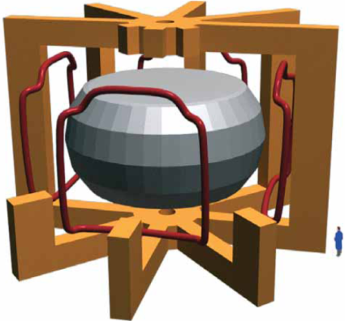
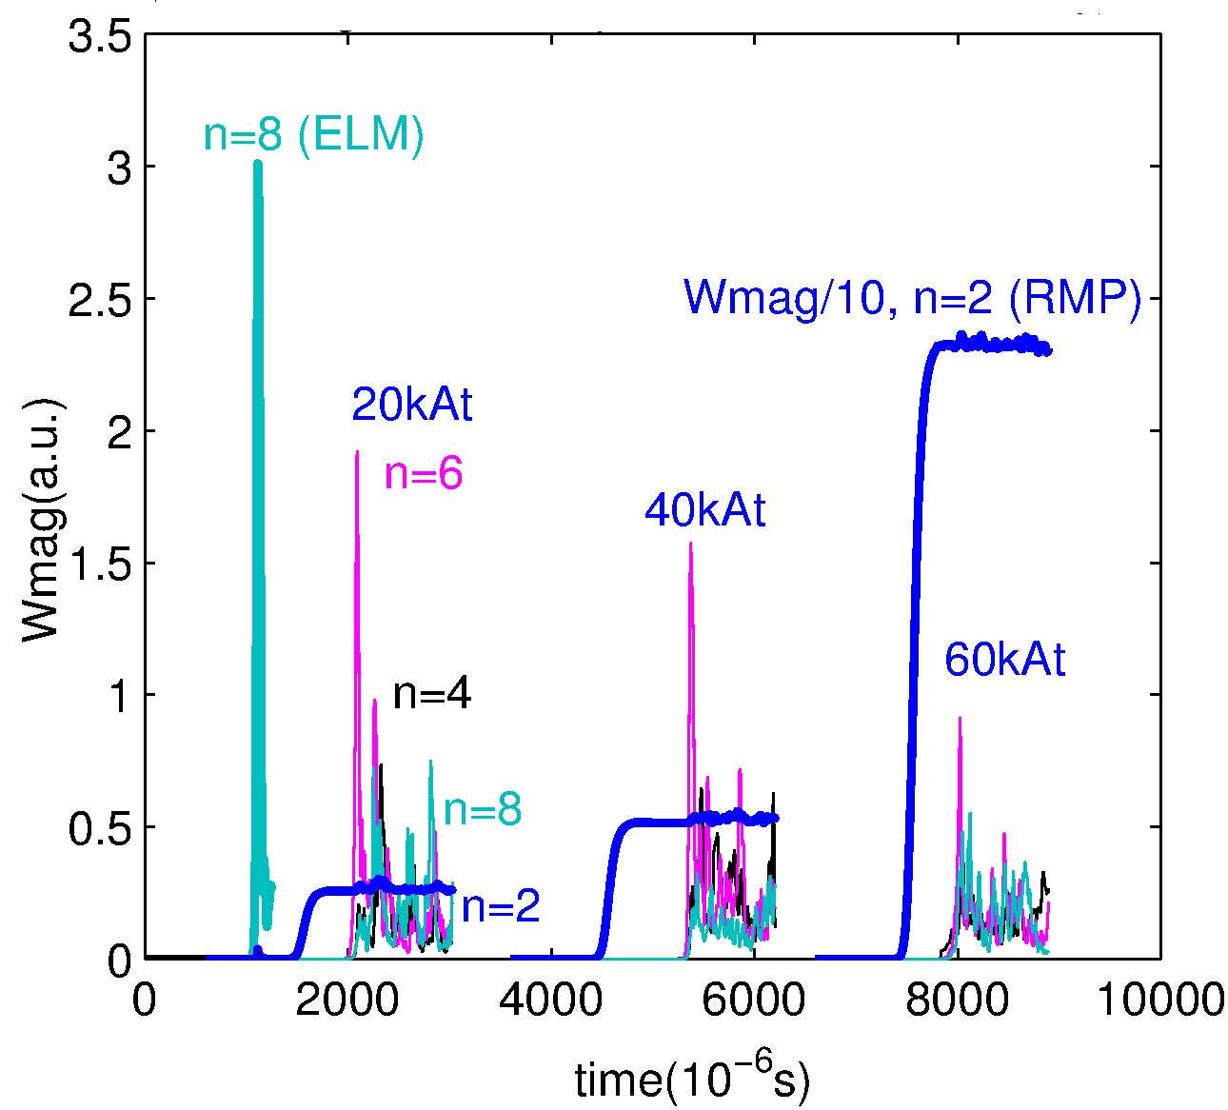
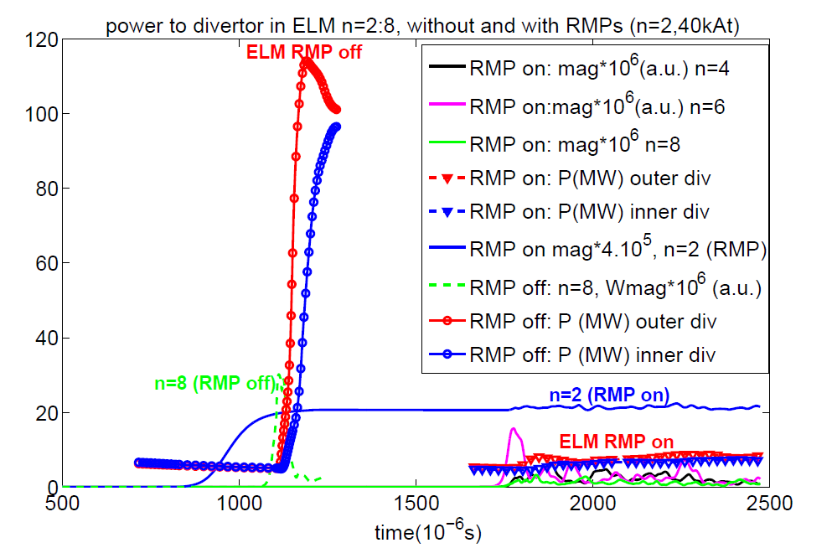
RMP ELM Mitigation
JET #77329, Error Field Correction Coils (EFCC), n=2
Large discrete ELMs are replaced by small bursty events- continuous MHD
Due to non-linear coupling of toroidal harmonics by low-n RMP
Threshold in RMP coil current
Divertor peak heat flux reduced up to factor ~10
[Becoulet, PRL2014]
magnetic energy perturbation
RMP off
RMP on
density perturbation

Slide 9
ELM Mitigation by RMPs
Ballooning mode structure of natural ELM changes to modes with tearing parity
Island chains form at q = m/n = 9/4, 14/6 and 15/6
Modes non-linearly driven through coupling with n=2 RMP fields
no RMP, n=0-8
n=2 RMP
n=2 RMP, n=0-8

Slide 10
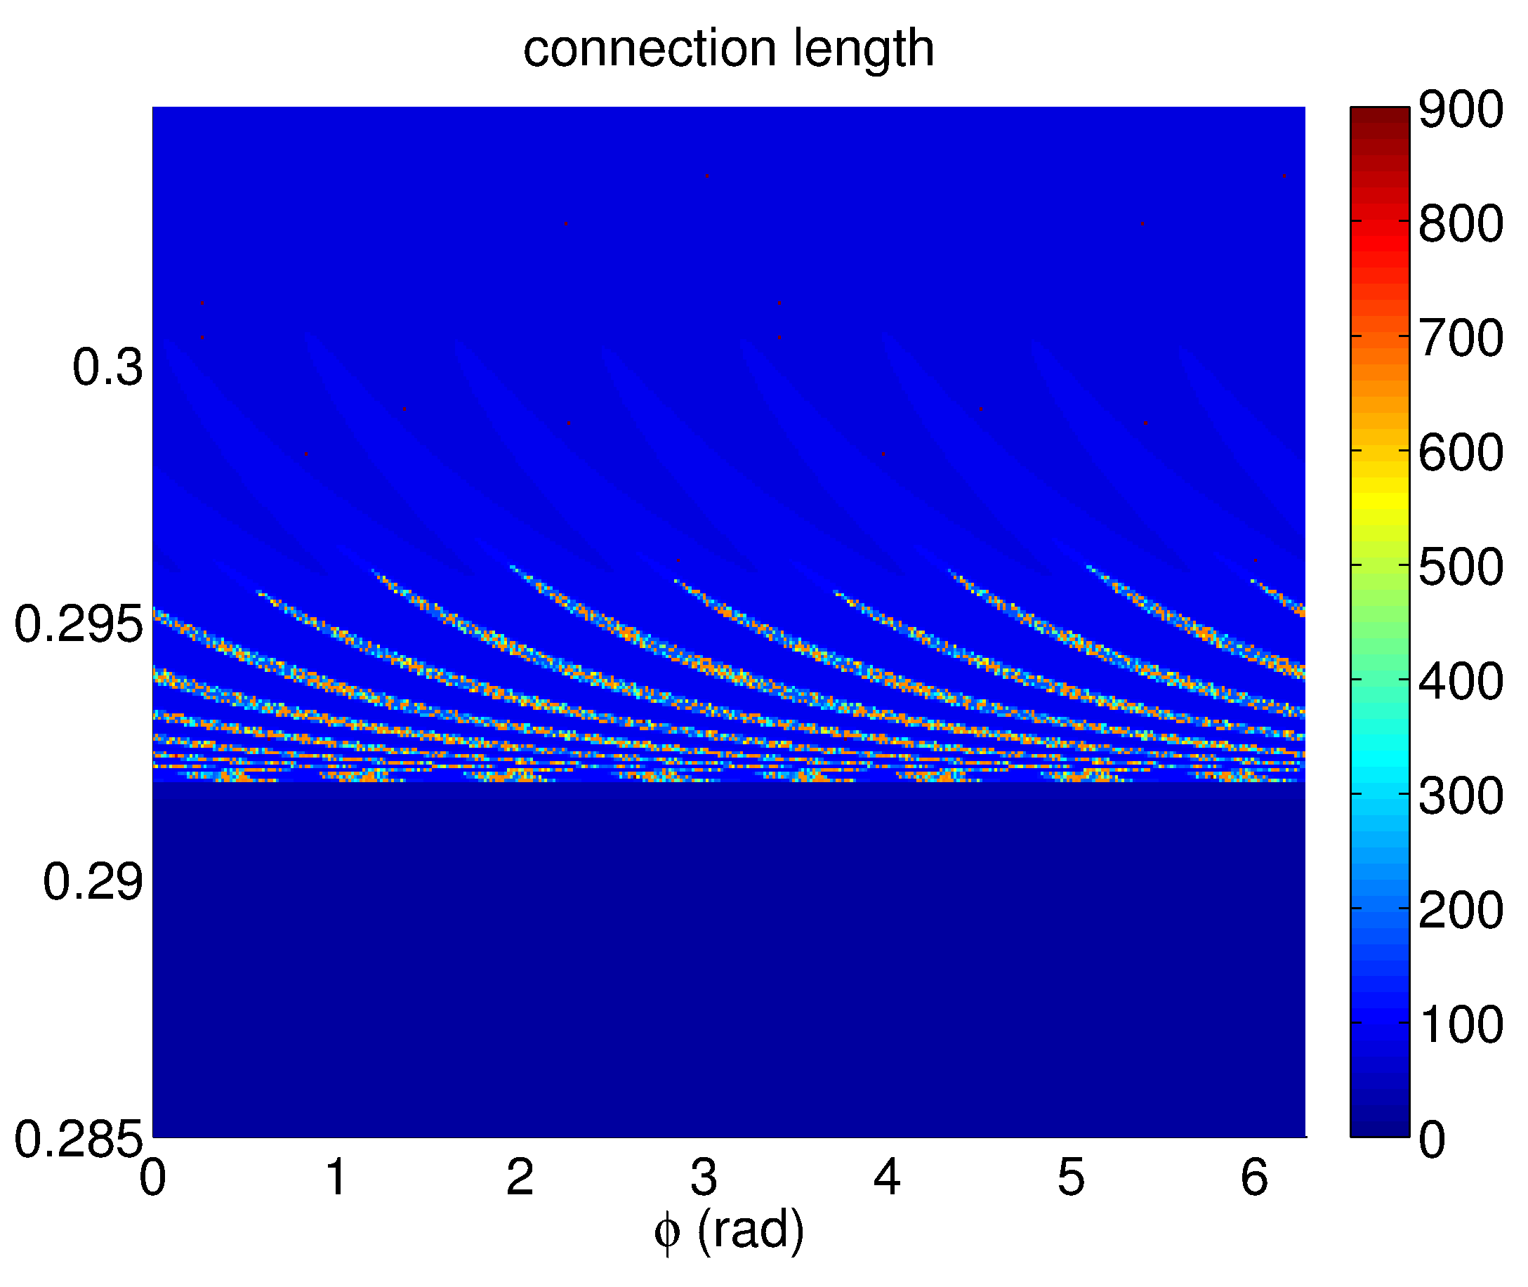
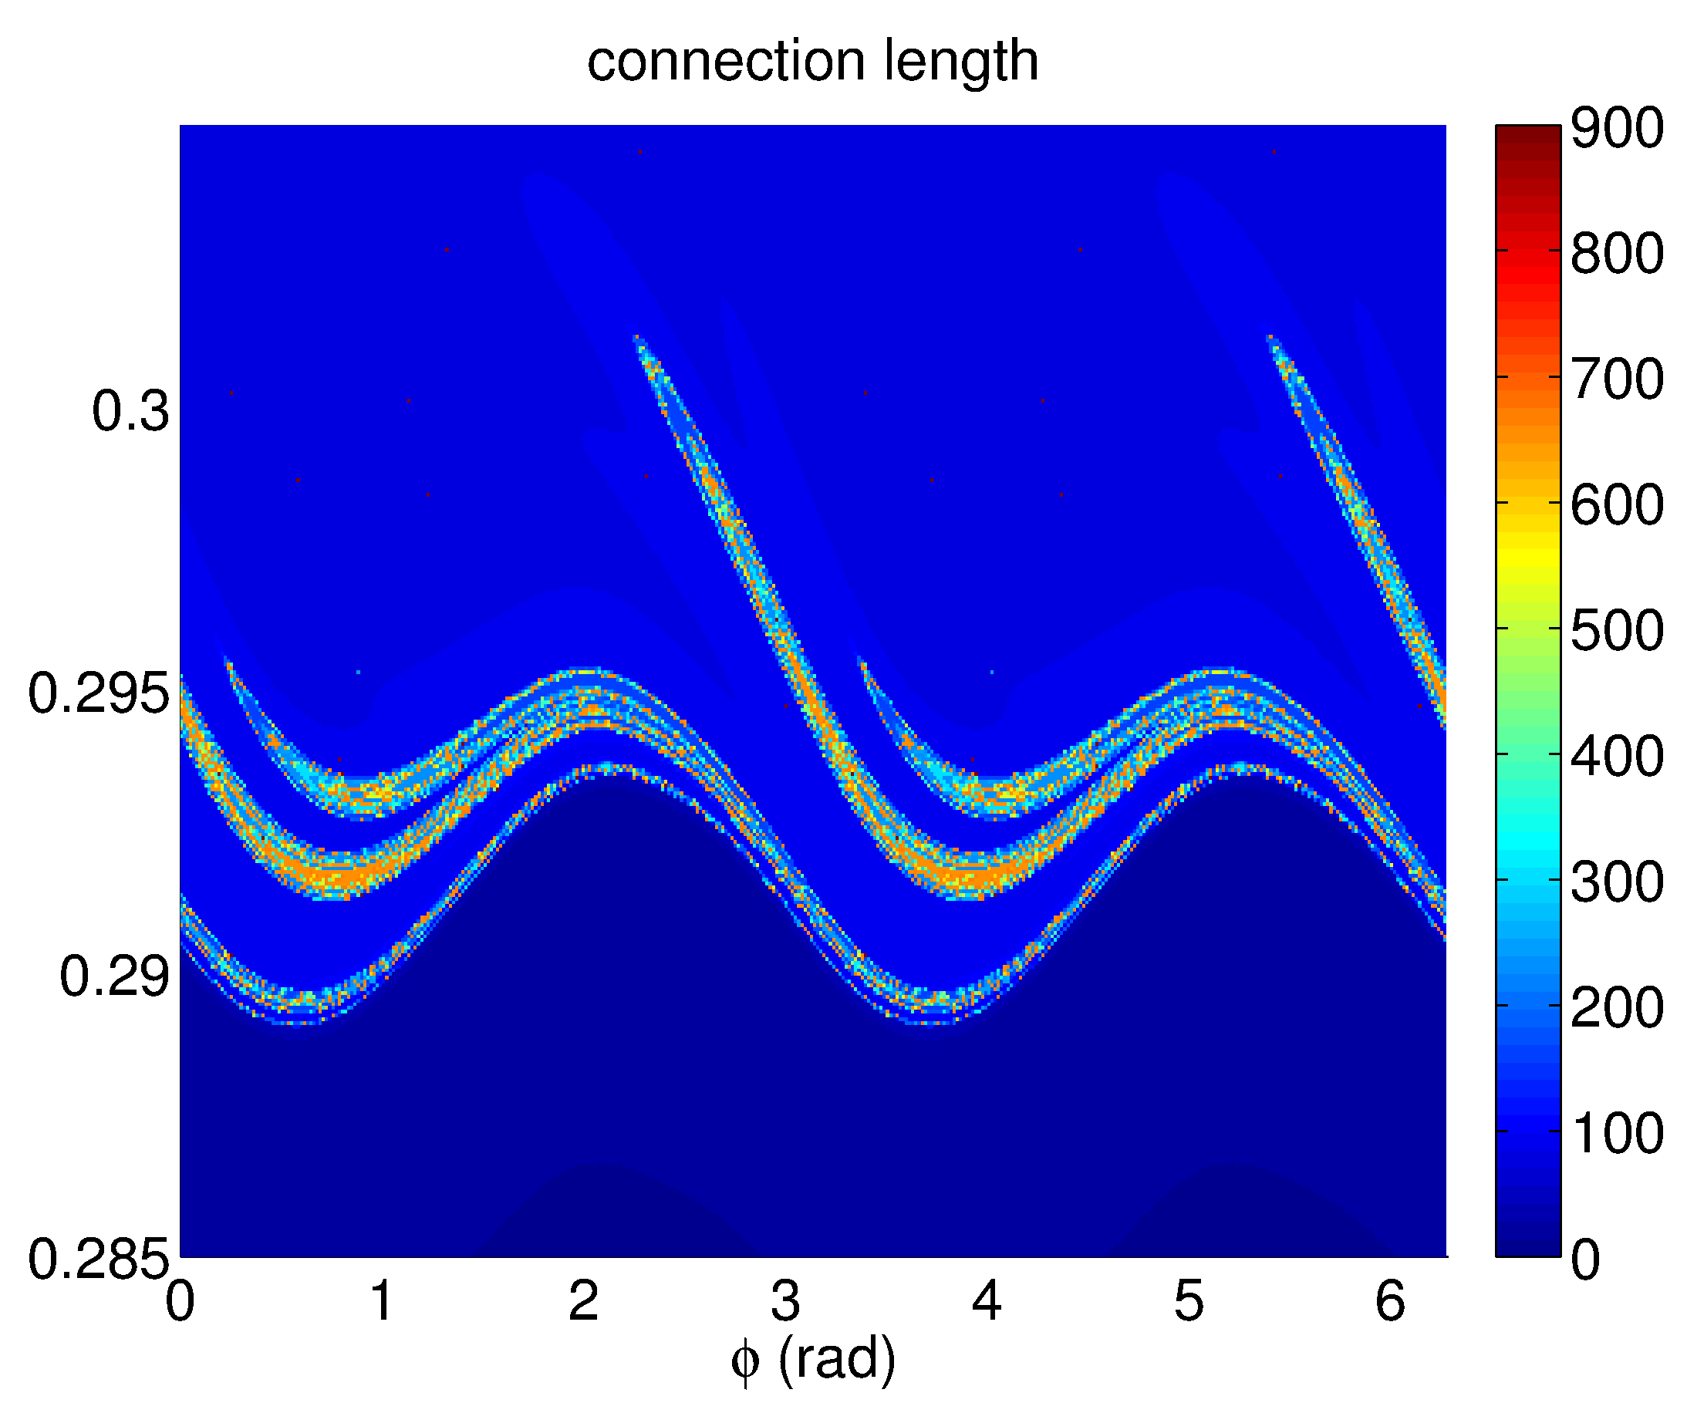
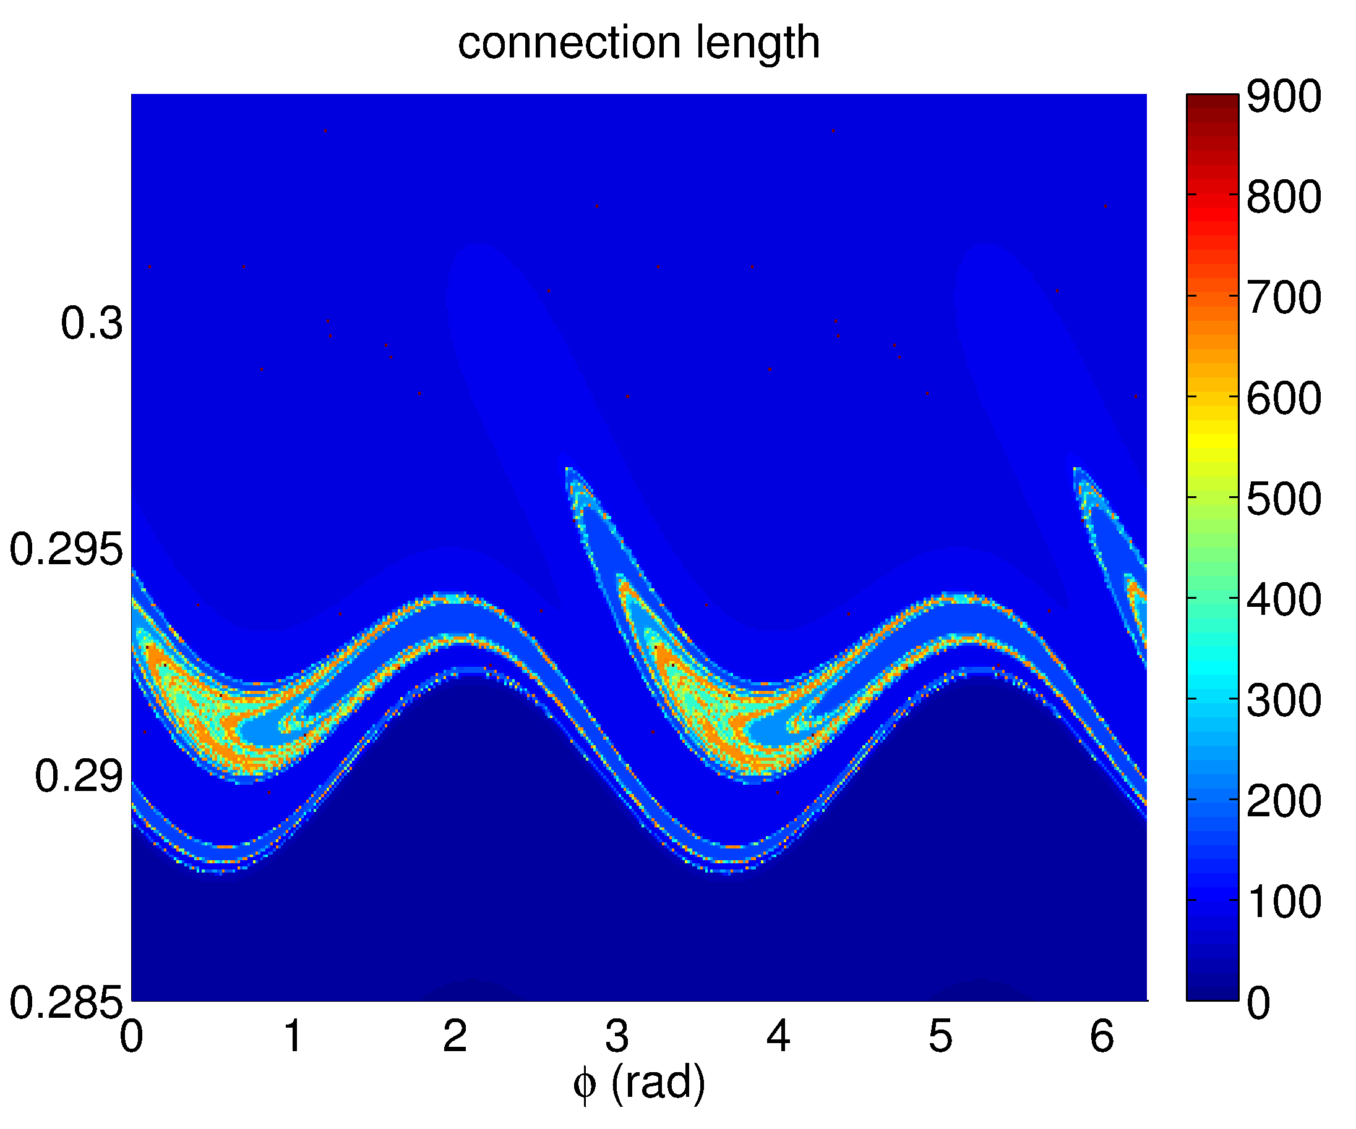
RMP Mitigated ELM Divertor Foot Prints
[Cahyna, TH/P6-1]
The divertor footprints of the simulated mitigated ELMs mainly exhibit structures created by RMPs (here n=2), modulated by other toroidal harmonics of mitigated ELMs (n=4,6,8)
Mitigated ELM perturbation not locked to RMP
RMP off: rotating footprints with main mode structure n=8 ELM
RMP(n=2)+ELMs: n=2,4,6,8
RMP n=2 only: static footprints
connection length
connection length

Slide 11
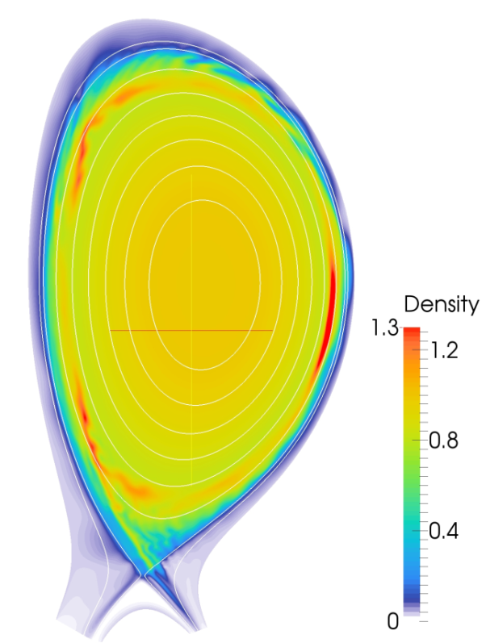
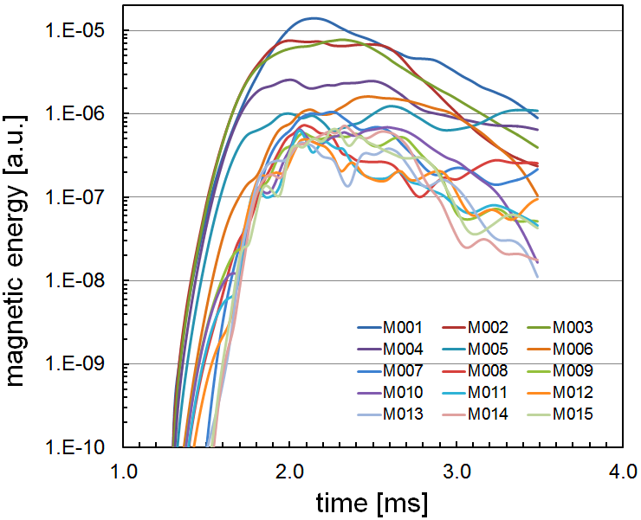
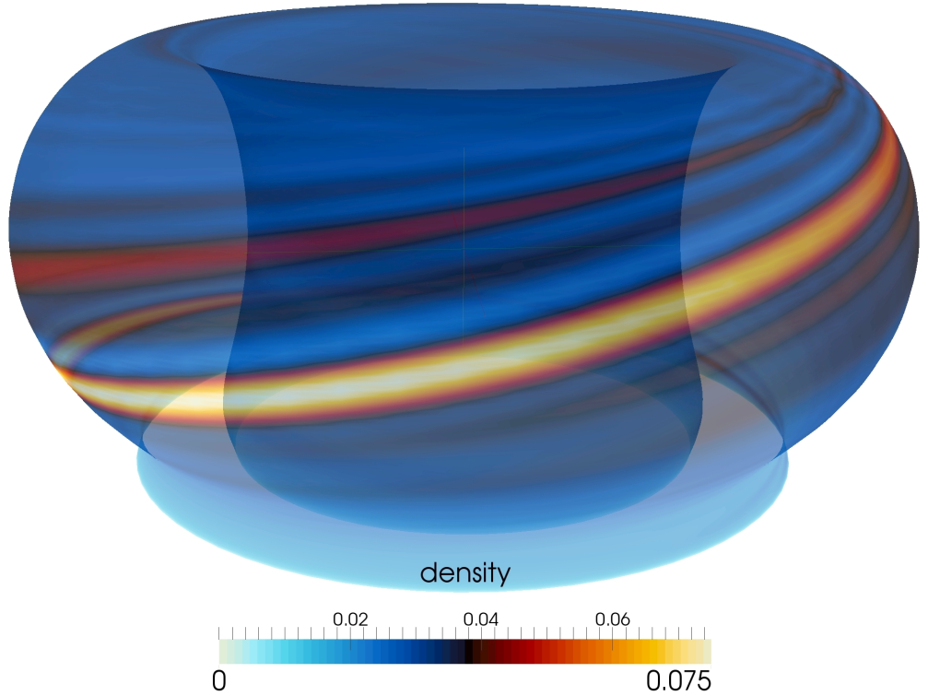
Pellet Triggered ELMs in JET
Previous: pellet triggered ELM simulations in DIII-D
ELMs (ballooning modes) are triggered by local 3D pressure perturbation created by the pellet
Density perturbation moving with sound speed, faster parallel conduction
Reasonable agreement on minimum pellet size required for ELM trigger
Here: complete cycle pellet triggered ELM in JET (#82885)
Pellets simulated as adiabatic moving density source using NGS ablation model
Pellet size 3.2x10²⁰, speed 78 m/s , LFS-mid plane, I_{p} = 2.0 MA, B₀ = 2.1T, W = 2.9 MJ
density at the wall

Slide 12
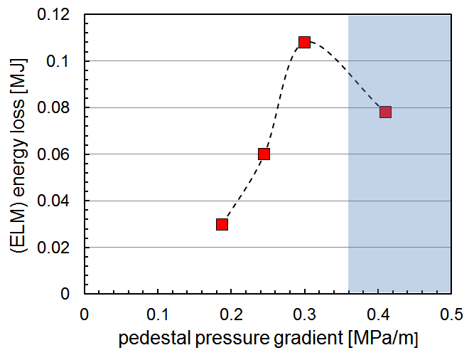
Pedestal Dependence Pellet Triggered ELMs Size
“Predicted” ELM size 108kJ (∆W/W=4%) compares to 100-250kJ in JET #82885
Experimentally, pellet triggered ELM size increases with time since previous ELM
Non-linear MHD simulations show strong dependence of pellet triggered ELM energy loss on pedestal pressure gradient
No sharp transition from stable to unstable
This dependence (and imposed pellet frequency) determines the maximum sustainable pedestal gradient and possible performance penalty due to pellet pacing.
JET #82885
ballooning unstable

Slide 13
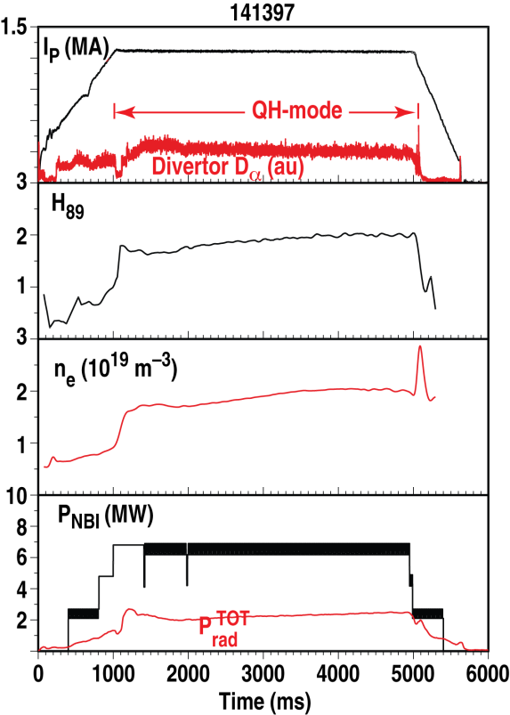
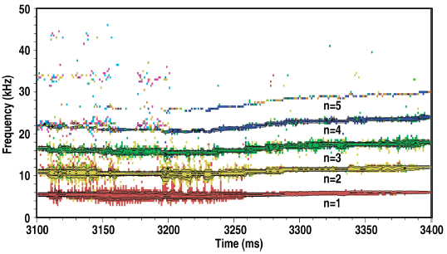
MHD Simulations of DIII-D QH-mode Plasmas
Quiescent H-mode regime characterised by good confinement without ELMs
discovered in DIII-D, reproduced in AUG, JET, JT60-U
Edge Harmonic Oscillation (EHO) induces density losses and allows a steady state H-mode
EHO assumed to be a saturated kink-peeling MHD mode
DIII-D QH-modes approaching ITER-relevant conditions
Can QH-mode be an option for ITER?
Towards validation of non-linear MHD simulations on DIII-D QH-mode plasmas
Extrapolation to ITER
DIII-D
Burrell, NF2013
DIII-D
Burrell, TTF2011

Slide 14
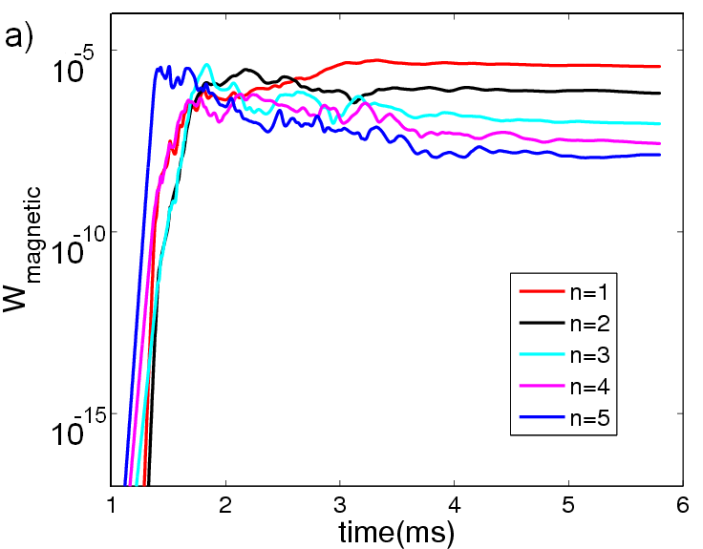
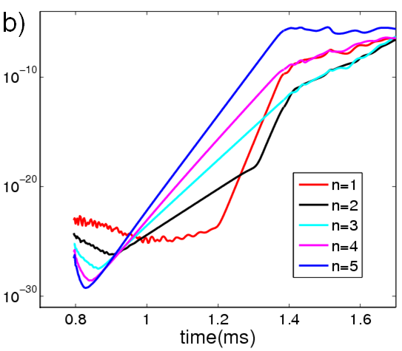
MHD Simulation of DIII-D QH-mode #145117
DIII-D #145117 pedestal close (below) to kink-peeling ideal MHD stability limit
JOREK simulations (ideal wall, no rotation) show saturated kink-peeling mode with dominant n=1 structure (3D stationary state)
n=5 mode most unstable mode, n=1 strong growth due to non-linear coupling
Bursting behavior found in some cases at high resistivity
magnetic energy perturbation
magnetic energy perturbation

Slide 15
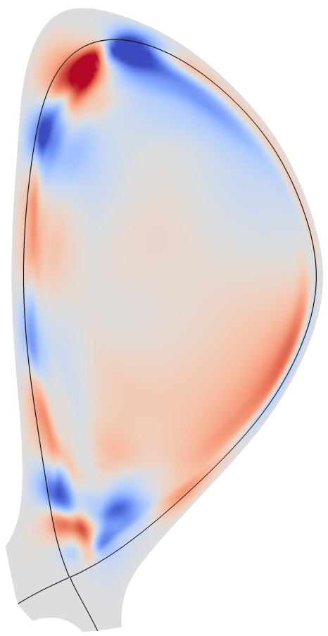
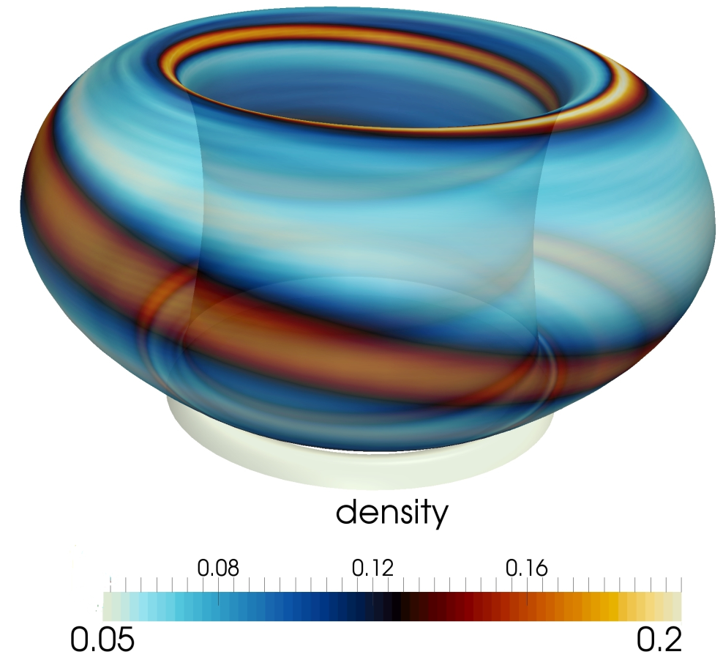
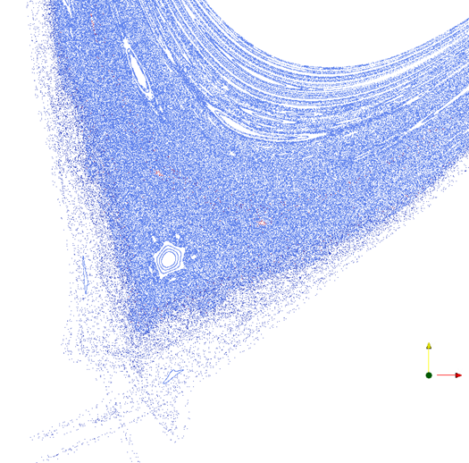
EHO: Saturated Low-n Kink-peeling Mode
Toroidal localisation, n=1-5 toroidal harmonics in phase
Localised density perturbation at the separatrix
Consistent with EHO observations
Ergodic region (~5cm width in mid-plane)
Contributes to mode saturation?
density at separatrix
DIII-D #145117
perturbed
flux
Poincare

Slide 16
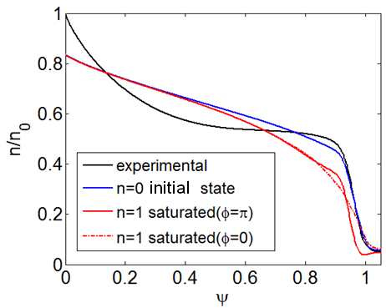
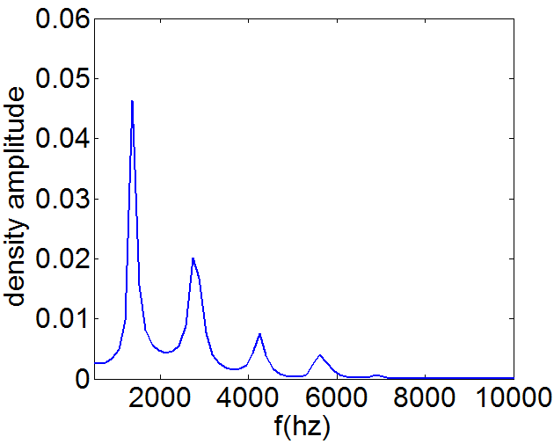
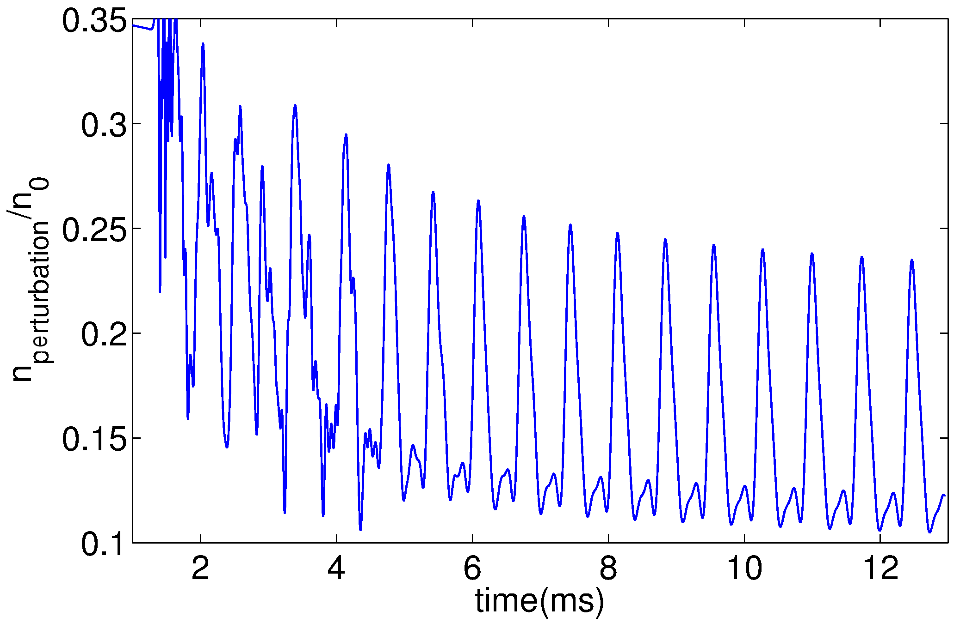
QH-mode Density Perturbation
ExB flows from external kink/peeling mode leading to a significant outflow of density
Reduction of pedestal density by ~25%
Provides density/energy loss channel necessary for stationary ELM free H-mode
density profiles
density (ψ=0.95) evolution
frequency spectrum density
n=1
n=2
n=3
n=4

Slide 17
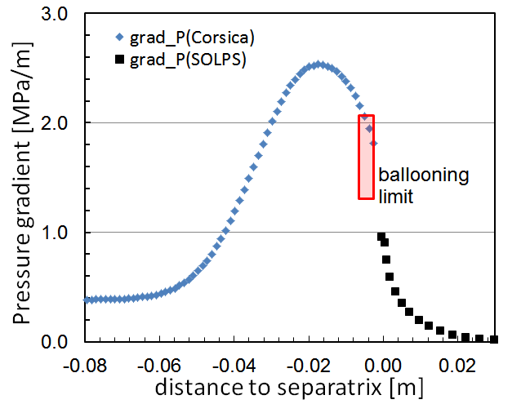
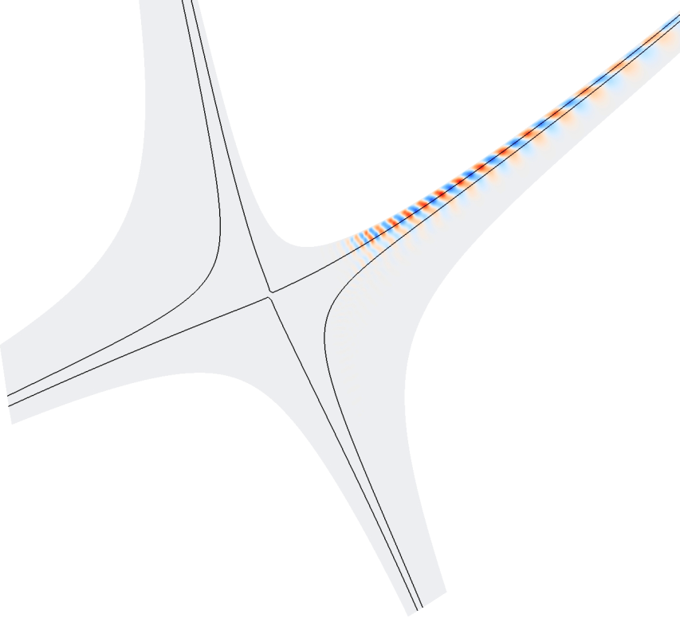
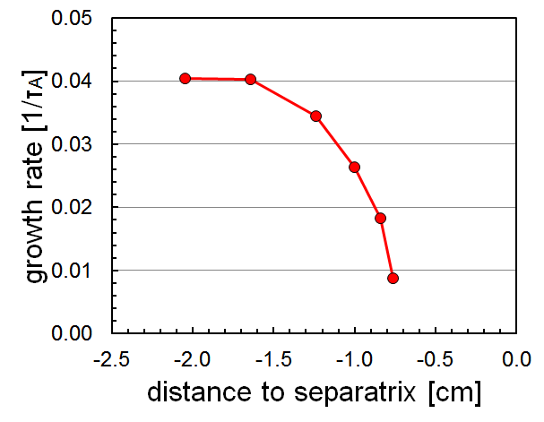
MHD Stability of Narrow SOL in ITER
Scaling laws for the SOL width (in low-recycling regime) predict narrow SOL widths in ITER attached divertor conditions
Is there an MHD limit to the narrow SOL widths in ITER?
MHD stability analysis shows ITER plasmas with a narrow 1.2mm SOL are MHD stable
Pressure gradient is below infinite-n ballooning limit at separatrix
Integrated pedestal/SOL MHD stability using JOREK code finds no local SOL MHD limit (n<50)
Ballooning mode (n=40)
perturbed flux (n=40)

Slide 18
Conclusions
Nonlinear MHD simulations of ELMs
Regular ELMy regime (diamagnetic effects)
ELM precursor rotates in electron diamagnetic direction, filaments mostly in opposite direction
RMP ELM mitigation
non-linearly driven by RMP modes with “tearing” like structure, providing reconnections with open field lines before large ELMs have time to develop
Pellet triggered ELMs
reasonable agreement on ELM amplitude
pellet triggered ELM amplitude depends on phase in ELM cycle
QH-mode
Simulation of DIII-D QH-mode plasmas show low-n saturated kink-peeling mode, with EHO-like features (density loss, toroidal localisation)
SOL Stability
No MHD stability limit found for SOL widths down to 1.2mm in ITER
MHD not likely to limit ITER SOL width

