Slide 1

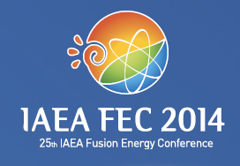
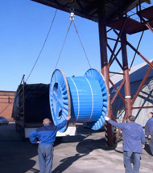
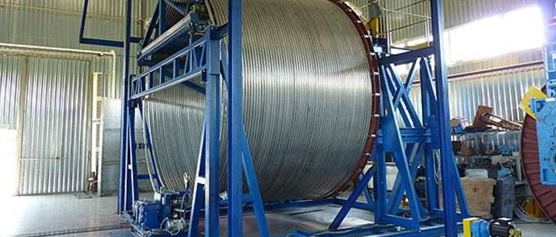
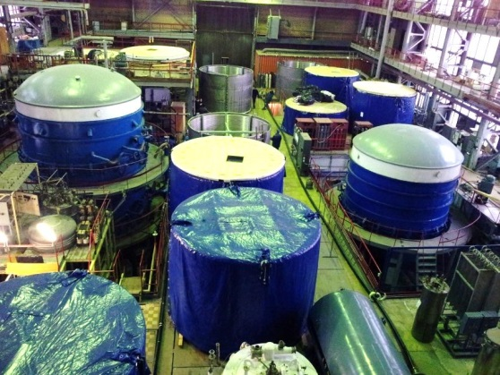
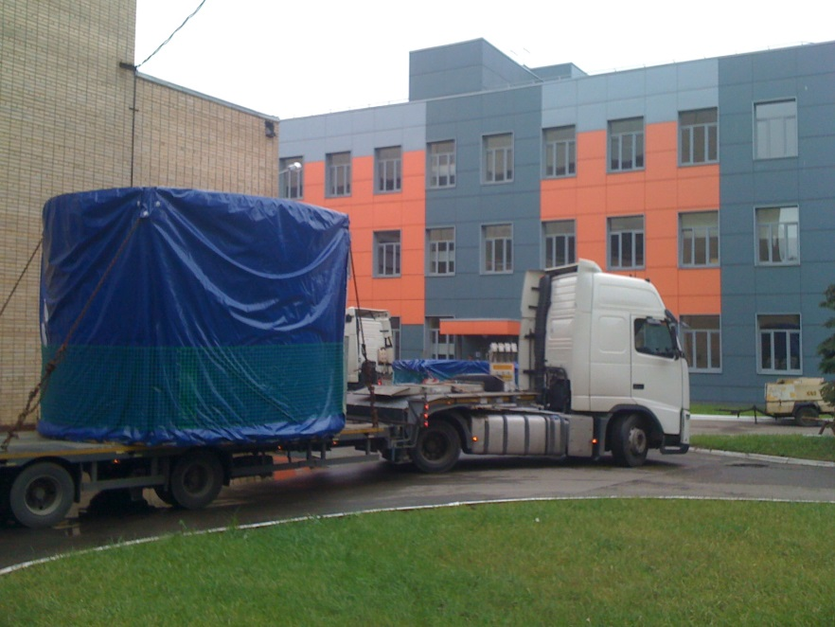
Summary for Poster FIP/1-4Rb
Russian Scientific R&D Cable Institute (VNIIKP) is responsible for production of ~20% of toroidal field conductors and ~20% of poloidal field cables for ITER magnet system
The production line of VNIIKP including coating of strands, cabling, compacting, jacketing, packaging and global leak test successfully passed all qualifications procedures
The production of PF cables is in full steam and 28 out of 41 cables have been produced, 19 of them have been delivered to EU.
The production of TF conductors is in full steam as well and 23 of 28 conductor length are produced - 16 of them delivered to EU.
The cable Institute is successfully completing its duty in production of PF cables and TF conductors as the in-kind contribution of Russia to ITER.

