Slide 1
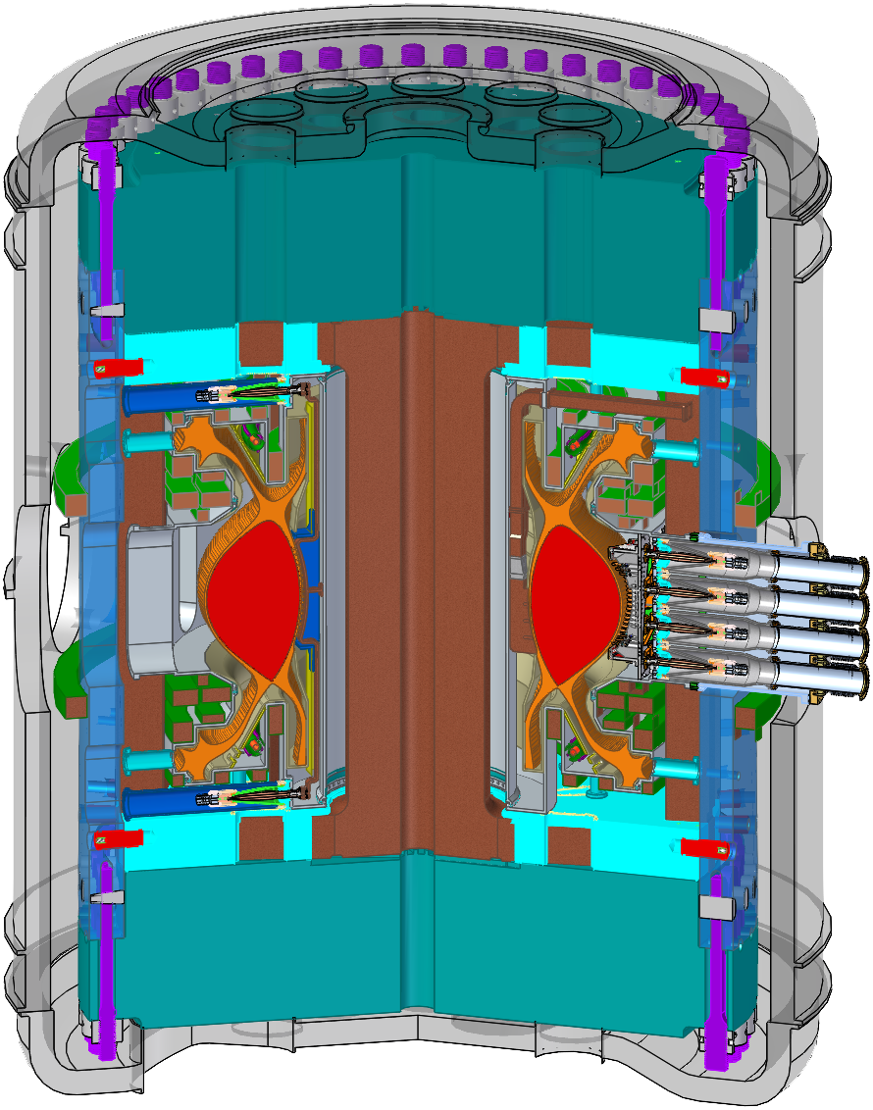
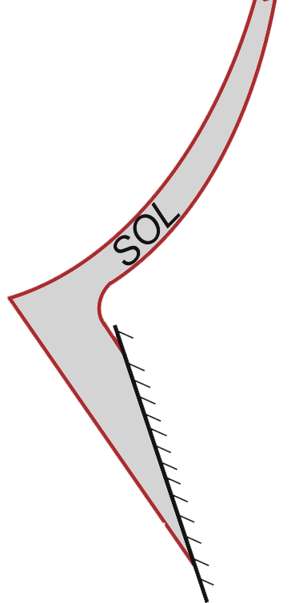
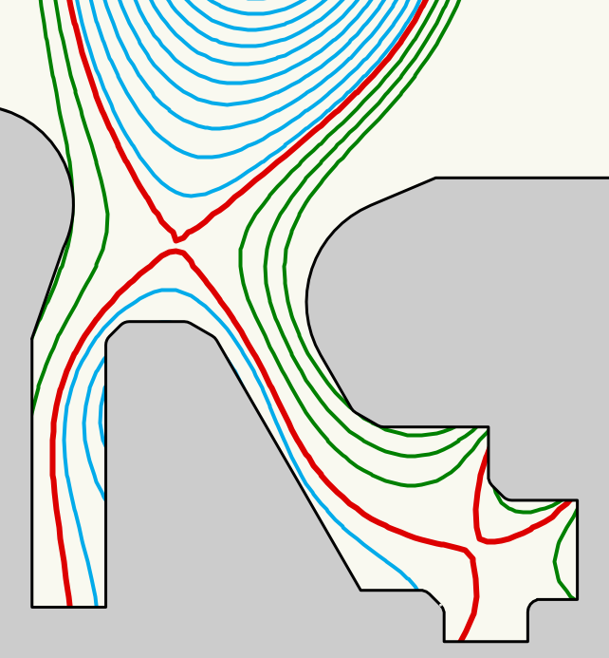
ADX: a High Field, High Power Density, Advanced Divertor Test Tokamak
The MIT PSFC and collaborators are proposing a new high-field (6.5 tesla), high power density
(P/S ~ 1.5 MW/m²) Advanced Divertor eXperiment to perform critical R&D on the pathway to a DEMO:
Demonstrate robust divertor power handling physics solutions, at DEMO-level heat flux densities
Demonstrate nearly complete suppression of divertor erosion
Demonstrate low PMI, efficient, RF current drive and heating technologies that scale to steady-state
Achieve 1, 2, 3 with core plasma performance compatible with obtaining a burning plasma
Background
- Recent results [1] project to very narrow power exhaust channel widths for ITER
and future DEMOs, λ_{q} ~ 1 mm. Parallel heat fluxes, q//, scale as
q// ~ P_{SOL}B/R
Power exhaust for a DEMO will be 3-4 times higher than ITER, with the additional need to completely suppress divertor erosion. New divertor solutions are required.
- Just as important: efficient, low PMI, RF current drive and heating
technologies that scale to steady state must be developed for a DEMO.
ADX
ADX employs high-field, demountable toroidal field magnet technology of Alcator C-Mod
ADX will uniquely access reactor-level q// ~ P_{SOL}B/R (~ 125 MW-T/m), with the unique-in-the-world ability to operate with key divertor parameters (B, q//, n_{div}, λ_{debye}/λ_{ion}, ρ_{z}/λ_{ion}, ...), identical to a reactor, while implementing advanced magnetic divertor topologies with an internal poloidal field coil set.
Innovative Divertor Solutions for a DEMO
ADX will test advanced divertor topologies, including Super-X, X-point Target long-leg divertor
concepts with options for heated and liquid metal targets.
λ_{q}
λ_{q}
Innovative RF Current Drive/Heating Solutions for a DEMO
ADX will employ high-field-side-launch Lower Hybrid current drive
and ICRF systems – for the first time in a diverted tokamak – which project
very favorably to high current drive efficiency and dramatically reduced PMI.
ADX will develop RF physics/technology at the magnetic fields (6.5T) and densities of a DEMO.
ITER
DEMO
∼1000xλ_{q}
∼10xλ_{q}
X-point Target Divertor
[1] Eich, et al., NF 53 (2013) 093031.

