Slide 1
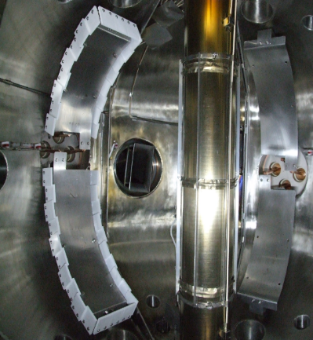
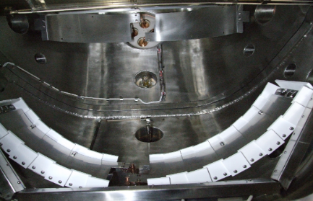
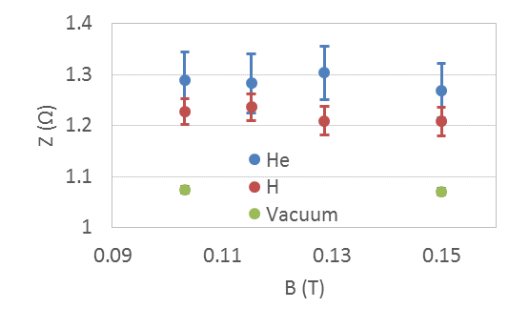
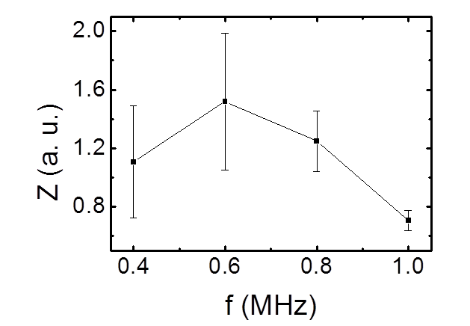
Study of the Alfven Wave Coupling in the SUNIST Spherical Tokamak (Yi Tan, Yangqing Liu, Zhe Gao, EX/P6-56)
The antenna system used for exciting waves with the same frequencies and spatial modes of Alfven waves in SUNIST
The 1-d MHD calculated impedance spectrum
qualitatively agree
weak coupling
The experimentally measured π phasing antenna impedance with BN limiters as a function of toroidal field. The frequency is fixed at 0.8 MHz.
The experimentally measured π phasing antenna impedance as a function of frequency

