Slide 1
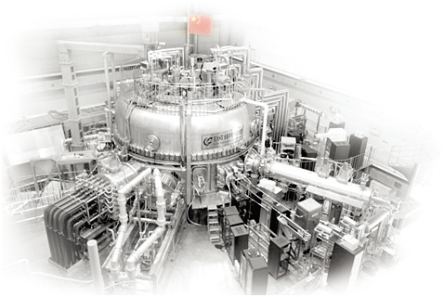
25th IAEA FEC, Oct 13-18, 2014 St. Petersburg, Russia
Advances in H-mode Physics for Long Pulse Operation on EAST
B. N. Wan*
for EAST team & collaborators**
*Email: bnwan@ipp.ac.cn
Institute of Plasma Physics, Chinese Academy of Sciences

Slide 2
Outline
Introduction
EAST upgraded capabilities
Physics advances for long pulse H-mode operation
Summary & future plans
2

Slide 3
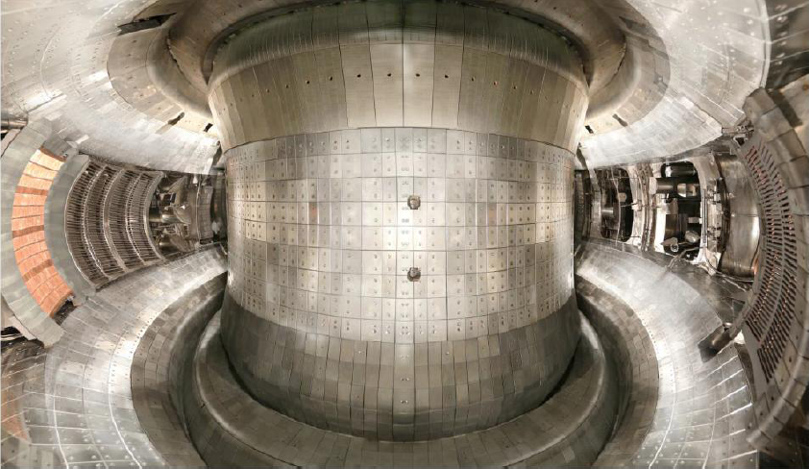
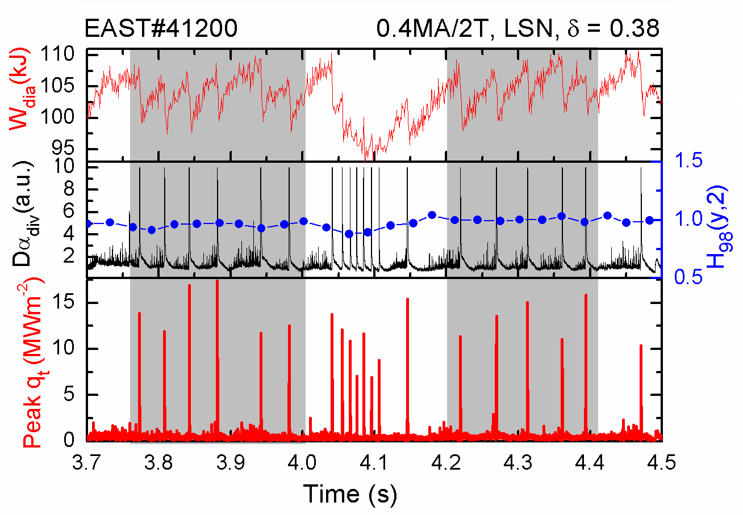
Introduction
EAST as a SC machine aims at high performance long pulse operations.
The enhanced capabilities since last IAEA-FEC allow EAST
Fully non-inductive operation with high f_{bs}.
Active control of transient and stationary heat load on divertors
Significant progress in H-mode physics for long pulse operations
EAST In-Vessel@2014
Transient peak heat load ~20MW/m² with P_{abs} ~2MW in type I ELMy H-mode
Significance for ITER & future reactors

Slide 4
Outline
Introduction
EAST upgraded capabilities
Physics advances for long pulse H-mode operation
Summary & future plans
4

Slide 5
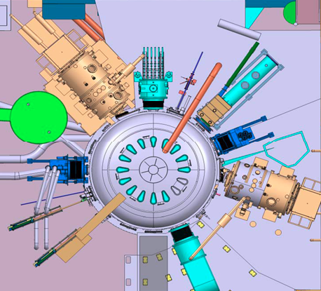
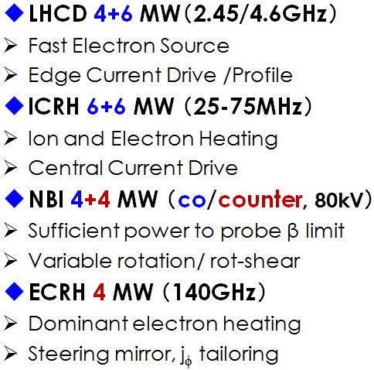
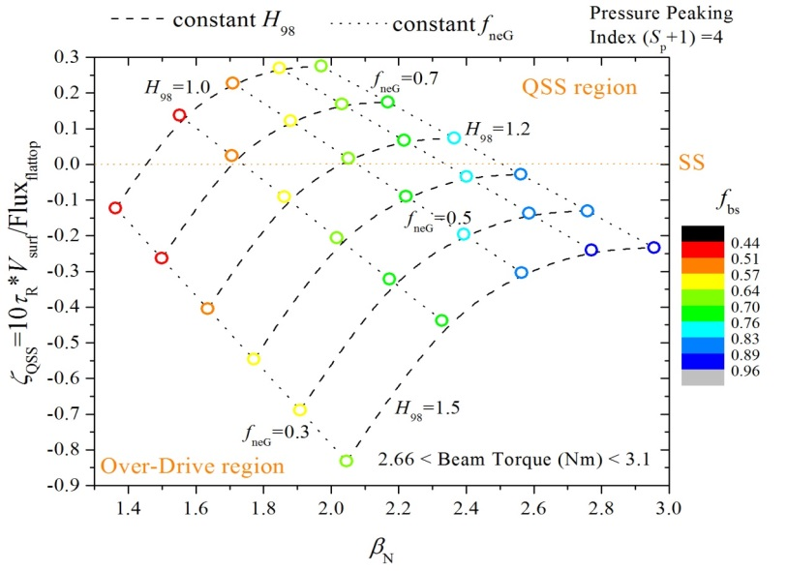
H & CD capabilities allow truly advanced steady state plasma operations
2012: 10MW
2014: 26MW
2016: 26+8MW
LHCD-2
NBI-2
ICRH-1
ICRH-2
NBI-1
ECRH-1
LHCD-1
ITER-like RF-dominant H&CD, capable to address key issues of high performance SS operations
EAST@I_{p}=0.5MA

Slide 6
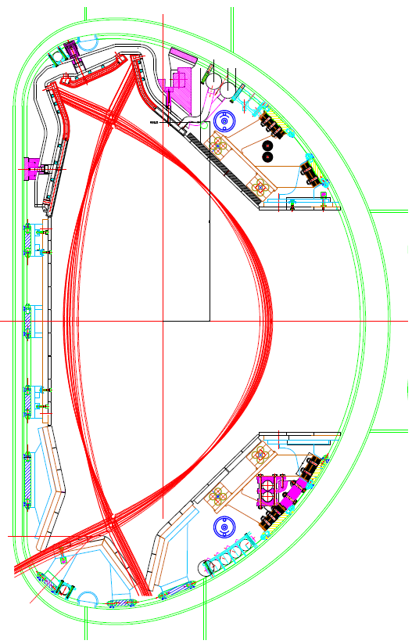
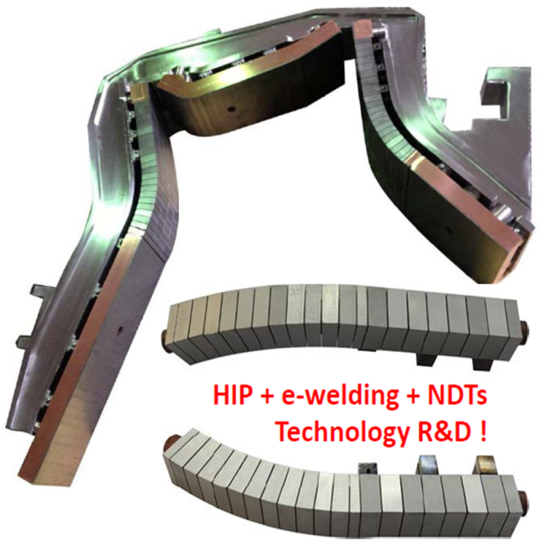
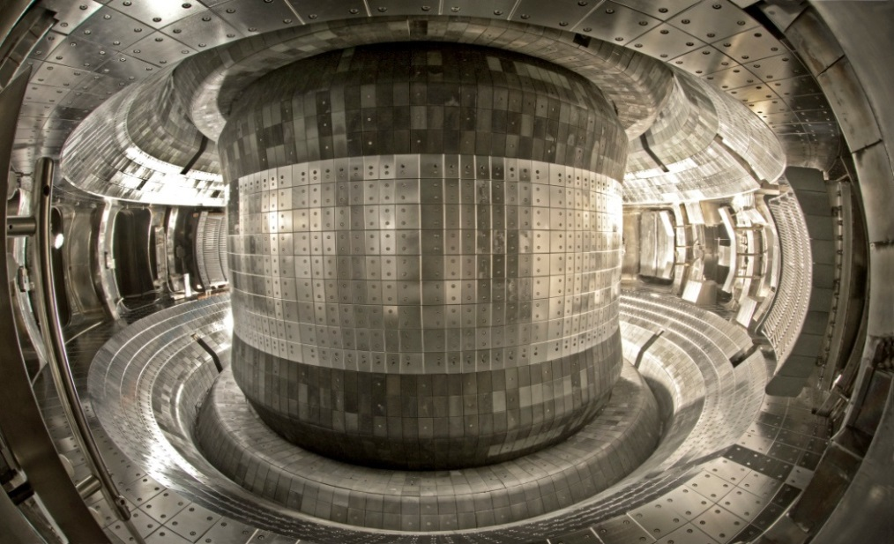
ITER-like PFC upgrade facilitate high power long pulse operations
ITER-like, water-cooled, cassetted, W top divertor
W
Top cryo-pump
(new)
Mo
C
2014: W + Mo + C
Low cryo-pump
2012: Mo + C divertor
6

Slide 7
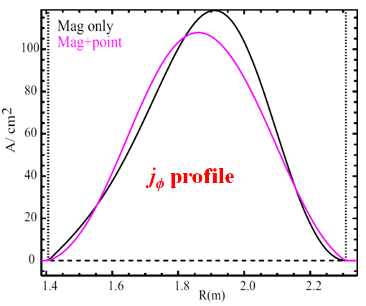
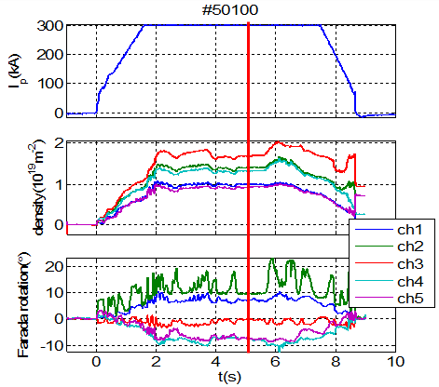
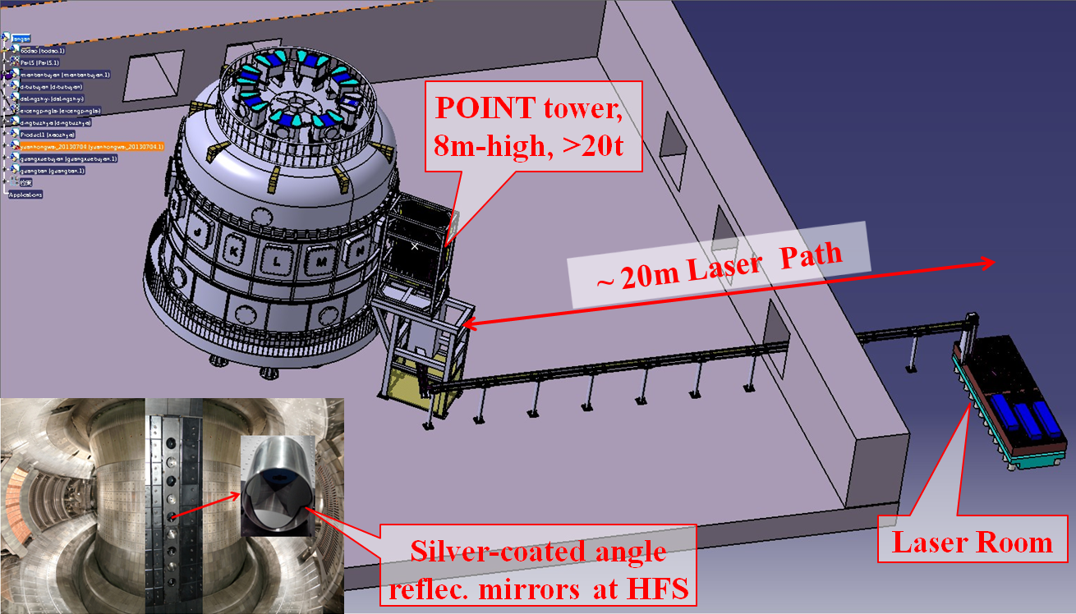
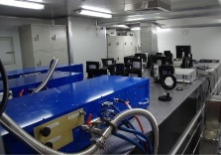
New or upgraded diagnostics for key profiles
Polarimeter/ interferometer (POINT): n_{e}, j_{ϕ}, q, B_{p} profiles
Core & edge TS: T_{e}, n_{e}
AXUV & Bolometer: radiation
CXRS & XCS: T_{i}, rotation
SXPHA & ECE: T_{e}
Reflectometry: pedestal n_{e}
He-BES: edge n_{e}, T_{e}
Recip.-LPs: SOL n_{e}, T_{e}, flow
Filterscope: D_{α}, impurity
Bremsstrahlung: Z_{eff}
FIDA: V_{fast-particle}
High speed CCD
IR camera: heat flux
Div-LPs: div. particle/heat flux
……

Slide 8
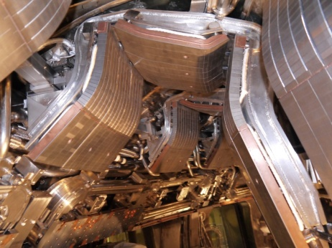
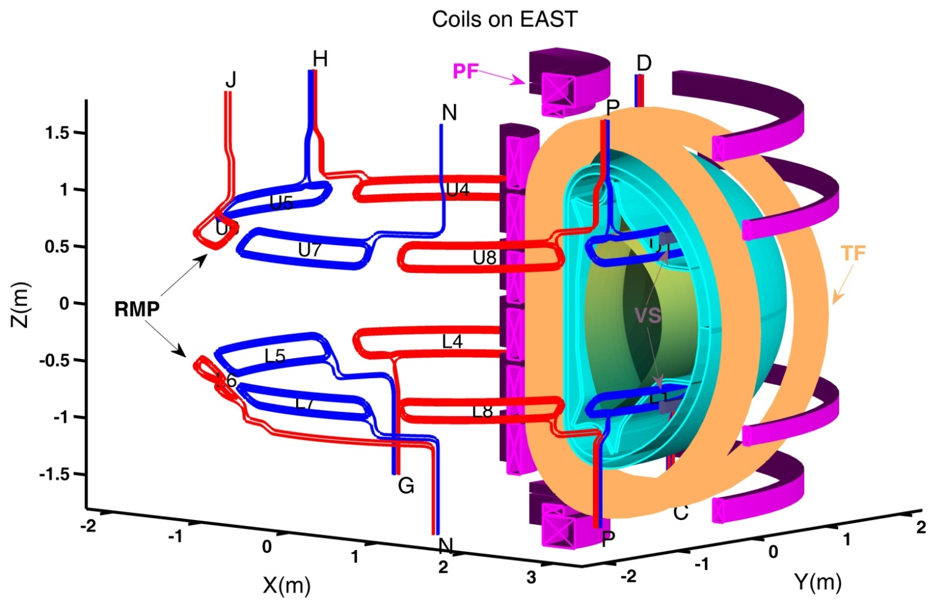
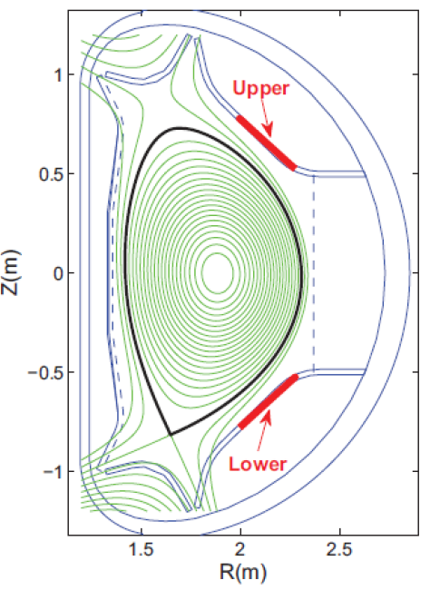
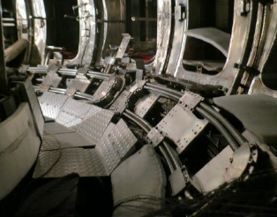
New RMP coils commissioned successfully
Measured Br in Vacuum commissioning shot
RMP coil set-up: 8 (U) + 8 (L)=16 coils; n = 1-3 rotating and n=1-4 non-rotating.
Multi-Functions:
Error Field correction (EFC)
Resistive Wall Mode (RWM control)
Edge Localized Mode (ELM control)
3-D physics studies
n=1
n=3
n=1
n=3
Static
rotating
8

Slide 9
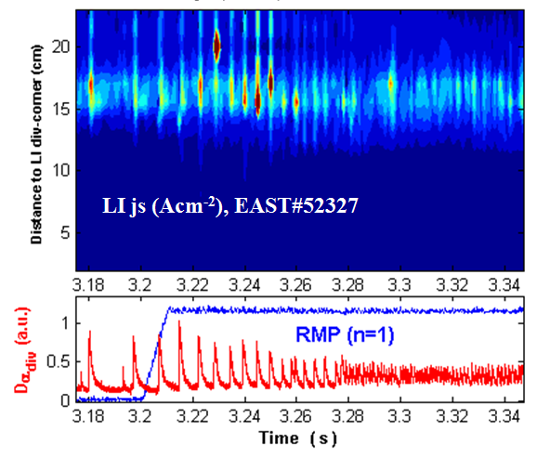
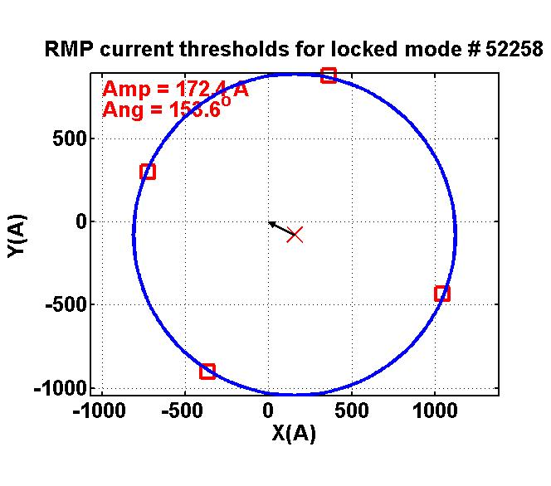
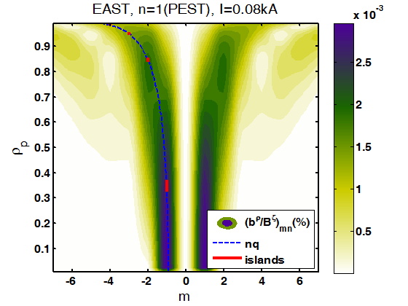
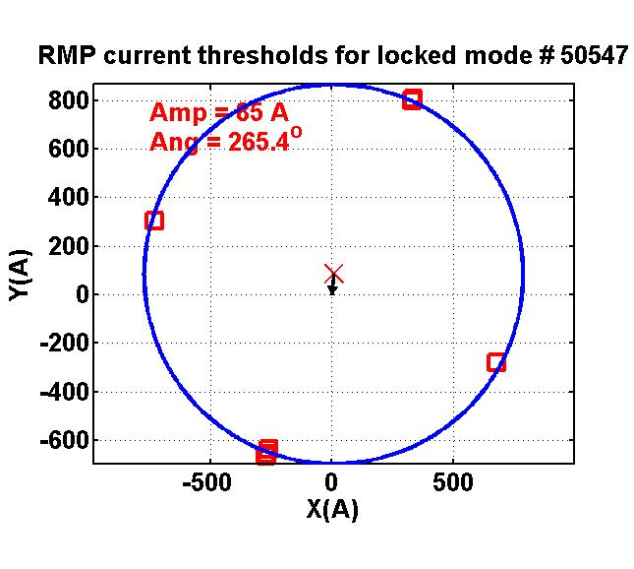
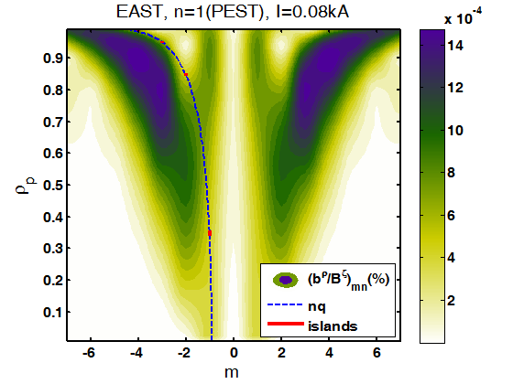
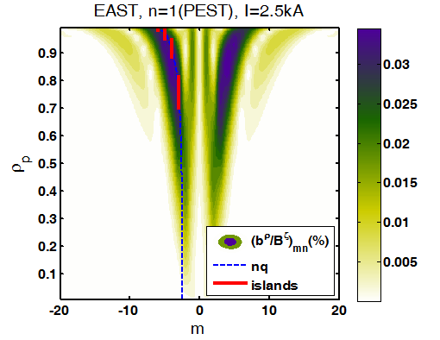
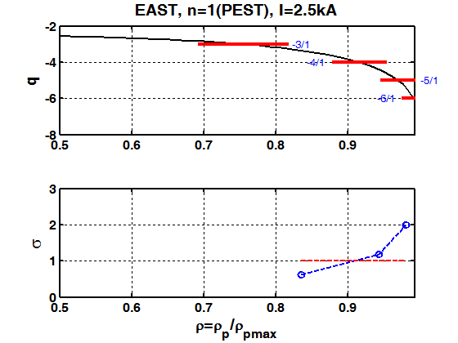
New RMP coils commissioned in ELM mitigation and error field measurements
Resonant
Non-Resonant
Error field measurement:
Both measured amplitude and phase of the intrinsic error field depends on the RMP configuration used.
Resonant: B_{2/1}/B₀ ~ 4.5e-5, φ ~ 154º
Non-Resonant: B_{2/1}/B₀ ~ 0.8e-5, φ ~ 265º
ELM Mitigation:
ELM mitigation observed with strong n=1 field with good resonance.
ELM frequency increased by a factor of 5.

Slide 10
Outline
Introduction
EAST upgrade capabilities
Physics advances for long pulse H-mode operation
Summary & future plans
10

Slide 11
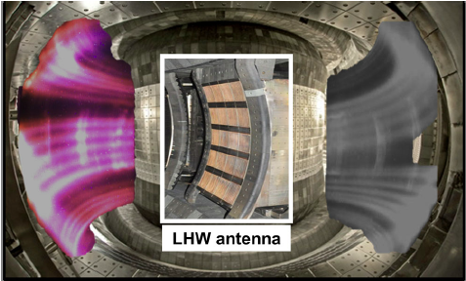
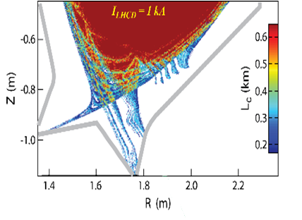
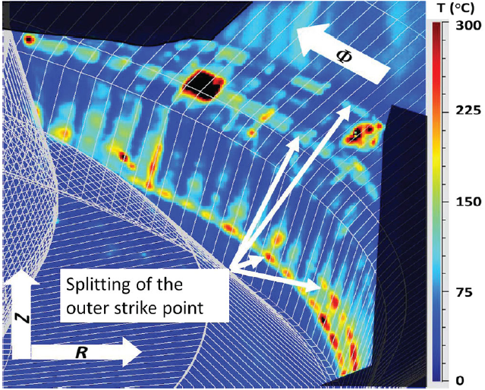
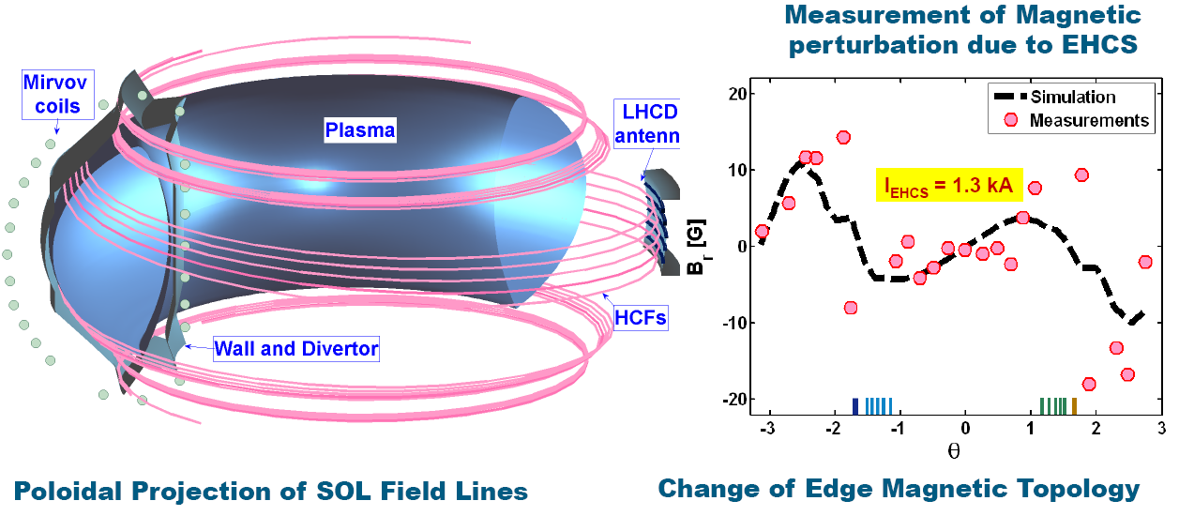
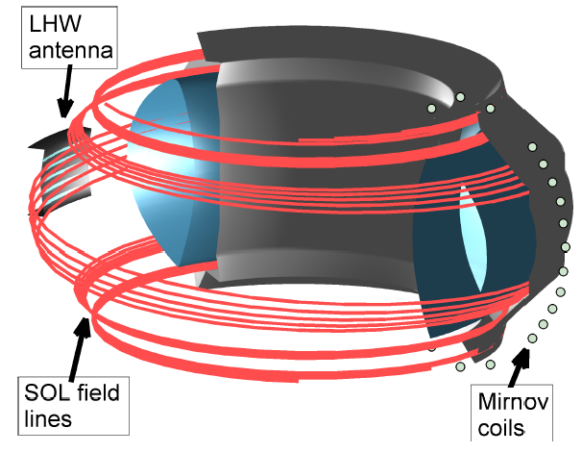
Edge magnetic topology changed by LHCD, like RMPs
Splitting of Strike Points
Helical Current Sheets induced by LHCD
Exhibit n=1 helical structure
Y. Liang et al., PRL 110, 235002 (2013)

Slide 12
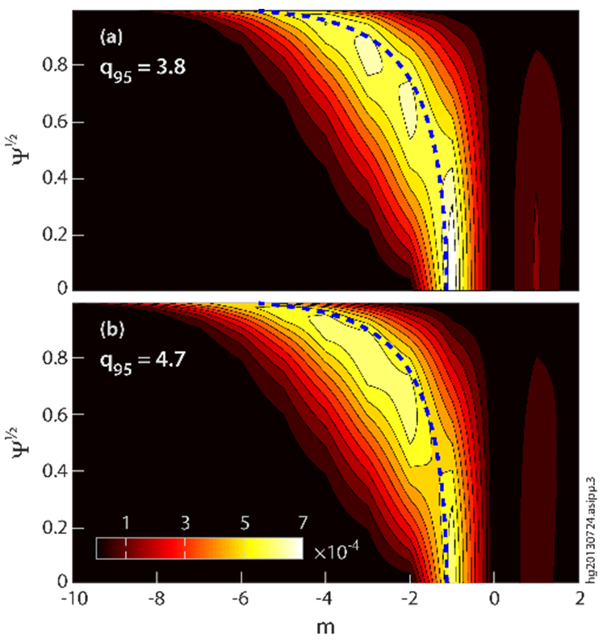
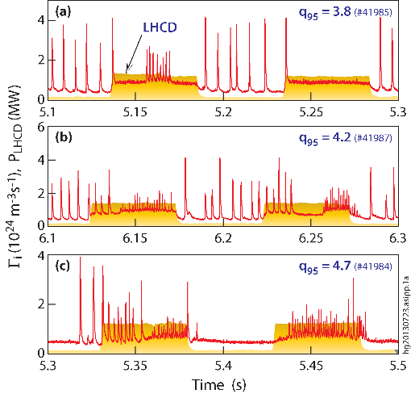
Flexible boundary control with LHCD
LHCD appears to be effective at controlling ELMs over a broad range q₉₅, in contrast to fixed RMP coils.
Magnetic perturbations induced by LHCD are well aligned with the resonant magnetic surfaces at the edge.
Closely matching the pitch of the edge field line for q₉₅.
Highly localized at edge, without significantly affecting plasma core plasma.
EX/P3-8 Liang Y.; J. Li, H.Y. Guo, B. N. Wan et al., Nature Phys. 9, 817 (2013)

Slide 13
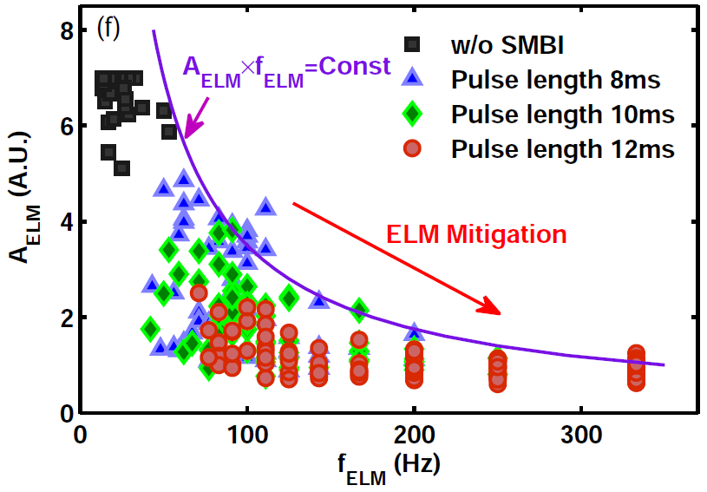
ELM control by SMBI
ELM suppression by intermittent small scale turbulence
induced by SMBI
X. L. Zou et al, submitted to PRL

Slide 14
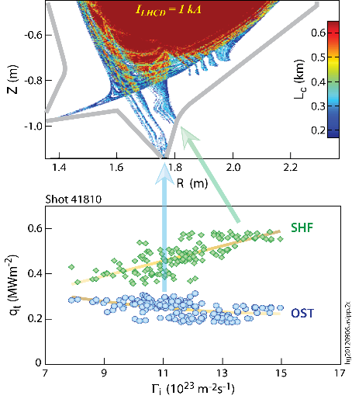
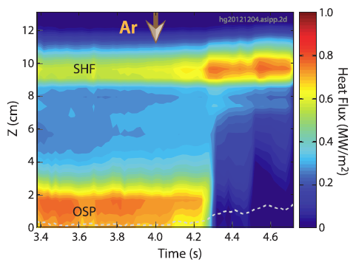
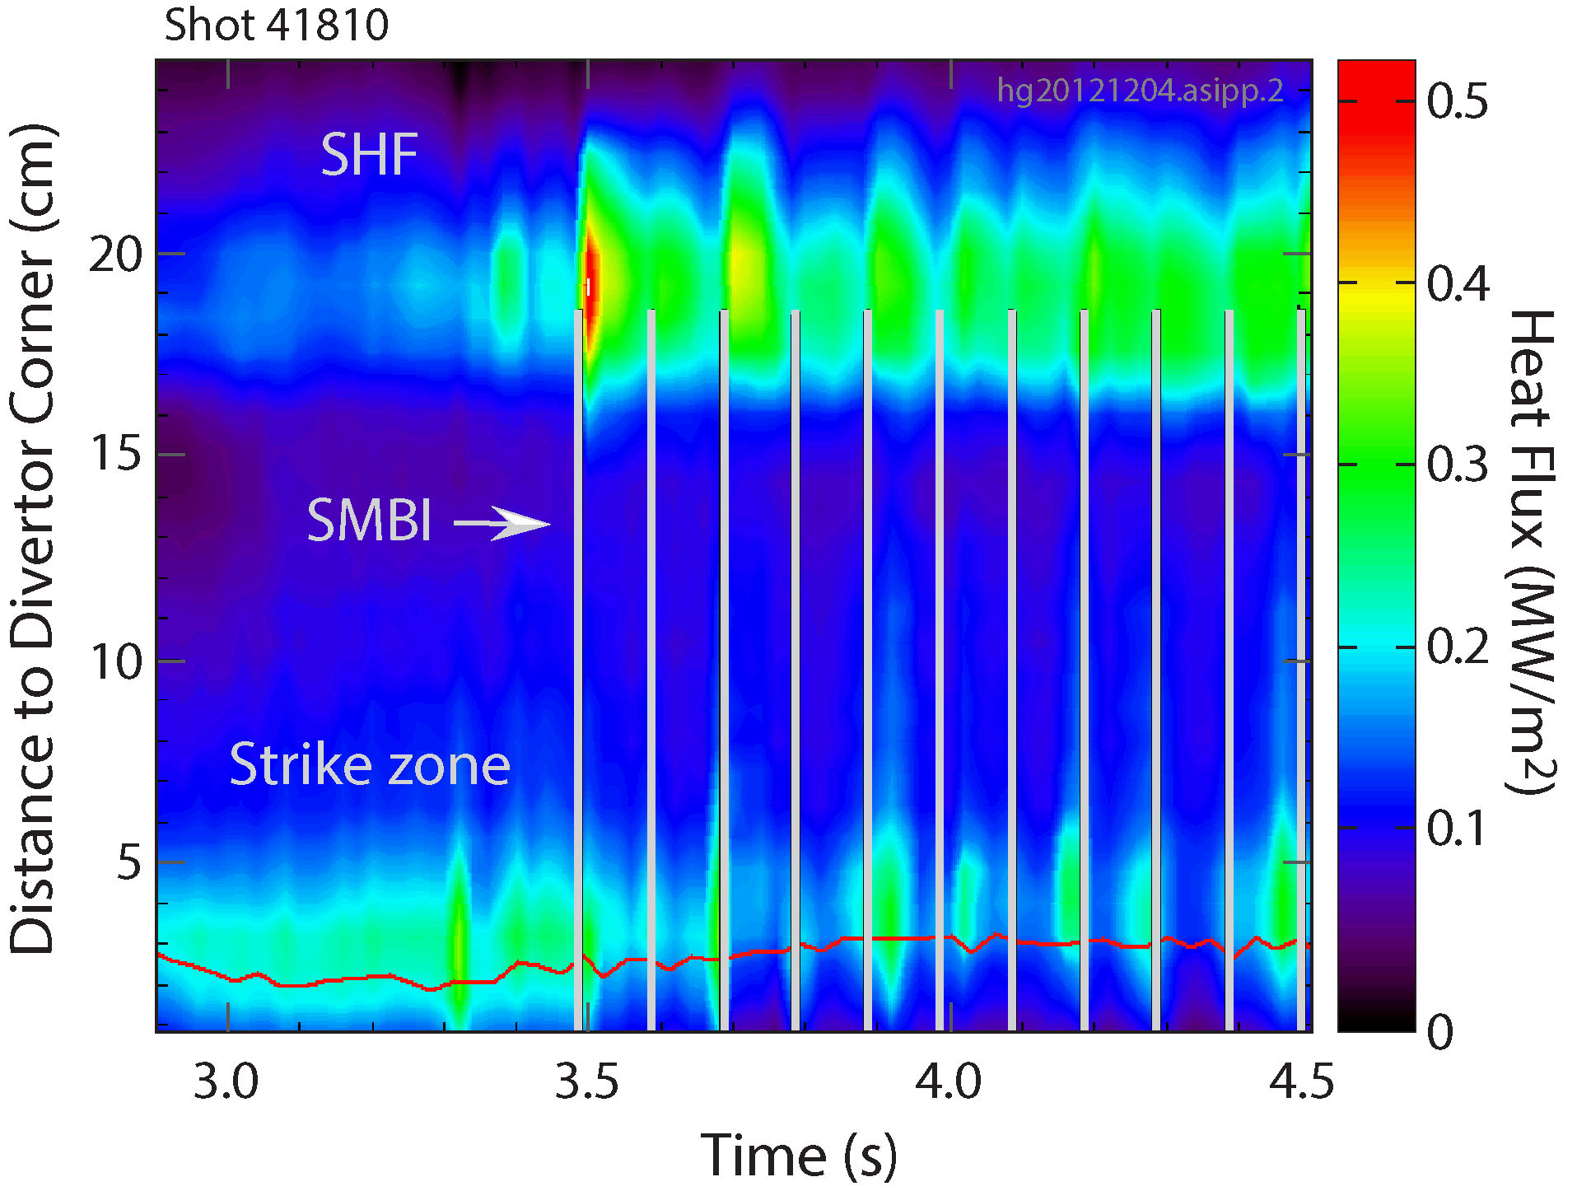
Active control of divertor power deposition by regulating edge particle fluxes (LHCD+SMBI)
Regulating divertor conditions by
SMBI into pedestal
Ar seeding into divertor region
Normal gas puffing to control ne → Г_{i}
Allowing active control of the ratio of q_{SHF}/q_{OST}, thus divertor power deposition pattern.
H.Y Guo, J. Li, B.N. Wan* et al 2014 PoP
14
EX/P3-10 Wang L.; J. Li, H. Y. Guo, B.N. Wan et al., Nature Phys. 9, 817 (2013)

Slide 15
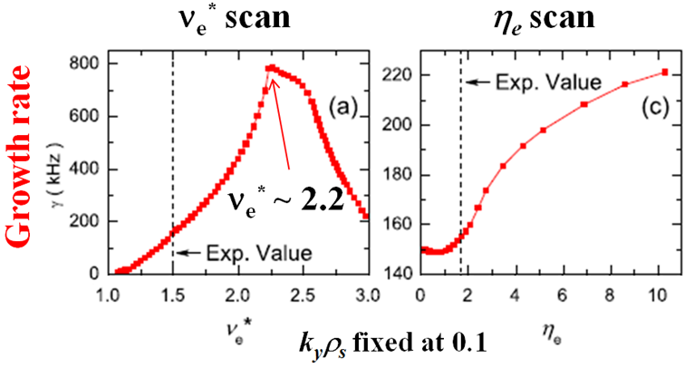
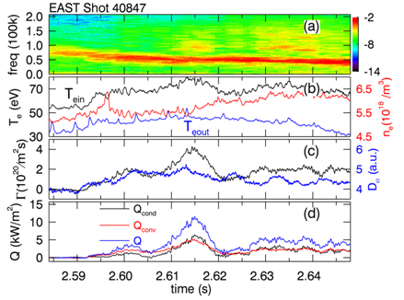
Evidence of particle & heat exhaust by ECM in LHCD H-mode plasma
Edge coherent mode (ECM) facilitates long pulse H-mode operations:
f = 15-90 kHz ~ ω_{*e}, electron dia-direction, n ~ 17, λ_{θ} ~ 10 cm, m > 50
Locates in the steep-gradient pedestal region, with
q₉₅>3.7,
GYRO simulations show the nature of dissipative trapped electron mode (DTEM)
Reciprocating-LP measurements directly show the ECM-driven radial particle and power transport.
EX/9-5 Xu G.
H. Q. Wang et al., PRL 112, 185004 (2014)

Slide 16
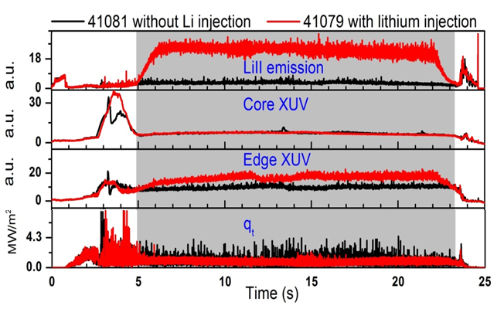
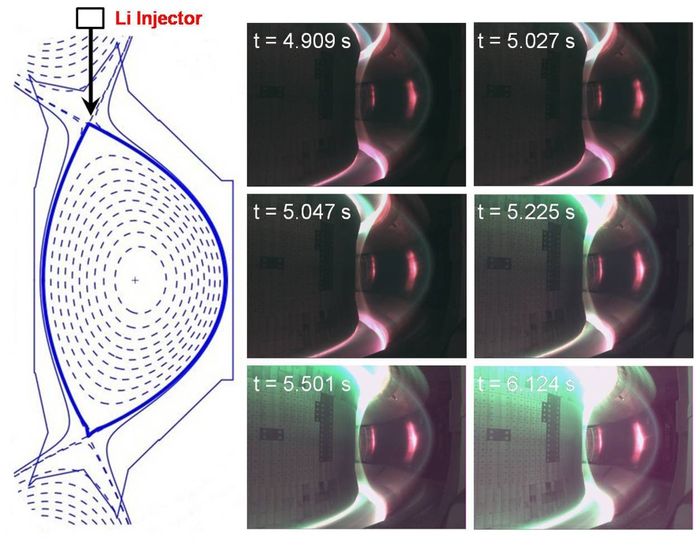
Real-time Li aerosol injection → long pulse ELM-free H-mode
J. S. Hu et al., submitted to PRL
Real-time Li aerosol injection can effectively suppress ELMs, then reduce heat load on divertor targets;
Charged Li shield located at edge also provide a radiation heat exhaust;
This provide a new method to achieve stationary H-mode;
Li aerosol facilitates edge coherent mode (ECM) for particle/power exhaust.

Slide 17
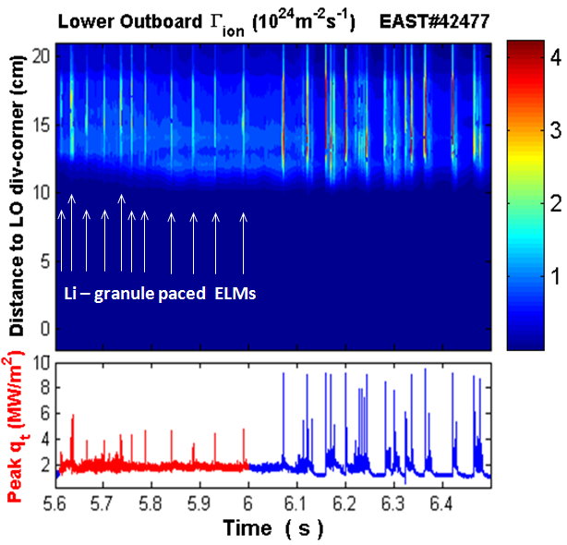
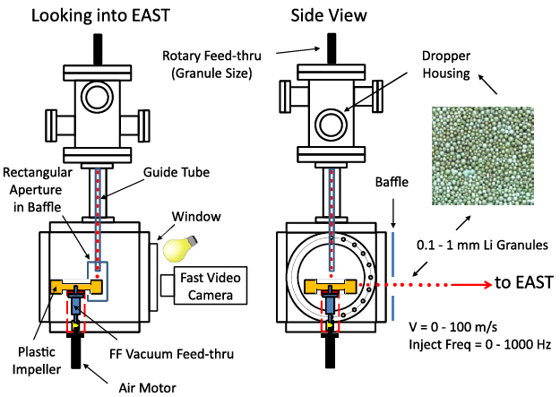
Demonstrated for the 1st time ELM pacing by innovative Li-granule injection
Collaborated with PPPL: D. Mansfield, 2013 NF
EX/P3-10 Wang L.
ELM trigger efficiency: ~100%.
Triggering ELMs (~25 Hz) with ϕ0.7 mm Li granules @ ~45 m/s.
Much lower divertor particle/heat loads than intrinsic type-I ELMs.

Slide 18
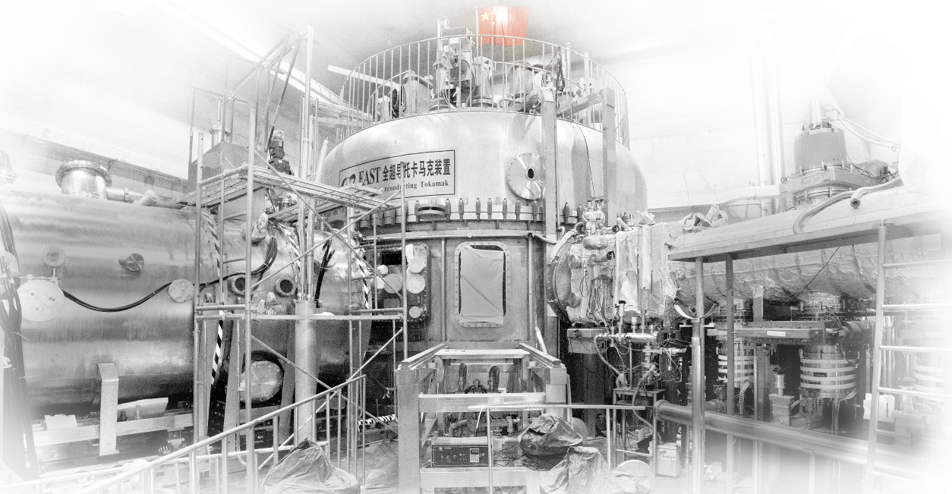
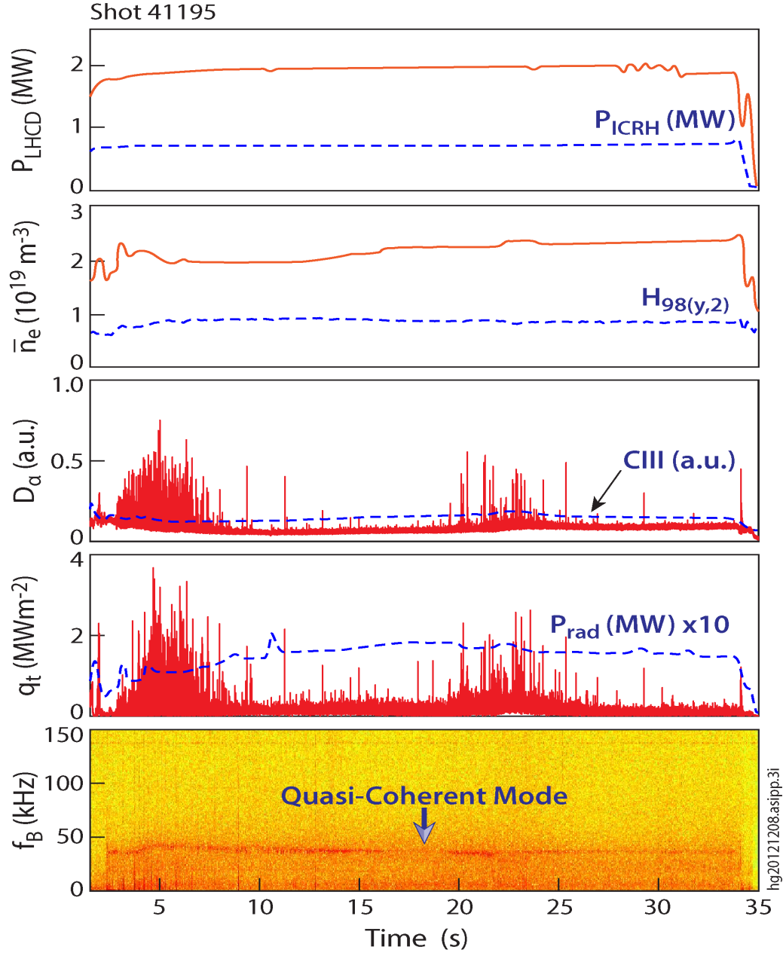
Integration for long pulse H-mode operations (2.45GHz-LHCD & Li-coating)
Predominantly small ELMs with H₉₈ ~ 0.9, between type-I and -III ELMy H-modes, DN.
Target heat flux is largely below 2 MW/m², with T_{target} < 250 ºC.
Accompanied by an ECM, continuously removing heat & particles.
J. Li, H.Y. Guo, B.N. Wan et al., Nature Phys. 9, 817 (2013)

Slide 19
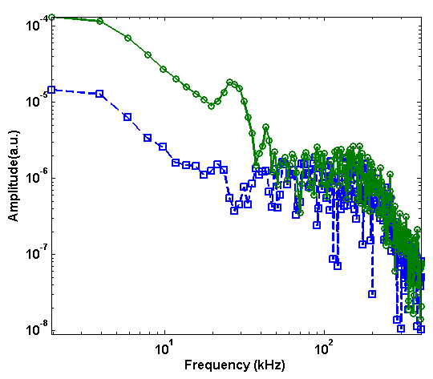
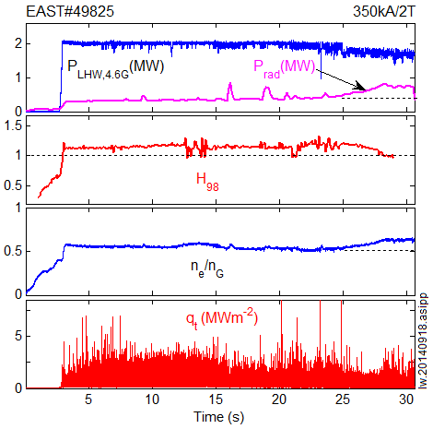
Long pulse H-mode operation with Newly installed 4.6GHz-LHCD& Li-coating
Long-pulse H-mode up to 28 s with H₉₈ ~1.2
ECM
LHCD & Li
High δ ~ 0.6, q₉₅ ~ 6.5, n_{e}/n_{G} ~ 0.55
Presence of an ECM ~ 30kHz
Peak heat flux: < 3MW/m² largely
Disrupted due to the raise of radia. power and n_{e}
Small ELMs with better confinement than the record 32 s H-mode.

Slide 20
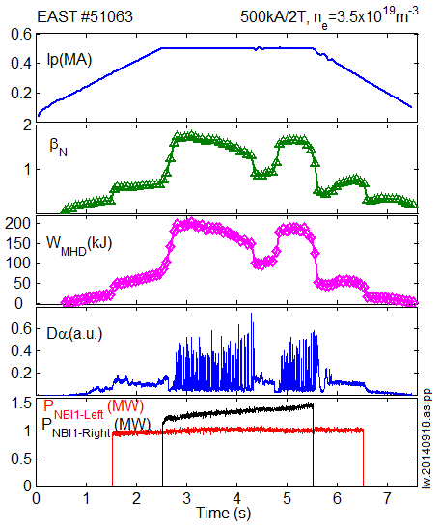
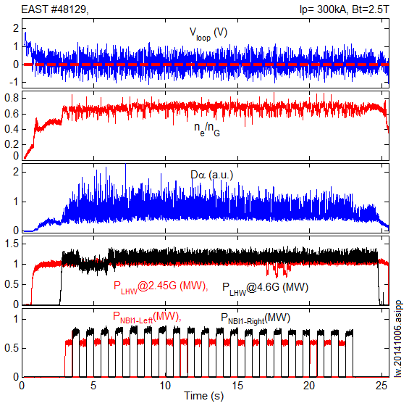
Newly installed Co-Ip NBI system commissioned successfully → H-mode with NBI alone or modulation
A H-mode plasma heated by NBI alone in EAST with P_{NBI} ~ 2.3 MW, β_{N} = 1.8 and W_{MHD} ~ 200kJ.
Nearly fully non-inductive long pulse H-mode by LHCD+NBI modulation with small ELMs, P_{NBI}=1.2 MW, P_{LHW,2.45G}=1MW, P_{LHW, 4.6G}=1.2MW, n_{e}/n_{G} ~0.7, V_{loop}<0.1V.
EX/P3-12 Xu Y.; EX/P3-5 Lu B.

Slide 21
Outline
Introduction
EAST upgrade capabilities
Physics advances for long pulse H-mode operation
Summary & future plans
21

Slide 22
Summary & Future Plans
Most of the upgraded EAST systems have been successfully commissioned.
Significant advances have been made in H-mode physics, especially at ELM control and divertor heat flux handling.
The new EAST capabilities will provide possibilities to address some of key issues for long pulse high performance operations.
Sufficient H&CD allow long pulse operation with ITER-like scheme:
low torque, off-axis, dominated Te heating, low Ip ramping rate
Multi-tools allow flexible heat flux control:
Transient (ELMs): LHCD, SMBI, Li-aerosol, Li/D₂ granule, RMP, …
Stationary: rad.-divertor/SMBI + edge topology change (LHCD/RMP)

Slide 23
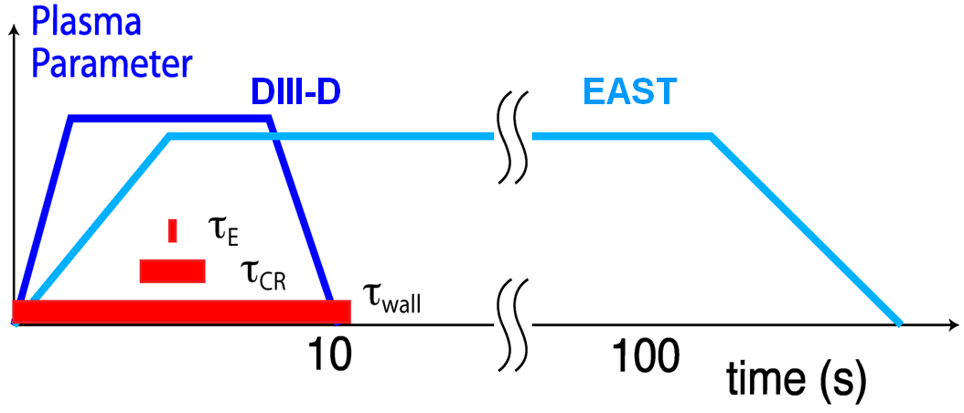
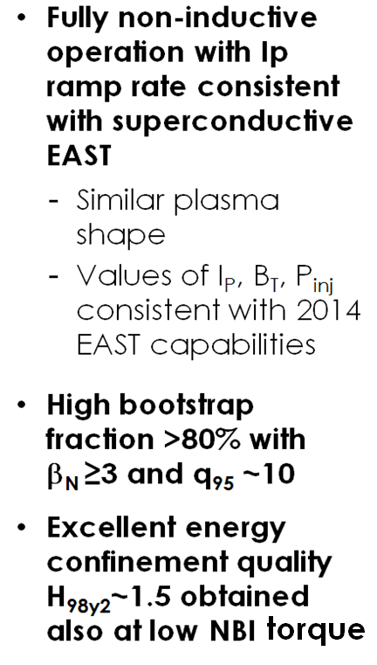
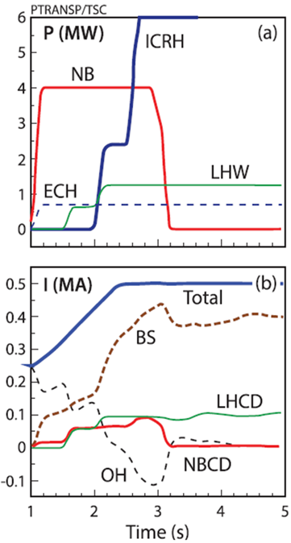
Joint DIII-D/EAST Experiment Developed Fully Non-inductive Scenarios for Steady-State H-mode Operations on EAST
Prediction for EAST
PPC/P2-31 Garofalo A.; EX/P2-39 Gong X.

Slide 24
List of EAST contributions
EX/P2-39 X. Gong: Development of Fully Non-inductive Scenario at High Bootstrap Current Fraction for Steady
State Tokamak Operation on DIII-D and EAST
EX/9-5 G. Xu: A Long-Pulse H-Mode Regime with a New Coherent Mode Providing Continuous Transport across Pedestal in EAST
EX/P3-3 X. Zhang: High Power ICRF Systems and Heating Experiments in EAST
EX/P3-4 G. Calabro: EAST Snowflake Experiment: Scenario Development and Edge Simulations
EX/P3-5 B. Lyu: Core Plasma Rotation Characteristics of RF-Heated H-Mode Discharges on EAST
EX/P3-6 L. Xiang: Investigation of Argon Seeding in Different Divertor Configurations in EAST and Corresponding SOLPS 5.0 Modeling
EX/P3-7 G. Li: Studies of Impact of Edge Current Profiles, Plasma Shaping, Nonlinearity on Edge Localized Modes with BOUT++ Code
EX/P3-8 Y. Liang: ELM Mitigation by Lower Hybrid Waves in EAST
EX/P3-9 X. Gao: Study of Pedestal Turbulence on EAST Tokamak
EX/P3-10 L. Wang: Progress in Active Control of Divertor Power Load in the EAST Tokamak
EX/P3-11 B. Ding: Investigation of LHW-Plasma Coupling and CD Related to H-Mode Experiments in EAST
EX/P3-12 Y. Xu: The Latest Development of EAST Neutral Beam Injector
FIP/P4-2 L. Hu: Progress on the ITER Diagnostic-Radial X-Ray Camera
TH/P2-1 C. Pan: The Combining Effect of the Inductive Electric Field and the Lower HybridWaves on the Impurity Ions Toroidal Rotation in the Lower Hybrid Current Drive Tokamak Plasmas
TH/P2-45 T. Xia: Fluid Simulation of Particle and Heat Fluxes during Burst of ELMs on EAST and DIII-D
TH/P3-13 X. Gong: Theoretical Analysis of ICRH Antenna’s Impedance Matching for ELMy Plasmas on EAST
EX/P6-54 G. Xu: The Role of Lithium Conditioning in Achieving High Performance Long Pulse H-Mode in the NSTX and EAST Devices
MPT/P8-14 G. Luo: Overview on Design and Development of EAST Tungsten/Copper Divertor and Tungsten-Related Plasma-Wall Interaction Experiments

Slide 25
Thank you!
EAST – Test Bed for ITER & CFETR

