Slide 1
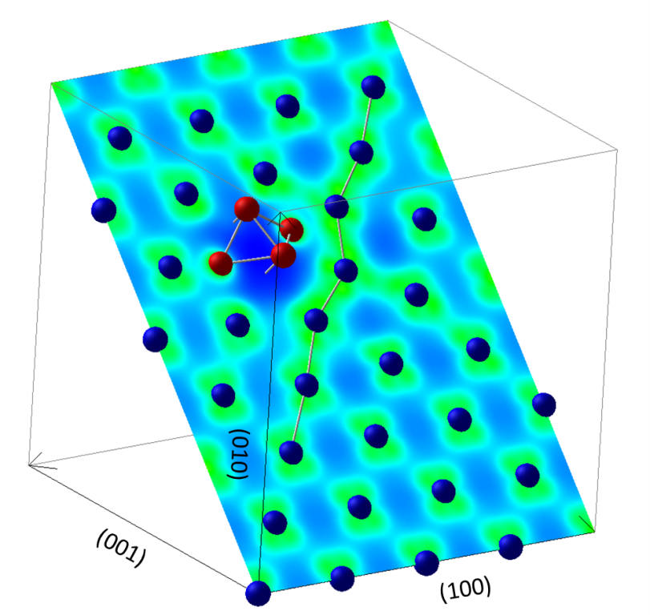
MPT/P7-36: Super-Saturated Hydrogen Effects on Radiation Damages in Tungsten under High-Flux Divertor Plasma Irradiation
D. Kato¹, H. Iwakiri², Y. Watanabe³, K. Morishita⁴, T. Muroga¹
¹NIFS, Toki, Japan, ²Univ. of Ryukyus, Okinawa, Japan, ³JAEA-IFERC, Aomori, Japan, ⁴Kyoto Univ., Kyoto, Japan
Purpose: For a better characterization of radiation damages in W under high-flux divertor plasma irradiation, influences of super-saturated H on vacancies in W are investigated by using first-principle methods based on density functional theories (DFT).
Summary of results: The present DFT calculations predicts an enhancement of the radiation damages in W due to super-saturated H, because 1) multiple H trapping in a vacancy increases the equilibrium concentration of the vacancy, 2) di-vacancy formation in W is enhanced by binding with one H atom (i.e. VH₂ formation), and 3) the H cluster stacking with a vacancy suppresses annihilation of a vacancy-SIA pair in neutron damaged W (see Fig. 1).
Fig. 1 Octahedron H (red) cluster stacking with a vacancy (VH₆) preventing it from recombining with a crowdion-type (111) self-interstitial-atom (SIA) in W (blue). W atoms only on (011) surface are drawn in the figure. Another two H atoms of VH₆ are behind the (011) surface. The crowdion structure distorted by the presence of VH₆ is indicated by a connected bond. Colors on the surface indicate electron densities; green indicates higher electron densities while blue indicates depletion of the electron density.

