Slide 1
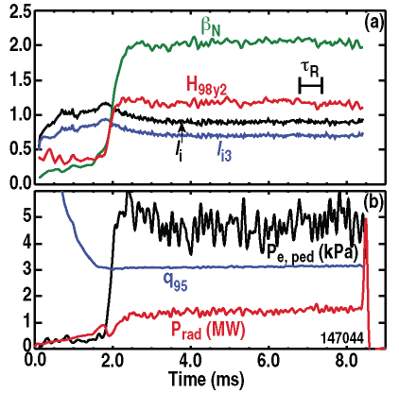
DIII-D example, β_{N}~2
Progress in Preparing Scenarios for ITER Operation (A. Sips, IOS-TG)
Joint experiments:
Plasma formation, current rise/decay
Scenarios for operation at high Q~10 →
Future: Dominant electron heating
Coordinated scenario simulations:
Benchmarking scenario codes →
Non active operation
Scenario exploration (H&CD)
Future: Add particle (W) transport

