Slide 1
International Nuclear Data Evaluation Network (INDEN) Nuclear data evaluation of structural materials (INDEN-SM) Overview of INDEN structural material evaluations after JEFF-4.0 release
Roberto Capote
Deputy Section Head, NDDU head
On behalf of the whole INDEN collaboration
Andrej Trkov
Josef Stefan Institute, Ljubljana, Slovenia
INDEN-SM meeting, 15-19 December 2025, IAEA HQ, Vienna, Austria

Slide 2



































International Nuclear Data Evaluation Network (INDEN)
https://www-nds.iaea.org/INDEN

Slide 3

INDEN evaluation strategy
INDEN collaboration is addressing data issues with the following strategy:
Identify data problems through integral validation and feedback
Identify underlying data issues in differential data evaluation (sensit)
Assess available experimental differential data to find alternative solutions to improve integral benchmarks (both shielding and criticality)
Update selected experimental data to the latest standards/references
A GLSQ fit of available comprehensive datasets is the preferred solution
If model is available, use model including correlations as prior
“It doesn't matter how beautiful your theory is,
it doesn't matter how smart you are.
If it doesn't agree with experiment, it's wrong.”
Richard Philips Feynman, Nobel Prize in Physics 1965

Slide 4
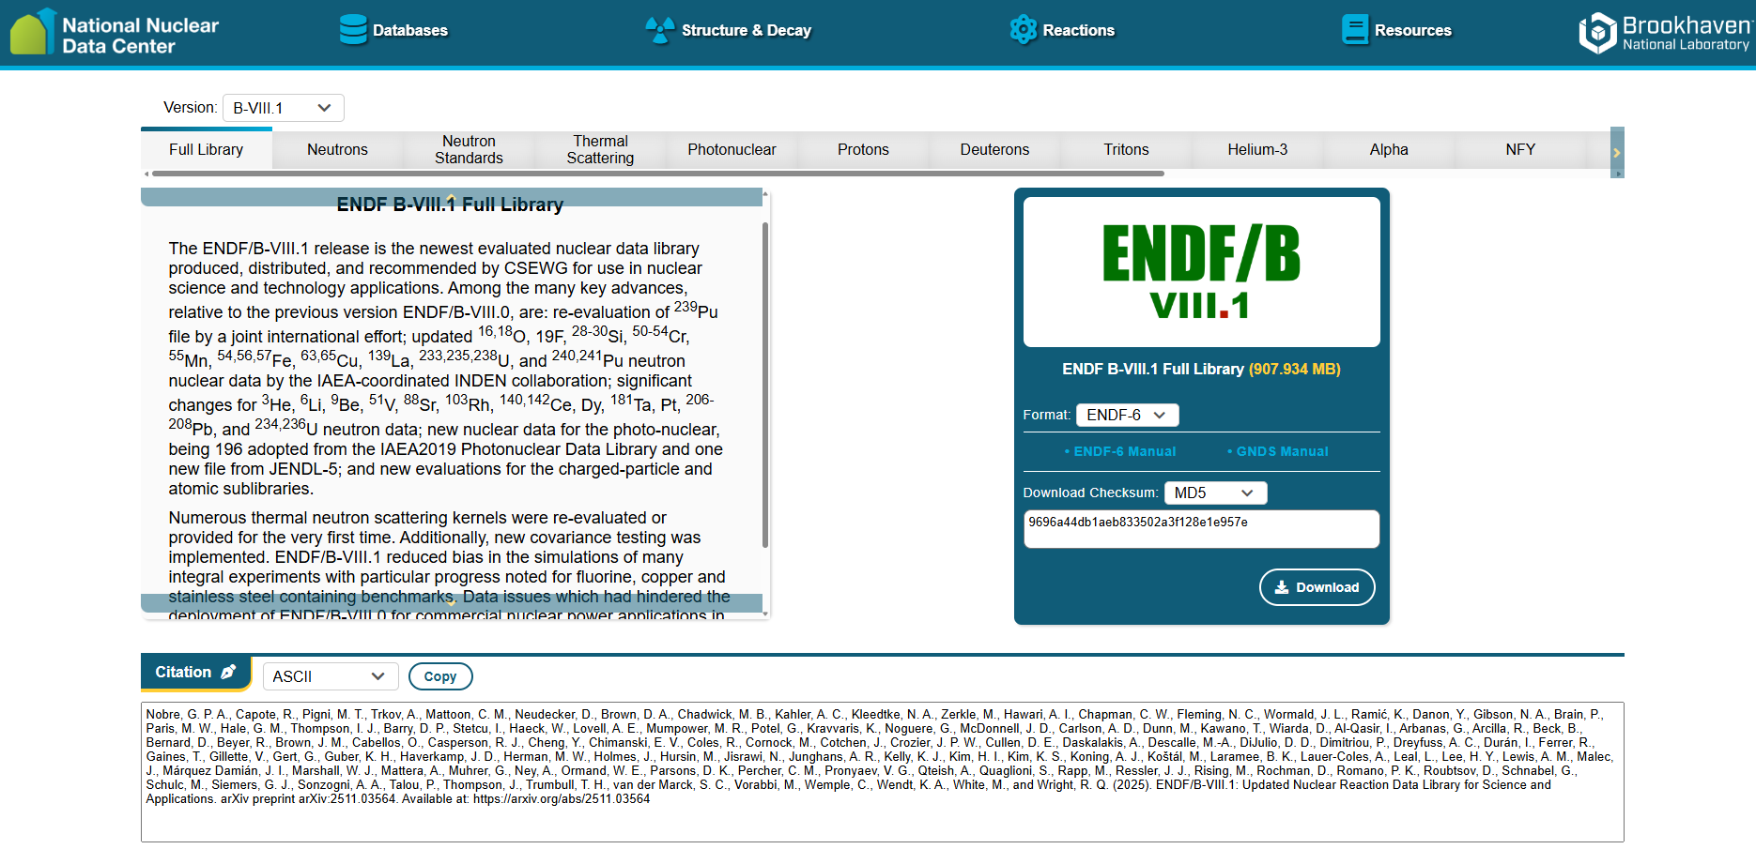
INDEN fluorine, copper, iron, manganese,
silicon, chromium evaluations adopted
+ JEFF-4.0
https://www.nndc.bnl.gov/endf-releases/

Slide 5
Outlook
Chromium (new data by Maroto et al, n_TOF)
Iron evaluations (new data by Gkatis, Kostal…)
F-19 evaluation (new data by Kostal, Viebach, Knijpstra,…)
Cu evaluations (new JRC exp, RRR evaluation needed)
Future evaluation needs from validation Zr, W, Pb (Ni,V,Bi)
“It doesn't matter how beautiful your theory is,
it doesn't matter how smart you are.
If it doesn't agree with experiment, it's wrong.”
Richard Philips Feynman, Nobel Prize in Physics 1965

Slide 6
Chromium updates
INDEN evals adopted by JEFF-4.0 and ENDF/B-VIII.1
IAEA/BNL/ORNL/JSI

Slide 7
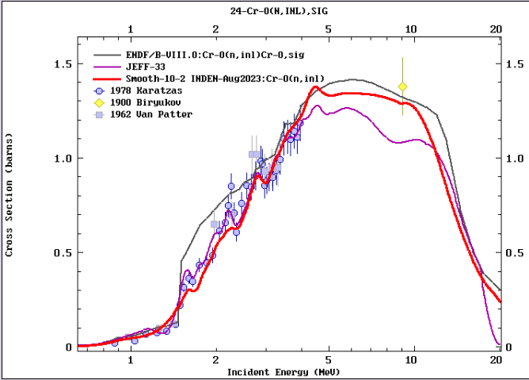

Slide 8
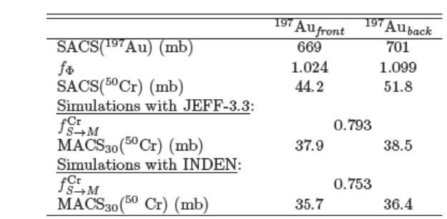
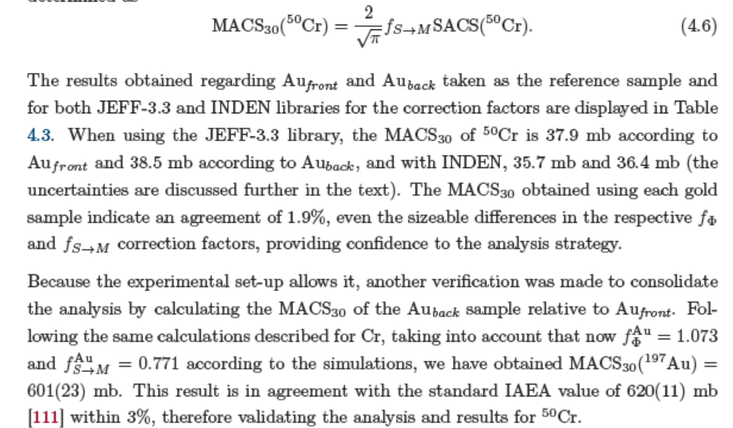
Cr-50(n,g) MACS (NEA HPRL)
MACS₃₀(¹⁹⁷Au)=601(23)mb
STD=620(11) mb
MACS₃₀(⁵⁰Cr)=37.1(20)mb
JEFF-3.3:
MACS₃₀(⁵⁰Cr)=37.8 mb
INDEN:
MACS₃₀(⁵⁰Cr)=44.3 mb
P. Maroto PhD, Univ. Sevilla, Spain, Sept 2024 (unpub)

Slide 9
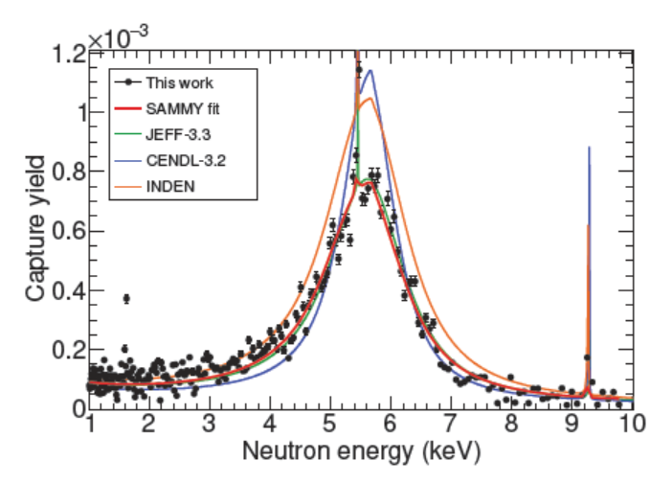
⁵⁰Cr(n,g) (NEA HPRL) ToF thin (n,g) yield
MACS₃₀(⁵⁰Cr)=37.1(20)mb
JEFF-3.3:
MACS₃₀(⁵⁰Cr)=37.8 mb
INDEN:
MACS₃₀(⁵⁰Cr)=44.3 mb
Cr-53, Cr-50 RRR eval needed using Maroto et al data

Slide 10
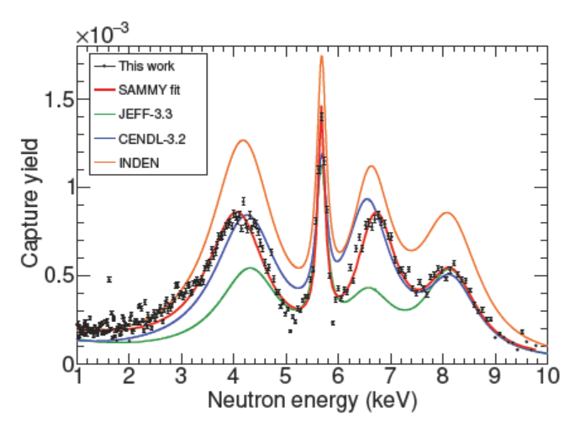
⁵³Cr(n,g) (NEA HPRL) ToF thin (n,g) yield
INDEN too high
CENDL-3.2 closest
JEFF-3.3 too low
Cr-53, Cr-50 RRR eval needed using Maroto et al data

Slide 11
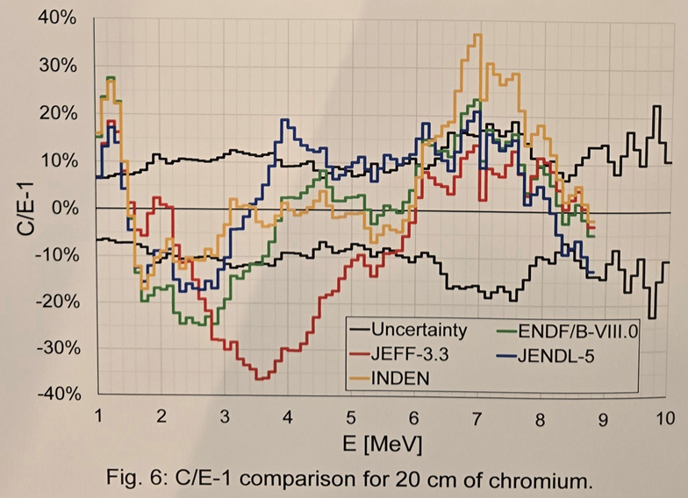
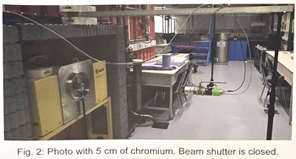
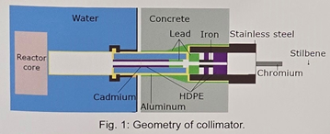
Cr-nat broomstick experiment
@ VR-1 reactor, Prague, CZ
T. Czakoj et al, NDST 2025, Madrid, unpublished

Slide 12
Iron updates INDEN evals adopted by JEFF-4.0 and ENDF/B-VIII.1

Slide 13
INDEN Fe evaluation
Fe-56 from 850keV up to 4 MeV based on exp. data alone
20-30% leakage underestimation found in ENDF/B-VIII.0
* New INDEN evaluation updated in 2019-2023, inelastic reduced
leakage problem solved
New transmission experiment in Dresden (Junghans, Beyer et al)
Overestimation of transmission near 300 keV
mostly solved by updating the Fe-57 evaluation
See validation of the RRR from Kostal presentation
TO DO:
New Fe-56 data appear in 2025, see Gkatis presentation, el+inl
New Fe-54 evaluation undertaken at RPI, check inelastic
Need of URR for Fe-54 and Fe-57 (see URR discussion later)
Self-shielding for inelastic in Fe-56 ??

Slide 14
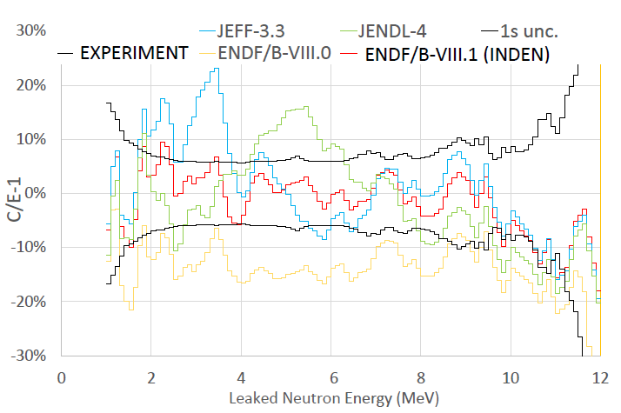
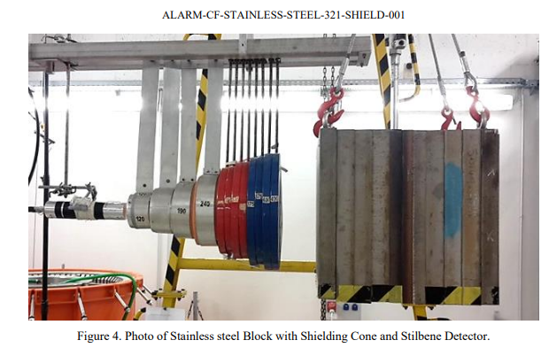
INDEN updated “structural” evaluations:
see nds.iaea.org/INDEN/ - Validation
Fe isotopes (IAEA/JSI), fe57e80m, fe56e80X29r41, fe54e80o
Cr isotopes, BNL/ORNL/IAEA/JSI/CEA, v2.3.2
This energy region
sensitive to Ni58(n,p)
B-VIII.0 iron:
-20% leakage
SS neutron leakage
(Rez, CZ, 11/2021)
M. Schulc et al, Ann. Nucl. En. 179 (2022) 109433
https://nds.iaea.org/INDEN/data/ALARM-CF-steel-SHIELD-001-final.pdf

Slide 15
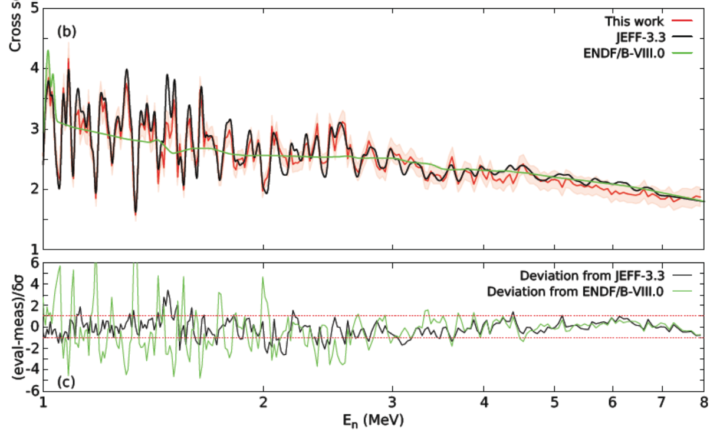
Fe-54 elastic cross sections
G. Gkatis PhD, Aix-Marseille Université, 10 June 2024 (unpub)

Slide 16
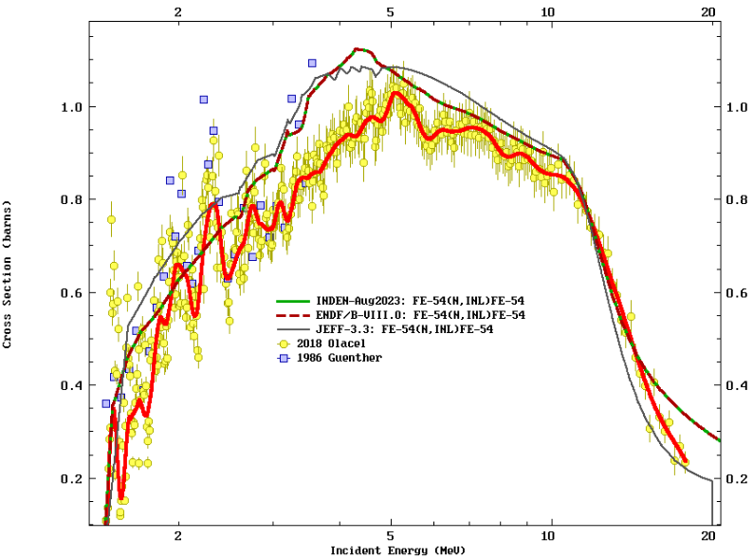
Fe-54 inelastic cross sections
Do we measure shielded INL XS?
See URR work & discussions

Slide 17
F-19 updates INDEN eval adopted by JEFF-4.0 and ENDF/B-VIII.1

Slide 18
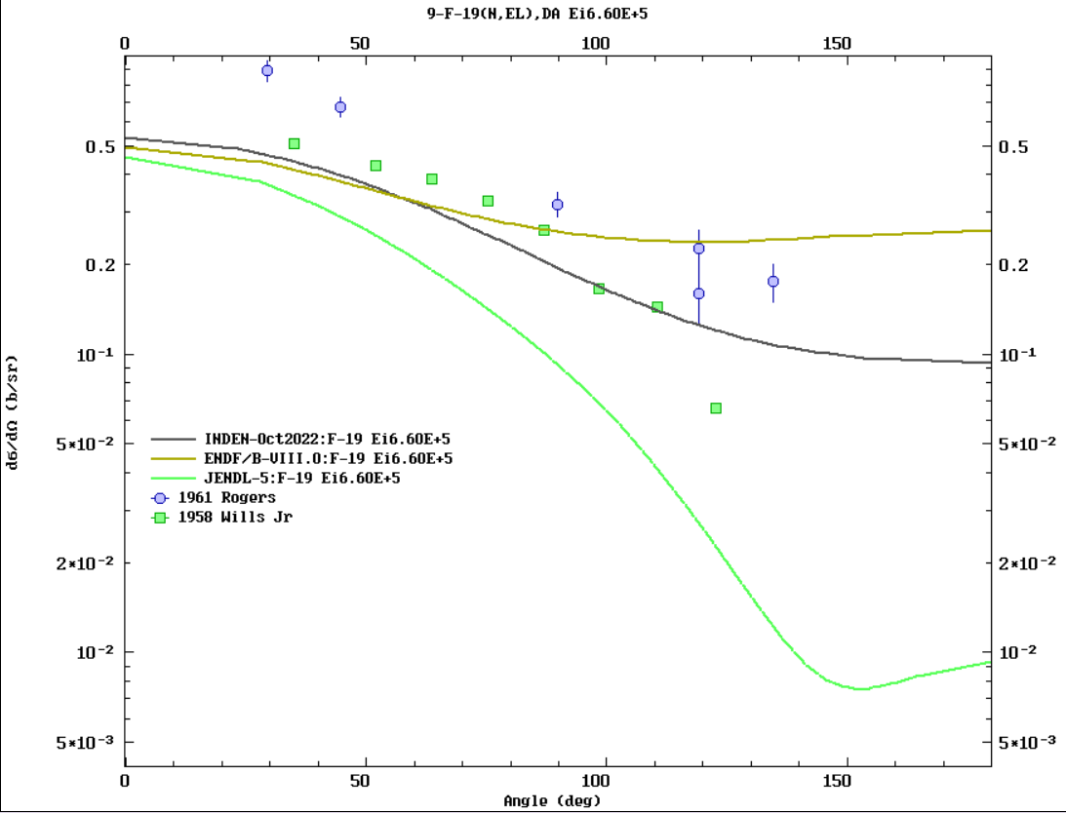
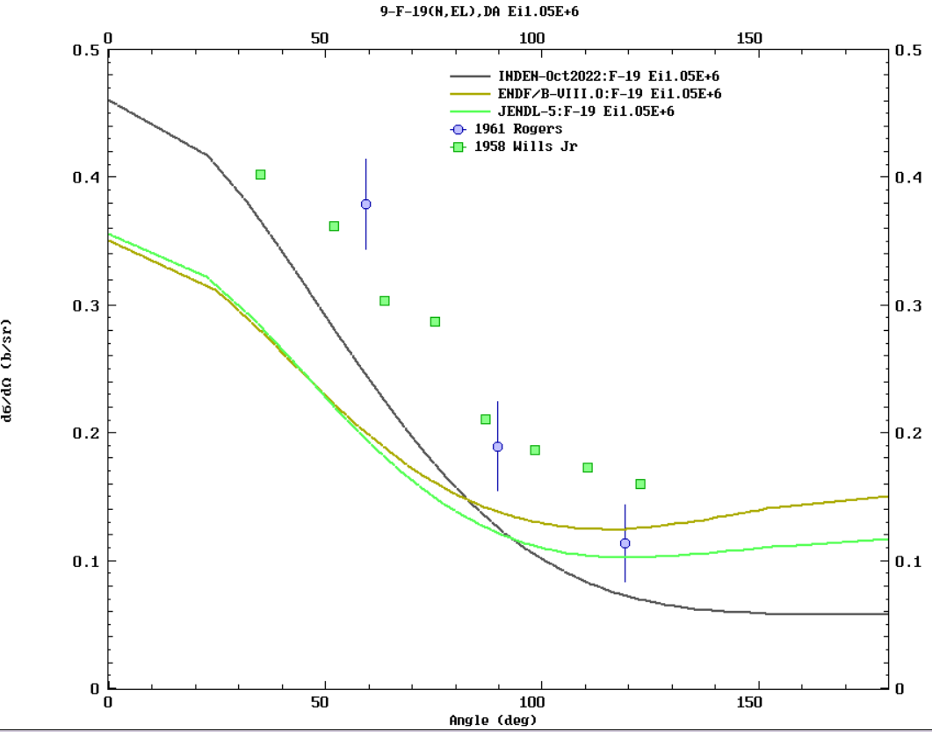
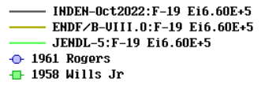
Issues in ¹⁹F(n,el) AD below 1 MeV at forward angles (JENDL colleagues)
ELISA (JRC) measurements of F-19 needed

Slide 19
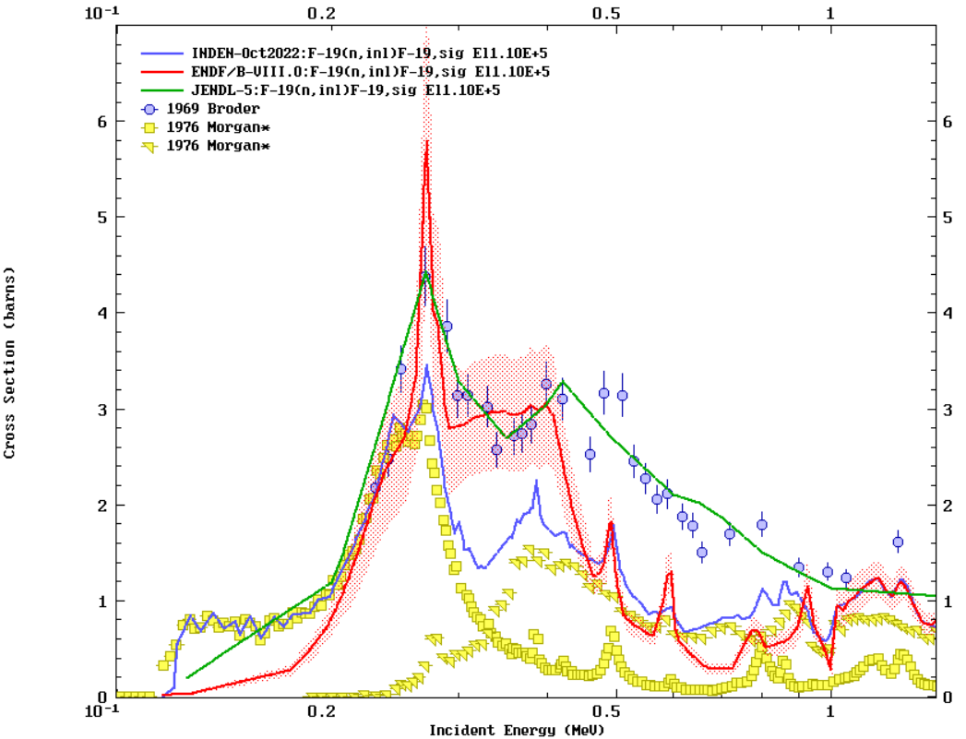
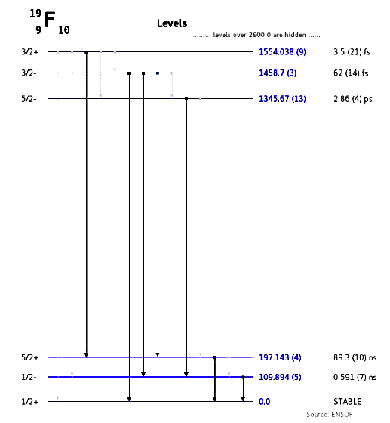
Morgan 76 data adopted << Broder data
B8 & JENDL-5
followed Broder
with REF Fe !
By using Morgan derived INL data (nng x 4pi)
F-19(n,inl) reduced by ~40% from 300 keV

Slide 20
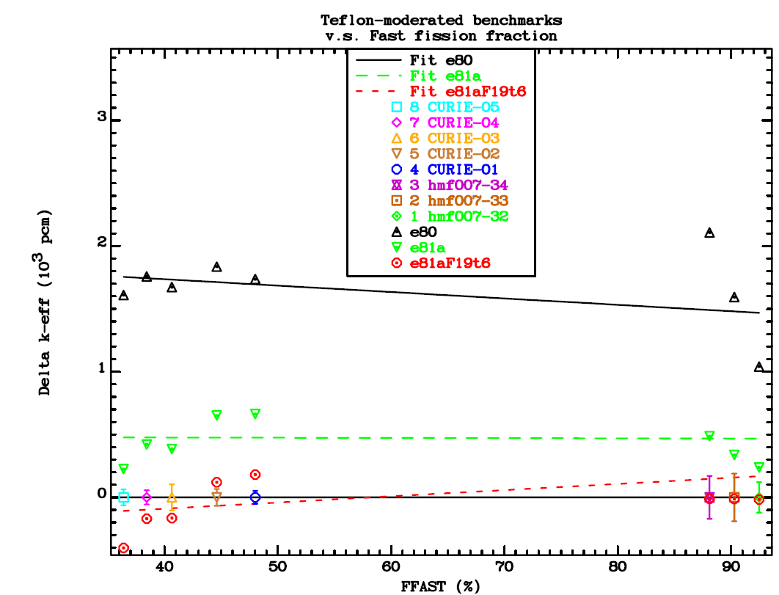
¹⁹F criticality impact (HEU) ≅ -1000pcm
hmi011
(CURIE)
hmf007
/32-34

Slide 21
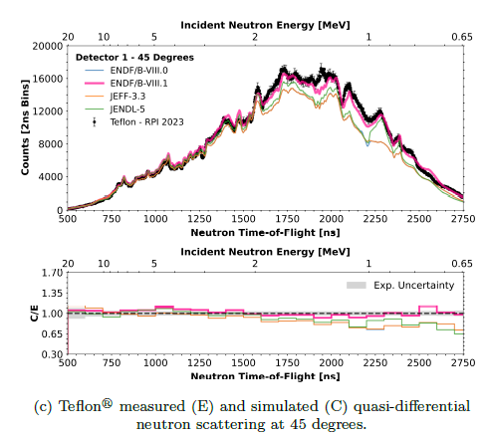
RPI quasidifferential data (Siemers et al)
45 deg
CSWEG,
Nobre et al,
ENDF/B-VIII.1 paper
(to be published in 2026)

Slide 22
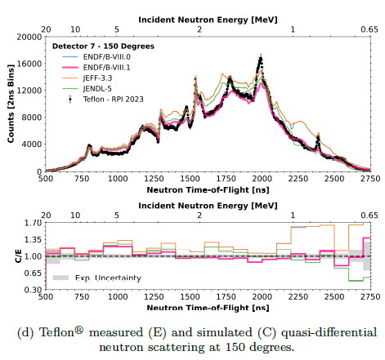
RPI quasidifferential data (Siemers et al)
150 deg
CSWEG,
Nobre et al,
ENDF/B-VIII.1 paper
(to be published in 2026)

Slide 23
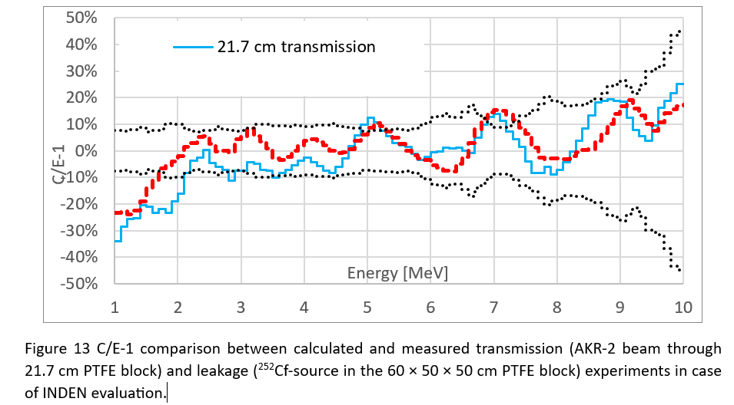
Teflon transmis. (TUD) & leakage (Rez)
F-19 validation (post-release)
Data issues below 2 MeV in 2 exps!

Slide 24
Teflon neutron transmission (TUD, Dresden)
Transmission very sensitive to σ_{tot}
Rez neutron leakage drop below 2 MeV confirmed
in transmission (TUD, Dresden) experiment

Slide 25
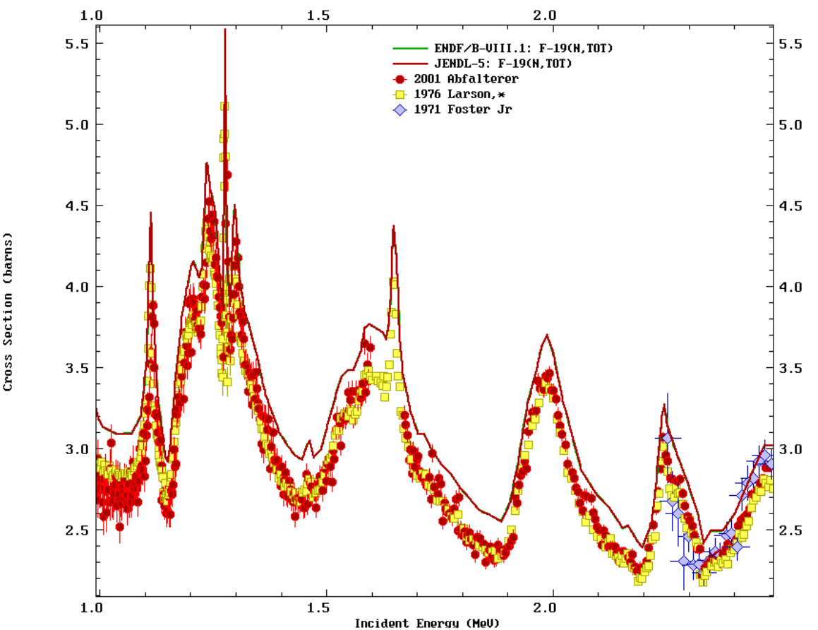

F-19: (n,tot) below 2 MeV
All evaluations based on Larson 76 data
f19e80_zt9
to
f19f4t4_tot6
Larson 76 x 0.92
consistent !!
with Foster Jr 71
& Abfalterer 2000
Larson x 0.92

Slide 26
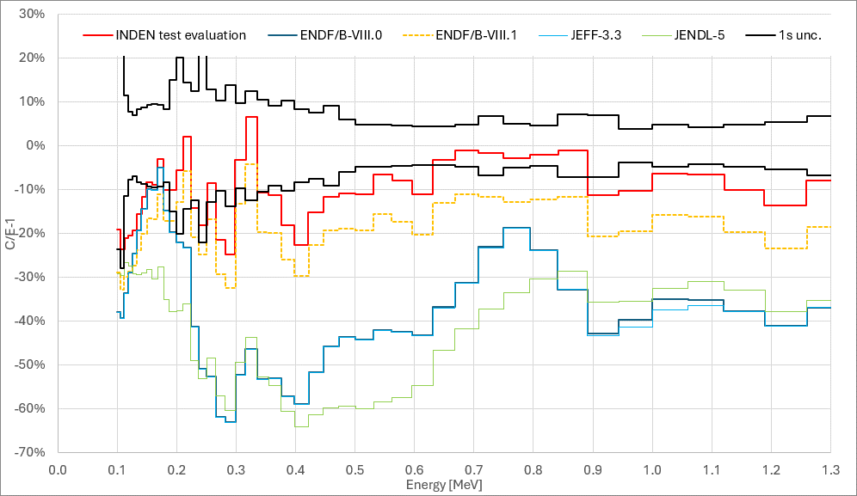
Teflon neutron leakage (HPD)
f19f4t4_tot6 f19e80_zt9
JEFF-4.0

Slide 27
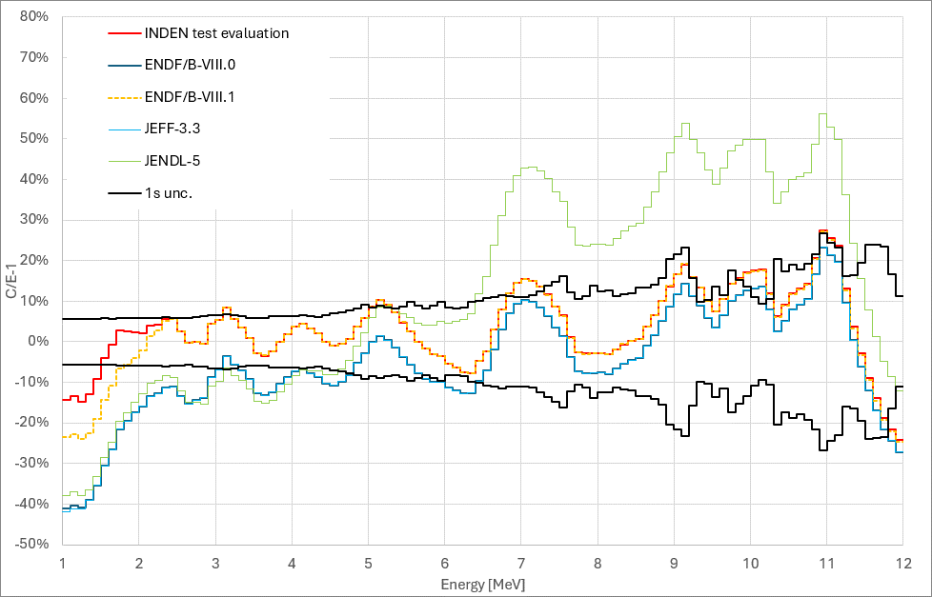
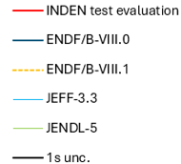
Teflon neutron leakage (stilbene)
and JEFF-4.0
Neutron leakage drop below 2 MeV
confirmed in broomstick experiments

Slide 28
New ¹⁹F criticality impact ≅ -400pcm
hmi011
(CURIE)
hmf007
/32-34
-1200 pcm: angular distributions & inelastic (0.1-1 MeV)
-400pcm: total XS below 2 MeV

Slide 29
INDEN 2024 Cu evaluation
Fast evaluation patched, a new RRR evaluation highly desirable
Corrected emission spectra above 10 MeV
Corrected angular distributions in the RRR
INDEN evals adopted by JEFF-4.0 and ENDF/B-VIII.1

Slide 30
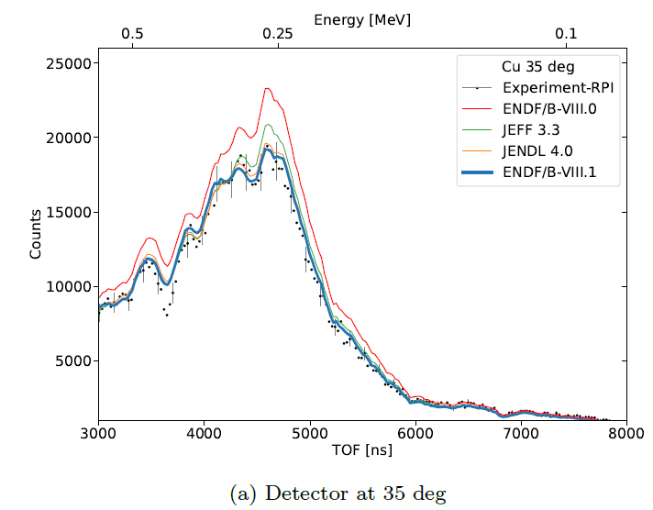
RPI quasi-differential experiment (2021)
Y. Danon, ENDF/B-VIII.1 paper (submitted)

Slide 31
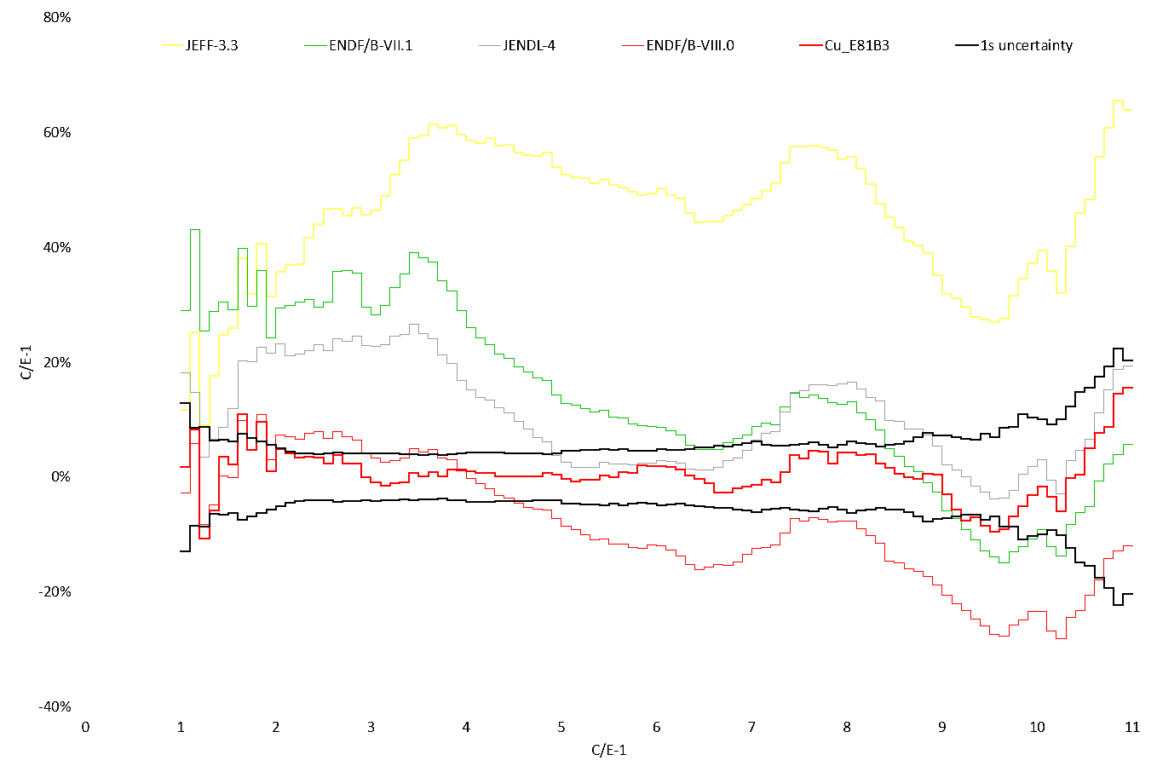
INDEN updated “structural” evaluations:
see nds.iaea.org/INDEN/ - Validation
Cu isotopes, ORNL/IAEA/JSI (in progress)
nds.iaea.org/INDEN/data/ALARM-CF-CU-SHIELD-001
INDEN-2024
ENDF/B-VIII.0
n,γ
discr.
Cu cube, neutron leakage (Rez, CZ)
Schulc et al, Rad.Phys.Chem. 2021

Slide 32
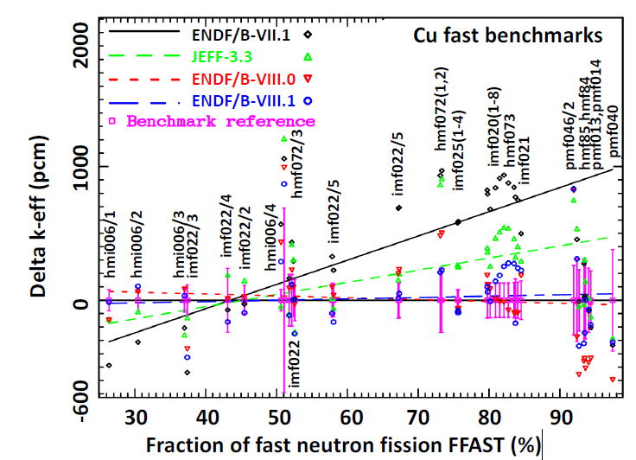
Fast neutron benchmarks - Cu

Slide 33
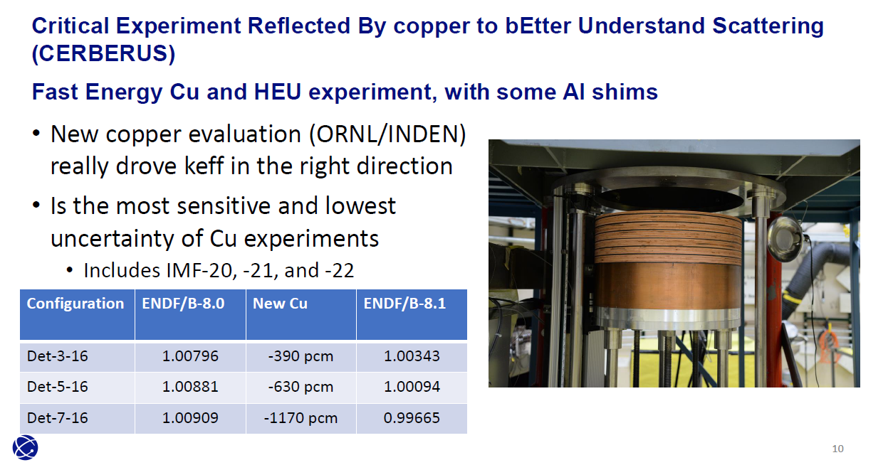
New LANL/NCERC Cu benchmark
JEFF-4.0
0.99983
0.99542
0.99335
AVER BIAS +862 pcm +34 pcm -580 pcm
P. Brain et al, INDEN 2024 meeting, hmf106

Slide 34
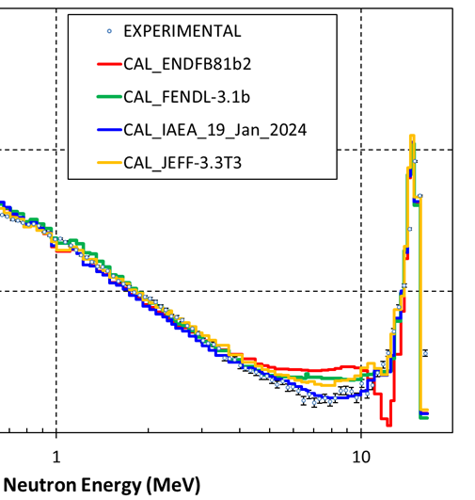

Oktavian shielding 14 MeV benchmark
INDEN (B81 & JEFF-4)
shows excellent
fusion performance
adopted JENDL-4
DDXS above En=10 MeV

Slide 35
W evaluation IAEA fast eval adopted by JEFF-4.0, and ENDF/B-VIII.0/VIII.1

Slide 36
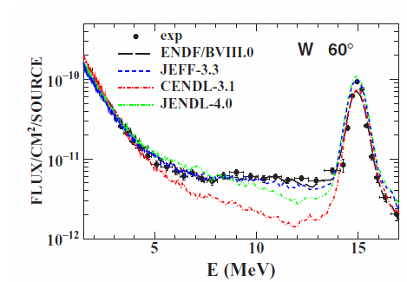
W DT testing @ CIAE, 60 deg
R. Han et al, EPJ Web of Conferences 239, 18009 (2020)
https://doi.org/10.1051/epjconf/202023918009

Slide 37
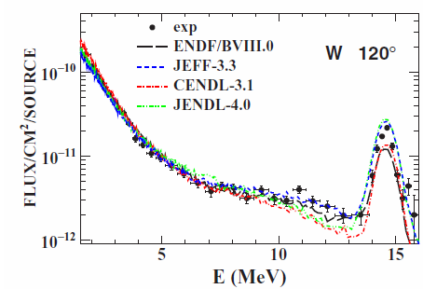
W DT testing @ CIAE, 120 deg
R. Han et al, EPJ Web of Conferences 239, 18009 (2020)
https://doi.org/10.1051/epjconf/202023918009

Slide 38
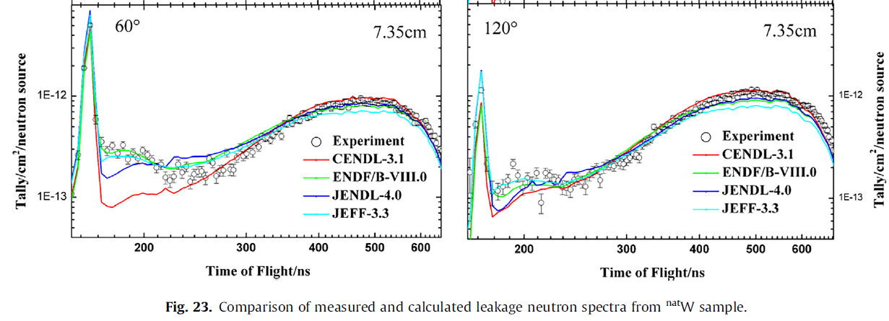
W-nat DT testing @ CIAE, 15 cm
Y. Nie et al. Annals of Nuclear Energy 136 (2020) 107040
https://doi.org/10.1016/j.anucene.2019.107040

Slide 39
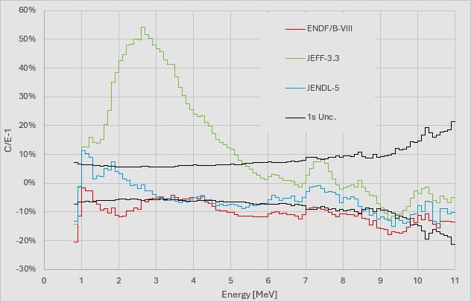
W-nat Cf(sf) testing @ Rez
M. Kostal et al, CVR, Rez near Prague, CZ, unpublished

Slide 40
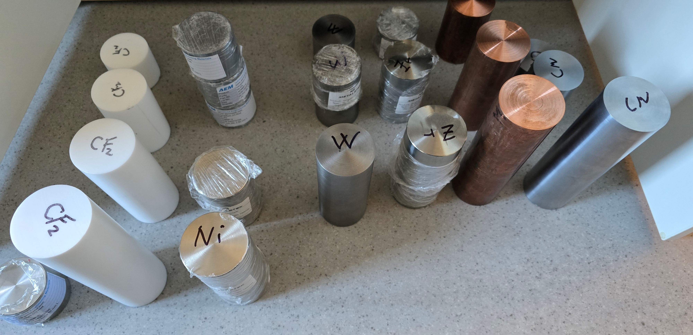
Future research @Rez is warranted !!
Teflon, Ti, V, Cr, Ni, Cu, Zr, Mo, W

Slide 41
Future work
To redo with new data: Cr-53 and Cr-50 (n_TOF, USE)
To improve with new data: Fe (Gkatis), Fe-54 and Fe-57
Need of new total XS data for F-19, new inl data (Knijpstra)
To improve: Zr, W, Pb, Ni, Cu (in the RRR), V, Bi
see Simakov, Kostal presentations on validation
To help with chlorine (Cl) ?
“It doesn't matter how beautiful your theory is,
it doesn't matter how smart you are.
If it doesn't agree with experiment, it's wrong.”
Richard Philips Feynman, Nobel Prize in Physics 1965

Slide 42
Thank you!
Notes:
Thank you!

