Slide 1
Revisiting Elastic scattering of fe-56: angular distributions and covariances across major libraries
December 2025
PSN-RES/SNC/LN
Juan A. Monleon de la LLUVIA
PhD student
juan-antonio.monleondelalluvia@asnr.fr
Mariya Brovchenko (ASNR)
Dimitri Rochman (Nagra)

Slide 2
Uncertainty need in safety
Ex: Criticality and reactor ageing observables (vessel fluence)
Approach 1:
DO not consider ND covariances
Use of integrals benchmark to evaluate a bias
Use only the bias (+/- exp unc)
Approach 2:
IF: NO integral representative experiments available OR integral data used during the evaluation
NEED of reliable ND covariance data (we have nothing else …) and propagate it to the observable
To test/validate the ND Covariance data we need to know exactly WHICH and HOW the experimental data was used during the evaluation
Historically used in France for criticality safety
For the ageing problem, we need to, at least partially, rely on the approach 2 → focus on Fe56 (to start)
Which differential data ?
What are the inputs of the XS cov for Fe56 generation ?
What integral benchmarks (SINBAD, ICSBEP), mentioned by Andrej Trkov, are used ?

Slide 3
Motivation
Thesis project: Uncertainty Quantifications for vessel neutron fluence in PWR
Cross sections and angular distributions
Quality of the covariance data we are propagating
Angular Distributions (MF4 and MF34)
Focus on Fe-56 (elastic)
Difference across major libraries
ENDF/B-VIII.1 same as JEFF-4.0: new evaluation but no covariance data
JENDL-5: evaluation of 2021 with covariances
Latest JEFF covariance evaluation in JEFF-3.3 comes from 3.1 (2005)
TENDL-23 available
Comparison of libraries vs EXFOR differential data

Slide 4
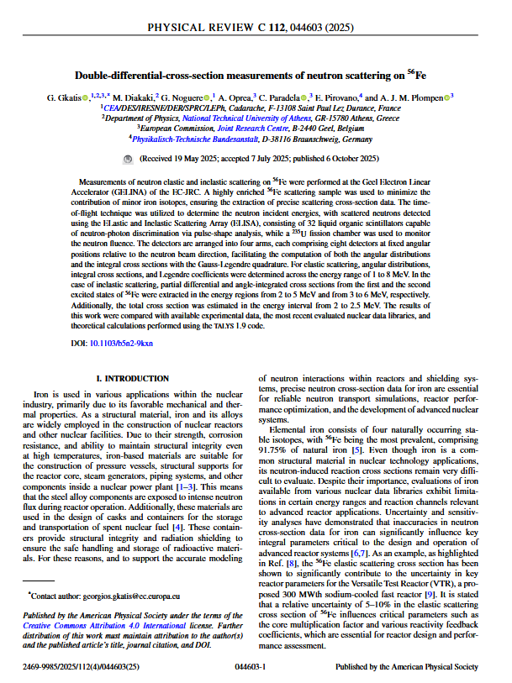
Motivation
Double-differential-cross-section measurements of neutron scattering on 56Fe
(6th October 2025)
New experimental data for Fe-56 by Georgios Gkatis et al.
Goal: Provide high-resolution neutron elastic and inelastic scattering data on highly enriched Fe-56 in the fast range (1-8 MeV)
Methodology: Measurements at GELINA facility (JRC, Belgium) using “white” neutron beam and Time-Of-Flight (TOF)
Instrumentation: Neutrons detected with ELISA spectrometer (Elastic and Inelastic Scattering Array) composed of 32 liquid organic scintillators capable of neutron-photon discrimination
Data Analysis Technique: Detectors at specific angles corresponding to the zeros of the eight-order Legendre Polynomial. Gives differential cross sections (angular distributions) and angle-integrated cross sections via the Gauss-Legendre quadrature)

Slide 5
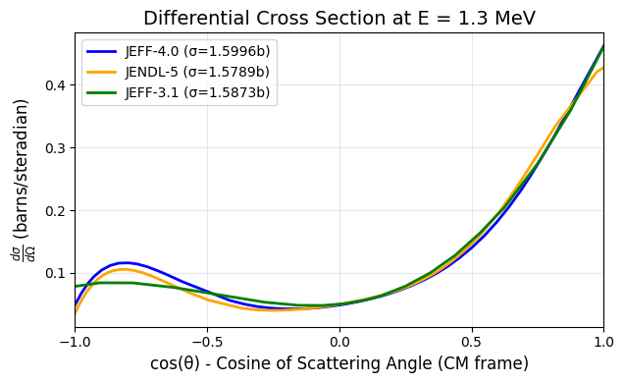




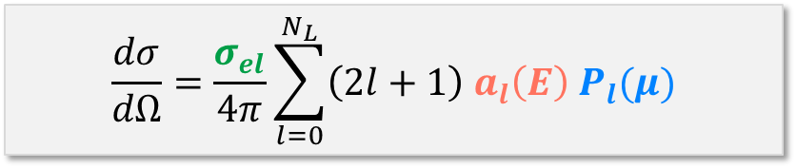
Angular distributions
neutron $(t′,E′)$
$$(E→E^{′})$$
$$θ$$
neutron $(t,E)$
nucleus
Differential cross section
$$\frac{dσ}{dΩ}=\frac{σ_{el}}{4π}\sum_{l=0}^{N_{L}}{\left(2l+1\right) a_{l}\left(E\right) P_{l}(μ)}$$
Elastic scattering cross section
Legendre Polynomial
Legendre Coefficients (in ENDF-6 files)

Slide 6
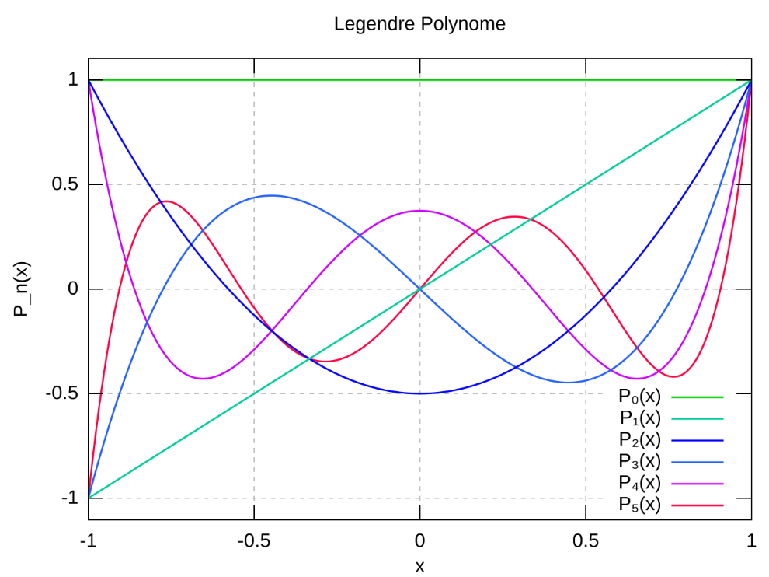
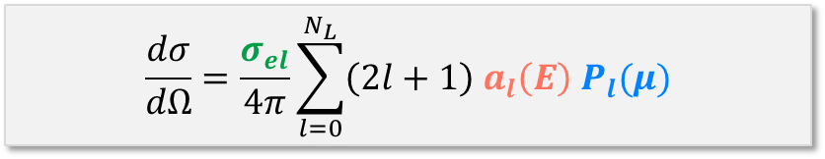
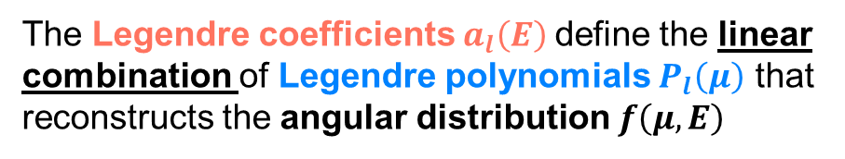
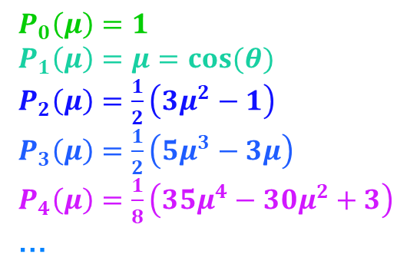
Legendre coefficients and polynomial
Differential cross section
$$\frac{dσ}{dΩ}=\frac{σ_{el}}{4π}\sum_{l=0}^{N_{L}}{\left(2l+1\right) a_{l}\left(E\right) P_{l}(μ)}$$
Legendre Polynomials
$P_{0}\left(μ\right)=1$
$P_{1}\left(μ\right)=μ=cos(θ)$
$P_{2}\left(μ\right)=\frac{1}{2}\left(3μ^{2}−1\right)$
$P_{3}\left(μ\right)=\frac{1}{2}\left(5μ^{3}−3μ\right)$
$P_{4}\left(μ\right)=\frac{1}{8}\left(35μ^{4}−30μ^{2}+3\right)$
…
The Legendre coefficients $a_{l}\left(E\right)$define the linear combination of Legendre polynomials $P_{l}\left(μ\right)$ that reconstructs the angular distribution $f\left(μ,E\right)$

Slide 7
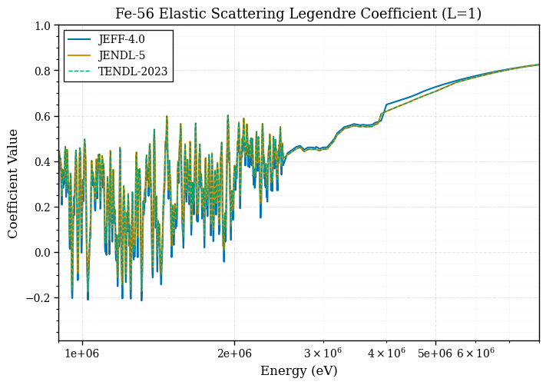
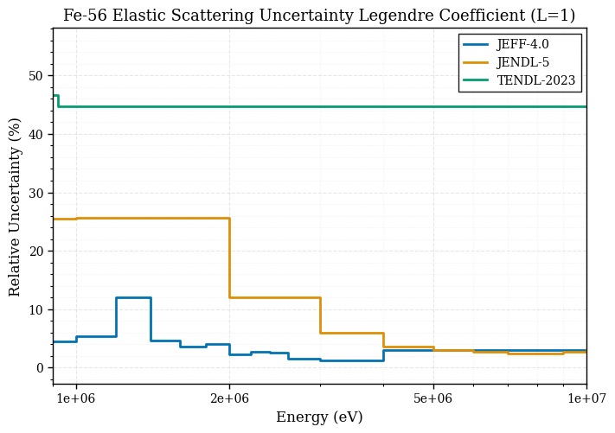
Uncertainties on fe-56 (JEFF & JENDL-5)

Slide 8
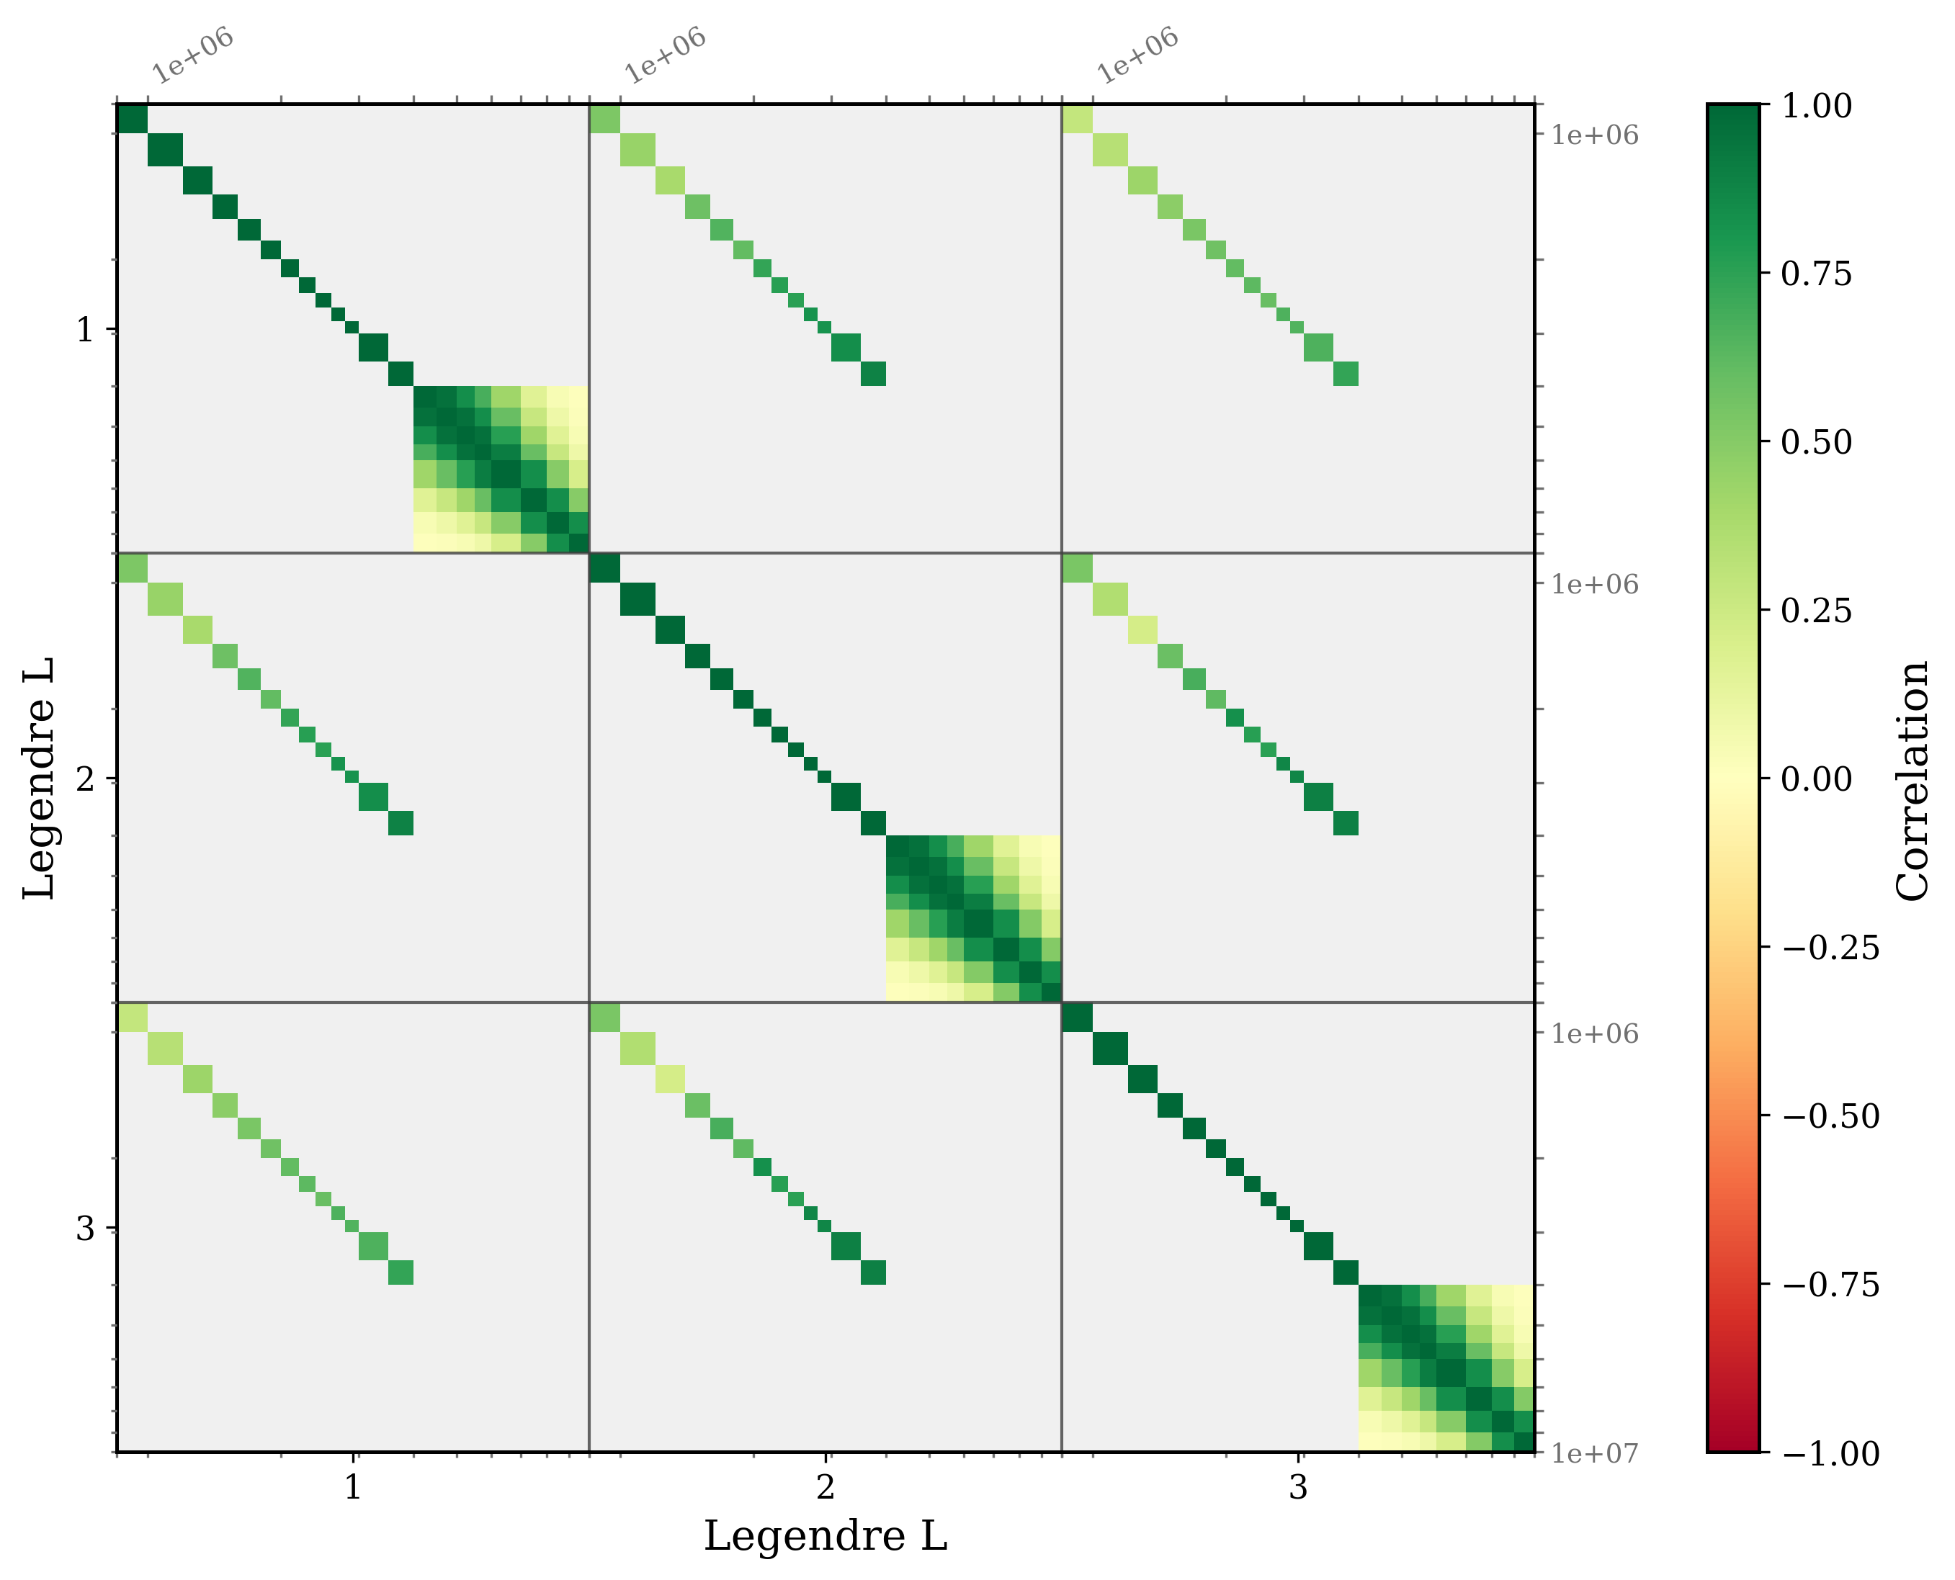
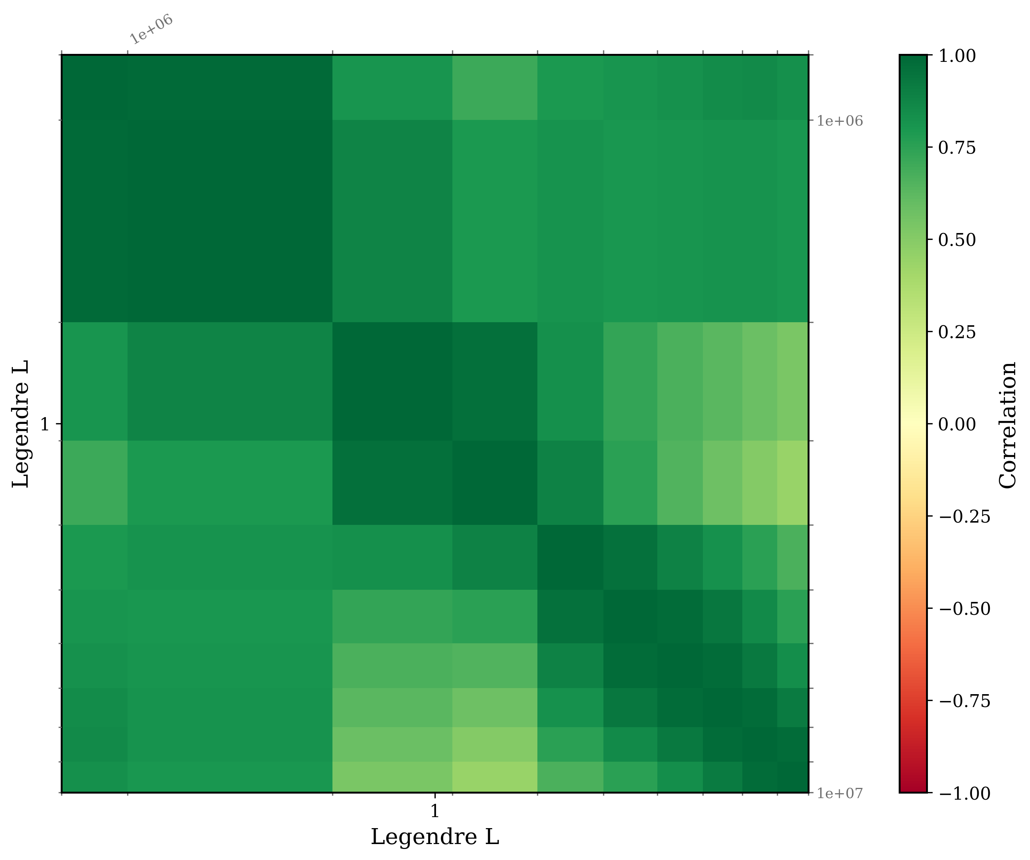
Covariance data on fe-56 (JEFF-3.3 & JENDL-5)
JEFF-3.3
JENDL-5

Slide 9
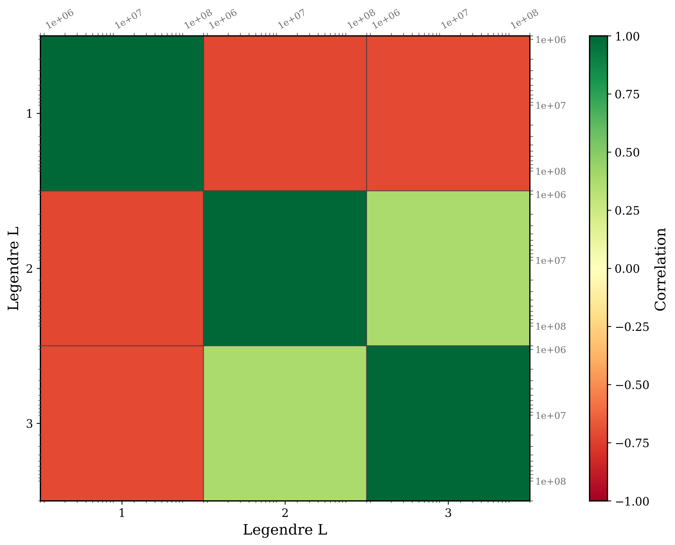
Covariance data on fe-56 (tendl-2023)
TENDL-2023

Slide 10
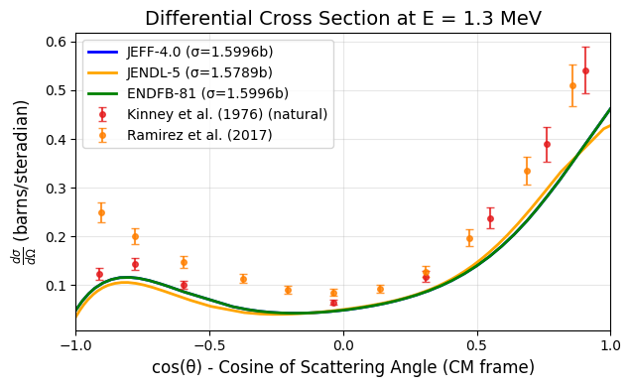
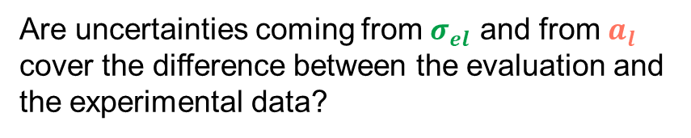

How do we judge whether uncertainties are “good”?
Angular differential data
$$\frac{dσ}{dΩ}=\frac{σ_{el}}{4π}\sum_{l=0}^{N_{L}}{\left(2l+1\right) a_{l}\left(E\right) P_{l}(μ)}$$
Are uncertainties coming from $σ_{el}$ and from $a_{l}$ cover the difference between the evaluation and the experimental data?
YES → “GOOD”
NO → “BAD”

Slide 11
EXFOR data
# | Subentry | Author | Year | Energy (MeV) | Points | Target
1 | 11276009 | Rodgers | 1967 | 2.33 | 5 | Fe-56
2 | 20482005 | Cabe | 1967 | 0.63 – 0.97 | 63 | Fe-56
3 | 11708006 | Kinney | 1968 | 4.60 – 7.55 | 85 | Fe-56
4 | 10037024 | Boschung | 1971 | 5.05 – 5.58 | 19 | Fe-56
5 | 40075002 | Morozov | 1972 | 1.80 | 34 | Fe-56
6 | 10571002 | Kinney | 1976 | 0.50 – 2.50 | 16008 | Natural
7 | 40532004 | Korzh | 1977 | 1.50 – 3.00 | 36 | Natural
8 | 30463020 | Schweitzer | 1978 | 3.40 | 12 | Fe-56
9 | 20743002 | Cierjacks | 1978 | 0.489 – 3.064 | 18399 | Natural
10 | 10886002 | Smith | 1980 | 1.684 – 3.905 | 490 | Natural
11 | 14462002 | Ramirez | 2017 | 1.30 – 7.96 | 192 | Fe-56
12 | 23365004 | Pirovano | 2019 | 1.995 – 5.975 | 952 | Natural
13 | 23365005 | Pirovano | 2019 | 1.998 – 5.983 | 1496 | Natural
14 | 27673002 | Gkatis | 2025 | 1.010 – 7.846 | 1016 | Fe-56

Slide 12
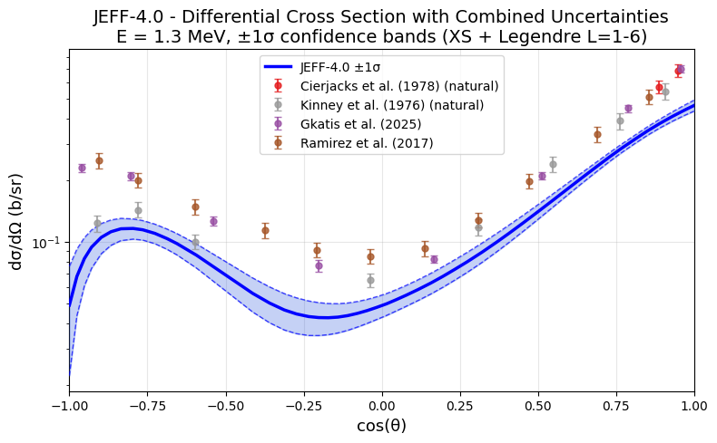
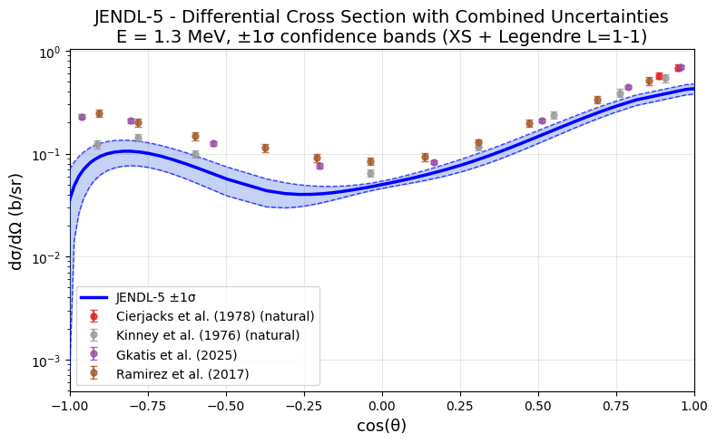
Propagating uncertainties to differential cross sections
JEFF
JENDL-5

Slide 13
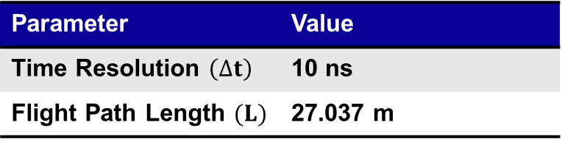
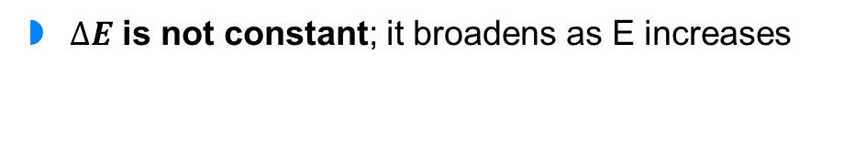
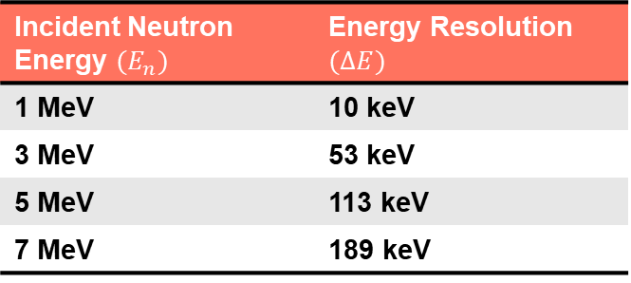
Energy resolution folding
Concept: Evaluated libraries must be convolved with a Gaussian kernel whose width $(∆E)$ matches the experimental TOF resolution
From Gkatis data:
Incident Neutron Energy $(E_{n})$ | Energy Resolution $(∆E)$
1 MeV | 10 keV
3 MeV | 53 keV
5 MeV | 113 keV
7 MeV | 189 keV
Parameter | Value
Time Resolution $\left(∆t\right)$ | 10 ns
Flight Path Length $(L)$ | 27.037 m
$∆E$ is not constant; it broadens as E increases
This analysis: Energies folded with Gkatis data to compare with EXFOR data
Only 2 experiments had data in EXFOR entry to do proper folding (Gkatis and Pirovano)
No folding for Legendre coefficients

Slide 14
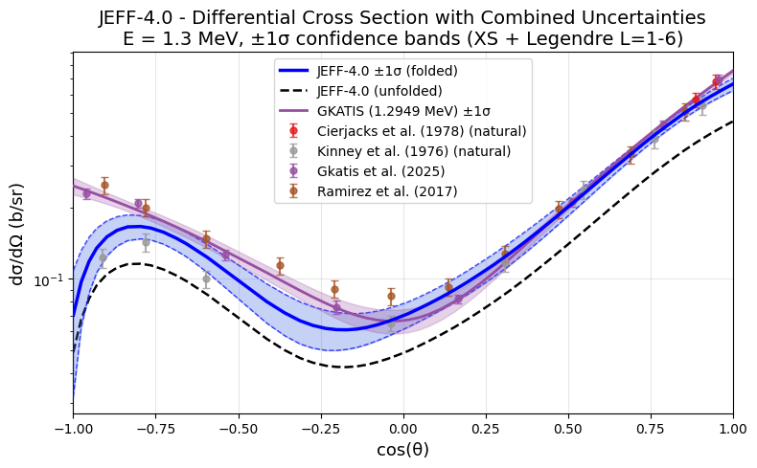
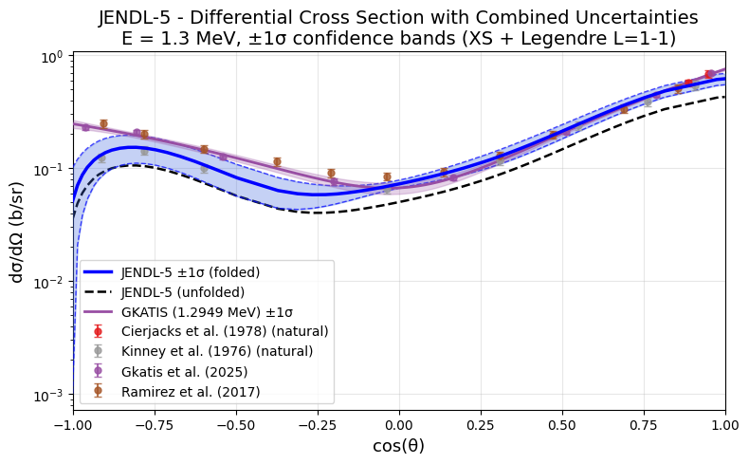
Propagating uncertainties to differential cross sections
JEFF
JENDL-5
Plots generated for 246 energies between 1 – 8 MeV

Slide 15
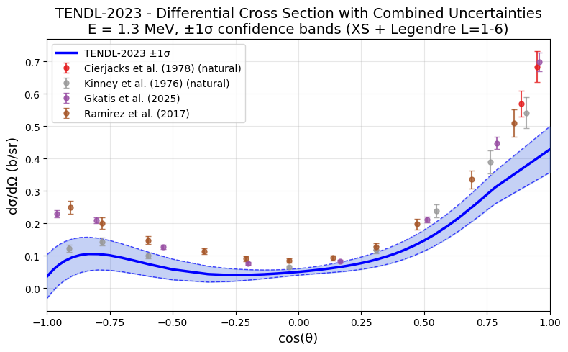
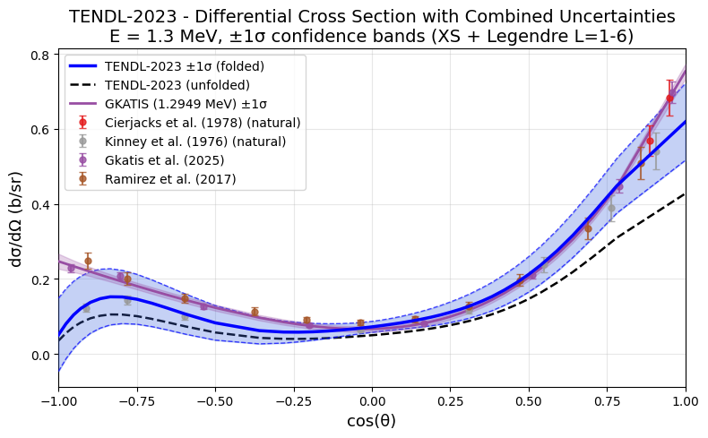
Propagating uncertainties to differential cross sections
Unfolded
Folded

Slide 16
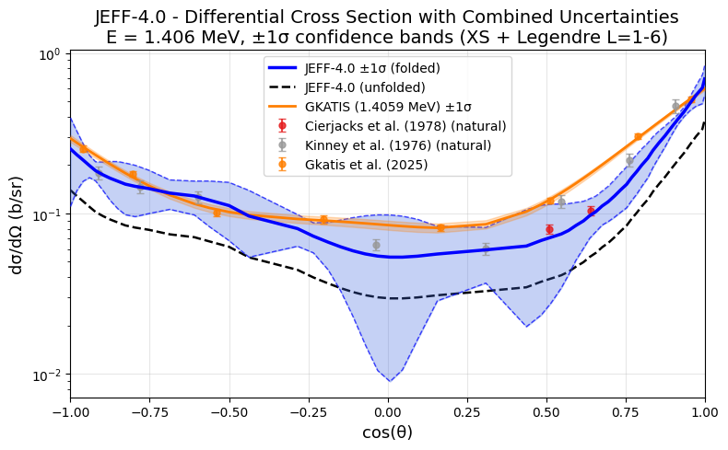
Propagating uncertainties to differential cross sections

Slide 17
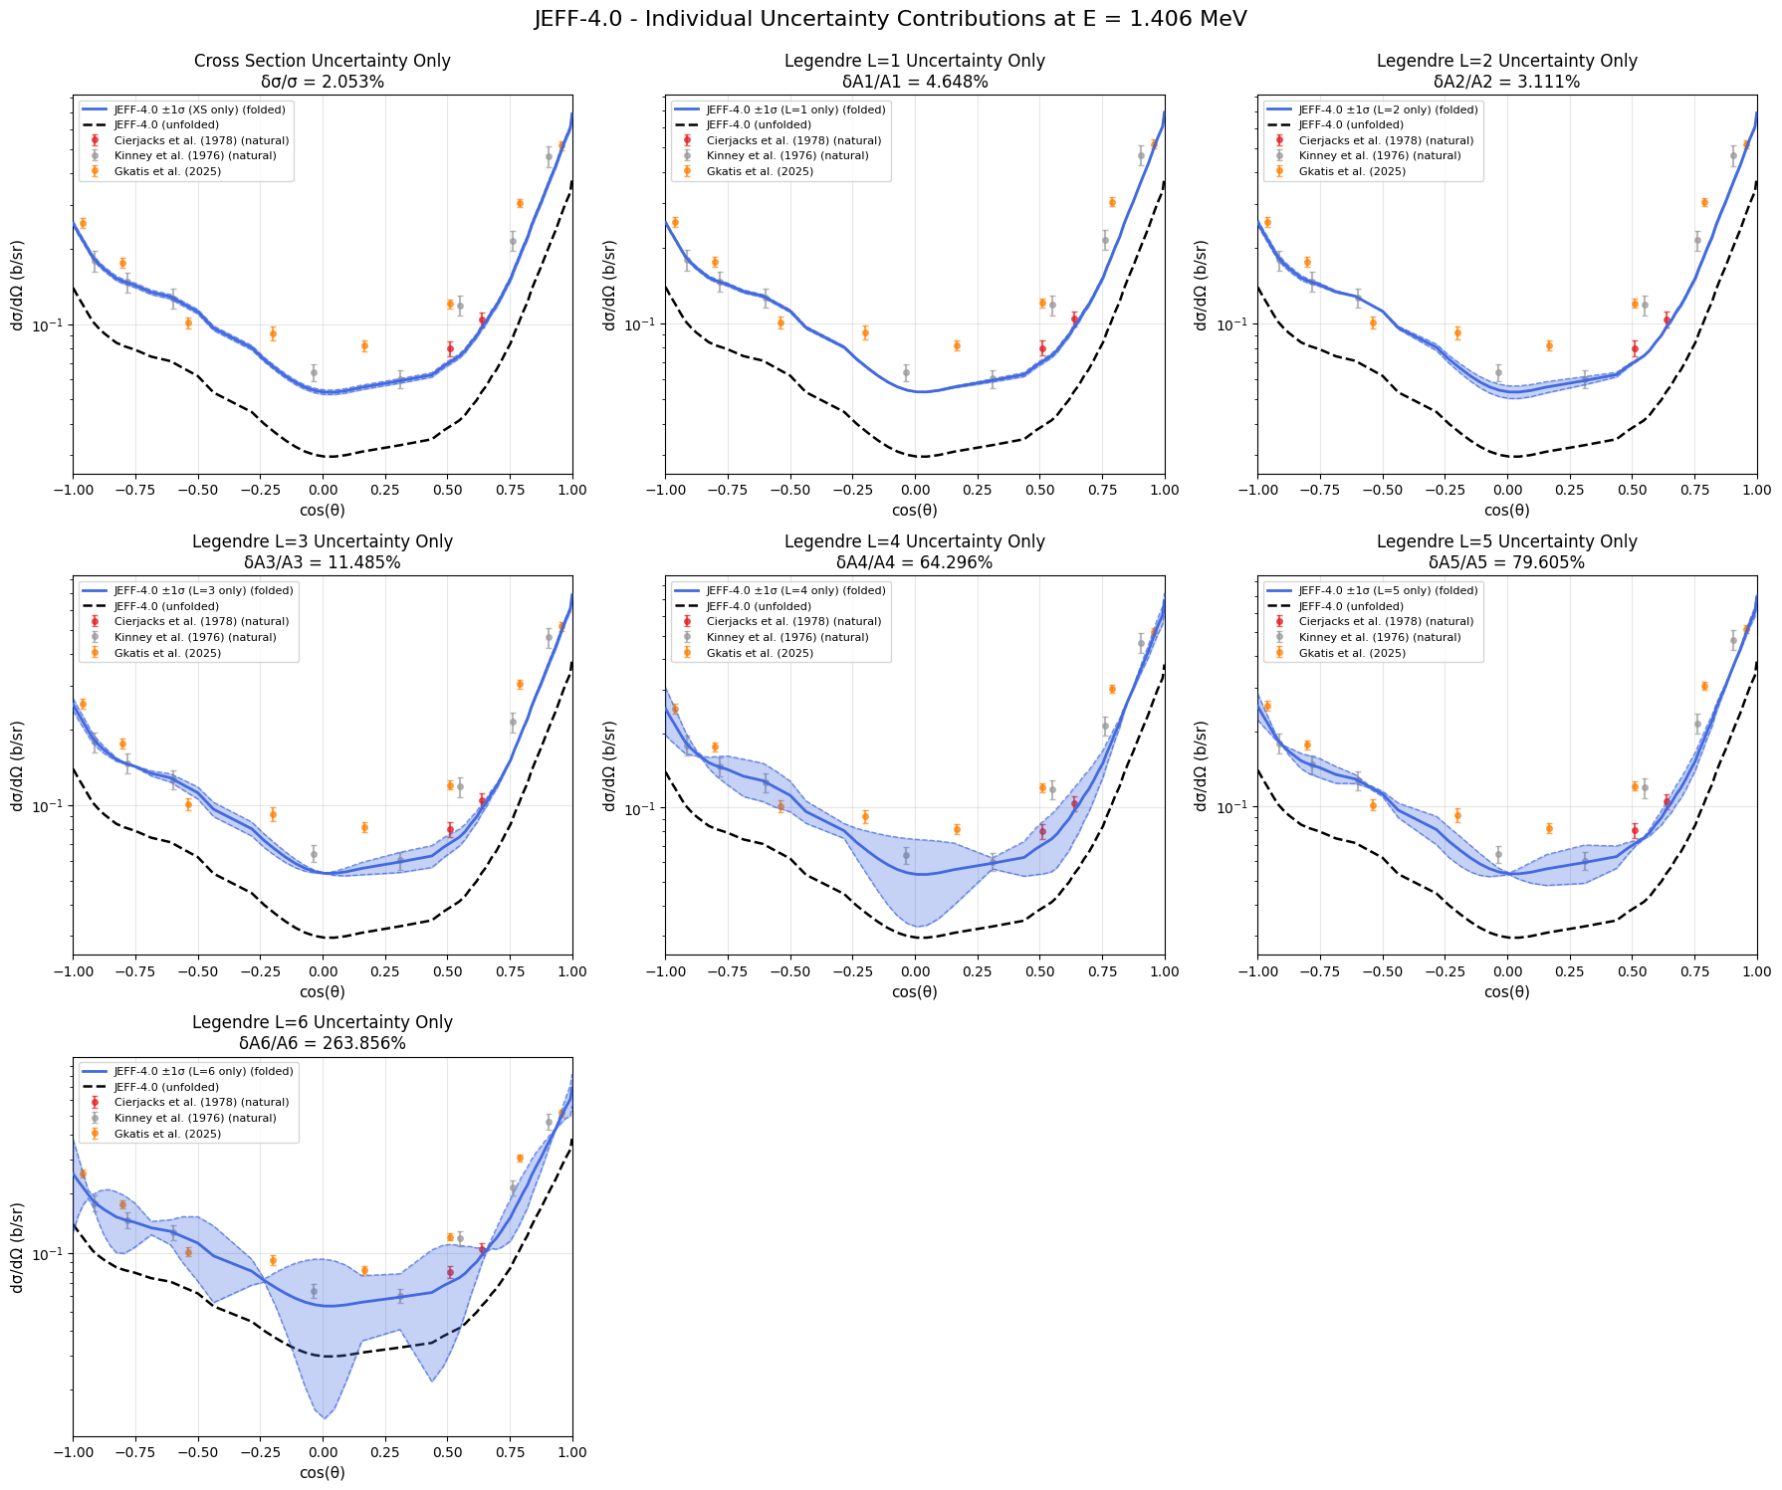
Propagating uncertainties to differential cross sections

Slide 18
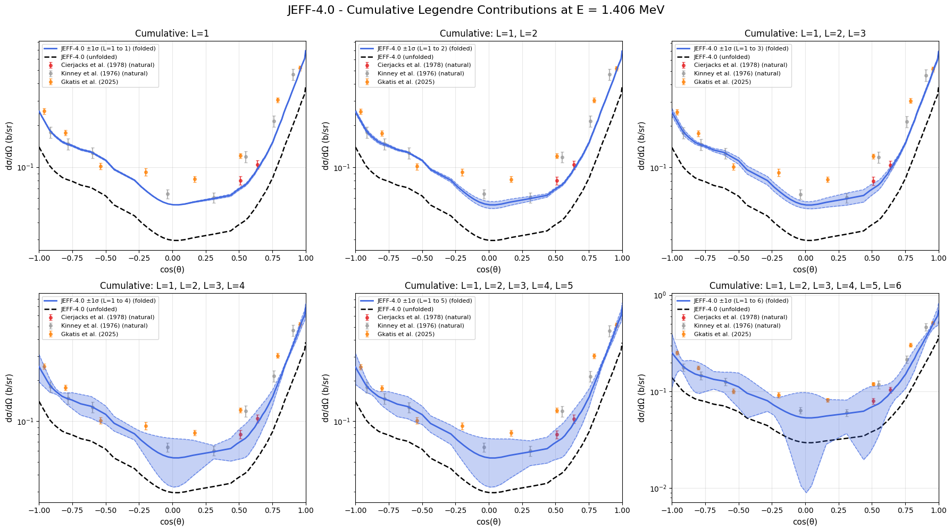
Propagating uncertainties to differential cross sections

Slide 19
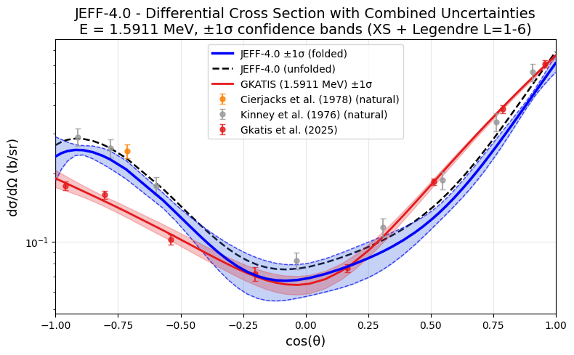
Propagating uncertainties to differential cross sections

Slide 20
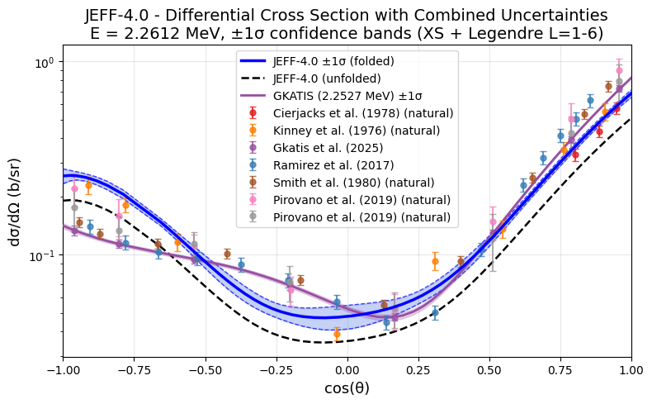
Propagating uncertainties to differential cross sections

Slide 21
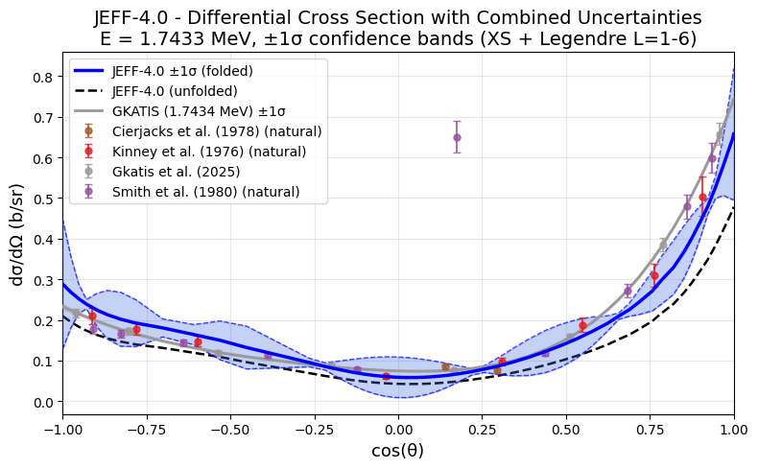
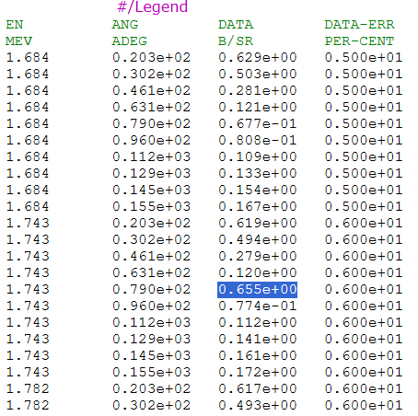
Propagating uncertainties to differential cross sections

Slide 22
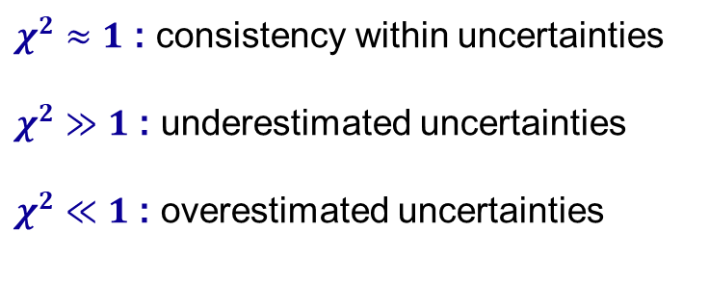
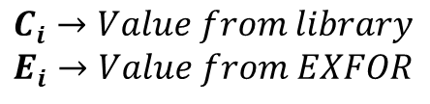


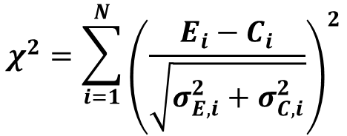
CHI square analysis
CHI SQUARE
REDUCED CHI SQUARE
RESIDUAL
$$χ^{2}=\sum_{i=1}^{N}{{\left(\frac{E_{i}−C_{i}}{\sqrt{σ_{E,i}^{2}+σ_{C,i}^{2}}}\right)}^{2}}$$
$$χ_{red}^{2}=\frac{χ^{2}}{N}$$
$$r_{i}=\frac{E_{i}−C_{i}}{\sqrt{σ_{E,i}^{2}+σ_{C,i}^{2}}}$$
$$C_{i}→Value from library$$
$$E_{i}→Value from EXFOR$$
$χ^{2}≈1$ : consistency within uncertainties
$χ^{2}≫1$ : underestimated uncertainties
$χ^{2}≪1$ : overestimated uncertainties

Slide 23
EXFOR data
# | Subentry | Author | Year | Energy (MeV) | Points | Target
1 | 11276009 | Rodgers | 1967 | 2.33 | 5 | Fe-56
2 | 20482005 | Cabe | 1967 | 0.63 – 0.97 | 63 | Fe-56
3 | 11708006 | Kinney | 1968 | 4.60 – 7.55 | 85 | Fe-56
4 | 10037024 | Boschung | 1971 | 5.05 – 5.58 | 19 | Fe-56
5 | 40075002 | Morozov | 1972 | 1.80 | 34 | Fe-56
6 | 10571002 | Kinney | 1976 | 0.50 – 2.50 | 16008 | Natural
7 | 40532004 | Korzh | 1977 | 1.50 – 3.00 | 36 | Natural
8 | 30463020 | Schweitzer | 1978 | 3.40 | 12 | Fe-56
9 | 20743002 | Cierjacks | 1978 | 0.489 – 3.064 | 18399 | Natural
10 | 10886002 | Smith | 1980 | 1.684 – 3.905 | 490 | Natural
11 | 14462002 | Ramirez | 2017 | 1.30 – 7.96 | 192 | Fe-56
12 | 23365004 | Pirovano | 2019 | 1.995 – 5.975 | 952 | Natural
13 | 23365005 | Pirovano | 2019 | 1.998 – 5.983 | 1496 | Natural
14 | 27673002 | Gkatis | 2025 | 1.010 – 7.846 | 1016 | Fe-56

Slide 24
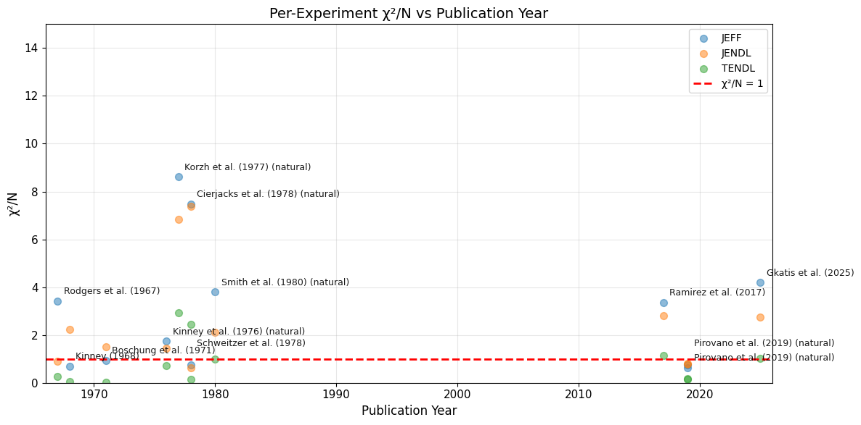

Slide 25
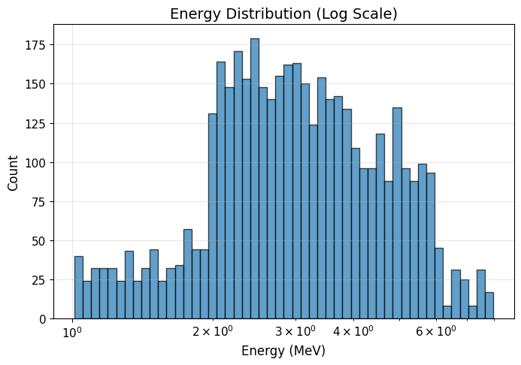
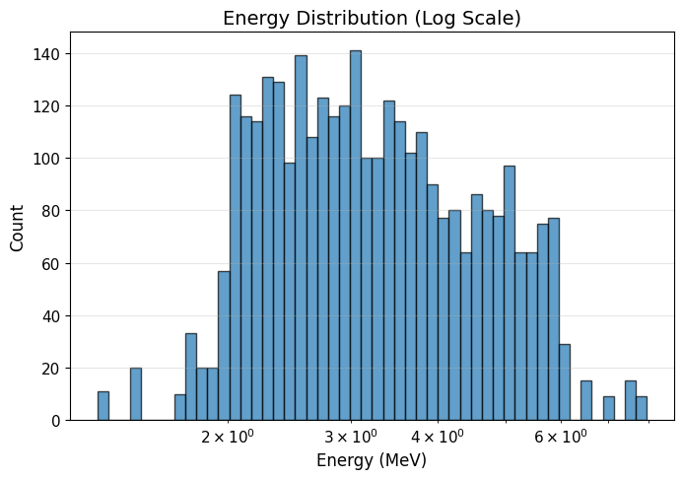
EXFOR LIST EXCEPT FOR:
Cabe et al. (1967)
Morozov et al. (1972)
Kinney et al. (1976)
Cierjacks et al. (1978)
EXFOR LIST EXCEPT FOR:
Cabe et al. (1967)
Morozov et al. (1972)
Kinney et al. (1976)
Cierjacks et al. (1978)
Gkatis et al. (2025)

Slide 26
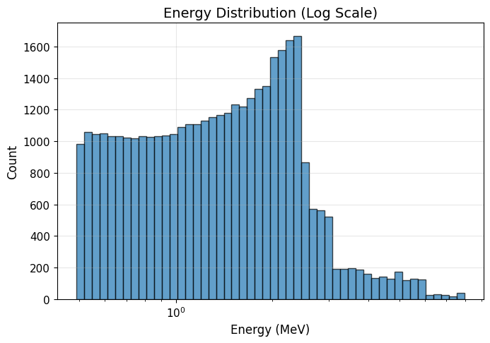
EXFOR LIST EXCEPT FOR:
Cabe et al. (1967)
Morozov et al. (1972)
Kinney et al. (1976)
Cierjacks et al. (1978)
EXFOR LIST EXCEPT FOR:
Cabe et al. (1967)
Morozov et al. (1972)

Slide 27
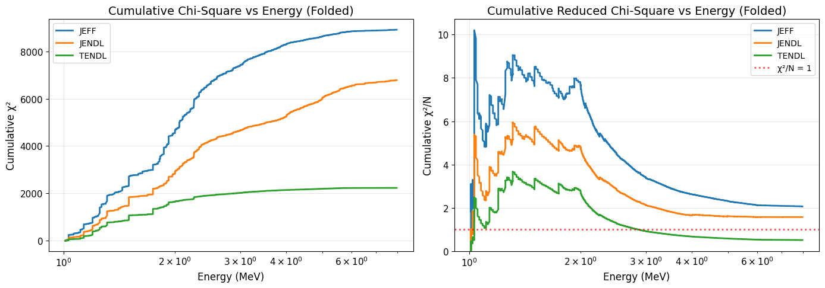
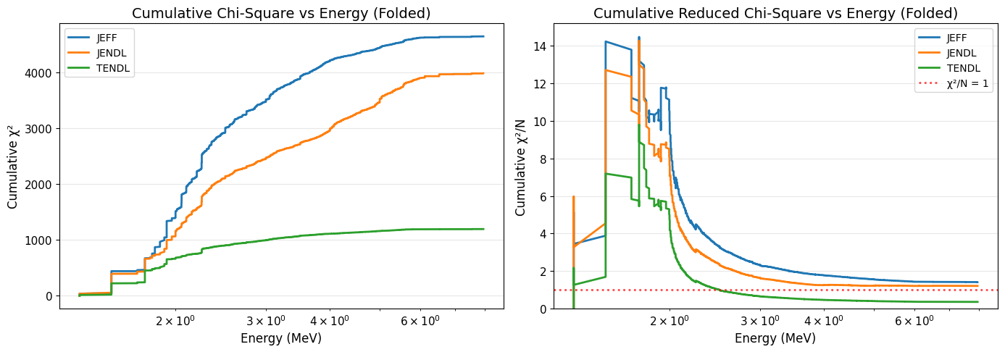
EXFOR LIST EXCEPT FOR:
Cabe et al. (1967)
Morozov et al. (1972)
Kinney et al. (1976)
Cierjacks et al. (1978)
EXFOR LIST EXCEPT FOR:
Cabe et al. (1967)
Morozov et al. (1972)
Kinney et al. (1976)
Cierjacks et al. (1978)
Gkatis et al. (2025)

Slide 28
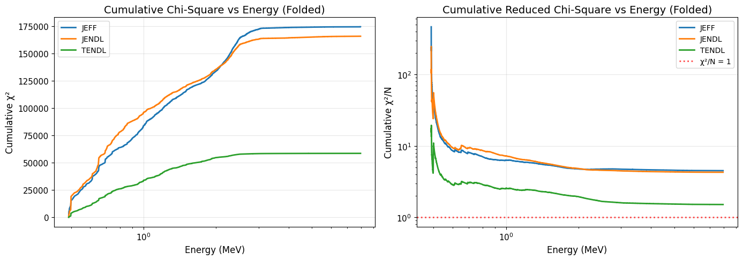
EXFOR LIST EXCEPT FOR:
Cabe et al. (1967)
Morozov et al. (1972)
Kinney et al. (1976)
Cierjacks et al. (1978)
EXFOR LIST EXCEPT FOR:
Cabe et al. (1967)
Morozov et al. (1972)

Slide 29
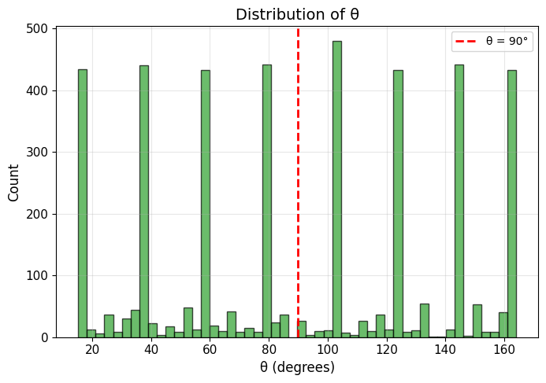
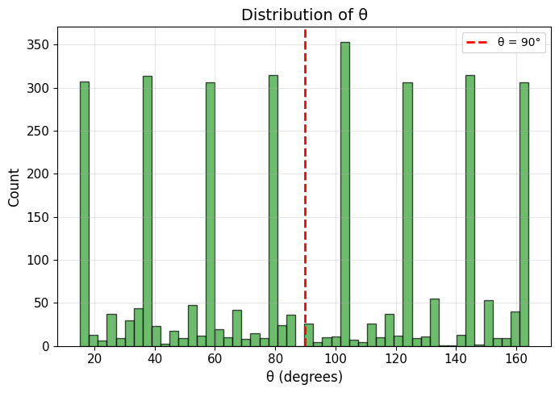
EXFOR LIST EXCEPT FOR:
Cabe et al. (1967)
Morozov et al. (1972)
Kinney et al. (1976)
Cierjacks et al. (1978)
EXFOR LIST EXCEPT FOR:
Cabe et al. (1967)
Morozov et al. (1972)
Kinney et al. (1976)
Cierjacks et al. (1978)
Gkatis et al. (2025)

Slide 30
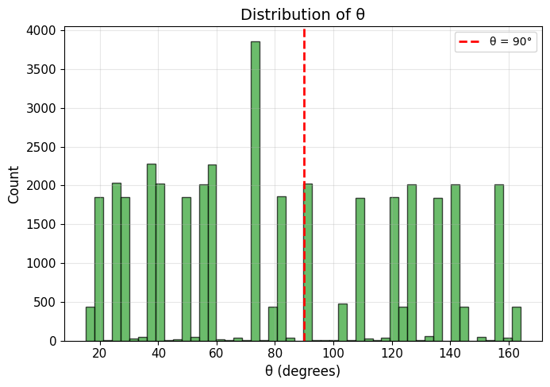
EXFOR LIST EXCEPT FOR:
Cabe et al. (1967)
Morozov et al. (1972)
Kinney et al. (1976)
Cierjacks et al. (1978)
EXFOR LIST EXCEPT FOR:
Cabe et al. (1967)
Morozov et al. (1972)

Slide 31
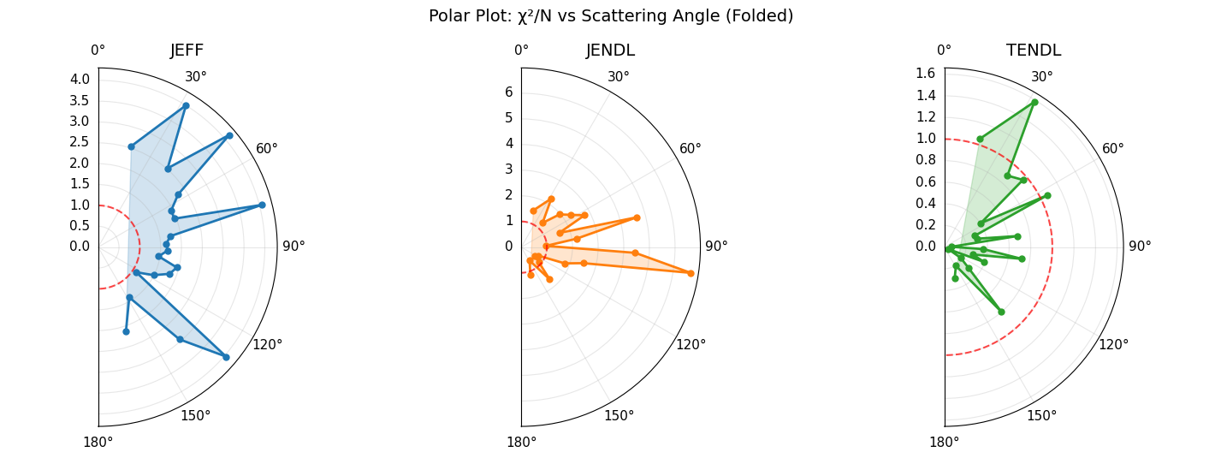
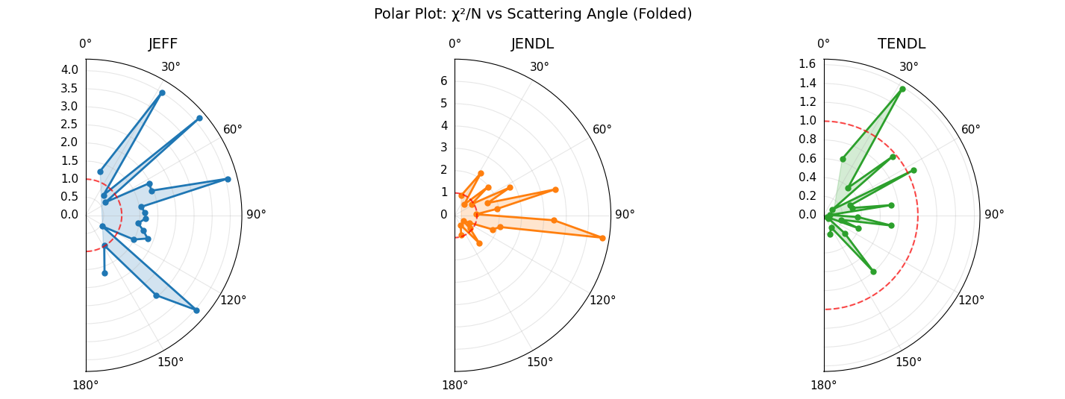
EXFOR LIST EXCEPT FOR:
Cabe et al. (1967)
Morozov et al. (1972)
Kinney et al. (1976)
Cierjacks et al. (1978)
EXFOR LIST EXCEPT FOR:
Cabe et al. (1967)
Morozov et al. (1972)
Kinney et al. (1976)
Cierjacks et al. (1978)
Gkatis et al. (2025)

Slide 32
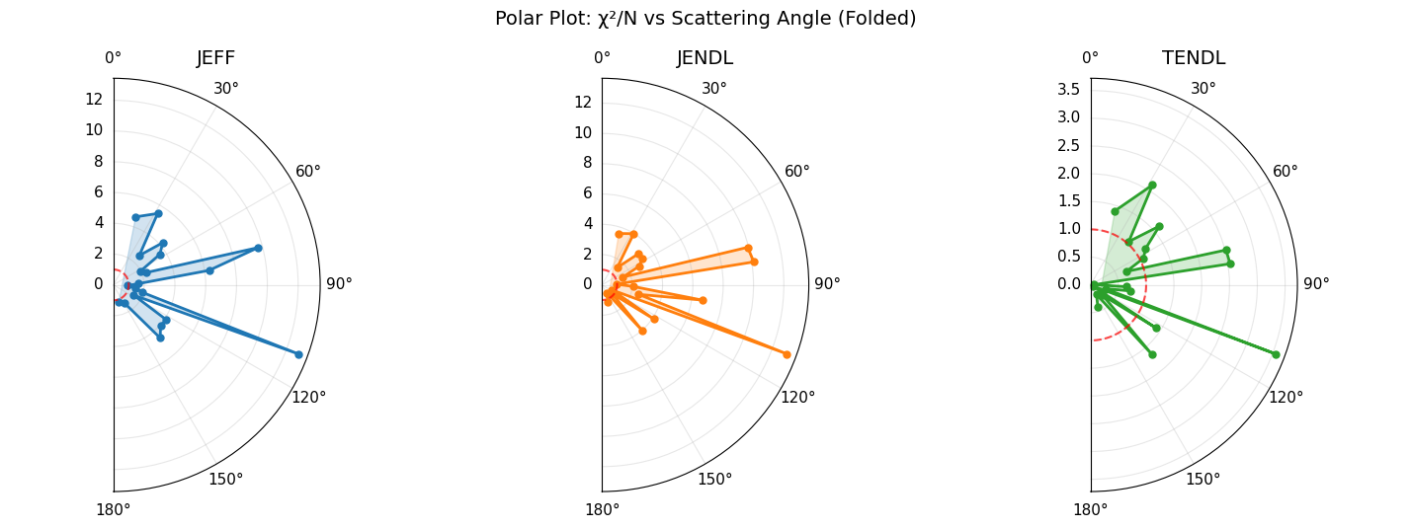
EXFOR LIST EXCEPT FOR:
Cabe et al. (1967)
Morozov et al. (1972)
Kinney et al. (1976)
Cierjacks et al. (1978)
EXFOR LIST EXCEPT FOR:
Cabe et al. (1967)
Morozov et al. (1972)

Slide 33
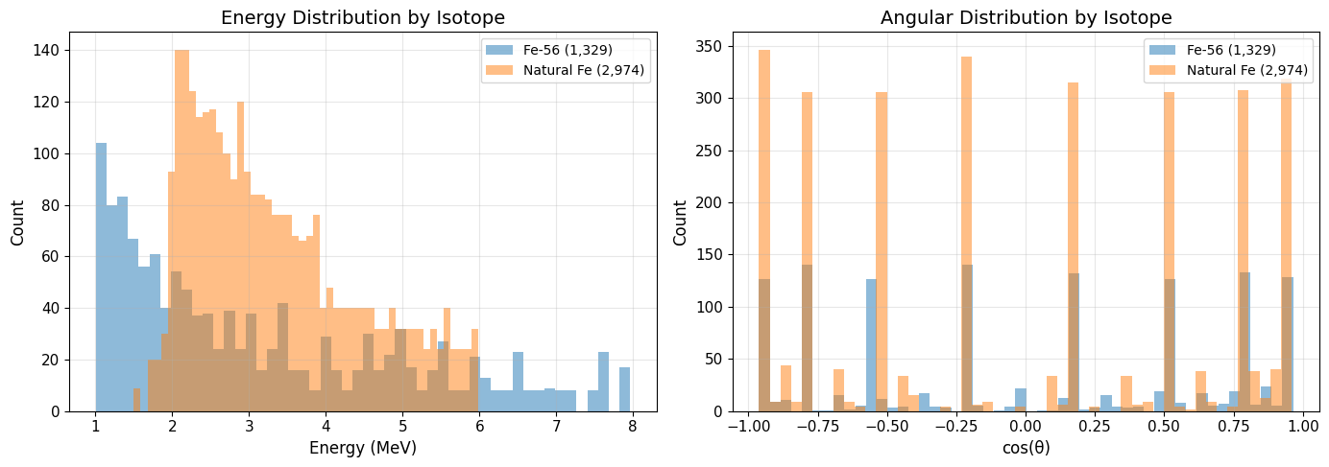
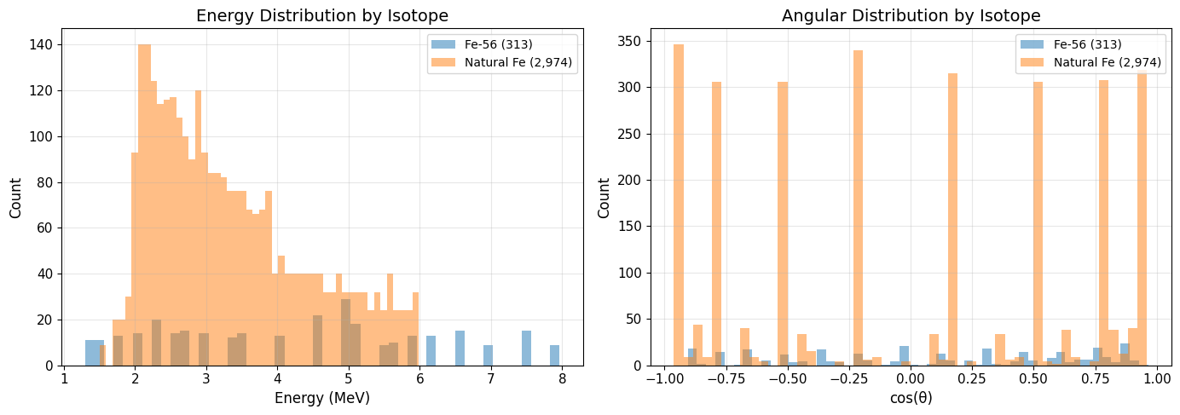
EXFOR LIST EXCEPT FOR:
Cabe et al. (1967)
Morozov et al. (1972)
Kinney et al. (1976)
Cierjacks et al. (1978)
EXFOR LIST EXCEPT FOR:
Cabe et al. (1967)
Morozov et al. (1972)
Kinney et al. (1976)
Cierjacks et al. (1978)
Gkatis et al. (2025)

Slide 34

EXFOR LIST EXCEPT FOR:
Cabe et al. (1967)
Morozov et al. (1972)
Kinney et al. (1976)
Cierjacks et al. (1978)
EXFOR LIST EXCEPT FOR:
Cabe et al. (1967)
Morozov et al. (1972)

Slide 35


EXFOR LIST EXCEPT FOR:
Cabe et al. (1967)
Morozov et al. (1972)
Kinney et al. (1976)
Cierjacks et al. (1978)
EXFOR LIST EXCEPT FOR:
Cabe et al. (1967)
Morozov et al. (1972)
Kinney et al. (1976)
Cierjacks et al. (1978)
Gkatis et al. (2025)

Slide 36

EXFOR LIST EXCEPT FOR:
Cabe et al. (1967)
Morozov et al. (1972)
Kinney et al. (1976)
Cierjacks et al. (1978)
EXFOR LIST EXCEPT FOR:
Cabe et al. (1967)
Morozov et al. (1972)

Slide 37


EXFOR LIST EXCEPT FOR:
Cabe et al. (1967)
Morozov et al. (1972)
Kinney et al. (1976)
Cierjacks et al. (1978)
EXFOR LIST EXCEPT FOR:
Cabe et al. (1967)
Morozov et al. (1972)
Kinney et al. (1976)
Cierjacks et al. (1978)
Gkatis et al. (2025)

Slide 38

EXFOR LIST EXCEPT FOR:
Cabe et al. (1967)
Morozov et al. (1972)
Kinney et al. (1976)
Cierjacks et al. (1978)
EXFOR LIST EXCEPT FOR:
Cabe et al. (1967)
Morozov et al. (1972)

Slide 39


EXFOR LIST EXCEPT FOR:
Cabe et al. (1967)
Morozov et al. (1972)
Kinney et al. (1976)
Cierjacks et al. (1978)
EXFOR LIST EXCEPT FOR:
Cabe et al. (1967)
Morozov et al. (1972)
Kinney et al. (1976)
Cierjacks et al. (1978)
Gkatis et al. (2025)

Slide 40

EXFOR LIST EXCEPT FOR:
Cabe et al. (1967)
Morozov et al. (1972)
Kinney et al. (1976)
Cierjacks et al. (1978)
EXFOR LIST EXCEPT FOR:
Cabe et al. (1967)
Morozov et al. (1972)

Slide 41


EXFOR LIST EXCEPT FOR:
Cabe et al. (1967)
Morozov et al. (1972)
Kinney et al. (1976)
Cierjacks et al. (1978)
EXFOR LIST EXCEPT FOR:
Cabe et al. (1967)
Morozov et al. (1972)
Kinney et al. (1976)
Cierjacks et al. (1978)
Gkatis et al. (2025)

Slide 42

EXFOR LIST EXCEPT FOR:
Cabe et al. (1967)
Morozov et al. (1972)
Kinney et al. (1976)
Cierjacks et al. (1978)
EXFOR LIST EXCEPT FOR:
Cabe et al. (1967)
Morozov et al. (1972)

Slide 43


EXFOR LIST EXCEPT FOR:
Cabe et al. (1967)
Morozov et al. (1972)
Kinney et al. (1976)
Cierjacks et al. (1978)
EXFOR LIST EXCEPT FOR:
Cabe et al. (1967)
Morozov et al. (1972)
Kinney et al. (1976)
Cierjacks et al. (1978)
Gkatis et al. (2025)

Slide 44

EXFOR LIST EXCEPT FOR:
Cabe et al. (1967)
Morozov et al. (1972)
Kinney et al. (1976)
Cierjacks et al. (1978)
EXFOR LIST EXCEPT FOR:
Cabe et al. (1967)
Morozov et al. (1972)

Slide 45


EXFOR LIST EXCEPT FOR:
Cabe et al. (1967)
Morozov et al. (1972)
Kinney et al. (1976)
Cierjacks et al. (1978)
EXFOR LIST EXCEPT FOR:
Cabe et al. (1967)
Morozov et al. (1972)
Kinney et al. (1976)
Cierjacks et al. (1978)
Gkatis et al. (2025)

Slide 46

EXFOR LIST EXCEPT FOR:
Cabe et al. (1967)
Morozov et al. (1972)
Kinney et al. (1976)
Cierjacks et al. (1978)
EXFOR LIST EXCEPT FOR:
Cabe et al. (1967)
Morozov et al. (1972)

Slide 47


EXFOR LIST EXCEPT FOR:
Cabe et al. (1967)
Morozov et al. (1972)
Kinney et al. (1976)
Cierjacks et al. (1978)
EXFOR LIST EXCEPT FOR:
Cabe et al. (1967)
Morozov et al. (1972)
Kinney et al. (1976)
Cierjacks et al. (1978)
Gkatis et al. (2025)

Slide 48

EXFOR LIST EXCEPT FOR:
Cabe et al. (1967)
Morozov et al. (1972)
Kinney et al. (1976)
Cierjacks et al. (1978)
EXFOR LIST EXCEPT FOR:
Cabe et al. (1967)
Morozov et al. (1972)

Slide 49

Application on propagation of uncertainties - aspis

Slide 50

Application on propagation of uncertainties - aspis

Slide 51
Scope & limitations
1
Analysis & scope
Results are based on neutron energies E > 0.5 MeV, with higher robustness above 1 MeV
Gkatis data agrees reasonably well over 2.5 MeV, not so much below
Many experimental points that don’t agree with evaluation!
Conclusions should not be extrapolated outside this energy range
2
Data coverage limitations
The list of EXFOR experiments may not be exhaustive
Some reactions/energy ranges may be underrepresented due to limited available data
3
Current status
This work is ongoing and subject to refinement
Feedback is welcome, particularly on:
Missing or relevant experimental data
Reactions or energy regions of higher interest
Alternative analysis approaches

Slide 52

Summary & open questions
Covariance quality is generally poor $\left(χ^{2}≫1\right)$ across libraries
From a nuclear safety standpoint, uncertainties must be accurate or conservative without any doubts, therefore reliability of ND variances/covariances is an issue
Which experimental datasets were actually used in the evaluations?
Big data sets of experiments are they trustworthy?
What energy resolution assumptions were applied in cases where experimental resolution is unclear or unavailable?
Which integral benchmarks were used to validate the evaluations?
Missing correlations between cross sections and angular distributions are acknowledged as important
Is it preferable to exclude correlations entirely rather than include model-driven correlations (e.g. TALYS-based)?
Is there a perspective or timeline for a new Fe-56 evaluation, including improved covariances?

Slide 53
BACKUP SLIDES

Slide 54










Propagation of uncertainties to differential cross section
$$\frac{dσ}{dΩ}=\frac{σ_{el}\left(E\right)}{2π}f\left(μ,E\right)=\frac{σ_{el}}{2π}\sum_{l=0}^{N_{L}}{\frac{\left(2l+1\right)}{2} a_{l}\left(E\right) P_{l}(μ)}$$
$$a={\left[a_{0},…,a_{L}\right]}^{T}$$
$$Σ_{a}=Cov\left(a\right)$$
$$ω_{l}\left(μ\right)=\frac{\left(2l+1\right)}{2}P_{l}\left(μ\right)$$
$$X\left(μ\right)≡\frac{dσ}{dΩ}\left(μ\right)=\frac{σ_{el}}{2π}ω{\left(μ\right)}^{T}a$$
$$ω\left(μ\right)={\left[ω_{0}\left(μ\right),…,ω_{l}\left(μ\right)\right]}^{T}$$
Gradients
$$f\left(μ\right)=ω{\left(μ\right)}^{T}a$$
$$\frac{∂X}{∂σ_{el}}=\frac{f\left(μ\right)}{2π}$$
$$\frac{∂X}{∂a}=\frac{σ_{el}}{2π}ω\left(μ\right)$$
$$Var\left[X\left(μ\right)\right]={\left(\frac{f\left(μ\right)}{2π}\right)}^{2}Var\left[σ_{el}\right]+{\left(\frac{σ_{el}}{2π}\right)}^{2}ω{\left(μ\right)}^{T}Σ_{a}ω\left(μ\right)$$

Slide 55






Energy folding
Goal: Smooth cross sections at energy $\left(E_{0}\right)$ by averaging the evaluated $σ\left(E\right)$ over a finite energy resolution
$E \left[MeV\right]:$neutron energy variable in the evaluation
$E_{0} \left[MeV\right]:$ central energy where we want the folded value
$σ\left(E\right) \left[barn\right]:$cross section from the evaluation (resonance structure)
$L \left[m\right]:$ flight path length (source → detector)
$t_{E} \left[s\right]:$ time of flighy (TOF) corresponding to energy $E$
$FWHM_{t} \left[s\right]:$ timing resolution (Full Width at Half Maximum)
$FWHM_{E}\left(E_{0}\right) \left[MeV\right]:$ corresponding energy resolution at $E_{0}$
${std}_{E}\left(E_{0}\right) \left[barn\right]:$Gaussian standard deviation in energy
$m_{n}:$ neutron mass
$$t\left(E\right)=L\sqrt{\frac{m_{n}}{2E}}$$
;
$$\frac{FWHM_{E}\left(E_{0}\right)}{E_{0}}≈2\frac{FWHM_{t}}{t\left(E_{0}\right)}$$
$${std}_{E}\left(E_{0}\right)=\frac{FWHM_{E}\left(E_{0}\right)}{2\sqrt{2\ln{2}}}=\frac{FWHM_{E}\left(E_{0}\right)}{2.355}$$
Define a Gaussian resolution kernel centered at $E_{0}:$
$$G\left(E;E_{0}\right)=\exp\left[−\frac{{\left(E−E_{0}\right)}^{2}}{2std_{E}{\left(E_{0}\right)}^{2}}\right]$$
Folded cross section with normalized Gaussian average:
$$σ_{fold}\left(E_{0}\right)=\frac{\int{σ\left(E\right)G\left(E;E_{0}\right)dE}}{\int{G\left(E;E_{0}\right)dE}}$$

