Slide 1
On the models of scattering kernels of structure materials in the keV range
R. Dagan, S. Biswas, M. Hornberger, P. Winney, F. Becker, A. Konobeev
KIT- Karlsruhe Institute of Technology, INE-Institute for Nuclear Waste Disposal,
Hermann-von-Helmholtz-Platz 1, 76344 Eggenstein-Leopoldshafen
How accurate Can we Calculate Neutrons Slowing Down in Water? R. Cullen 2006 UCRL-TR 220605
From this report by R. Cullen:
“human nature is such that if we know the (experimental) answer to a given problem today’s codes allow us enough flexibility to dial in almost any answer we want.”

Slide 2
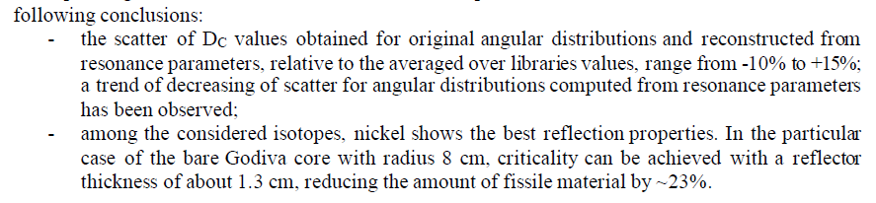

Motivation I: From INDEN 2020
INDEN 2020: V. V. Sinitsa
Godiva experiment with different reflectors : Ni62, Ni64, FE52, Cr-52
Blatt Biedenharn scattering kernel based on GRUCON vs Reference ENDF/B-8
From INDEN report , section 2.10:
INDEN 2020: R. Capote

Slide 3
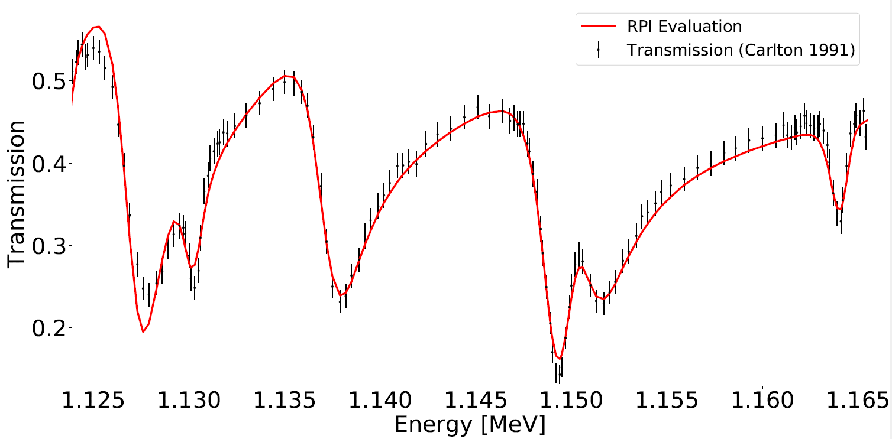
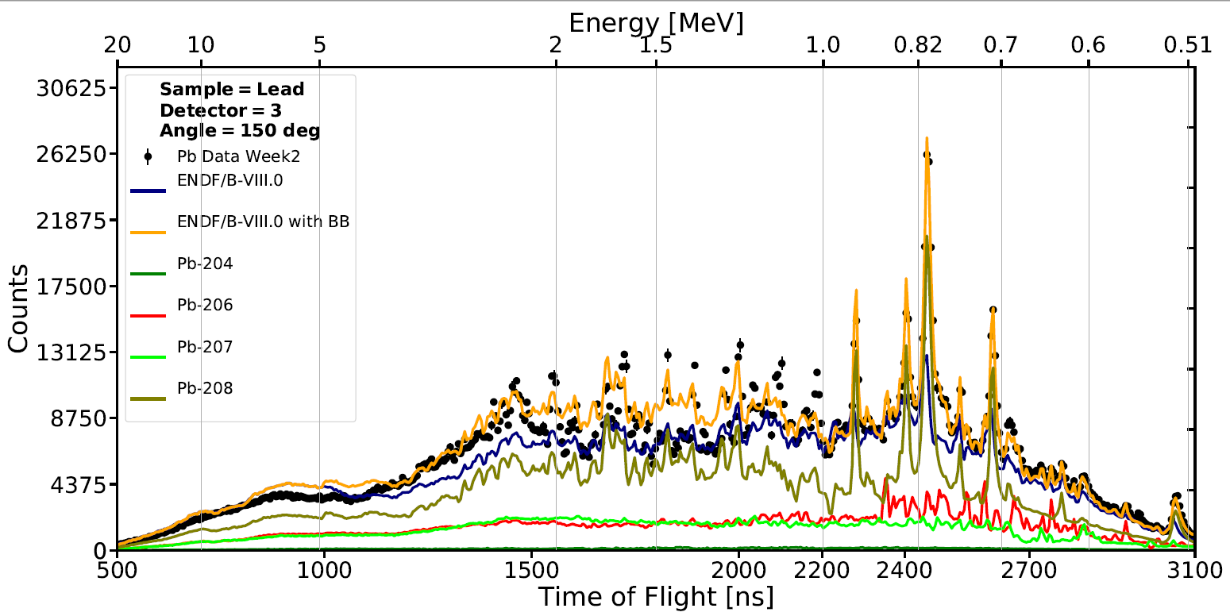
Motivation II: Angular distributions modelling using BB in Mev range
Generating total resonance cross sections from differential cross sections.
Adjusting target spin used in BB for the target spin of the total cross section.
Work done in RPI: fitting resonance parameter to angular distribution experiments.
Picking spin and refitting in SAMMY

Slide 4

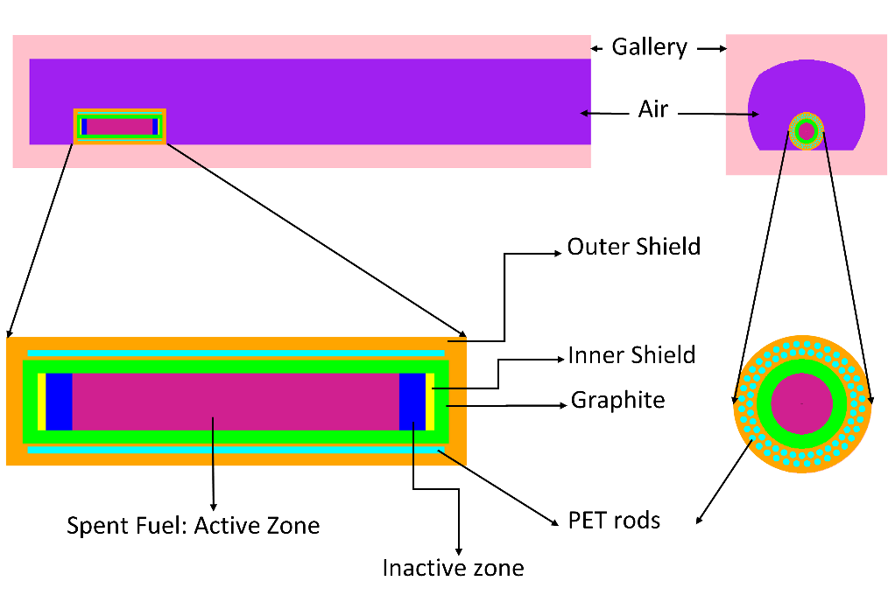
Motivation III: DBRC based Scattering kernel for storage cask in horizontal tunnel
5,1 m
distance(m) | Neutron dose(µSv/h)
 | Salt rock |  | Concrete cover
 | DBRC without DBRC |  | DBRC without DBRC
0.5 | 12.88 (0.5%) | 13.03 (0.3%) | 11.38 (0.6%) | 11.51 (0.4%)
1.0 | 6.94 (0.5%) | 6.99 (0.3%) | 5.27 (0.6%) | 5.31 (0.3%)
2.0 | 3.76 (0.4%) | 3.81 (0.3%) | 2.32 (0.5%) | 2.36 (0.4%)
4.0 | 1.88 (0.4%) | 1.92 (0.7%) | 1.00 (0.4%) | 1.01 (0.3%)
5.0 | 1.43 (0.5%) | 1.45 (0.5%) | 0.73 (0.5%) | 0.75 (0.7%)
10.0 | 0.45 (0.7%) | 0.46 (1.1%) | 0.23 (0.7%) | 0.23 (0.6%)
3,7 m
air
Outer shielding
Graphite
1,6 m
Inner shielding
Burned up fuel: Active Zone
PET rods
Inactive Zone
5,5 m
56. Jahrestagung des Fachverbandes für Strahlenschutz Frank Becker
Notes:
Pollux in Einlagerungsstrecke DBE-Tec

Slide 5
Open Issues for scattering at the lower keV range
4 formally relevant Models are available to handle the scattering kernel:
Energy and angular variables are
Target at rest : dependent
Rothenstein Dagan (RD): independent
(QM) Blatt Biedenharn (BB): dependent
(QM) Optical Model Potential: dependent
Resonance and temperature dependency:
Target at rest : Resonance independent
Rothenstein Dagan (RD): Temperature & Resonance dependent
(QM) Blatt Biedenharn (BB): Resonance (parameters) dependent
(QM) Optical Model Potential: Resonance independent

Slide 6
Angular Distribution BB vs. RD 25110 eV 300K ENDF8.0 and JEFF3.3 with Temperature Effect

Slide 7
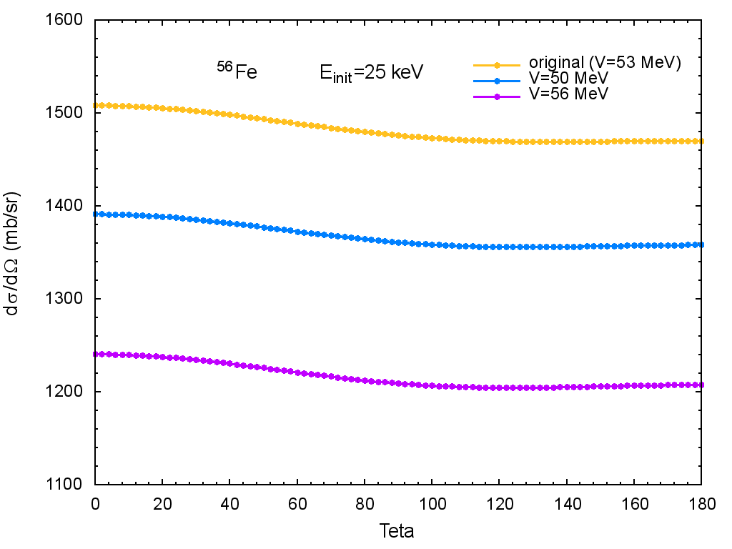
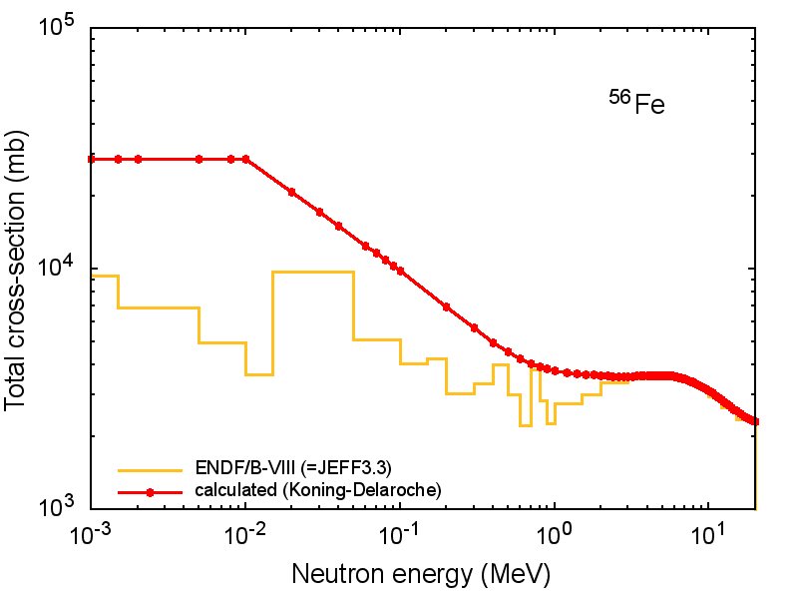

koning Delarouche Optical model based scattering kernel for FE56 at 25 KEV
~3% more forward scattering at 0 °
compared to 180°
comparison between the OM (Koning-Delaroche) and ENDF/B-VIII library for Fe56 (Konobeev 2019)

Slide 8
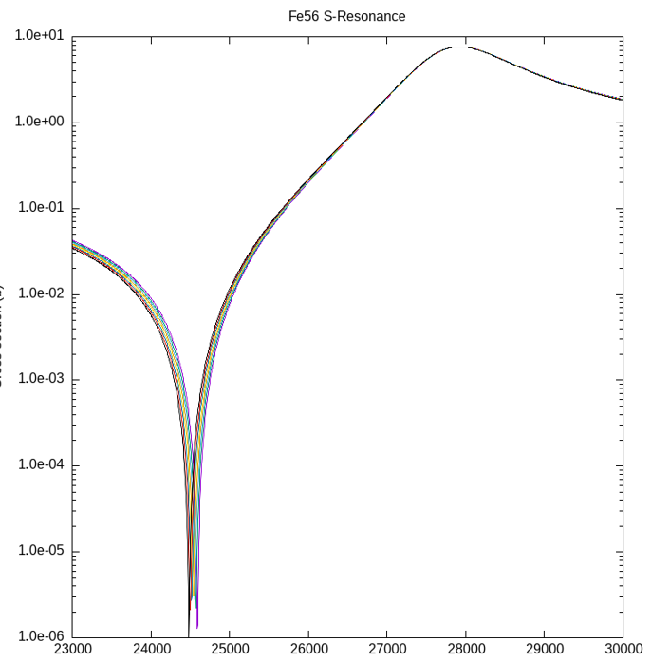
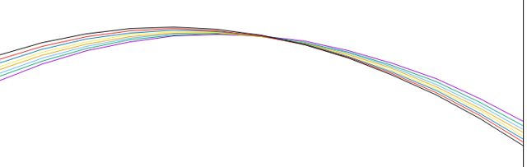
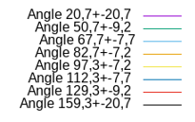
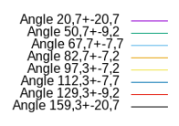
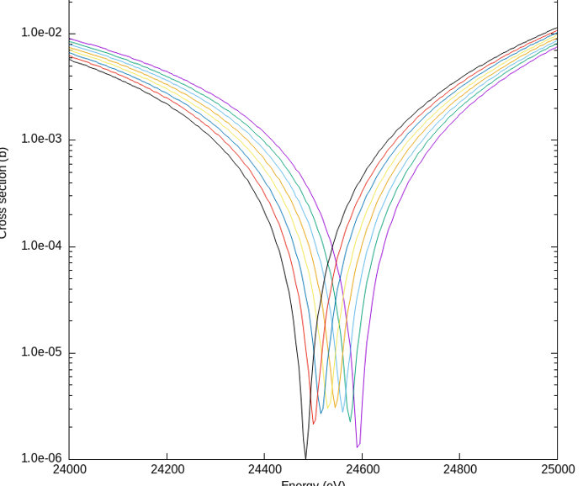
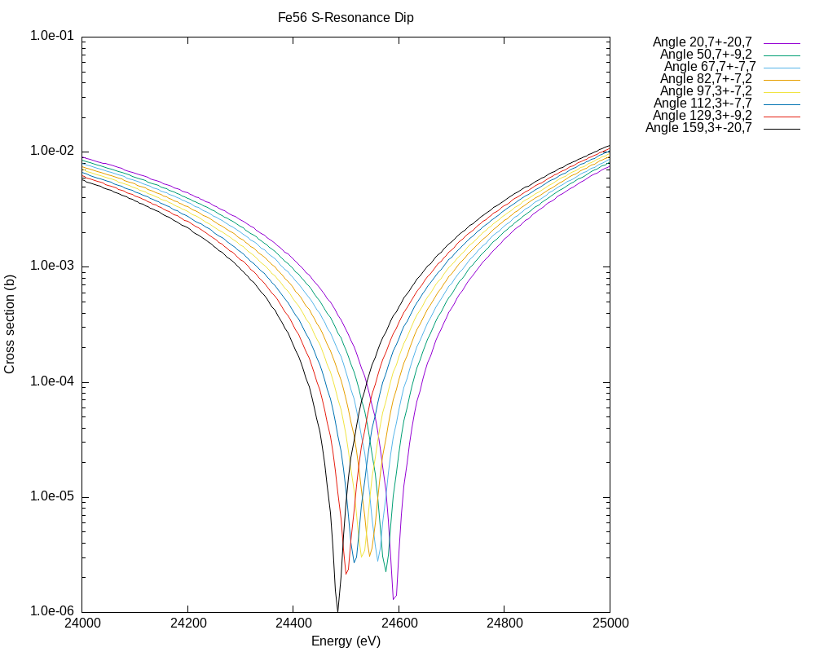
Differential scattering for for S resonance by BB model with SAMMY

Slide 9
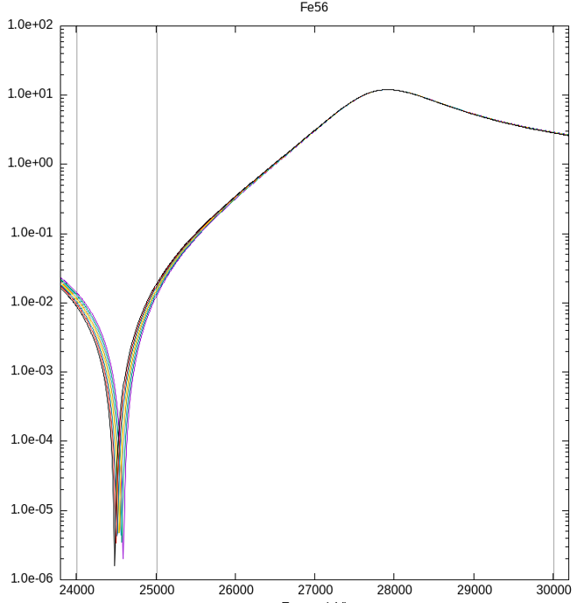
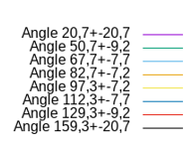
Angular Distribution BB vs. RD 300K ENDF8.0

Slide 10
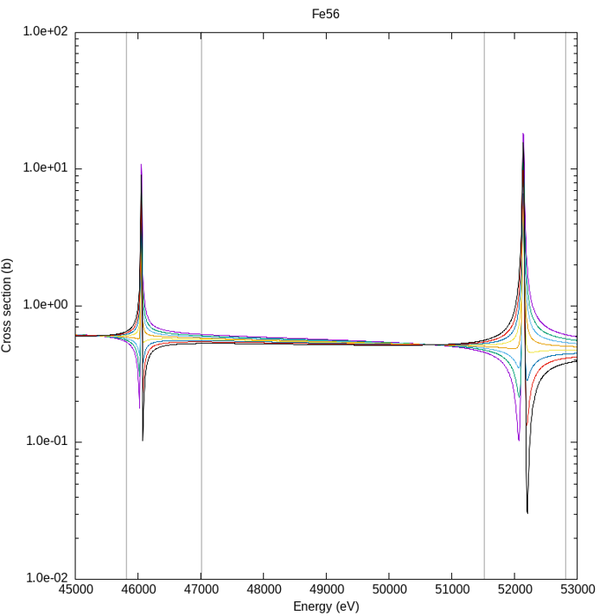
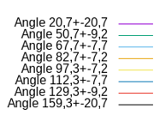
Differential scattering for for p resonances BB model in (SAMMY) compared with the RD model

Slide 11
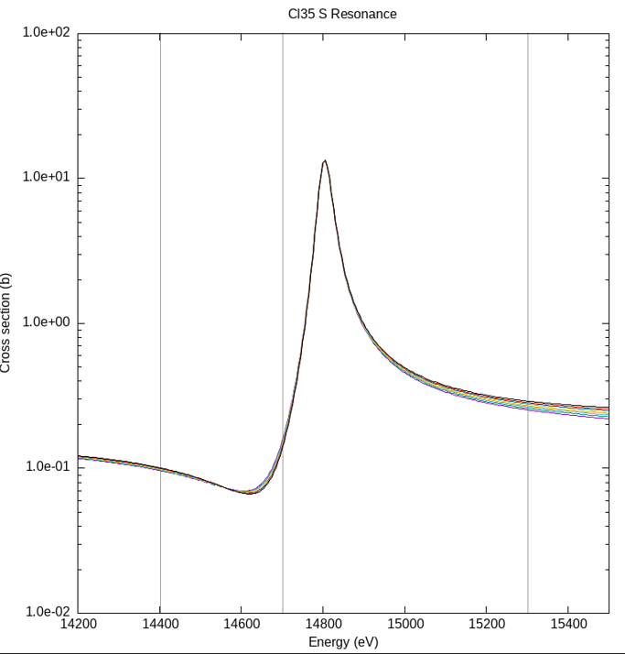
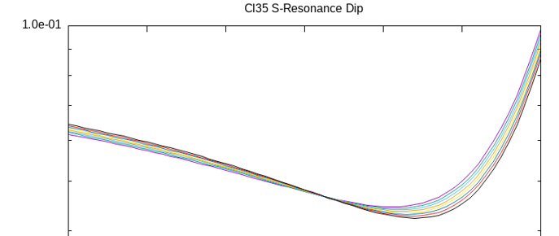
Differential scattering for for S resonance by BB model in SAMMY

Slide 12
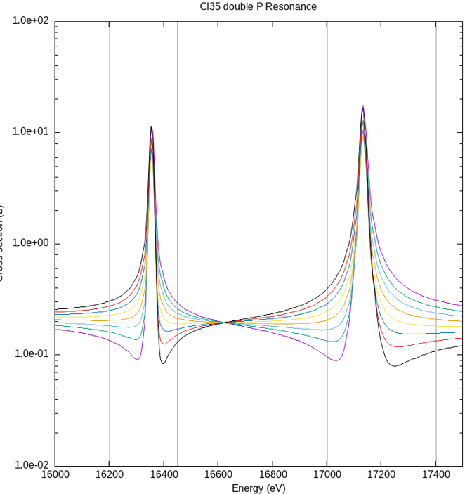
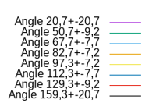
Differential scattering for for p resonances BB model in (SAMMY)

Slide 13
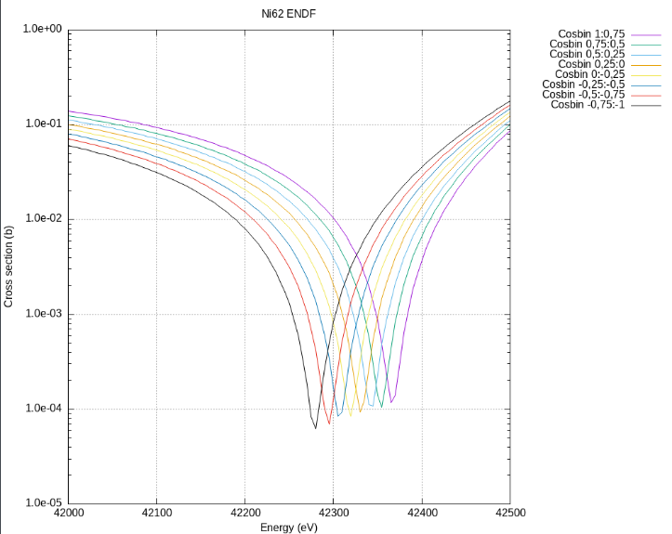
Angular Distribution BB vs. RD 42 and 42.5 keV 300K ENDF8.0 (S Resonance at 42.87)

Slide 14
Angular distribution BB vs RD Ni62 23 keV, ENDF/B8.0
It seems that a problem exists by the spin data of Ni62.
The BB values do not sum up to the total elastic scattering
Data normalized by factor 4.8

Slide 15
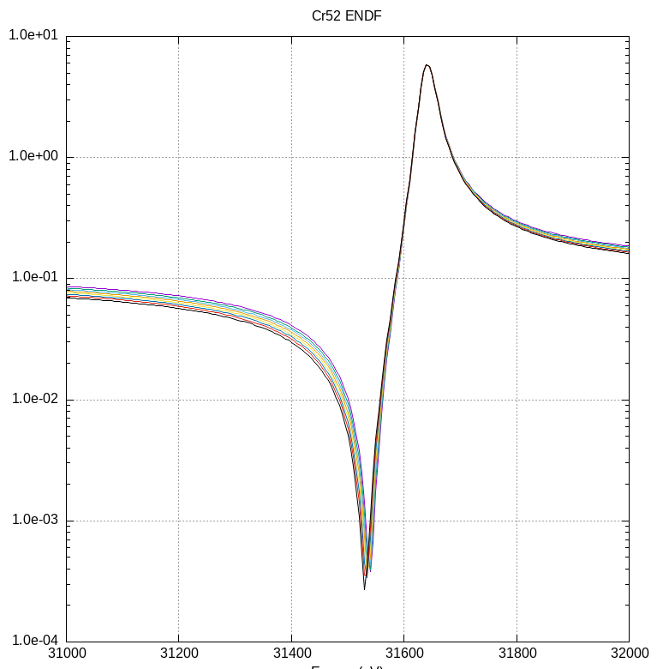
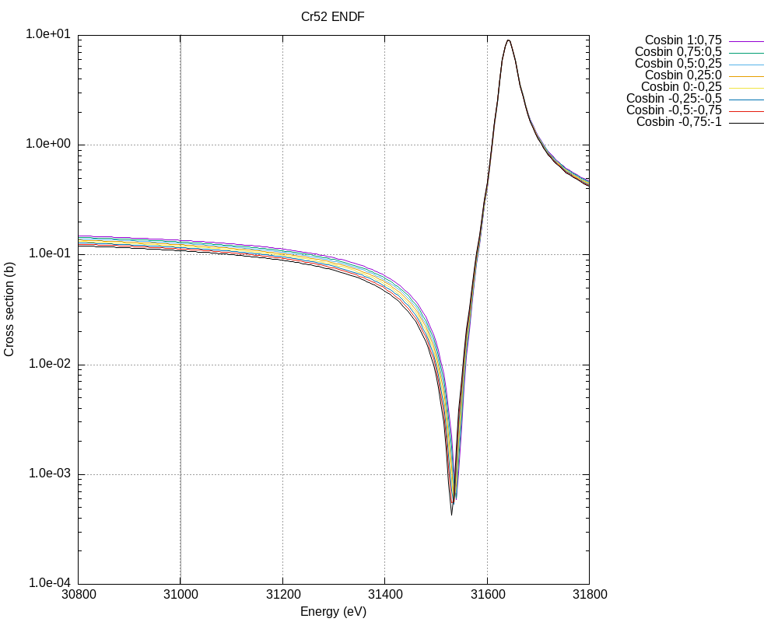
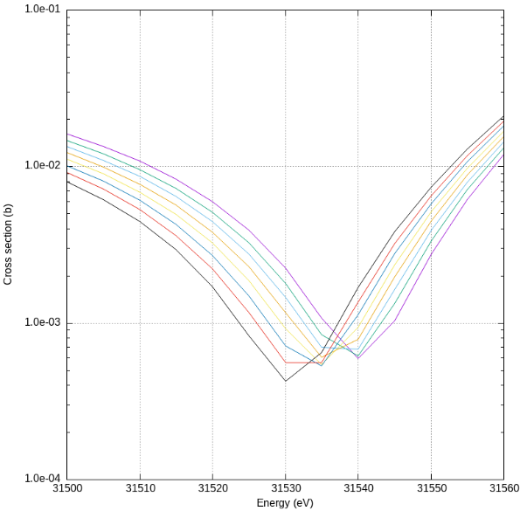
Angular distribution BB vs RD CR52 31 keV, ENDF/B8.0 (S-resonance at 31.68 keV)

Slide 16
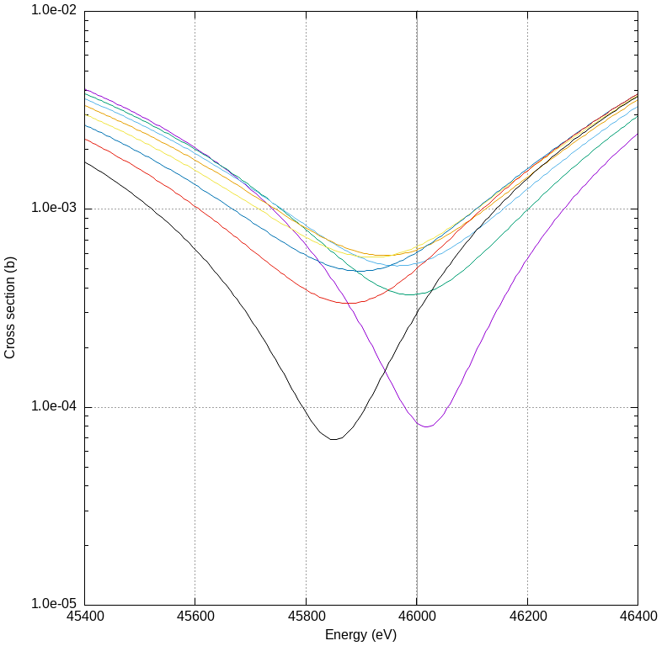
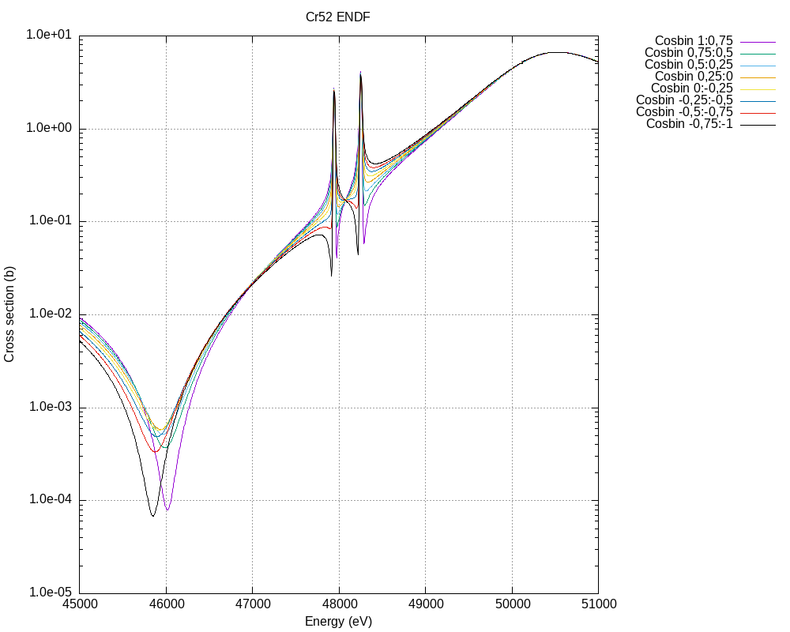
Angular distribution BB vs RD CR52 46 keV, ENDF/B8.0
(S-resonance at 51.0 keV, 2 p resonances between the dip and the s Resonance)

Slide 17
Open Issues for scattering at the lower keV range
Differential scattering by Classic approach
The azimuth angle is a dependent variable via the classical Resonant scattering (see R. Dagan “On the Angular Distribution of ideal gas scattering kernel”. Annals of Nuclear Energy 35, pp 1109-1116, may 2008)
In QM the azimuth angle is connected to magnetic quantum number.
via the spherical harmonic function

Slide 18
~1920-1998: Different types of scattering kernels for
a 6.52 eV neutron interacting with U238
MCNP Manual:
“If the energy of the neutron is greater than 400KT and the target is not Hydrogen the velocity of the target is set to Zero” (Asymptotic kernel)
Temp=0K
Temp=T K , XS=f (E)
Temp= T K ,XS=Const.

Slide 20
The Blatt Biedenharn approach (I)
Using of BB coefficients and Legendre polynomials in physical and mathematical form.
physical interpretation of BB: at the peak Isotropic scattering (BB) for S resonances and anisotropy for p resonances. This means l=0 or l=1 for S and p resonances respectively.
The practical solutions uses generally 6 Mathematical Legendre terms to achieve mathematically improved accuracy (NJOY, SAMMY etc)
The angular distributions plots show alternating tendency of forward and backward scattering by transition points( peak, dip or change from S to P resonances)
The BB coefficients points out the adjustment of the spins used for the total and differential scattering and “define” resonances (see RPI study)

Slide 21
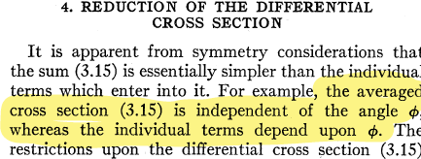
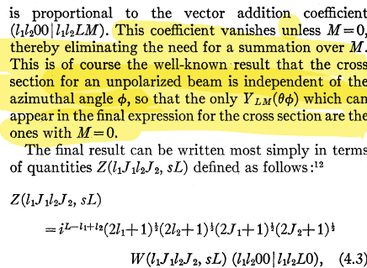
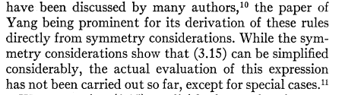
The Blatt Biedenharn (1952) approach (II):
Similar but not identical to the RD model

Slide 22
Conclusions (I)
The RD and BB models handle the resonance dependent scattering kernel in a very accurate manner. Yet with some differences:
The RD model allows for a full description of angle, energy and temperature dependent scattering kernel
The BB model shows at different energies opposite tendency of forward and backward scattering whereas in the RD model the forwards scattering is stronger pronounced.
The RD model emphasizes the use of the azimuth angle not in an isotropic independent manner, while the BB model averages the “individual” impact of the azimuth angle
Dedicated differential angle and energy dependent measurements are needed to confirm the models.

Slide 23
Conclusion (II)
From a practical point of view the RD based model in Monte Carlos codes should be extended up to about 50 KeV, which is very easy to do for MC codes.
Implementation of the BB model is more cumbersome but offers a better method to handle the scattering kernels even up and beyond 1 MeV. (see GRUCON)
With further dedicated experiments the scattering kernels as well as the total scattering cross sections can be improved further
which is needed for further medical and industrial applications with their own relevant materials beyond Fe and Cl.

Slide 24
Thank You for your attention

Slide 25
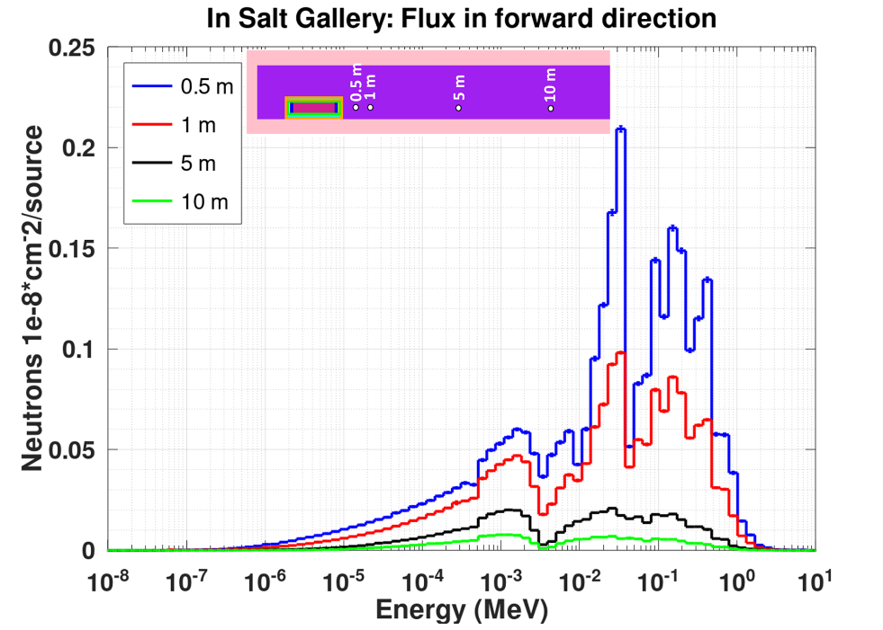
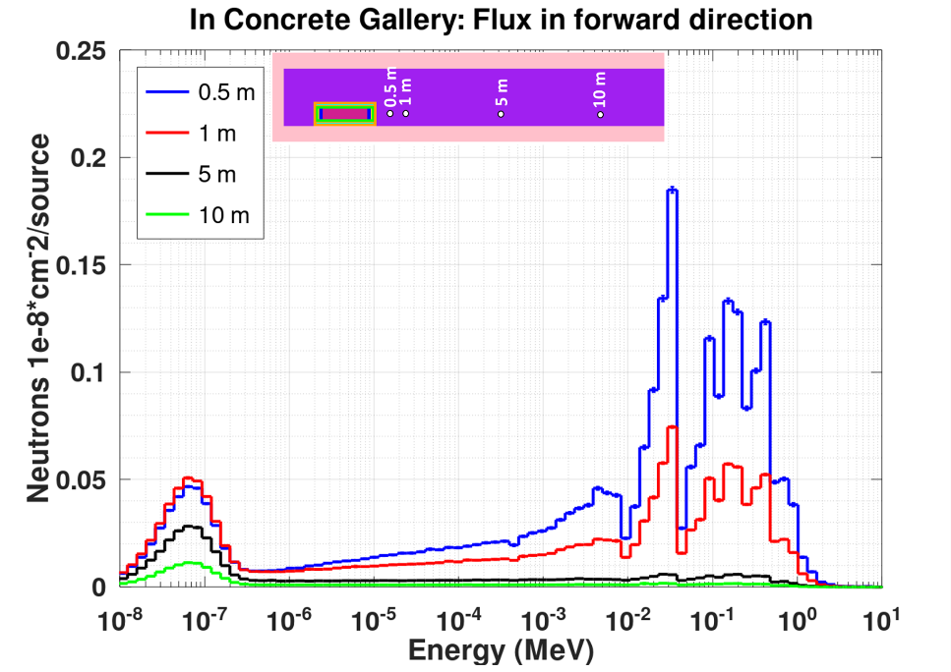
Differential cross section application for and
Both materials are relevant for different types of storage galleries.
Clay Rocks with concrete cover with iron strengthening
salt rocks
salt rocks
concrete
Work performed by Sushanta Biswas in KIT.

Slide 26
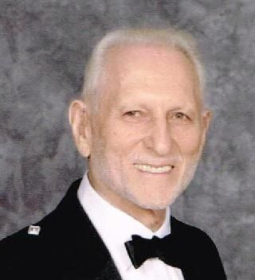
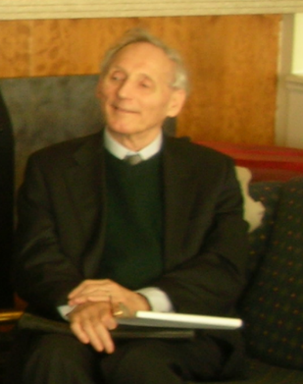
How far should we go with developing nuclear data?
Cecil R. Lubitz (1925-2021)
“…He and I often disagree when it comes to whether processing codes (i.e., NJOY) should invent cross sections or simply translate what the evaluators already invented,, .
John Rowlands (1929-2011)
“…and now we will see that all what we have done is wrong” … by presenting a new speaker on a new scattering theory (…he himself was part of it.)

Slide 27
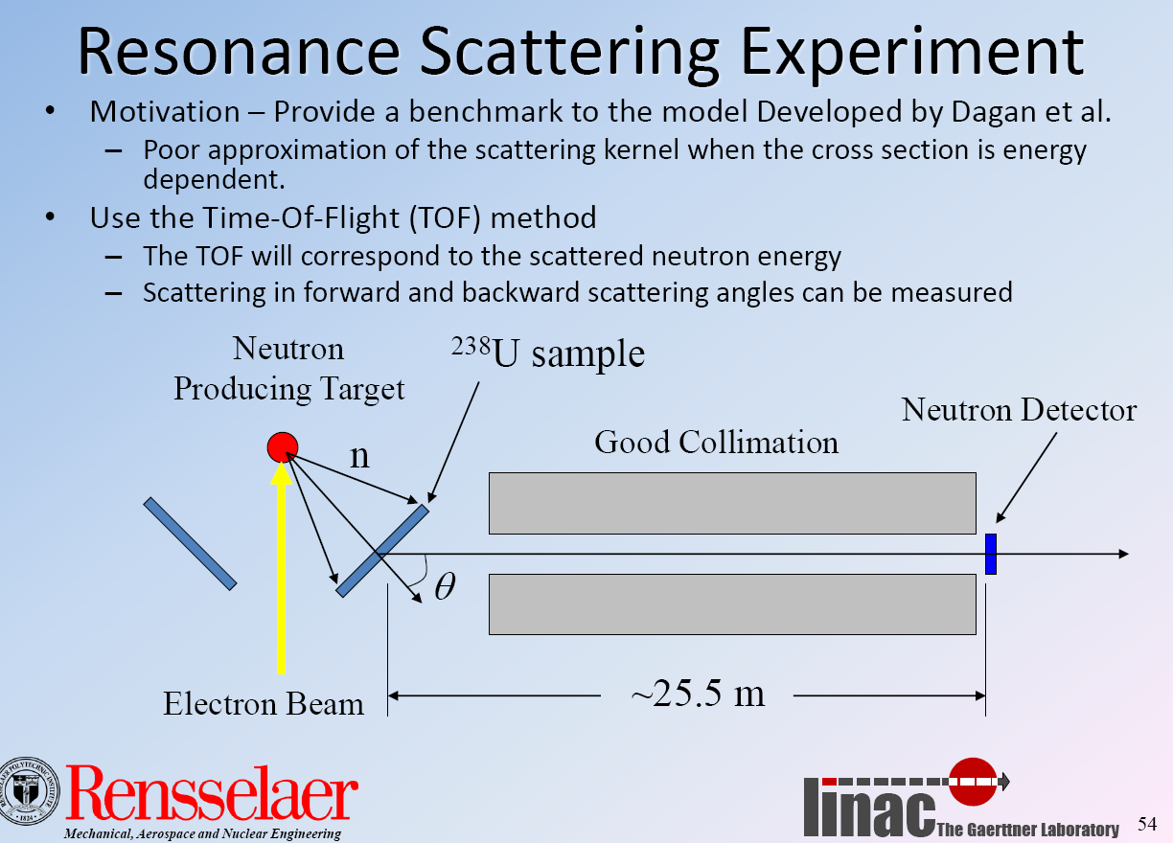
The Danon Experiment

