Slide 1
1/20
Polynomial trends in nuclear electromagnetism
Basic moments
Data on polynomial trends
On the current IAEA database
On a digital database
An example

Slide 2









Basic moments
2/20
Dipole moment
(magnetic)
Radial moments
(charge)
Quadrupole moment
(electric)
$$μ$$
$$δ\left\langle r^{2}\right\rangle$$
$$Q$$
$$N$$
$$N$$
$$N$$
$$μ=∓j\frac{3.8}{2l+1}μ_{N}$$
$$δ{\left\langle r^{2}\right\rangle }^{g,m}=\frac{5}{4π}\left\langle r_{0}^{2}\right\rangle \left(β_{m}^{2}−β_{g}^{2}\right)$$
$$Q=\frac{2j+1−2n}{2j−1}Q_{sp}$$
On the magnetic moments of atomic nuclei
Schmidt 1937
Configuration mixing and quadrupole moments
of odd nuclei, Horie and Arima 1955
j^{n} configurations, n - odd

Slide 3







Basic moments
3/20
Dipole moment
(magnetic)
Radial moments
(charge)
Quadrupole moment
(electric)
$$\hat{μ}=μ_{N}\left(g_{l}^{t_{z}}\hat{l}+g_{s}^{t_{z}}\hat{s}\right)/ℏ$$
$$e\hat{Q}=e^{t_{z}}e\left(3z^{2}−r^{2}\right)$$
$$\left\langle r^{n}\right\rangle =\frac{\int{ρ\left(\hat{r}\right)r^{n}dV}}{\int{ρ\left(\hat{r}\right)dV}}$$
$$μ=m\left(g_{l}^{t_{z}}±\frac{g_{s}^{t_{z}}−g_{l}^{t_{z}}}{2l+1}\right)μ_{N}$$
$$eQ=\frac{j\left(j+1\right)−3m^{2}}{2j\left(j+1\right)}\left\langle r^{2}\right\rangle e^{t_{z}}e$$
j | j-1 |  |  | 3/2 | 1/2
-j | 1-j |  |  | -3/2 | -1/2
$μ\left(m\right)$+ $μ\left(−m\right)=0$
$$Q\left(m\right)=Q\left(−m\right)$$
j^{n} configurations, n - odd

Slide 4
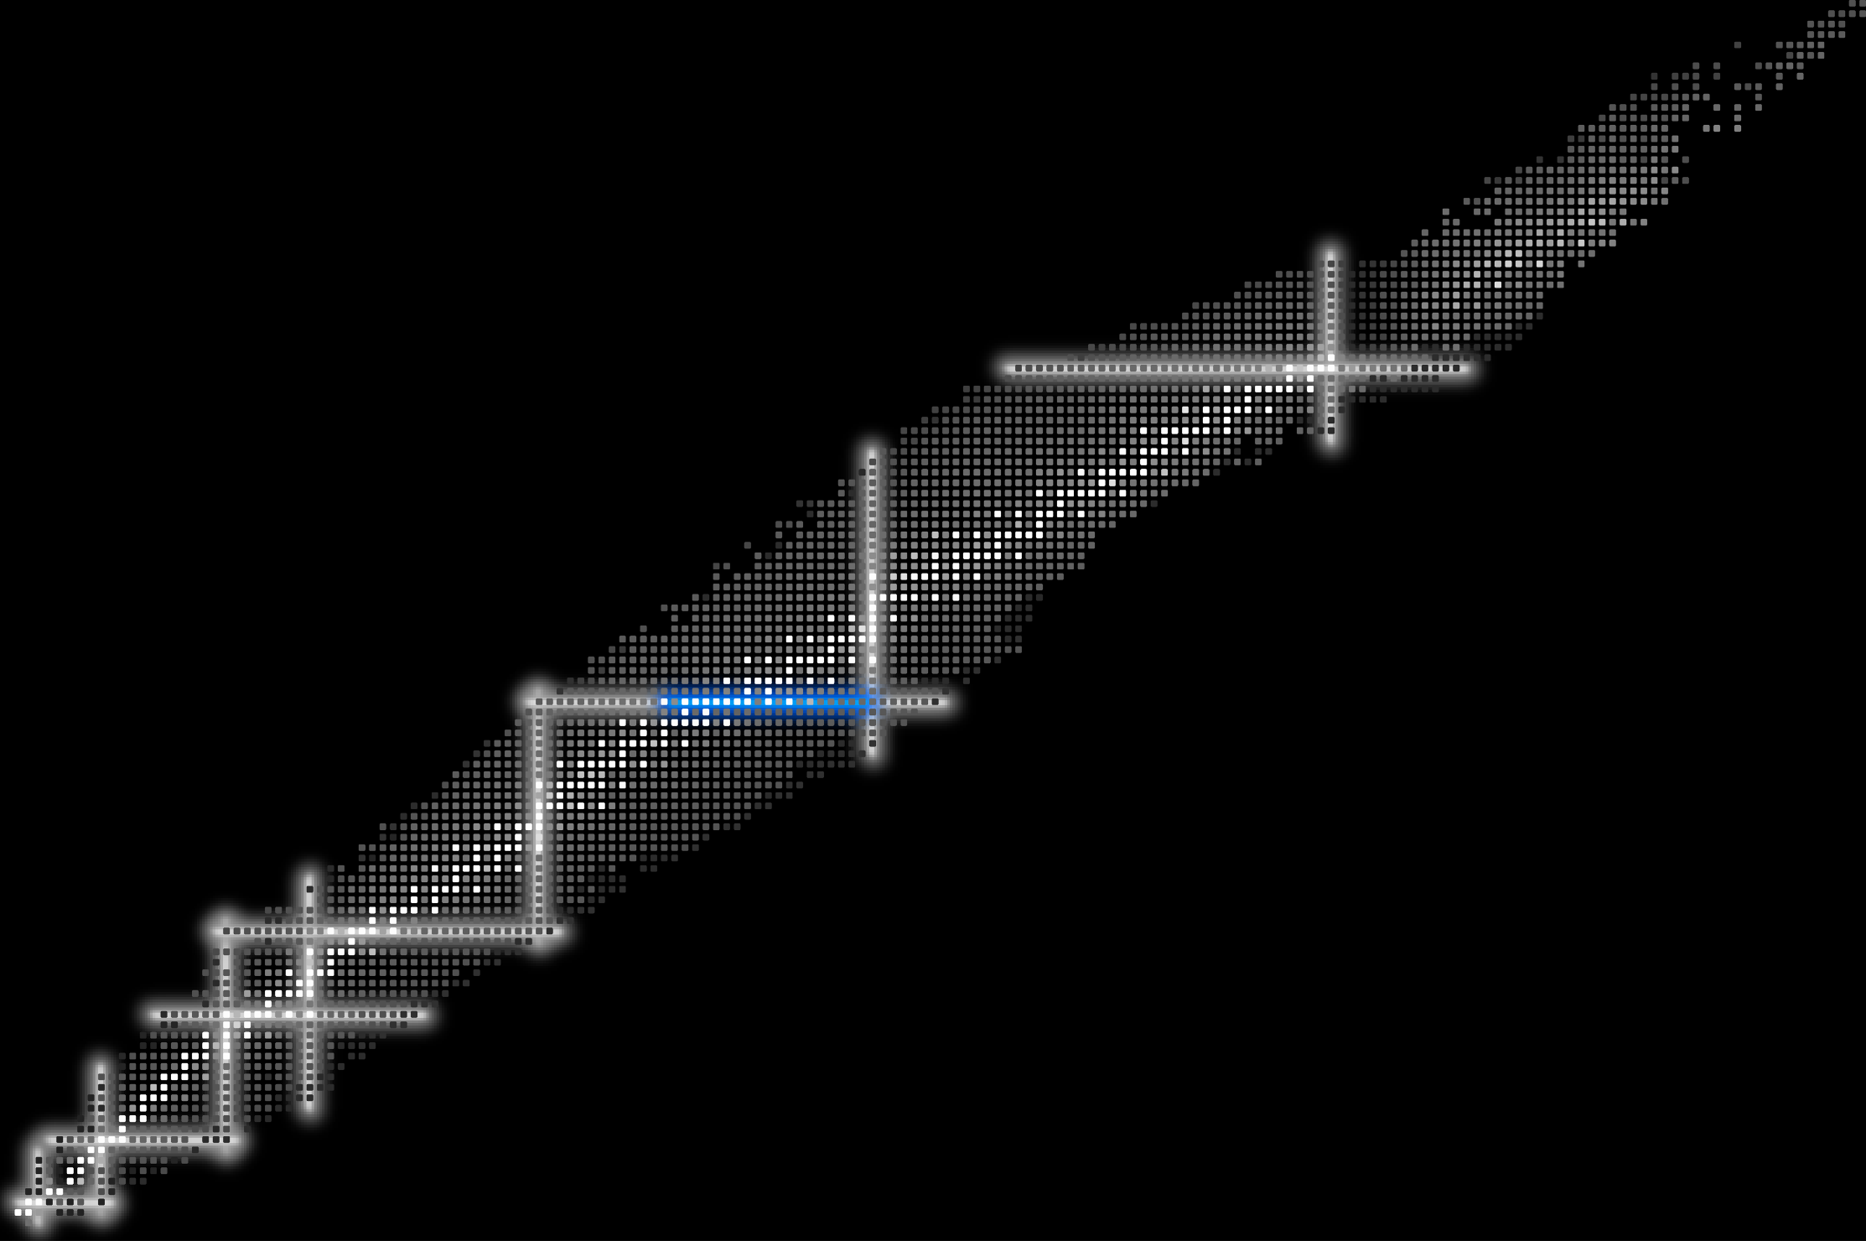











Basic moments
4/20
82
126
$$1h_{9/2}$$
82
$$1h$$
50
82
$$1h_{11/2}$$
$$3s$$
$$3s_{1/2}$$
$$2d_{3/2}$$
28
$$2d$$
50
$$2d_{5/2}$$
20
$$1g_{7/2}$$
$$1g$$
50
8
28
2
20
$$1g_{9/2}$$
2
8

Slide 5
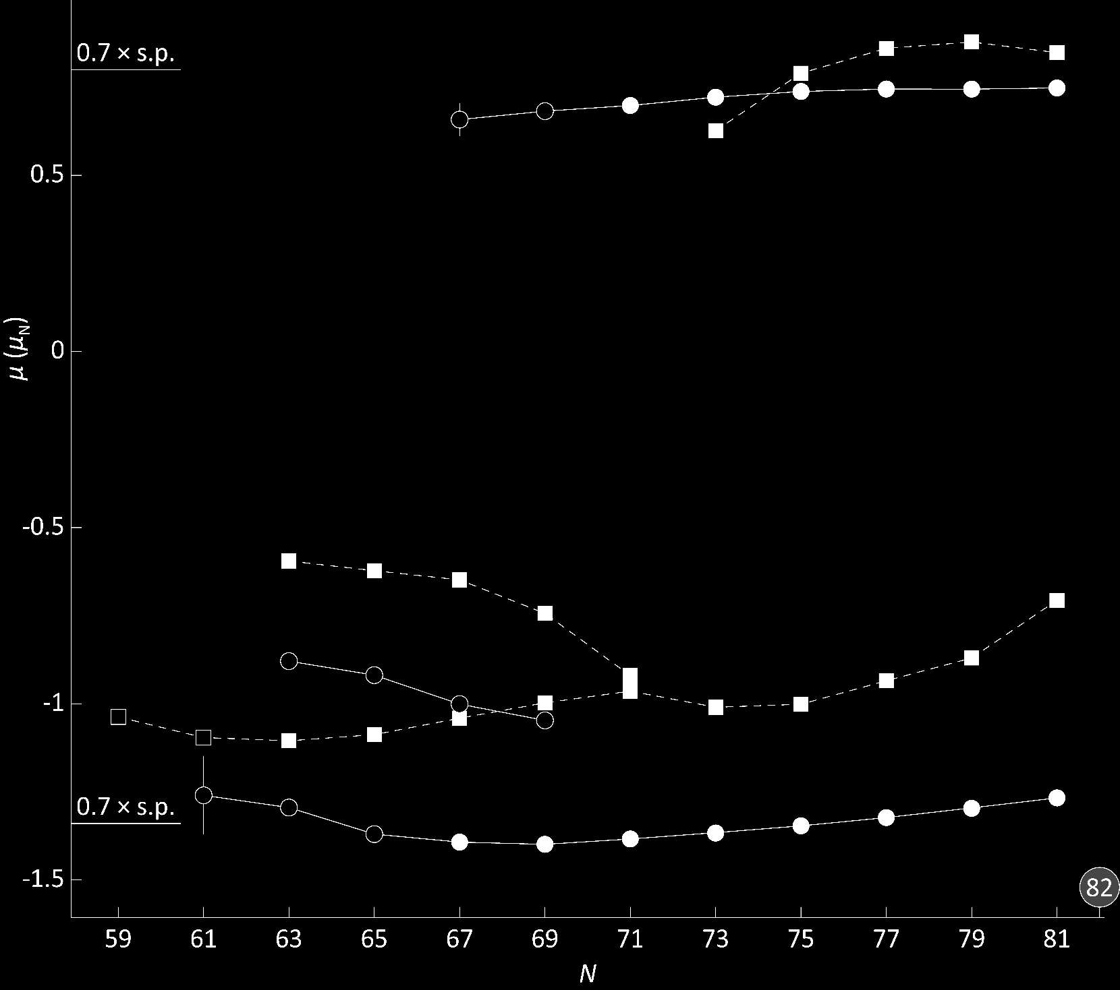



Data on polynomial trends
5/20
Cd, 3/2⁺
Dipole moment
(magnetic)
Sn, 3/2⁺
$$μ$$
Cd, 1/2⁺
Cd, 11/2⁻
Sn, 1/2⁺
$$N$$
Sn, 11/2⁻
$$μ=∓j\frac{3.8}{2l+1}μ_{N}$$
Commun. Phys. 3, 107 (2020)
Phys. Rev. Lett. 110, 192501 (2013)

Slide 6
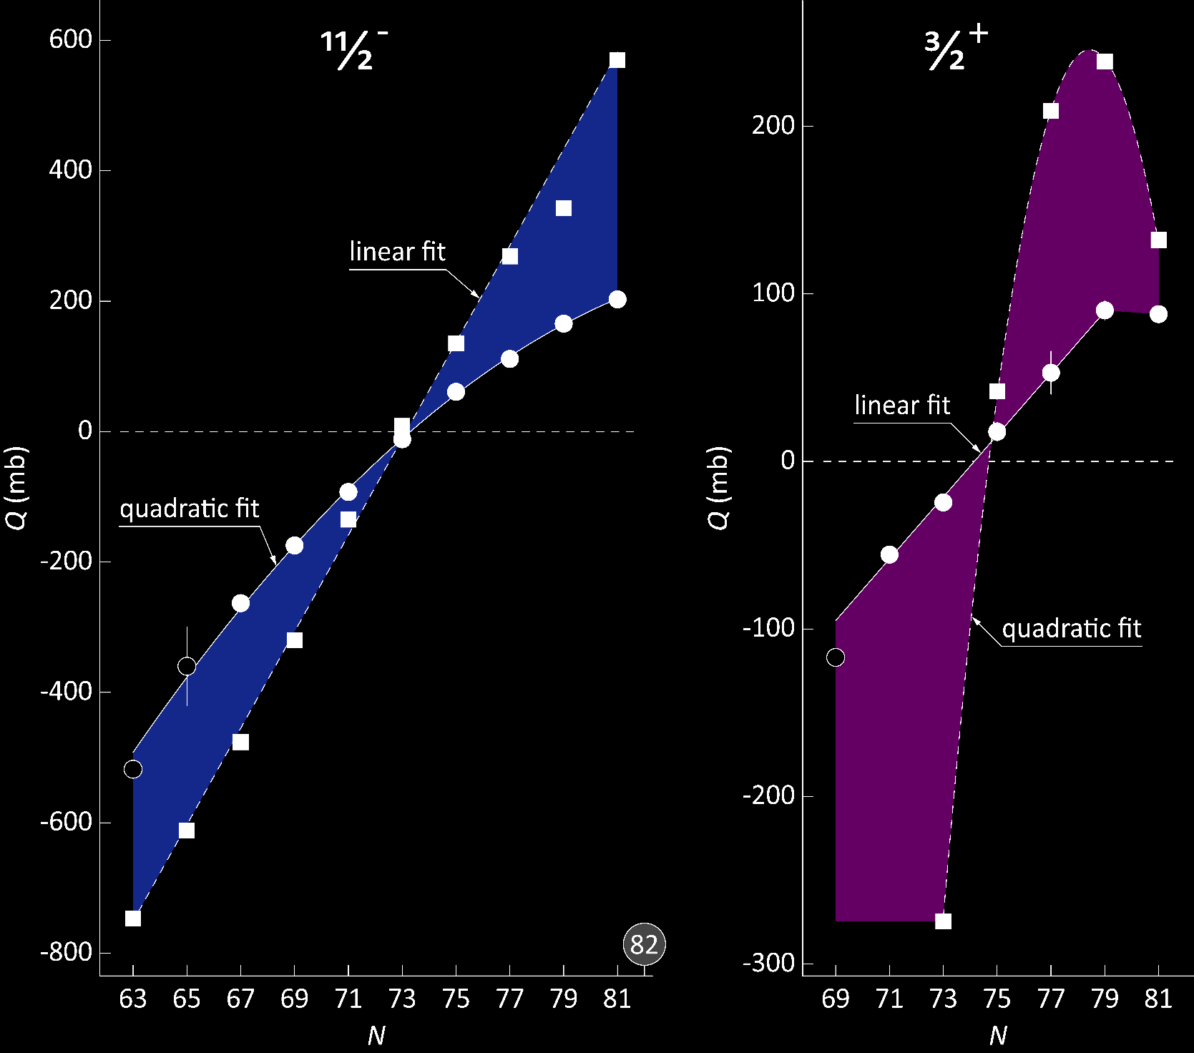
Data on polynomial trends
6/20
Quadrupole moment
(electric)
Cd
Cd
$$Q$$
Sn
Sn
$$N$$
$$Q=\frac{2j+1−2n}{2j−1}Q_{sp}$$
Commun. Phys. 3, 107 (2020)
Phys. Rev. Lett. 110, 192501 (2013)

Slide 7




Data on polynomial trends
7/20
Radial moments
(charge)
$$δ\left\langle r^{2}\right\rangle$$
Cd
$$N$$
$$δ{\left\langle r^{2}\right\rangle }^{g,m}=\frac{5}{4π}\left\langle r_{0}^{2}\right\rangle \left(β_{m}^{2}−β_{g}^{2}\right)$$
Sn
Commun. Phys. 3, 107 (2020)
Phys. Rev. Lett. 116, 032501 (2016)

Slide 8
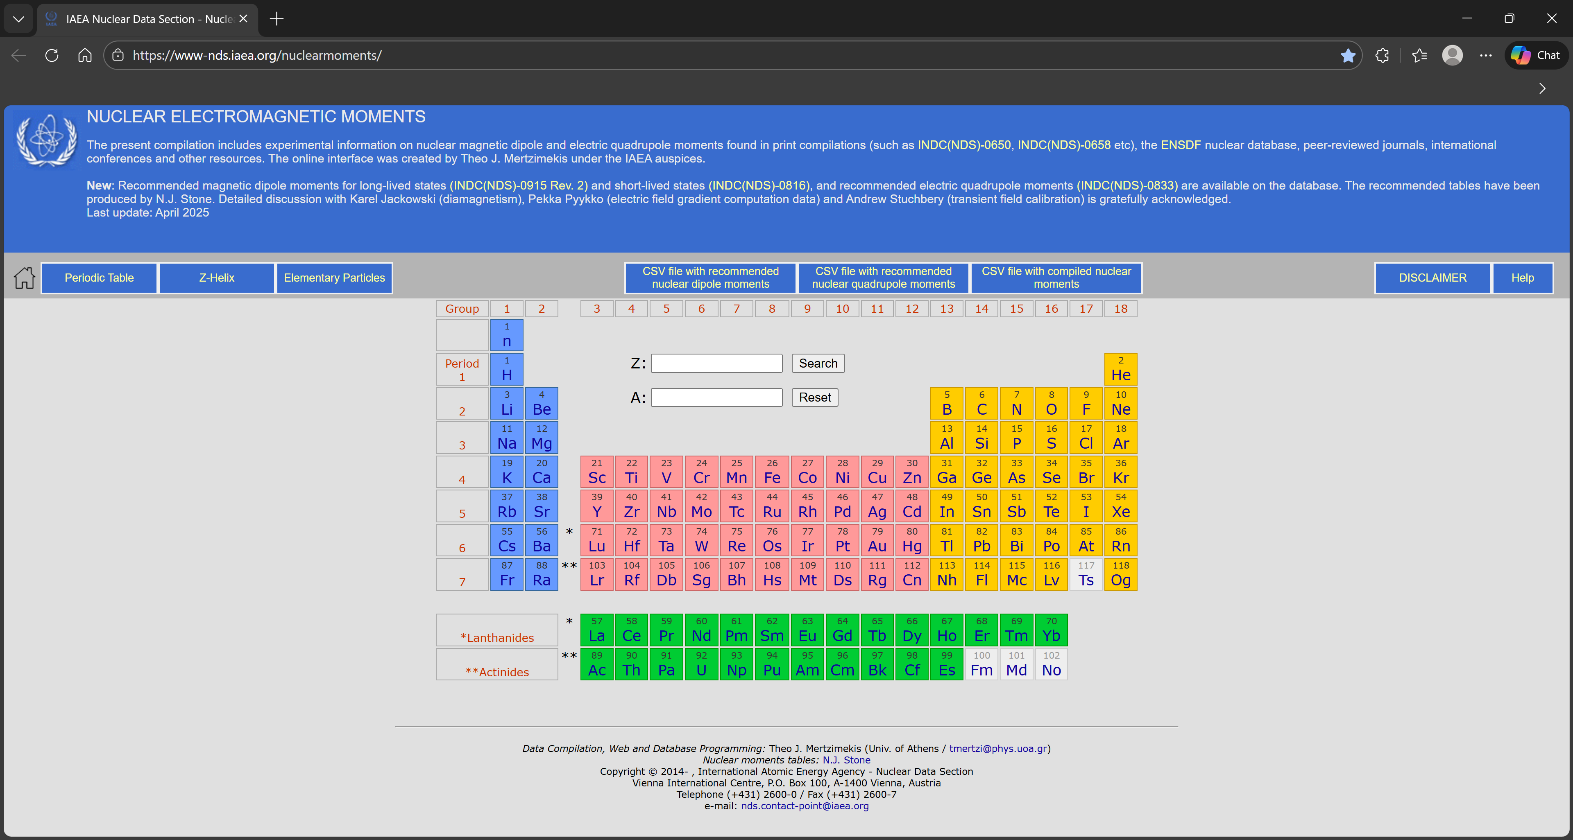
On the current database
8/20
magnetic

Slide 9
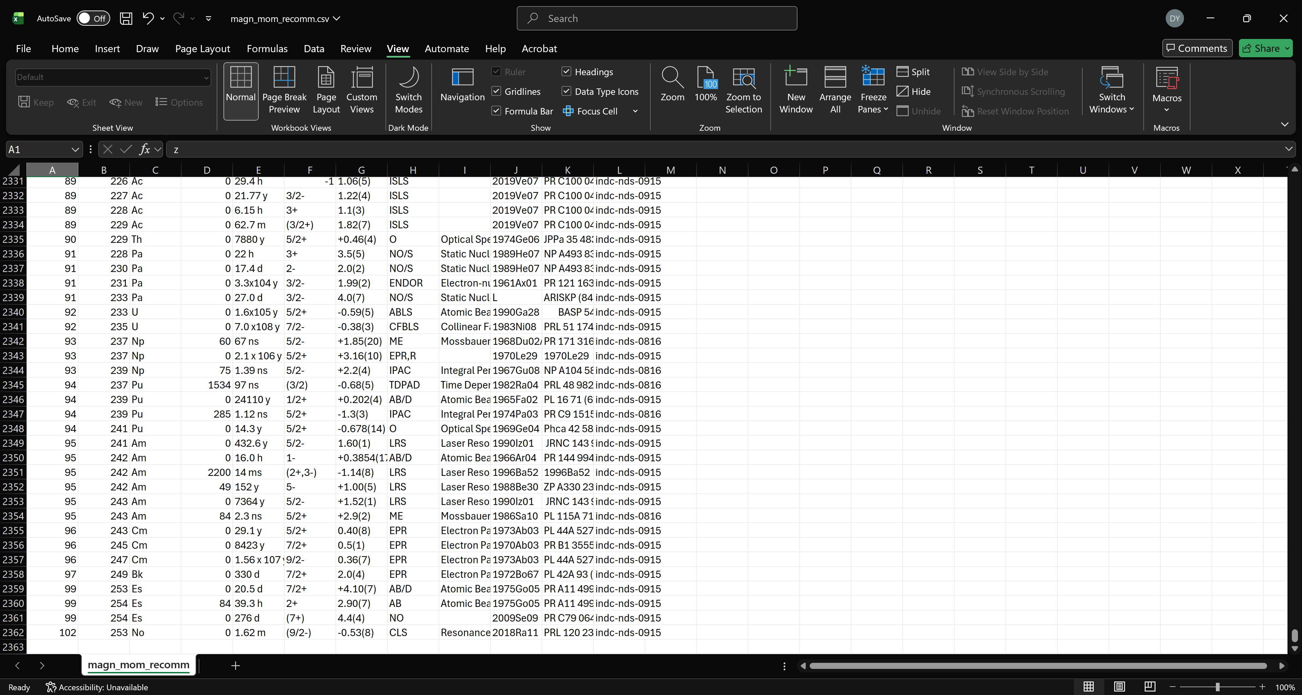
On the current database
9/20

Slide 10
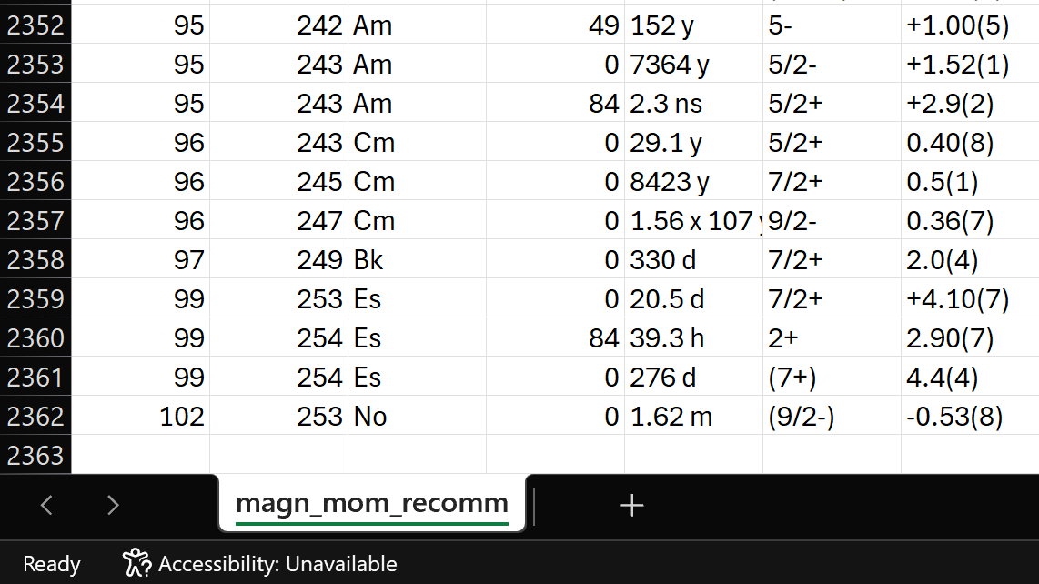
On the current database
10/20

Slide 11
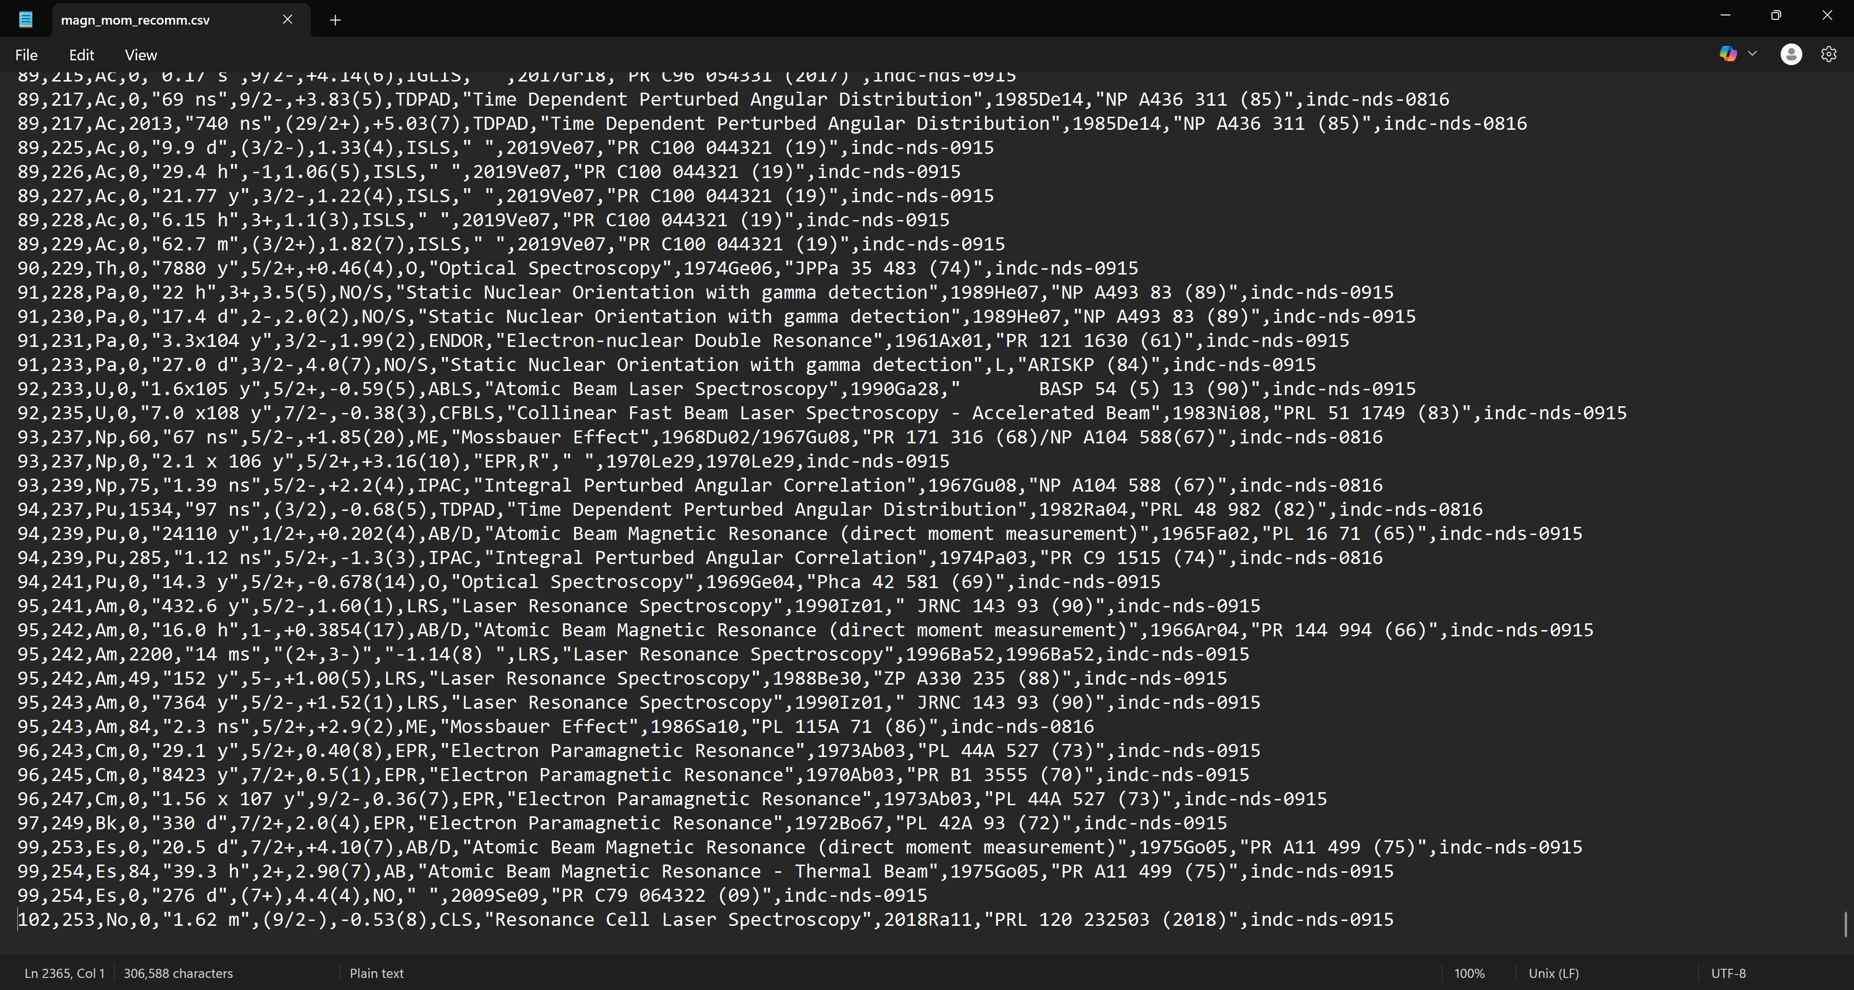
On the current database
11/20

Slide 12
On the current database
12/20

Slide 13

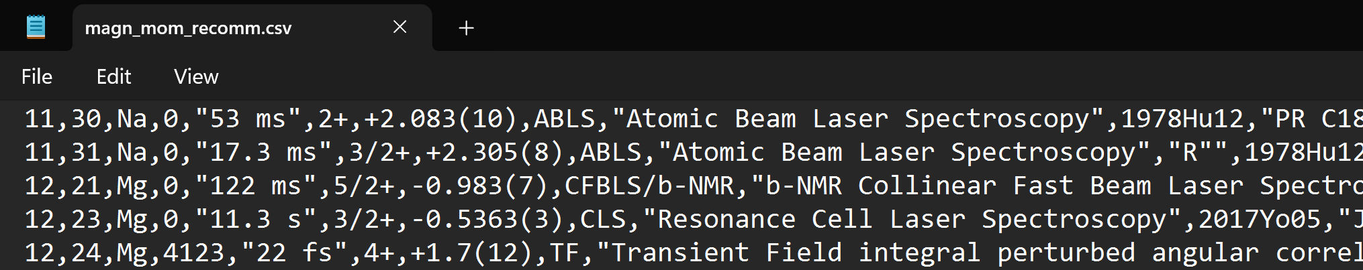
On the current database
13/20

Slide 14
On the current database
14/20
electric

Slide 15
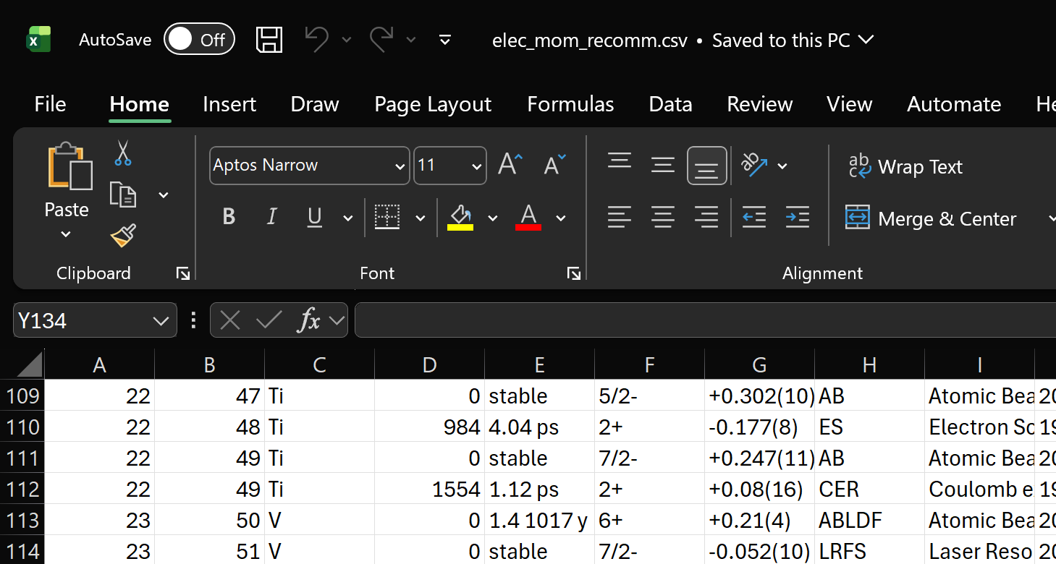
On the current database
15/20

Slide 16
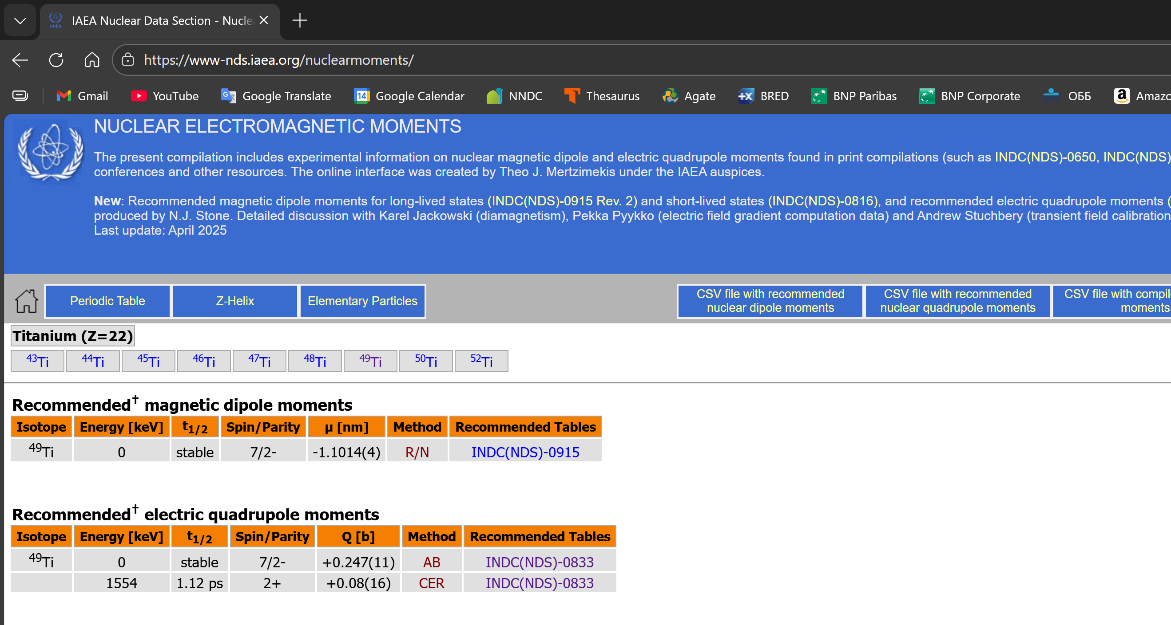
On the current database
16/20

Slide 17
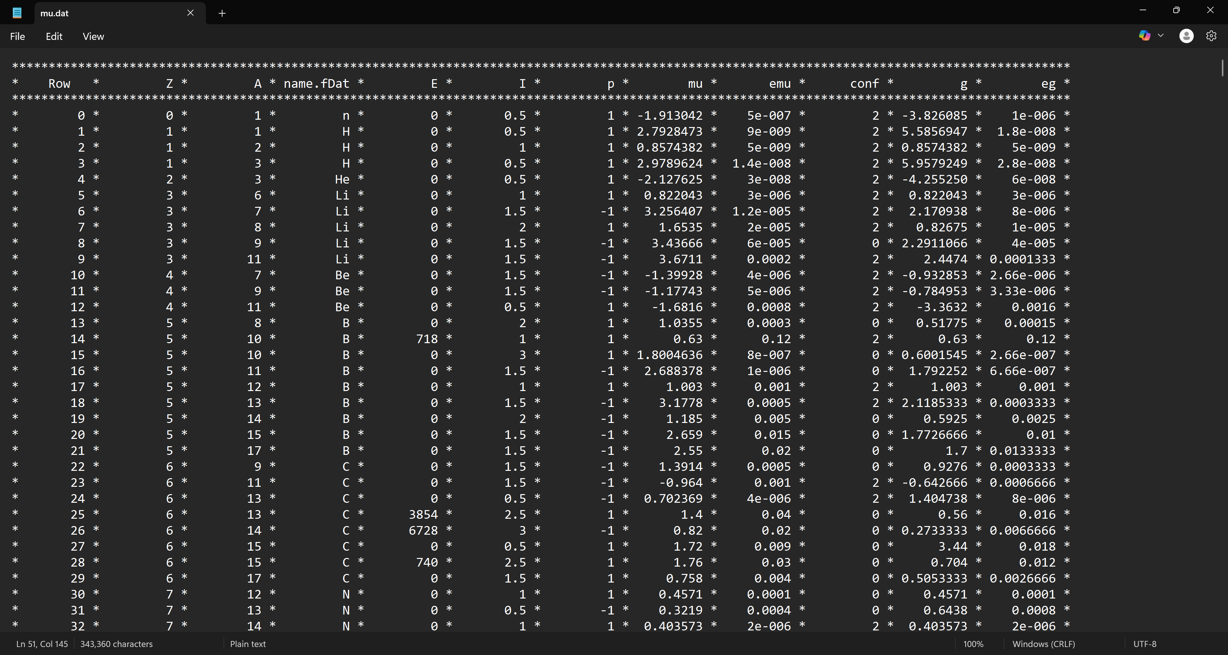
On a digital database
17/20

Slide 18




On a digital database
18/20
Dipole moment
(magnetic)
$$1h_{9/2}$$
$$μ$$
82
$$1h$$
$$1h_{11/2}$$
$−1.9$ µ_{N}
$$3s$$
$$3s_{1/2}$$
$$2d_{3/2}$$
$$2d$$
$$2d_{5/2}$$
$$1g_{7/2}$$
$$1g$$
50
$$N$$
$$1g_{9/2}$$
$$μ=∓j\frac{3.8}{2l+1}μ_{N}$$

Slide 19
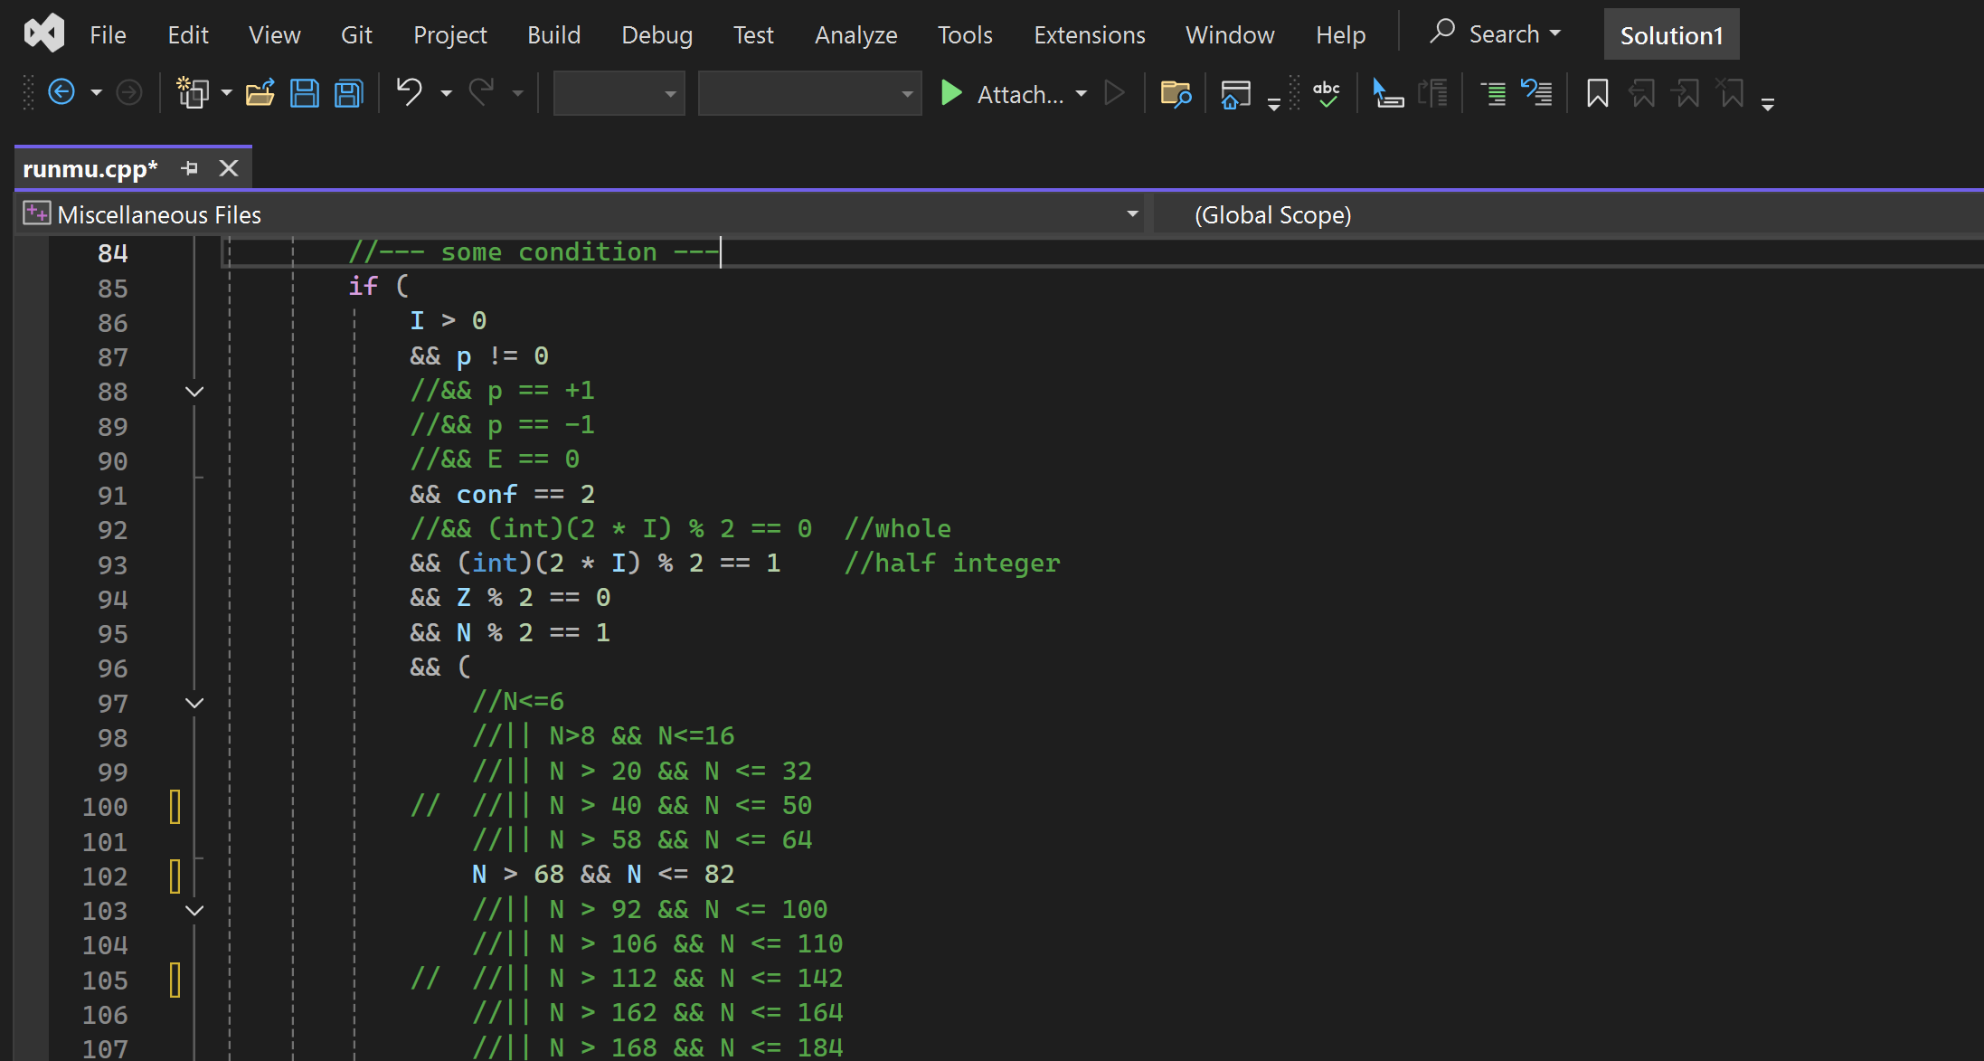
On a digital database
19/20

Slide 20

An example
20/20
µ (µ_{N})

