Slide 1


Comparison of theoretical calculations to Oslo-type data
T.A. Laplace, K.L. Malatji, M. Wiedeking
Nuclear Science Division, Lawrence Berkeley National Laboratory
Department of Nuclear Engineering, University of California, Berkeley
Theoretical models by S. Goriely
IAEA PSF meeting – November 2025

Slide 2
Outline
Looking at Oslo data vs 3 theoretical models
PSF vs A (as a function of energy)
PSF vs quadrupole deformation

Slide 3
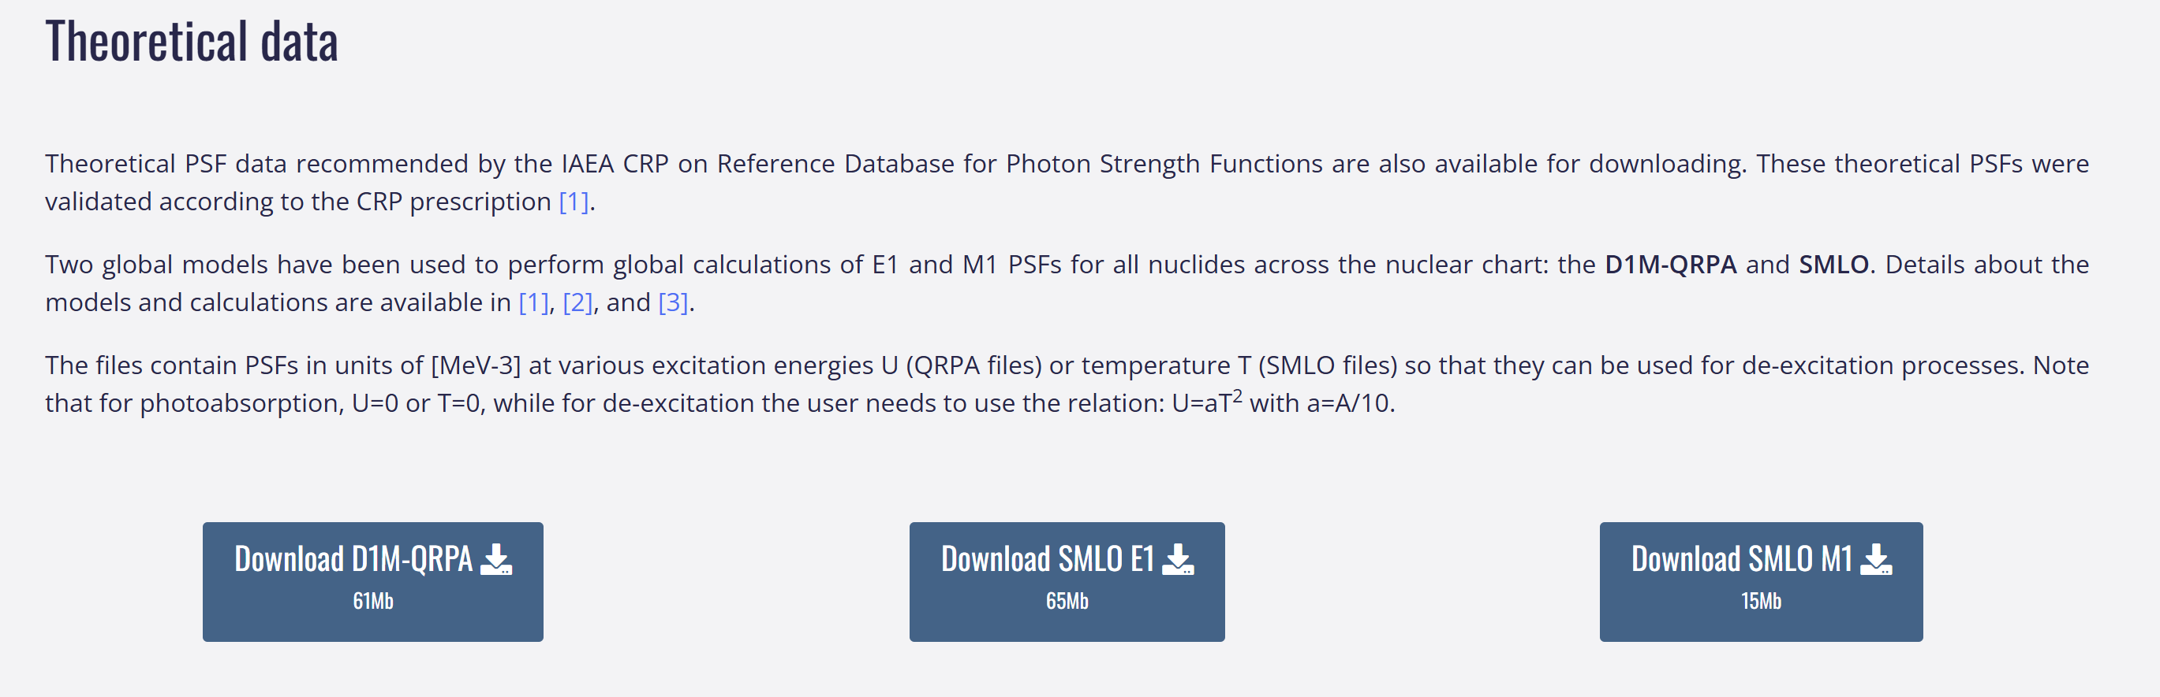
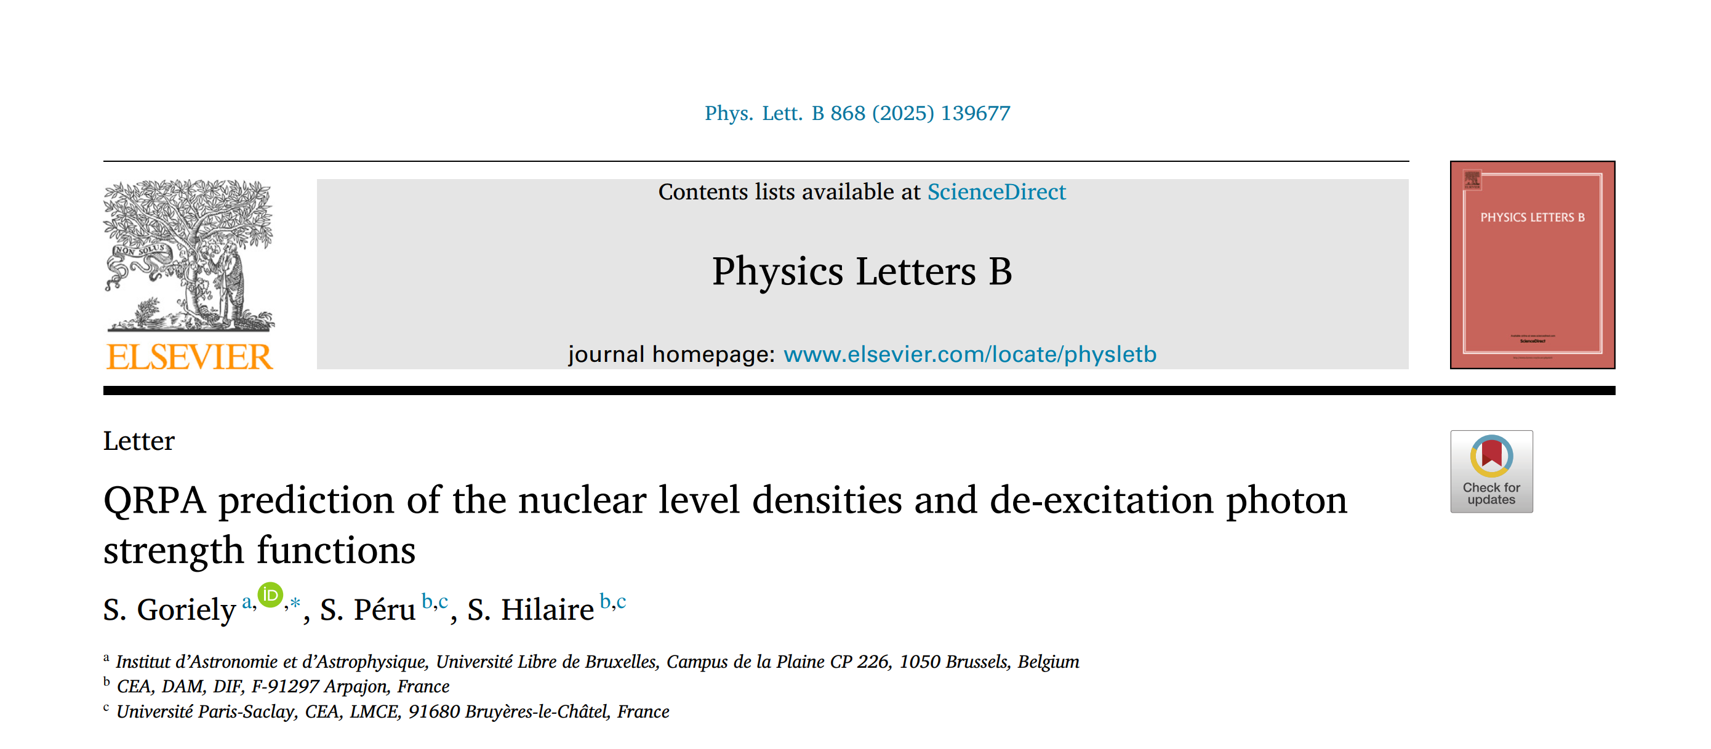
Theoretical models
D1M-QRPA de-excitation

Slide 4
Quality indicators for Oslo data
See talk from Kgashane Malatji
In brief, quality indicators were assigned to take into account:
Presence of external nuclear data used for normalization (D0, Γ_{γ})
Quality of uncertainty analysis
At this time, no clear correlation between quality indicators and discrepancy with models

Slide 5
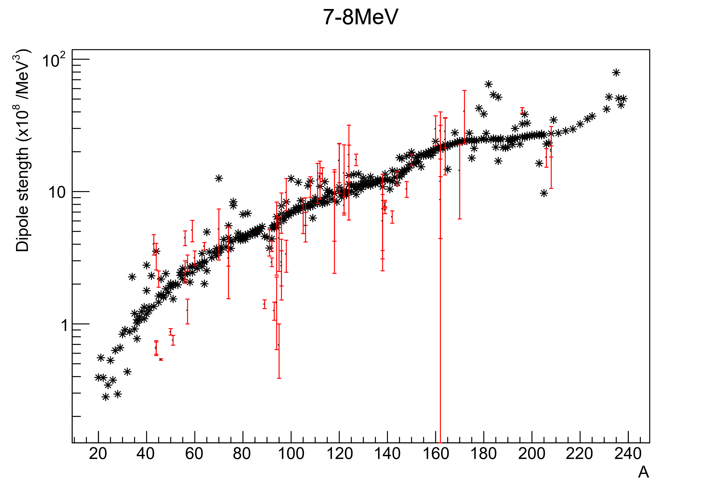
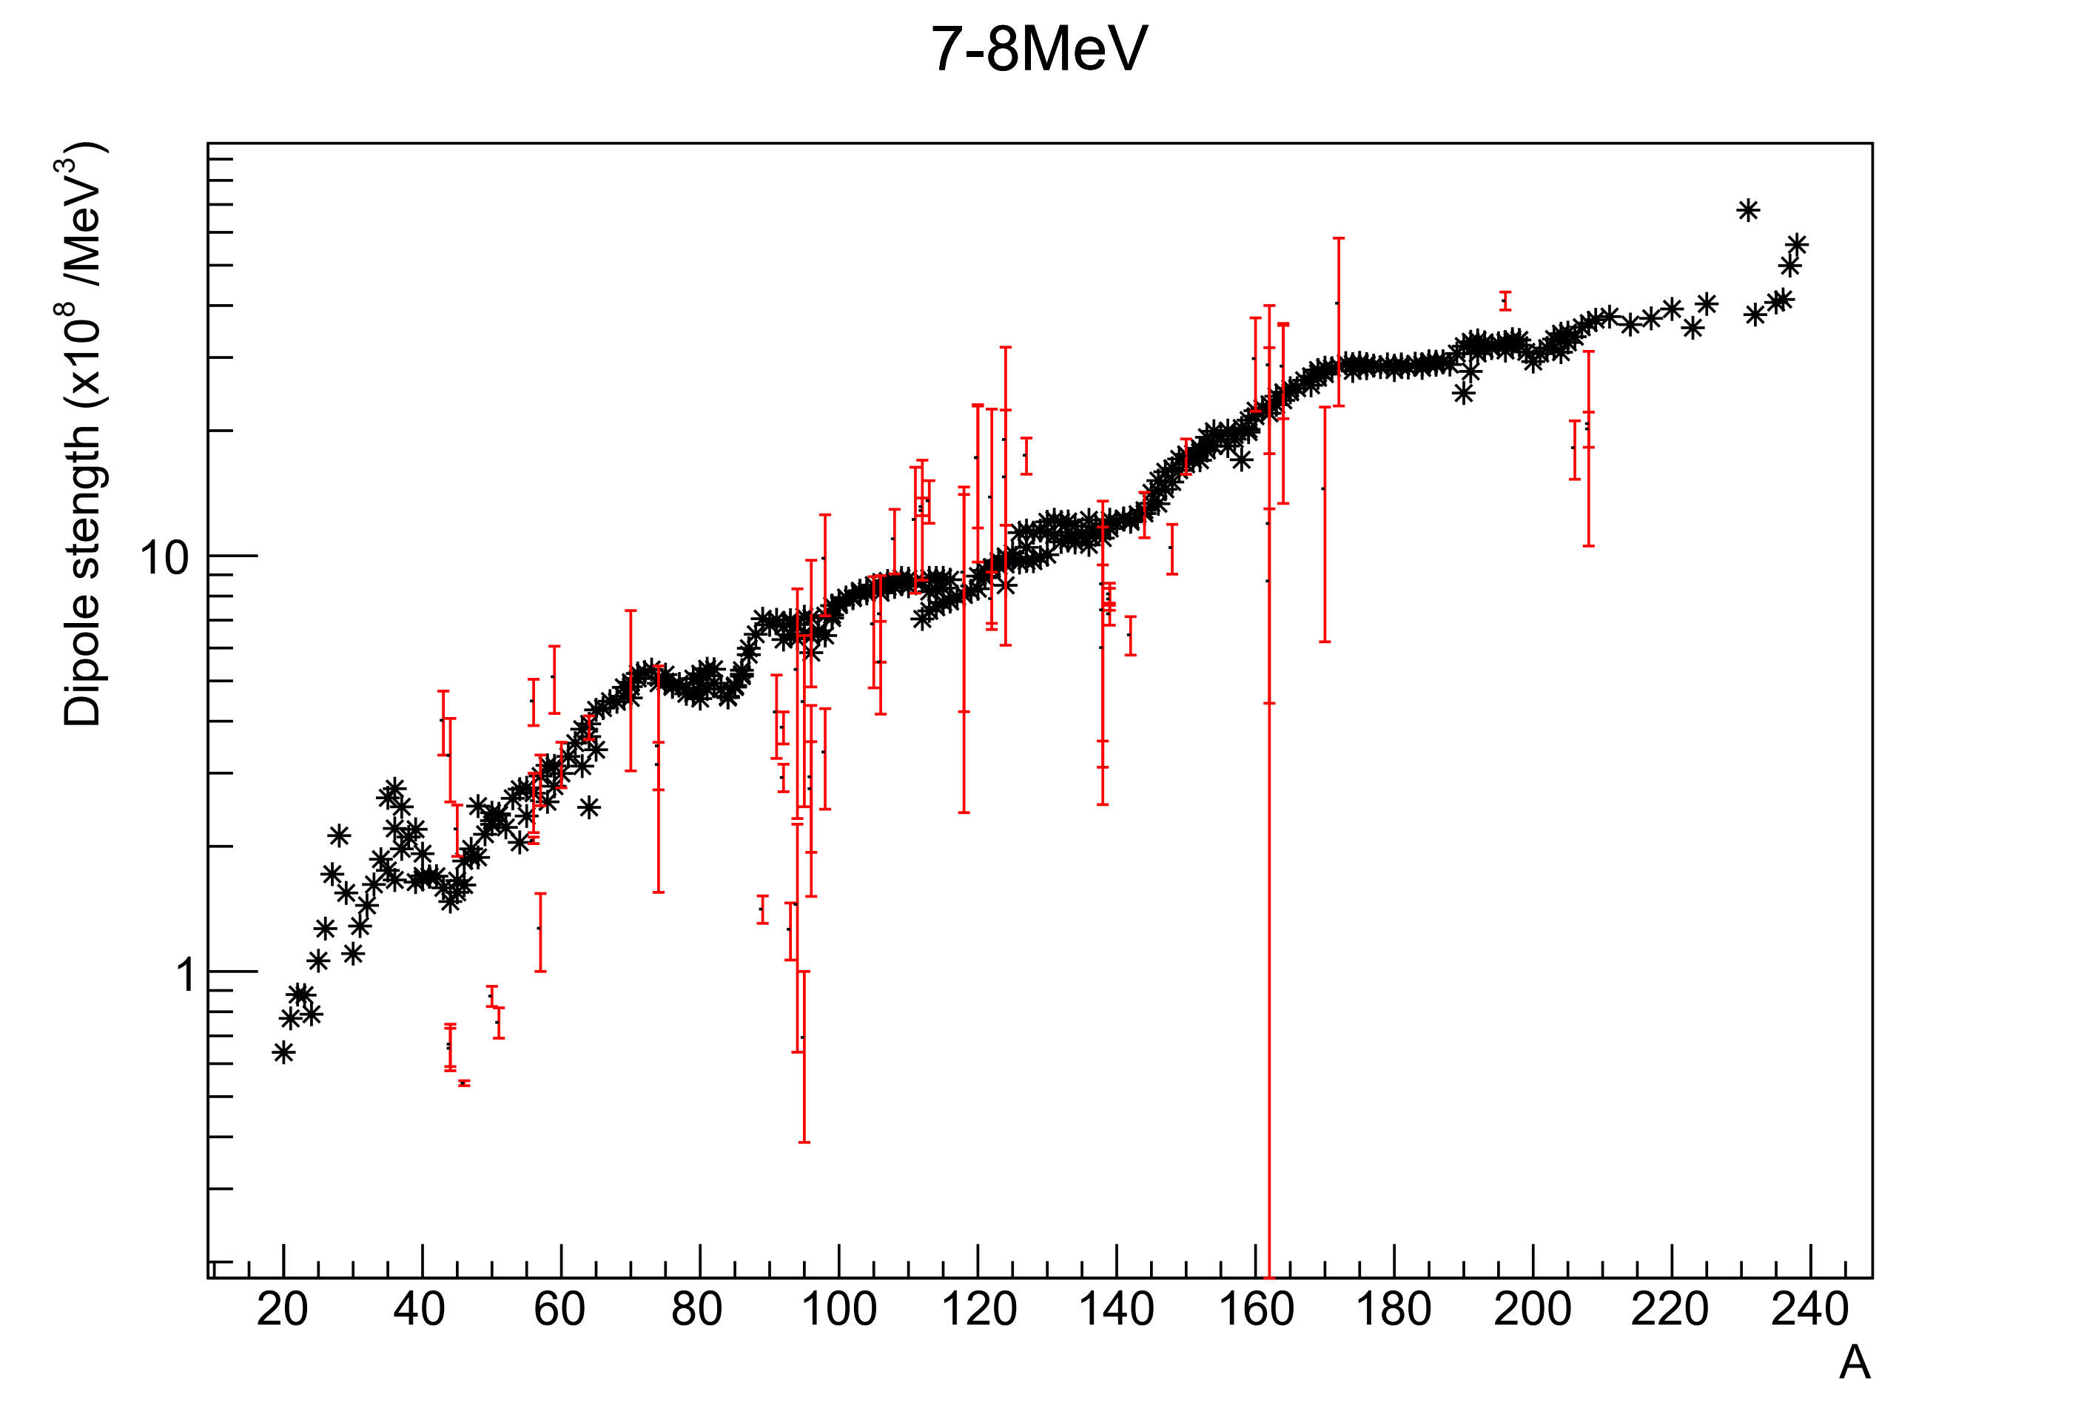
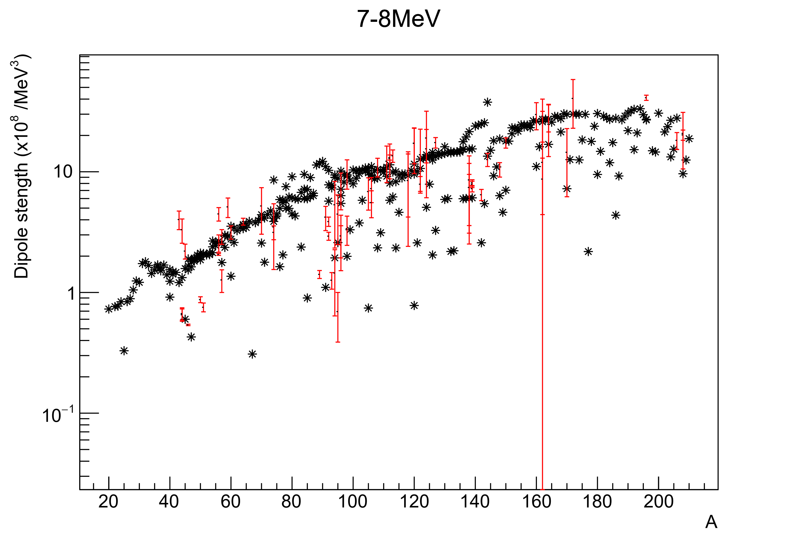
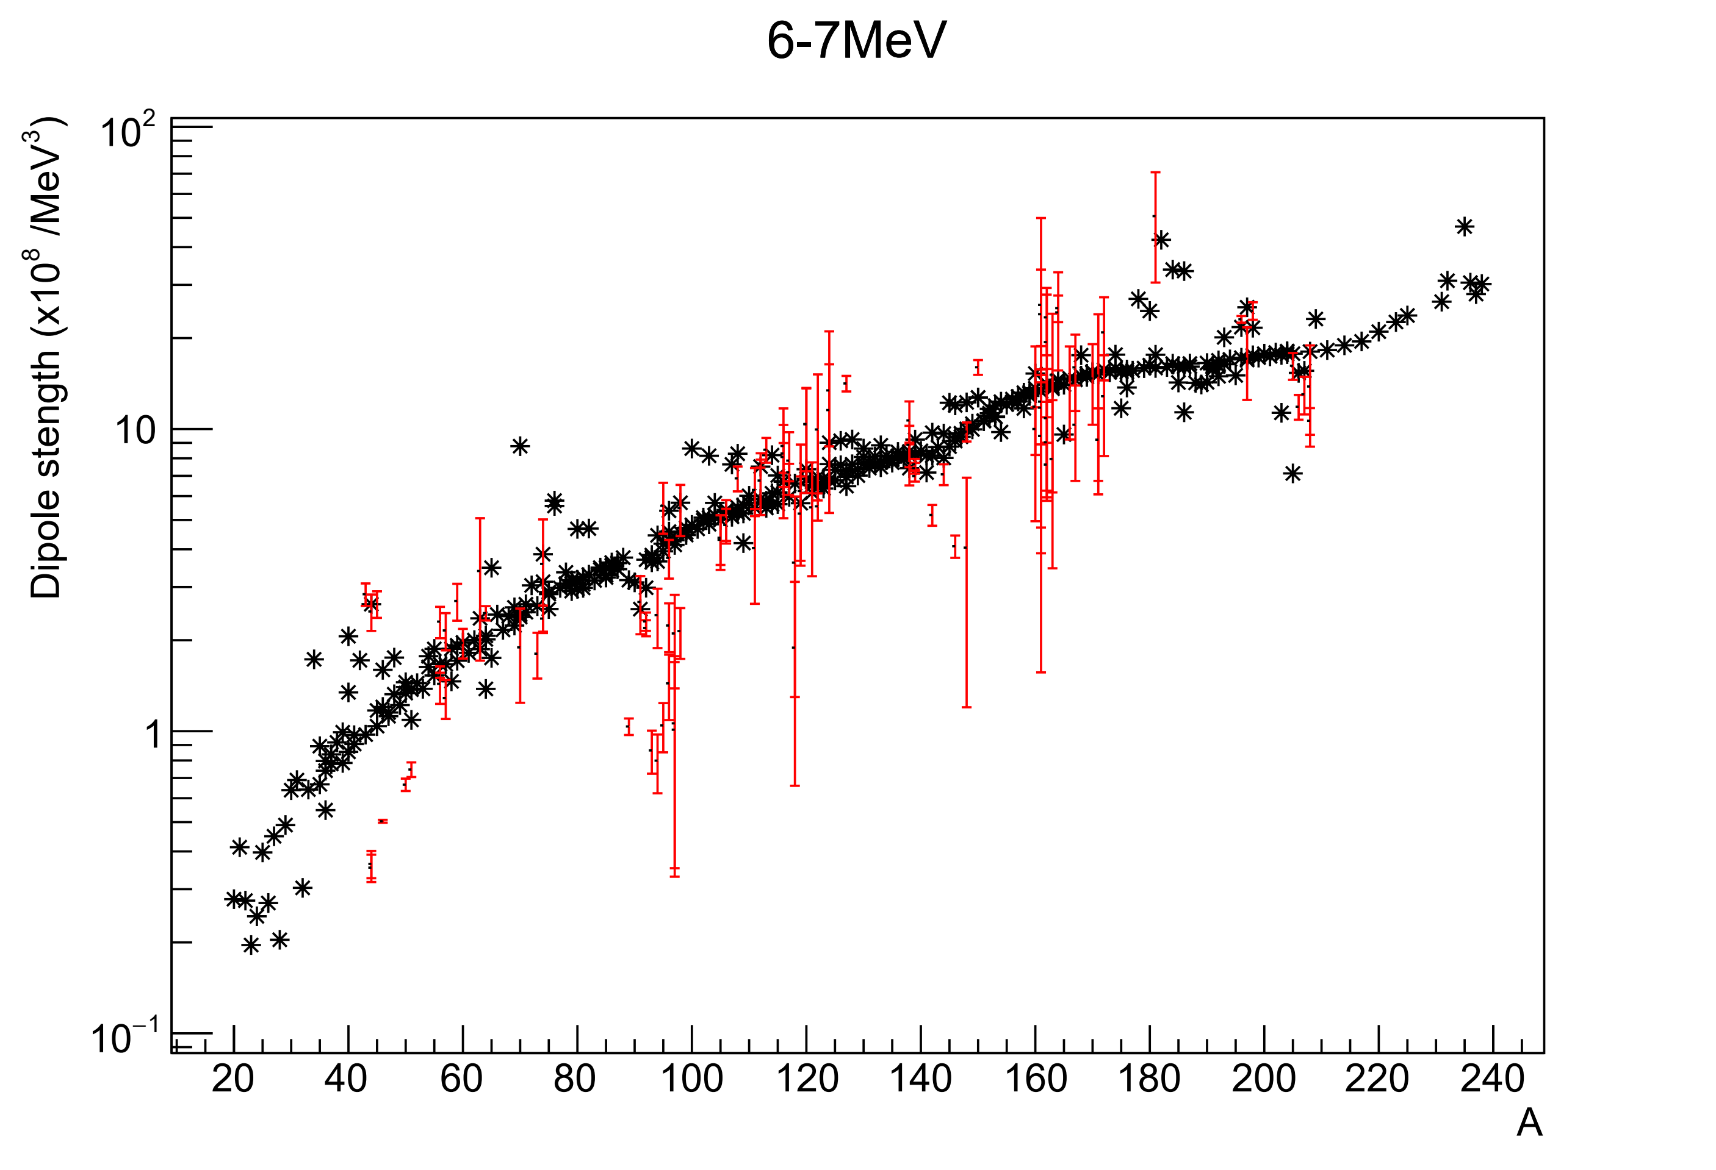
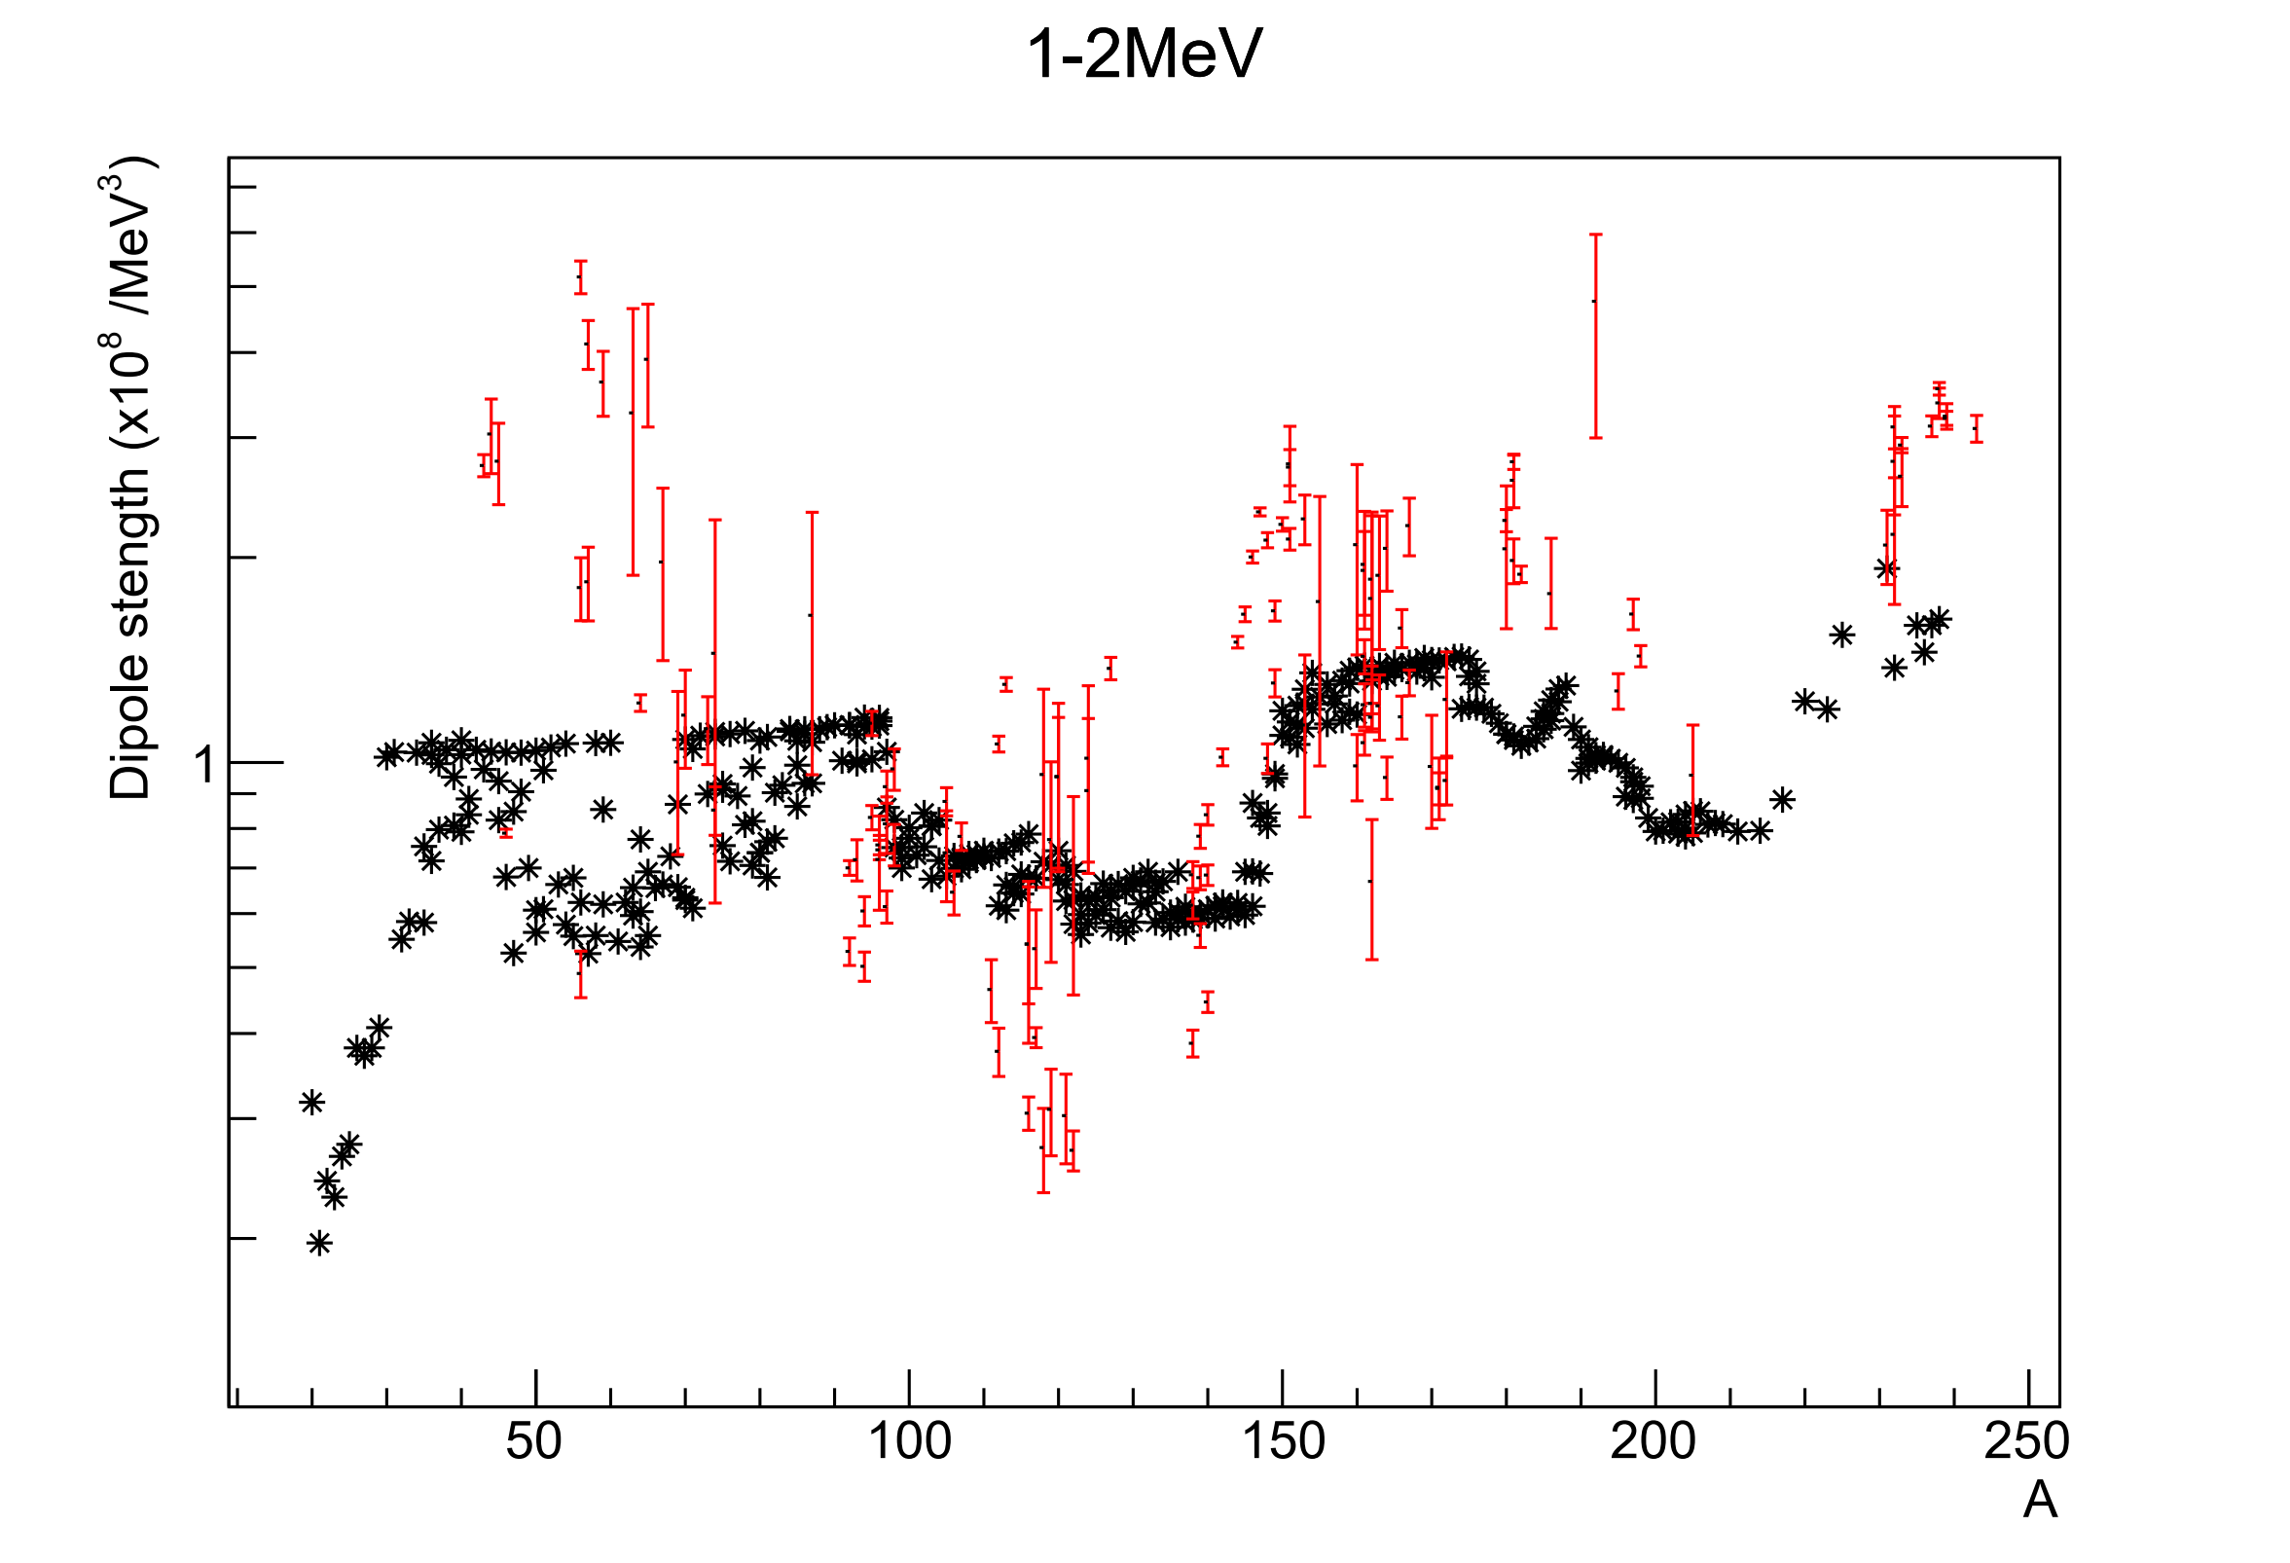
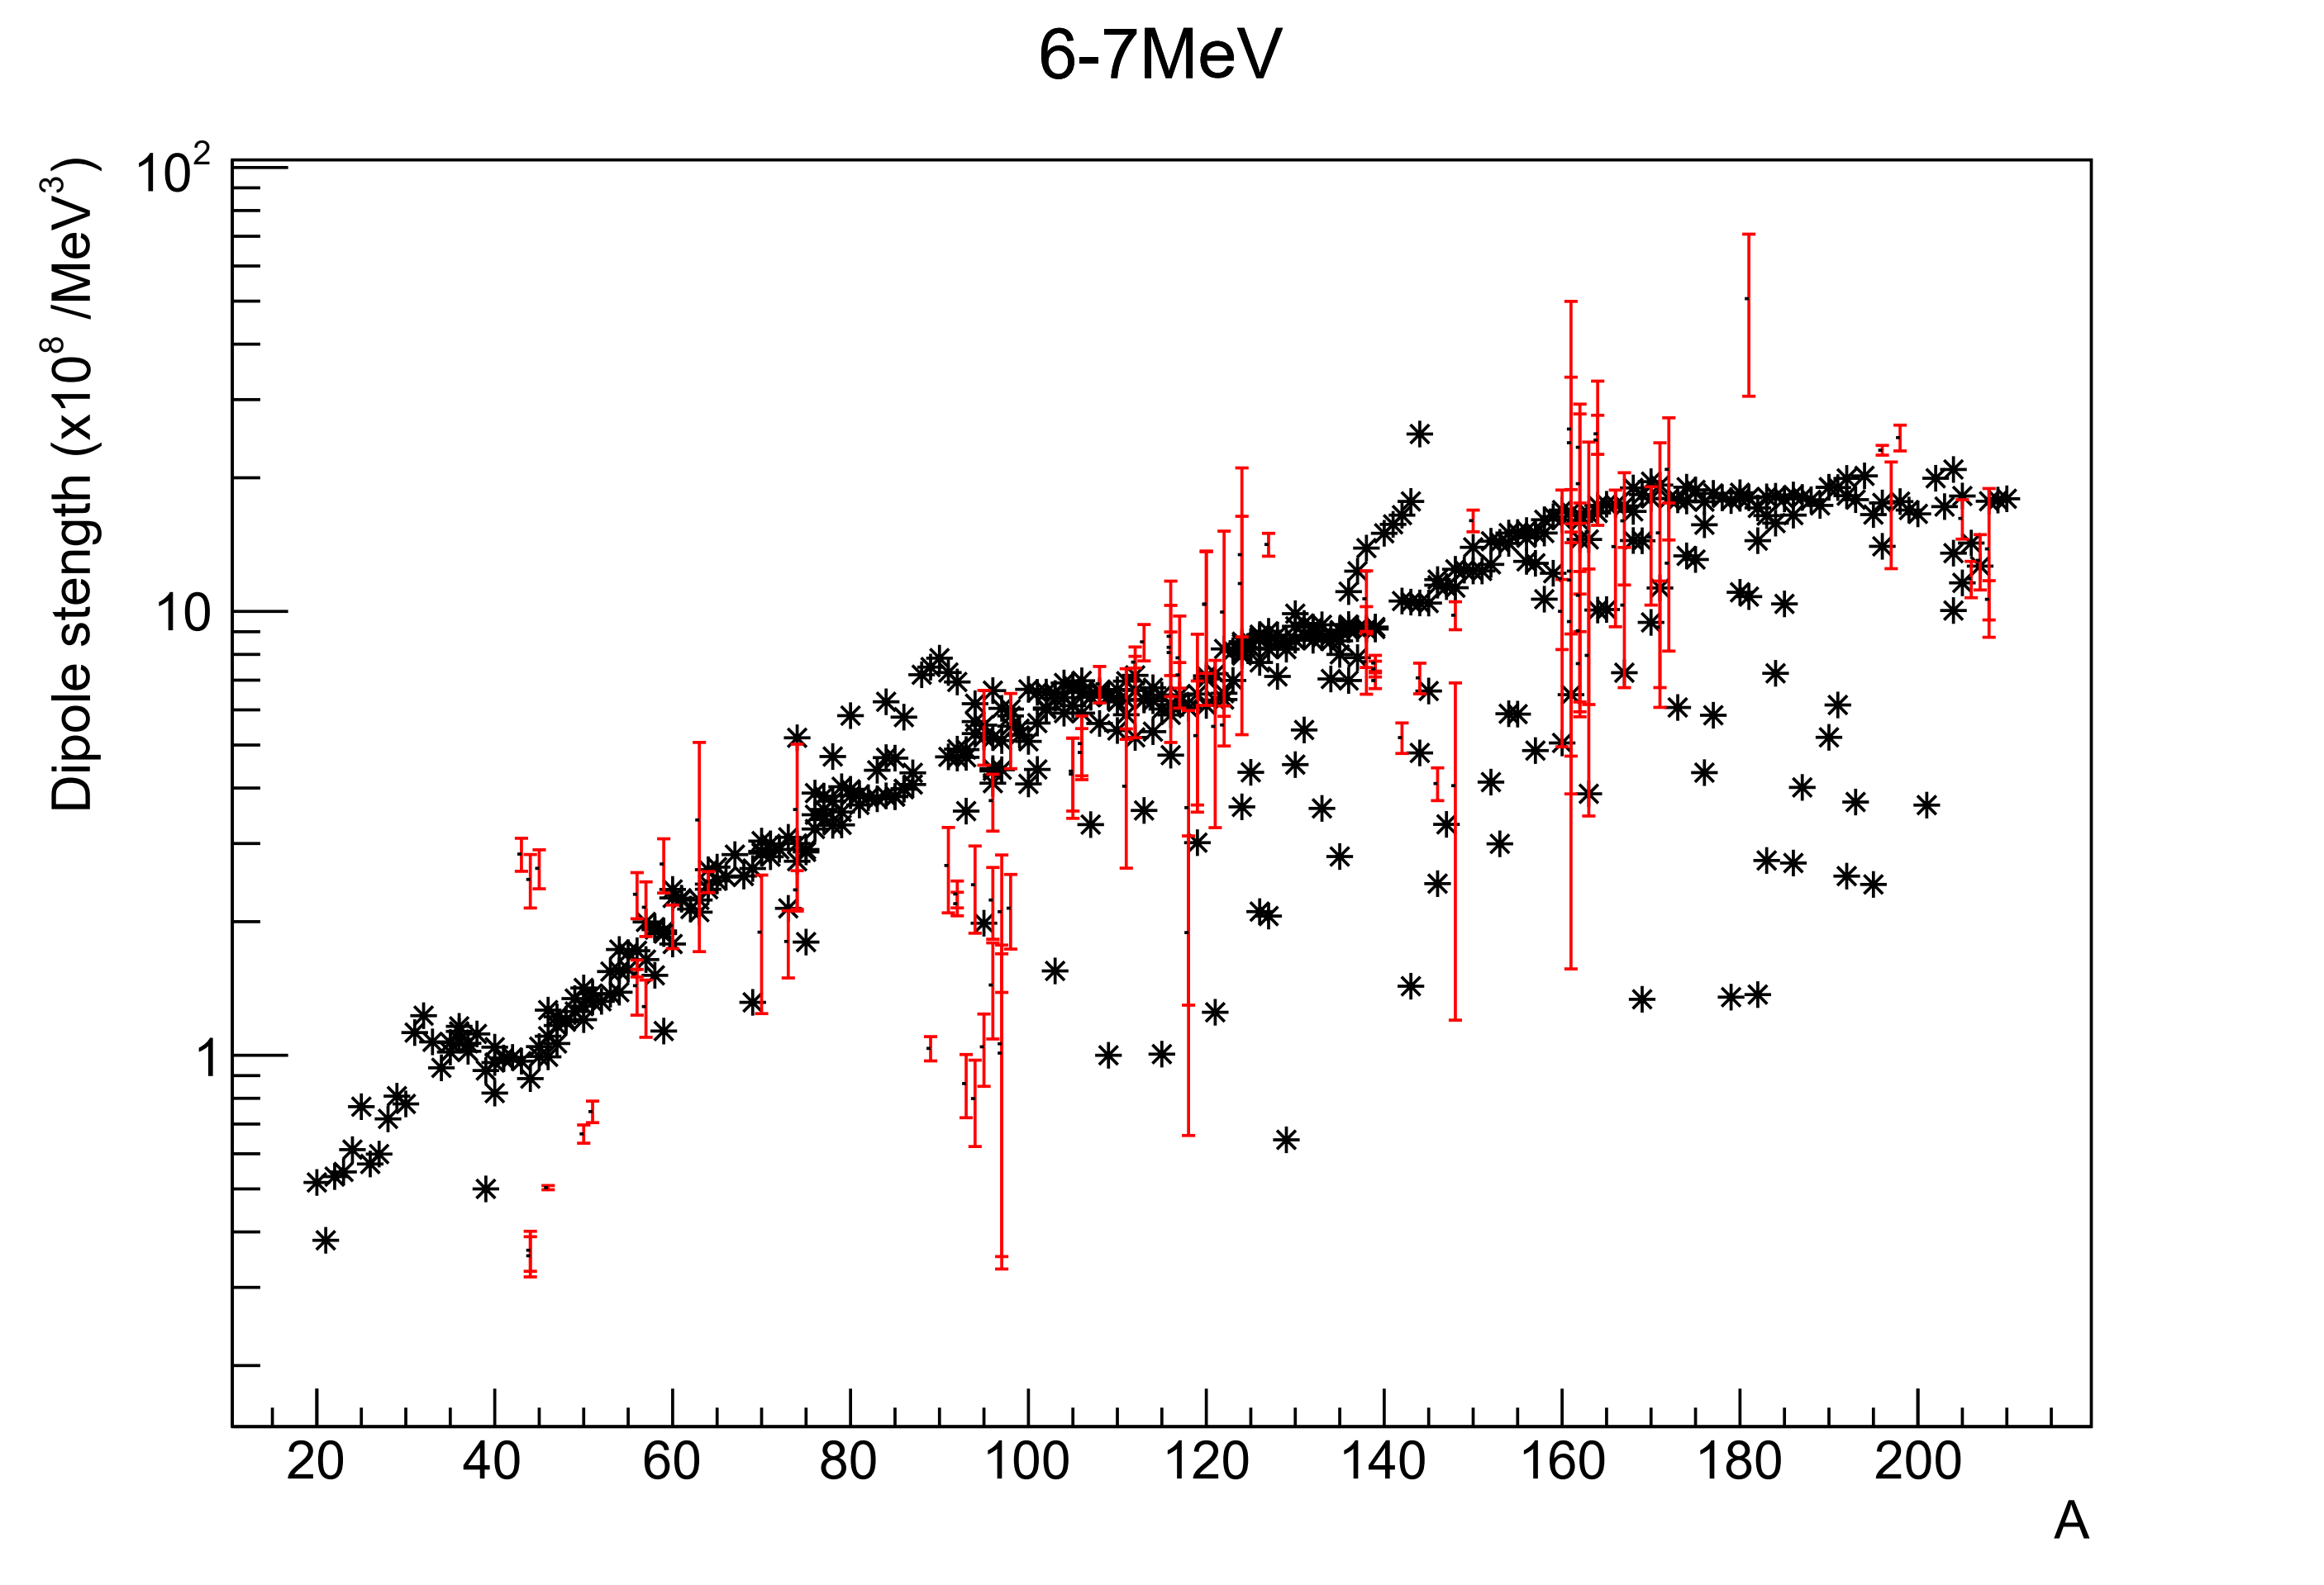
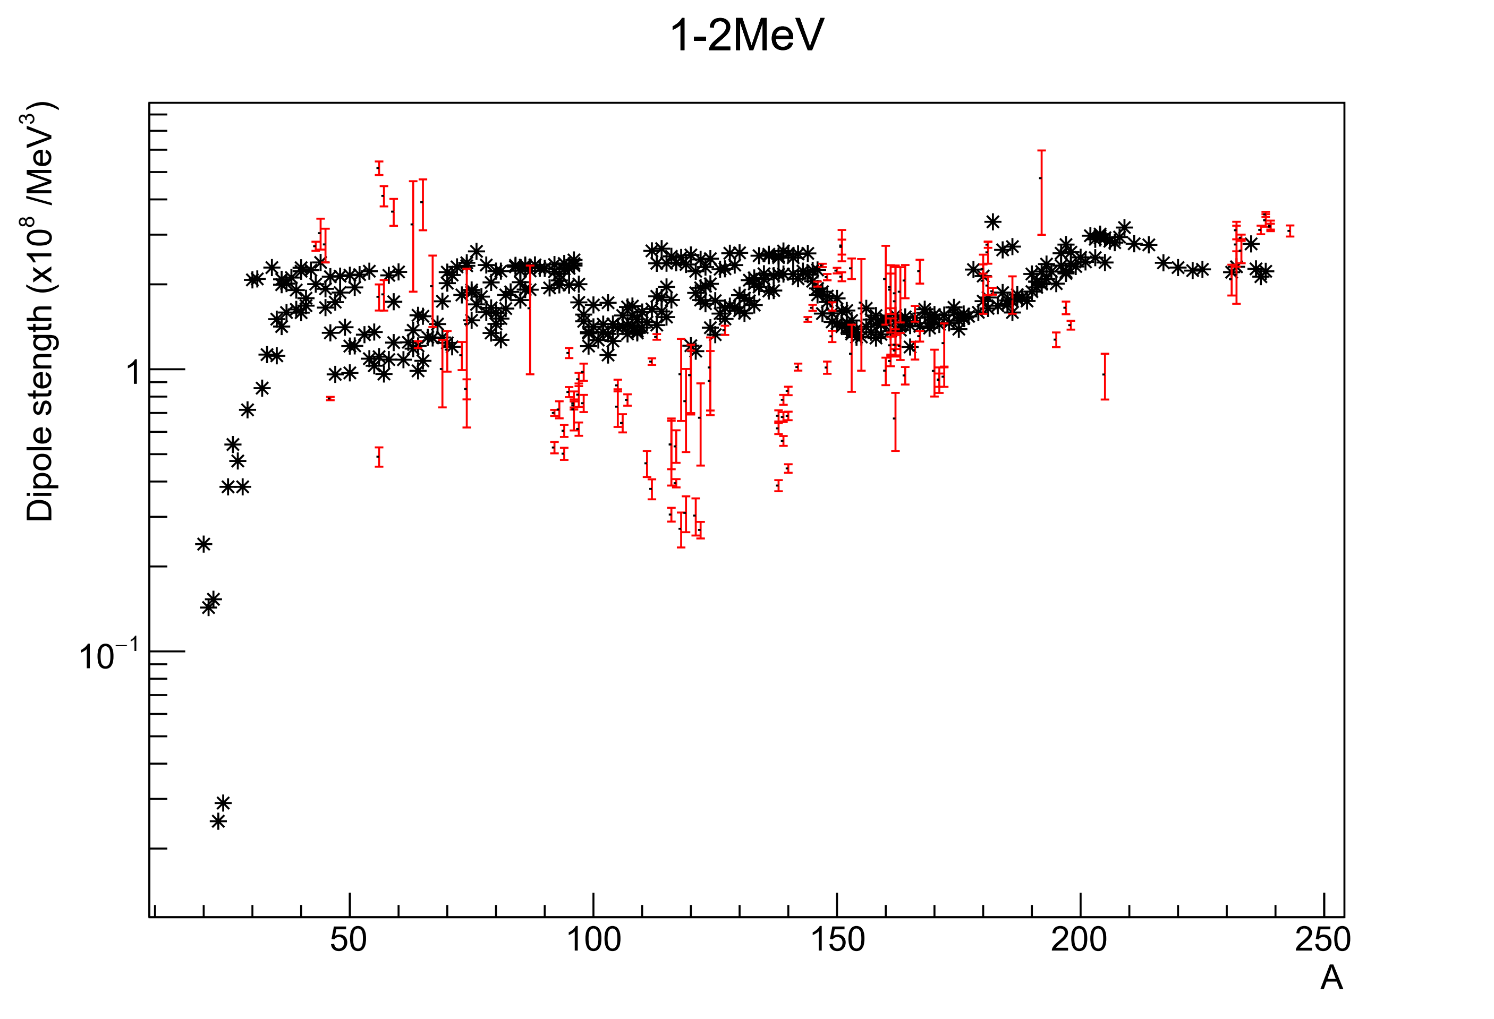
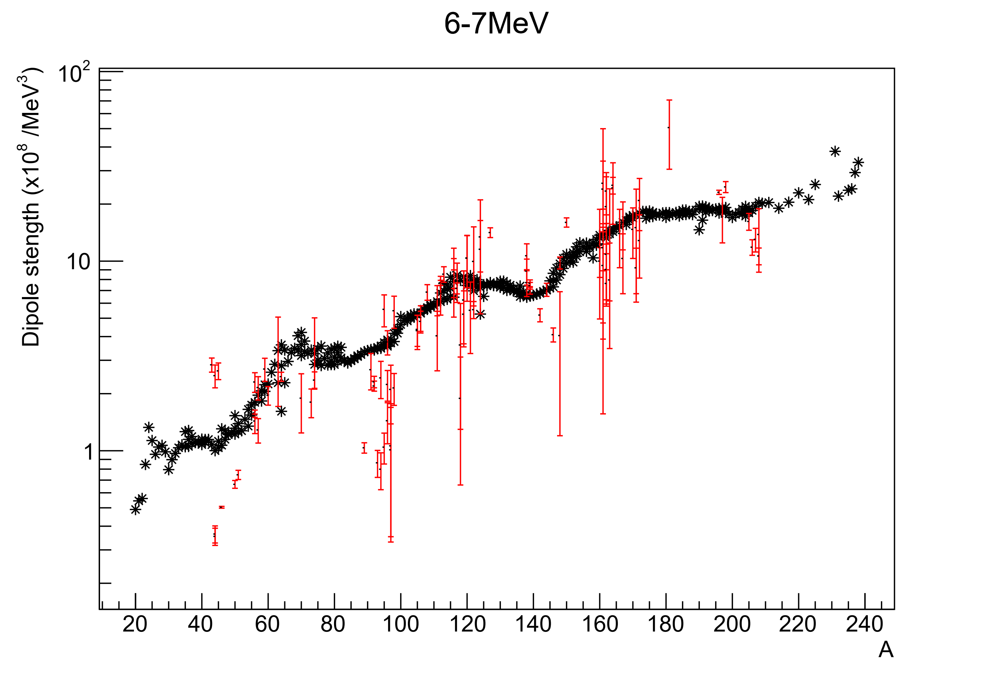
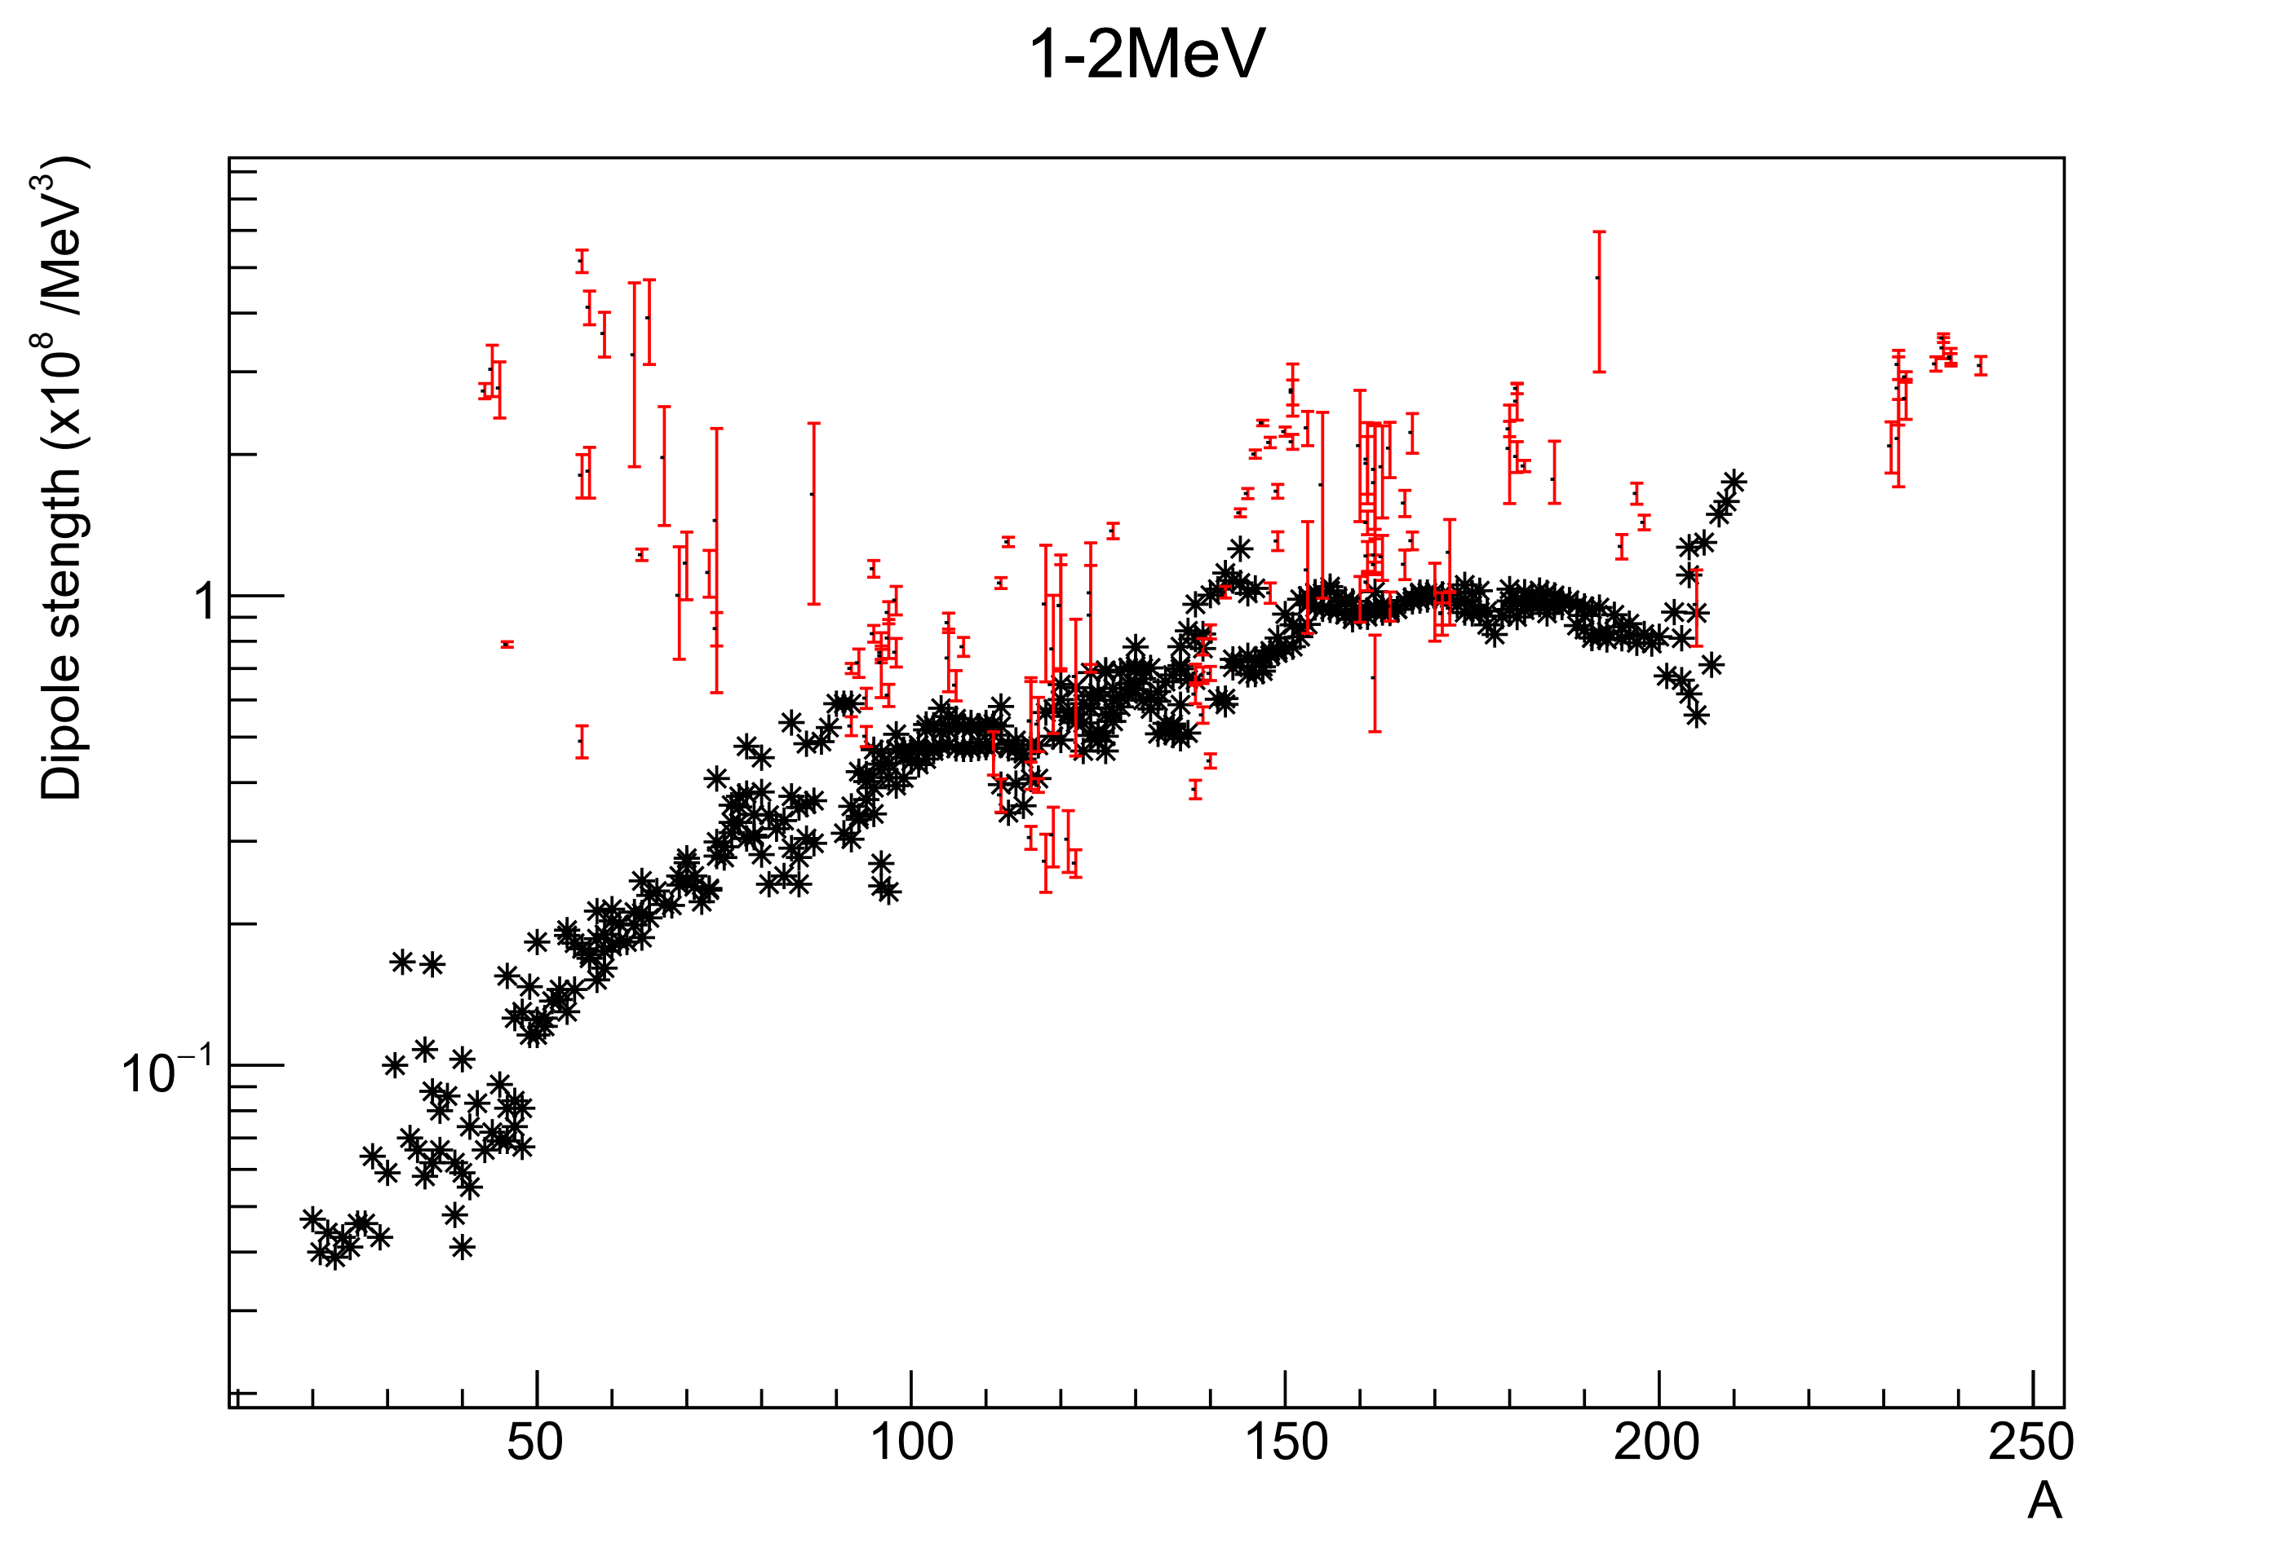
7-8 MeV
SMLO
D1M-QRPA
D1M-QRPA de-excitation

Slide 6
6-7 MeV
SMLO
D1M-QRPA
D1M-QRPA de-excitation

Slide 7
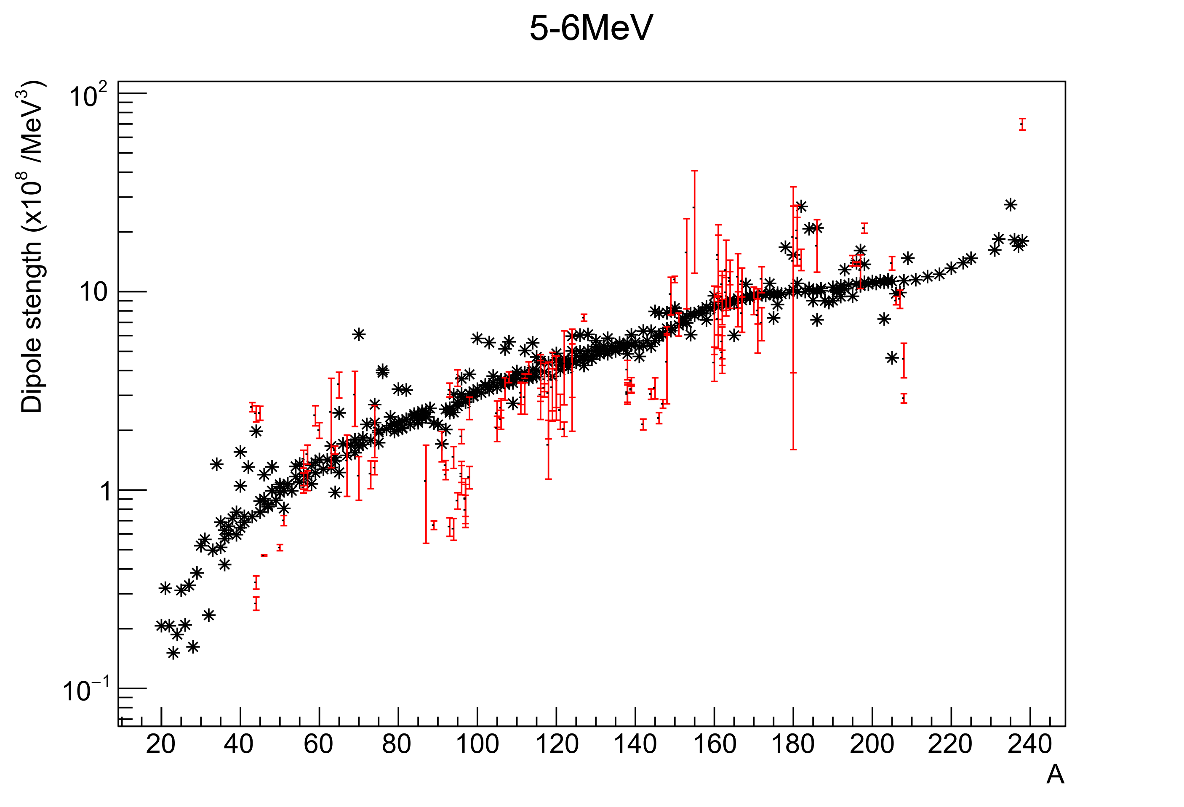
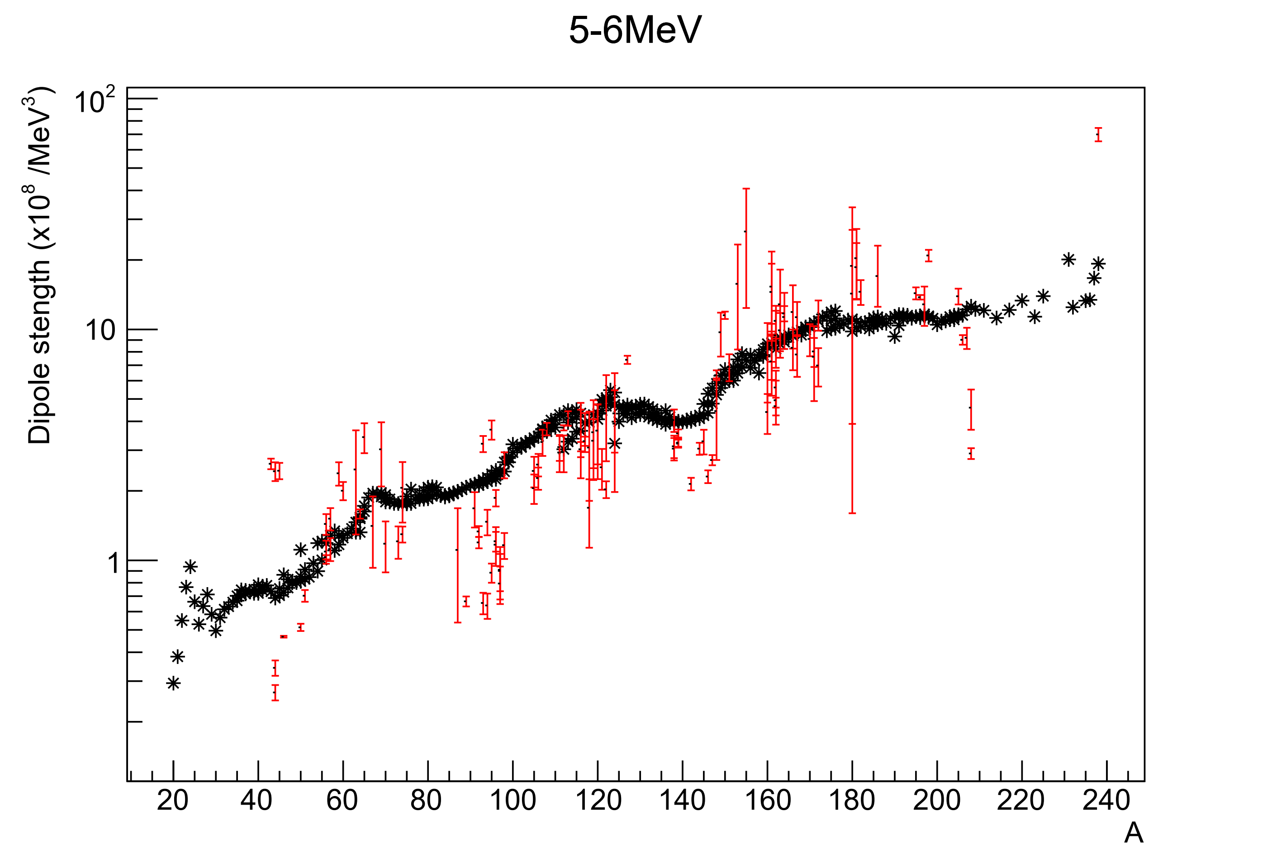
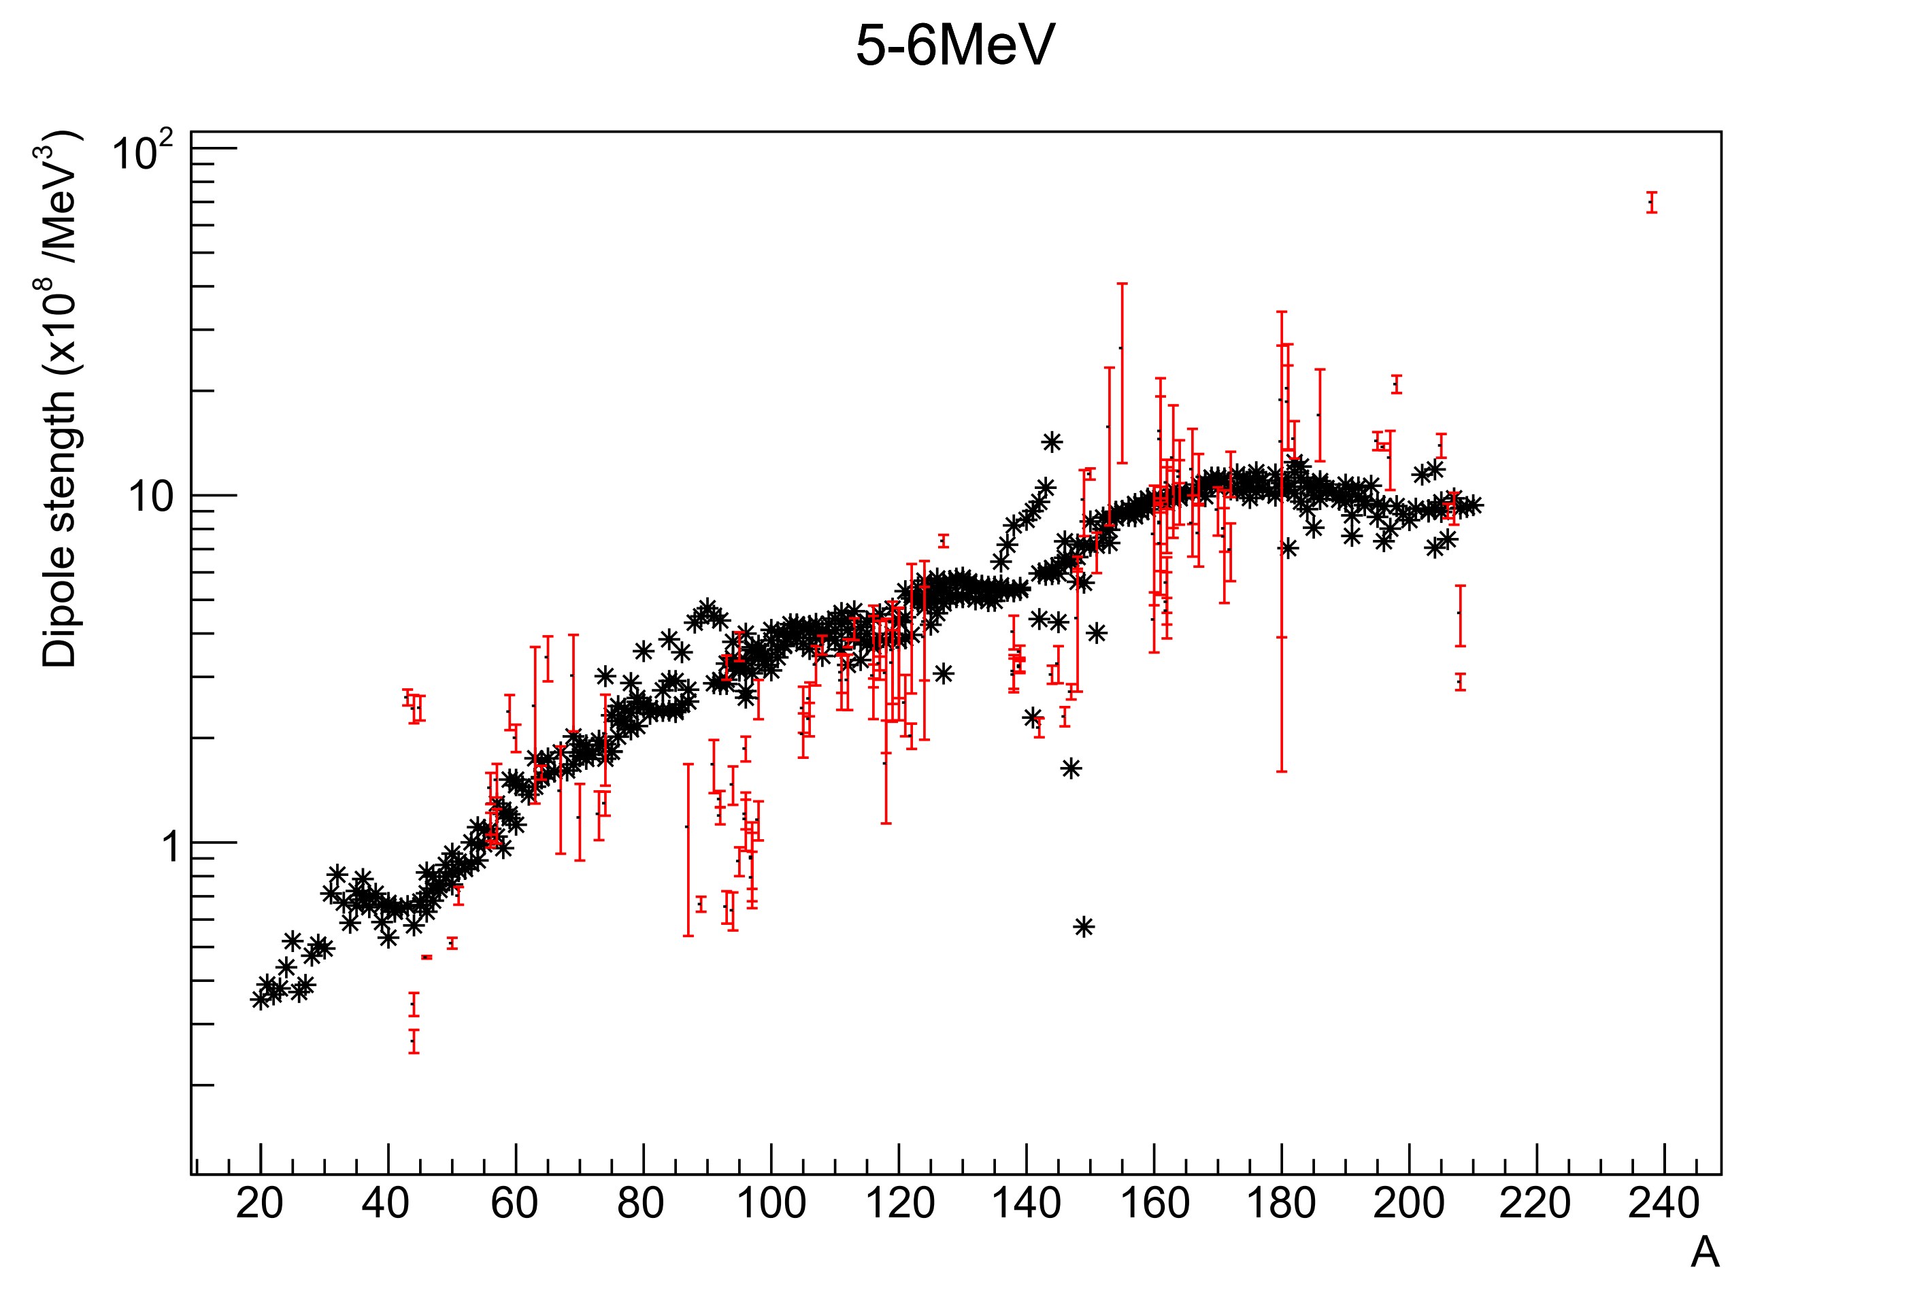
5-6 MeV
SMLO
D1M-QRPA
D1M-QRPA de-excitation

Slide 8
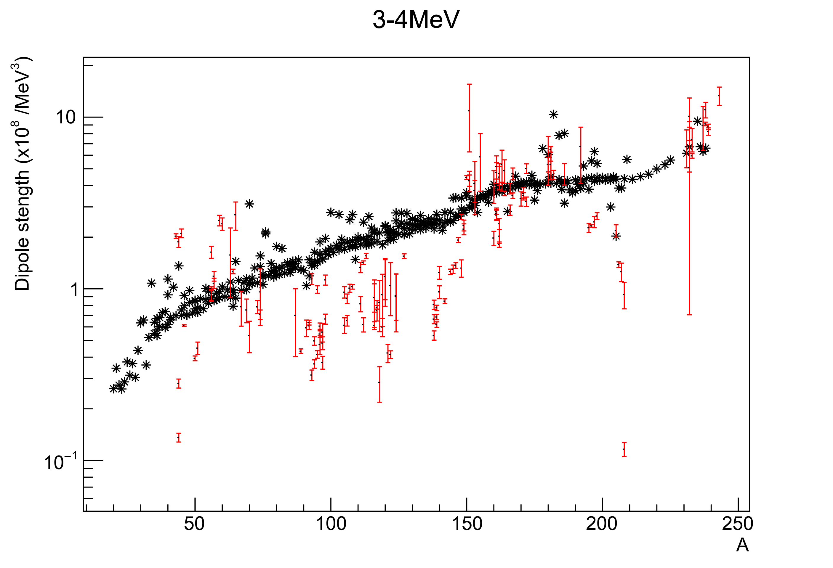
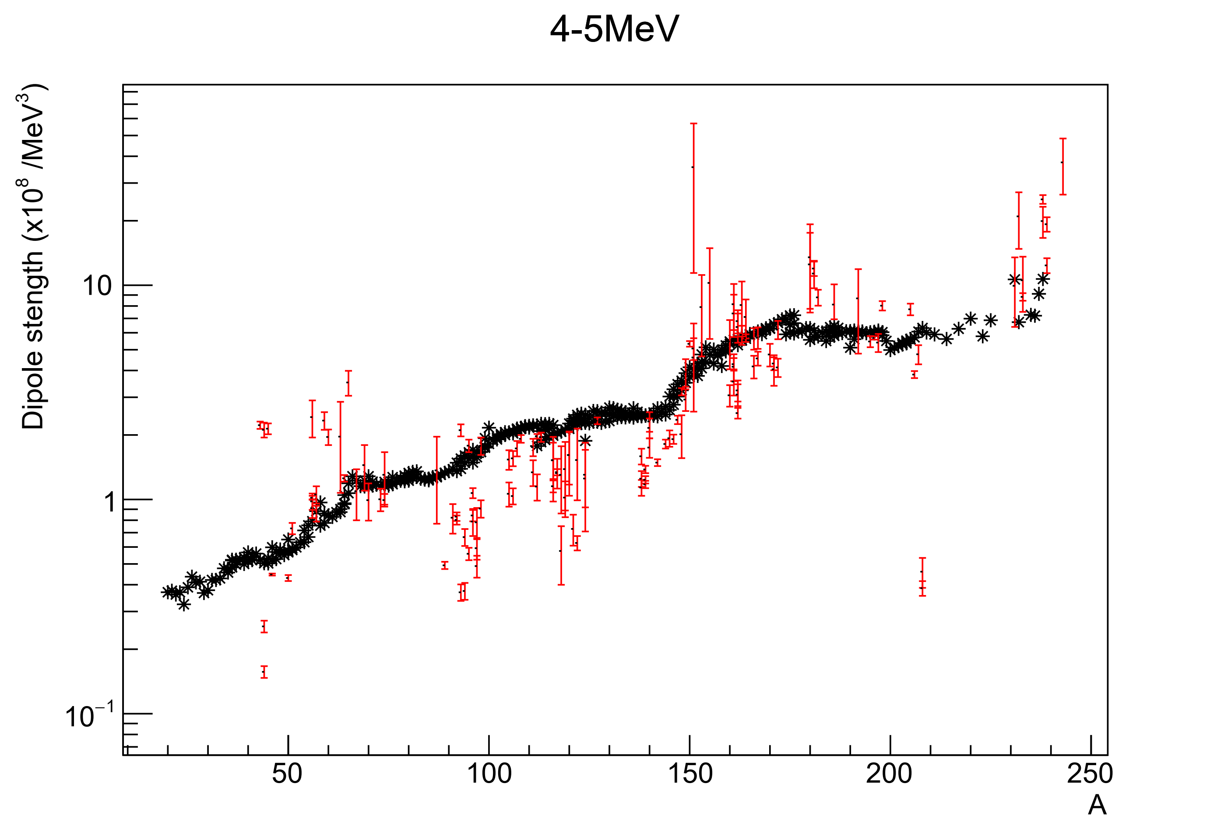
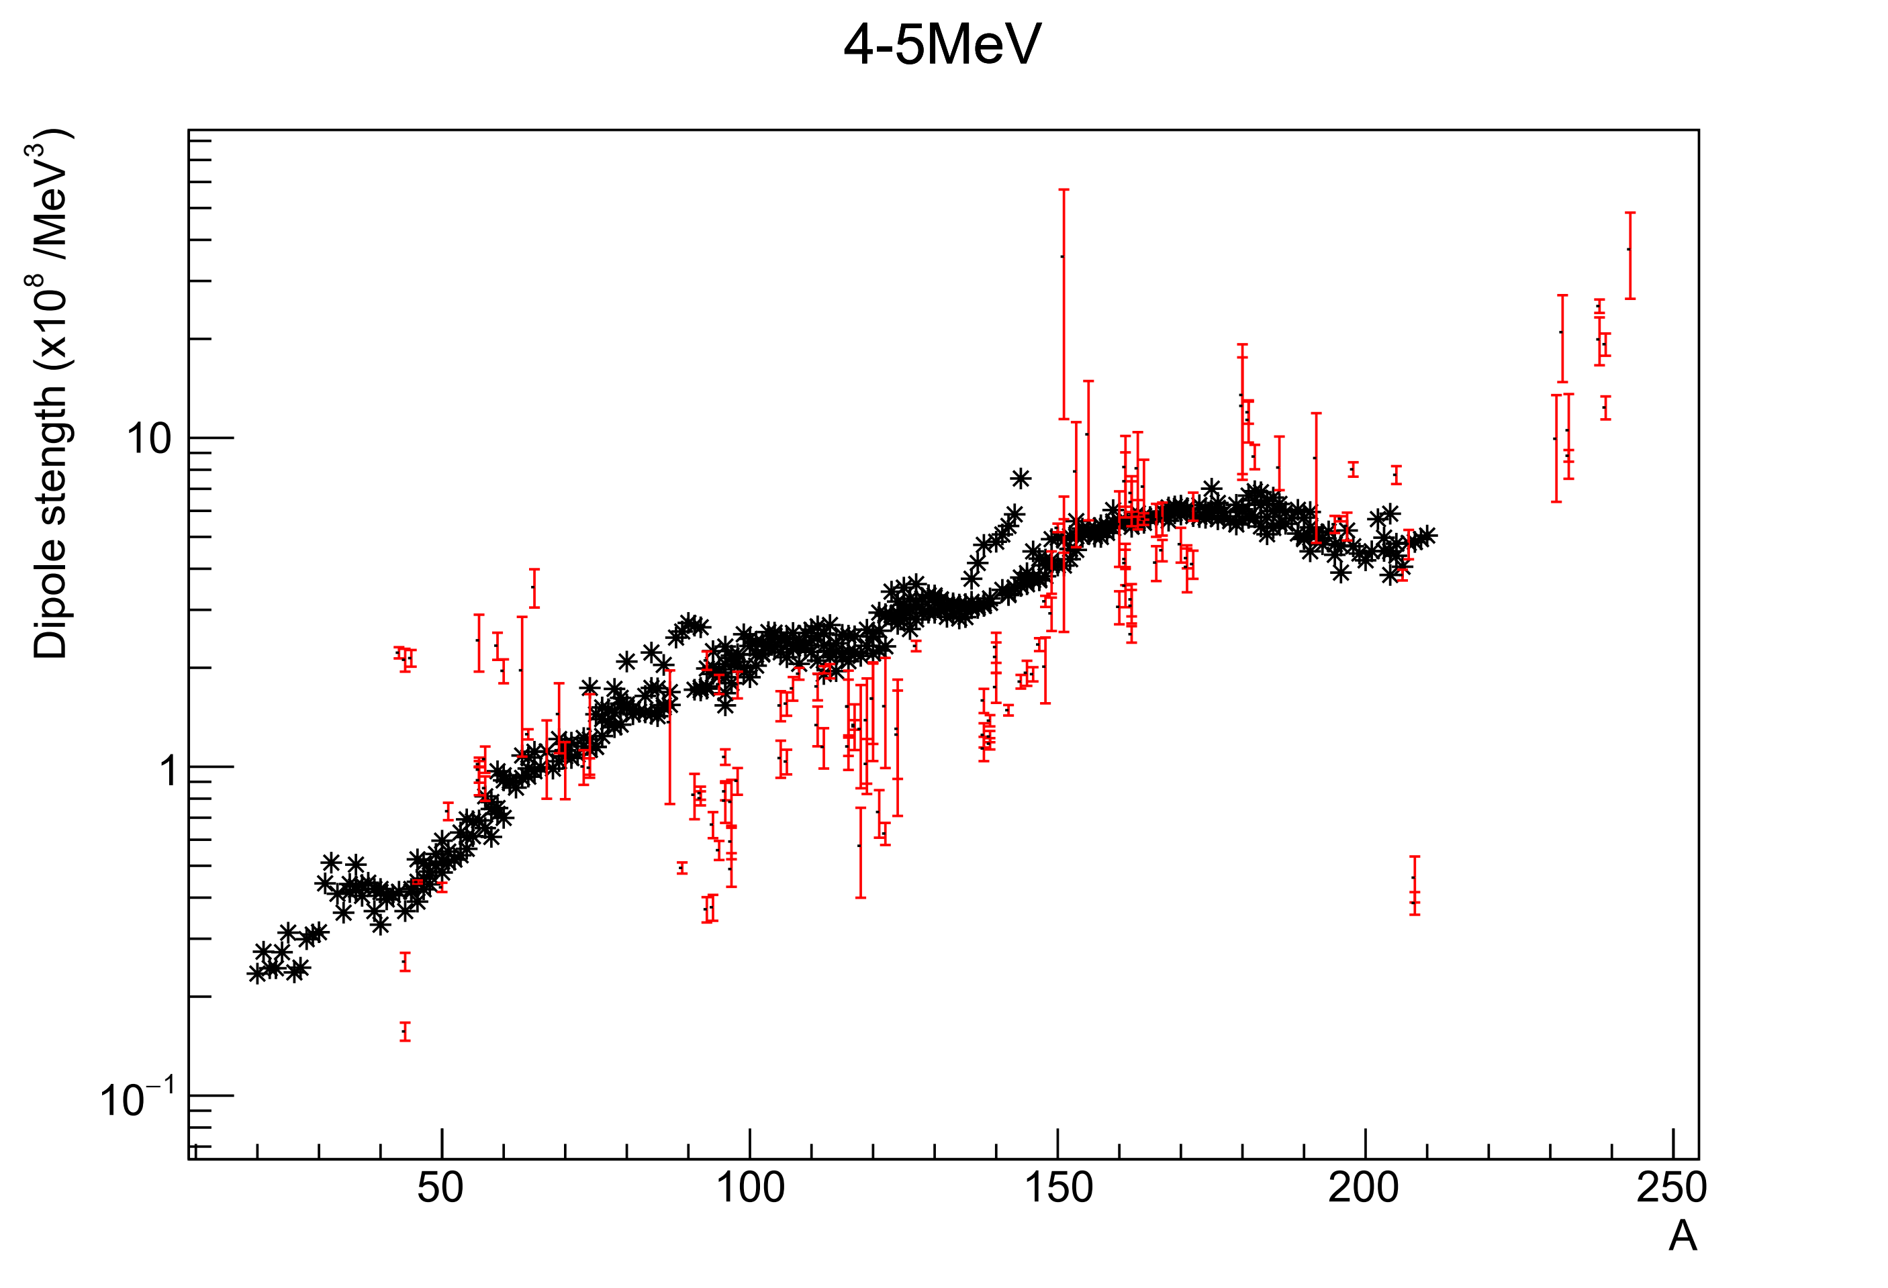
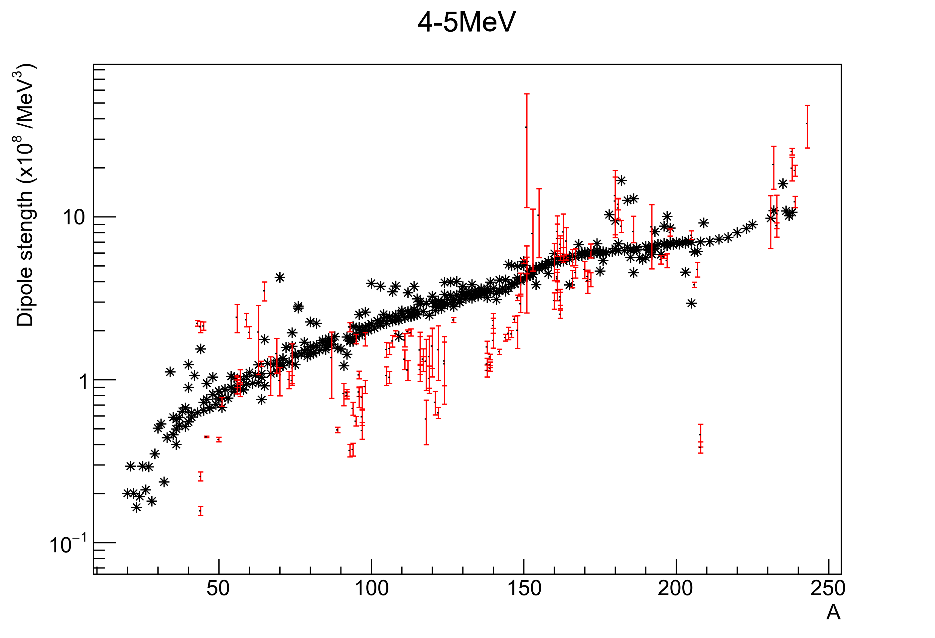
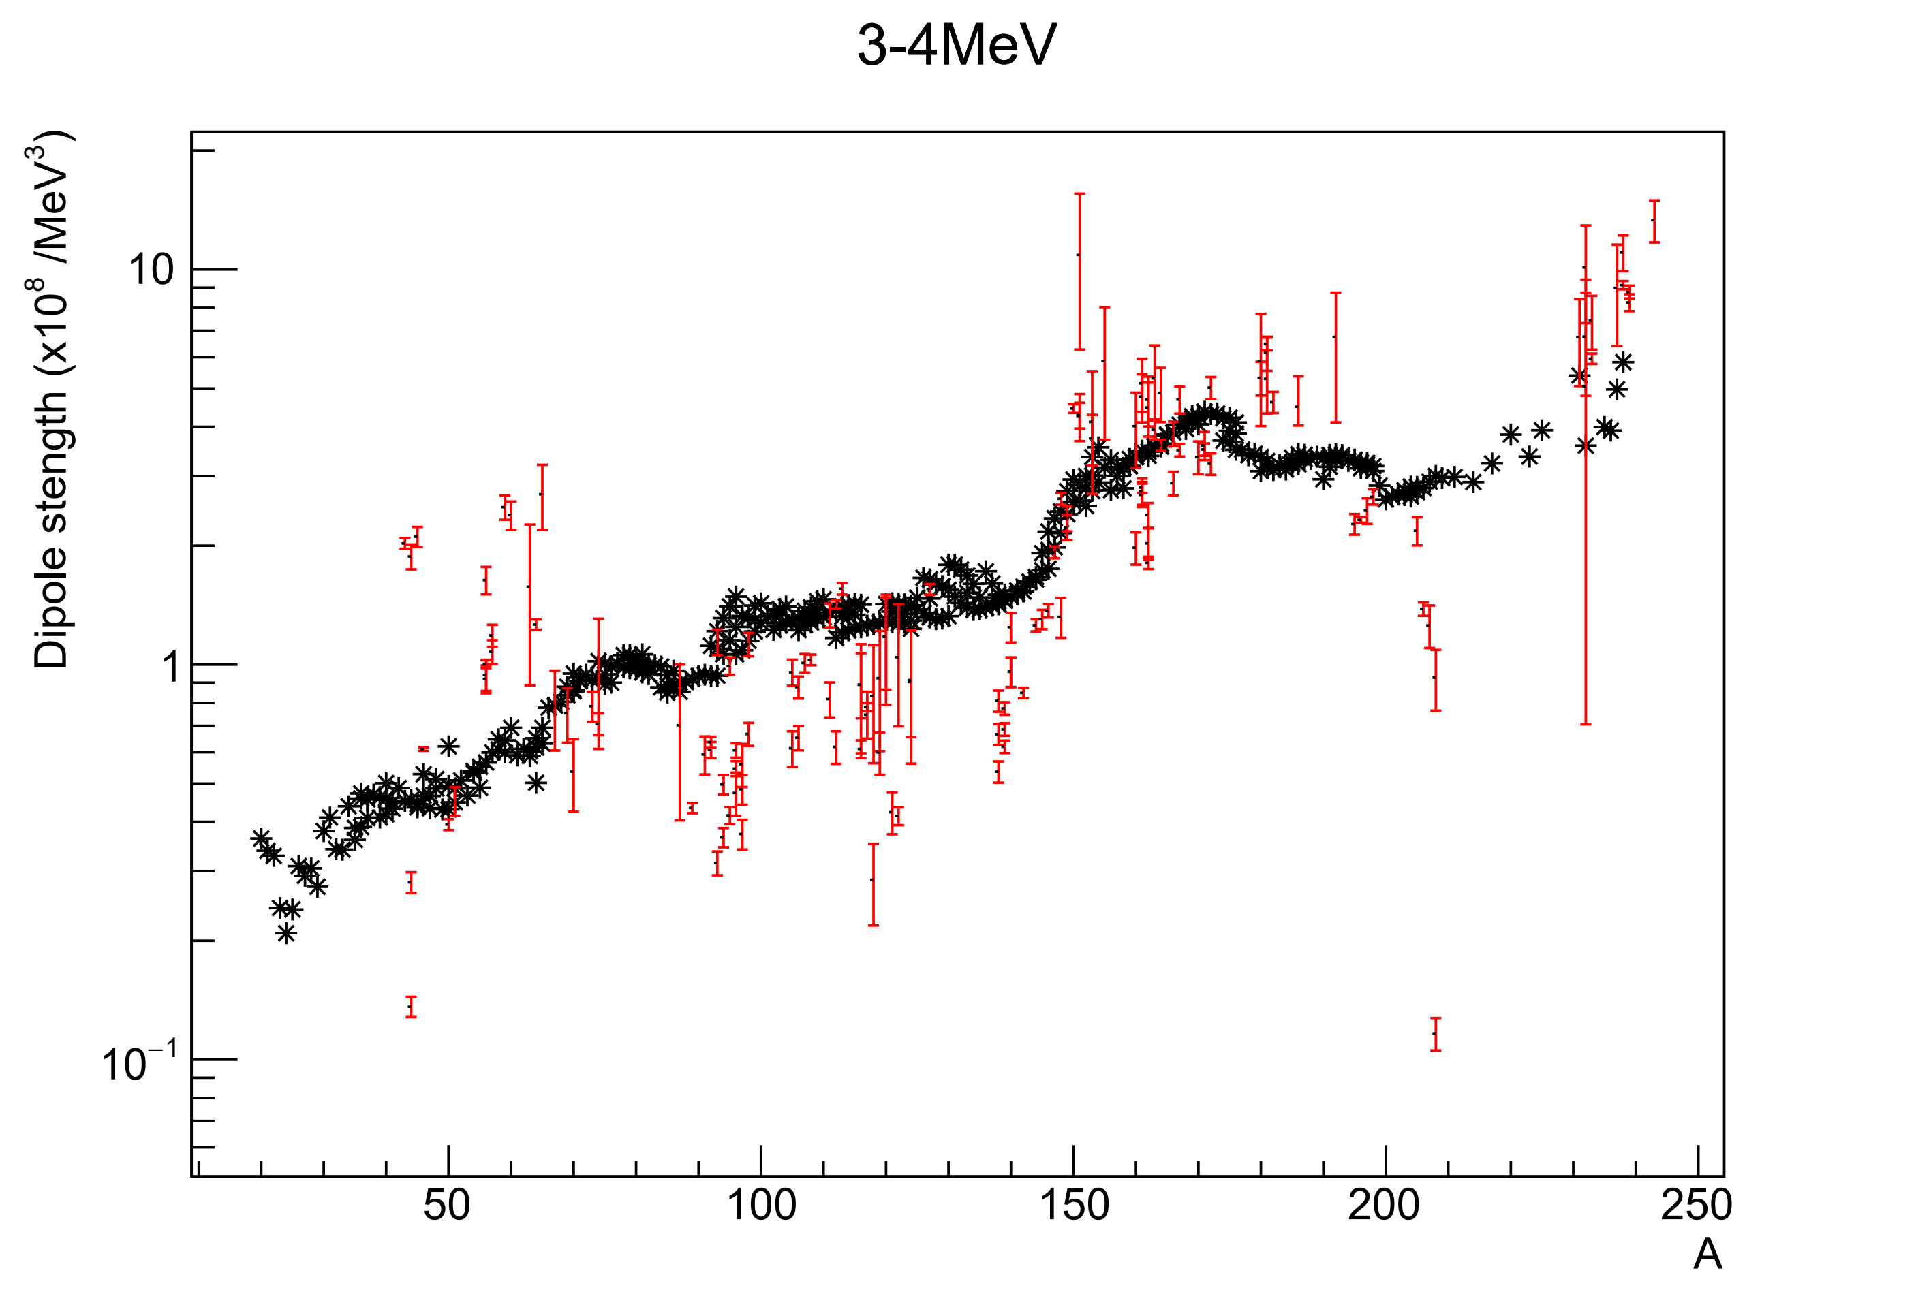
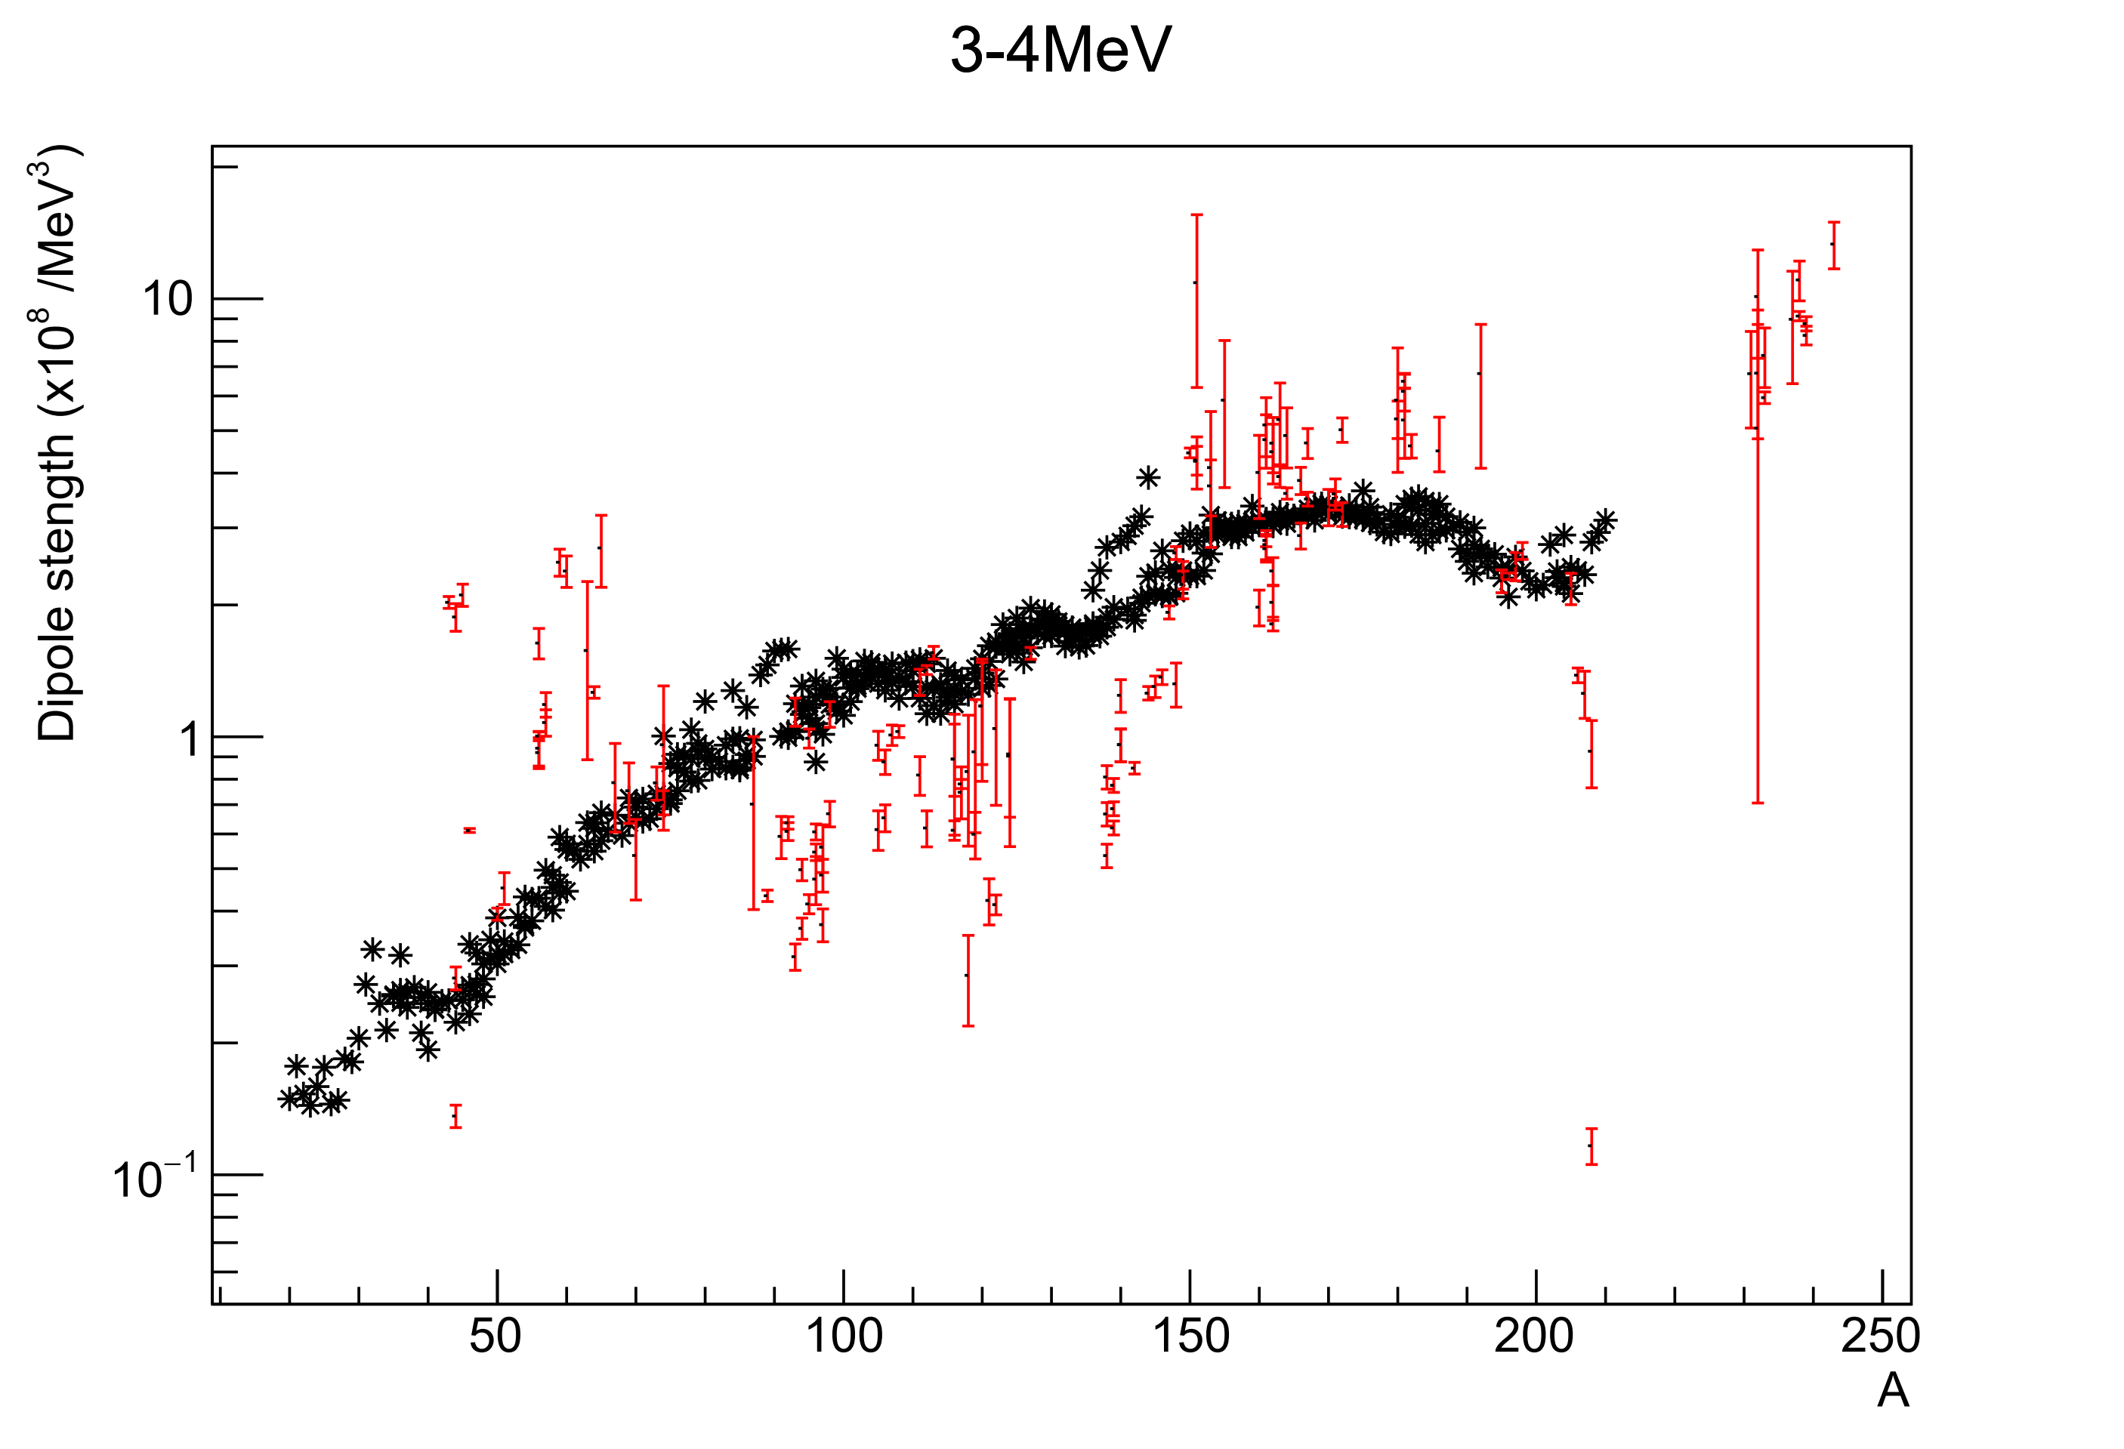
4-5 MeV
SMLO
D1M-QRPA
D1M-QRPA de-excitation

Slide 9
3-4 MeV
SMLO
D1M-QRPA
D1M-QRPA de-excitation

Slide 10
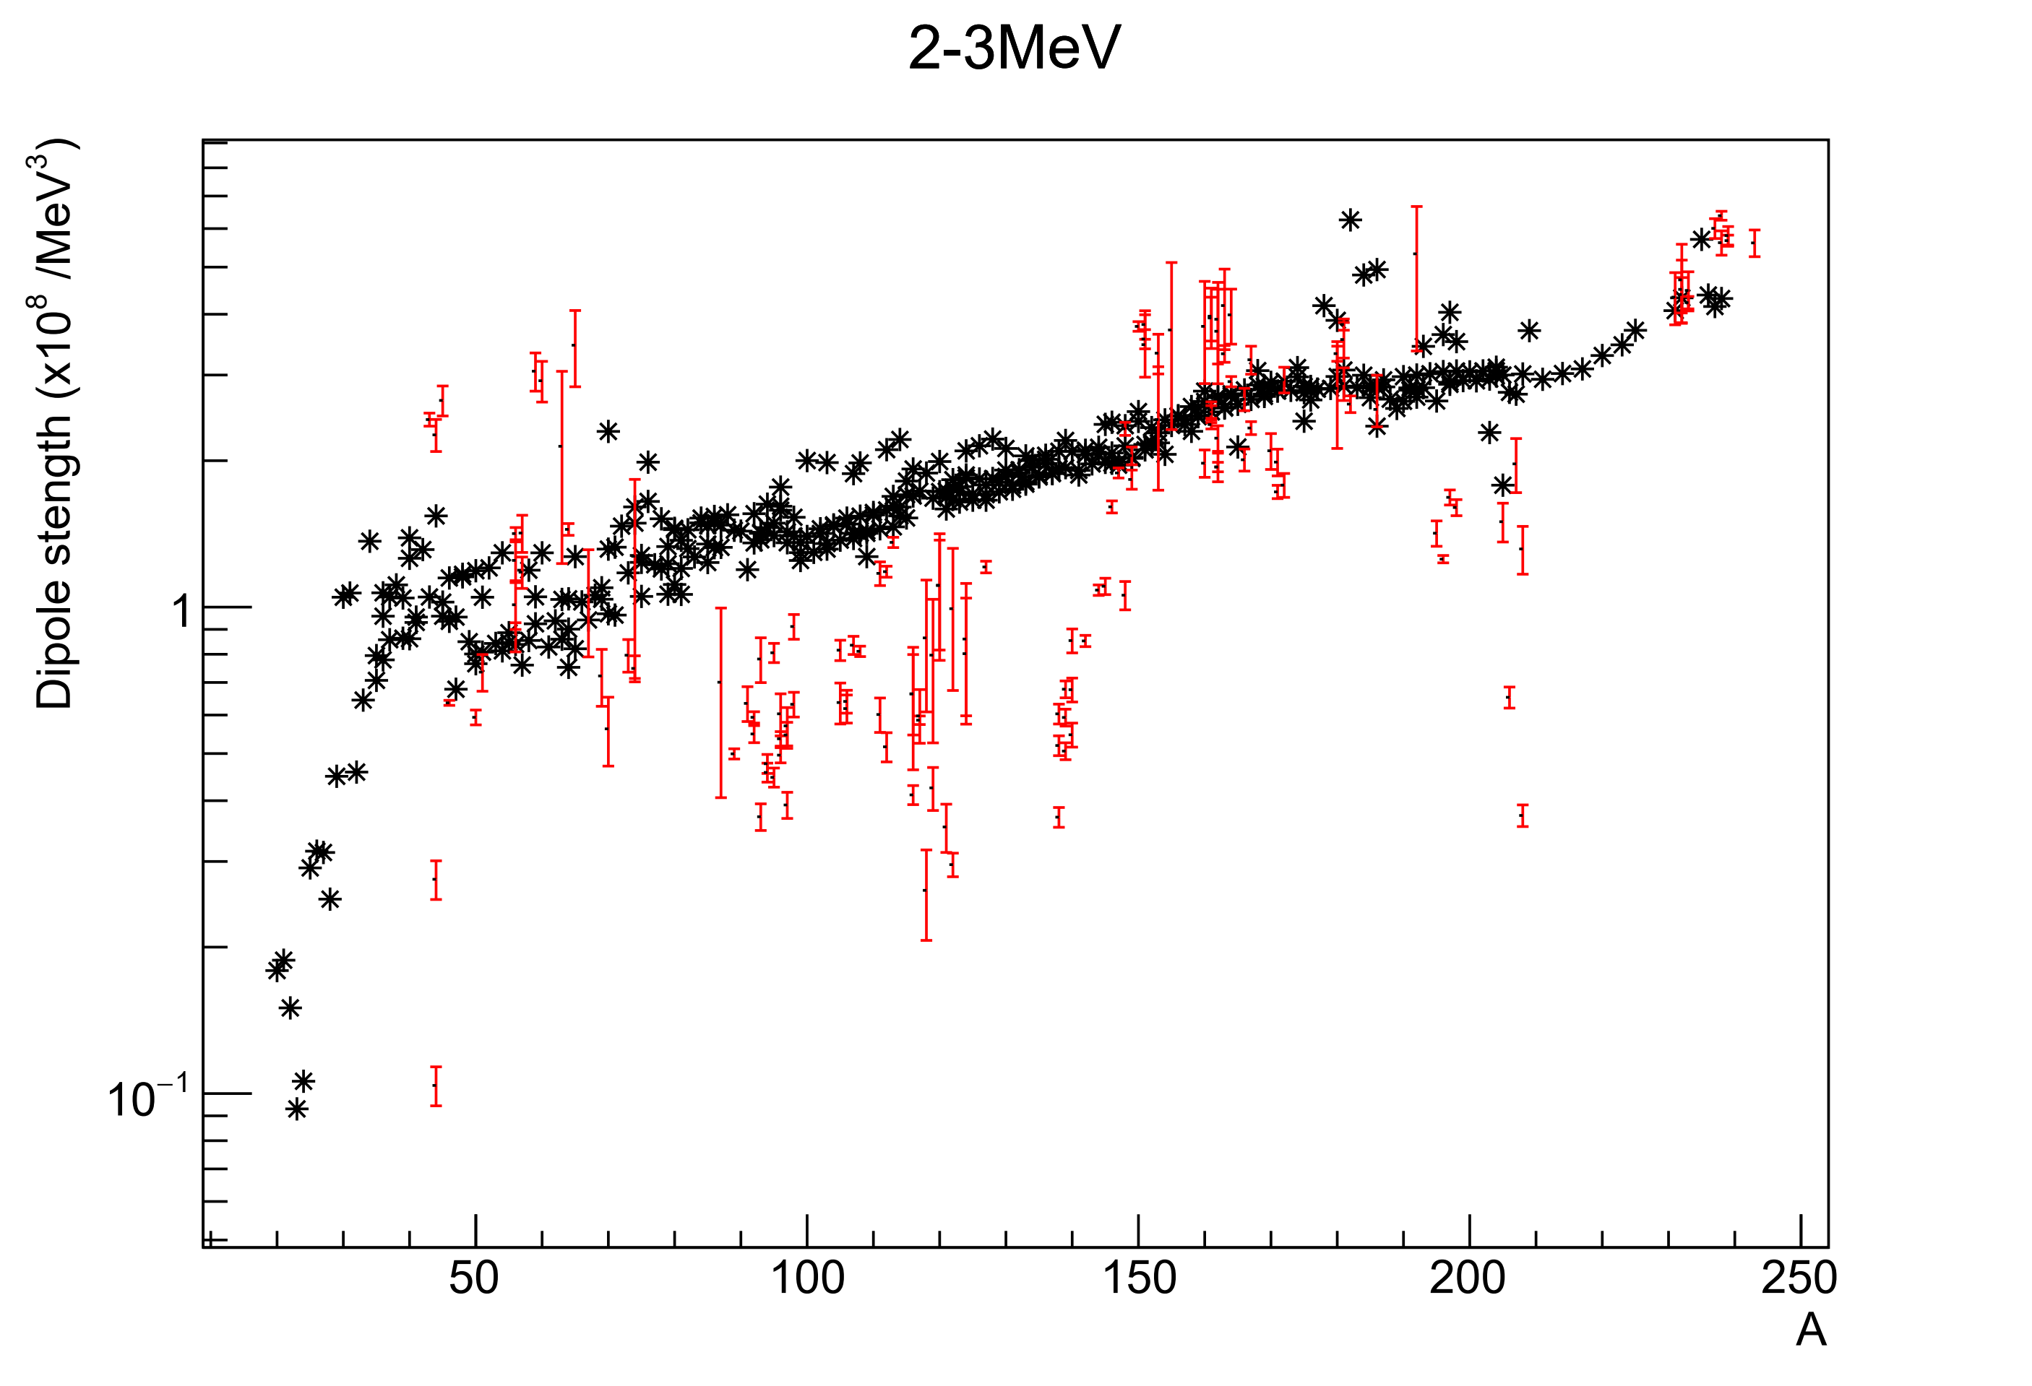
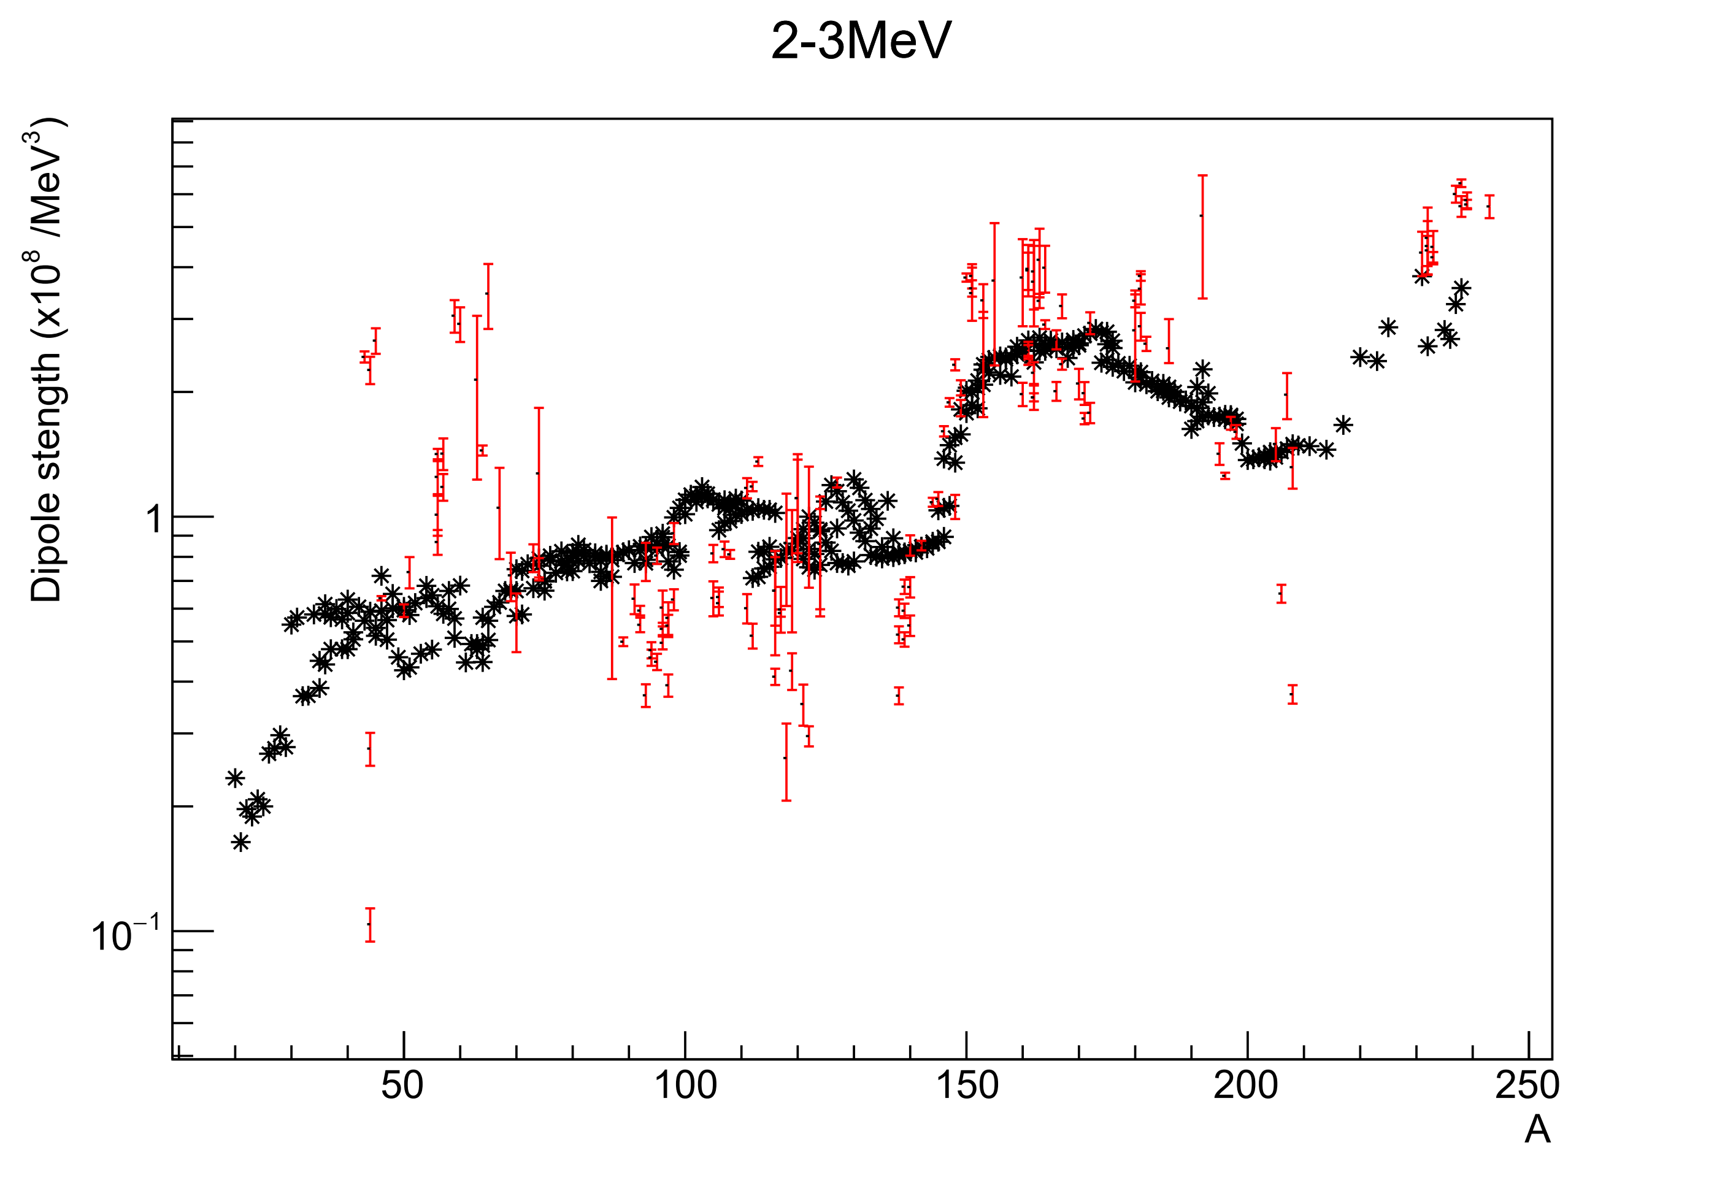
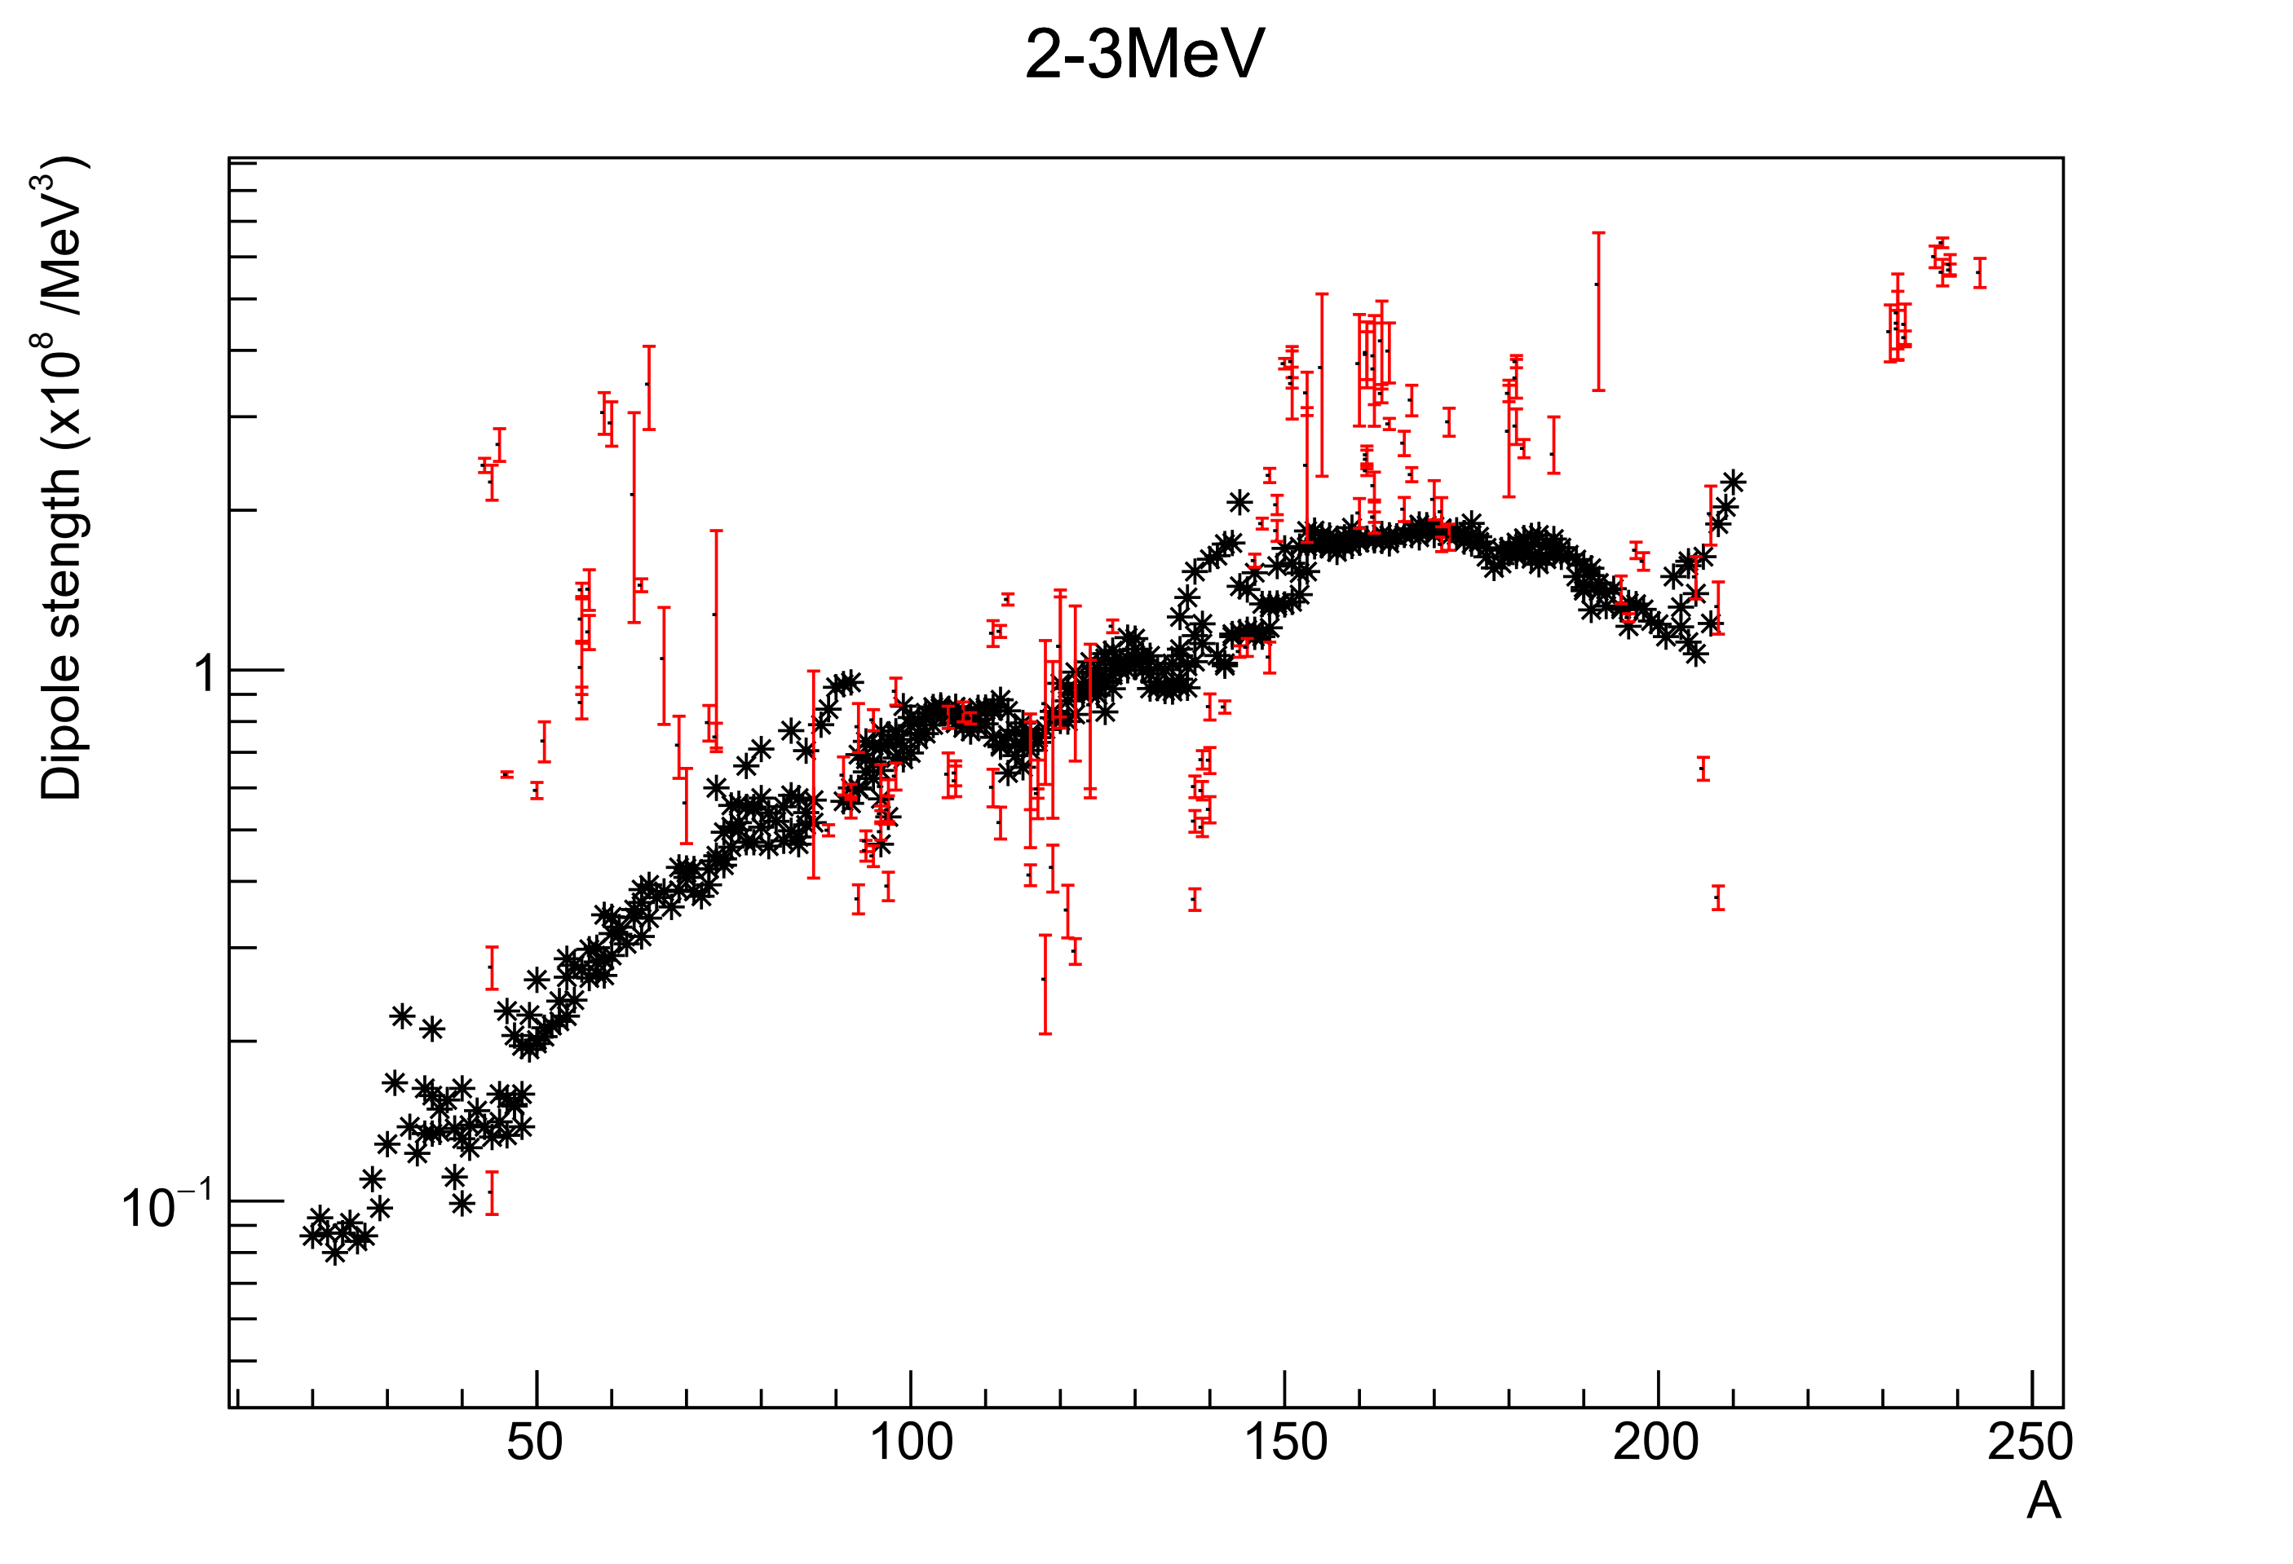
2-3 MeV
SMLO
D1M-QRPA
D1M-QRPA de-excitation

Slide 11
1-2 MeV
SMLO
D1M-QRPA
D1M-QRPA de-excitation

Slide 12
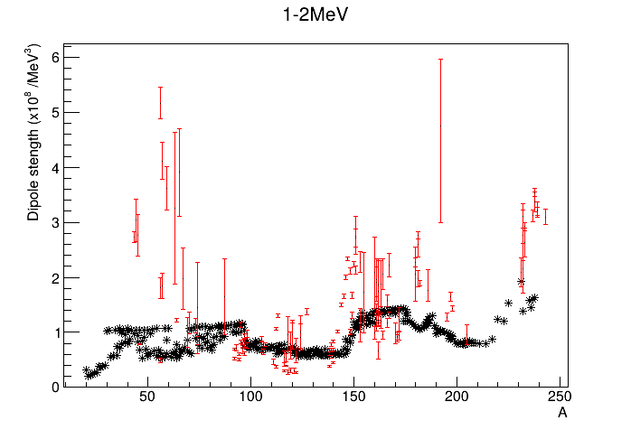
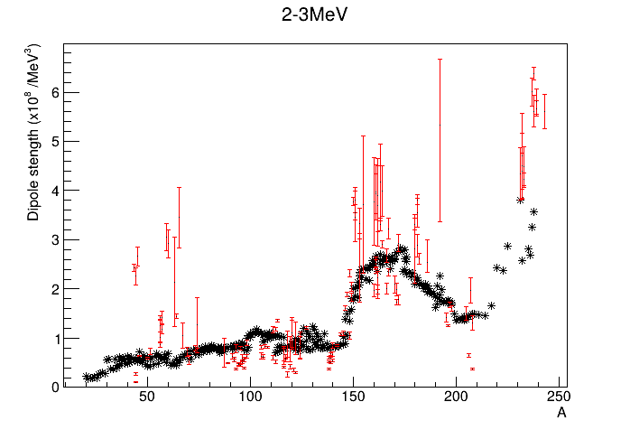
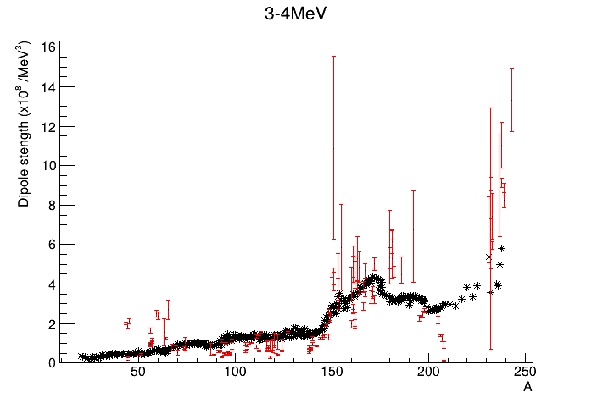
Some outliers (here showing D1M-QRPA)
Closed shells (Pb, Sn, A=82)
LEE underestimated A~50-65
Scissors A~150-180 + actinides

Slide 13
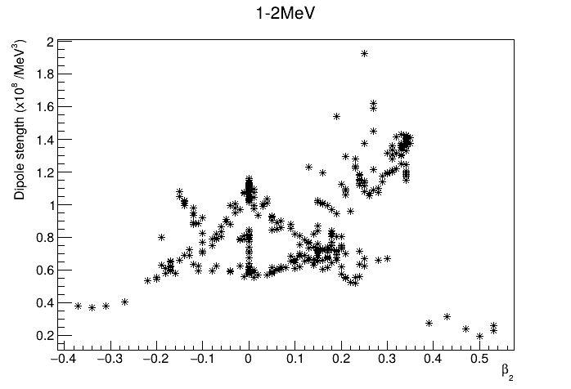
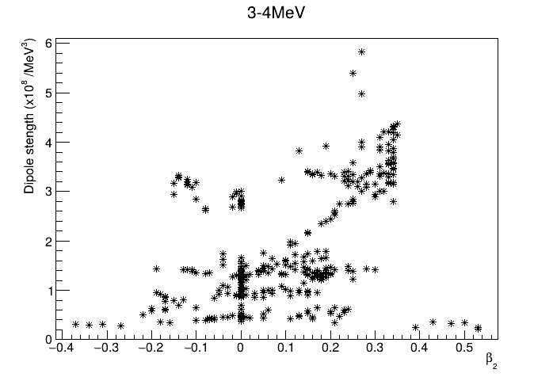
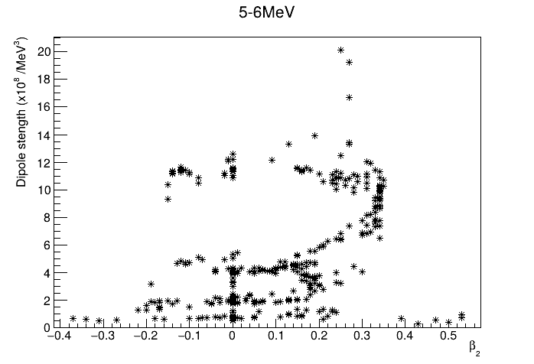

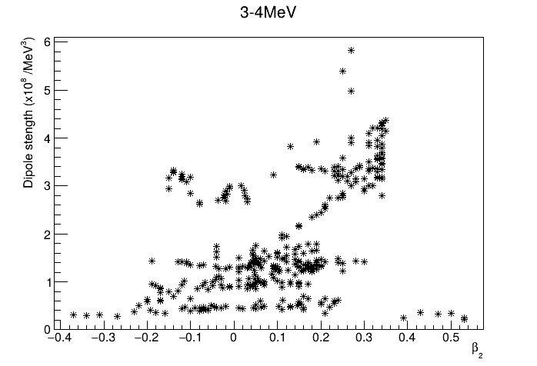
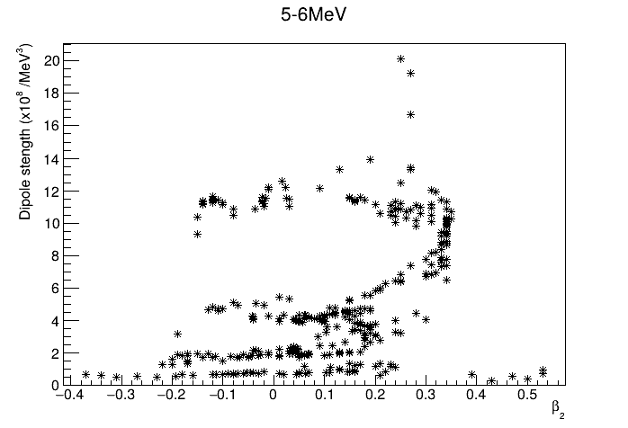
Strength vs deformation
Clustering of data as we increase gamma-ray energy

Slide 14
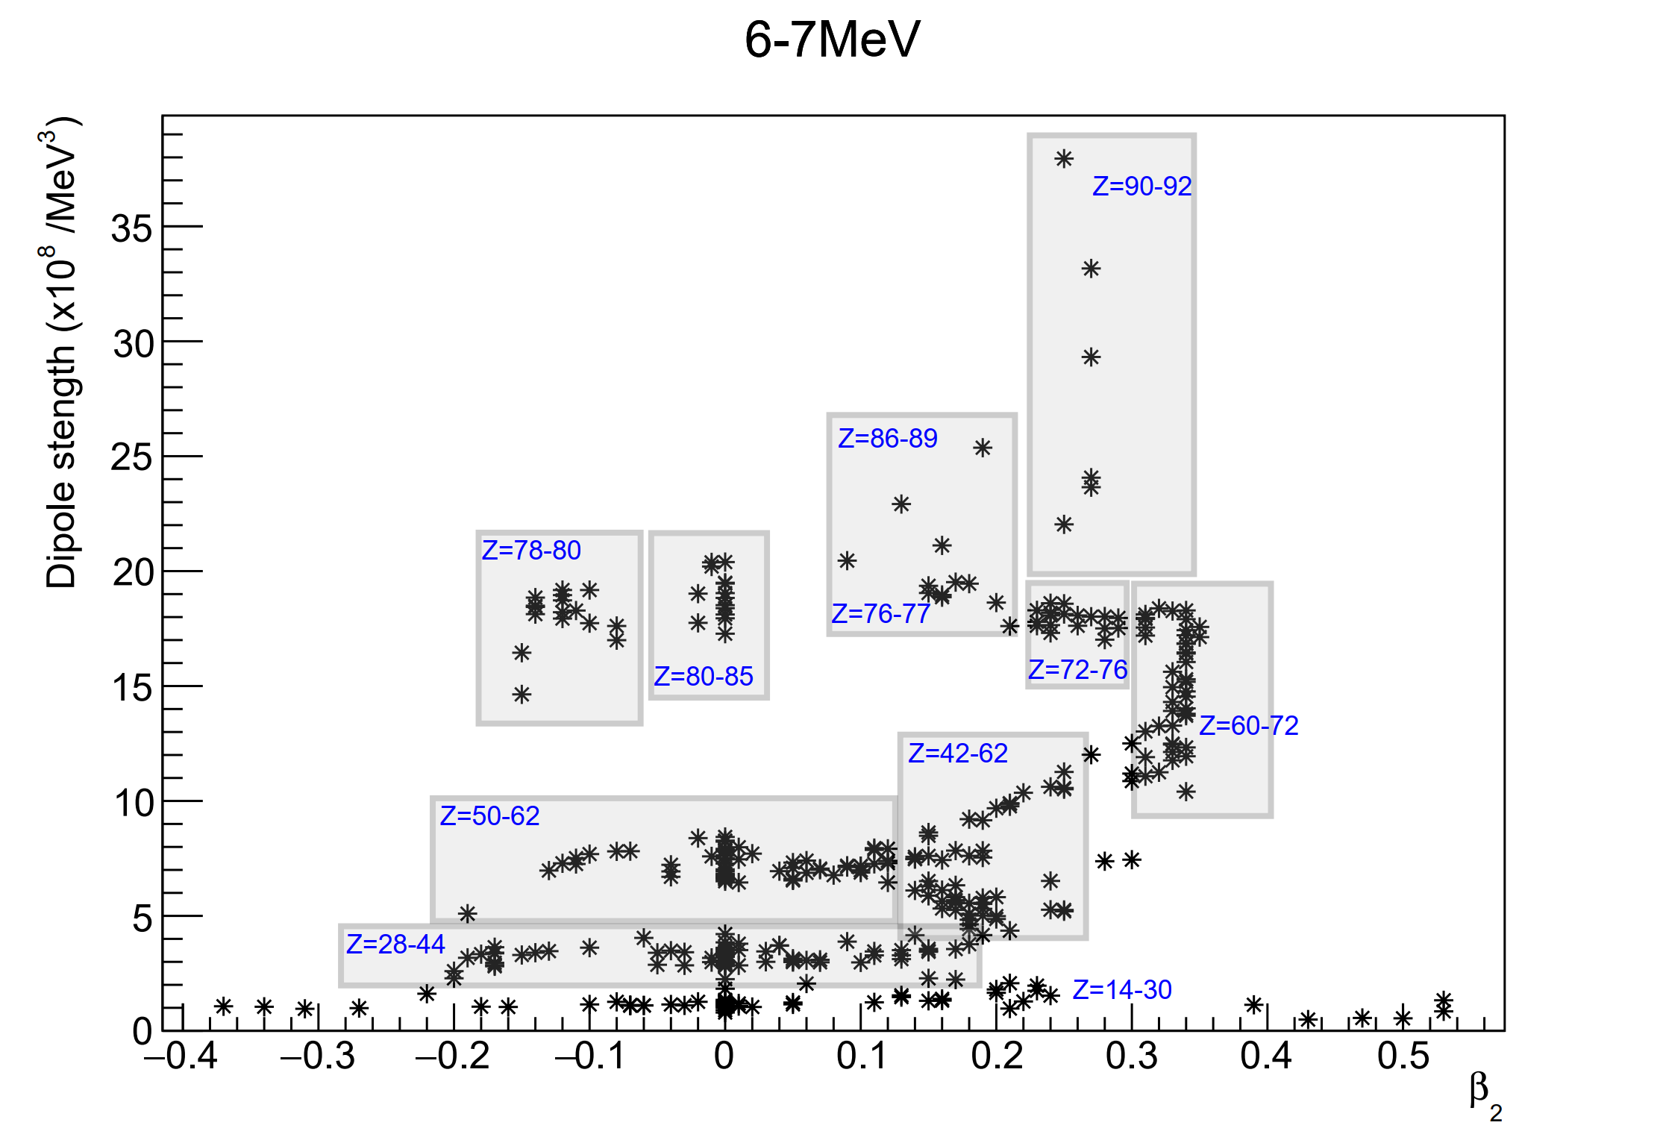
Z-dependent clusters (D1M)

Slide 15
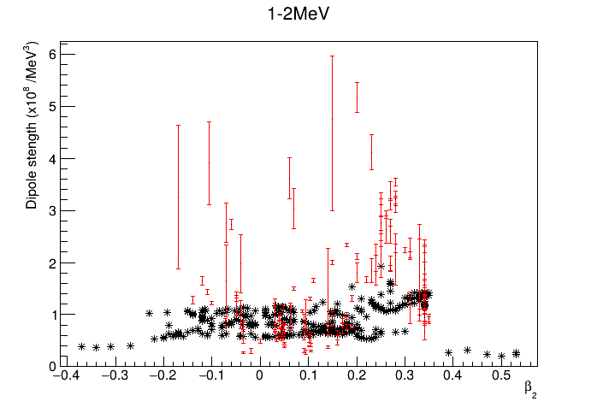
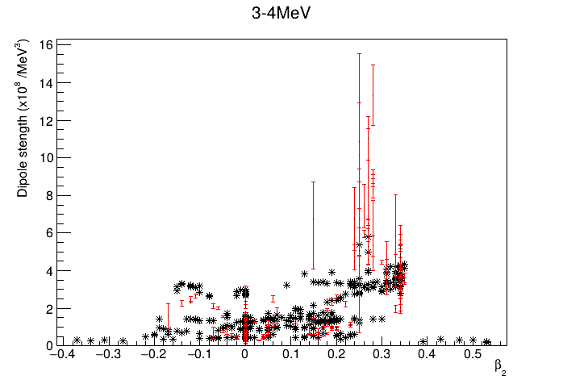
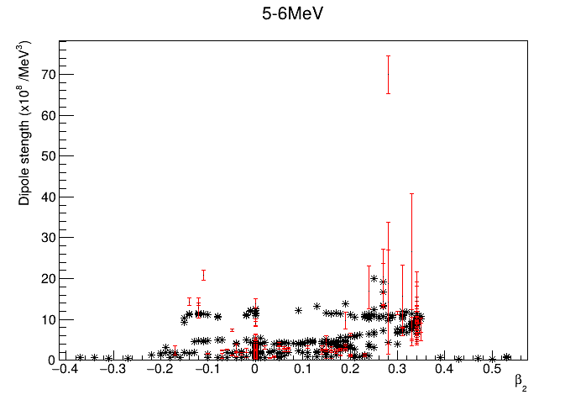
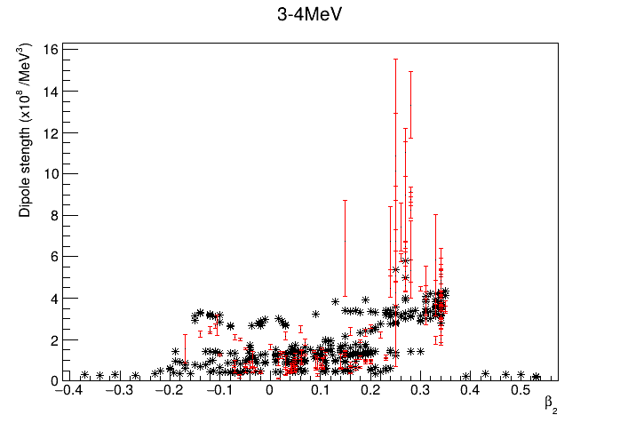
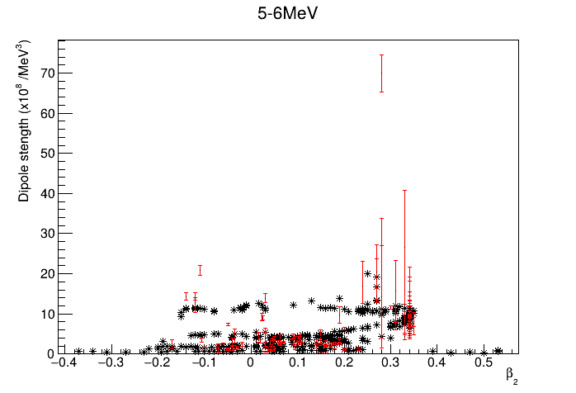
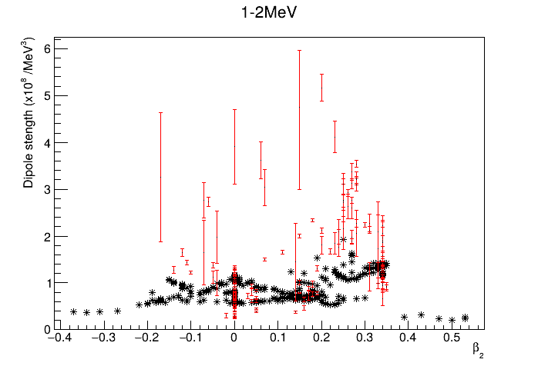
Strength vs deformation (D1M)
Overall, Oslo data follows similar clustering
In 3-4 MeV range
Z ~ 80-85: theory systematically overpredicts
Z~14-30 and actinides: theory systematically underpredicts

Slide 16
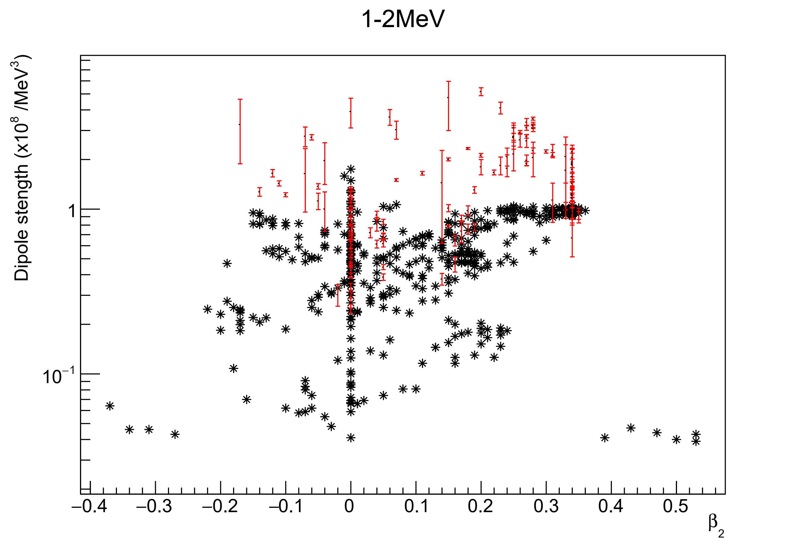
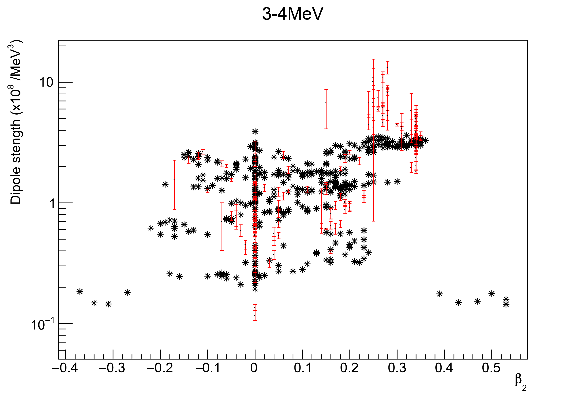
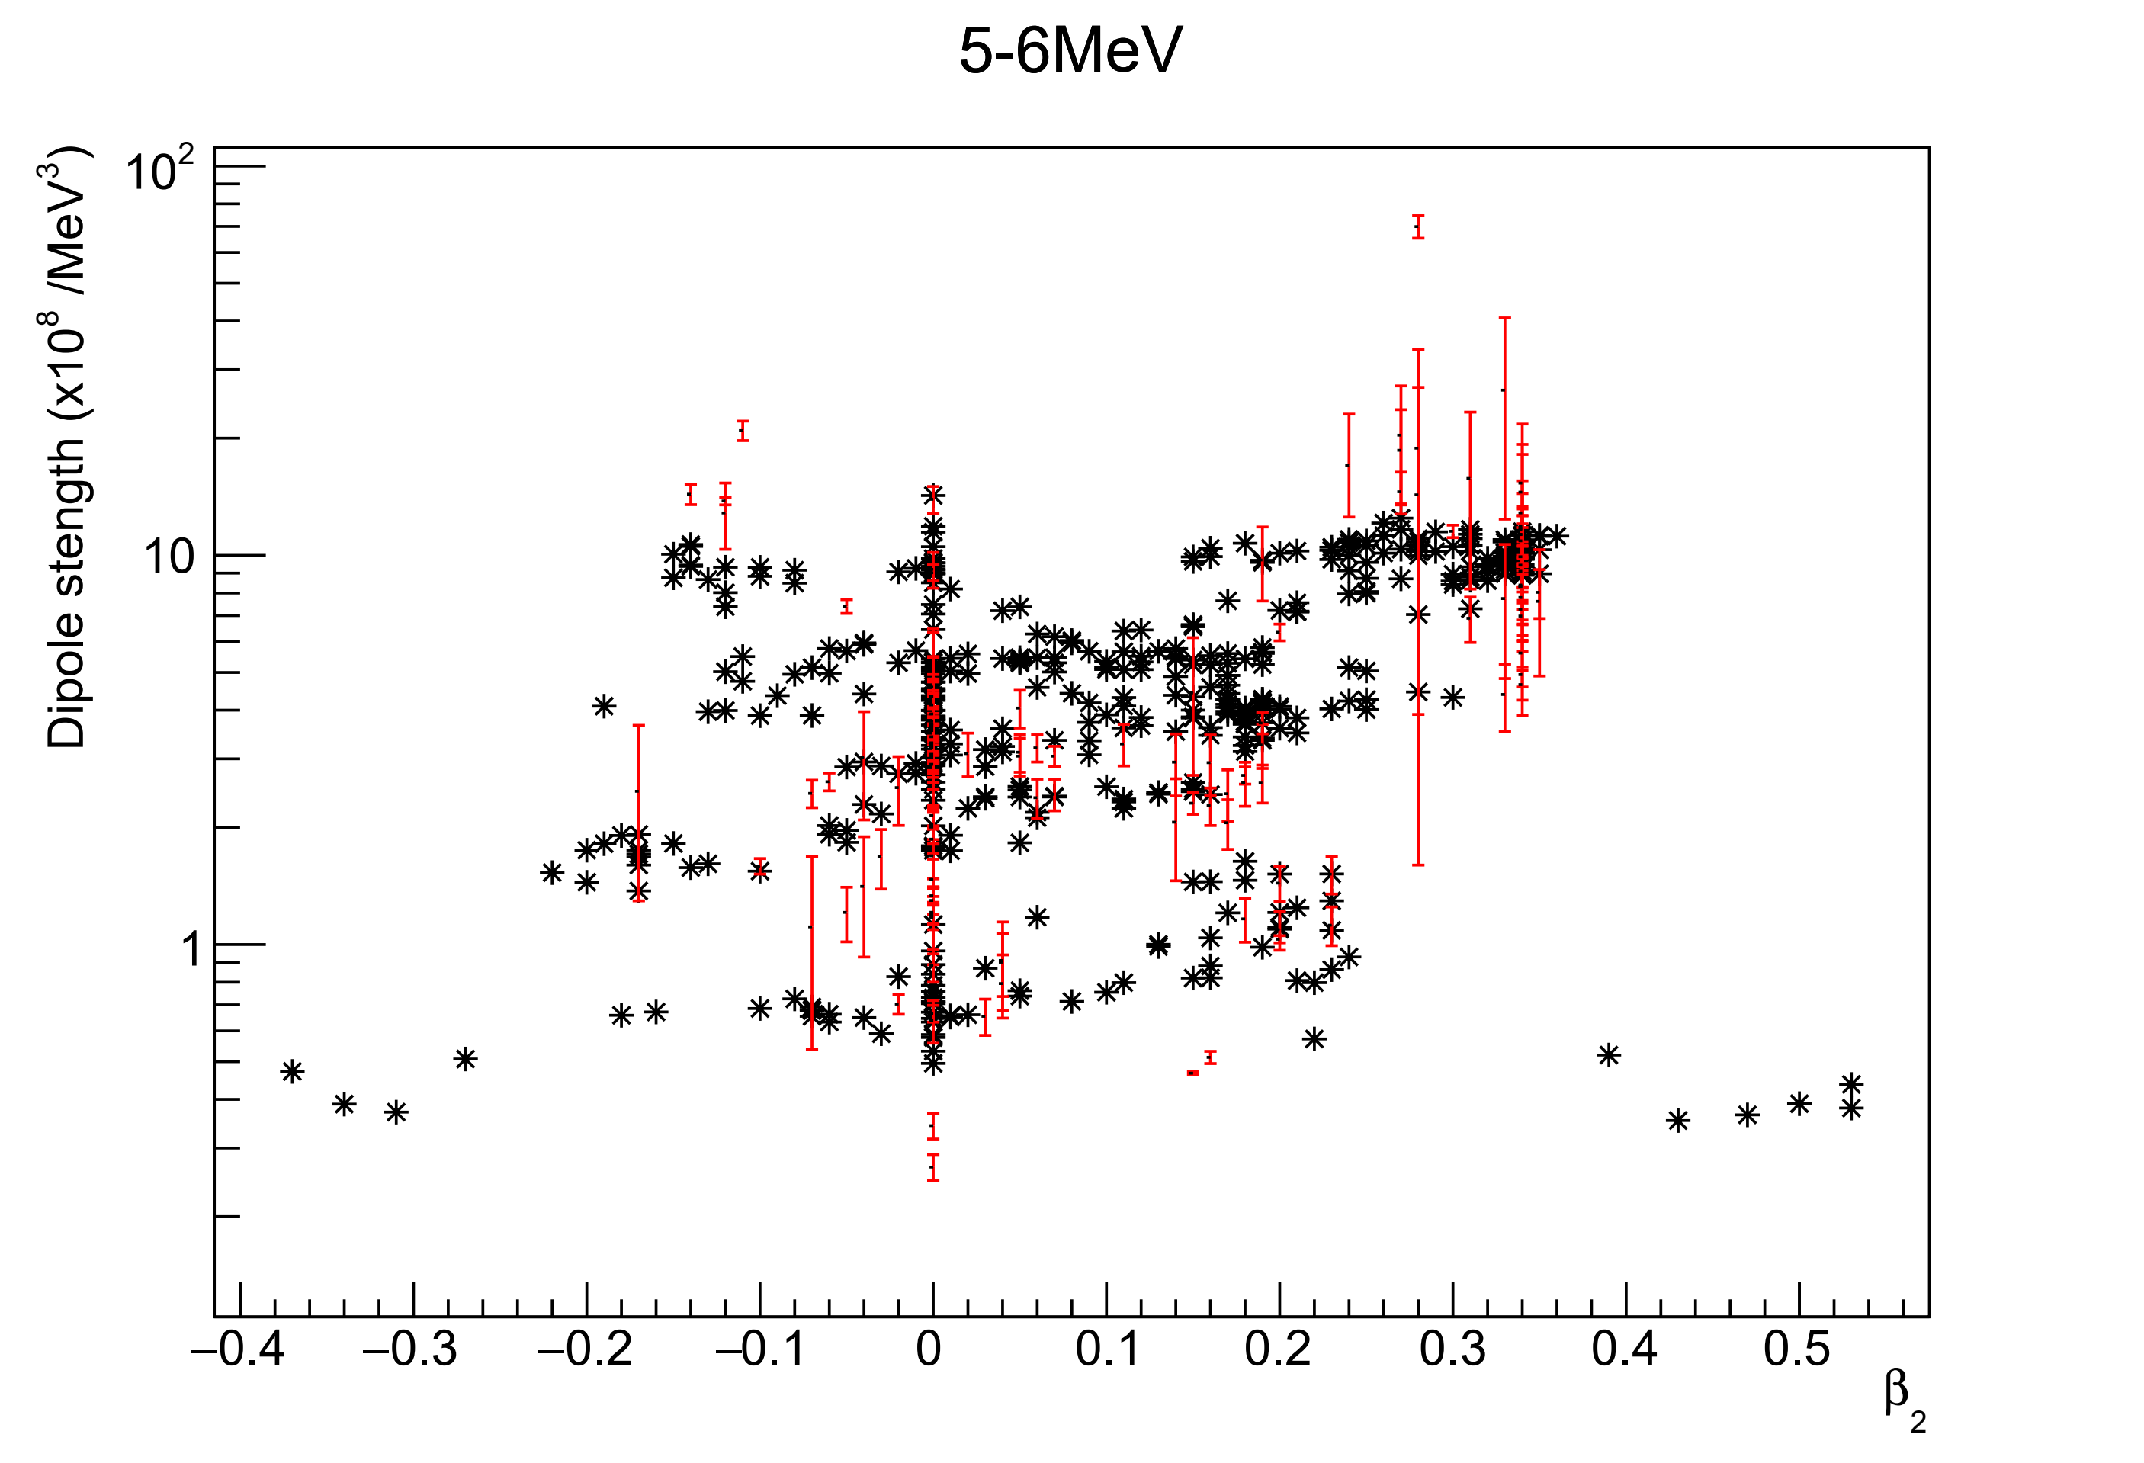
Strength vs deformation (D1M-QRPA de-excitation)
Overall, Oslo data follows similar clustering
In 3-4 MeV range
Z ~ 80-85: theory systematically overpredicts
Z~14-30 and actinides: theory systematically underpredicts

Slide 17
Summary
Compared PSF data from Oslo type measurements to theoretical models
Introduced Quality Indicators (no clear correlations but let’s not discard them just yet)
➔ re-evaluation of D0 as part of the NLD collaboration ➔ spin distribution assumption – can this be improved?
Identified outliers – look at it on case-by-case basis
Theory underestimate Low Energy Enhancement (LEE) and Scissors Mode (SM)
Interesting clustering as a function of deformation ➔ could improve phenomenological description of LEE and SM

