Slide 1
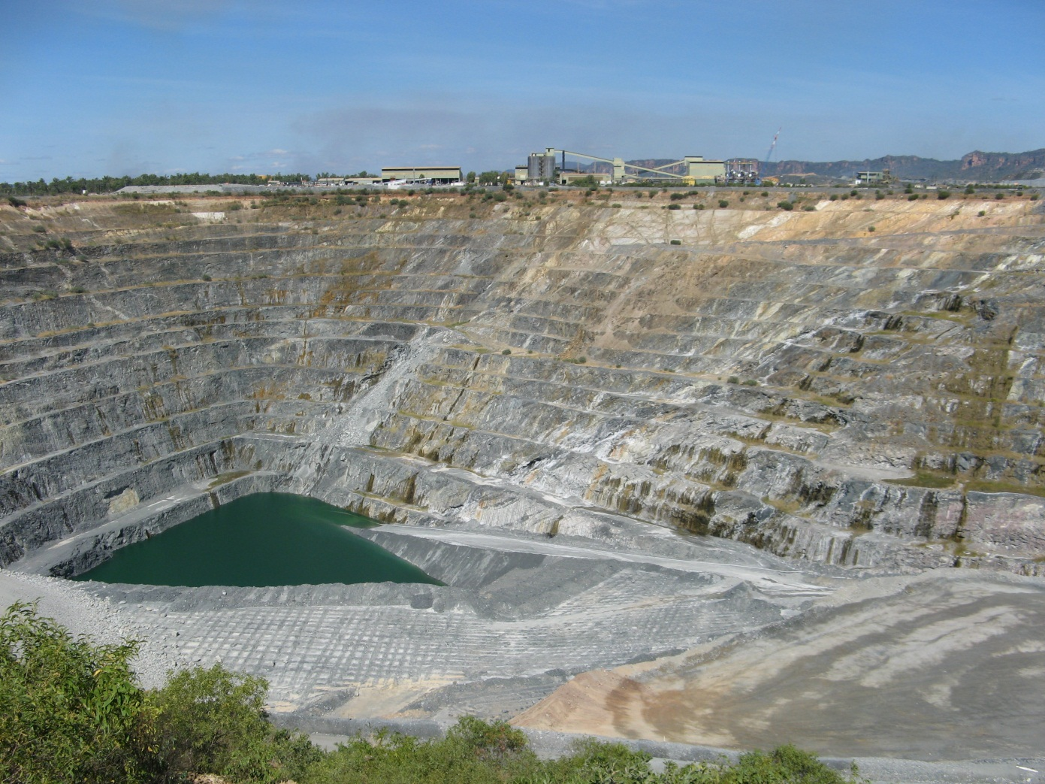
Methods of Mineral Potential Assessment: A Mineral Systems Approach
Ranger

Slide 2
Outline
Mineral potential assessment
  Methods of assessment (mineral potential, prospectivity, and favourability maps)
Mineral-systems approach
  definition, advantages and disadvantages
Lessons learnt and not learnt

Slide 3
Mineral potential
Likelihood that an economic mineral deposits could have formed in the area
Probabilistic approach to mineral deposits instead of deterministic
Probabilities are conditional
  on geological processes occurring in an area
  on geological features indicative of those processes
Probability of sandstone-hosted uranium deposits in an area
  process: transport of U
  geological features: leachable source of U; permeable sandstone; hydrogeological gradient

Slide 4
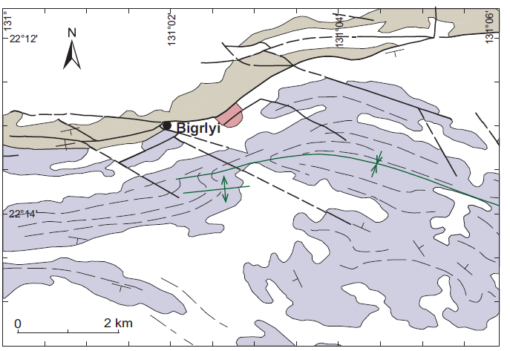
Methods of assessment (Quantitative)
Delineate areas permissive for a deposit
Estimate number of deposits
Estimate tonnage of metals at different probabilities
Methods: NURE; 3-part USGS; Deposit density etc
probability | 90% | 50% | 10%
Uranium (t) | xx | yy | zz

Slide 5
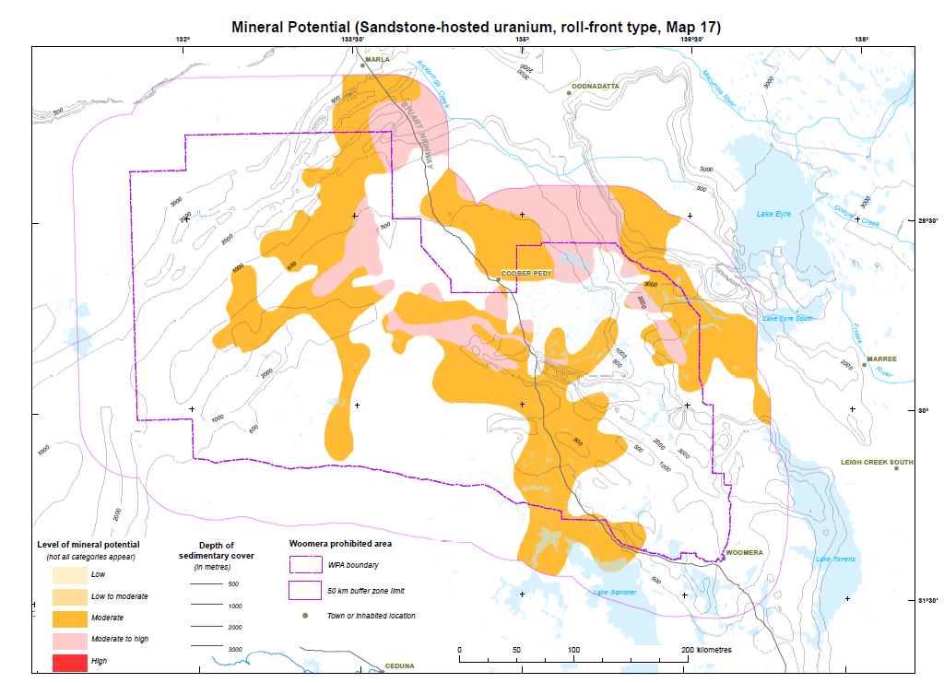
Methods of assessment (Qualitative)
Delineate areas permissive for a deposit
Estimate and assign probabilities
  Non-numerical (high, moderate, low)
  Ordinal (numbers expressing ranking)
  Cardinal (numbers expressing quantities); can be computed by probability equations

Slide 6
GIS methods of assessment
Methods are not quantitative but the method of visualisation is quantitative
Produce favourability or prospectivity maps by estimating probabilities
Dominantly data-driven and ‘objective’
Techniques (see Bonham-Carter, 1994):
  Boolean logic
  Index overlay
  Bayesian (Weights of evidence)
  Fuzzy logic

Slide 7
Which method and why
  Depends on the purpose/aim/objective
  For regional-scale exploration targeting
    qualitative (GIS-based)
  For local-scale brown-fields exploration
    qualitative (GIS-based)
  Competing land-use decisions
    quantitative
    qualitative
  For mineral endowment and inventory
    quantitative
Prospectivity map
Favourability map
Mineral potential
map

Slide 8
Essential for qualitative and quantitative methods
Delineation of permissive or favourable areas
Using
Features essential for a fertile mineralising process
Identified in
Mineral deposit models/types
Or
Mineral-systems

Slide 9
Mineral system: initial concept
Wyborn et al (1994)
Australian Proterozoic mineral system: essential ingredients and mappable criteria
“All geological factors that control generation and preservation of mineral deposits …”
Stress on “Processes”
Analogous to Petroleum Systems
Emergence of Relational Databases and GISs

Slide 10
Seven important geological factors
Source of fluids and ligands
Source of metals and other components
Migration pathways (inflow and outflow zones)
Thermal gradients
Source of energy to transport fluid and metals
Mechanical and structural focusing mechanism at the trap site
Chemical and/or physical cause for precipitation at the trap site

Slide 11
Mineral system (Knox-Robinson & Wyborn, 1997)
source-pathway-trap paradigm

Slide 12
Mineral potential assessment method
Features
Of
Mineral System
combining 2 approaches
Mineral System
+
Probabilistic
Setting
Source
Metal
Ligand
Energy
Assess
mineral
potential
(by computing
probabilities)
Identify
mappable
geological
features
Assign
probabilities to
mappable features
Pathway
Trap:
Mechanical
Chemical
Timing
Map:
prospectivity,
favourability,
mineral potential
Preservation

Slide 13
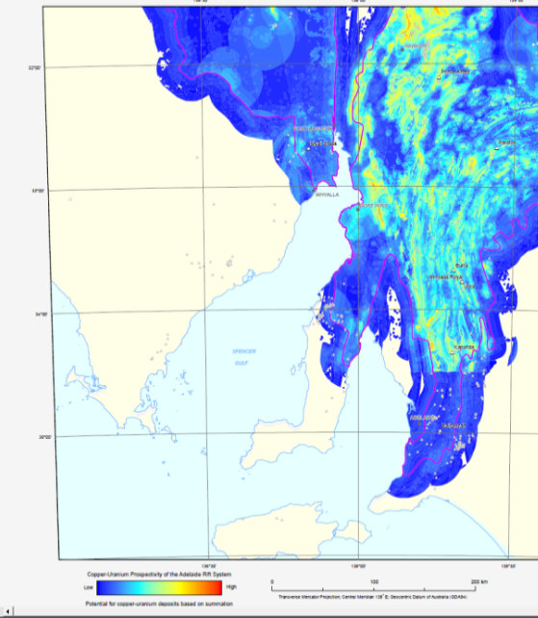
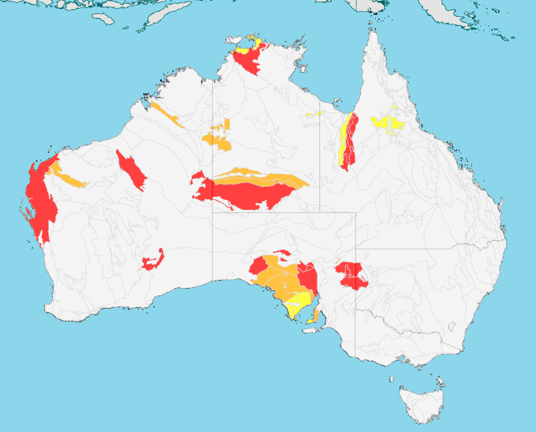
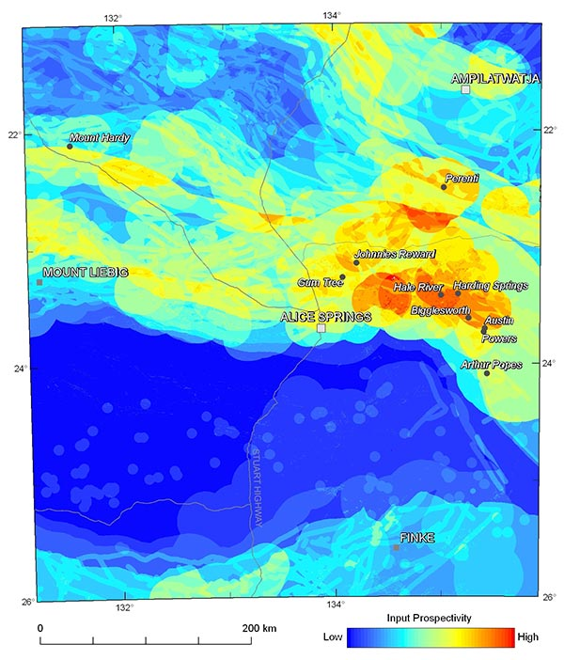
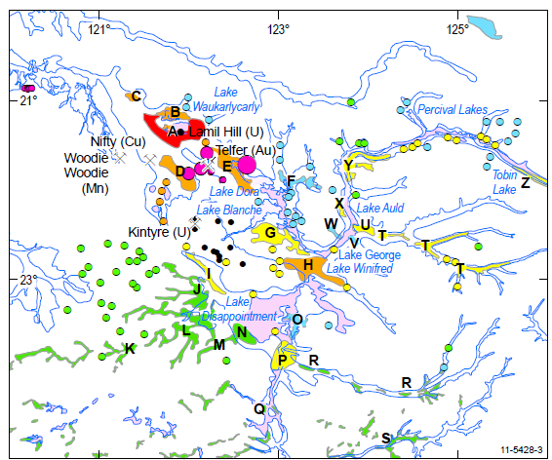
Assessments at various scales
http://www.ga.gov.au/minerals/projects/concluded-projects/mineral-potential.html
http://www.ga.gov.au/minerals/projects/concluded-projects/uranium-systems.html

Slide 14
Limitations of mineral-systems approach
Preservation considered important but listed factors do not include features critical for preservation
Age, duration and relative timing of events in a mineral system do not receive adequate attention
Requires change to focus on ‘giant’ instead of average-size deposits
Requires rethinking to take in take into account clustering of deposits

Slide 15
4 regions with unconformity-related uranium
Rum Jungle and
S Alligator Valley
different
Alligator Rivers and Eastern Athabasca similar

Slide 16
Supergiant (Bull Elephant): Olympic Dam
Prominent Hill
(0.01 Mt U₃O₈;
1.5 Mt Cu; 115 t Au)
Olympic Dam
(2.24 Mt U₃O₈;
68 Mt Cu; 2480 t Au)
Olympic Dam is larger than Prominent Hill:
~200 times for U
~45 times for Cu
~20 times for Au
Notes:
The next obvious super-giant is Olympic Dam. It is 45 times larger than Prominent Hill in terms of copper resources. Although gold and uranium grades are not high in comparison to gold and uranium only deposits, the total resources of gold and uranium are huge and make it a super-giant gold and/or uranium deposit.
I have only shown two super-giants. There are many in Australia and outside. Most super-giants sit alone. Some notable examples are:
Mt Isa and Hilton/George Fisher: 35 Mt and 37 Mt respectively
Mt Isa Copper: ~15 Mt
Telfer: ~ 760 T (gold)
Bendigo: 1032 T (gold); Stawell: 170 T (gold)
Murantau: 3950 T (gold); Amantaitu: 290 T (gold)
Ashanti: 2070 T (gold); Prestea: 390 T (gold)
Lubin (Poland): 52 Mt (Cu)
Fungurume (Zaire): 41 Mt (Cu); Kolweizi: 36 Mt (Cu)
Also mention porphyry Cu (e.g. Butte)

Slide 17
Reliability or robustness of assessment
Depends on
  Knowledge of mineral systems/deposit styles (their critical features)
  Identification of mappable signatures in datasets which correspond to critical features of mineral systems
  Extent and quality of datasets

Slide 18
Conclusions
  Choice of methods depends on the objective
  Basics:
    Know your mineral system (deposit-type): SCIENCE
    Create useful datasets: A MUST
  Mineral system approach can be rewarding. For successful examples visit GA’s website:
    http://www.ga.gov.au/minerals/projects/concluded-projects/mineral-potential.html; and http://www.ga.gov.au/minerals/projects/concluded-projects/uranium-systems.html
  Don’t overdo or oversell it (only detailed exploration such as drilling can find a deposit)

