Slide 1
Electron collisions with atoms and molecules
D.V. Fursa
Curtin University, Perth, Australia
in collaboration with N. A. Mori, H. Umer, L.H. Scarlett, I. Bray, M.C. Zammit
Acknowledgements
Australian Research Council
Pawsey Supercomputing Centre
Los Alamos National Laboratory
US Air Force Office of Scientific Research

Slide 2
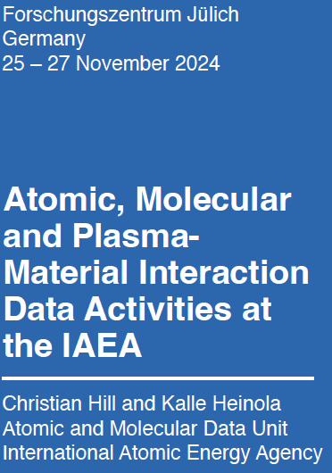
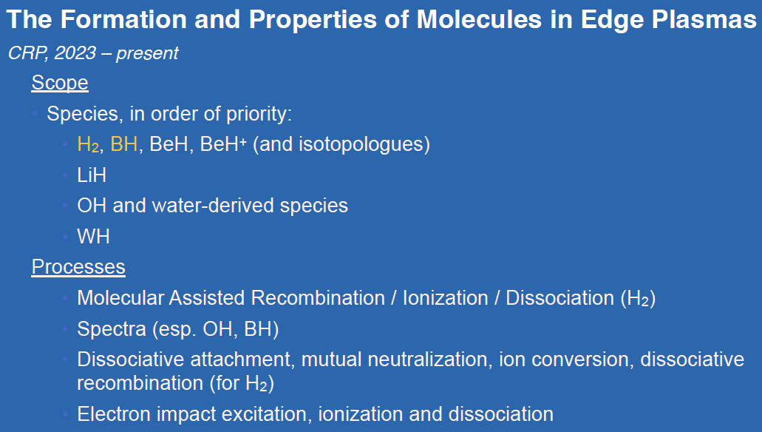
(2)

Slide 3
Content
Electron collisions with molecules:
MCCC method
H₂ and isotopologues
Results & applications
Beyond H₂
HeH+
LiH → NaH, Li₂, Cs₂, CsRb, …
H₃+ → H₂O,…
(3)

Slide 4


MCCC method: fixed-nuclei (FN) approach
Born-Oppenheimer approximation
Fixed-nuclei approximation, R = fixed
Diagonalization of the target Hamiltonian H_{T}
in a Sturmian (Laguerre) basis
Solve for the electronic
wave function
$$→$$
$$→$$
modeling of infinite number of bound & continuum states with a finite number of pseudostates
N-state multi-channel expansion
Solve integral LS equation for the T matrix
Cross sections
Why electron-molecule is difficult: no central potential
→ multi-channel expansion + projectile partial wave expansion lead to a very large size of
coupled equations, to solve need fast computers, effective parallelization, etc….

Slide 5
MCCC method: adiabatic nuclei (AN) approach
AN T matrix
ϕ_{nμ}(R) are vibrational wave functions
vibrationally-resolved cross sectionsC
computationally expensive (many R)
need high accuracy of FN model at large R
Spheroidal-coordinate formulation of the MCCC method
Many FN calculations have to be performed on a grid of R
Computationally efficient / feasible approach is required

Slide 6
Explicit demonstration of convergence
e--H₂ excitation ICS: B 1Σ_{g}+ - Lyman band
SMC, RM ~ 9-state; recommended cross sections are due to Yoon et al., J. Phys. Chem. Ref. Data 37 (2008) 913
Zammit, Savage, Fursa & Bray, Phys. Rev. A 95 (2017) 022708
(6)

Slide 7
Cross sections for the b ³Σ_{u}⁺ state
(7)

Slide 8
Cross sections for the b ³Σ_{u}⁺ state
New time of flight (TOF) spectrometer at California State University, Fullerton:
Prof. Murtadha Khakoo group
  details: Phys. Rev. A 97 (2018 050702(R), 98 (2018) 062704
Old experiments: likely transmission problems for electrostatic spectrometers
(8)

Slide 9
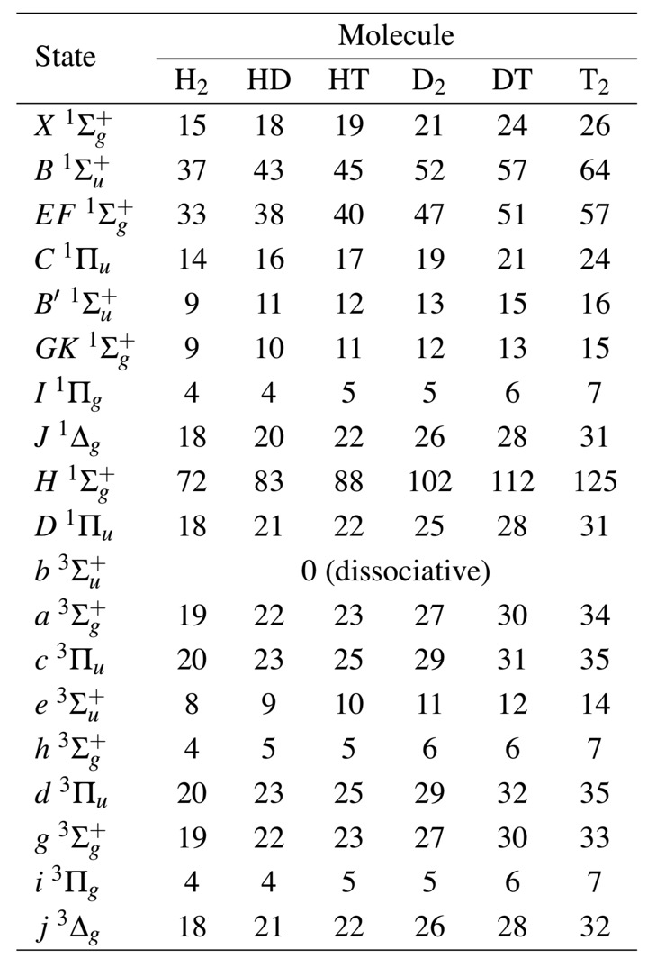

MCCC fully vibrationally resolved cross sections
Calculations have been performed for over 70,000 transitions in H₂ and its 5 isotopologues
includes dissociation cross sections and analytic fits
Scattering on all bound levels of the $X^{ 1}Σ_{g}^{ +}$ state
Number of bound vibrational levels
All cross sections and fits are available online
Initial states
Atom. Data Nucl. Data Tables supplementary materials
Complete collision data set for electrons scattering on molecular hydrogen and its isotopologues:
I. Fully vibrationally-resolved electronic excitation of H₂(X 1Σ_{g}+ ): 137 (2021) 101361
II. Fully vibrationally-resolved electronic excitation of the isotopologues of H₂(X 1Σ_{g}+): 139 (2021) 101403
III. Vibrational excitation via electronic excitation and radiative decay: 148 (2022) 101534
IV. Vibrationally-resolved ionization of the ground and excited electronic states: 151 (2023) 101573
LXCat Database – lxcat.net
IAEA hcdb: Atomic and Molecular Data for Fusion Energy Research https://db-amdis.org/hcdb/
MCCC Database – mccc-db.org
Final states

Slide 10
Electron-impact dissociation of H₂ to neutral fragments
Recommended cross sections are due to Yoon et al. J.Phys. Chem. Ref. Data 37 (2008) 913
based on the data of Corrigan
(J. Chem. Phys. 43 (1965) 4381
Main features
low energy dominated by the b 3Σ_{u}+ state
other triplet states make equally large contribution at the peak and above
singlet states dominate above 50 eV :
  At high energies (> 50 eV) the main dissociation pathway for H₂ is radiative decay to the ground state vibrational continuum via the B 1Σ_{u}+ state.
Scarlett et al., Eur. Phys. J. D 72 (2018) 34
(11)

Slide 11
Isotopic and vibrational-level dependence of H₂ dissociation by electron impact
AN R-matrix calculations TT02: Trevisan and Tennyson,
Plasma Phys. Control. Fusion 44 (2002) 1263, 2217
TT02 theoretical method:
Explicit mass dependence – cross sections scale with mass of the isotopologue
Explicit dependence on the energy of the dissociating fragments E_{k} for KER cross sections
- widely used in plasma modelling applications
- recommended dataset
TT02: AN R-matrix calculations:
- R-matrix part is fine.
- Errors in the account of nuclear motion.
See detailed analysis in:

Slide 12
Isotopic and vibrational-level dependence of H₂ excitaions by electron impact
Cross sections for total electronic excitation (summed over final vibrational levels) and dissociative excitation (DE) of the B 1Σ_{g}+, B’ 1Σ_{g}+, c 3Π_{u} and h 1Σ_{g}+ states of H₂, D₂, T₂, HD, HT, and DT from the X 1Σ_{g}+, (v_{i} = 0) state.
Cross sections for total electronic excitation and dissociative excitation (DE) of the B 1Σ_{g}+, B’ 1Σ_{g}+, c 3Π_{u} and h 1Σ_{g}+ states of H₂, D₂, T₂, HD, HT, and DT from excited vibrational levels in the X 1Σ_{g}+, (v_{i} = 0) state. The cross sections are presented as a function of the initial vibrational level energy (relative to the X 1Σ_{g}+ equilibrium energy) at a fixed incident energy.
Atom. Data Nucl. Data Tables 139 (2021) 101403

Slide 13
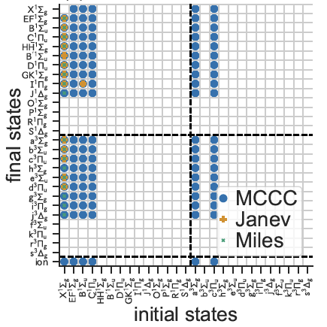
Applications of H₂ collision data
MCCC - (nearly) complete dataset
Previous datasets - a limited set of transitions
- Miles, Thompson, Green, J. App. Phys. 43 (1972) 678
- Janev, Reiter, Samm, JÜL-4105, Jülich, 2003
Availability of the electron-impact excitation cross-sections. The circle markers indicate the available data in MCCC database, while plus markers and dots indicate those available in Janev dataset and Miles, respectively.
Fujii et al, arXiv:2405.10227v1 (2024)
MCCC dataset is extended to scattering from several electronically excited states
Significant differences between cross sections from MCCC, Miles, and Janev datasets.
(14)
However, many cross sections from excited states are still
missing, which are important for high-density plasmas

Slide 14
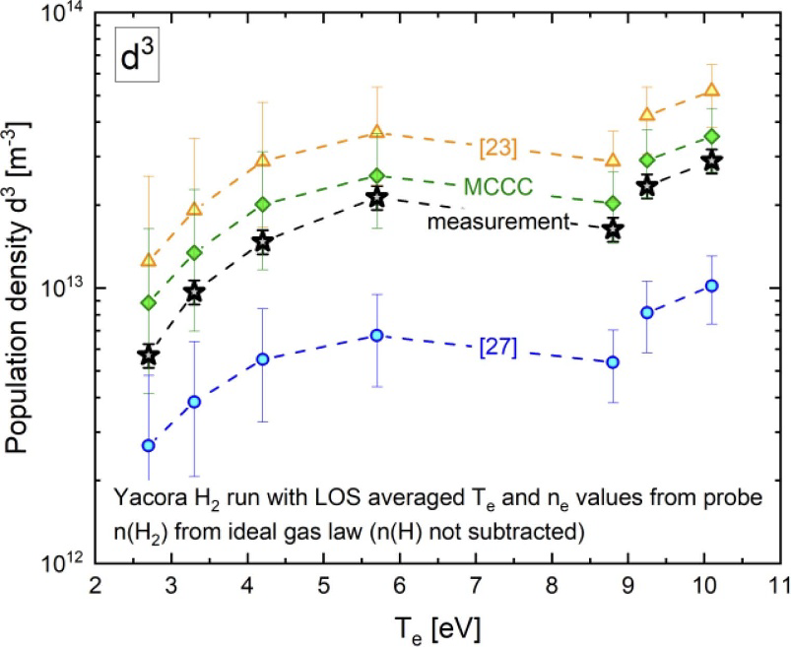
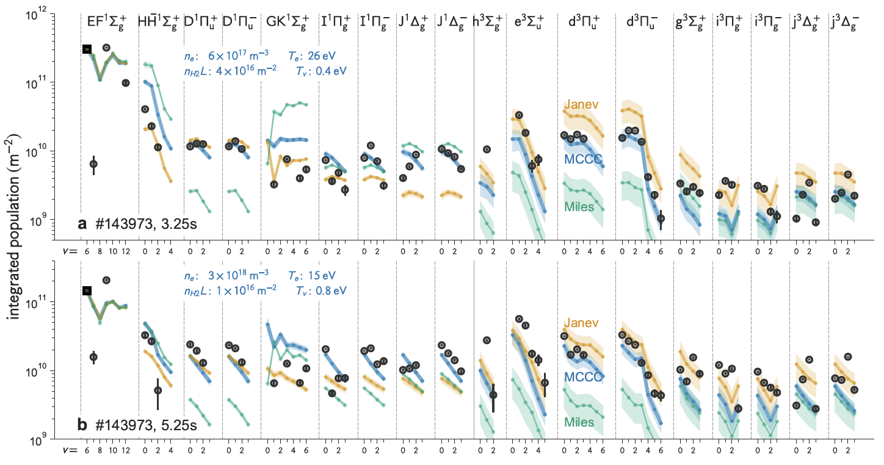
Applications of H₂ collision data
Collision Radiative Models for H₂
solves the excited-state population based on the rate equations.
Wünderlich et al, J. Phys. D: Appl. Phys. 54 (2021) 115201
The Yacora model for the triplet system of the hydrogen molecule.
All electronic states of to the principal quantum number n = 10
are included in the CRMbut without the ro-vibrational levels.
Janev et al
Comparison of measured population densities of the d 3Π_{u} state to the ones calculated with the CRM Yacora H₂ using
cross section from either Miles, Janev or the MCCC data.
Miles et al
Fujii et al, arXiv:2405.10227v1 (2024)
The CRM considers the population of molecule in each electronic- and vibrational states up to n = 4 states,
the rotational states are not resolved.
Distribution of the line-integrated population of molecular hydrogen observed for the LHD divertor plasmas.
Compared with Miles’ and Janev’s cross sections, MCCC cross sections show a better agreement with the experiment.
(15)

Slide 15
Beyond H₂: HeH+
AN calculations
Scarlett et al. Phys. Rev. A 106, 042818 (2022)
Dissociation
Excitations
- Above 30 eV only one set of measurements (Lecointre) and calculations (MCCC)
- MCCC predicts total DE cross section larger than measured
More theory/experiment required to resolve this issue
Only two previous calculations (Kohn)
A. E. Orel et al., Phys. Rev. A 44, 4328–4335 (1991)
E. Ertan et al., EPJ Web Conf. 113, 4–9 (2016)
Lecointre et al., J. Phys. B 47, 015203 (2014)
Stromholm et al., Phys. Rev. A 54, 3086 (1996)
(16)

Slide 16

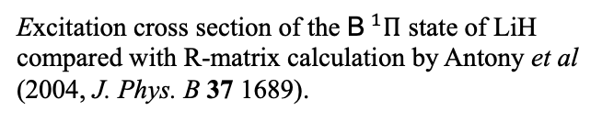



Beyond H₂: LiH
H. Umer etal, PHYSICAL REVIEW A 111, 022810 (2025)
(extended to Li₂,; to be extended to NaH, Cs₂, CsRb, …)
e⁻
r₁
r₂
R
p⁺
X$^{1}Σ^{+}$
a$^{3}Σ^{+}$, A$^{1}Σ^{+}$, b$^{3}Π$, B$^{1}Π$, c$^{3}Σ^{+}$, C$^{1}Σ^{+}$, d$^{3}Σ^{+}$, D$^{1}Σ^{+}$
Li⁺ ($1s^{2}$)
e$^{3}Σ^{+}$, i$^{3}Π$, I$^{1}Π$, j$^{3}Π$, E$^{1}Σ^{+}$, k$^{3}Δ$, K$^{1}Δ$, J$^{1}Π$
X$^{1}Σ^{+}$
B$^{1}Π$
Excitation cross section of the B$^{1}Π$ state of LiH compared with R-matrix calculation by Antony et al (2004, J. Phys. B 37 1689).
Convergence of the MCCC ionisation cross section.
Compared with a Spherical Complex Optical Potential (SCOP) presented by Shelat et al (2012, Indian J. Phys. 85 1739).
(17)

Slide 17
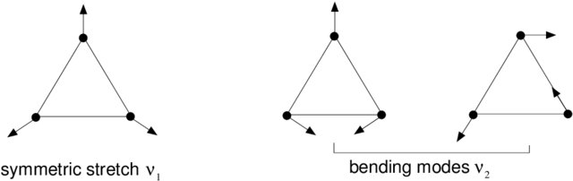
Beyond H₂: H₃+
R. Horton etal,
Phys. Rev. Lett. 134, 063001 (2025)
Phys. Rev. A 111, 022802 (2025)
Phys. Rev A 111, 062817 (2025)
Comparison of the MCCC-AN(61,6) total dissociative excitation cross section with (Lecointre et al, 2009, J. Phys. B, 42 075201), (Jensen J. et al, 2001, Phys. Rev. A, 63 052701), the fixed-nuclei R-Matrix results of (Gorfinkiel J. D. and Tennyson J. 2005, J.Phys.B, 38 1607) and the adiabatic complex-Kohn results of (Orel A. 1992, Phys. Rev. A, 46 1333).
Experimental total dissociative ionisation cross section of (Lecointre et al, 2009, J. Phys. B, 42 075201), the fixed-nuclei R-Matrix results of (Gorfinkiel J. D. and Tennyson J. 2005, J.Phys.B 38 1607) and present SCB-AN(778,6) model.
(18)

Slide 18
Conclusions and future directions
A comprehensive set of cross sections for electron collisions with H₂ and isotopologues: elastic, electronic, vibrational, rotational excitations, dissociation, ionization, more than 70,000 entries
The dataset is available through open-access web databases (mccc-db.org, LXCat, ATOMDB)
Electron impact on HeH⁺
New results for LiH and H₃⁺ are published
Future directions:
more complex diatomic molecules: O₂, N₂, NO, CO,… and beyond… H₂O
Thank you
(23)

