Slide 1
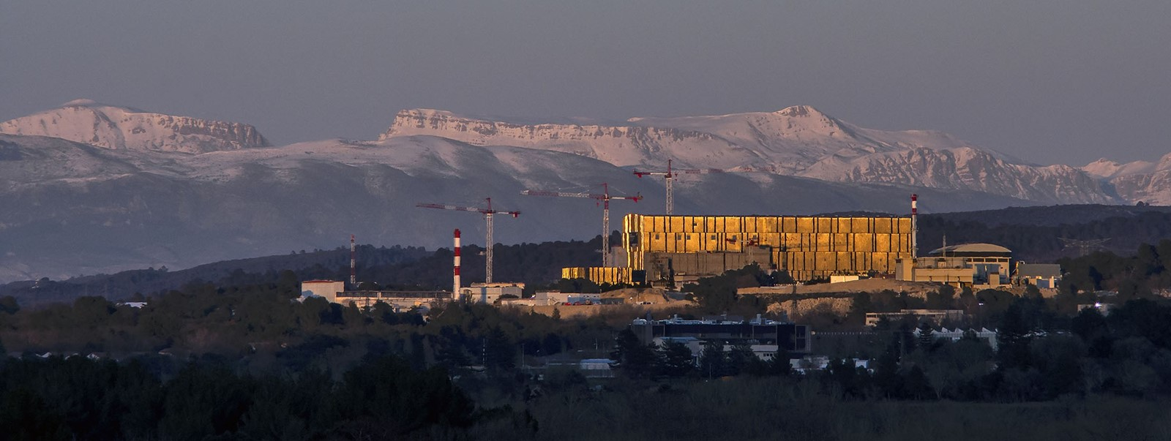

ITER requirements and policies regarding AMNS data
Xavier Bonnin, Science Division
GNAMPP Meeting, 9-11 July 2025, IAEA Headquarters
The views and opinions expressed herein do not necessarily represent those of the ITER Organization

Slide 2
Outline
IMAS Requirements
Data gaps in AMNS
Data from outside the ITER Member States
A. Outline

Slide 3
IMAS Requirements
Open-source data handling code and dictionary
  Routines for accessing data, creating fits and tables
FAIR principles:
  Findability
  Accessibility
  Interoperability
  Reusability
IMAS provenance fields
  Access to different versions of the data as it evolved (backward-compatibility)
  Data recommendations and confidence levels
A mechanism for revising existing data and/or requesting new data
B. IMAS Requirements

Slide 4
FAIR principles (from Wikipedia)
F1. (Meta)data are assigned a globally unique and persistent identifier
F2. Data are described with rich metadata (defined by R1 below)
F3. Metadata clearly and explicitly include the identifier of the data they describe
F4. (Meta)data are registered or indexed in a searchable resource
A1. (Meta)data are retrievable by their identifier using a standardised communications protocol
A1.1 The protocol is open, free, and universally implementable
A1.2 The protocol allows for an authentication and authorisation procedure, where necessary
A2. Metadata are accessible, even when the data are no longer available
I1. (Meta)data use a formal, accessible, shared, and broadly applicable language for knowledge representation.
I2. (Meta)data use vocabularies that follow FAIR principles
I3. (Meta)data include qualified references to other (meta)data
R1. (Meta)data are richly described with a plurality of accurate and relevant attributes
R1.1. (Meta)data are released with a clear and accessible data usage license
R1.2. (Meta)data are associated with detailed provenance
R1.3. (Meta)data meet domain-relevant community standards
B. IMAS Requirements

Slide 5
AMNS Data gaps
Isotopologue-resolved molecular rates
  Ro-vibrational states
Metastable-resolved atomic data
  Helium, (Nitrogen), Argon, …
New species
  Liquid metal candidates (Sn, Ga, …)
More dedicated spectral line data
  Tools to deduce spectra from local plasma parameters (C. Coleandra PhD Work @SPC)
Surface data:
  Sputtering yields (Eckstein database?)
    Adapt the IMAS sputtering yields structures to the provided data
  Reflection rates (particle and energy) for AFN models
  Implantation depth tables
  → Surface inventory models
C. AMNS Data gaps

Slide 6
Data from outside the ITER Member States
Some data sources (ADAS, Perth group, …) are outside the ITER Member States
ITER cannot easily negotiate contracts for access/use of these data
  No official mechanism for requesting extensions/revisions of data
Need for a “neutral” man-in-the-middle actor: IAEA NDS? EUROfusion?
  Need to provide for long-term secure access to the data
Ideally something we can point to from the ITER GitHub portal
Direct online access via a DOI link or an IMAS URI
D. Data from outside the ITER Member States

Slide 7
Thank you!
ITER requirements and policies regarding AMNS data
Xavier Bonnin, Science Division
GNMAPP Meeting, 9-11 July 2025, IAEA Headquarters

