Slide 1


IAEA CRP ATF-TS, 28-31 Oct. 2025, Vienna
AEOI
Atomic Energy Organization of Iran
AEOI Activities Report in the Framework of CRP ATF-TS
A. Riahi, A. Zareidoost

Slide 2
Contents
WT1-Provided ATF samples;
Used coating technology and some investigations into the studied samples;
Oxidation experiments on samples and corresponding results;
Summary

Slide 3
WT1-Provided ATF samples

Slide 4
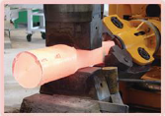
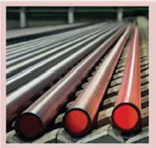
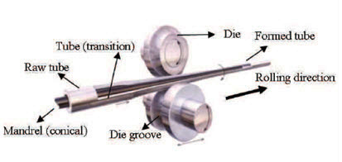
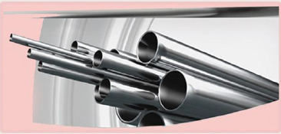

Nuclear Reactors Fuel (NRF) company

Slide 5
WT1-Provided ATF samples
The first step of the provided ATF samples
September 2021
Provider | Shared with | Material | Geometry | Size (mm) | Num. (each group)
AEOI | JRC (Karlsruhe) | Reference- Cr, CrN and Multilayer Coated | Tube | D: 9.1, L: 250 | 1
AEOI | INCT | Reference- Cr, CrN and Multilayer Coated | Tube | D: 9.1, L: 250 | 2
AEOI | UPM | Reference- Cr, CrN and Multilayer Coated | Tube | D: 9.1, L: 250 | 5
AEOI | CTU/UJP | Reference- Cr, CrN and Multilayer Coated | Tube | D: 9.1, L: 250 | 5
AEOI | EK | Reference- Cr, CrN and Multilayer Coated | Tube | D: 9.1, L: 250 | 5
AEOI | KIT | Reference- Cr, CrN and Multilayer Coated | Tube | D: 9.1, L: 250 | 4
AEOI | JRC (Petten) | Reference- Cr, CrN and Multilayer Coated | Tube | D: 9.1, L: 250 | 3
AEOI | VTT | Reference- Cr, CrN and Multilayer Coated | Tube | D: 9.1, L: 250 | 3

Slide 6
WT1-Provided ATF samples
The second step of the provided ATF samples
November 2022
Provider | Shared with | Material | Geometry | Size (mm) | Num.
AEOI | UPM | Reference | Tube | D: 9.5, L: 250 | 5
 |  | Cr Coated
 |  |  |  |  | 5
 |  | CrN Coated
 |  |  |  |  | 5
 |  | Multilayer Coated |  |  | 4
AEOI | CTU/UJP | Reference | Tube | D: 9.1, L: 300 | 10
 |  | Cr Coated
 |  |  |  |  | 10
 |  |  |  |  | 3
 |  | CrN Coated
 |  |  |  |  | 2
 |  | Multilayer Coated
AEOI | INCT | Reference | Tube | D: 9.1, L: 250 | 3
 |  | Cr Coated |  |  | 5
 |  | CrN Coated |  |  | 5
 |  | Multilayer Coated |  |  | 3
 |  | Reference | Sheet | 50 * 50 | 3
 |  | Cr Coated |  |  | 5
 |  | CrN Coated |  |  | 5
 |  | Multilayer Coated |  |  | 5

Slide 7
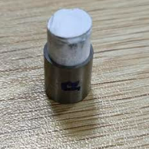
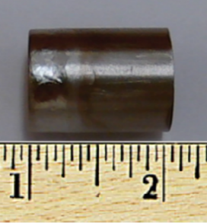
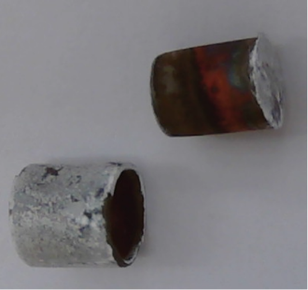
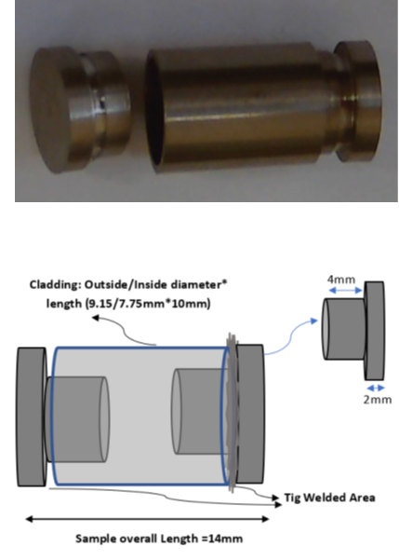
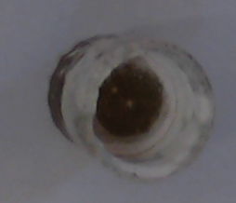
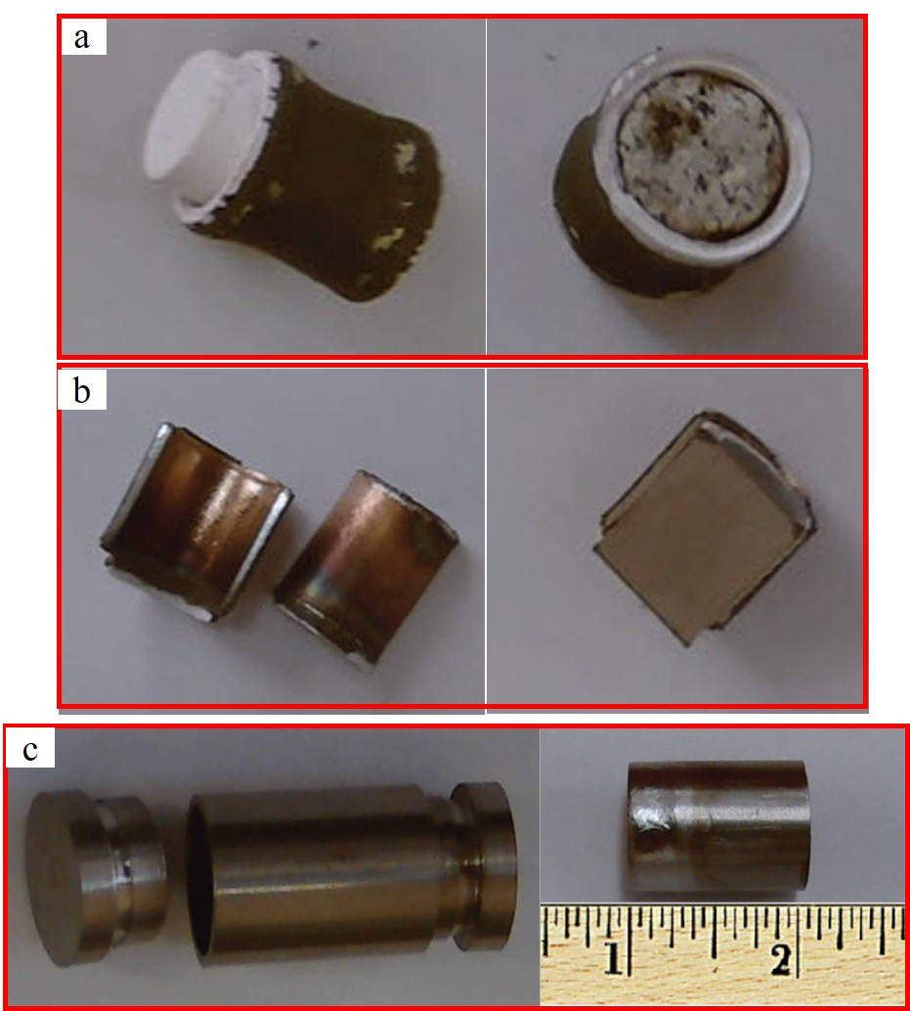
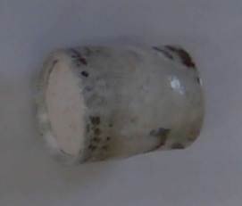
Preparation and shipment of the prepared samples
Bar Inside the clad
Ceramic pellet Inside the clad
One-Side Capped
Both side welded

Slide 8
Samples arrangement for coating
Preparation and shipment of the prepared samples

Slide 9
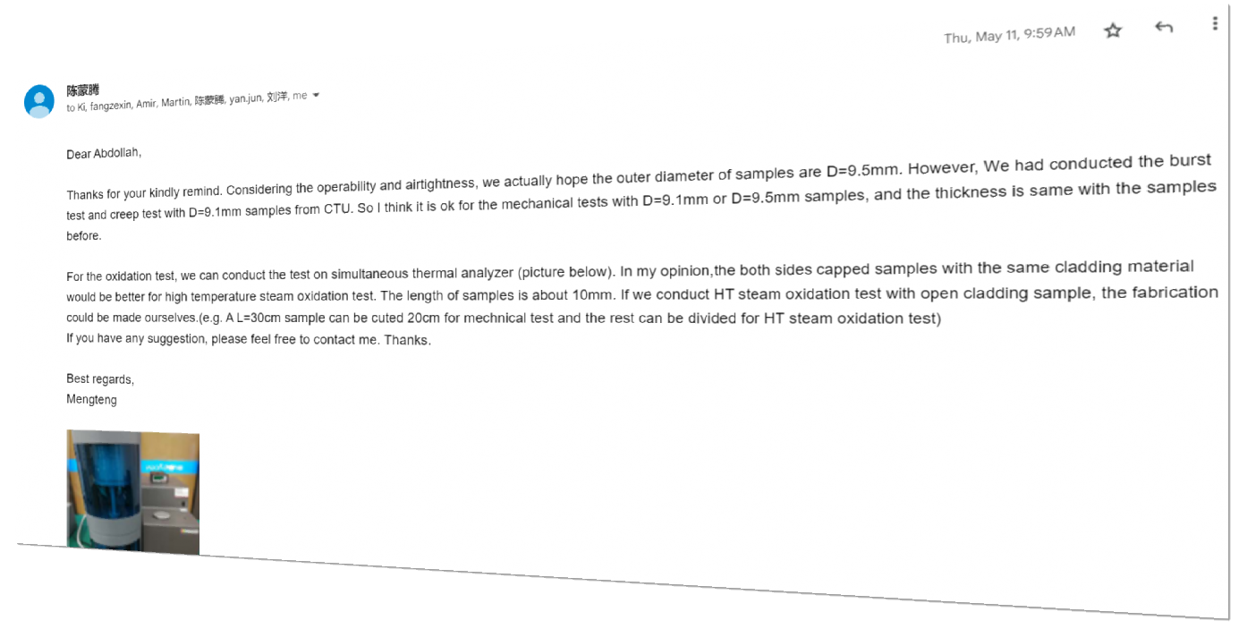
CNPRI-China

Slide 10
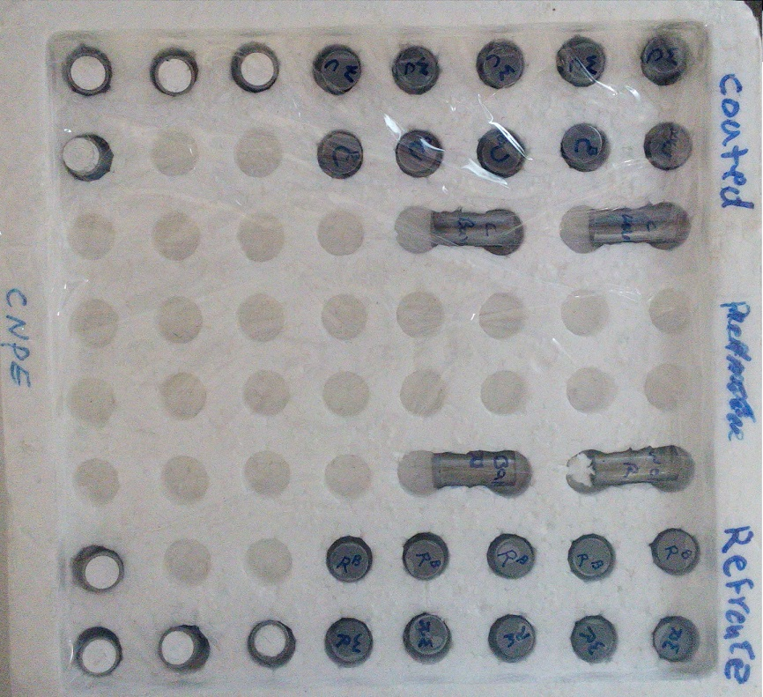
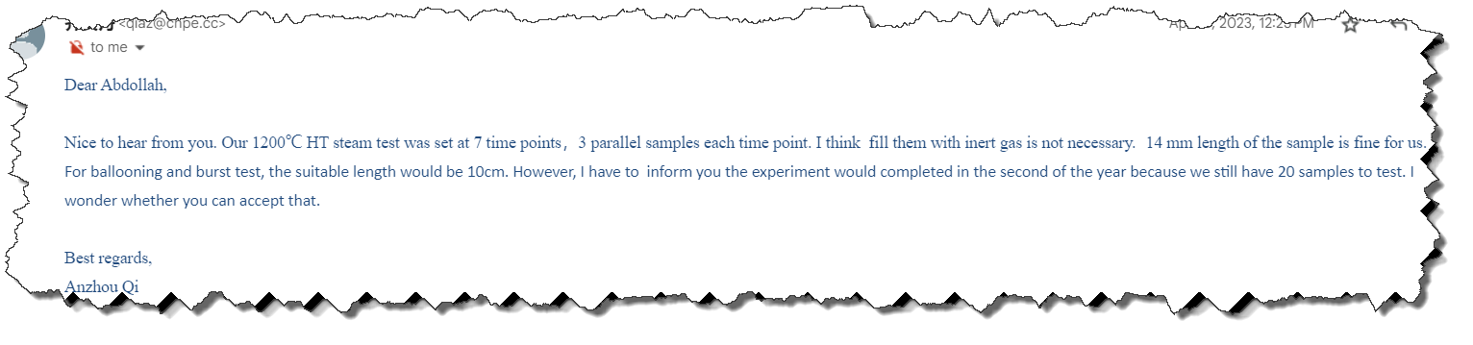
CNPE-China

Slide 11
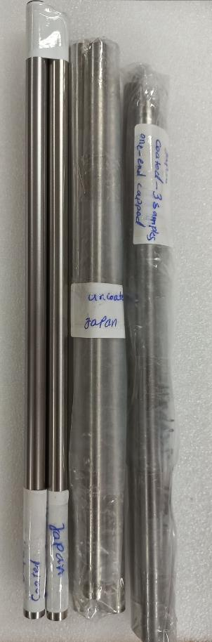
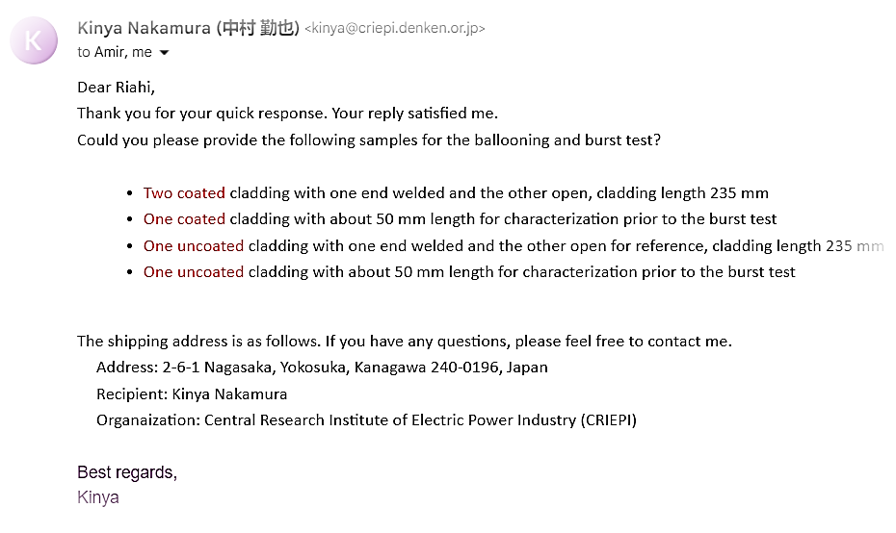
WT1-Provided ATF samples
CRIEPI-Japan

Slide 12
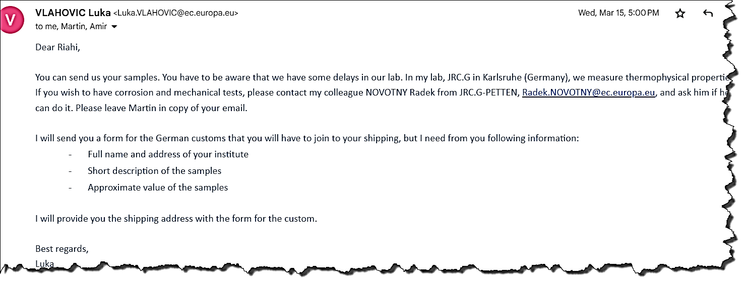
WT1-Provided ATF samples
JRC-Germany

Slide 13
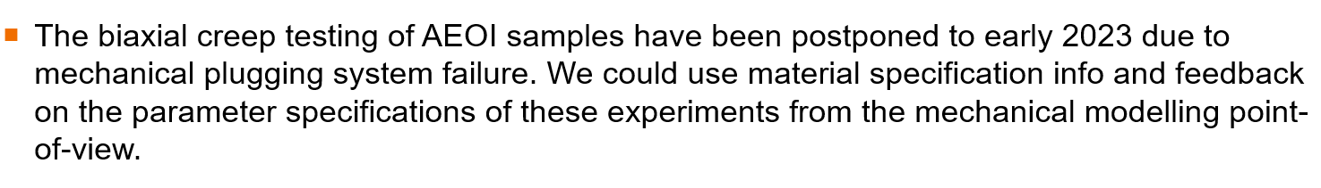
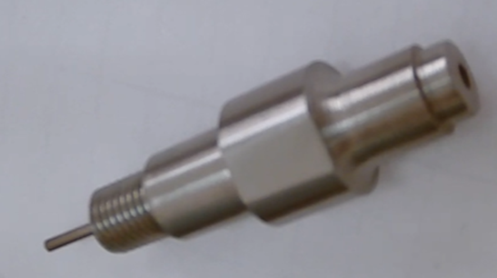

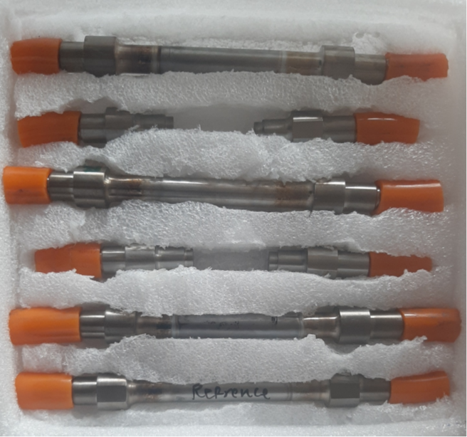
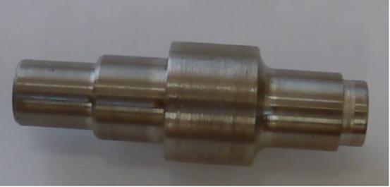
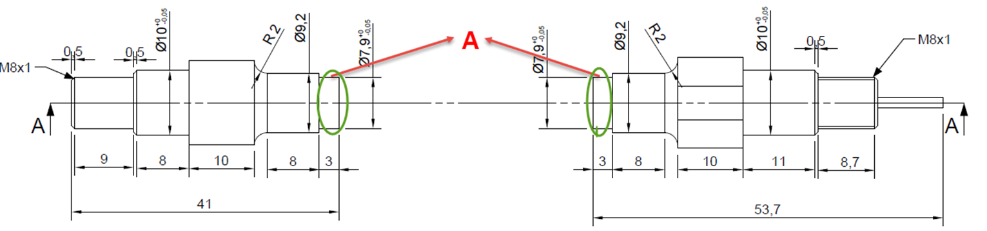
VTT-Finland

Slide 14
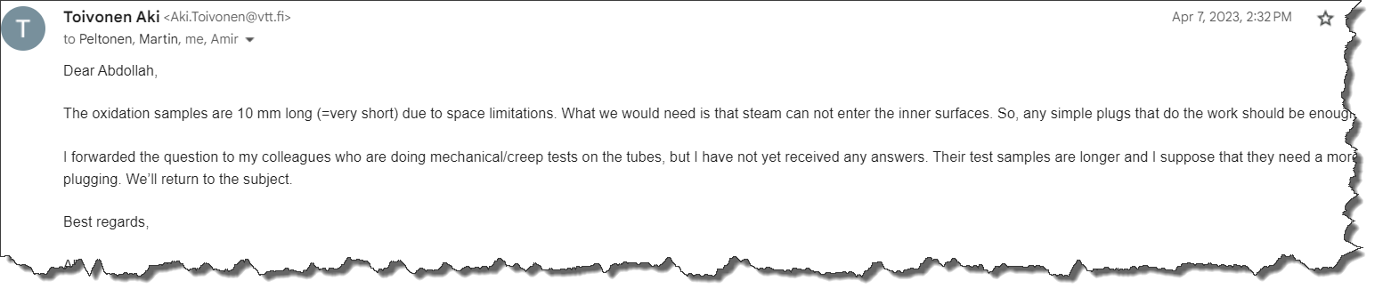
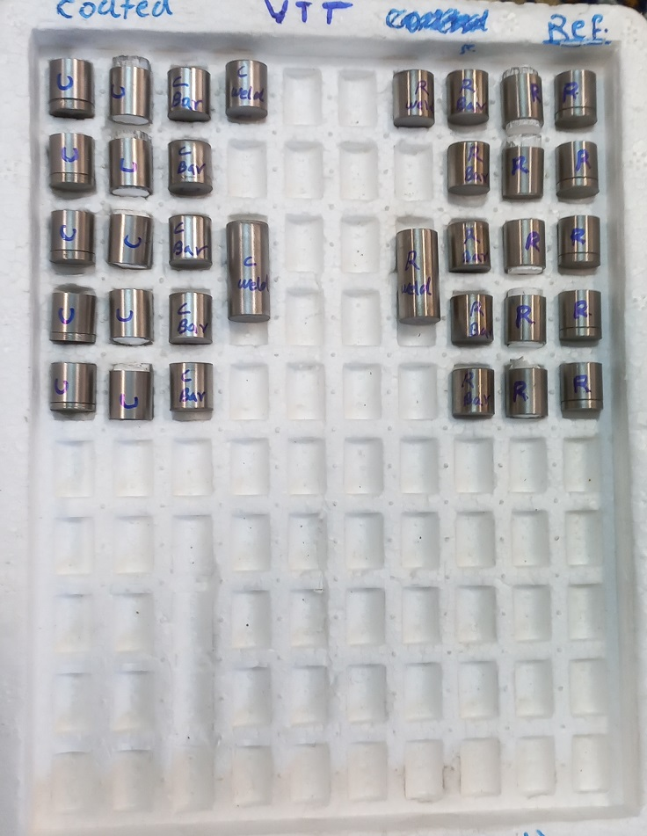
VTT-Finland
13

Slide 15
WT1-Provided ATF samples
The third step of the provided ATF samples
Provider | Shared with | Material | Geometry | Length (mm) | Num. | Comment
AEOI | CRIEPI | Reference and Multilayer Coated | Tube | L: 237 | 2 | One-side capped (welded)
 |  |  |  | L: 250 | 1 | Open sample
AEOI | KIT | Reference and Multilayer Coated | Tube | L: 130 | 5 | One-side capped (welded)
AEOI | VTT | Reference and Multilayer Coated | Tube | L: 10 | 5 | One-side capped (mechanical)
 |  |  |  |  | 5 | Capped with ceramic
 |  |  |  |  | 2 | Capped with welded plug
 |  |  |  |  | 7 | Capped with Zr rod
 |  |  |  | L: 20 | 1 | Capped with welded plug
 |  |  |  |  | 1 | Capped with Zr rod
 |  |  |  | L: 50 | 4 | Capped with VTT plug
 |  |  |  | L: 250 | 6 | Open sample
AEOI | CNPRI | Reference and Multilayer Coated | Tube | L: 10 | 8 | Capped with Zr rod
 |  |  |  |  | 12 | Capped with ceramic
 |  |  |  | L: 20 | 4 | Capped with ceramic
 |  |  |  | L: 100 | 2 | Capped with welded plug
 |  |  |  | L: 250 | 14 | Open sample
AEOI | CNPE | Reference and Multilayer Coated | Tube | L: 10 | 5 | Capped with Zr rod
 |  |  |  |  | 4 | Capped with ceramic
 |  |  |  | L: 14 | 5 | Capped with welded plug
 |  |  |  | L: 20 | 1 | Capped with welded plug
 |  |  |  |  | 1 | Capped with Zr rod
 |  |  |  | L: 100 | 4 | One-side capped (welded)
 |  |  |  | L: 250 | 7 | Open sample
May 2023

Slide 16
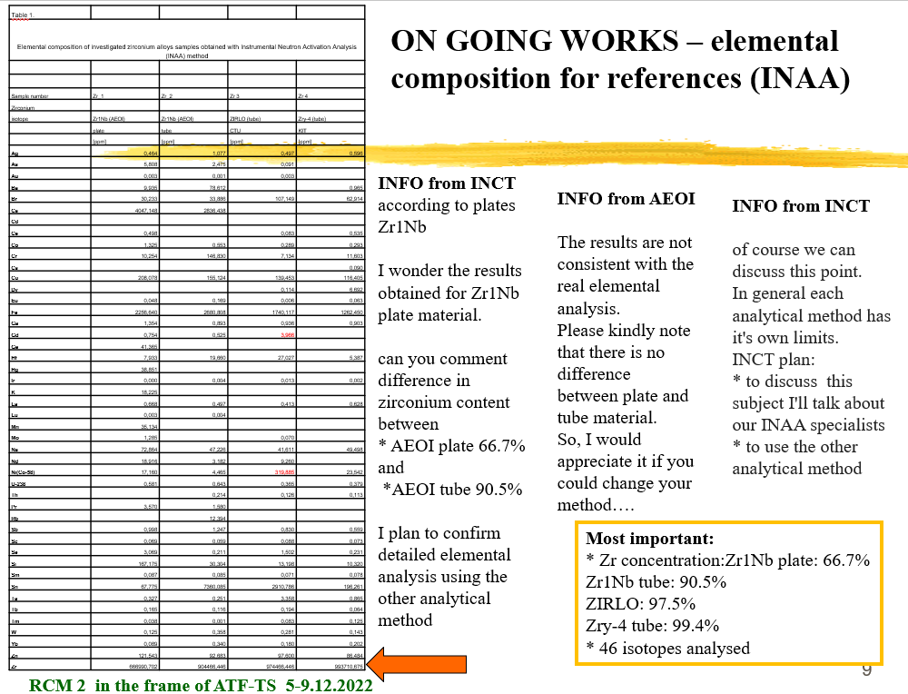
INCT (Poland)

Slide 17
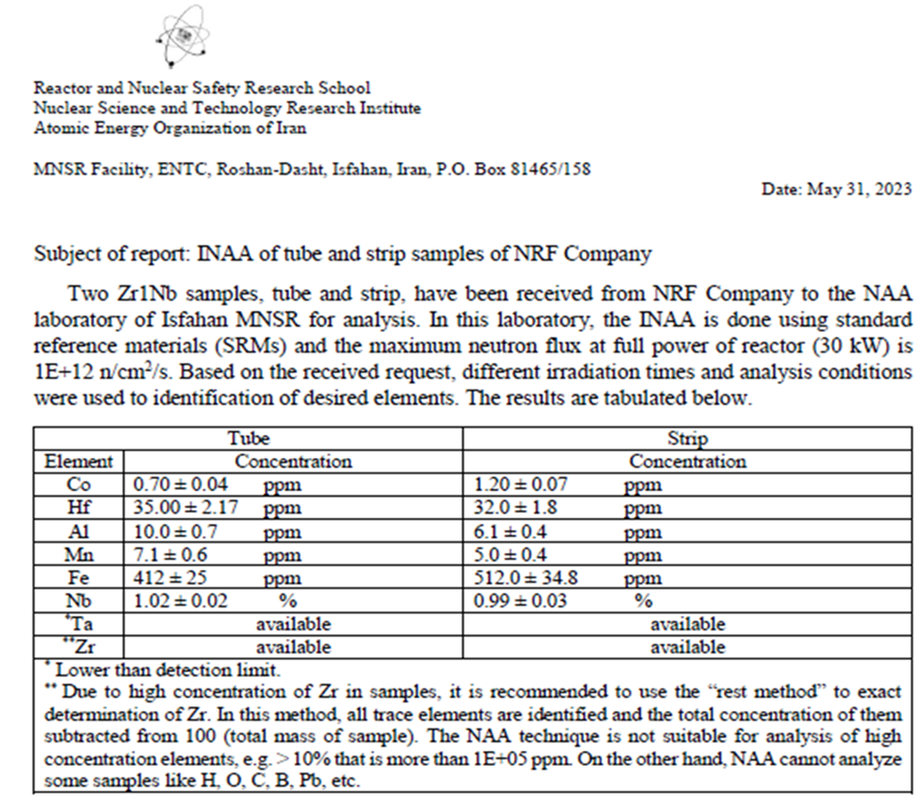
Neutron Activation Analysis of tube and sheet samples
NAA (Neutron Activation Analysis) is a powerful analytical technique used for determining the elemental composition of various materials. However, like any other method, it also has some drawbacks and limitations:
Detection limits: NAA can detect very low levels of elements, but it may not be sensitive enough for trace analysis of some elements. Additionally, it is not suitable for elements with low neutron capture cross-sections.
Sample preparation: The sample preparation process for NAA is time-consuming and requires careful handling to prevent contamination or loss of sample material.
Interference from matrix effects: Matrix effects, such as the presence of other elements in the sample, can interfere with the accuracy of the analysis.

Slide 18

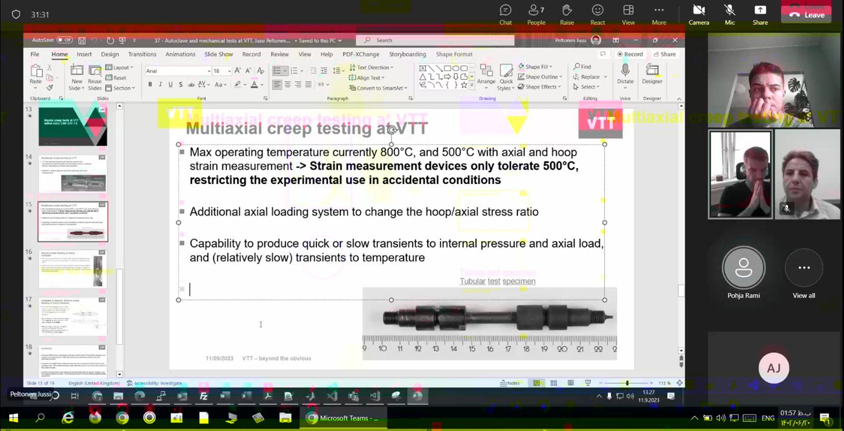
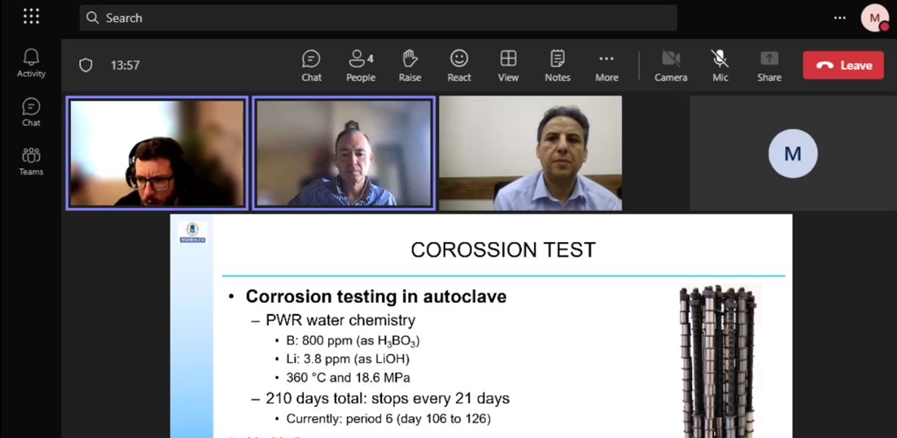
Bilateral Meetings

Slide 19
Used coating technology and some investigations into the studied samples

Slide 20
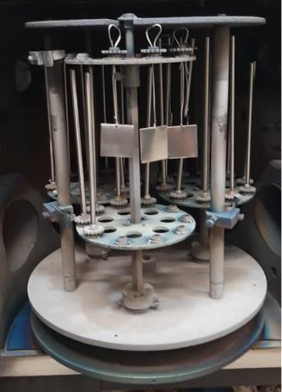
Coating Technology
AEOI prepared Cr, CrN, and multi layer Cr/CrN-coated Zr-1%Nb and one group as a reference
The Arc-PVD coating parameters used for preparing theses coatings
Type of coating Parameter | Multi-layer (Cr/CrN) | CrN | Cr
Coating thickness (micron) | 7 - 10 | 7 - 10 | 6 - 10
Number of the targets | 2 | 2 | 4
Bias voltage (V) | 100 | 100 | 100
Substrate temperature (°C) | 300 ± 2 | 300 ± 2 | 300 ± 2
Ar gas pressure (sccm) | 15 | 15 | 60
Periodic injection of Nitrogen gas (min) | ~4.0 | ~55.0* | 0.0
Coating duration (hr) | ~8.5 | ~7.0 | ~4.5
* To control the shedding and decreasing the residual stress of the CrN coating
The inside view of the ARC-PVD coating chamber.
Notes:
As part of the Coordinated Research Project on Testing and Simulation of Accident-Tolerant and Advanced Technology Fuels (ATF-TS), four groups of samples—comprising Cr-coated, CrN-coated, Cr/CrN multilayer-coated specimens, and uncoated reference tubes—were prepared and distributed to participating institutes.
coatings were deposited onto the outer surfaces of Zr–1Nb alloy tubes using the cathodic arc evaporation (Arc-PVD) technique. Prior to deposition, the samples were degreased sequentially in acetone and ethanol using an ultrasonic bath for at least 15 minutes each, followed by rinsing with distilled water. After cleaning, the surfaces were subjected to argon ion sputtering inside the coating chamber for 20 minutes at a bias voltage of −700 V to enhance surface activation and adhesion. The total coating thickness was controlled to approximately 7–10 μm by adjusting the deposition time, with a near 1:1 thickness ratio between the Cr and CrN layers. Detailed coating parameters are summarized in Table.

Slide 21
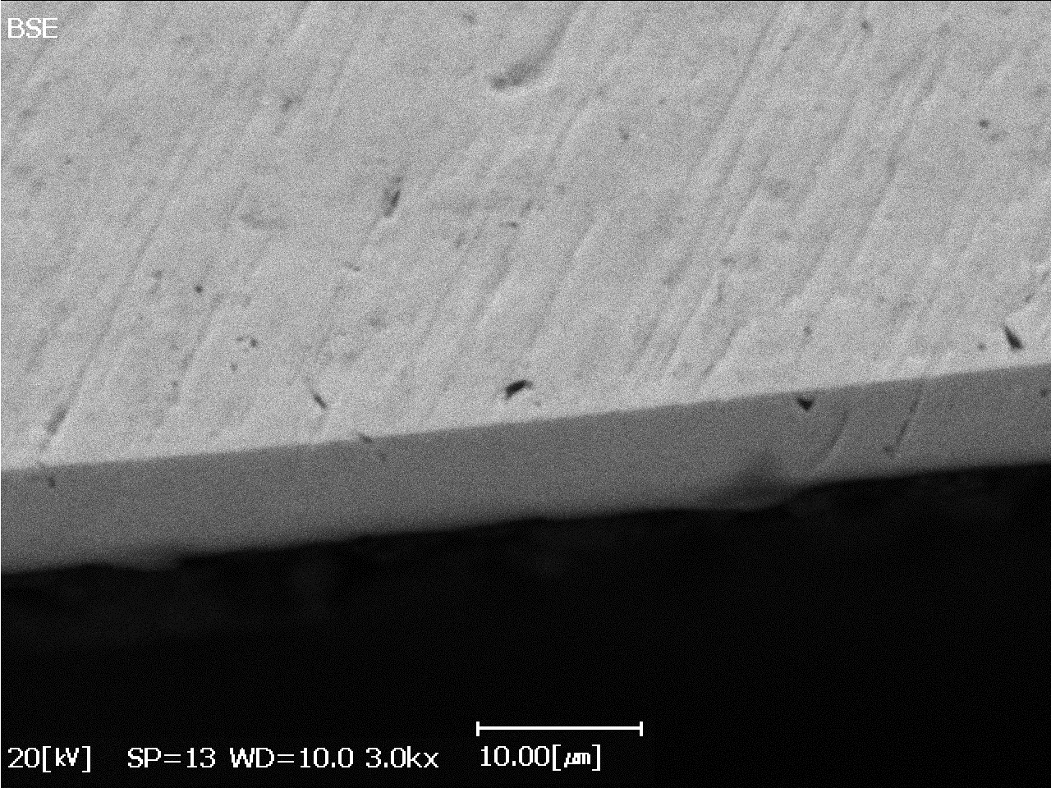
Characterization of the coated samples
Phase characterization of the Cr coating
Method: Scherrer
Peak Position: 64.6102º
D≈ 42 nm
Lattice Strain: 0.27%
Zr-1%Nb (Substrate)
Cr coating
The XRD pattern of the Cr coating
The SEM-BSE image of the Cr coating
Cr coating shows a strong crystallographic orientation
The Cr layer is uniformly coated on the Zr-1%Nb substrate

Slide 22
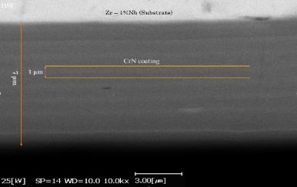
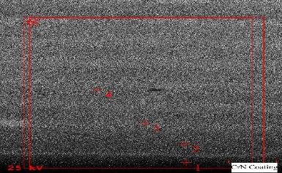
Characterization of the coated samples
Phase characterization of the CrN coating
Method: Scherrer
Peak Position: 43.56º
D ≈ 17 nm
Lattice Strain: 0.62%
The XRD pattern of the CrN coating
The SEM image of the CrN coating.
The elemental composition from different points of the CrN coating by EDS analysis
Element | 1 | 2 | 3 | 4 | 5
Cr | 87.6 | 92.2 | 94.4 | 94.2 | 92.4
N | 12.4 | 7.8 | 5.6 | 5.8 | 7.6
CrN Coating
Chemical composition

Slide 23
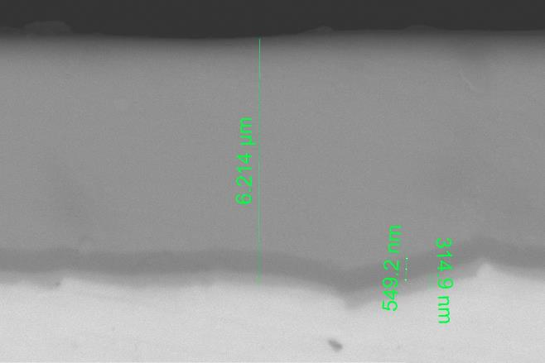

Characterization of the coated samples
Phase characterization of the Multi-layer Cr/CrN coating
The interface between the coating and the Zr–1Nb substrate appears uniform and smooth, with no visible defects or delamination.
Two distinct transition layers are evident in Figure: the Cr layer adjacent to the substrate is approximately 300 nm thick, while the overlying CrN layer measures about 550 nm in thickness.
the layer-by-layer structure of the Cr/CrN multilayer coating is clearly resolved in the high-resolution FE-SEM image, where individual layers exhibit thicknesses in the range of 20–30 nm.
Multilayer Cr/CrN
CrN (interlayer)
Cr (interlayer)
substrate
Elemental composition and microstructural characterization
Notes:
The microstructure of the Cr/CrN multilayer coating was examined by scanning electron microscopy (SEM), as shown in Fig. 2. The interface between the coating and the Zr–1Nb substrate appears uniform and smooth, with no visible defects or delamination, indicating good adhesion. Two distinct transition layers are evident in Figure: the layer adjacent to the substrate is approximately 300 nm thick, while the overlying layer measures about 550 nm in thickness.
Furthermore, the layer-by-layer structure of the Cr/CrN multilayer coating is clearly resolved in the high-resolution FE-SEM image, where individual layers exhibit thicknesses in the range of 20–30 nm. As shown in Figure, the chromium content gradually increases across the transition region, which aligns well with the sequential deposition process. The outermost functional coating zone has a total thickness of approximately 6.2 μm.

Slide 24


Characterization of the coated samples
Phase characterization of the Multi-layer Cr/CrN coating
*CrN (200)
◊Cr (110)
GI-XRD (Grazing Incidence Angle XRD) configuration at two grazing angles of 2 and 5 degree was used for characterizing the phase analysis of the multilayer coating.
Three crystalline phases are identified: Cr, CrN, and Cr₂N.
The presence of the Cr₂N phase is likely attributed to the cut-off and connect the nitrogen gas flow during the coating process.
The deposition technique and process stability significantly influence phase composition.
■Cr₂N (002)
●ZrN (200)
*CrN (111)
■ Cr₂N (-1-12)
◊Cr (200)
$$θ_{s}=5°$$
$$θ_{s}=2°$$
Phase characterization via XRD analysis
Notes:
The XRD pattern of the nano-multilayer Cr/CrN coating is presented in Fig. 3. Three crystalline phases are identified: Cr, CrN, and Cr₂N. The presence of the Cr₂N phase is likely attributed to the cut-off and connect the nitrogen gas flow during the coating process—which can promote Cr₂N formation at the interfaces between Cr and CrN layers. Notably, some studies employing magnetron sputtering have reported no detectable Cr₂N peaks, suggesting that the deposition technique and process stability significantly influence phase composition.
Furthermore, the multilayer structure promotes a preferential (200) orientation in the CrN layers, consistent with findings by Lousa et al. [17], who utilized a cathodic arc deposition method. Overall, the XRD results align well with the microstructural and compositional observations from SEM and EDS analyses.

Slide 25
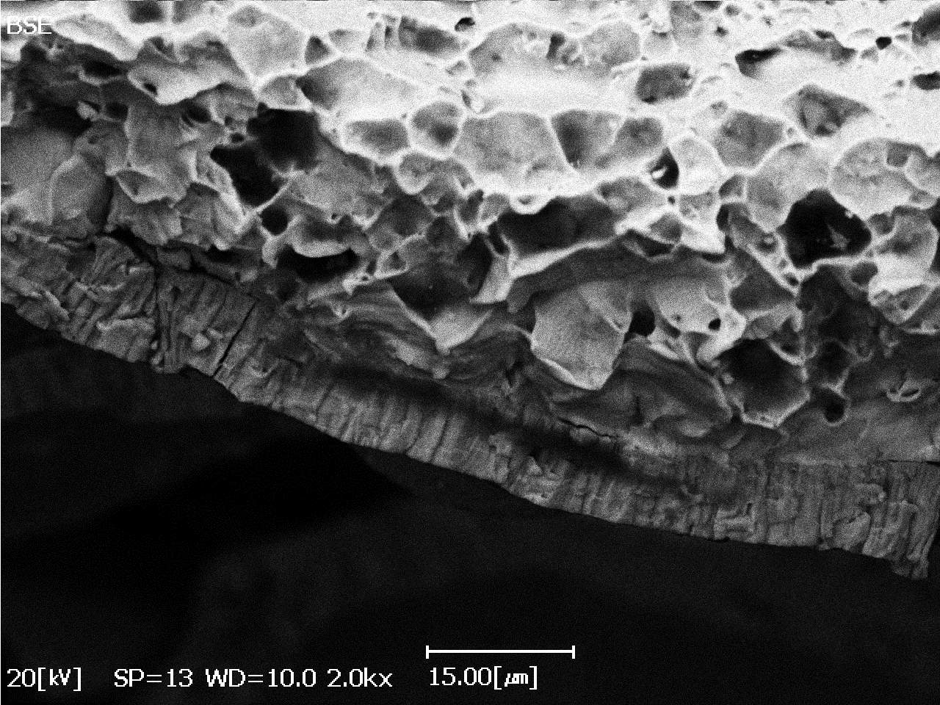
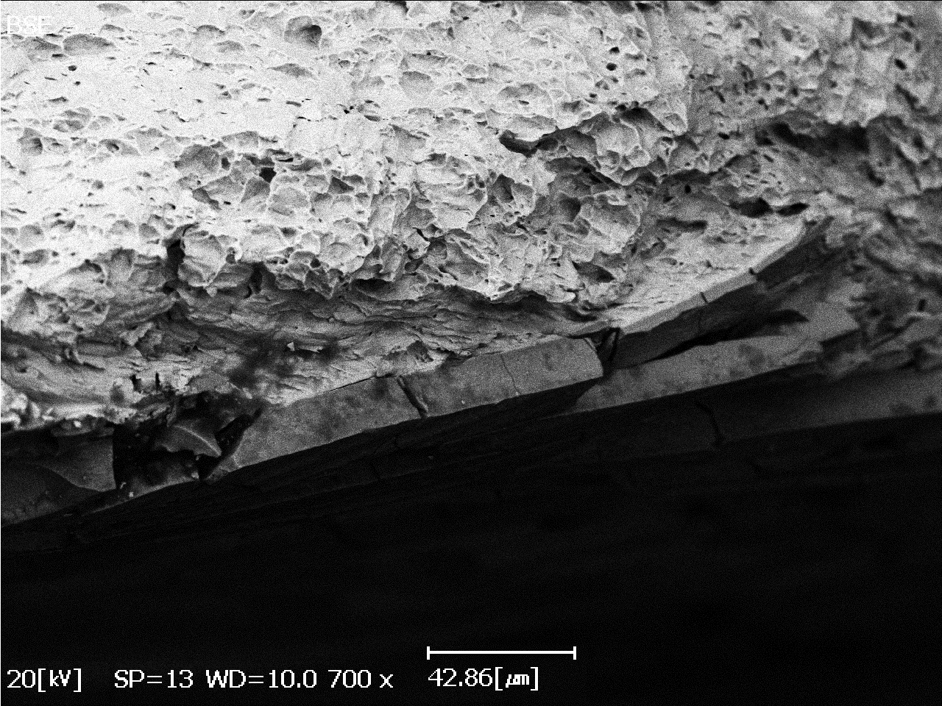
Characterization of the coated samples
Mechanical Properties of the Cr and CrN coatings
Zr-1%Nb
The Mechanical properties of the coated and uncoated Zr-1%Nb at room temperature.
Sample | Yield Stress, (MPa) | Ultimate Tensile Strength, (MPa) | Elongation (%) | Young’s Modulus (GPa)
Reference (Uncoated Zr-1%Nb) | 280 | 423 | 50 | 82
Cr-coated (Zr-1%Nb) | 266 | 430 | 43 | 86
CrN-coated (Zr-1%Nb) | 269 | 430 | 35 | 84
Cr Coating
Crack
Fracture surface of Cr-coated Zr-1Nb cladding tube
Zr-1%Nb
Without dimple
There is no significant deference between Ys, UTS, and YM;
After coating, the elongation is decreased (It is probably owing to the incoherency of the deformation behavior for the CrN coated sample).
There are the non-dimple regions in the near of the CrN coating and substrate interface, affecting the elongation parameter of the sample.
For Cr coating, the non-dimple regions are less than that of the CrN coating.
CrN Coating
Crack
Fracture surface of CrN-coated Zr-1Nb cladding tube

Slide 26
Oxidation experiments on samples and corresponding results

Slide 27
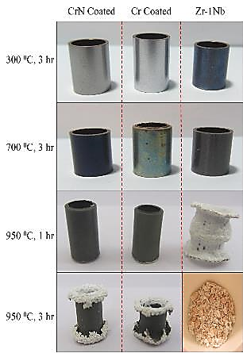
Oxidation experiments on samples and corresponding results
With Thermogravimetric Apparatus
(Ref.)
(Continual weighing of sample while heating)
(Ref.)
~
~
~
No obvious weight gain was observed for all samples in low temperatures (300 and 700 ⁰C)
With an increase in temperature up to 950 ⁰C for 1 hour, the weight gain of the uncoated samples was significantly higher than that of the coated samples (about 10-15 times).
The oxidation rate of the Cr and CrN coated samples was similar
With further increases in time (i.e., 3 hours), the difference between the coated and uncoated samples in terms of weight gain became 2-3 times owing to the predominant oxidation of the internal surface.
Notes:
Left Figure shows the changes in weight gain (due to oxidation) versus oxidation temperature up to 3 h for the investigated samples. For the double-side oxidized samples, a slight increase in weight gain was observed at 300 and 700 ⁰C. With an increase in temperature up to 950 ⁰C for 1 hour, the weight gain of the uncoated samples was significantly higher than that of the coated samples (about 10-15 times).
On the other hand, with further increases in time (i.e., 3 hours), the difference between the coated and uncoated samples in terms of weight gain became 2-3 times owing to the predominant oxidation of the internal surface.
Compared to the Cr or CrN-coated samples, the uncoated samples depicted that their weight gain suddenly increased after about 50 min, as shown in right Figure. Furthermore, further increase in oxidation time showed the oxidation rate of the coated samples was similar and lower than that of the uncoated sample.

Slide 28
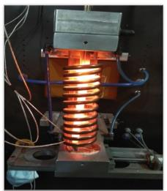
H.T. Oxidation experiments on samples and corresponding results
With Induction Furnace
Heating
Oxidation time
Quench
Parameters for high-temperature oxidation tests
1200
Sample | Condition | Heating Rate (⁰C/s) | Max. Temp. (⁰C) | Duration of oxidation (sec) | Cooldown
Multilayer Coated & Ref. | Air | 5 | 1200 | 120 | water
Multilayer Coated & Ref. | Air | 5 | 1200 | 140 | water
Multilayer Coated & Ref. | Air | 5 | 1200 | 180 | water
Multilayer Coated & Ref. | Air | 5 | 1200 | 300 | water
800
3-5 ⁰C/s
400
0
0
Test Scenario
High frequency induction furnace
(180 kHz)
Notes:
Based on the findings from the CRP-ATF(TS) project and prior research indicating that the Cr/CrN multilayer coating offers superior protective performance compared to single-layer Cr or CrN coatings, the present study focuses exclusively on the multilayer-coated samples in the following sections.
Figure 1 illustrates the oxidation setup for the 15-cm-long samples tested in an induction furnace. High-temperature oxidation tests were conducted at the durations specified in Table 3 under both steam and air atmospheres. For the steam oxidation tests, the samples were introduced into the preheated induction furnace once the target temperature had been stabilized. A steam flow rate of approximately 4.0 mg·cm⁻²·s⁻¹ was maintained throughout the test. Immediately after oxidation, the samples were quenched in water to halt further reaction. In each test, uncoated reference samples were subjected to identical conditions for direct comparison.

Slide 29
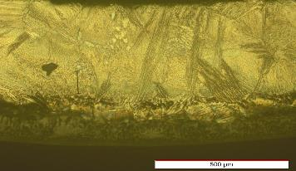
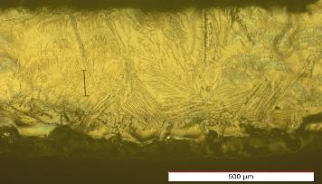
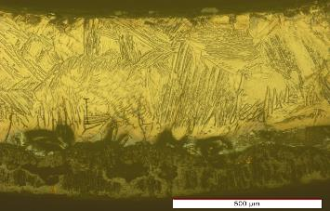
H.T. Oxidation experiments on samples and corresponding results
The effect of time on oxidation of reference (un-coated) sample
1200 ⁰C, 120 sec, Air
1200 ⁰C, 140 sec, Air
prior β-Zr
prior β-Zr
Both the oxide layer and the underlying α-layer thicken with increasing oxidation time
Beneath the α-layer, a prior β-Zr phase layer remains, which retains ductility
Likely due to the distinct surface preparation methods, the oxide layer formed on the outer surface is consistently thicker than that on the inner surface
During the short oxidation times, the oxide scale remained intact without spallation.
after 300 seconds of oxidation in air, microdefects were observed in the oxide layer. The formation of such microdefects can accelerate the corrosion rate by providing additional pathways for oxygen diffusion into the underlying metal.
α-Zr(O)
ZrO₂
ZrO₂
α-Zr(O)
1200 ⁰C, 180 sec, Air
1200 ⁰C, 300 sec, Air
prior β-Zr
prior β-Zr
Microdefects
α-Zr(O)
α-Zr(O)
ZrO₂
Notes:
THE OXIDATION BEHAVIOR OF THE UNCOATED SAMPLES IN AIR ENVIROMENTS
Figure presents cross-sectional optical micrographs of samples oxidized in air at 1200 °C for short durations (120, 140, 180, and 300 seconds). In the uncoated samples, oxygen diffusion to the metal/oxide interface leads to the formation of a stabilized α-Zr(O) layer beneath the oxide scale. This oxygen-enriched α-layer is brittle and significantly reduces the ductility and plasticity of the cladding tube, resulting in microcracks in this region. As shown in Figure, both the oxide layer and the underlying α-layer thicken with increasing oxidation time. Beneath the α-layer, a prior β-Zr phase layer remains, which retains ductility; the residual ductility of the cladding is therefore largely dependent on the thickness of this β-layer. However, as oxidation progresses and oxygen diffusion through the oxide scale intensifies, the β-layer gradually transforms into the brittle α-phase, leading to a continuous reduction in ductility.
Notably, the oxide layer formed on the outer surface is consistently thicker than that on the inner surface. This difference is likely attributed to the distinct surface preparation methods: the outer surface was mechanically ground, whereas the inner surface was chemically etched (acid-pickled). It is also worth noting that, during these short oxidation times, the oxide scale remained intact without spallation.
In contrast, the coated samples (Fig. 4e–h) show no evidence of an oxygen-stabilized α-layer beneath the Cr/CrN multilayer coating, even after exposure to high temperatures for varying durations. Furthermore, no cracks or delamination were observed in the Cr/CrN coating. These observations confirm that the Cr/CrN multilayer coating effectively acts as a diffusion barrier, significantly inhibiting oxygen ingress into the Zr–1Nb substrate.

Slide 30
H.T. Oxidation experiments on samples and corresponding results
The effect of time on oxidation of multilayer Cr/CrN coated samples
1200 ⁰C, 120 sec, Air
1200 ⁰C, 140 sec, Air
The coated samples show no evidence of an oxygen-stabilized α-layer beneath the Cr/CrN multilayer coating, even after exposure to high temperatures for varying durations.
The Cr/CrN multilayer coating effectively acts as a diffusion barrier, significantly inhibiting oxygen ingress into the Zr–1Nb substrate
Coated layer
Coated layer
Cr₂O₃
Cr₂O₃
1200 ⁰C, 180 sec, Air
1200 ⁰C, 300 sec, Air
Coated layer
Coated layer
Cr₂O₃
Cr₂O₃
Notes:
THE OXIDATION BEHAVIOR OF THE UNCOATED AND MULTILAYER COATED SAMPLES IN AIR ENVIROMENTS
In contrast, the coated samples show no evidence of an oxygen-stabilized α-layer beneath the Cr/CrN multilayer coating, even after exposure to high temperatures for varying durations. Furthermore, no cracks or delamination were observed in the Cr/CrN coating. These observations confirm that the Cr/CrN multilayer coating effectively acts as a diffusion barrier, significantly inhibiting oxygen ingress into the Zr–1Nb substrate.

Slide 31
Conclusions and Outlook
Four groups of samples—comprising Cr-coated, CrN-coated, Cr/CrN multilayer-coated specimens, and uncoated reference tubes—were prepared and distributed to participating institutes.
For CrN and the Cr/CrN multilayer coating a layer by layer structure is clearly observed, as each layer has the thickness of 1 µm and 20-30 nm, respectively.
The presence of the Cr₂N phase in Cr/CrN multilayer coating is likely attributed to the cut-off and connect the nitrogen gas flow during the coating process—which can promote Cr₂N formation.
Mechanically, the elongation of coated samples is decreased, probably due to incoherency of the deformation behavior for CrN coated sample.
The difference between the coated and uncoated samples in terms of weight gain became lower after 3 hours of oxidation, owing to the predominant oxidation of the internal surface.
At 1200 ⁰C, for 300 seconds of oxidation in air, microdefects appeared in the middle part of the oxide layer accelerating the corrosion rate.
Considering the oxidation of the inner surface of the coated samples, determining the meticulous mass gain has been difficult; so our future studies would be focused on the single-sided oxidation tests.
Notes:
The primary focus of this study was the double-sided high-temperature oxidation of both coated and uncoated Zr–1Nb alloy samples in steam and air environments. A Cr/CrN multilayer coating with a total thickness of 7–10 µm was deposited onto the alloy substrates using cathodic arc physical vapor deposition (Arc-PVD). Comparative analysis of the post-oxidation microstructures—particularly cross-sectional observations—led to the following key conclusions:
The Cr/CrN multilayer coating exhibited effective protective behavior during high-temperature oxidation in both air and steam atmospheres.
Uncoated samples oxidized in air at 1200 °C for 30 minutes showed severe oxidation, accompanied by a wavy oxide/metal interface resulting from localized thickening of the oxide scale.
A greater thickness of unoxidized (residual) Cr layers was retained after steam oxidation compared to air oxidation, indicating superior coating stability in steam.
Due to concurrent oxidation of both the inner and outer surfaces of the cladding tubes—and the resulting difficulty in accurately measuring mass gain—future work will focus on single-sided oxidation tests to enable precise quantification of oxidation kinetics.

Slide 32

Thank you for your attention!

