Slide 1
EATF safety benefit: edf preliminary assessment
Antoine Ambard, Anthony Dyan, Marc Ton-That, Jérôme Hazan, Marie Moatti, Jean-Jérôme Vermoyal, Julian Soulacroix, Edouard Pouillier
EDF R&D, EDF DT, EDF DCN

Slide 2
Introduction
Since 2012, new fuel concepts envisioned with better performance in accidental conditions
  Evolutionary concepts such as coated cladding, doped fuel
  New cladding materials such as MAX phases, silicon carbide…
  New fuels (for commercial reactors) such as silicide or carbide or even metallic
They are named « enhanced accident tolerant fuel », E-ATF
  They are under development and most of them are not available yet at a commercial scale
Chromium coated claddings (CCC) are the readiest products
  Various lead test assemblies irradiated throughout the world
  Including in EDF’s reactors (Blayais)
Chromium doped pellets are not considered because of reprocessing issues
CCC are the focus of EDF’s interest

Slide 3
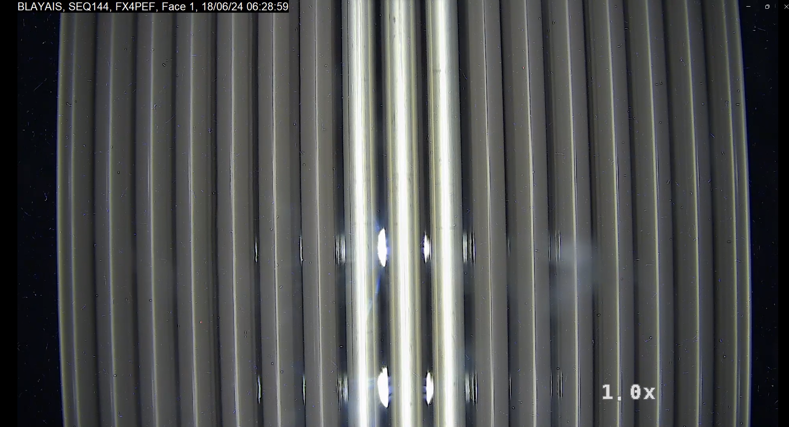
EATF within EDF
EDF is irradiating lead test rods in Blayais 3 with FRAMATOME
  The second cycle is running to its end
  Extracted rods will be shipped to hot cells for PIE ([H]…)
  ITV after the first cycle show unaffected rod, bright, non corroded
Lead test rods irradiation with Westinghouse is under review

Slide 4
Improvements from coated claddings
From litterature, four major improvements over classical zirconium claddings are expected with the following results obtained so far:
Lower corrosion in primary water
  Few measurements available
  Visual inspection shows rods are bright
Lower oxidation at high temperature
  At a given time spent at temperature, the coated cladding is less brittle than the non-coated one
Lower hydrogen pick-up
  Few measurements available
Lower thermal creep
  Irradiation creep seems to be similar
Further results are needed to assess the effect on CRUD
Brachet et al. Corrosion Science 2020 108537
Schweitzer et al. The gochrom irradiation program TOPFUEL 2025

Slide 5
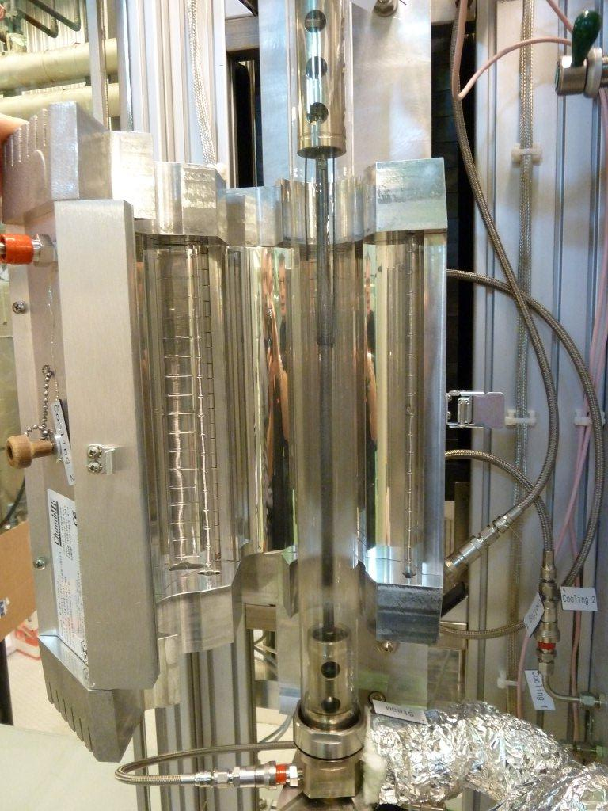
ECR case
A limiting ECR is defined based on mechanical resistance of the oxidized cladding
  Used to be based on ring compression test after oxidation
  The ultimate goal is to prevent core disintegration upon quenching
In France, the critical ECR is now based on a quench test under load in a specific LOCA testing device
  The whole test is ballooning, burst, oxidation and quenching under load
  ECR is calculated based on the ballooning diameter and the time spent at temperature
  Critical ECR is defined as the max. ECR for non-failed rod during quenching
  Critical ECR encompass rupture at the balloon caused by oxydation AND failure at secondary hydriding position
System of rod inner pressurization
Infrared furnace
Infrared lamp
Test rod
Quartz tube
Flooding water
Steam injection at 100°C
Elongation measurement by LVDT
Axial loading system + load cell

Slide 6
CRITICAL ECR
It is a decreasing function of the pre-transient H content
  Coated specimens could provide some margins because of the decrease of [H]
  Should also provide some margins because of the lowering of the oxidation embrittlement
We are currently assessing the impact of Cr coating on this limiting ECR.
Boutin et al. EUROSAFE 2016

Slide 7
Preliminary tests
With coated specimens provided by MIT and CTU
ECR is calculated for coated specimen considering double face oxidation to enable comparison
The results show that the first non-failed ECR of coated claddings is similar to the one of classical claddings
The reason lies in the secondary hydriding which occurs inside the burst specimen
  Rupture occurs at this location in both cases
Hazan et al. Journal of the Nuclear Materials 2021, 152940

Slide 8
Balloon size
Reduction in balloon size (hoop strain) would be beneficial
  e.g. to reduce FFRD
  Effect reported by CEA
Further works by Alakiozidis et al. Show that it depends on the burst temperature
  The effect is more effective when burst occurs in the beta phase
The gain of Cr-coated cladding depends on the LOCA methodology and its conservatisms
Brachet et al. WRFPM 2017
Alakiozidis et al. Journal of Nuclear Materials, 2025, 155766

Slide 9
Specific to coating
Tritium release
  Most of the tritium is generated in the fuel
  It has been demonstrated that tritium is retained inside the fuel rod by the zirconia layer (s)
  What about the coating?
If not, it would be released in the primary water generating huge difficulties
  Tritium release in the environment is hardly preventible and severely controlled
Currently under investigation
Uncoated surfaces: what does happen around an uncoated surface?
  Could occur as insertion scratches, spalling
    Specifically insertion scratches machined on the lead test rods introduced in Blayais
    No specificity observed
Defects in the coatings
  Known to exist (pores, splats...)
  If the quality of the CC influences the cladding's behaviour under accident conditions, this introduces a level of complexity in the safety demonstration.
Andrieu et al. JNM 304 (2005) 12-19

Slide 10
Specific to the french closed fuel cycle
Need to demonstrate that every fuel assembly is reprocessible
In nuclear waste, chromium is limited
  Forms a detrimental phase if dissolved in the glass
  Could increase the fine level which is also limited
Both phenomena are currently being assessed
From Treatment and recycling of spent nuclear fuel Actinide partitioning – Application to waste management, A CEA DEN monograph

Slide 11
Conclusions
Coated claddings provide improvements over classical claddings
  Better corrosion resistance
  Lower hydrogen pickup
  Better oxidation resistance
  Lower thermal creep rate
When it comes to the french safety files, the transposition of these improvements into benefit is hardly seen
  In the case of ECR: because the actual limiting phenomenon (secondary hydriding) is not modified by the coating
  In the case of ballooning: because in the actual safety framework, the conditions where the benefit materializes are not reached
Additional phenomena must be taken into account
  Tritium permeation, uncoated surface, defects
Specificities from the closed french nuclear cycle must also be assessed

