Slide 1
Separate effects tests conducted with ATF fuel cladding materials Márton Király, Zoltán Hózer, Márta Horváth, Tamás Novotny, Erzsébet Perez-Feró, Nóra Vér, Péter Szabó, Anna Pintér, Dávid Cinger, Barbara Somfai, Levente Illés IAEA Technical Meeting on Advanced Technology Fuels, October 2025

Slide 2
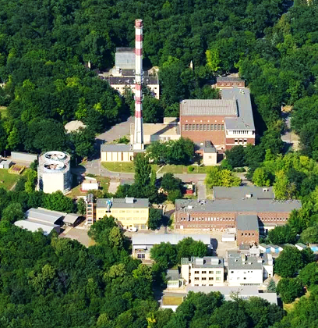
Overview
ATF materials
Planned experiments
Burst test
Oxidation tests
Tensile and RCT tests
Mandrel tests

Slide 3
Tests and experiments
In the IAEA CRP ATF-TS programme, various ATF cladding samples underwent testing and examinations, including:
Ballooning and burst tests with linear pressure increase of samples at 800-1000 °C (isothermal).
Mandrel ductility tests at room temperature to investigate the cladding under radial pellet-cladding interaction (PCMI) loads.
Oxidation in high temperature steam (1000 °C and 1200 °C).
Mechanical tests, ring tensile tests and ring compression tests, with as-received and pre-oxidized samples.
Profilometry, metallography and SEM of selected samples
CODEX-ATF integral test, simulating beyond design basis conditions, with temperatures above 1400 °C in steam

Slide 4
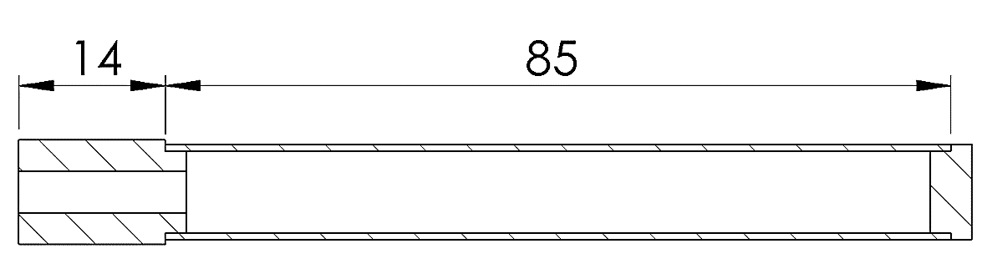
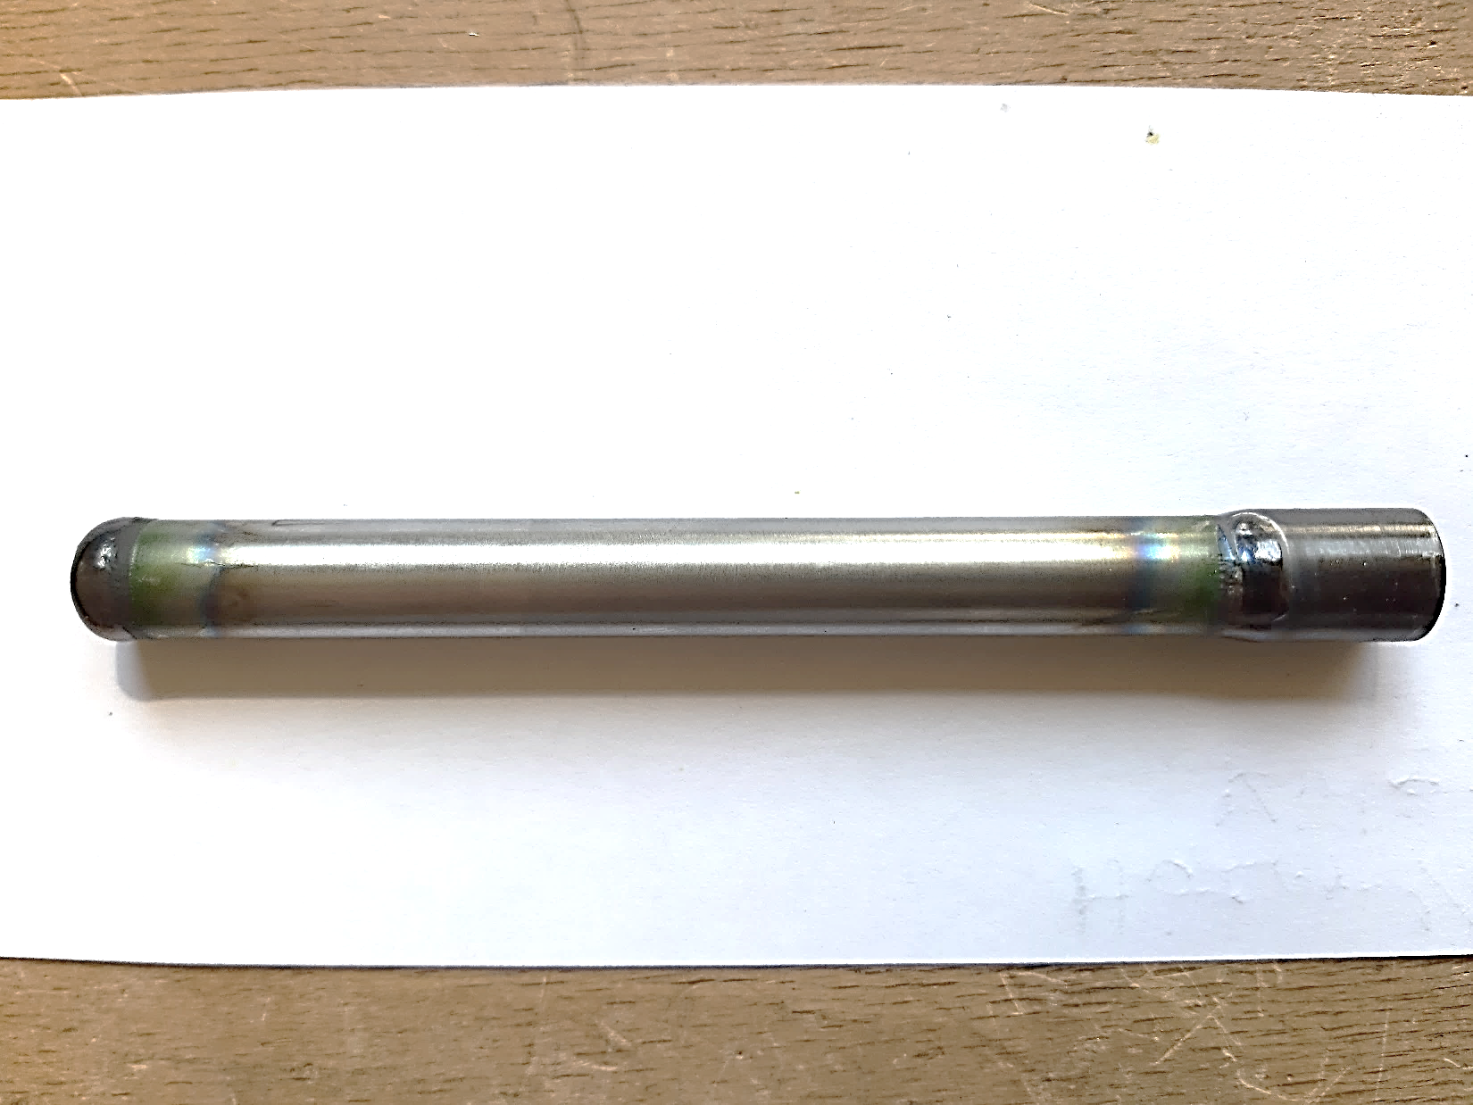
Materials tested
Tests were conducted with Zr-based cladding alloys and coated ATF variants in the framework of the programme.
These experiments were part of a collaborative effort to provide data on the changes in the ATF fuel cladding during normal operation and design basis accidents.
Over 300 ATF cladding samples underwent testing in more than 600 measurements and examinations.
It was intended to carry out parallel tests with all cladding types, however, the total amount of tubes provided by partners varied, so the number of tests performed with cladding types was limited by the available materials.

Slide 5
Materials tested
Short name | Cladding | Provider | OD | Wall thickness
OPZ- | Uncoated optZIRLO™ | CTU | 9.075 mm | 0.568 mm
OPZCR- | Cr coated optZIRLO™ | CTU | 9.085 mm | 0.576 mm
EI- | Uncoated Zr1%Nb | AEOI | 9.077 mm | 0.679 mm
ECRI- | Cr coated Zr1%Nb | AEOI | 9.08 mm | 0.699 mm
ECRNI- | CrN coated Zr1%Nb | AEOI | 9.05 mm | 0.685 mm
EXI- | CrN/Cr coated Zr1%Nb | AEOI | 9.08 mm | 0.704 mm
BSU- | Cr coated Zr alloy | BSU | 9.10 mm | 0.696 mm
ZRY4- | Uncoated Zircaloy-4 | KIT | 10.70 mm | 0.718 mm
ZRY4CR- | Cr coated Zircaloy-4 | KIT | 10.68 mm | 0.695 mm
ZCR- | Cr coated ZIRLO™ | KIT | 10.70 mm | 0.722 mm
FCA- | FeCrAl (B136Y) | KIT | 9.445 mm | 0.377 mm
ZY4TIAL- | TiAl coated Zircaloy-4 | CNL | 12.991 mm | 0.389 mm
ZY4- | Uncoated Zircaloy-4 | CNL | 12.985 mm | 0.383 mm

Slide 6
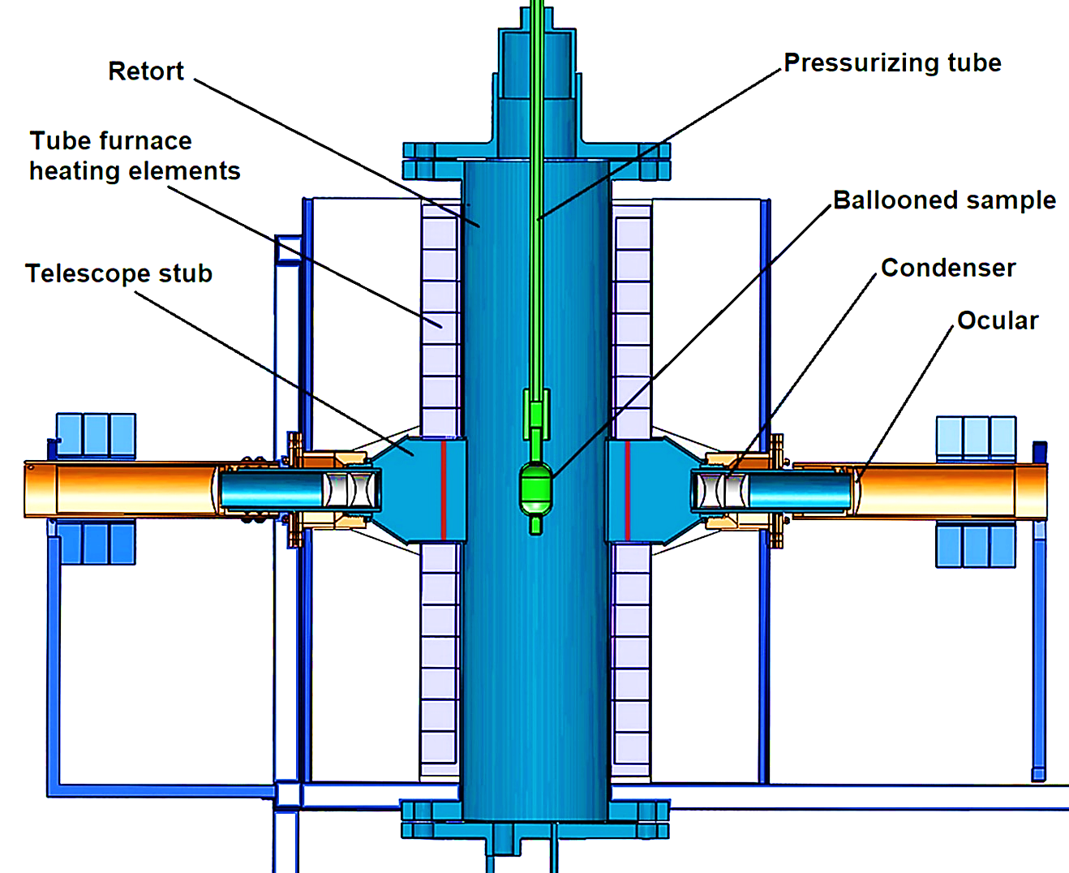

Burst tests
The burst test rig consists of a high temperature tube furnace, a pressure regulating system, a data acquisition and control system, and two high temperature telescopes that were built into the furnace.

Slide 7
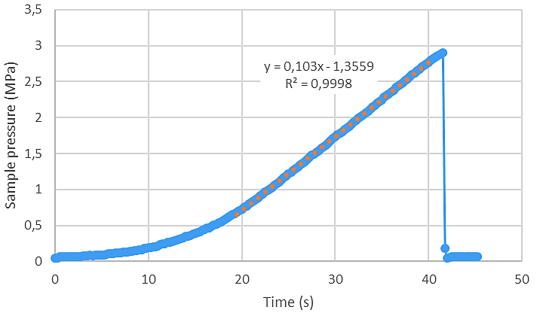
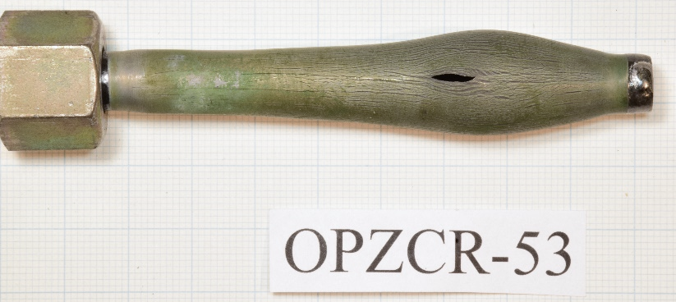
Burst tests
The samples were welded, plugged on one end and a diameter converter welded on the other, that was attached to the pressure system.
Isothermal temperatures 800°C, 900°C and 1000 °C, constant argon pressure increment of 100 kPa/s in most tests.
90 successful burst tests in inert atmosphere and 23 successful burst tests in steam atmosphere. The first 24 tests completed by 2022 were the basis of benchmark calculations in the CRP.
Photography and raw measurement data (t, T, p)
Post-test circumference measurement at 5 points.

Slide 8
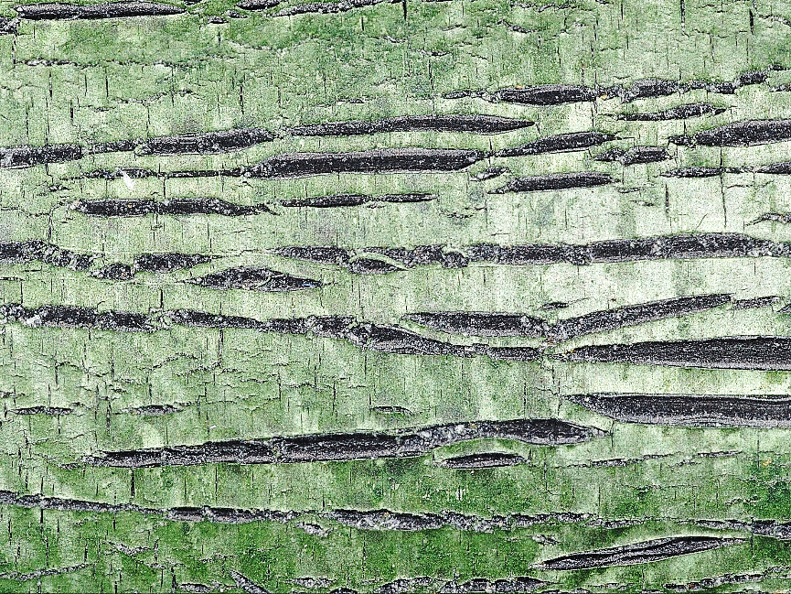
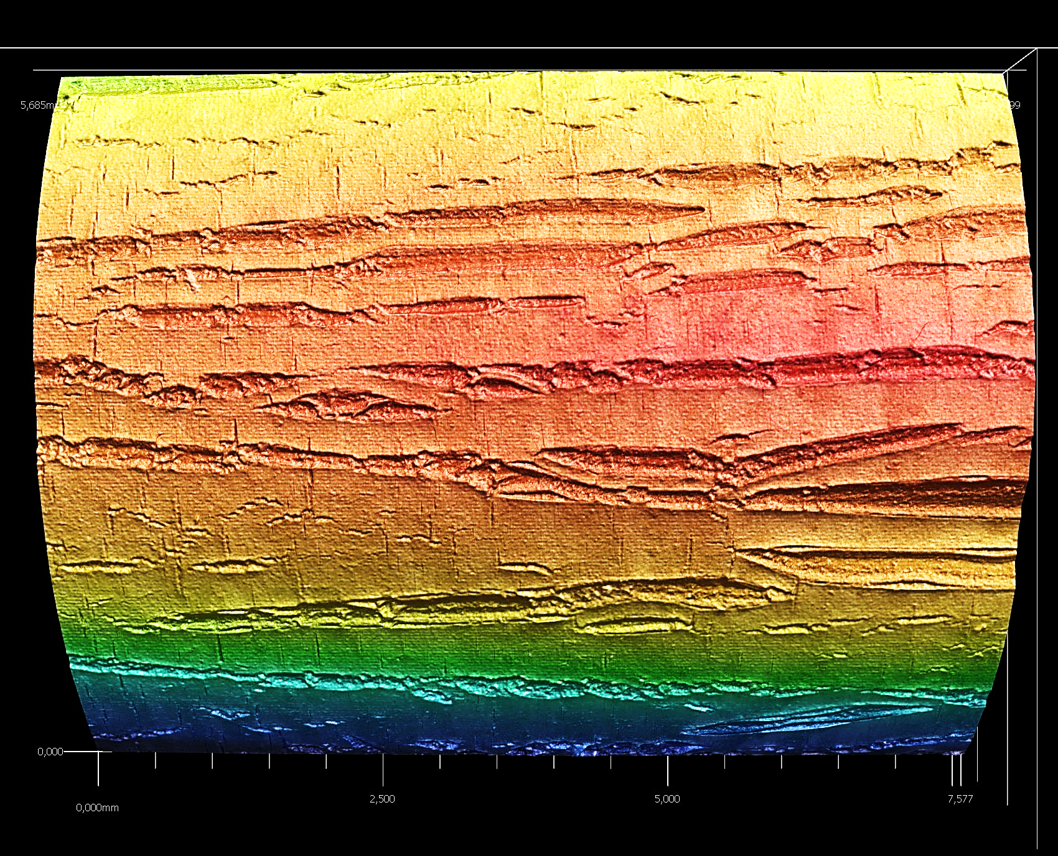
Burst post-test examinations
Significant cracking of the coating, long axial ridges were observed on the Cr coating post-test, not only at the burst location, but all along the tubes.

Slide 9
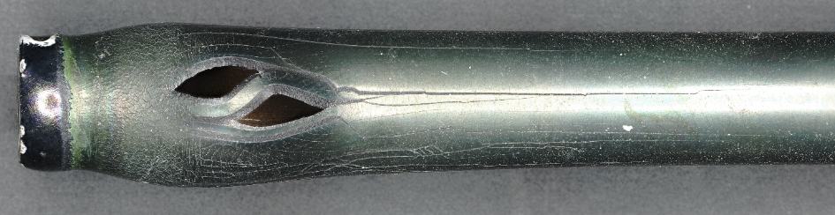
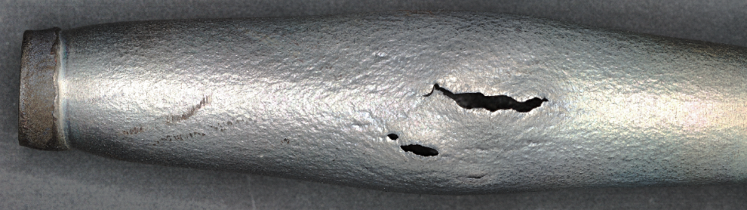
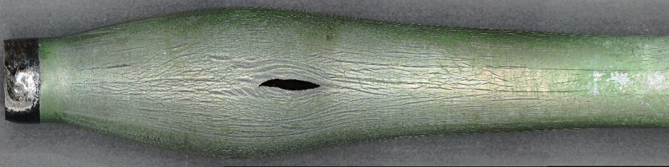
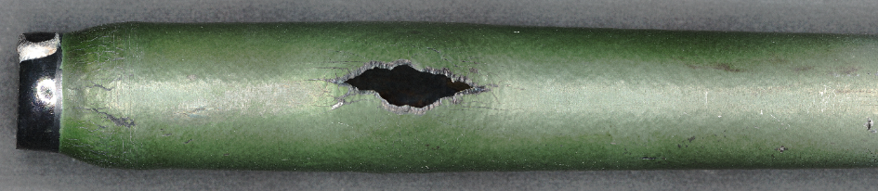
Burst results
14 samples were analyzed in detail:
The behavior of the coatings varied based on the temperature, different cracking patterns were seen.
The burst of the FeCrAl cladding was different, it needs to be investigated further.
Cr CrN Cr/CrN FeCrAl

Slide 10
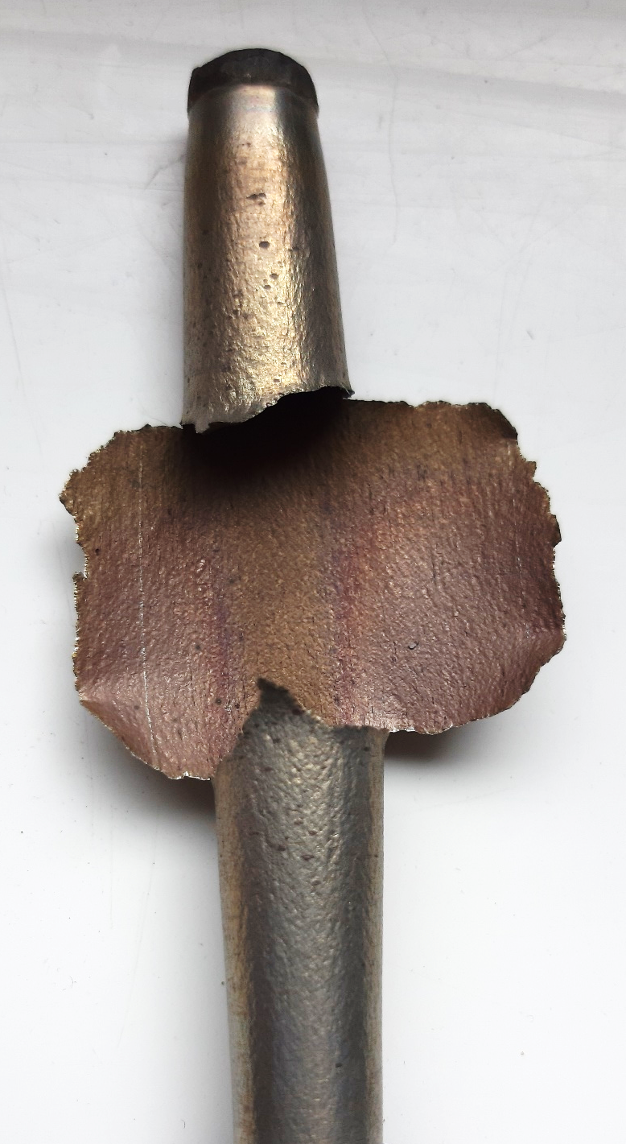
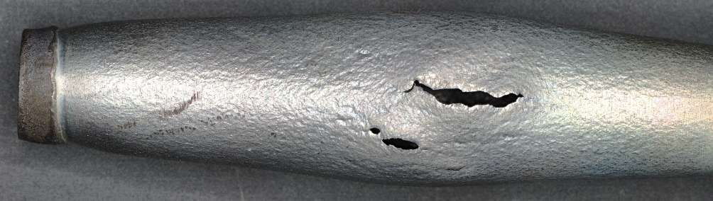
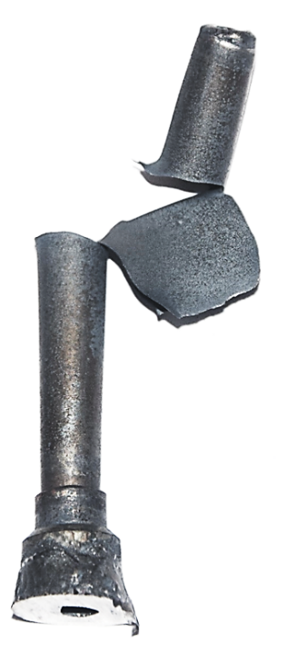
Failure modes
Some samples, especially the FeCrAl samples failed after small ballooning, but the crack propagation was different than for Zr-based alloys.
We have seen similar behaviour with the 15-15Ti fast reactor cladding samples.

Slide 11
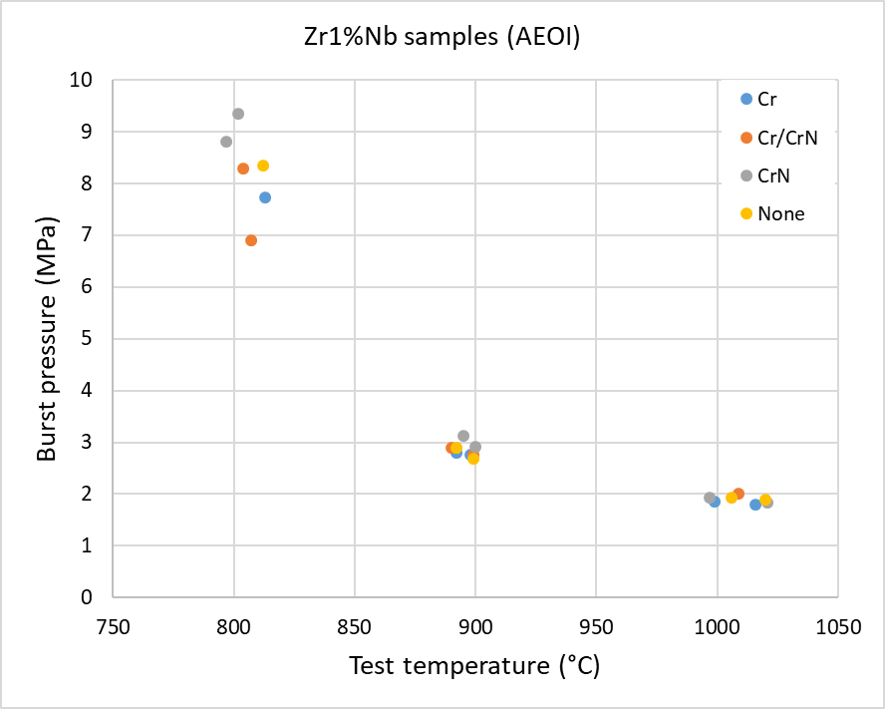
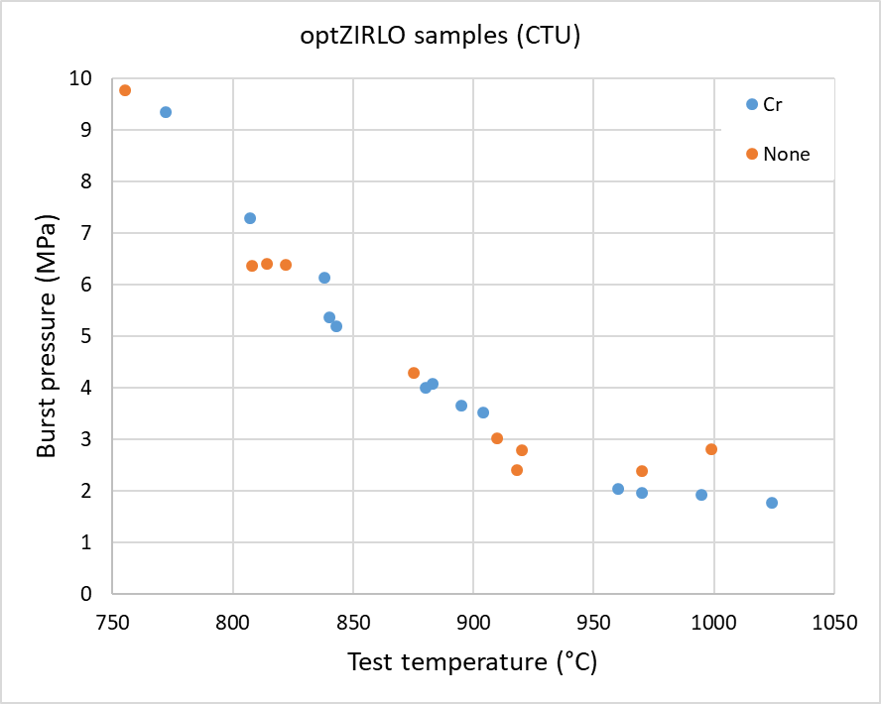
Burst results
We have found no evidence of the effect of the coatings on the burst pressure, even after some oxidation in steam.

Slide 12
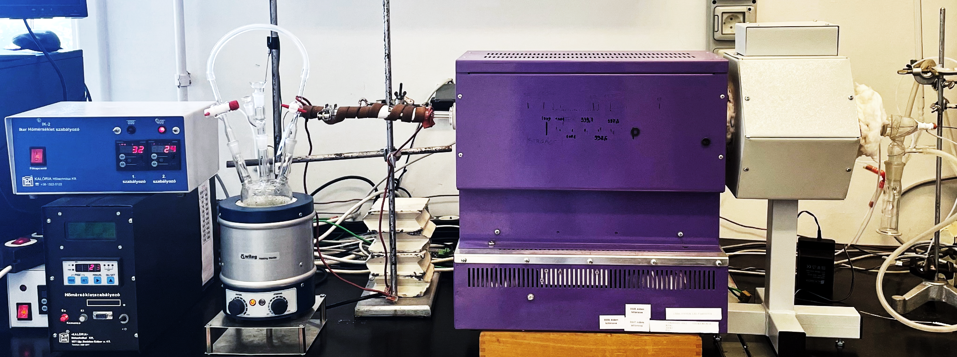
Oxidation tests
The protectiveness of candidate ATF coatings was investigated in high temperature steam, at 1000 °C for 3600 s and at 1200 °C for 1800 s, double sided oxidation, 8 mm rings, the reference uncoated samples were compared to the coated samples.
The oxidation in high temperature steam is used to determine the kinetics of oxidation at different temperatures during a design basis accident, to be implemented in various codes.

Slide 13
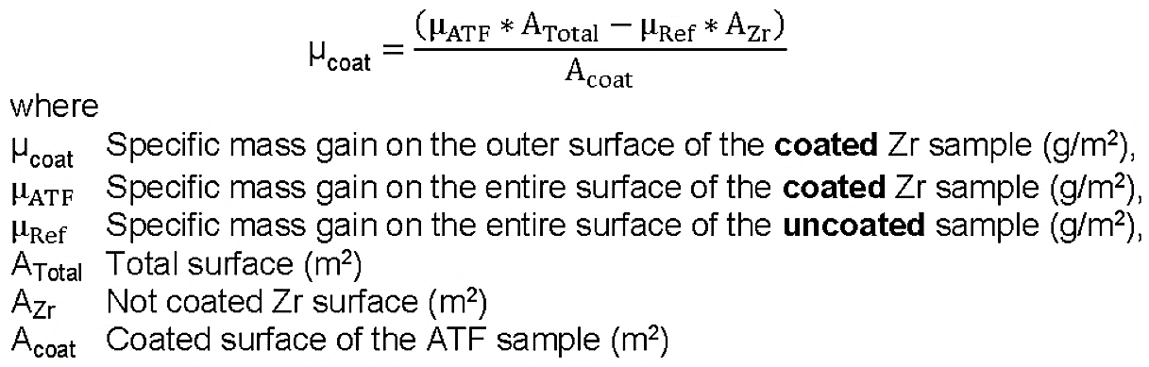
Oxidation tests
The specific mass gain of the coated side was calculated as:
In most cases, the coatings adequately protected the claddings, the coatings reduced the oxidation at 1000 °C by over 95%, at 1200 °C by 70-90%, the Cr/CrN coating was the most effective.
The FeCrAl cladding hardly oxidized, at 1200 °C to 1.3 ECR%.

Slide 14
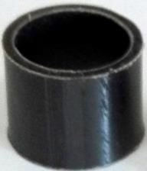
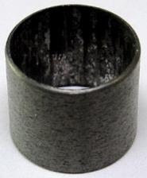
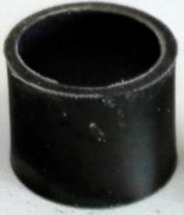
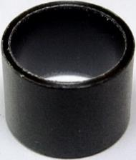
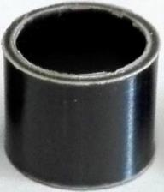
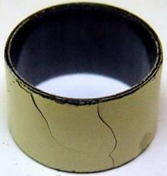
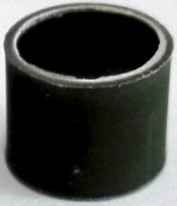
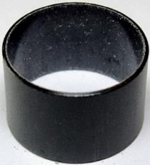
Oxidation results

Slide 15
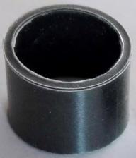
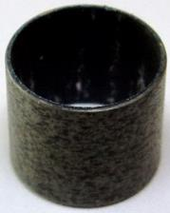
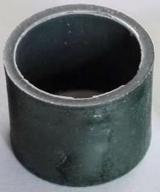
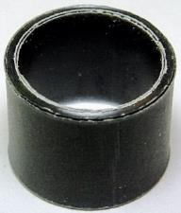
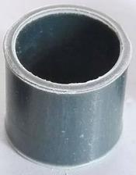
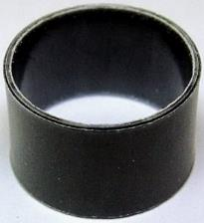
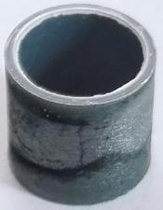
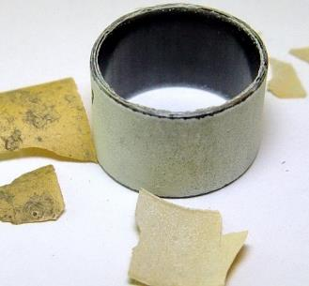
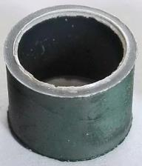
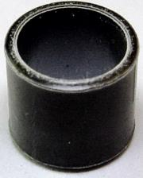
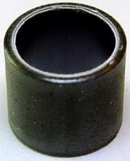
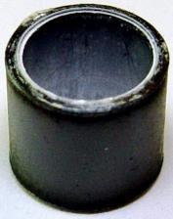
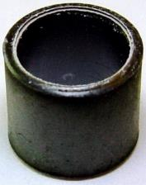
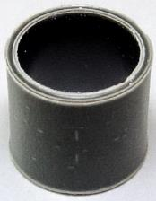
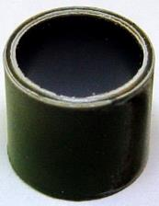
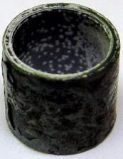
Oxidation results

Slide 16
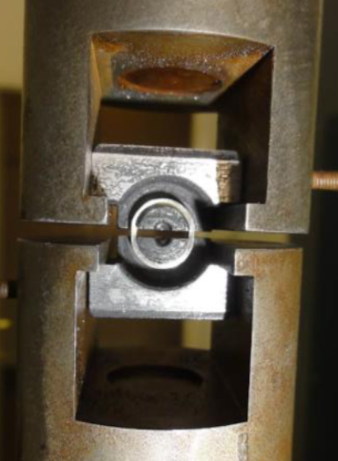
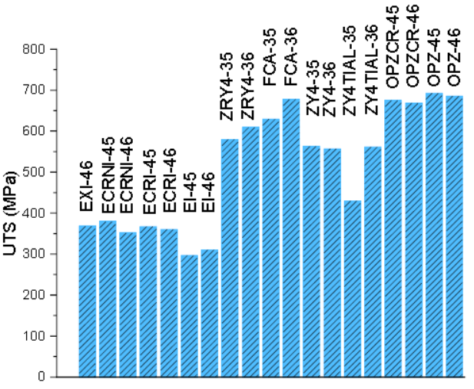
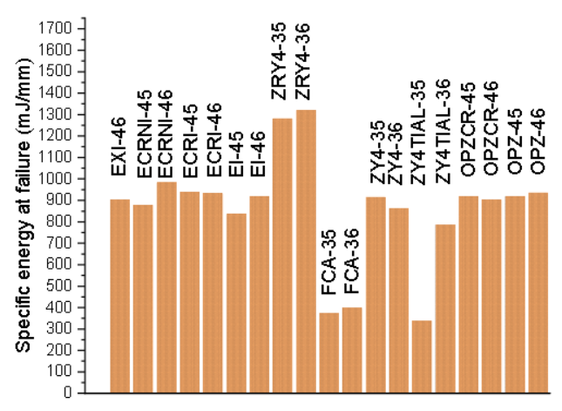
Ring tensile tests
The cladding samples were cut into 2 mm full rings and were tested at room temperature.
From each cladding type two rings were tested in as-received state, two after oxidation in steam at 1000 °C and at 1200 °C.
The UTS of untreated samples was not influenced by the coatings.

Slide 17
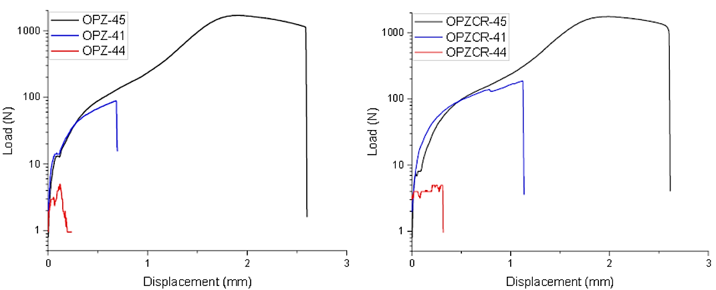
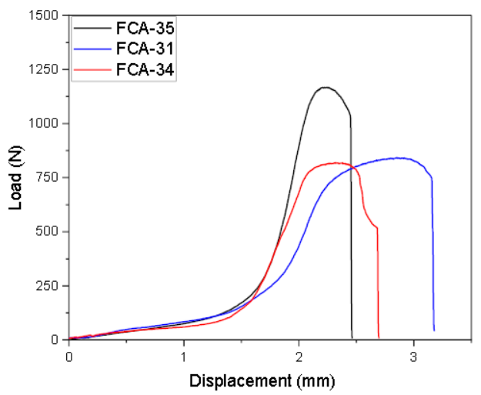
Ring tensile tests
Double-sided oxidation with coating only on the outer side, the protective effect is hardly visible after 30 ECR% oxidation.
The FeCrAl lost 30% strength after only 1.3 ECR% oxidation at 1200 °C, may be due to changes in the crystal structure.
As-received
Oxidation 1000 °C
Oxidation 1200 °C

Slide 18
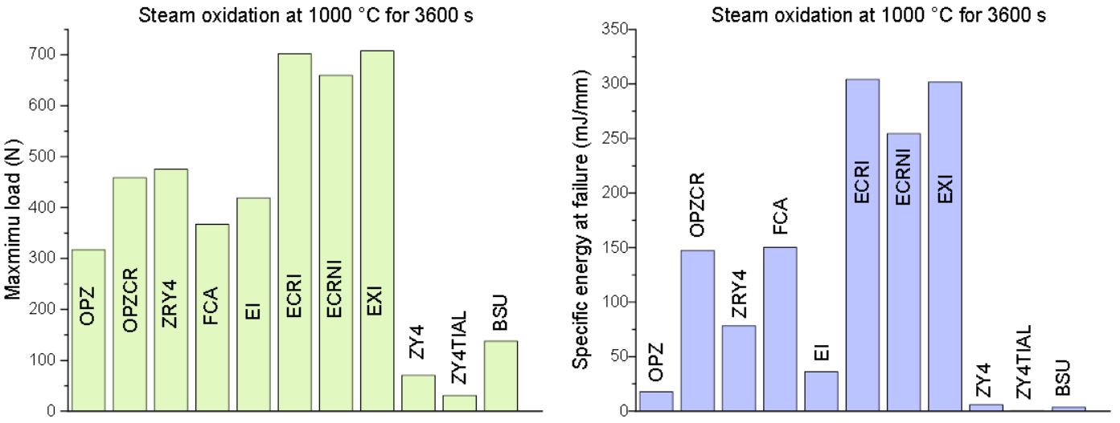
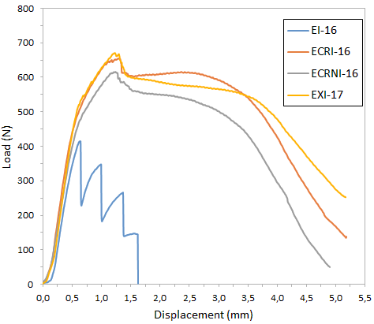
Ring compression tests
Ring compression tests were carried out at room temperature with 8 mm long samples after oxidation at 1000 °C and 1200 °C.
The Zr-based claddings with coatings could keep ductility after oxidation at 1000 °C, while the mechanical behavior of FeCrAl cladding was not influenced by the oxidation.

Slide 19


Ring compression tests
The double-sided oxidation at 1200 °C resulted in brittle behavior and failure at low loads for the Cr coated samples.
The CrN coating and the multilayer Cr/CrN coating significantly improved the cladding behavior, the FeCrAl was unaffected.

Slide 20




Mandrel ductility tests
The mandrel ductility test is similar to the ring compression tests, but the load is radial, simulating PCMI with the radially cracked fuel pellet

Slide 21



Mandrel ductility tests
Mandrel ductility test were conducted with untreated cladding materials (8 mm rings) to assess the possible strengthening effects of the coatings and failure mechanisms.
The crosshead speed was 2 mm/min, the deformation rate was 5%/min average inner diameter increase. All tests were conducted at room temperature and up to full sample rupture.

Slide 22


Mandrel ductility tests
There was no significant effect of the coatings on the ductility

Slide 23



SEM as-received
Two scanning electron microscopes were used for morphological and composition (EDX) studies. Secondary electron images were taken on the outer side surface of the samples at 5 keV. SEI and BEI images were taken on the cross sectional samples.
In some cases FIB (Ga+) was used to investigate the samples in depth by ablating a few micrometer deep trenches.

Slide 24



SEM post-test
After characterizing the as-received samples, some were investigated after the mandrel and the oxidation tests
ECRI-11
ECRNI-11
OPZCR-11
EXI-22
OPZCR-22
ECRI-22

Slide 25
Summary
Several kinds of tests and experiments have been performed with the ATF candidate materials received from the partners.
There was no significant difference in the mechanical properties of the coated and uncoated reference claddings.
The protectiveness of the Cr and CrN coatings against oxidation in high temperature steam was adequate at 1000 °C, but their performance varied at 1200 °C, and TiAl was not protective.
The FeCrAl alloy needs to be studied further as it showed very different behavior under LOCA-related circumstances as the Zr-based claddings, especially in ductility and burst behavior.
The data was collected into a Database of separate effect tests.

Slide 26
Thank you for your attention!

