Slide 1

IAEA ATF-TS BENCHMARK FOR SIMULATION OF BUNDLE TESTS
J. Stuckert, Z. Hózer, A. Khaperskaia

Slide 2
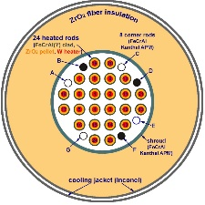

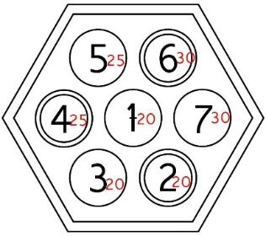
Simulation of three tests performed under BDBA conditions
with electrically heated bundles
WT2.2.1: QUENCH-19 with 24 internally DC heated rods, FeCrAl claddings, not pressurized rods, quench with water (test performed 2018 during the CRP ACTOF)
WT2.2.2: DEGREE-B3 with 9 inductively heated rods, Cr coated Zry-4 claddings, pressurized rods, cooling in Ar
WT2.2.3: CODEX-ATF with 7 internally DC heated rods and DC heated shroud, Cr coated opt. ZIRLO claddings (4 rods) , pressurized rods, quench with water
pressure

Slide 3
ATF-TS, Work Task 2.2.1.
Benchmark on the QUENCH-19 test
with FeCrAl bundle.
Participants (7) and codes (7)
CNEA Argentina | CTU Czech Republic | GRS Germany | IBRAE Russia | KIT/INR Germany | NINE Italy | UPM Spain
DIONISIO | MELCOR | ATHLET-CD | SOCRAT | ASTEC | MELCOR | MELCOR
Modelling output parameters for QUENCH-19:
1) temperature progress at the surface of claddings for the elevations 250, 550, 850, 950, 1050, and 1350 mm;
2) hydrogen release rate as indicator of cladding oxidation progress and integral hydrogen release.
The final report on the experimental results of the QUENCH-19 bundle test released in August 2022
https://www.doi.org/10.5445/IR/1000148370

Slide 4
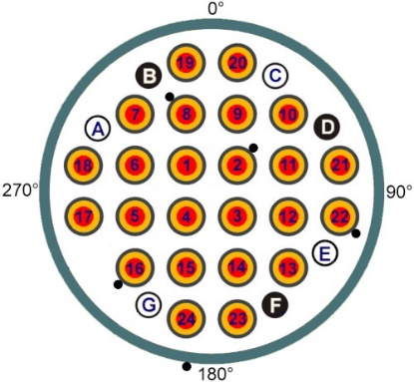
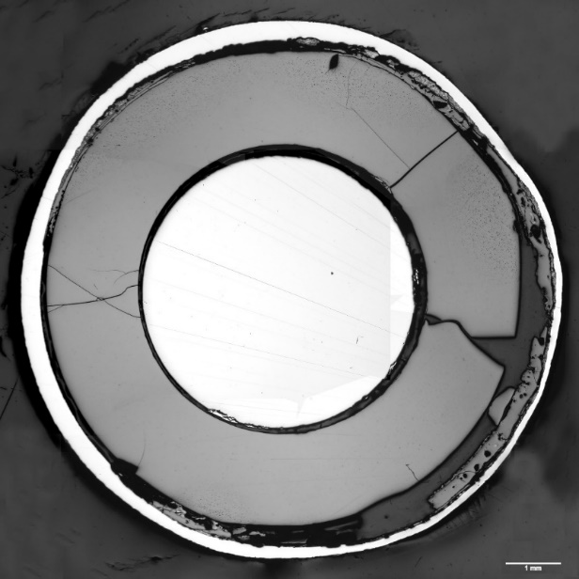
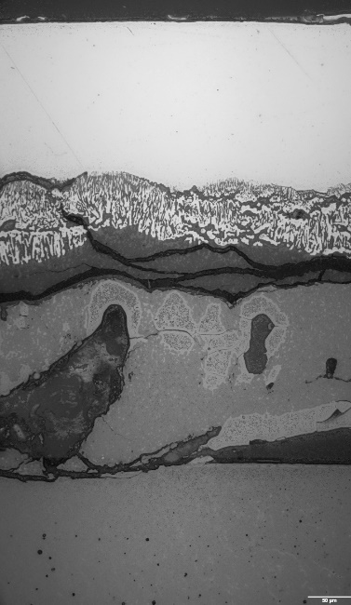
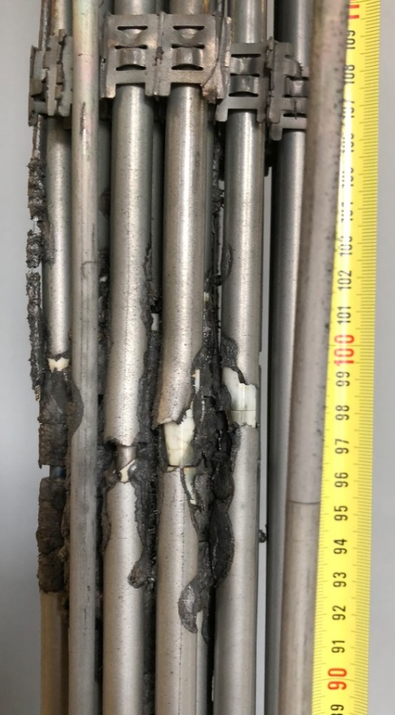
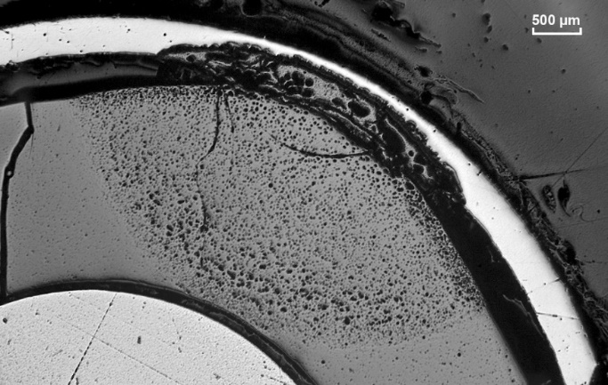
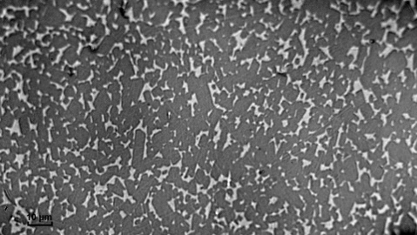
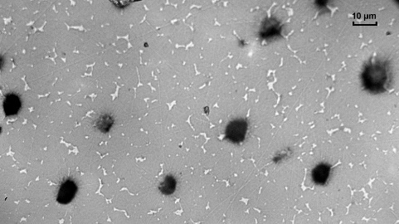
QUENCH-19 bundle at hottest elevations (T_{pct}=1455 °C): cladding and pellet damages by FeO melt formed already at 1370 °C, i.e. below the melting range of FeCrAl alloys (1500…1520°C)
/J. Stuckert et al., Report NUSAFE-3574, https://doi.org/10.5445/IR/1000148370 /
thin Al₂O₃ layer 2.5 µm
residual
metal cladding
positions of TCs (•) at 850 mm
two layers of oxidized inner surface of cladding
FeO melt with
(FeCrAl)O_{x} precipitates
FeO melt
porous part of pellet
rod 1 at 750 mm: melt interaction with cladding
oxidized FeCrAl precipitates (dark) in frozen FeO melt (light)
bundle side view: axial rupture of some claddings during quenching due to high coefficient of thermal expansion
rod 4 at 850 mm: interaction of melt with pellet
and thinning of cladding
FeO melt (light) penetrated between the grains of ZrO₂ pellet

Slide 5
QUENCH-19: Comparison of calculated and experimental temperatures
Axial temperature profiles before quench | Temperature progress for internal rods at 950 mm
Temperature progress for external rods at 950 mm | Temperature progress for shroud at 950 mm
Overestimation of temperatures for all codes - satisfactory for the first and second groups of rods
and significantly overestimated for the shroud.

Slide 6
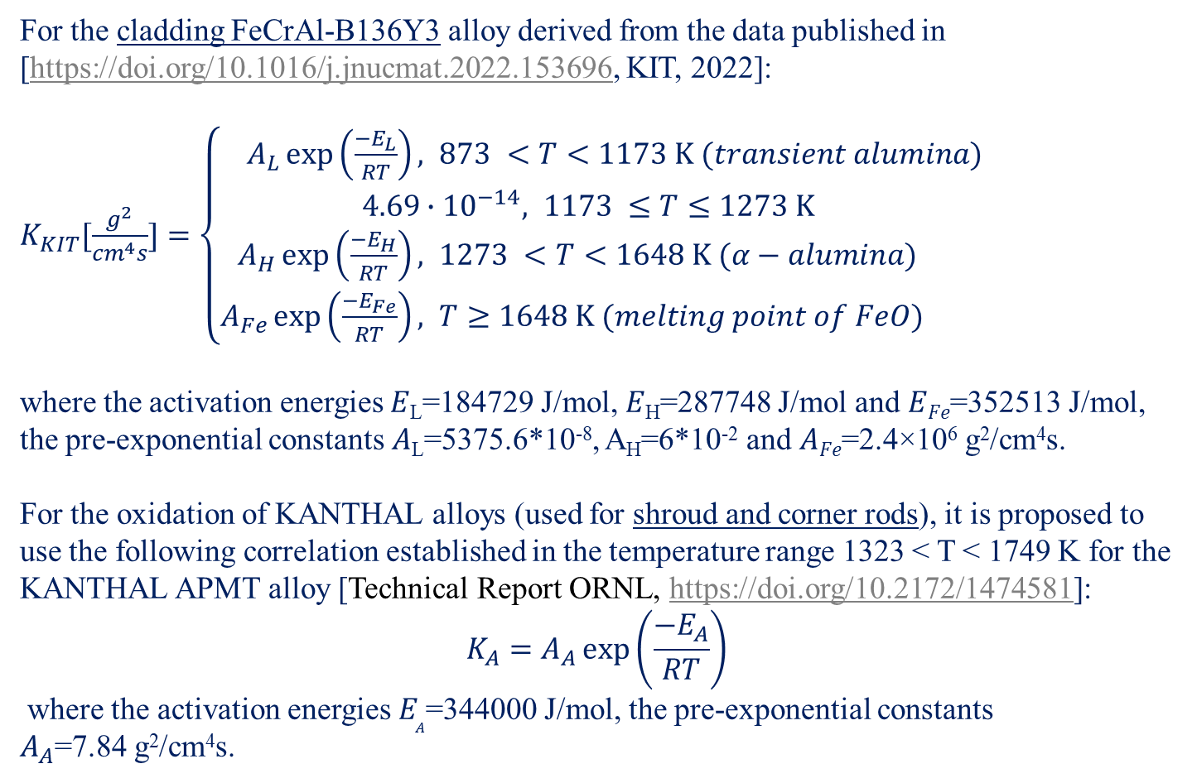
QUENCH-19: suggested oxidation kinetics
for the bundle elements
For the cladding FeCrAl-B136Y3 alloy derived from the data published in [https://doi.org/10.1016/j.jnucmat.2022.153696, KIT, 2022]:
$K_{KIT}[\frac{g^{2}}{{cm}^{4}s}]=\left\{\begin{aligned}A_{L}\exp\left(\frac{−E_{L}}{RT}\right), &873 <T<1173 K (transient alumina) \\ 4.69∙{10}^{−14}, 1173 ≤T≤1273 K \\ A_{H}\exp\left(\frac{−E_{H}}{RT}\right), &1273 <T<1648 K (α−alumina) \\ A_{Fe}\exp\left(\frac{−E_{Fe}}{RT}\right), &T≥1648 K (melting point of FeO)\end{aligned}\right.$
where the activation energies 𝐸_{L}=184729 J/mol, 𝐸_{H}=287748 J/mol and 𝐸_{𝐹𝑒}=352513 J/mol,
the pre-exponential constants 𝐴_{L}=5375.6*10⁻⁸, A_{H}=6*10⁻² and 𝐴_{𝐹𝑒}=2.4×10⁶ g²/cm⁴s.
For the oxidation of KANTHAL alloys (used for shroud and corner rods), it is proposed to use the following correlation established in the temperature range 1323 < T < 1749 K for the KANTHAL APMT alloy [Technical Report ORNL, https://doi.org/10.2172/1474581]:
$${K_{A}=A}_{A}\exp\left(\frac{−E_{A}}{RT}\right)$$
where the activation energies $E_{A}$=344000 J/mol, the pre-exponential constants $A_{A}$=7.84 g²/cm⁴s.

Slide 7
Simulation results for hydrogen released during the QUENCH-19 bundle test
2Al + 3H₂O = Al₂O₃ + 3H₂; xFe + yH₂O = Fe_{x}O_{y} + yH₂
A very good prediction for the total mass of released hydrogen was given by three codes, which is primarily due to the fairly
accurate calculation of bundle temperatures by these codes. The deviation in the prediction of total hydrogen release by
other codes is due to either increased calculated temperatures (overprediction of hydrogen) or individual modification
of the oxidation correlation for iron (underprediction of hydrogen).

Slide 8
Modelling of bundle tests DEGREE-B3 and CODEX-ATF
with Cr-coated claddings

Slide 9




Oxidation correlations used for Cr coated claddings
ASTEC and FRAPTRAN
ATHLET-CD
derived at CEA from
Brachet et al. (Corrosion Science 167, 2020) https://doi.org/10.1016/j.corsci.2020.108537
1073 K<T<1573 K
derived at RUB from
Brachet et al. (Corrosion Science 167, 2020) https://doi.org/10.1016/j.corsci.2020.108537
1073 K<T<1573 K
$$δ=2630∙e^{−\frac{119747}{R∙T}}∙\sqrt{t}$$
$$δ=2661∙e^{−\frac{120000}{R∙T}}∙\sqrt{t}$$
$$∆m=0.4327∙e^{−\frac{119747}{R∙T}}∙\sqrt{t}$$
$$∆m=0.4378∙e^{−\frac{120000}{R∙T}}∙\sqrt{t}$$
δ – Cr₂O₃ layer thickness in µm,
Δm – mass gain due to oxygen uptake by Cr [g/cm²],
T – temperature in K,
t – time in s,
gas constant R=8.314 J/(mol*K)
Correlations for mass gain used in SOCRAT
T< 1373 К: K=40∙exp(-28890/T) [kg²/m⁴s]
1373 К ≤T≤ 1523 K: K=(T-1333)∙exp(-28890/T) [kg²/m⁴s]
T> 1523 К: K=190∙exp(-28890/T) [kg2/m⁴s]
T> 1700 К: K=190∙exp(-28890/1700) [kg2/m⁴s]
J. Bischoff, et al., 2018. Cr-coated cladding development at Framatome. TopFuel 2018 - Light Water Reactor (LWR) Fuel Performance Meeting 2018, Sep 2018, Prague, Czech Republic
Brachet J., et al., 2018. Behavior of Cr-Coated M5 Claddings during and After High Temperature Steam Oxidation from 800°C up to 1500°C (Loss-of-Coolant Accident & Design Extension Conditions). TopFuel 2018 (p. A0100). Prague, Czech Republic
Guangbin Li, et al., 2020. High Temperature Anti-Oxidation Behavior and Mechanical Property of Radio Frequency Magnetron Sputtered Cr Coating, Metals 2020, 10, 1509
E.B. Kashkarov, et al., 2020. Oxidation kinetics of Cr-coated zirconium alloy: Effect of coating thickness and microstructure, Corrosion Science 175 (2020) 108883

Slide 10
ATF-TS, Work Task 2.2.2.
Benchmark on the DEGREE-B3 bundle test.
Participants: 9 planned, 3 participated
participant | KIT/INR Germany | CRIEPI Japan | IBRAE Russia
code | ASTEC | FRAPTRAN | SOCRAT
post-test data delivered | + | + | +
Important point for the simulation of inductive heating: power distribution between tungsten heaters inside rods and direct heating of claddings by eddy currents.
Modelling output parameters for DEGREE-B3:
1) temperature progress at the surface of claddings for the elevations 125 and 180 mm;
2) hydrogen release rate as indicator of cladding oxidation progress and integral hydrogen release;
3) rod inner pressure change during cladding ballooning and burst.

Slide 11
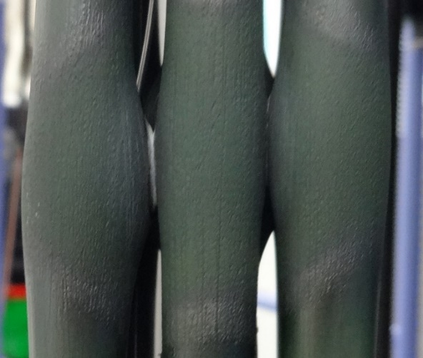
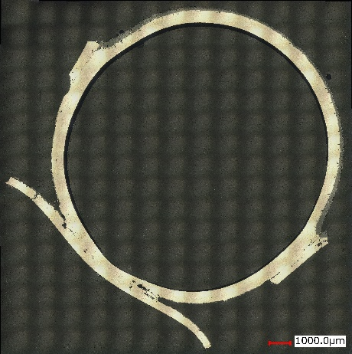
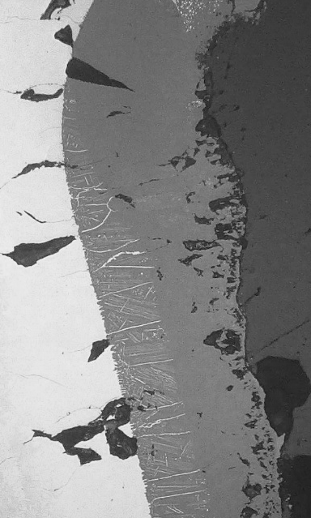
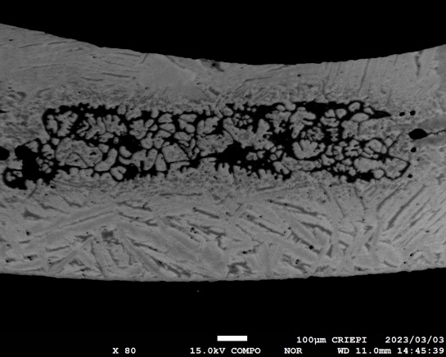
DEGREE-B3 test performed at CRIEPI on 11th April 2023
/K. Nakamura et al. “Preliminary BDBA tests of Cr-coated Zr alloy cladding at DEGREE facility”, QWS-28, Karlsruhe, 2023, https://doi.org/10.5445/IR/1000165938 /
Test Scenario
5
4
3
P_{max} ~23 kW
~2 kW
9
ZrO₂
250 µm
9
Zr-Cr eutectic at 1330 ℃
5
4
3
4
100 µm

Slide 12
DEGREE-B3: Comparison of temperature simulations
Clad temperatures of central rod at 125 mm | Clad temperatures of central rod at 180 mm
Good agreement with the experiment;
The temperature escalation predicted by the SOCRAT code at 125 mm should be associated with the diffusion of chromium into the zirconium matrix, leading to the disappearance of the protective chromium layer and accelerated oxidation of zirconium at this temperature.

Slide 13
DEGREE-B3: Comparison of hydrogen release simulations
Hydrogen release without Zr oxidation (ASTEC and FRAPTRAN) | Hydrogen release with Zr oxidation (SOCRAT)
Calculations with the SOCRAT code showed an excess of the threshold temperature of 1332 °C, so after reaching this value, the standard Cathcart-Pawel correlation was used for the oxidation of Zircaloy-4 (right diagram).
From the two presented diagrams it is clear that taking into account only the oxidation of chromium leads to an underestimation of hydrogen, while inclusion of the kinetics of zirconium oxidation too early gives an overestimated result.

Slide 14
Work Task 2.2.3.
Benchmark on the CODEX-ATF bundle test.
Participants: 9 planned, 4 participated
pressure
Participant | CNEA Argentina | GRS Germany | IBRAE Russia | NUBIKI Hungary
Code | DIONISIO | ATHLET-CD | SOCRAT | MELCOR
pre-test |  | + | + | +
post-test | + | + | +
Modelling output parameters for CODEX-ATF:
1) temperature progress at the surface of claddings for the bundle elevations with TCs:
50, 150, 200, 300, 400, 500 and 550 mm;
2) hydrogen release rate as indicator of cladding oxidation progress and integral hydrogen release.

Slide 15
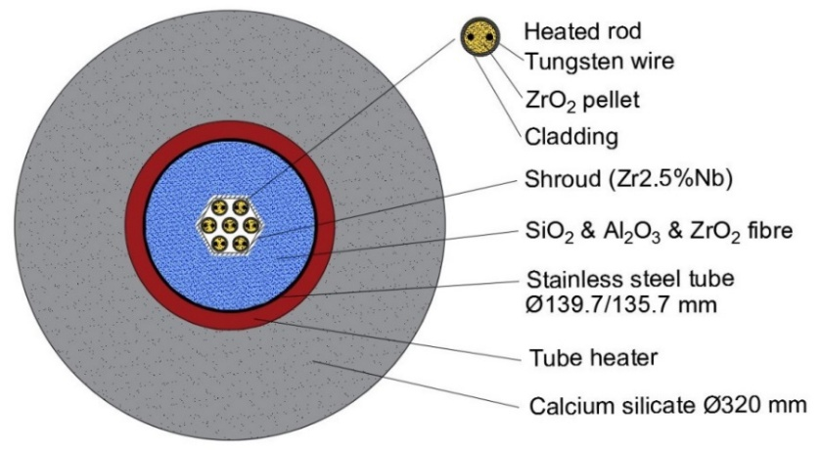
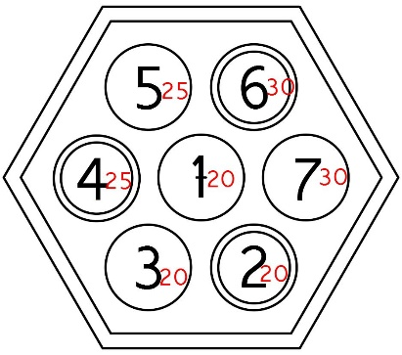
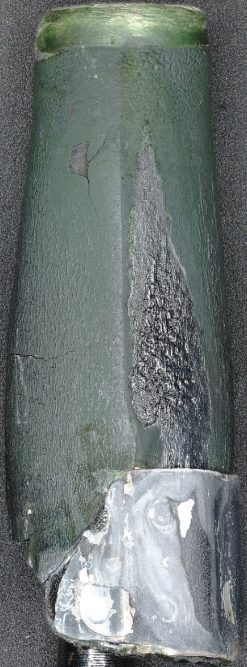
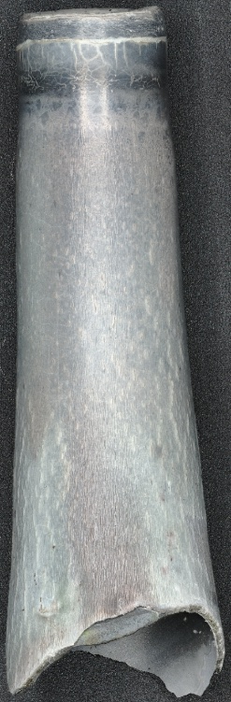
CODEX-ATF test performed at HUN-REN EK on 11th August 2023
/R. Farkas et al., “The CODEX-ATF experiment”, 28th QUENCH Workshop, Karlsruhe, 2023, https://doi.org/10.5445/IR/1000165938 /
opt. ZIRLOTM
Cr-coated (18 µm) opt. ZIRLOTM
pressure
rod 3: Cr coated opt. ZIRLO | rod 4: not coated opt. ZIRLO
real Tmax=1655 °C
Cr₂O₃
proposed P_{max}:
Zr/Cr
eutectic
real P_{max}: 1000 W
ZrO₂
not coated
spacer grid

Slide 16
CODEX-ATF: Comparison of temperature simulations
Until escalation: well prediction for coated, overestimation for uncoated rods
Simulated jump at T ≈ 1300 °C (failure of chromia layer)
Common: no reproduction of temperature escalation
Underestimation until escalation

Slide 17
CODEX-ATF: Comparison of hydrogen integral release simulations
total H₂ release
ATHLET-CD: overestimation (due to overestimation of T)
SOCRAT: well prediction (accurate T prediction, oxidation of Zr substrate under Cr layer)
DIONISIO: underestimation (shroud not simulated)
contribution of 4 coated claddings
ATHLET-CD: oxidation of Zr substrate not simulated
SOCRAT: simulation of Zr substrate
DIONISIO: underestimation (strong T underestimation)

Slide 18
Conclusion on WT 2.2 of IAEA ATF-TS projects
Benchmarks for simulating bundle experiments with ATF cladding materials, organized within the framework of the IAEA ATF-TS project, showed a good possibility of adapting codes for new materials.
Data of post-test simulations delivered by: 1) 7 participants for QUENCH-19, 2) 3 participants for DEGREE-B3, 3) 3 participants for CODEX-ATF.
While the thermal-hydraulic parameters of the experiments were calculated using algorithms already built into the codes, the oxidation modules were modified to take into account the correlations of FeCrAl and Cr oxidation. Temperatures are mostly overestimated (before the escalation cases), whereas the hydrogen release values are widely scattered.
The oxidation of FeCrAl included the entire operating temperature range, while the behavior of the chromium coating was described for temperatures below the point of formation of the Cr/Zr eutectic melt. Further research is needed to take into account processes above this eutectic point.

Slide 19
Acknowledgements
This work has been conducted within the framework of IAEA’s Coordinated Research Project on Testing and Simulation for Advanced Technology and Accident Tolerant Fuels (ATF-TS).
The authors are grateful to Alejandro Soba, Martin Lemes and Matias Loza (CNEA), Martin Ševeček (CTU), Thorsten Hollands (GRS), Kirill Dolganov and Nikolai Ryzhov (IBRAE), Fabrizio Gabrielli (KIT), Marco Cherubini and Hector Lopez (NINE), Cesar Queral and Kevin Fernández Cosials (UPM), Kenta Inagaki (CRIEPI), Pál Kostka and Gábor Lajtha (NUBIKI) for performing pre- and post-test calculations.

Slide 20
Thank you for your attention
QUENCH at KIT: https://www.iam.kit.edu/awp/english/163.php
http://quench.forschung.kit.edu/
CRIEPI (DEGREE facility): https://criepi.denken.or.jp/en/
CODEX at HUN-REN EK: https://www.ek.hun-ren.hu/en/fuel-and-reactor-materials-department/

