Slide 1


LWR Perspective of Industrial Applications of ATF (high burnup, FFRD, time @ temperature)
Baris Sarikaya, Constellation, BWROG
Brian Mount, Dominion Energy, PWROG
Vienna
October 2025

Slide 2
Outline
Why ?
Why ?
What ?
What ?
How ?
1

Slide 3
Why ?
Future
Advances
Challenges
Capacity Factor, Safety, Reliability,
modeling
simulation
methodology
tools
operating experience
innovation
Challenges
Technical
Regulatory
More Nuclear
safe,
reliable,
clean/green,
economic
2
Notes:
Future: Climate crisis - > More nuclear generation -> Power uprates (operating fleet) & new build (SMRs)
Advances: Advances in modeling and simulation techniques, methodologies, tools, operating experience, LWR fleet capacity factor and reliability have improved significantly over the last few decades.
Challenges : these new opportunities often present technical and regulatory challenges. Experts from LWR industry will discuss these challenges as well as the new opportunities identified while addressing these challenges via application of innovative solutions

Slide 4
Why ?
Future
Advances
Challenges
Opportunities
3
Notes:
Future: Climate crisis - > More nuclear generation -> Power uprates (operating fleet) & new build (SMRs)
Advances: Advances in modeling and simulation techniques, methodologies, tools, operating experience, LWR fleet capacity factor and reliability have improved significantly over the last few decades.
Challenges : these new opportunities often present technical and regulatory challenges. Experts from LWR industry will discuss these challenges as well as the new opportunities identified while addressing these challenges via application of innovative solutions

Slide 5
What ?
Opportunities
Power Uprates
Cycle Extension
HBU
IE
t@T
4

Slide 6
What ?
High Burnup / Increase Enrichment
Challenges
LOCA – FFRD
Dose – Source term
Decay Heat
Transportation
Storage
Benefits
Increased fuel efficiency
longer cycles
Power uprates
Reduced batch fraction
Reduced spent fuel & storage
Opportunities
Modernized LOCA rule, 50.46(a) & 50.46(c)
New Fuel Integrity Criteria, t@T
Modernized Dose Analysis Regulations, RG 1.183 Rev 2 (DG-1425)
FFRD: Fuel Fragmentation Relocation Dispersal
t@T: time at Temperature

Slide 7
How ?
High Burnup / Increase Enrichment
FFRD
t@T
RG 1.183
Modernized LOCA Rule (50.46)
  50.46(c)
  50.46(a)
Performance based LOCA
Risk Informed LOCA
Re-defining design basis and licensing basis LOCA definition.
Fuel integrity criteria is redefined
Limited entry in BT does not result in fuel failure
Fuel failure conditions are significantly worse than those for onset of BT.
Operating Limits and Dose Benefit
Fuel cycle cost benefit
Enabler for Power Uprate
Rev 0 is licensing basis for all
Rev 1 takes us to 68 GWd/MTU
  Limited increase for PWRs
  Significant increase for BWRs
Rev 2 is being developed
(≤ 80 GWd/MTU)
Increase Enrichment Rulemaking

Slide 8
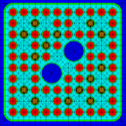
How ?
High Burnup / Increase Enrichment – LOCA
LOCA

Slide 9
How ?
High Burnup / Increase Enrichment – LOCA
Why Change ?
Current approach is very conservative
  Large break LOCA (as analyzed) is very unlikely event
  Modern PRA applications demonstrated very low CDF and LERF contribution by LB LOCA
  Recent improvements in plant safety and operation
  Improved analytical, modeling, and computing capabilities

Slide 10
How ?
High Burnup / Increase Enrichment – LOCA
Change to ?
Risk informed LOCA (50.46a)
  Risk informed
  Breaks larger than Transition Break Size (TBS) are considered BDB
      No change to the analyses below TBS

Slide 11
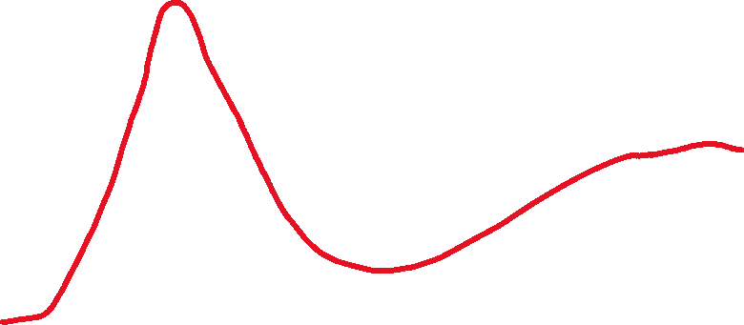

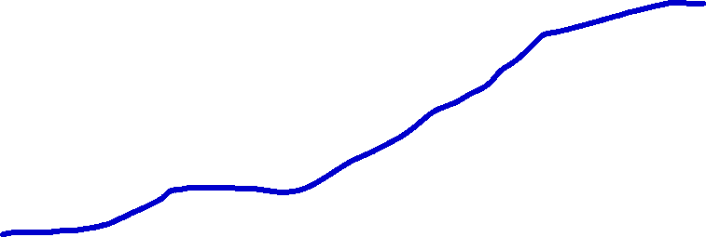

How ?
High Burnup / Increase Enrichment – LOCA
Break Spectrum
Peak Cladding Temperature
TBS
Break Area
10

Slide 12
How ?
High Burnup / Increase Enrichment – t@T
time @ Temperature
t@T

Slide 13
How ?
High Burnup / Increase Enrichment – t@T
Current Approach
NO BT
NO
Cladding Heat-up
NO
Fuel Failure
BT: Boiling Transition

Slide 14
How ?
High Burnup / Increase Enrichment – t@T
Why Change ?
Current approach is conservative
  Margin between onset of boiling transition and fuel failure conditions
  In other words, “limited” entry in to boiling transition would not result in reaching fuel failure conditions or Fuel failures
Alternative fuel integrity criteria are already in use outside the moderate frequency transient applications
    NUREG-0562, “Fuel Rod Failure as a Consequence of Departure from Nuclear Boiling or Dryout,” June 1979.

Slide 15
How ?
Why Change (continued) ?
Excess conservatism in fuel integrity criteria places an inordinate burden on fuel cycle economics
Spent fuel storage
Limits core design
More spent fuel
Fuel under-utilization
Fuel cycle economics
Dose
impact
More fuel bundles

Slide 16
How ?
High Burnup / Increase Enrichment – RG 1.183
RG 1.183

Slide 17
How ?
High Burnup / Increase Enrichment – RG 1.183
Rev. 1
Draft Rev. 2
Supports
  Burnup ≤ 68 GWd/MTU
  Enrichment ≤ 8w/o U²³⁵
Significant increase in BWR releases
Negligible impact on PWR releases
Supports
  Burnup ≤ 80 GWd/MTU
  Enrichment ≤ 8w/o U²³⁵ (PWRs) and ≤ 10w/o U²³⁵ (BWRs)
Adds pathway dependent releases for BWRs
Increase Control Room Design Criterion to 0.10 Sv (10.0 rem) for several events

Slide 18

How ?
There is more…is conservative really conservative ?
Excess conservatism in analysis and acceptance criteria leads to
    Restricted operating limits
    Additional maintenance leading to increased outage worker dose
Conservative/restricted operating limits could result in perturbations to steady state plant operation
    Control rod/blade moves or down-power operation to stay within operating limits
      Resulting in local and/or core-wide transients
    Any transient (local or core-wide) creates more challenging environment for fuel rod integrity
    Increase likelihood for reactor trips.

Slide 19
Summary
Once in a generation opportunities (Risk informed LOCA, t@T, HBU, LEU+, …)
Several Challenges (FFRD, material behavior, …)
Collaboration Opportunities
Reshape the industry!

Slide 20
LWR Perspective of Industrial Applications of ATF (high burnup, FFRD, time @ temperature)
Baris Sarikaya, Constellation, BWROG
Brian Mount, Dominion Energy, PWROG
Vienna
October 2025

