Slide 1
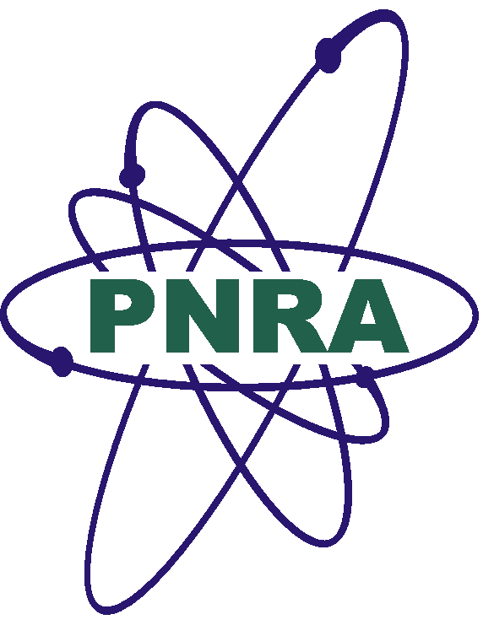
Constraints Involved in Safety Review of Accident Tolerant Fuel (ATF) - Pakistan's Perspective
Technical Meeting on “Advanced Technology Fuels: Progress on their Design, Manufacturing, Experimentation, Irradiation, and Case Studies for their Industrialization, Safety Evaluation, and Future Prospects”
October 28-31, 2025, Vienna, Austria
Hamid Saeed Raza
Principal Engineer, Centre for Nuclear Safety
Pakistan Nuclear Regulatory Authority
Islamabad, Pakistan

Slide 2

Outline
Introduction
Pakistan’s Perspective on ATF
Capacity Building Project on ATF
Expected Outcome
Conclusions
Photo courtesy: https://www.pda.org/home

Slide 3
Introduction
In the era of rapidly advancing technologies, the capacity of regulatory bodies to conduct thorough and timely safety reviews has become increasingly critical.
Approaches to evaluate novel nuclear fuel technologies vary across regulatory bodies; however, a shared objective remains to assess the safety benefits of advanced fuels, particularly Accident Tolerant Fuels (ATFs) and to shape future review strategies accordingly.
Despite the existing presence of conventional nuclear fuels within the industry, the accelerating pace of innovation in advanced fuel development demands enhanced review expertise.

Slide 4
Introduction
Engaging with this emerging domain further demands to ensure the country-specific regulatory oversight. ATFs represent a significant advancement in the nuclear fuel technology.
Through advanced materials and innovative design improvements in both fuel cladding and fuel pellets, ATFs offer superior performance characteristics.
The development of ATFs introduces meaningful enhancements to nuclear safety by strengthening the safety margins, such as the core overheating.
These technological upgrades make ATFs a promising choice for future reactors, seeking improved accident response capabilities.

Slide 5
Pakistan’s Perspective on ATF
As the global nuclear industry evolves toward the use of higher fuel burnup rates and increased uranium enrichment levels, the adoption of ATFs will require substantial regulatory assessment.
For regulatory bodies, this means investing in deeper technical understanding, refining analytical methods, and establishing clear pathways for evaluation to ensure that ATFs meet both national and international safety standards.

Slide 6
Pakistan’s Perspective on ATF
Currently, ATF is not in use within Pakistan’s nuclear infrastructure.
However, it seems that the ATF will be a promising candidate for next-generation nuclear fuels, likely to become globally viable in upcoming years.
Therefore, PNRA is committed to preparing for future regulatory demands by staying updated on the latest technical progress and safety considerations.
As many nations continue to make progress in this emerging field of ATFs, the Pakistan Nuclear Regulatory Authority (PNRA) is also actively working to understand and assess its potential.

Slide 7
Capacity Building Project on ATF
In the light of growing international interest in ATFs, PNRA has initiated a capacity building project.
To explore the advancements in this emerging field and to proactively identify associated intricacies involved in the safety review of ATFs.
A dedicated team was formulated in (2022) and the said project is in-progress.

Slide 8
Expected Outcome
The capacity building project involves:
Conducting a gap analysis to assess our existing regulatory capabilities and to determine its relevance to future applications for advanced nuclear fuels.
The findings aim to result in informed decision making for safe and responsible deployment of ATFs, and for the targeted regulatory enhancements to strengthen safety of future reactor operations.

Slide 9
Conclusions
Knowledge gained through this technical meeting will have a critical role in enhancing the ongoing capacity building project at PNRA and to learn from the experiences of the other countries.
Taking advantage of the participation in this forum, we aim to further perform a gap analysis between our regulatory infrastructure and the global regulatory framework.

Slide 10

Coordination with COPB
COPB is the PoC for all correspondences with SPD
PNRA refers all cases to COPB for:
Approval of regulations (as per directives of SPD)
Policy matters, ROSS approval
Approval for holding various events such as workshop/training courses, etc in Pakistan involving foreign experts
Clearance of research papers for publication
International interactions (arrangements with foreign countries, data sharing, issuance of NOC for visits abroad), etc.
Thank You
hamid.saeed@pnra.org

